Slide 1
rolePlayedBy
cagv:Agent
belongsTo
playsRoleOf
cagv:Role
cagv:Organization
cagv:Person
<<extends>>
<<extends>>
<<extends>>
epo:ServiceProvider
epo:CivilServant
cagv:ContactPoint
epo:Buyer
epo:EconomicOperator
epo:Organization
epo:NaturalPerson
epo:System
playsRoleOf
roleOf
<<instanceOf>>
<<instanceOf>>
<<instanceOf>>
<<instanceOf>>
<<instanceOf>>
<<instanceOf>>
everis
OP
NM
Dankö-QS
playsRoleOf
SP1
BUYER_1
EO_1
EO_2
playsRoleOf
playsRoleOf

Slide 2
rolePlayedBy
epo:Agent
belongsTo
playsRoleOf
cagv:Role
cagv:Organization
cagv:Person
<<metaclass>>
<<extends>>
<<extends>>
<<extends>>
<<metaclass>>
<<metaclass>>
epo:NaturalPerson
epo:ServiceProvider
epo:CivilServant
cagv:ContactPoint
epo:Buyer
epo:EconomicOperator
epo:Organization
epo:System
<<metaclass>>
<<metaclass>>
<<metaclass>>
<<instanceOf>>
<<instanceOf>>
<<instanceOf>>
roleOf
everis
OP
NM
Dankö-QS
playsRoleOf

Slide 3
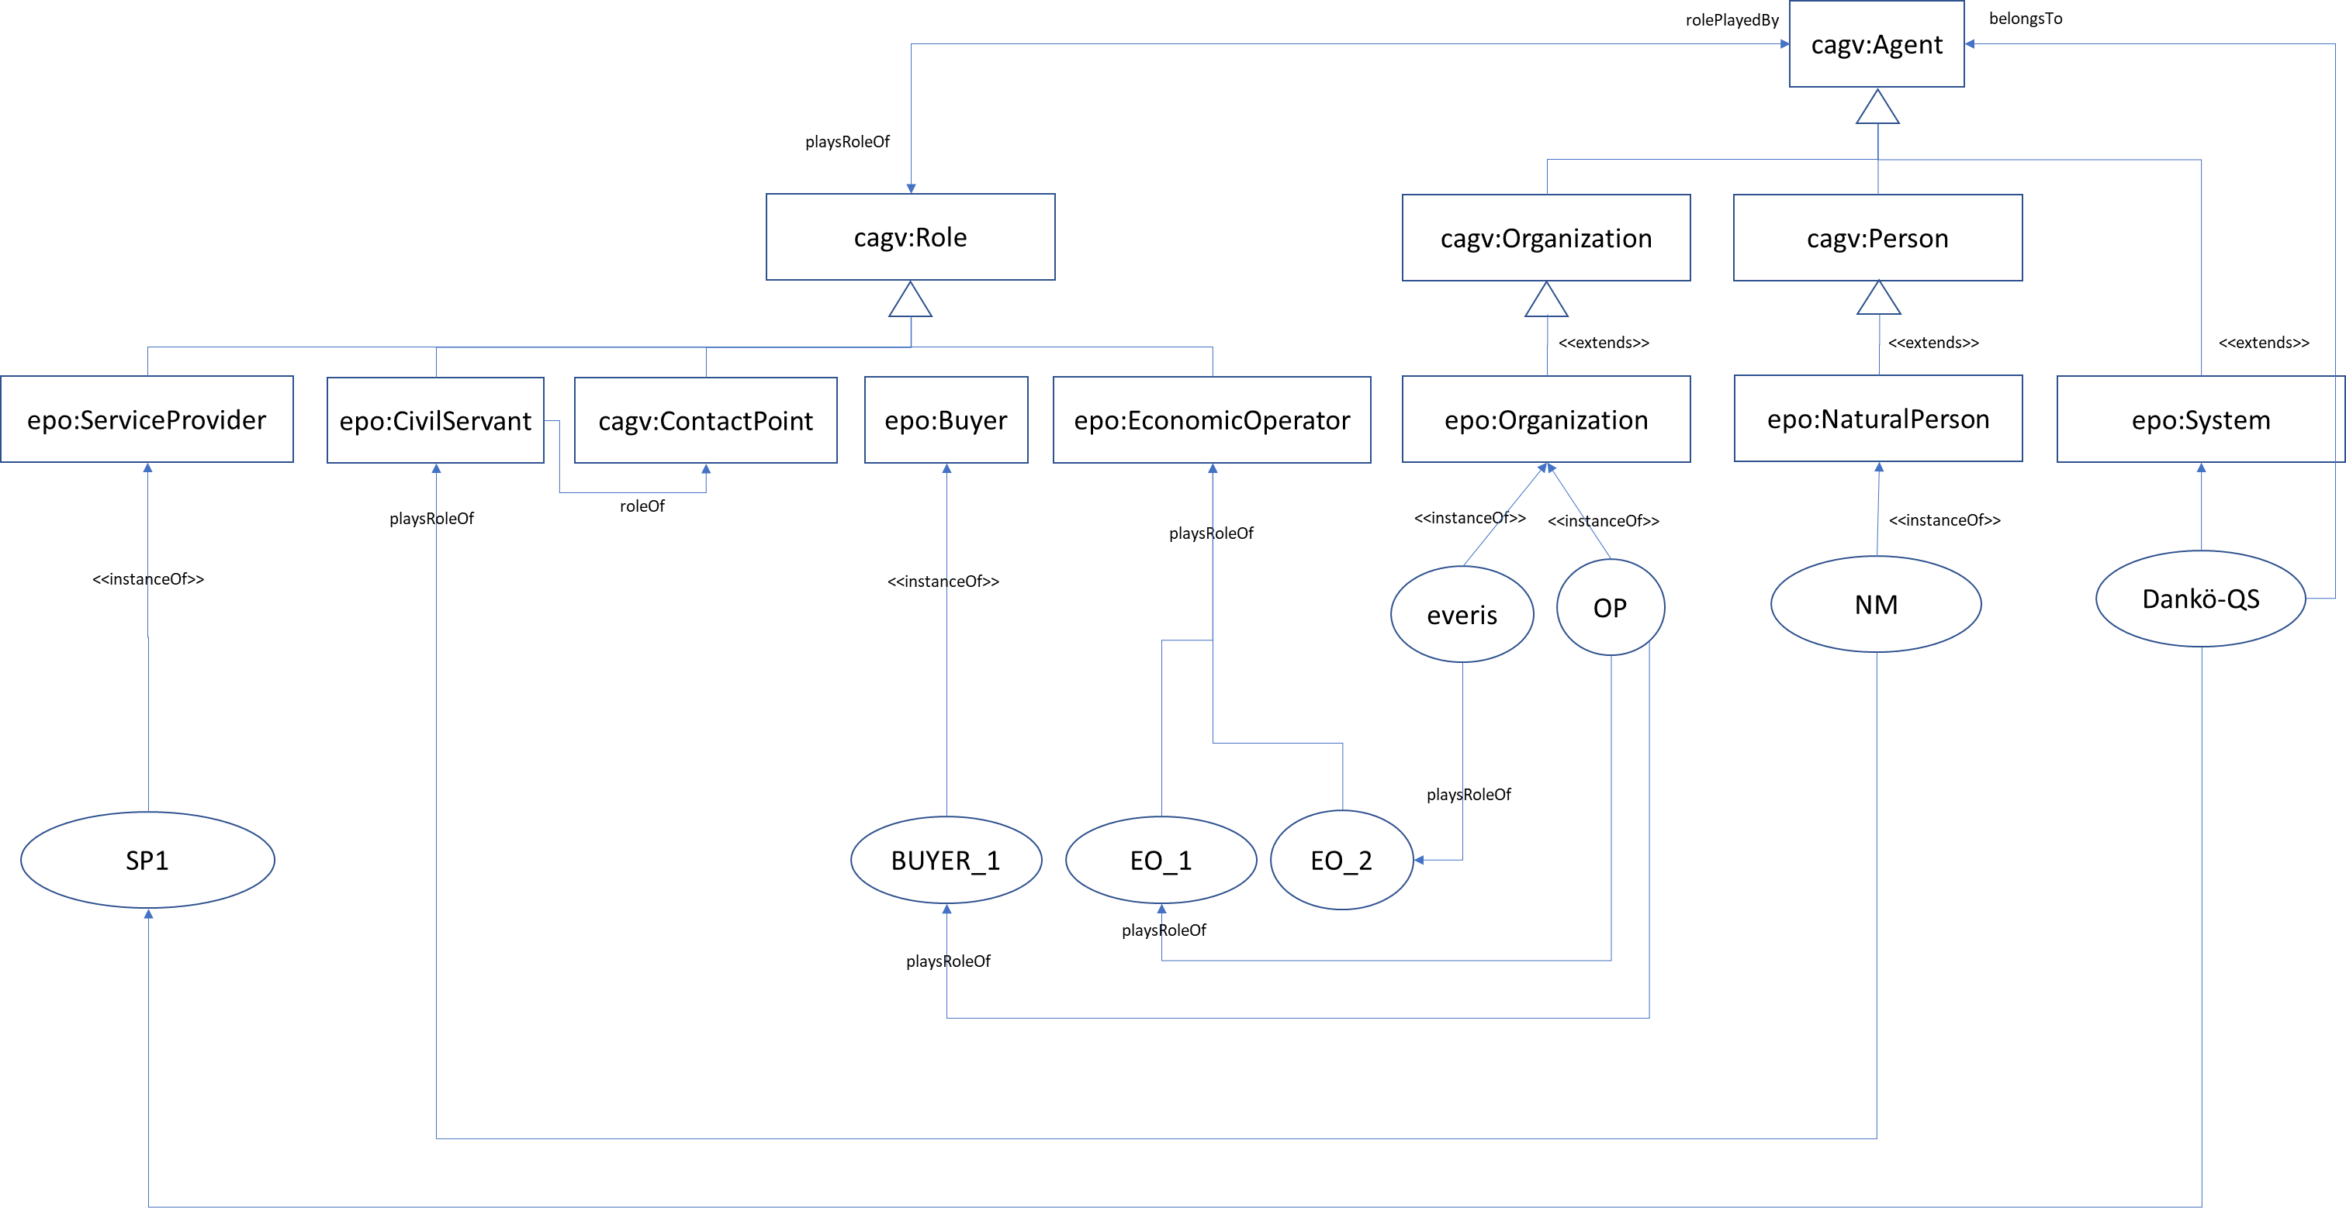

Slide 4
Triples made of Individual ← predicate → Individual
Triples made of of Indivual ←predicate→ Class (Punning)
epo:Organization owl:subClassOf epo:Agent .
(CLASS) epo:Role a owl:Class .
(CLASS) epo:Organization a owl:Class .
(CLASS) epo:Buyer owl:subClassOf epo:Role .
(CLASS) epo:EconomicOperator owl:subClassOf epo:Role .
:OP a epo:Organization .
:everis a epo:Organization .
:BUYER_1 a epo:Buyer .
:EO_1 a epo:EconomicOperator .
:EO_2 a epo:EconomicOperator .
:OP epo:playsRoleOf :BUYER_1 ;
epo:playsRoleOf :EO_1 .
:everis epo:playsRoleOf EO_2.
epo:Organization owl:subClassOf epo:Agent .
(CLASS) epo:Role a owl:Class .
(CLASS) epo:Organization a owl:Class .
(CLASS) epo:Buyer owl:subClassOf epo:Role .
(CLASS) epo:EconomicOperator owl:subClassOf epo:Role .
(CLASS) epo:Tenderer owl:subClassOf epo:EconomicOperator .
(CLASS) epo:Winer owl:subClassOf epo:Tenderer .
:OP a epo:Organization .
:everis a epo:Organization .
:OP epo:playsRoleOf epo:Buyer;
epo:playsRoleOf epo:EconomicOperator .
:everis epo:playsRoleOf epo:EconomicOperator.

