Slide 1
Definitions (1/2)
eProcurement Information Resource (ePIR):
Machine-readble Information Resource (MIR):
An entity, tangible or intangible, that comprises intellectual and/or eProcurement Business content and is conceived, produced and/or issued as a unit.
Additional Information
Examples of ePIR can be:
The data on a buyer returned by a Service Provider’s Service;
A VCD exchanged via an e-Delivery system;
Any of the Documents used in eProcurement.

Slide 2
Definitions (2/2)
eProcurement Document:
An entity, tangible or intangible, that comprises a single set of eprocurement business interrelated information.
Additional Information
Examples of eProcurement document can be:
Any of the Documents used in eProcurement, as ones published in TED;
An online Public Service responding with an electronic certificate, e.g. a certification about the Qualification of an Economic Operator.

Slide 3
ePO use of IFLA FRBR (1/4)
ePIR can be described by Matadata organized into FRBR model. A distinction between
Taxonomy of ePIRs
Relation of each ePIR to classes of the FRBR model
Needs to be done and implemented.
ePIR = Work +Expression+Manifestation+Item
(disjoint union of FRBR classes)
The relationship between an ePIR and its FRBR classes is therefore of part-of / aspect
Every FRBR level is an aspect of an ePIR and a collector of the set of metadata at that level

Slide 4
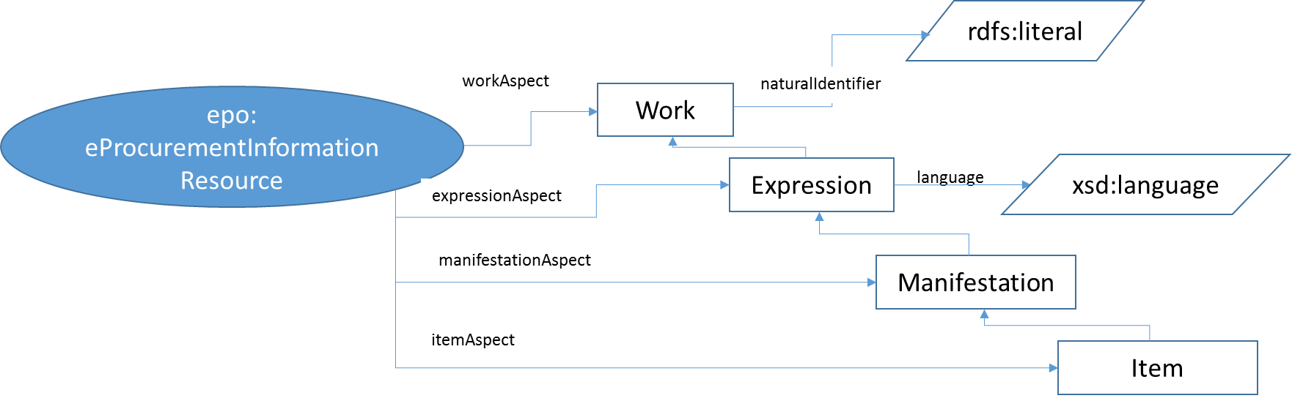
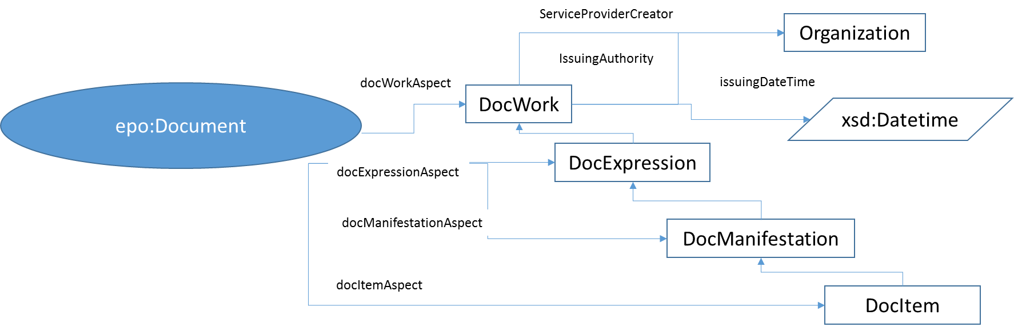
ePO use of IFLA FRBR (2/4)
rdfs:SubPropertyOf
rdfs:SubclassOf
rdfs:SubclassOf

Slide 5
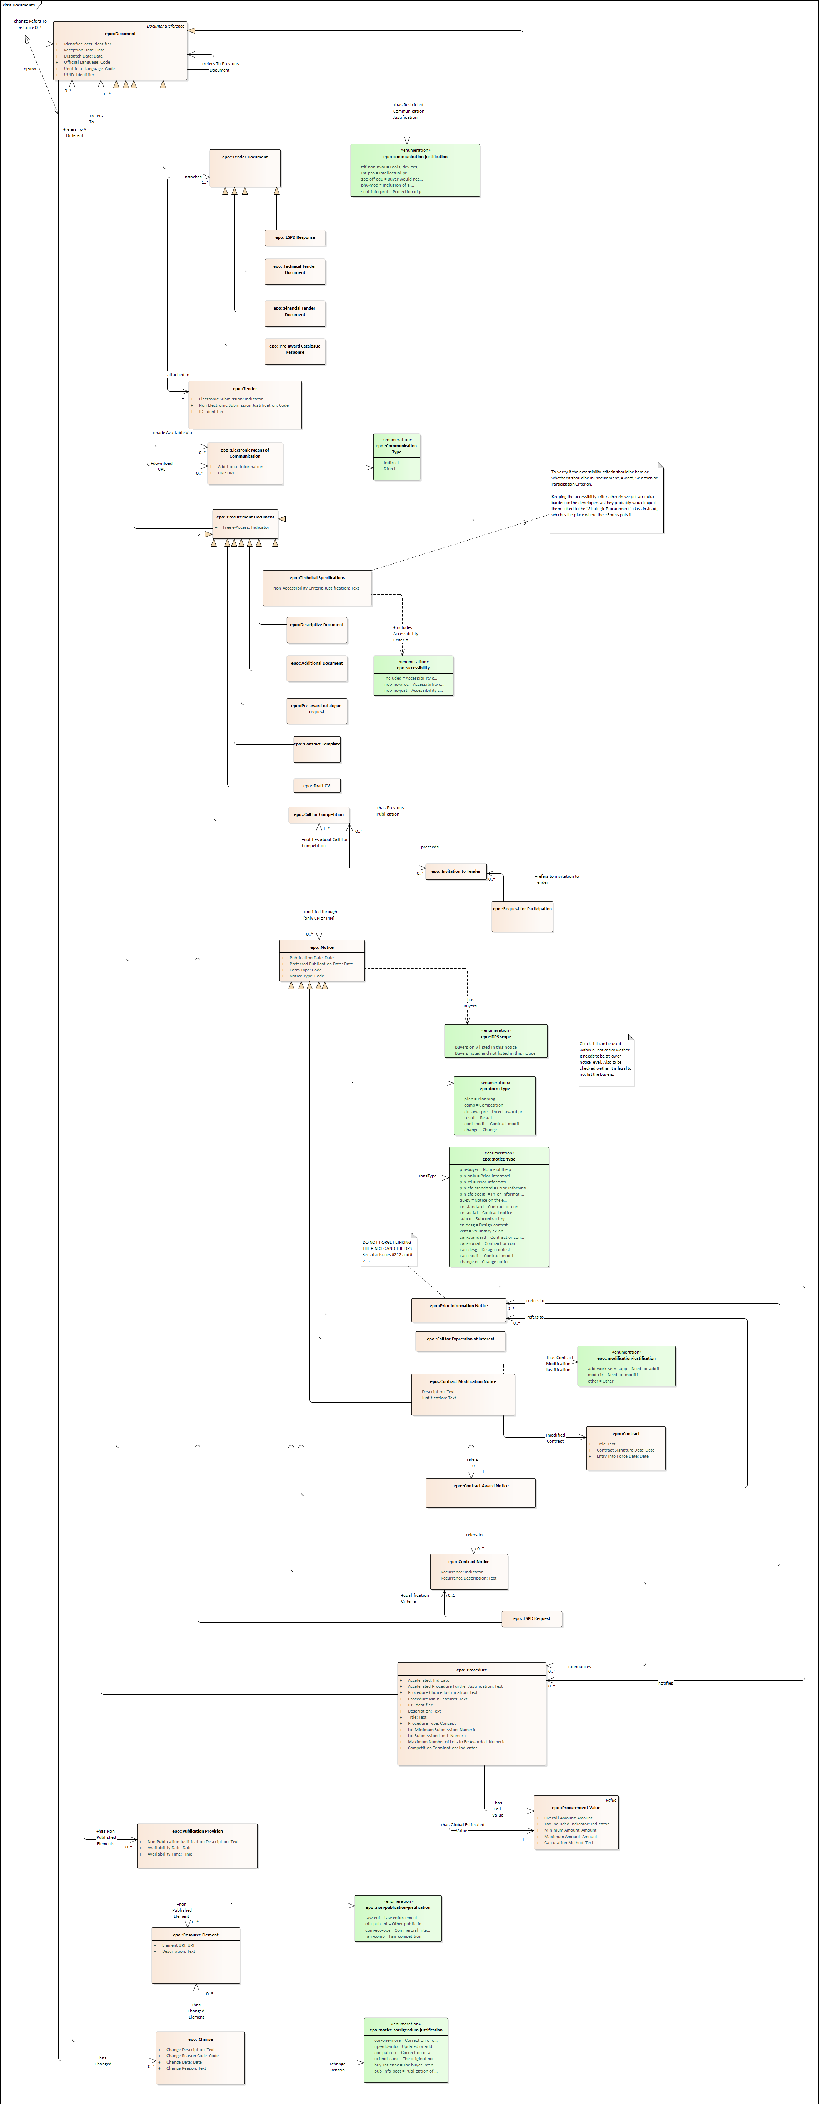
ePO use of IFLA FRBR (3/4)
This is our taxonomy of documents
QUESTION: Do we need to develop a Taxonomy of as many ePIRs, subproperties and subclases as types of documents we have in eProcurement?

Slide 6
ePO use of IFLA FRBR (4/4)
Do we need to develop a Taxonomy of as many ePIRs as types of documents we have in eProcurement?
My answer would be: NO, except for a type of document with particular metadata that the rest of documents do not have. To be identified…..but not probable.

Slide 7
Versioning (1/3)
LEX : general approach
ePO: general approach
Multiversion → internal annotations keeping track of the changes (validity datetime, type of change, reason, affected resource, etc.)
Single version -> a new disctint object per version. The object, at the global level, is headed with the versioning metadata.
Single version -> a new disctint object per version. The new object contains classes explicitely designed to indicate which parts of the documents have change, how, the reason, etc.

Slide 8
Versioning (2/3)
LEX: linking versions
ePO: linking versions
current = in-force
previous
[RFC8288] relations that can be used:
- current (or last or last-version): in-force version
- self: this version
- next: next version
- previous: previous version
- first: original version

Slide 9
Versioning (3/3)
LEX: identification of the version
ePO: identification of the version
version = (amendment-date / specification)
*(";" (event-date / event))
<amendment-date> contains the issuing date of the last considered amendment or of the last communication of amendment. In case the original text introduces differentiated periods in which an act is effective and the information system produces one version for each of them, such element contains the string "original";
- <specification> any information useful to identify unambiguously and univocally the version;
- <event-date> contains the date in which a version is put into force, is effective or is published;
- <event> is a name assigned to the event producing a further version (e.g., amendment, decision, etc.).
Proposal: CEN/BII (CEN TC440) versioning policy →
MajorVersionID.MinorVersionID.BugFixingID
Versioning needs not/should not carry semantics. All semantics needed is already inside the document

Slide 10
Identification of documents in ePO (1/3)
LEX: principles for RESOURCE identification
ePO: principles for DOCUMENT identification
- Use URIs as names for things;
- Use HTTP URIs, so that people can look up those names;
- When someone looks up a URI, provide useful information, using the standards (RDF, SPARQL);
- Include links to other URIs, so that they can discover more
things.

Slide 11
Identification of documents in ePO (2/3)
lex: Resource Identifier structure
ePO: DOCUMENT identifier structure
"http://" host-name "/lex/" jurisdiction "/" local-name
where:
- <host-name> represents the name of the organization server publishing the resource;
- "lex" is the equivalent of the URN namespace ID and provides the reference to the naming convention adopted;
- <jurisdiction> and <local-name> share meaning and syntax of the corresponding components in the LEX specifications.
jurisdiction = jurisdiction-code *(";" jurisdiction-unit)
local-name = work "/@/" expression "/$/" manifestation
Proposal:
"http://" host-name "/eproc/" jurisdiction "/" local-name
where:
- <host-name> represents the name of the organization server publishing the resource;
- “eproc" is the equivalent of the URN namespace ID and provides the reference to the naming convention adopted;
- <jurisdiction> and <local-name> share meaning and syntax of the corresponding components in the LEX specifications.
jurisdiction = jurisdiction-code *(";" jurisdiction-unit)
local-name = work "/@/" expression "/$/" manifestation

Slide 12
Identification of documents in ePO (3/3)
lex: Resource Identifier structure examples
ePO: DOCUMENT identifier structure examples
At Work level:
http://www.senato.it/stato/legge/2006-05-14;22
At Expression level:
http://www.senato.it/stato/legge/2006-05-14;22 /@/originale/it
At manifestation level:
http://www.senato.it/stato/legge/2006-05-14;22 /@/originale/it /$/testo.xml
At Work level:
http://www.publicationsoffice.eu/eproc/ted/2021-05-10;56
At Expression level:
http://www.publicationsoffice.eu/eproc/ted/2021-05-10;56
/@/original/en
At manifestation level:
http://www.publicationsoffice.eu/eproc/ted/2021-05-10;56
/@/original/en/cn.xml

