Slide 1
e-Procurement Ontology
Publications Office – Unit C2
4th Working Group Meeting: 2018-02-23

Slide 2
Presentations of the attendants
Introduction (Manuela Cruz)
Current Status of Work (Natalie Muric)
Glossary (Laia Bota)
Wiki Content Management (Enric Staromiejski)
Code lists (Natalie Muric)
Conceptual Data Model (Maria Font)
Technical Documentation (Enric Staromiejski)
Planning of actions and tasks

Slide 3
Presentations of the attendants
Introduction (Manuela Cruz)
Current Status of Work (Natalie Muric)
Glossary (Laia Bota)
Wiki Content Management (Enric Staromiejski)
Code lists (Natalie Muric)
Conceptual Data Model (Maria Font)
Technical Documentation (Enric Staromiejski)
Planning of actions and tasks

Slide 4
Presentations of the attendants
Introduction (Manuela Cruz)
Current Status of Work (Natalie Muric)
Glossary (Laia Bota)
Wiki Content Management (Enric Staromiejski)
Code lists (Natalie Muric)
Conceptual Data Model (Maria Font)
Technical Documentation (Enric Staromiejski)
Planning of actions and tasks

Slide 5
3. Current status of work
ePO V.1
Specifications & Methodology
3 draft use cases
Basic illustrative: Conceptual model & OWL file
Today
Draft
Glossary
Data definition dictionary (DED)
June 2018
ePO V.2
eNotification/eAccess
Data definition dictionary (DED)
Conceptual model
Proof of Concept
Use case testing
OWL file

Slide 6
Presentations of the attendants
Introduction (Manuela Cruz)
Current Status of Work (Natalie Muric)
Glossary (Laia Bota)
Wiki Content Management (Enric Staromiejski)
Code lists (Natalie Muric)
Conceptual Data Model (Maria Font)
Technical Documentation (Enric Staromiejski)
Planning of actions and tasks

Slide 7
4. Glossary
Background
e-Forms review
OP
List of Business Terms
everis
GLOSSARY

Slide 8
4. Glossary
Content (1/2)
Definitions tab
List of the Business Terms and their corresponding definitions;
Details tab
Other extra definitions obtained from additional sources of information to get a broader overview of the Business Terms;
Comments from everis and from OP
The Use Case related to each Business Term;
The e-Procurement phases related to each Business Term

Slide 9
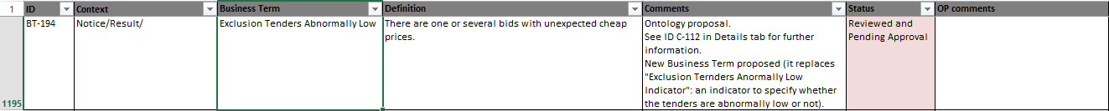
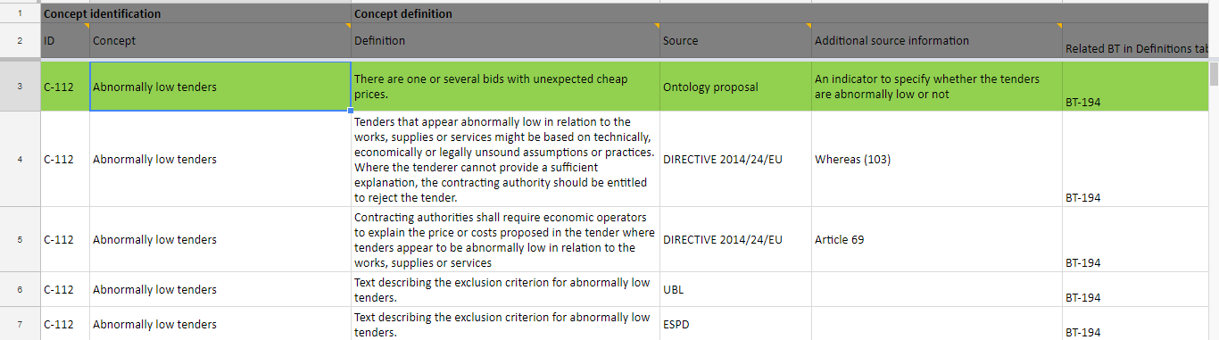
4. Glossary
Content (2/2)
Definitions tab:
Details tab:

Slide 10
Presentations of the attendants
Introduction (Manuela Cruz)
Current Status of Work (Natalie Muric)
Glossary (Laia Bota)
Wiki Content Management (Enric Staromiejski)
Code lists (Natalie Muric)
Conceptual Data Model (Maria Font)
Technical Documentation (Enric Staromiejski)
Planning of actions and tasks

Slide 11
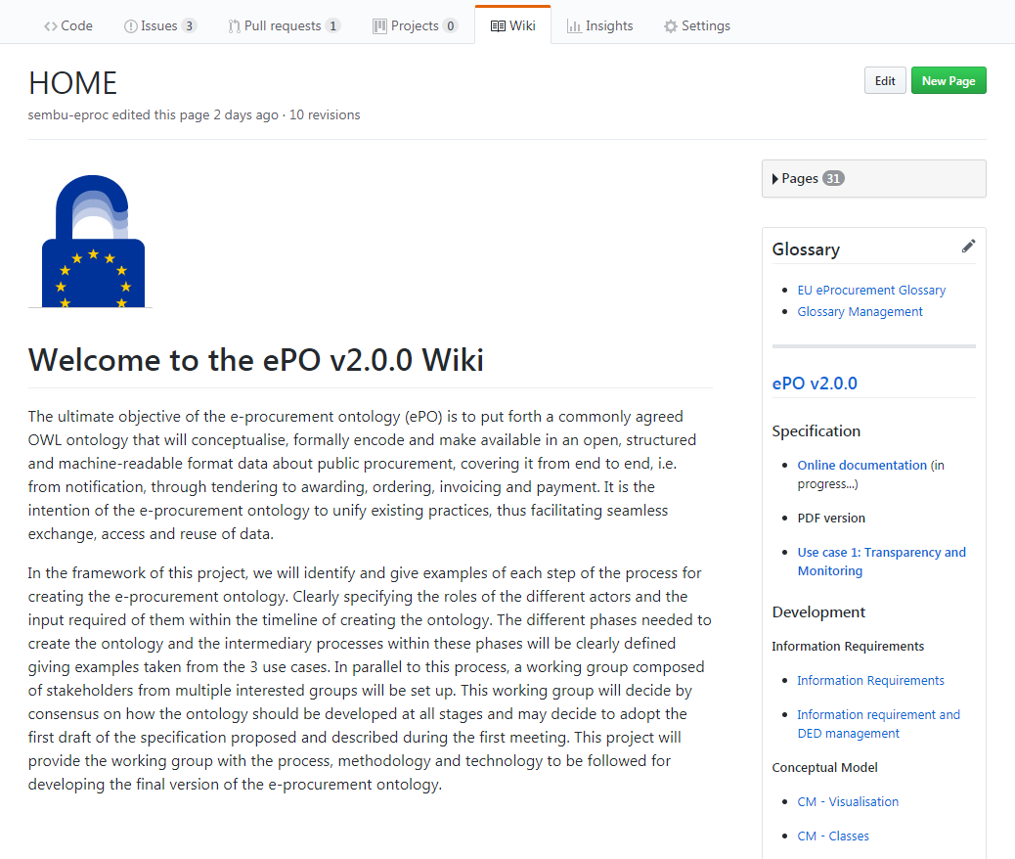
5. Wiki Content Management
Link to the Wiki

Slide 12
Presentations of the attendants
Introduction (Manuela Cruz)
Current Status of Work (Natalie Muric)
Glossary (Laia Bota)
Wiki Content Management (Enric Staromiejski)
Code lists (Natalie Muric)
Conceptual Data Model (Maria Font)
Technical Documentation (Enric Staromiejski)
Planning of actions and tasks

Slide 13
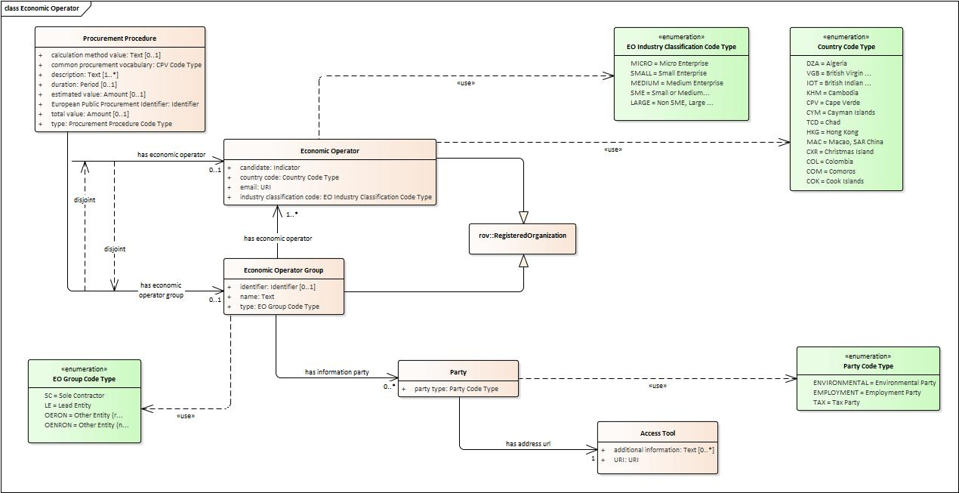
6. Code lists Conceptual data model

Slide 14
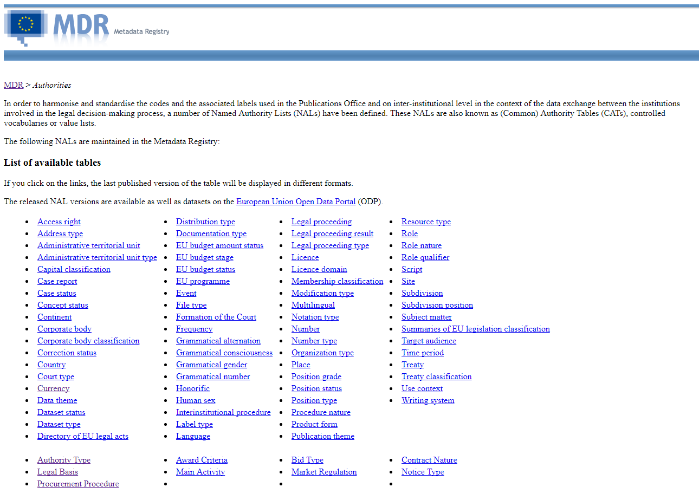
6. Code lists

Slide 15
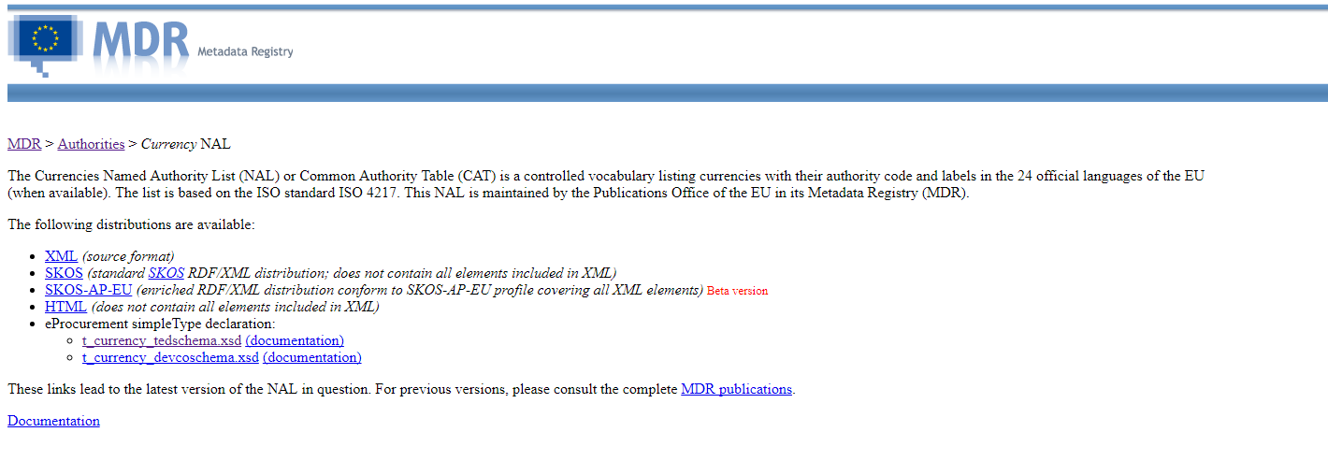
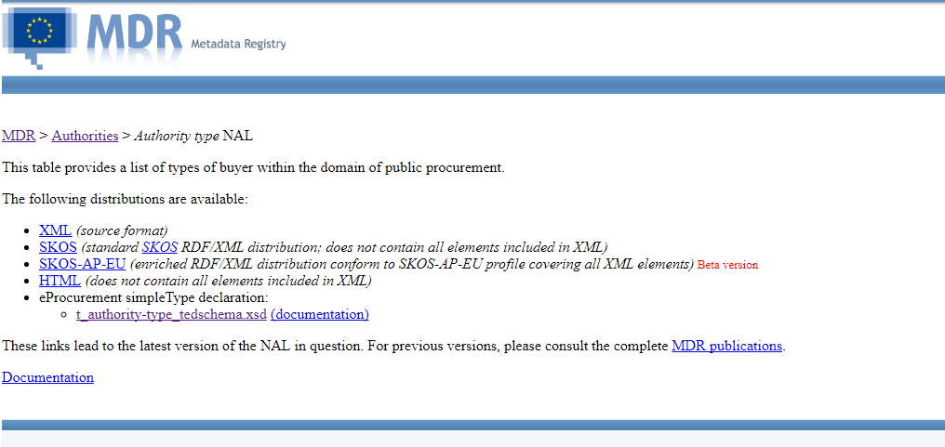
6. Code lists Public procurement formats

Slide 16
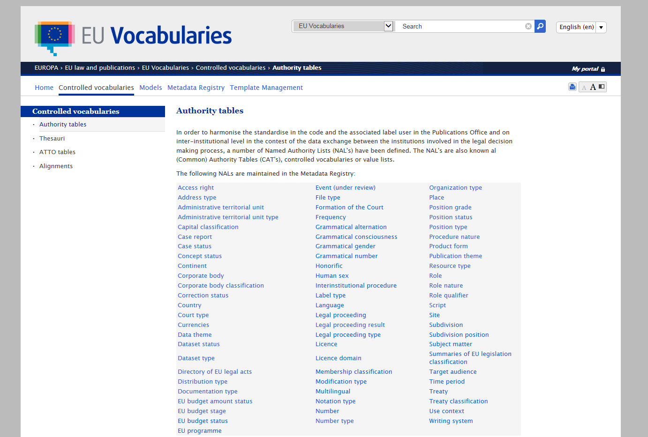
6. Code lists

Slide 17
Presentations of the attendants
Introduction (Manuela Cruz)
Current Status of Work (Natalie Muric)
Glossary (Laia Bota)
Wiki Content Management (Enric Staromiejski)
Code lists (Natalie Muric)
Conceptual Data Model (Maria Font)
Technical Documentation (Enric Staromiejski)
Planning of actions and tasks (Natalie Muric)

Slide 18
7. Conceptual Data Model
EU e-Procurement Glossary
Data Entry Dictionary (DED)
Conceptual Model
DED.
Excel file;
The result of a mapping between the Glossary and the Ontology;
The classes and the attributes will be identified together with the data types and their cardinality.
Conceptual Model.
Enterprise Architect (EA) file;
This tool will allow us to obtain a first version of this model: a graphic with all the classes, attributes and relations.

Slide 19
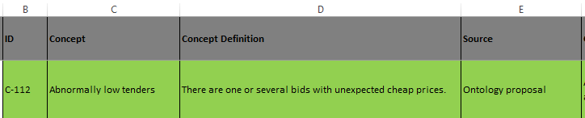
7. Conceptual Data Model
EU e-Procurement Glossary
Data Entry Dictionary (DED)
Conceptual Model
Glossary is static.
Glossary definition or Updated WG definition
DED is dynamic.
Any concept definition improvement coming from the Working Group is updated in this file.
Notes:
Business term: A term is a set of one or more words that represent a concept;
Concept Definition: The definition of each concept as it appears in the ePO Glossary.

Slide 20
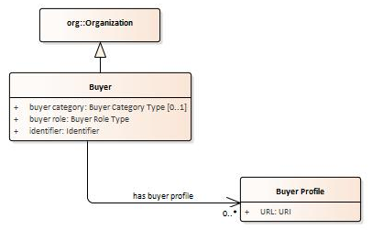
7. Conceptual Data Model
EU e-Procurement Glossary
Data Entry Dictionary (DED)
Conceptual Model
"Pink rows": represent a class. The rows between one pink row and another show the content of the class;
“White rows": represent an attribute (simple data type) of a class;
"Green rows": represent a relationship between other classes of the Ontology.
Notes:
"Pink rows": represents a class. The rows between one pink row and another are the content of the class;
"Transparent rows": represent a property of a class the range of which is an attribute (simple data type);
"Green rows": represents a property of class the range of which is another class of the Ontology.

Slide 21
Presentations of the attendants
Introduction (Manuela Cruz)
Current Status of Work (Natalie Muric)
Glossary (Laia Bota)
Wiki Content Management (Enric Staromiejski)
Code lists (Natalie Muric)
Conceptual Data Model (Maria Font)
Technical Documentation (Enric Staromiejski)
Planning of actions and tasks

Slide 22
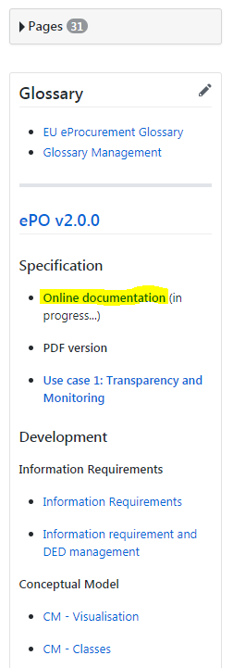
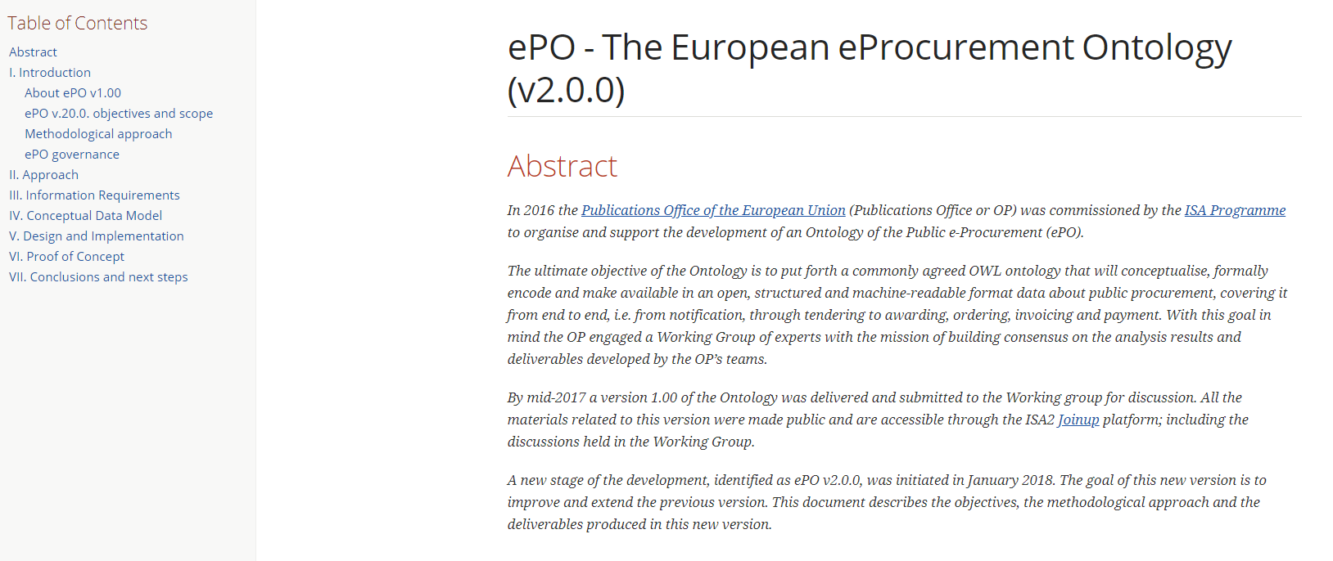
8. Technical Documentation
Link to the Technical Documentation

Slide 23
Presentations of the attendants
Introduction (Manuela Cruz)
Current Status of Work (Natalie Muric)
Glossary (Laia Bota)
Wiki Content Management (Enric Staromiejski)
Code lists (Natalie Muric)
Conceptual Data Model (Maria Font)
Technical Documentation (Enric Staromiejski)
Planning of actions and tasks (Natalie Muric)

Slide 24
