Slide 1
e-Procurement Ontology
Publications Office – Unit C2
6th Working Group Meeting: 2018-05-16

Slide 2
Roll call
Conceptual Data Model
Development of the PoC
Any other business

Slide 3
Roll call
Conceptual Data Model
Development of the PoC
Any other business

Slide 4
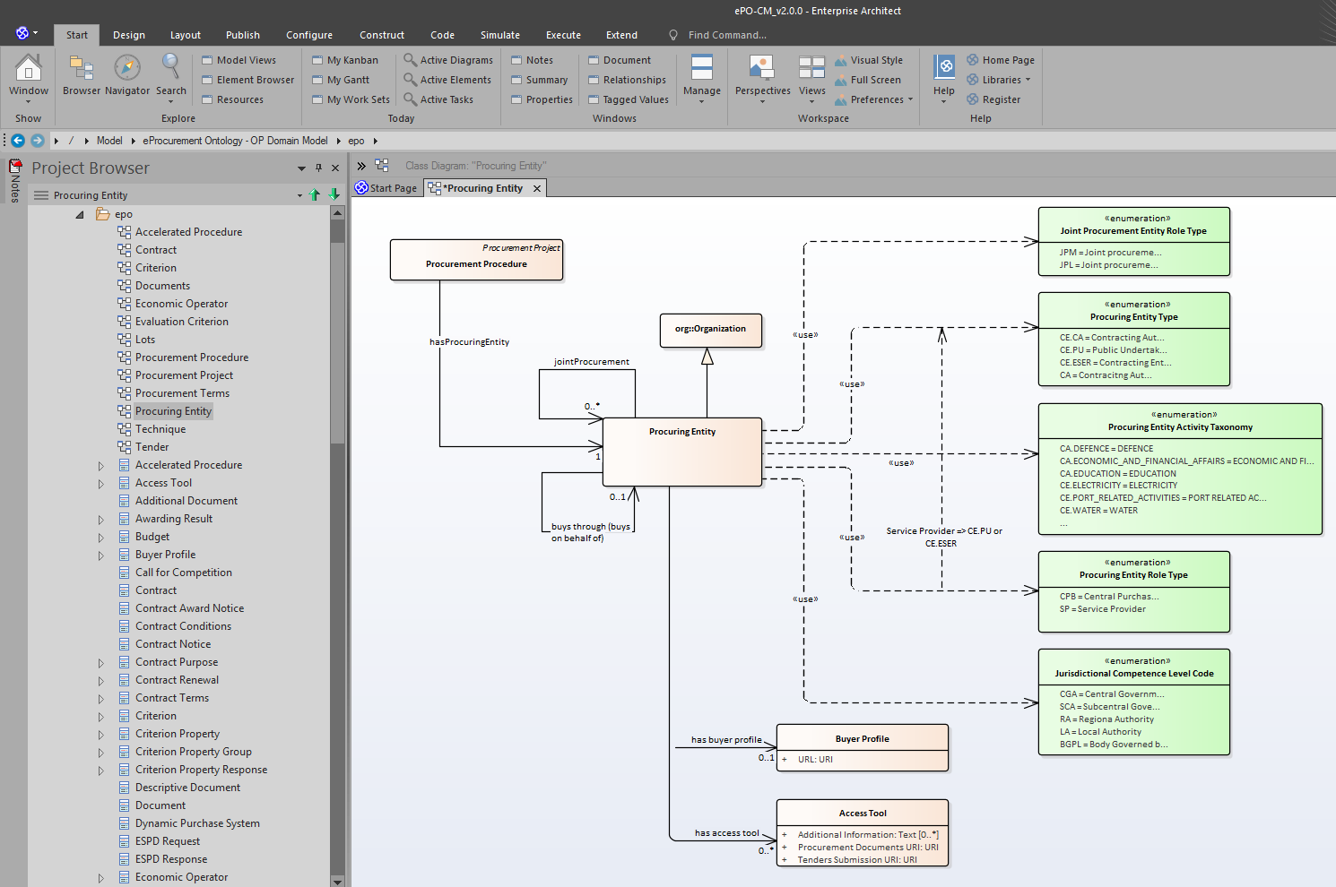
2. Conceptual Data Model
Internal analysis re-iteration (OP + contractor)

Slide 5
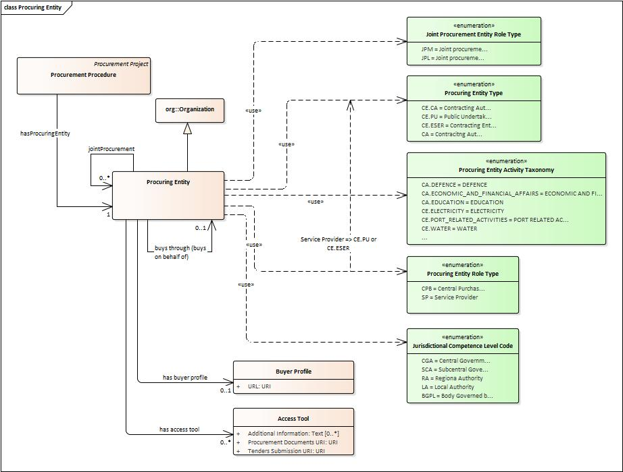
2. Conceptual Data Model
Procuring Entity
Diagram

Slide 6
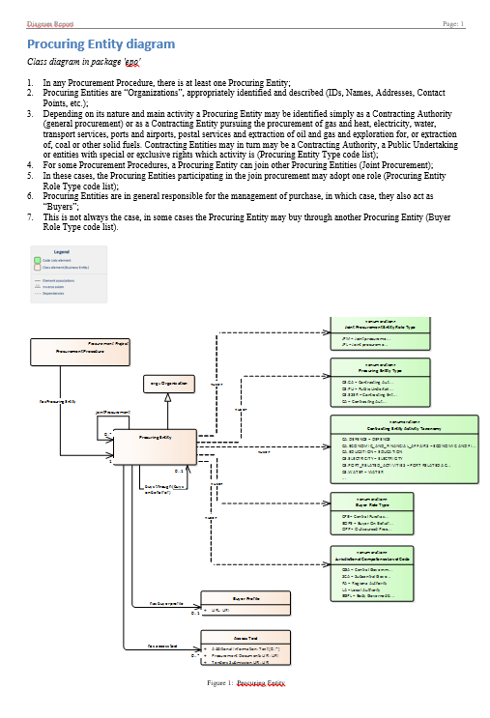
2. Conceptual Data Model
Procuring Entity
narrative

Slide 7
Roll call
Conceptual Data Model
Development of the PoC
Any other business

Slide 8
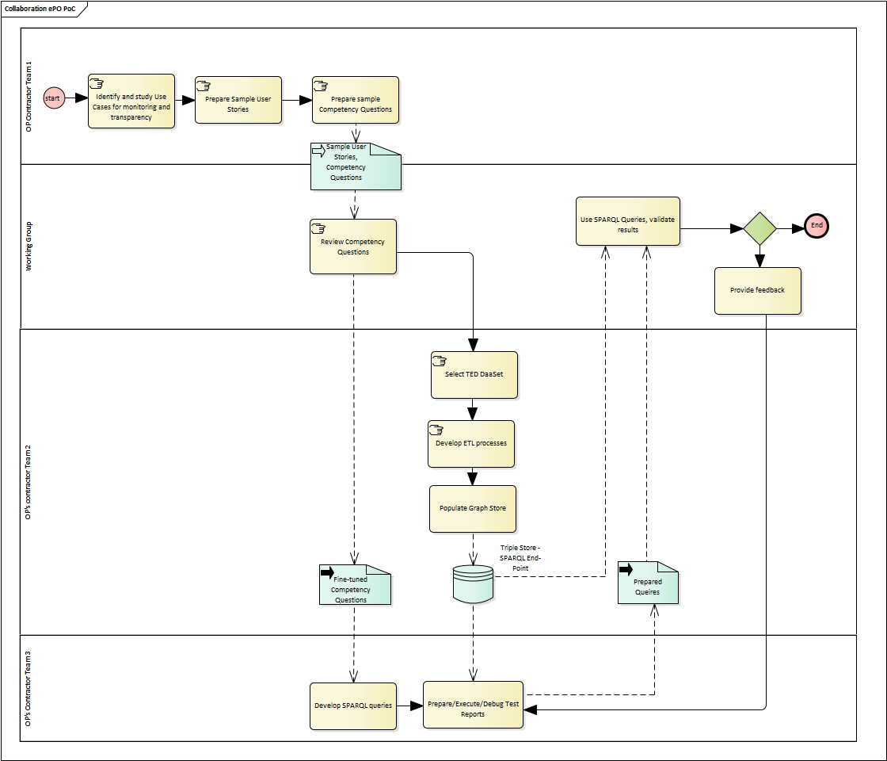
3. Development of the PoC
PoC Workflow (reminder)
https://github.com/eProcurement-everis/eProcurement-everis.github.io/blob/master/images/ePO_PoC.png

Slide 9
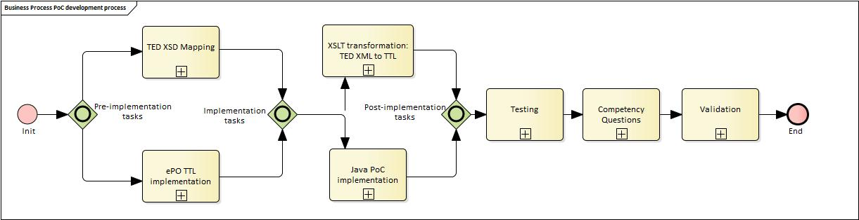
3. Development of the PoC
PoC development sub-process

Slide 10
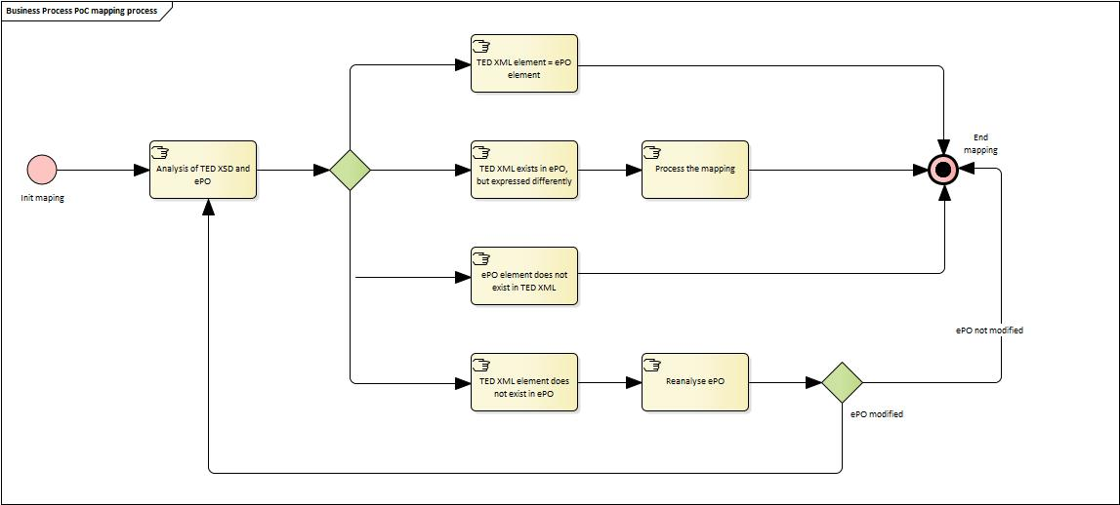
3. Development of the PoC
TED XSD to ePO Mapping sub-process

Slide 11
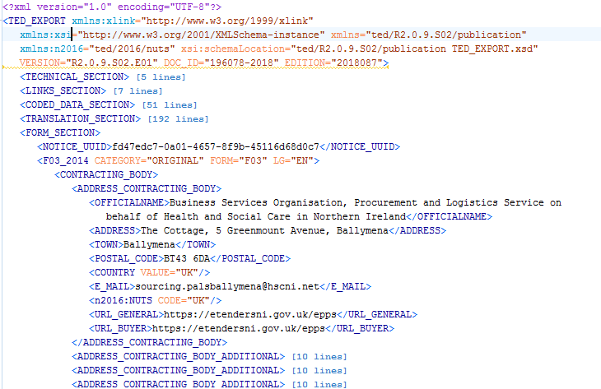
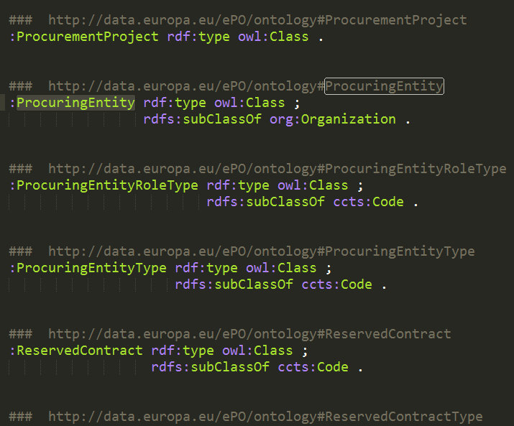
3. Development of the PoC
Mapping TED into ePO (summary)
TED XML
eProcurement Ontology

Slide 12
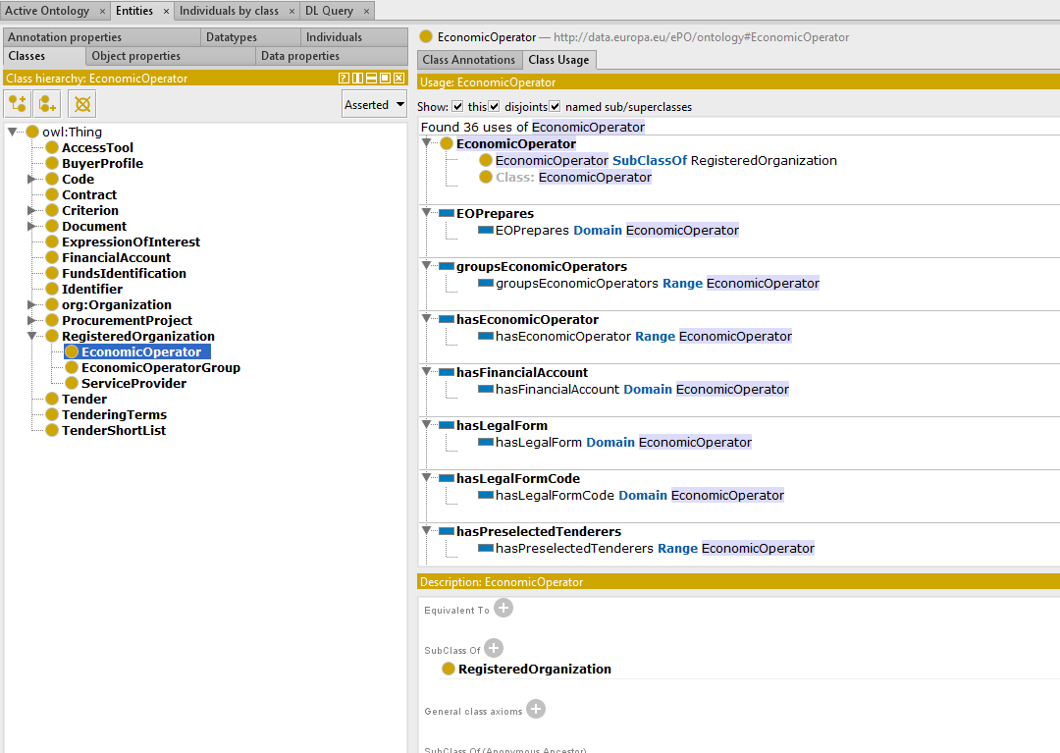
3. Development of the PoC
Developing the TTL file from the Conceptual Map
Protégé

Slide 13
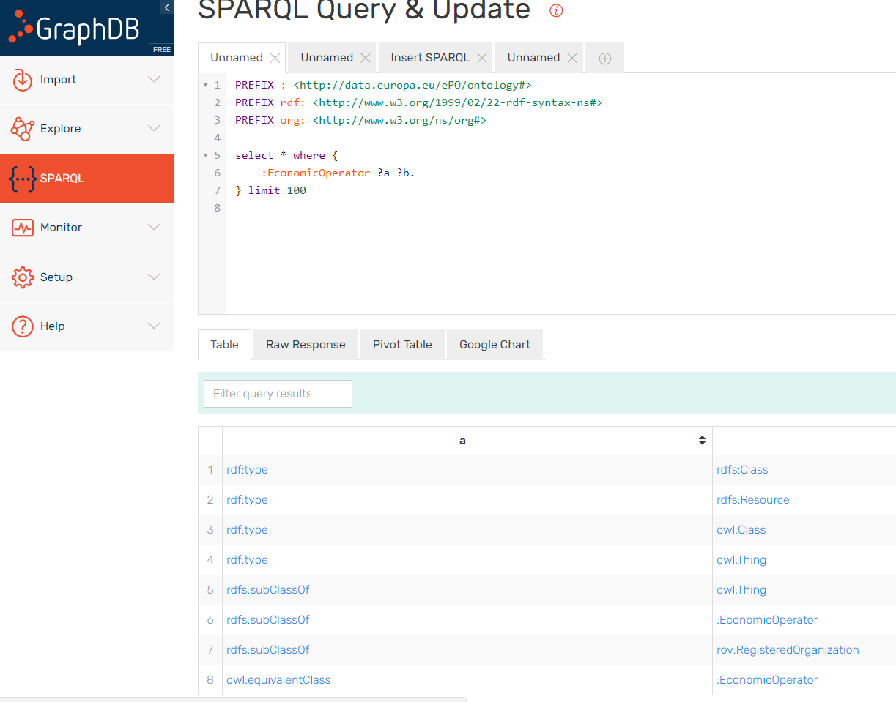
3. Development of the PoC
Importing TTL file into GraphDB
GraphDB

Slide 14
3. Development of the PoC
Extraction of the information from TED XMLs and transform it into triples to import them into GraphDB

Slide 15
3. Development of the PoC
7th June
PoC final report available for comments by WG.

Slide 16
Roll call
Conceptual Data Model
Development of the PoC
Any other business

