Slide 1
e-Procurement Ontology
Publications Office – Unit C2
7th Working Group Meeting: 2018-06-21

Slide 2
Roll call
Glossary
Conceptual Data Model
Development of the PoC
Future work
Any other business

Slide 3
Roll call
Glossary
Conceptual Data Model
Development of the PoC
Future work
Any other business

Slide 4
2. Glossary
The ePO Glossary is being perfected on the basis of the weekly meeting with Members of the WG (every Friday from 10:00 to 12:00 hrs.);
Terms and definitions agreed by the attendants are published on the GitHub;
The revision of the ePO glossary has fed relevant insights that contributed to perfect the ePO Conceptual Data Model;
The result is that the ontology is right now quite aligned to the terms of glossary reviewed up now.
The glossary is being updated weekly with the help of WG members. To see which terms and definitions have been approved by the WG see the column D (“WG Approval Date”) of the online spread-sheet (just click on the GitHub/wiki ePO Glossary menu link and then on one entry of the glossary.

Slide 5
Roll call
Glossary
Conceptual Data Model
Development of the PoC
Future work
Any other business

Slide 6
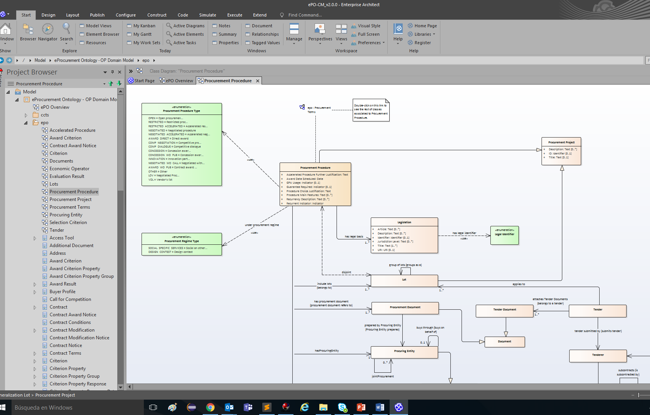
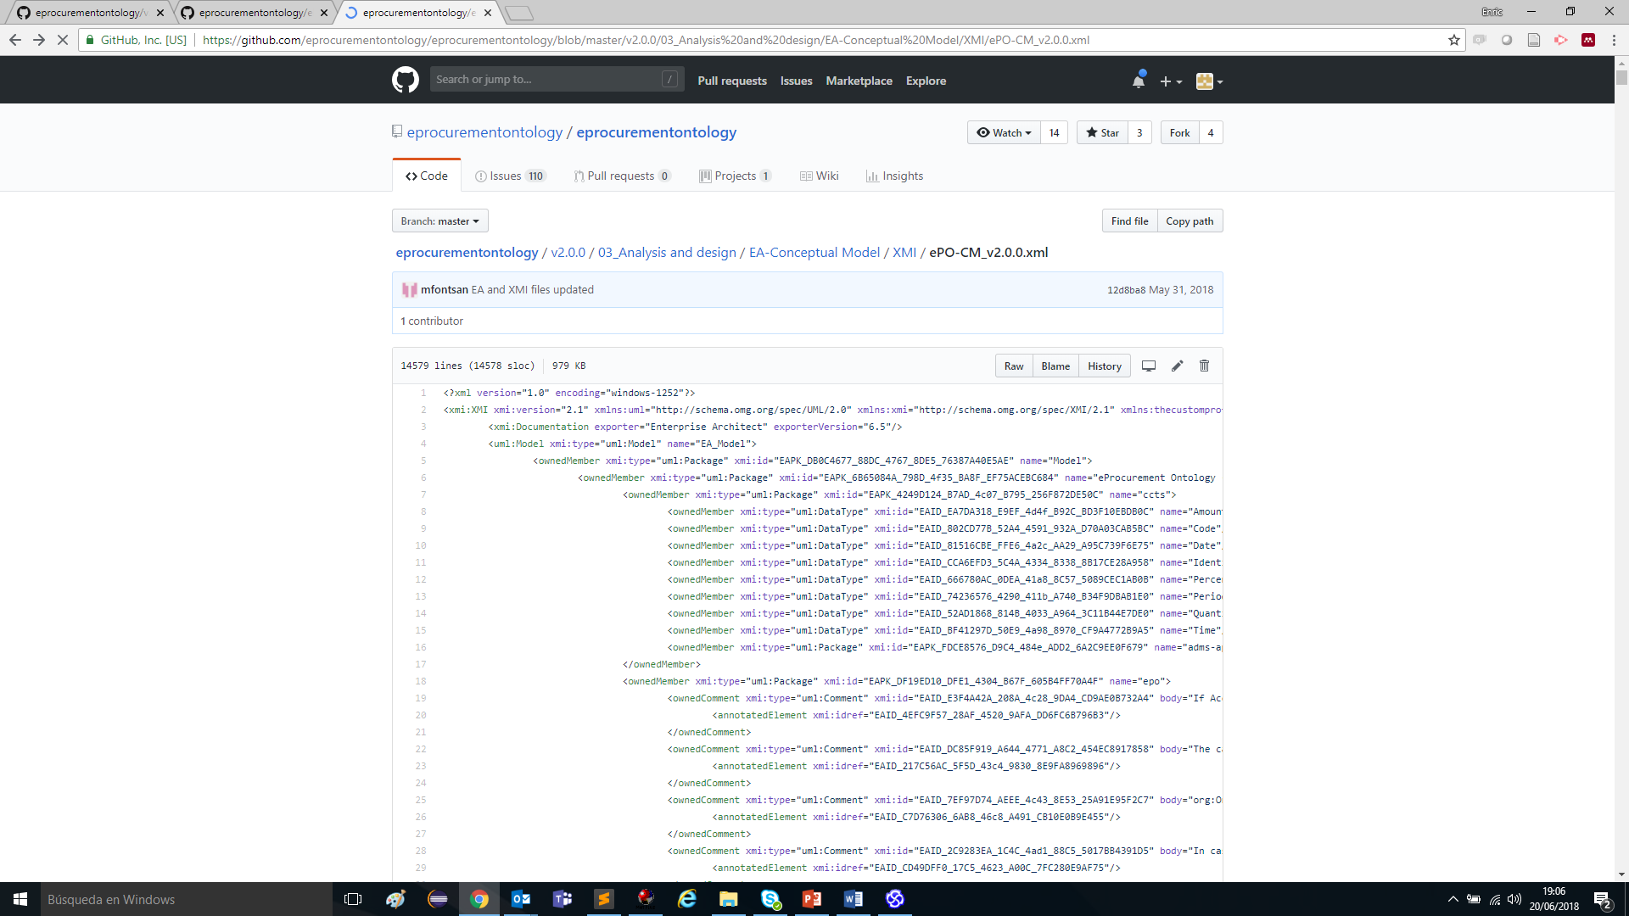
2. Conceptual Data Model
The Conceptual Data Model is being improved taking into account the inputs from the ePO Glossary and, also, the development and results of the PoC;
One general overview and fourteen topic-diagrams show all the classes and properties designed until now (in the scope of eNotification and eAccess);
These diagrams are represented in the EAP file and as a standard XMI file

Slide 7
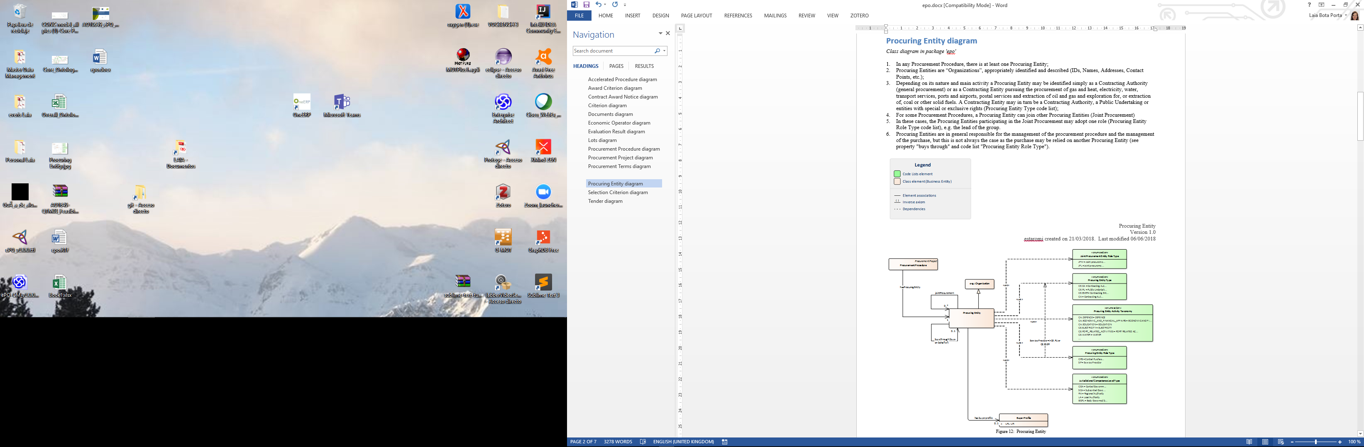
2. Conceptual Data Model
Each diagram of the Conceptual Data Model contains a short description of how to read the diagram in a business-comprehensible manner.

Slide 8
Roll call
Glossary
Conceptual Data Model
Development of the PoC
Future work
Any other business

Slide 9
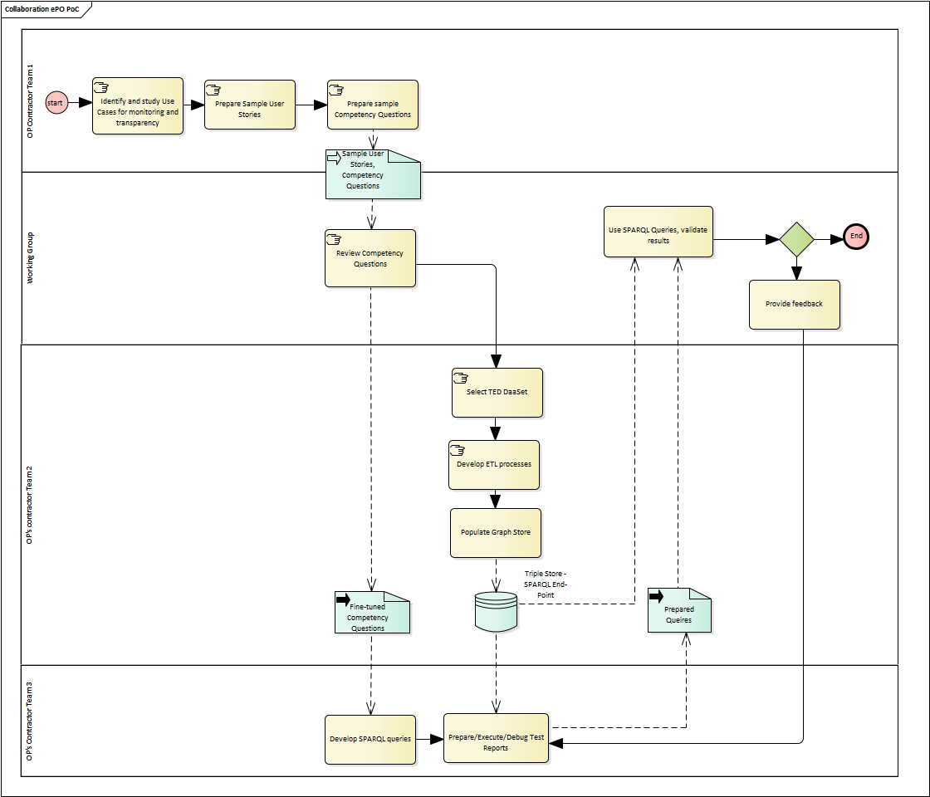
3. Development of the PoC
The main goals of the PoC are:
To come up with the OWL (Turtle) implementation of the ePO Conceptual Data Model (CM). This was done manually using Protégé (the DED has not been used to generate the OWL automatically because the CM is still being improved);
To test the model and improve it;
The OWL implementation has implied:
An exhaustive mapping between the source of the data (TED XML) and the ePO CM;
The development of an ETL process (Extraction of the data from TED, the Transformation of the XML elements into Turtle syntax and the Loading of the data into a Graph store.
The way of executing the PoC consists in:
Based on the Competency Questions, proposed as examples, SPARQL Queries are produced.
The Graph store populated with the data from TED is publicly available;
The SPARQL Queries can be edited in the public SPARQL endpoint, and executed.
PoC Workflow (reminder)

Slide 10
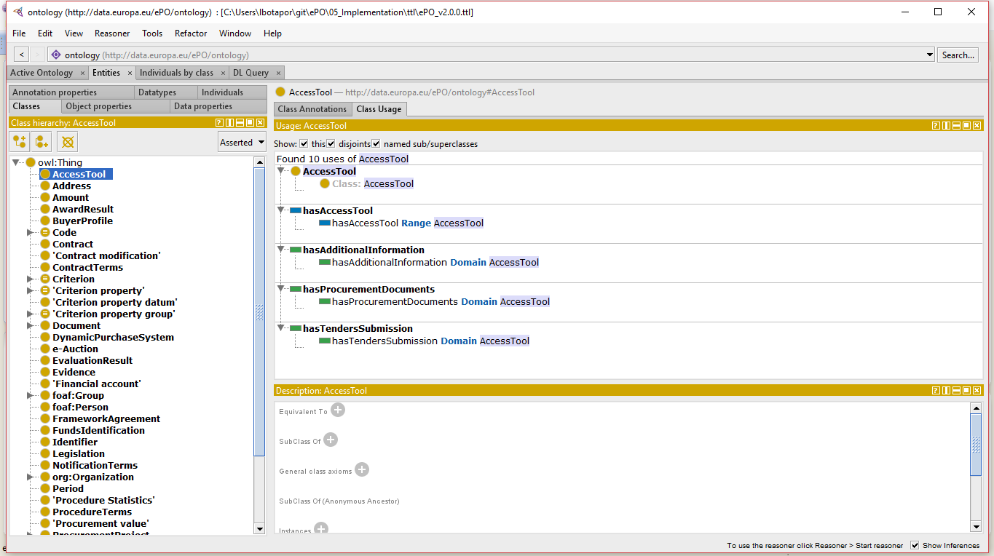
3. Development of the PoC
Developing the TTL file from the Conceptual Map
Protégé

Slide 11
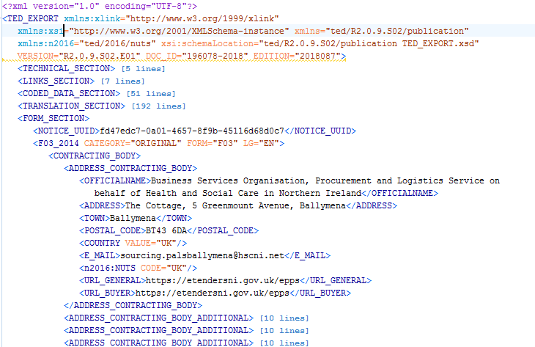
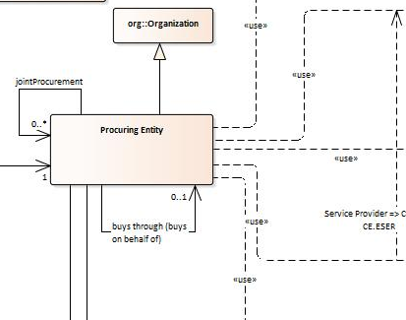
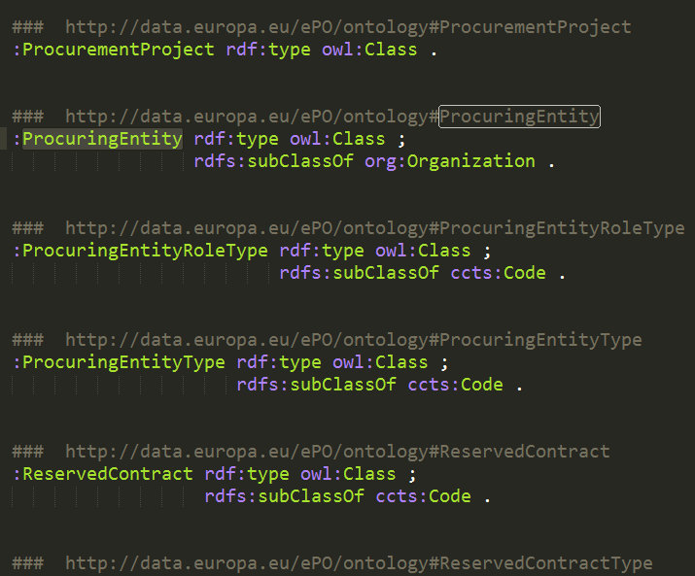
3. Development of the PoC
Mapping TED into ePO (summary)
TED XML
eProcurement Ontology

Slide 12
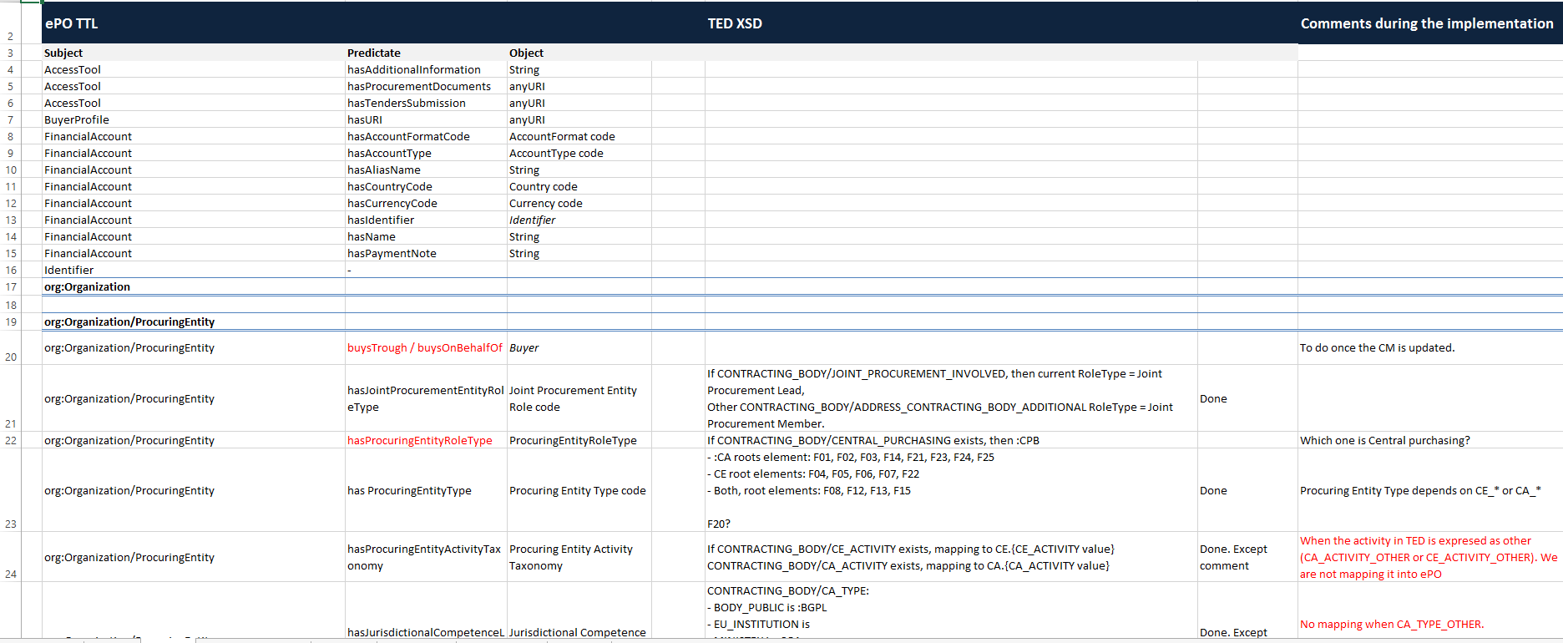
3. Development of the PoC
Mapping TED into ePO (summary)

Slide 13
3. Development of the PoC
Examples of Queries and how to execute them:
Go to the Graph store: http://34.245.181.248:7200/
Edit/paste the queries in the SPARQL endpoint query editor
Run the queries

Slide 14
3. Development of the PoC
Example of execution of Competency Questions (CQ)
CQ: For a given period of time, get the number of SMEs awarded
PREFIX : <http://data.europa.eu/ePO/ontology#>
PREFIX rov: <http://www.w3.org/ns/regorg#>
PREFIX dcterms: <http://purl.org/dc/terms/>
PREFIX rdf: <http://www.w3.org/1999/02/22-rdf-syntax-ns#>
PREFIX rdfs: <http://www.w3.org/2000/01/rdf-schema#>
select (count(?Award_Date) as ?NUMBER_OF_AWARDED_SME) where {
?Award_Result :hasWinner ?Winner ;
:hasAwardResultDateOfConclusion ?Award_Date .
?Winner :usesEOIndustryClassificationType :SME .
FILTER (?Award_Date > "2015-01-01"^^xsd:dateTime && ?Award_Date < "2018-12-31"^^xsd:dateTime)
}

Slide 15
3. Development of the PoC
Example of execution of Competency Questions (CQ)
CQ: The number of contracts awarded for each CPV
PREFIX : <http://data.europa.eu/ePO/ontology#>
SELECT ?cpv (COUNT(DISTINCT(?contract)) AS ?number_contracts) where {
?contract :refersToLot ?lot.
?lot :hasPurpose ?purpose.
?purpose :hasCPVCode ?cpv.
?contract a :Contract.
} group by ?cpv order by desc(?number_contracts)

Slide 16
Roll call
Glossary
Conceptual Data Model
Development of the PoC
Future work
Any other business

Slide 17
Roll call
Glossary
Conceptual Data Model
Development of the PoC
Future work
Any other business

