Slide 1
eProcurement Ontology 3.1.0
Online Presentation 08/12/2022
Eugeniu Costetchi, Andreea Pasare
Meaningfy/Infeurope

Slide 2
The goal of this meeting is:
(a) to provide a better understanding of the eProcurement Ontology (ePO) and
(b) to present the model to all the interested people, regardless of their professional background.

Slide 3
Agenda
Welcome
What is the eProcurement ontology (ePO)?
ePO Releases
ePO HTML version presentation
ePO core updates
— break [15 min] —
eNotice
eCatalogue
eOrdering
eFulfilment
Work planned for 2023
Open discussion
Closing

Slide 4
What is the eProcurement Ontology?

Slide 5
What is the purpose of the ePO?
To provide a common understanding of the procurement domain between all stakeholders, enabling the correct input of data in systems and solutions thus:
- ensuring the data exchanged is understood
- ensuring data quality and viability
- allowing data to be combined and analysed
To facilitate:
- data transparency
- trend detection
- monitoring
- reporting
- informed policy decisions

Slide 6
What is the eProcurement Ontology?
A tool that provides an understanding of concepts and terms used in EU public procurement.
Describes the structure of data in a standardised manner.
Allows a common understanding of the concept which enables:
- the exchange of information between humans without ambiguity.
- the exchange of data via machine-to-machine communication without ambiguity.
Improves understanding and quality of data.

Slide 7
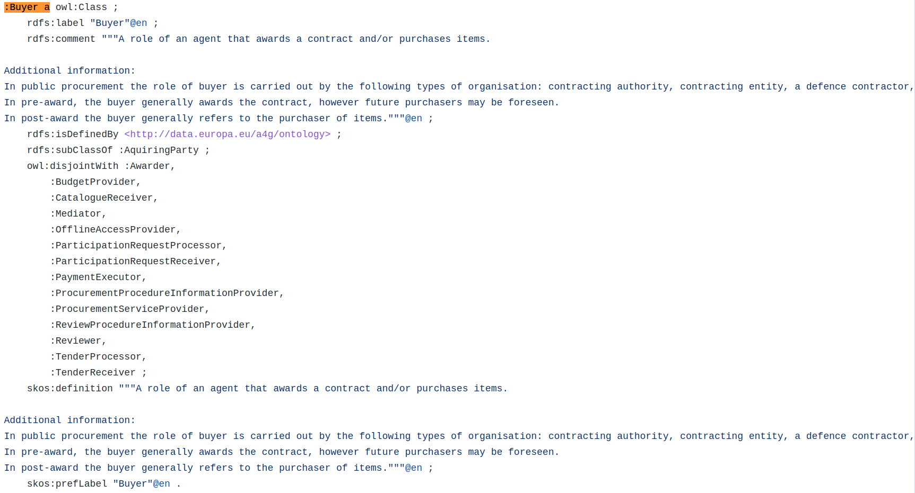
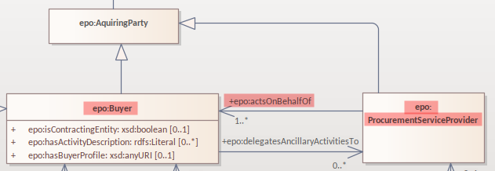
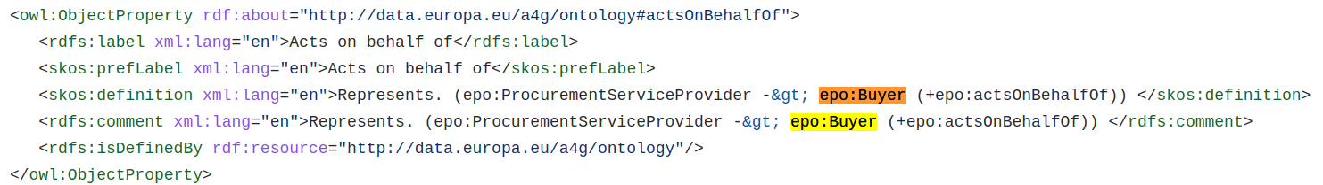
Human-readable and machine-readable formats
Human-readable format
Machine-readable format

Slide 8
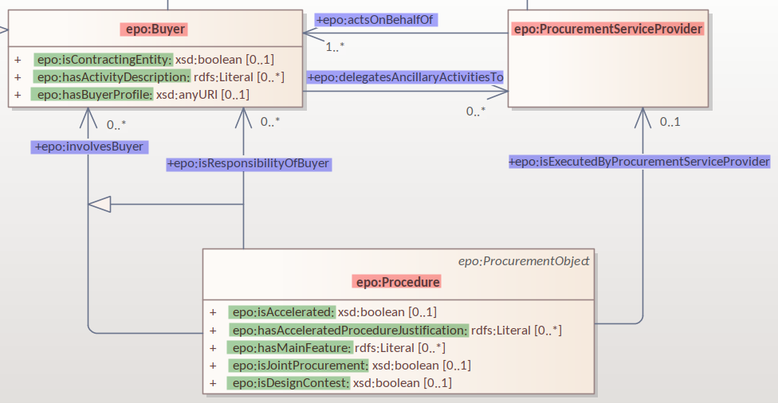
Building blocks of ePO
The European Public Procurement Ontology describes the structure and definition of data in a standardised manner.
Concept/class:
- epo:Buyer
- epo:ProcurementServiceProvider
- epo:Procedure
Attribute:
- epo:isContractingEntity
- epo:hasActivityDescription
- epo:isAccelerated
- etc.
Predicate/relation/property:
- epo:isResponsibilityOfBuyer
- epo:actsOnBehalfOf
- etc.

Slide 9
Building blocks of ePO
The European Public Procurement Ontology describes the structure and definition of data in a standardised manner.
Concept/class definition
epo:Buyer is "A role of an agent that awards a contract and/or purchases items."
Attribute definition
epo:hasBuyerProfile is a "Website address where the buyer publishes information on its procurement procedures and general information."
Predicate/relation/property definition
epo:isResponsibilityOfBuyer is "The buyer in charge of the procedure."

Slide 10
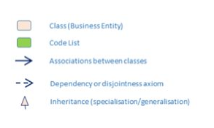
Transformation of the model
The human readable Universal Modeling Language (UML) diagram is transformed to machine-readable OWL and SHACL shapes files automatically.
As UML is open to interpretation, UML conventions have been defined for this project.
Each transformation is preceded by checking the conformity to the conventions.

Slide 11
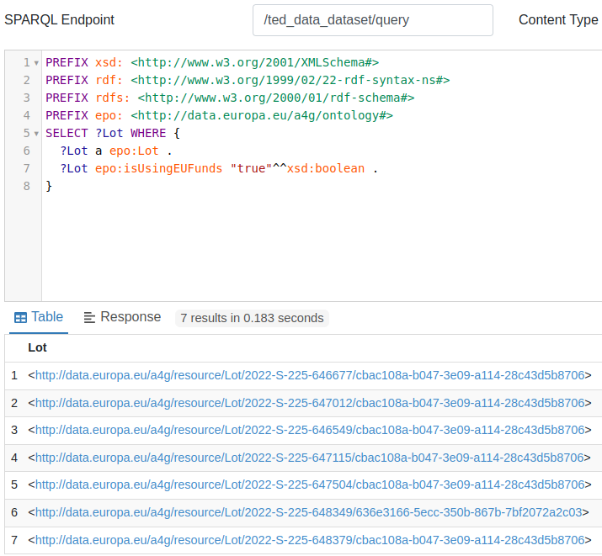
Querying datasets using the ePO
Datasets implemented in conformity with the ePO can then be queried.
Example of a query:
Retrieve all the Lots that foresee funding by the European Union funds.

Slide 12
The ontology in use
The ontology is:
Used to build the new public procurement eForms.
Being mapped for the current standard forms (TED-RDF-mapping).
Reused by CEN/TC440 for their business vocabulary.
Will be used as a basis for the data in the Public Procurement Data Space (PPDS). The PPDS will bring together data published in TED and data published in national platforms.

Slide 13
ePO releases

Slide 14
ePO releases
2.0.0
3.0.0
3.1.0
(Release in Dec 16th 2022)
1.0.0
2.0.1
3.0.1
Notes:
- Procurement object
- Role - Agent
- Term
- Criterion
- Strategic Procurement
- Technique
- Contextual description
- Document
- Notice description
- Empirical types
- Controlled Vocabularies

Slide 15
ePO HTML version presentation

Slide 16
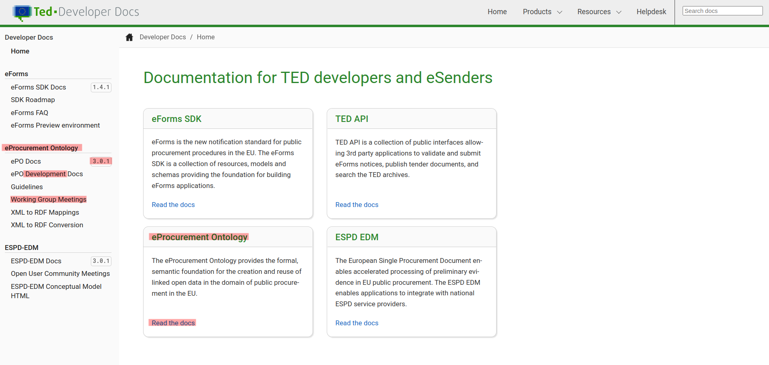
ePO HTML version presentation
TED developer docs link: https://docs.ted.europa.eu/

Slide 17
ePO 3.1.0 core updates

Slide 18
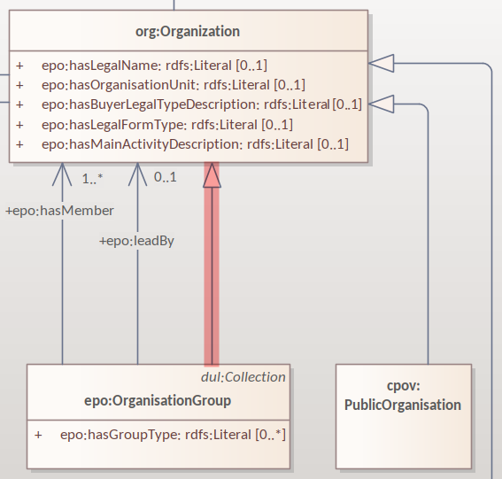
Feedback after last ePO meeting
How many triples do we have for F03?
Answer: 350 triples on average.
An OrganisationGroup should also be an Organization.

Slide 19
ePO core updates
Procurement Objects (Procedure, PlannedProcurementPart, Lot)
Roles hierarchy restructure
model2owl updates
GitHub issues revision and labeling
GitHub issue fixes for Q4 2022 milestone
Updates for standard forms mappings - TED-RDF-mapping

Slide 20
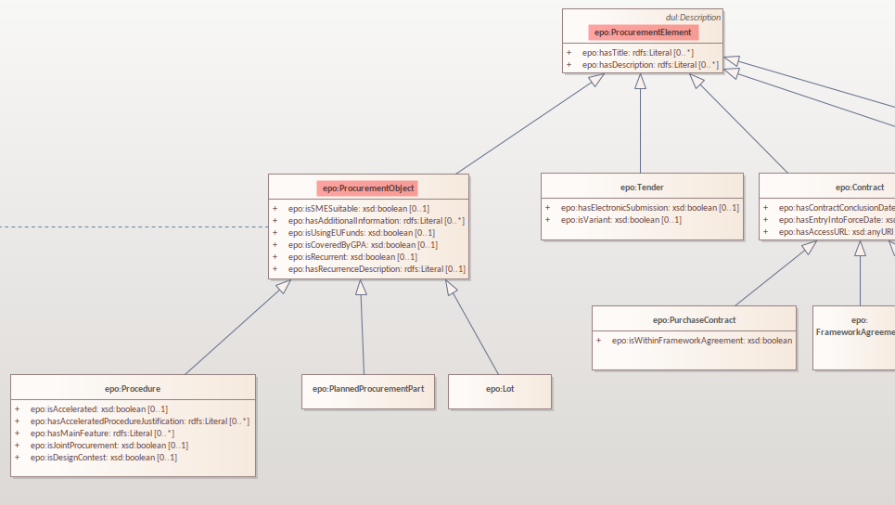
Procurement Objects

Slide 21
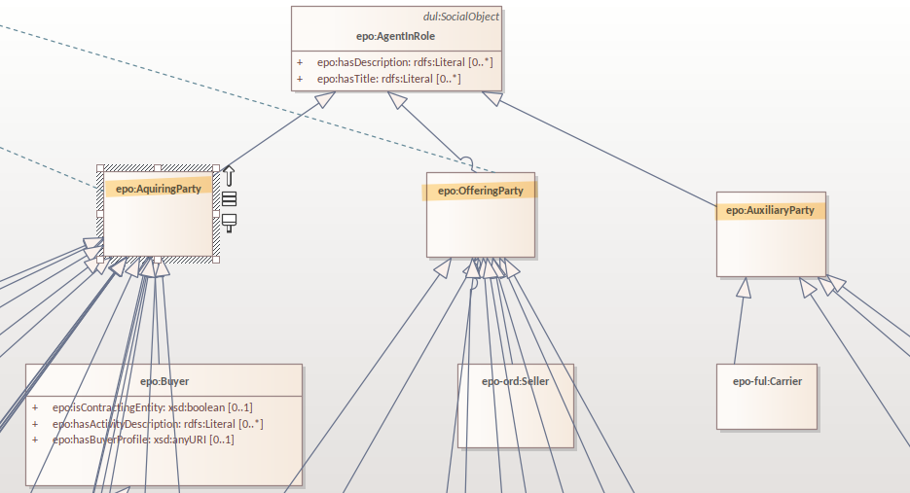
Roles hierarchy restructure

Slide 22
Roles hierarchy restructure
AquiringParty - the role of an agent that acts on the buying side of a procurement process.
OfferingParty - the role of an agent that acts on the economic operator side during a procurement process.
AuxiliaryParty - the role of an agent who may be mentioned in the information exchanged during the procurement process but who does not play an active part in it.

Slide 23
model2owl updates
Provide combined glossary output for all ePO modules.
Provide Turtle output files.
Implemented metadata management mechanism:
- imports
- prefixes
- ontology version
- authors & contributors
- creation date
GitHub issues for model2owl: https://github.com/OP-TED/model2owl/issues

Slide 24
Break

Slide 25
eNotice 3.1.0 updates

Slide 26
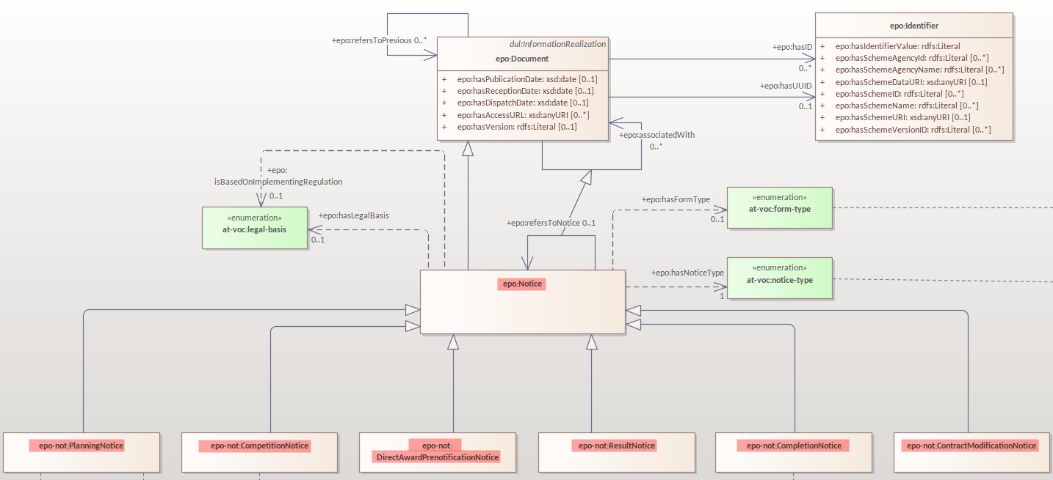
eNotice

Slide 27
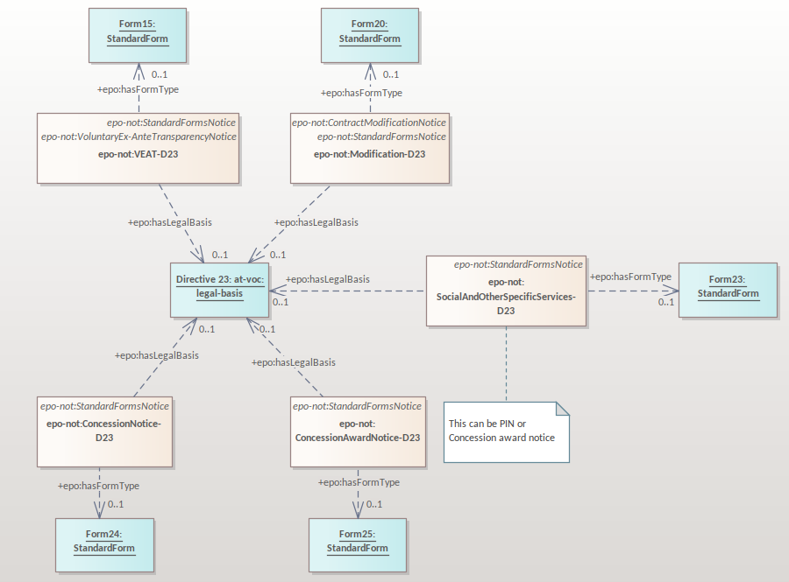
Standard Forms

Slide 28
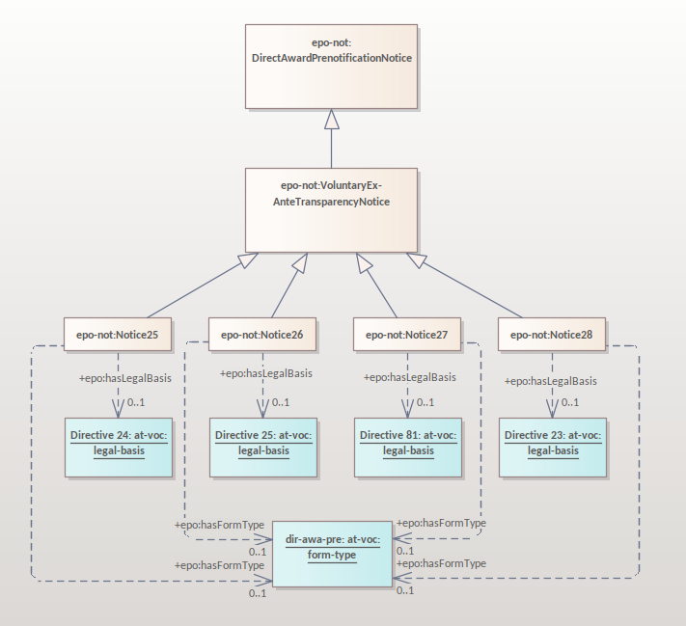
eForms

Slide 29
eCatalogue 3.1.0 updates

Slide 30
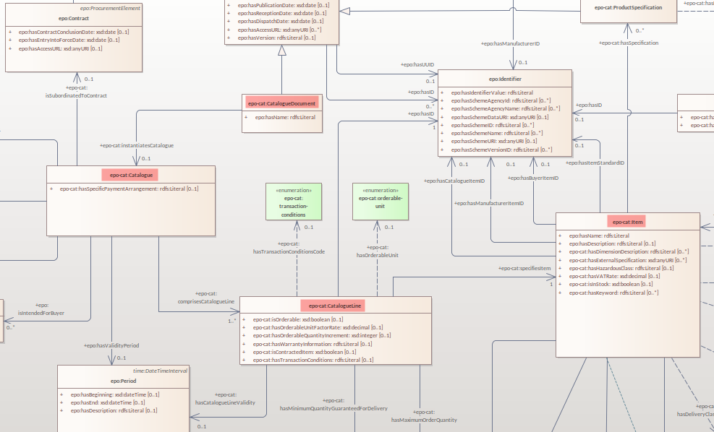
eCatalogue

Slide 31
eCatalogue
Add the Buyer's item identifier to the Item#413
Add a way to indicate the type of a epo-cat:ProductSpecification#415
Add a type to epo-cat:Price#414
Link Buyer and Seller to epo:Catalogue#412
epo:CatalogueReceiver not linked to epo-cat:Catalogue#376

Slide 32
eOrdering 3.1.0

Slide 33
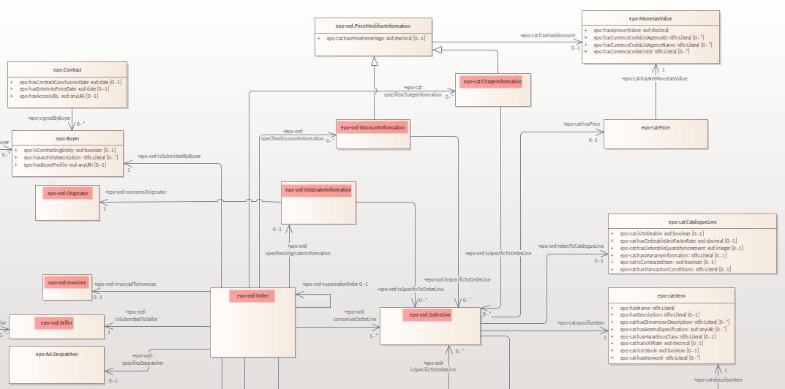
eOrdering
PEPPOL BIS Order Only 3.2

Slide 34
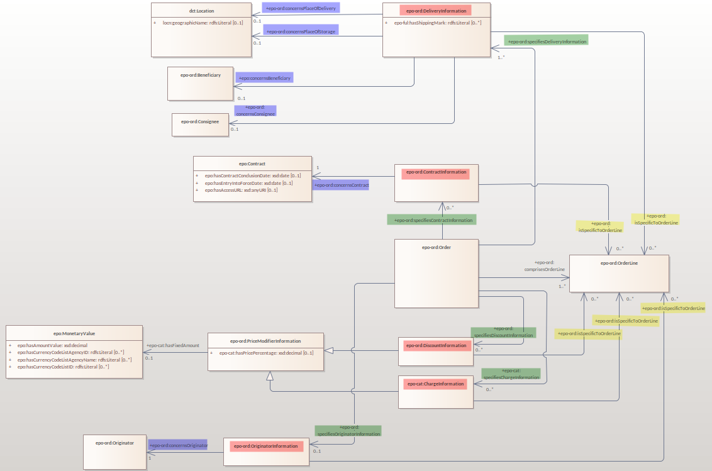
eOrdering
Information hubs
Relation from hub to object of concern
Relation from Order to hub
Relation from hub to OrderLine

Slide 35
eFulfilment – future release

Slide 36
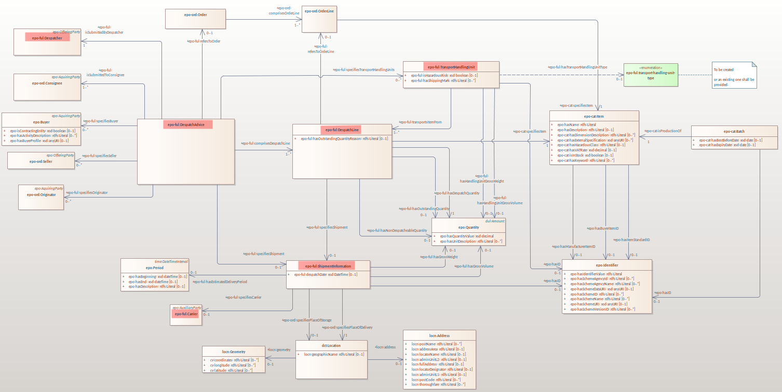
eFulfilment
PEPPOL BIS Despatch Advice 3.1

Slide 37
Work planned for 2023

Slide 38
Work planned for 2023
Updates for the following modules:
- ePO core
- eNotice
- eCatalogue
- eOrdering
Development of new modules:
- eFulfilment
- eAccess
- eContract
- eSubmission
- eInvoicing
- Contracts Registry
Continue with GitHub issue fixes

Slide 39
Open discussion

Slide 40
Meeting schedule
Regular ePO Working Group meetings:
- every Tuesday from 14:30 to 16:30 (EET)
- meeting link
Specific ePO Working Group meetings:
- every other Thursday from 14:30 to 16:30 (EET)
- meeting link
Quarterly seminars:
- Tues 7 or Thurs 9 March (afternoons)
- Tues 13 or Thurs 15 June (afternoons)
- Tues 5 or Thurs 7 September (afternoons)
- Tues 5 or Thurs 7 December (afternoons)

Slide 41
Feedback and questions
Looking forward to hearing from you.
Feedback and questions can be sent via:
GitHub issues: https://github.com/OP-TED/ePO/issues
or alternatively via:
Email: OP-EPROCUREMENT-ONTOLOGY@publications.europa.eu
Email: natalie.muric@publications.europa.eu

Slide 42
THANK YOU

