Slide 1
eProcurement Ontology 3.0.0
Presentation and Request for Feedback
Online Presentation 28/06/2022
Eugeniu Costetchi, Andreea Pasare
Meaningfy/Infeurope

Slide 2
The goal of this meeting is:
(a) to present the major changes and evolutions in the eProcurement ontology
(b) invite feedback.

Slide 3
Agenda
Welcome
Methodology [20 min]
Model refactoring & modules [20 min]
— break 15 min —
Evolution of 2.0.1 to 3.0.0 [30 min]
Open discussion [30 min]
— break 15 min —
Open discussion [30 min]
Closing

Slide 4
Methodology

Slide 5
Methodology
Adopted and published a source management methodology
Ontology development oriented by
* time-based perspective
* upper-level organisation
* principle-based perspective
Scoping to the eForms & standard forms conceptual coverage
Module based ontology management

Slide 6
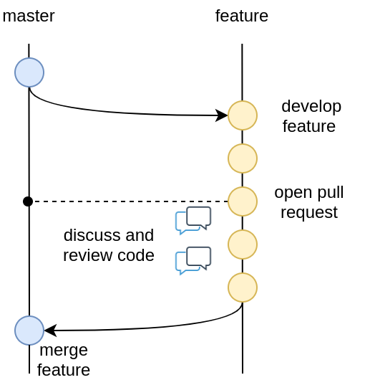
Methodology
Adopted and published a source management methodology.

Slide 7
Methodology
Ontology development oriented by a time-based perspective.
Planning
Competition
Submission
Award
Contract
Completion

Slide 8
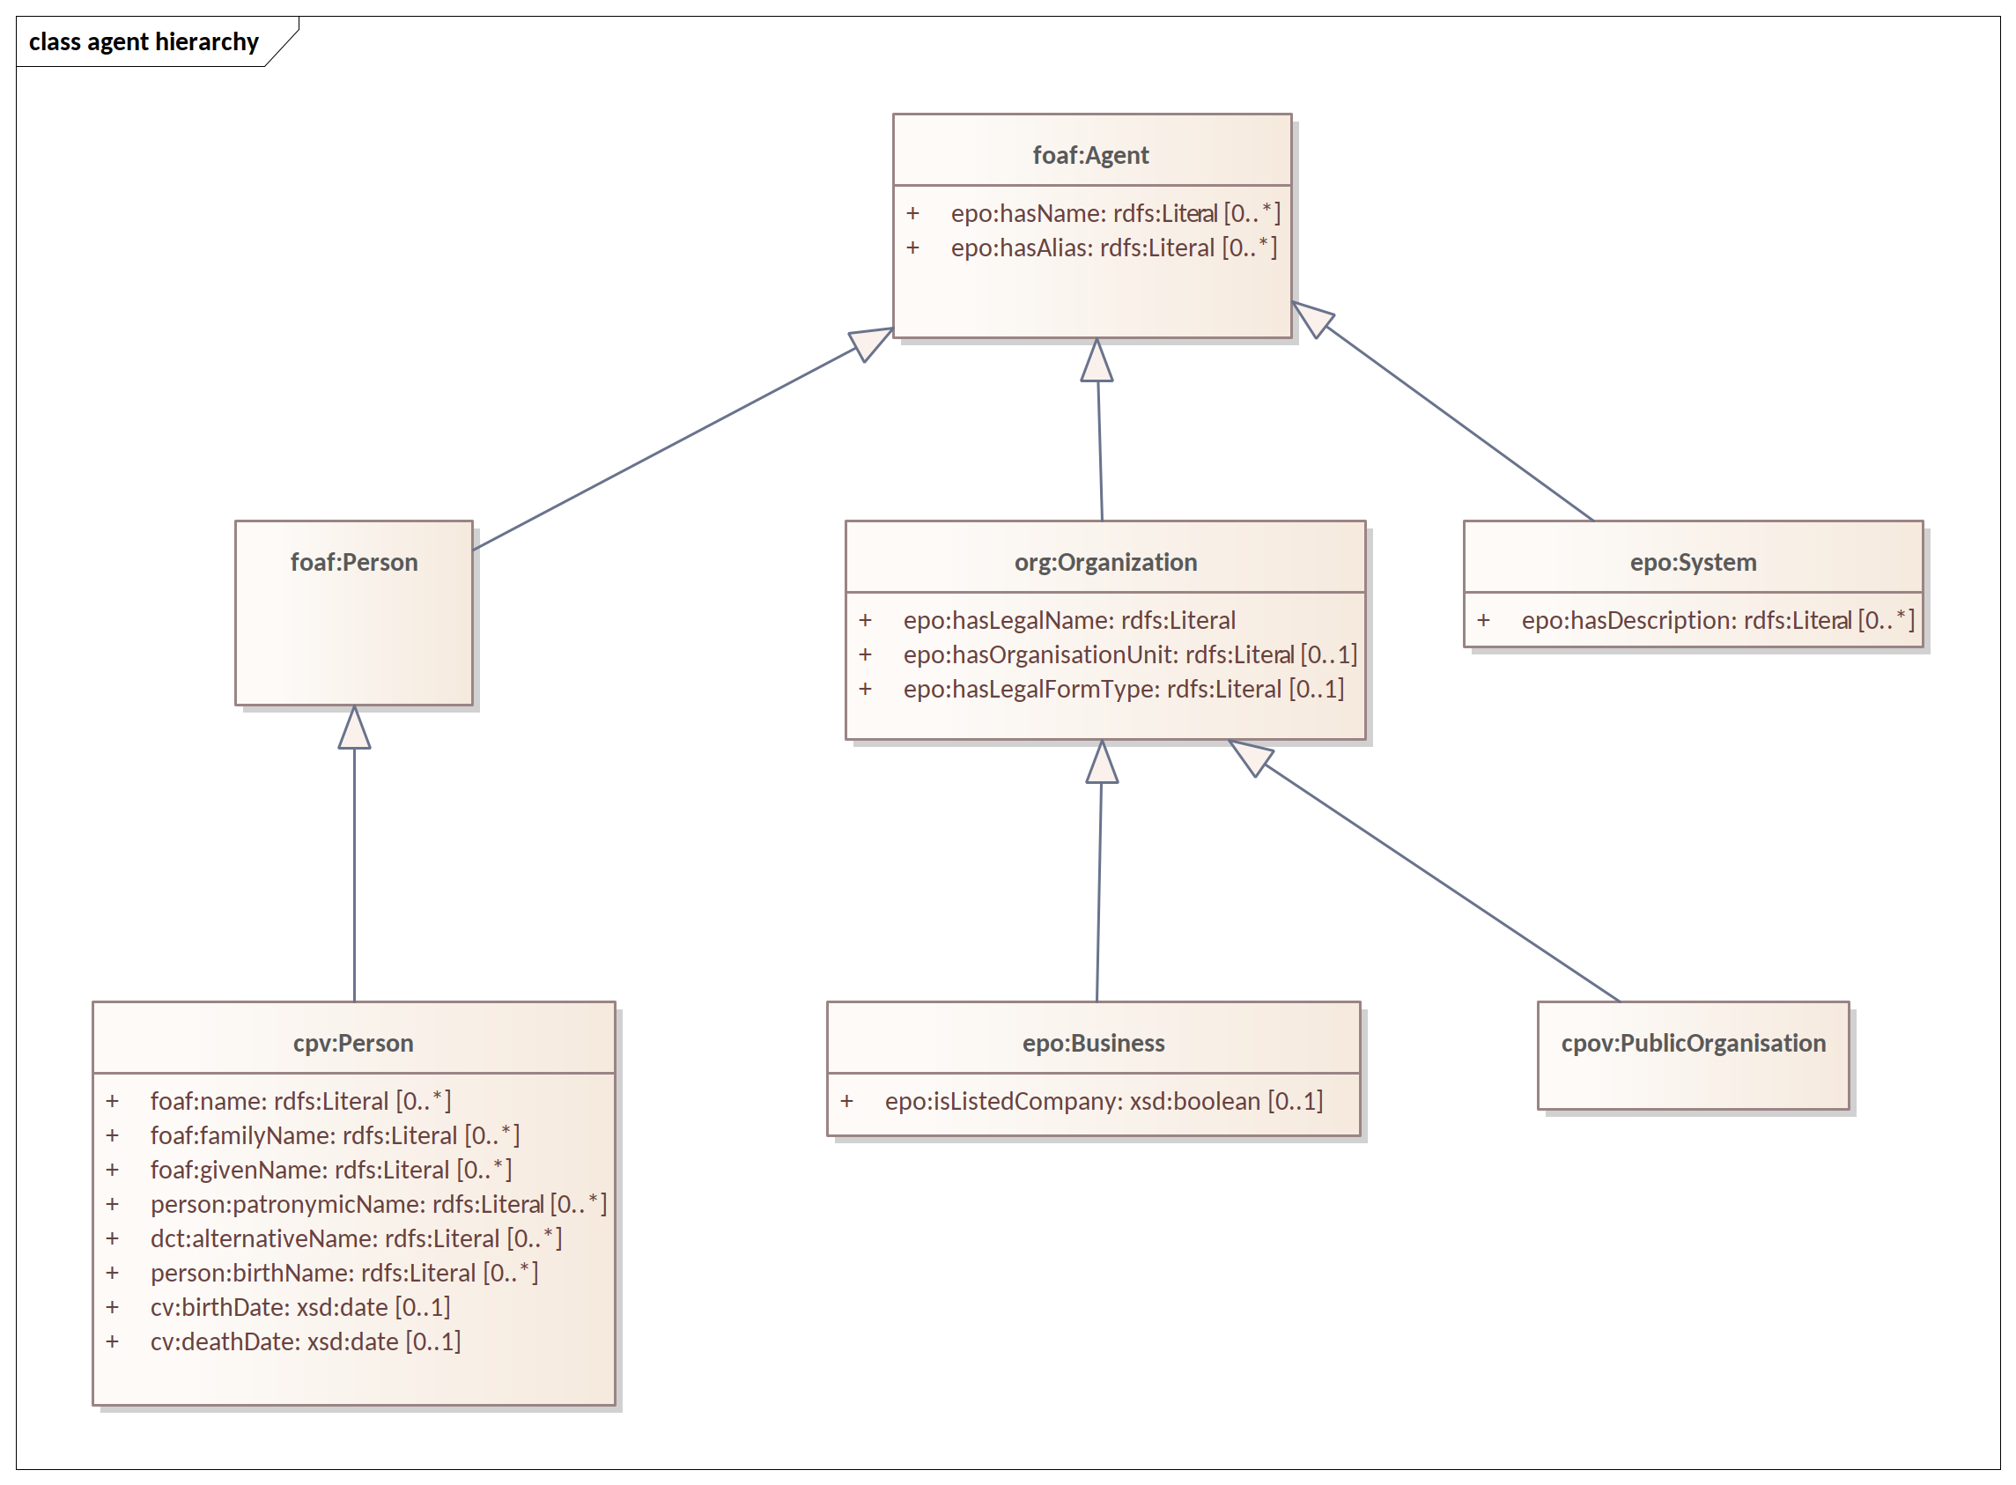
Methodology
Ontology development oriented by an upper-level organisation.

Slide 9
Methodology
Ontology development oriented by a principle-based perspective.
ID | Principle Item | Description
PR_01 | Instance immutability | Once (created) published, an instance shall not be conceptualised as changeable. Of course we may correct the information, but not extend it so that it may evolve into something different that was initially meant.
PR_02 | Non redundancy | The properties of an entity must be instantiated only once and not repeated in the data. In case properties need to be made available in another context, this shall be done by reference not by duplication.

Slide 10
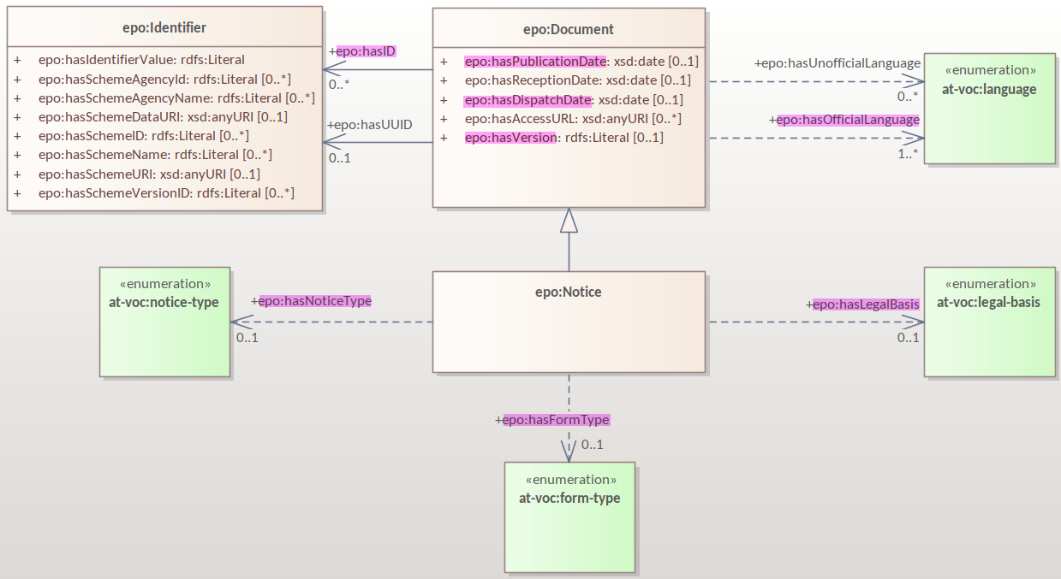
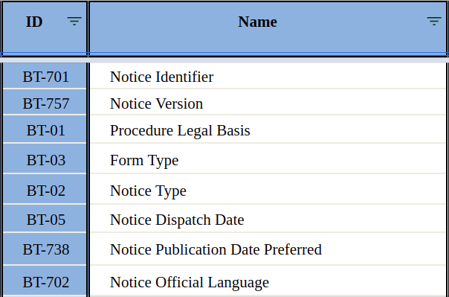
Methodology
Scoping to the eForms & standard forms conceptual coverage

Slide 11

Methodology
Module based ontology management
Work in progress

Slide 12
Methodology
UML conventions
UML transformation rules
Automation
- documentation publication (using GitHub, Antora, AsciiDoc)
- transformation of model to OWL & SHACL (using model2owl)
- glossary generation & publication

Slide 13
Model refactoring & modules

Slide 14
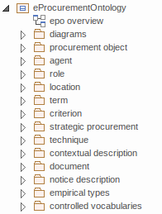
Model refactoring
Package based grouping of concepts
Aspect oriented diagrams
- more diagrams than before
- easier to read
- hierarchy vs relations view
- scoped vs wide view
On finding concepts (glossary , HTML)
Notes:
- Procurement object
- Role - Agent
- Term
- Criterion
- Strategic Procurement
- Technique
- Contextual description
- Document
- Notice description
- Empirical types
- Controlled Vocabularies

Slide 15
Model refactoring
Hierarchy diagram
focus on the abstraction

Slide 16
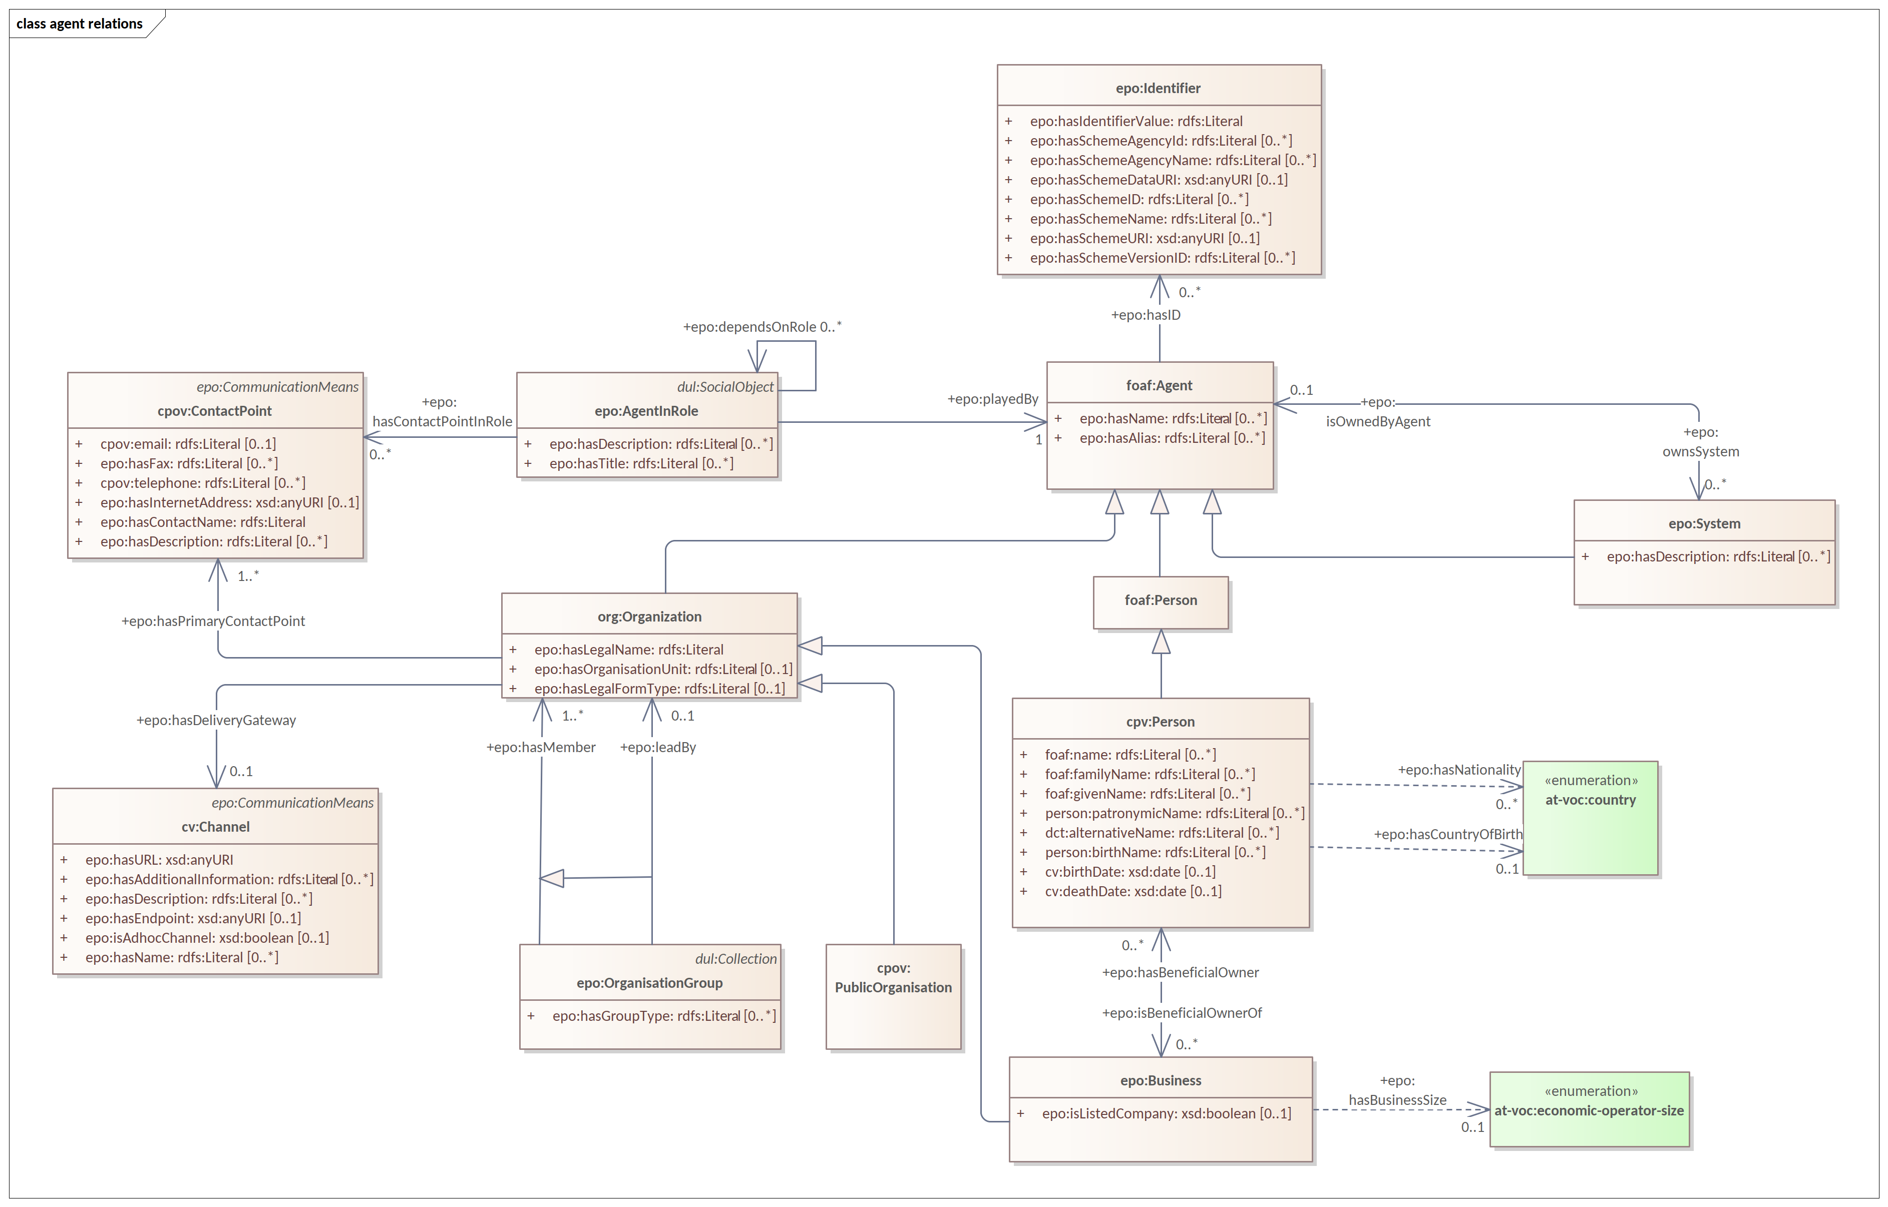
Model refactoring
Relations diagram
focus on the connections

Slide 17
Model refactoring
Wide view diagram

Slide 18
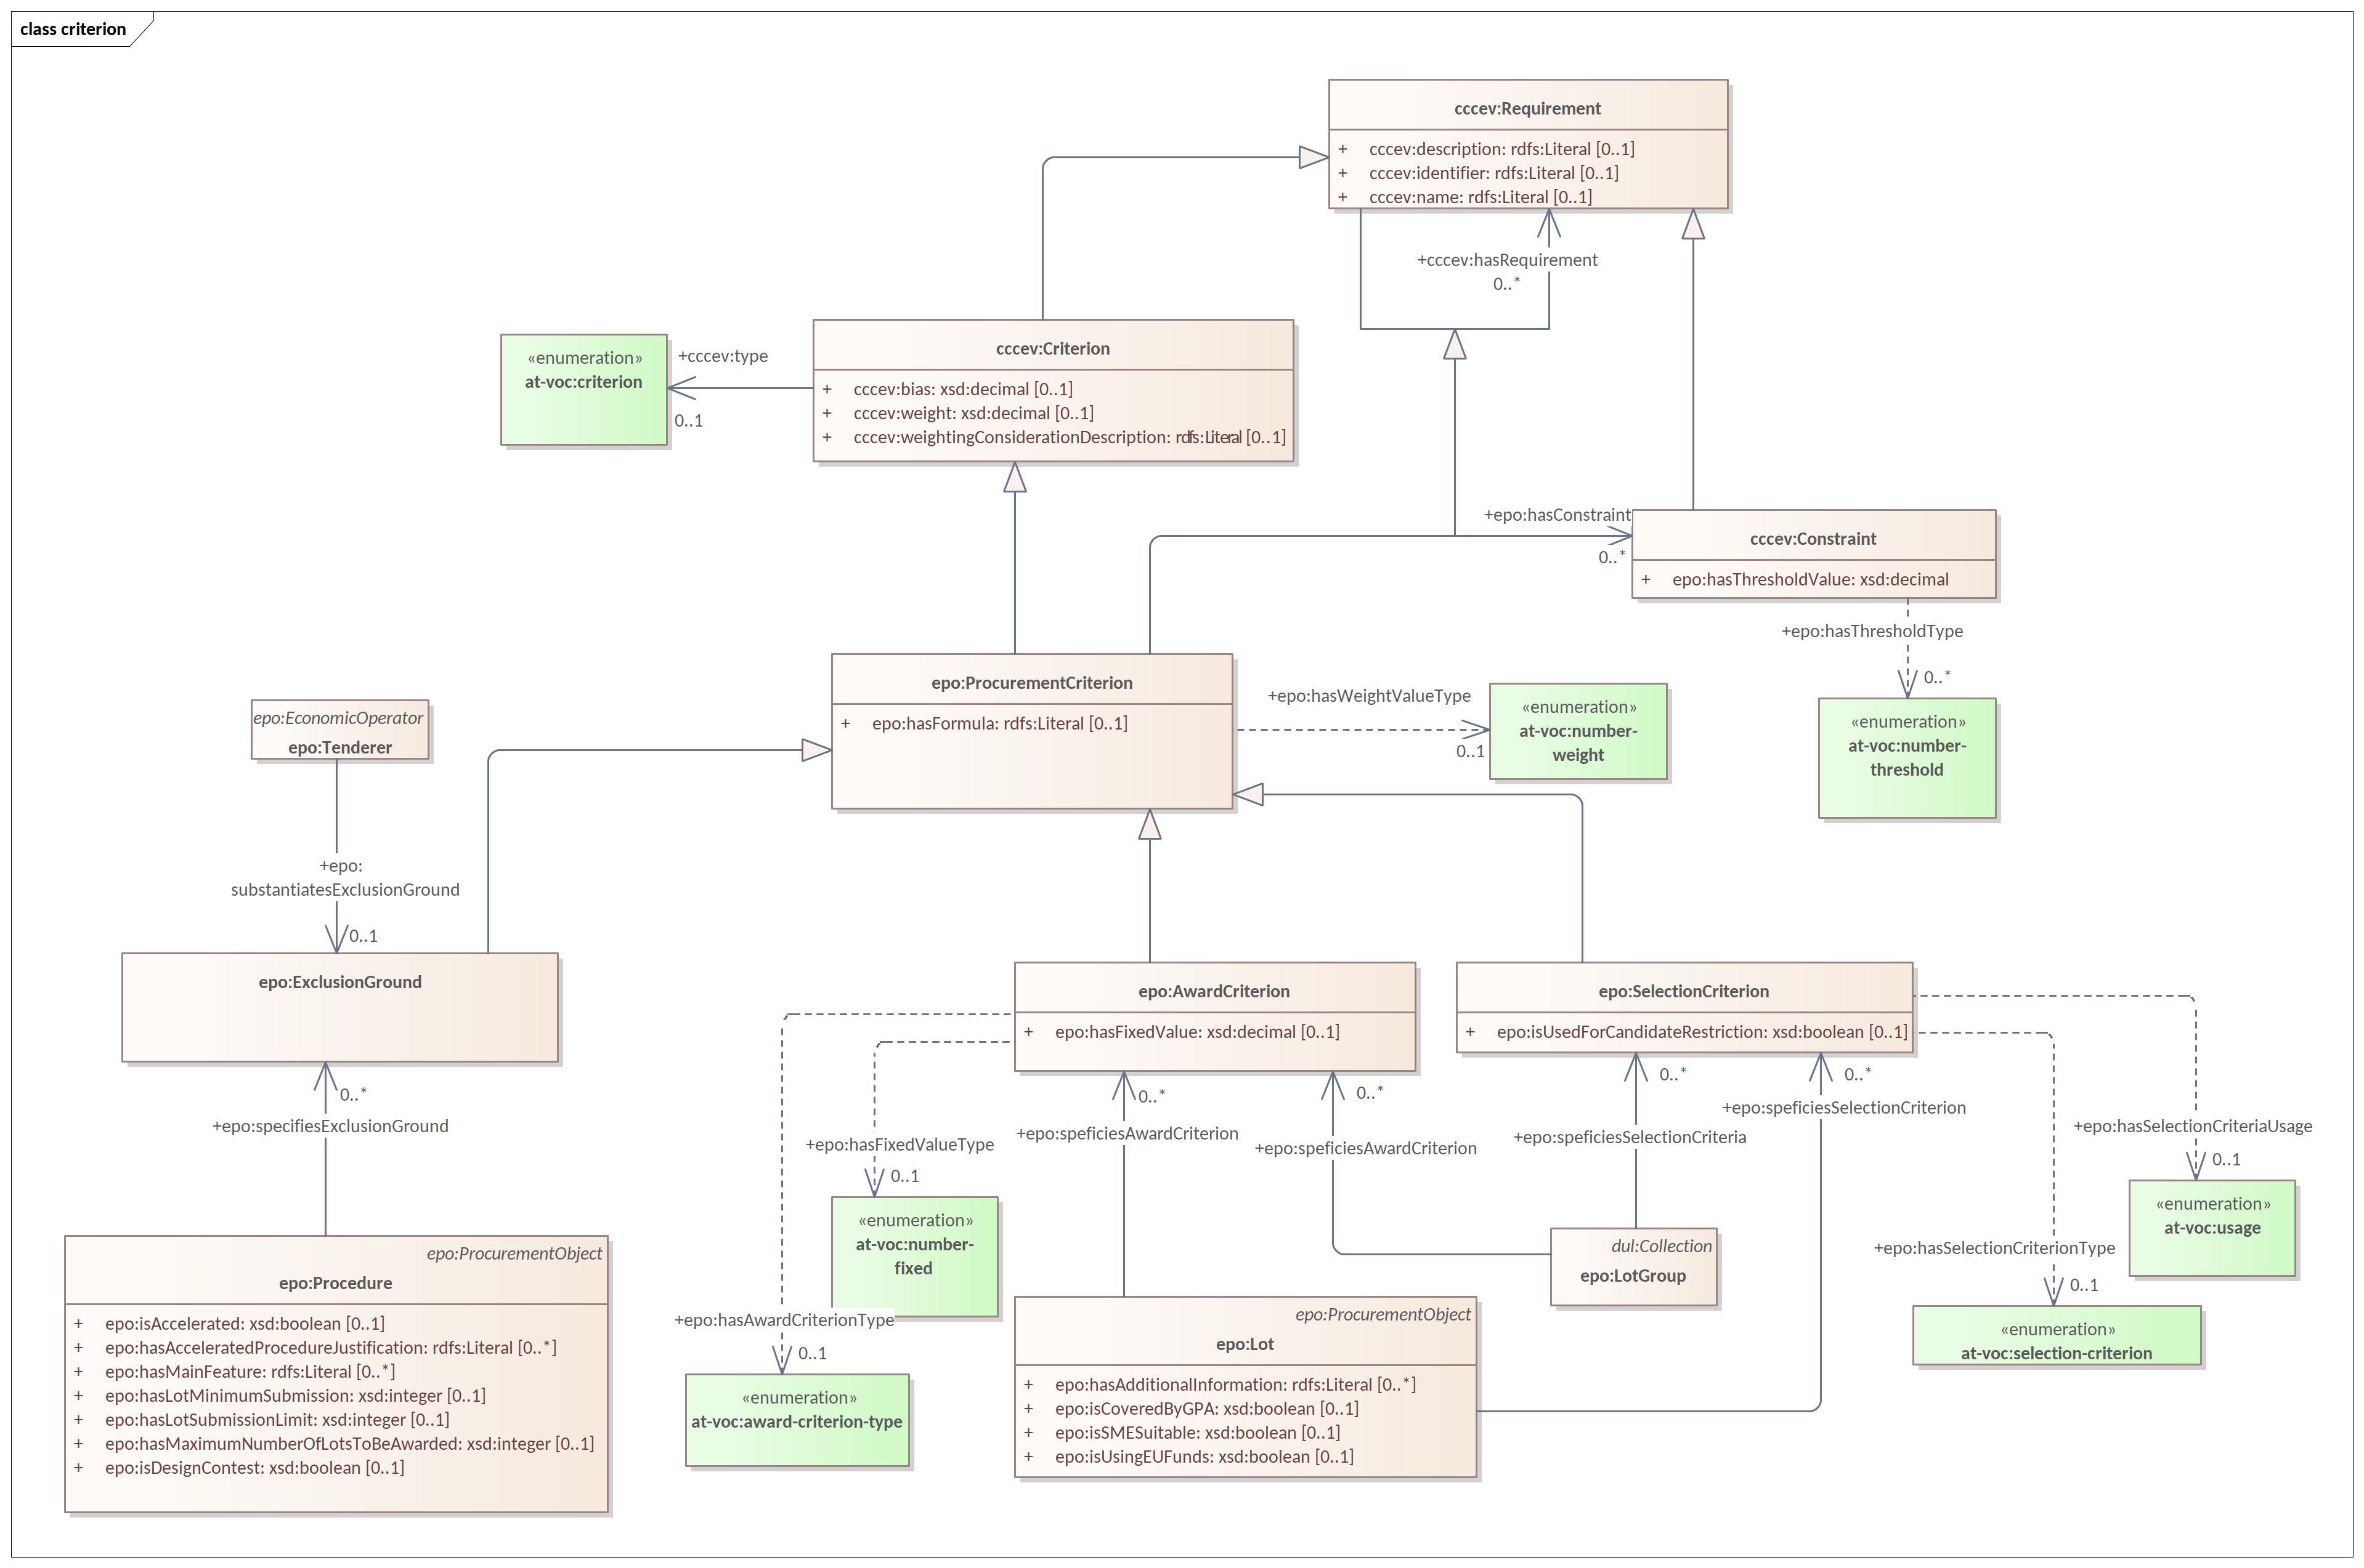
Model refactoring
Scoped view diagram

Slide 19
Modules
ePO core
work in progress
eNotice
eCatalogue
eOrder
eAccess
eSubmission
eFulfillment
ePO core
eInvoicing
eContract
Contract Registry
eEvaluation
eAwarding
eRequest
ePayment
imports
imports
eCatalogue
eNotice
Notes:
Modules are not packages! These are model extensions that import ePO core.

Slide 20
Evolution of 2.0.1 to 3.0.0

Slide 21
Evolution of 2.0.1 to 3.0.0
Migration of Documentation from GitHub Wiki to TED documentation
UML/UBL datatypes --> XSD datatypes
Removed attributes of type “Code”
Harmonisation of predicate & class names
Completed the definitions of classes, attributes & relations
New & deleted classes
Changed classes
New & deleted controlled vocabularies
Re-use of Core Vocabularies
Agent in Role design pattern & roles hierarchy
Monetary values
Classes: 145
Attributes (datatype properties): 206
Relations (object properties): 269

Slide 22
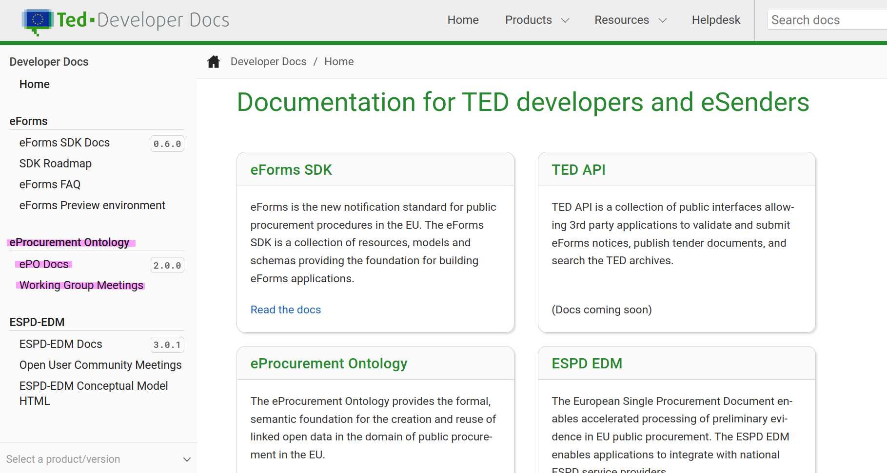
Evolution of 2.0.1 to 3.0.0
Migration of Documentation from GitHub Wiki to TED documentation
Notes:
Maybe a short demo on the website.

Slide 23
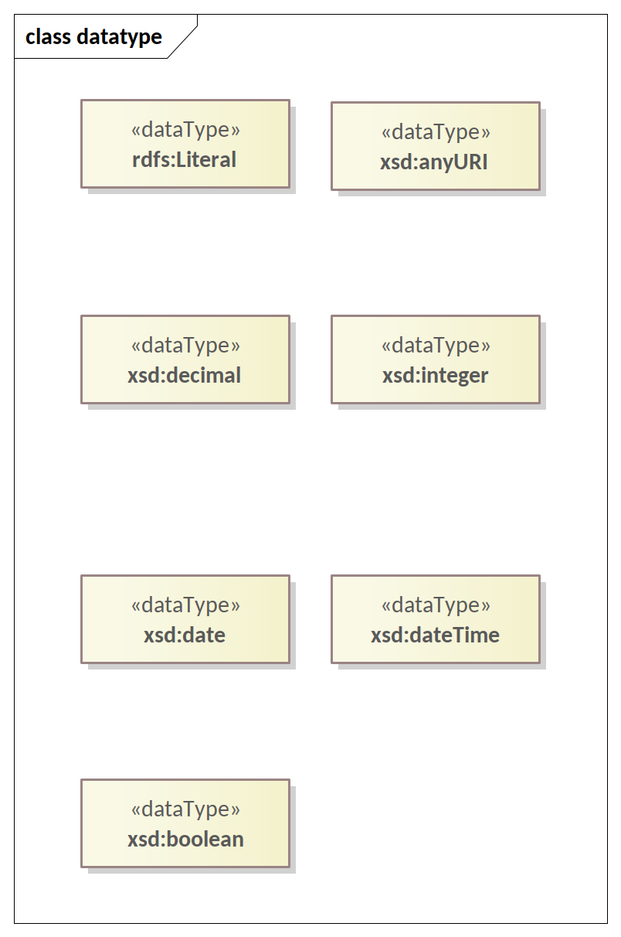
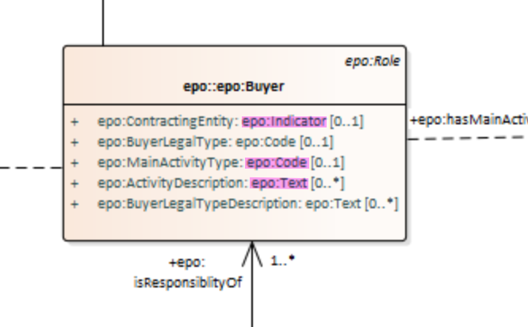
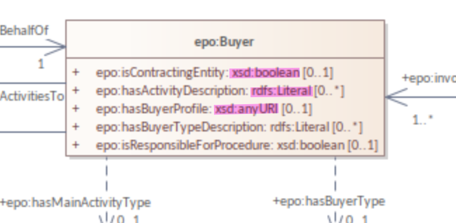
Evolution of 2.0.1 to 3.0.0
Migration from UML/UBL datatypes to XSD datatypes
ePO 3.0.0 beta
ePO 2.0.1

Slide 24
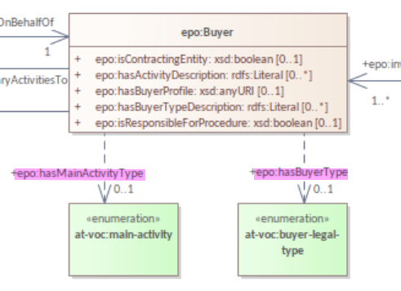
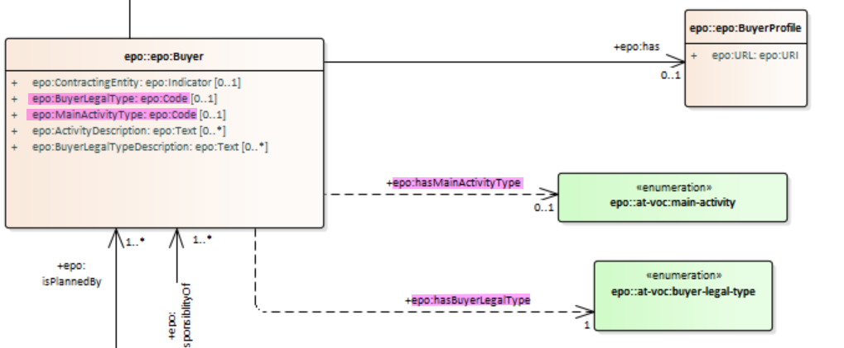
Evolution of 2.0.1 to 3.0.0
Removed attributes of type “Code”
ePO 2.0.1
ePO 3.0.0 beta

Slide 25
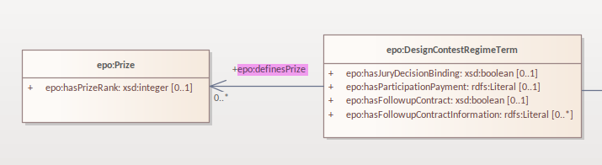
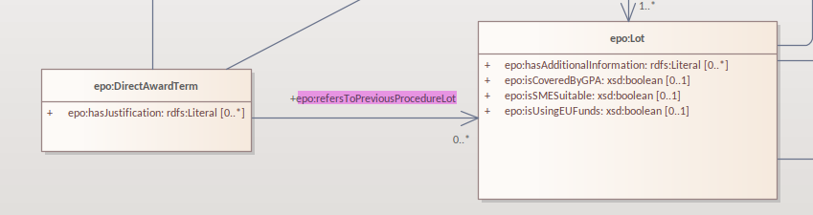
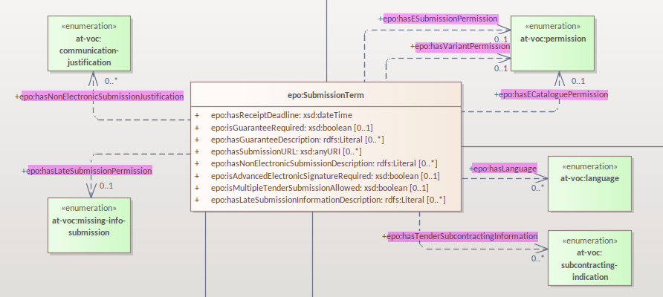
Evolution of 2.0.1 to 3.0.0
Harmonisation of predicates and class names
Source class type | Predicate type | Target class type
Terms | has | some controlled vocabulary or an empirical type
Terms | define | some object/entity
Terms | refersTo | some object/entity

Slide 26
Evolution of 2.0.1 to 3.0.0
Completed the definitions of classes, attributes & relations
Change notes:
- new classes & removed classes
- changed classes
- added & removed controlled vocabularies

Slide 27
Evolution of 2.0.1 to 3.0.0
Re-use of Core Vocabularies
- Core Location Vocabulary
- Core Person Vocabulary
- Core Public Organisation Vocabulary
- Core Business Vocabulary
- Core Criterion and Core Evidence Vocabulary
- Core Public Service Vocabulary Application Profile

Slide 28
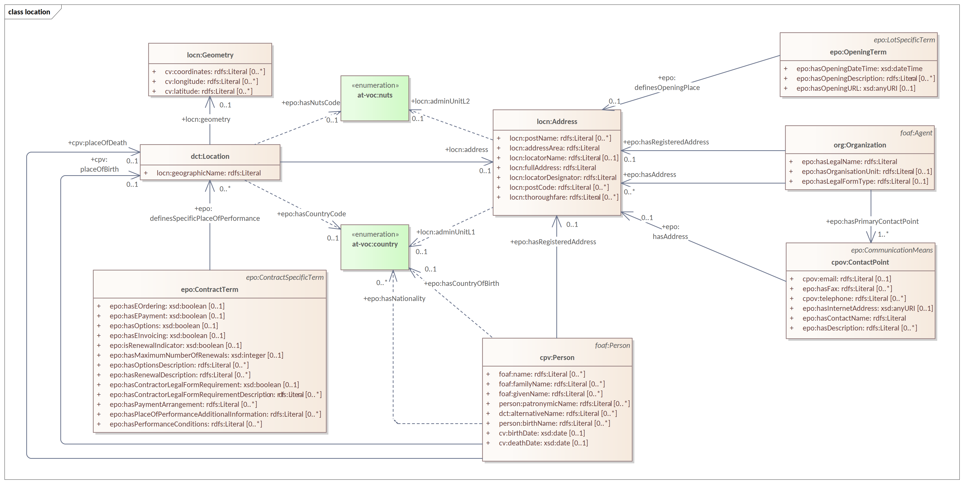
Evolution of 2.0.1 to 3.0.0
Re-use of Core Location

Slide 29
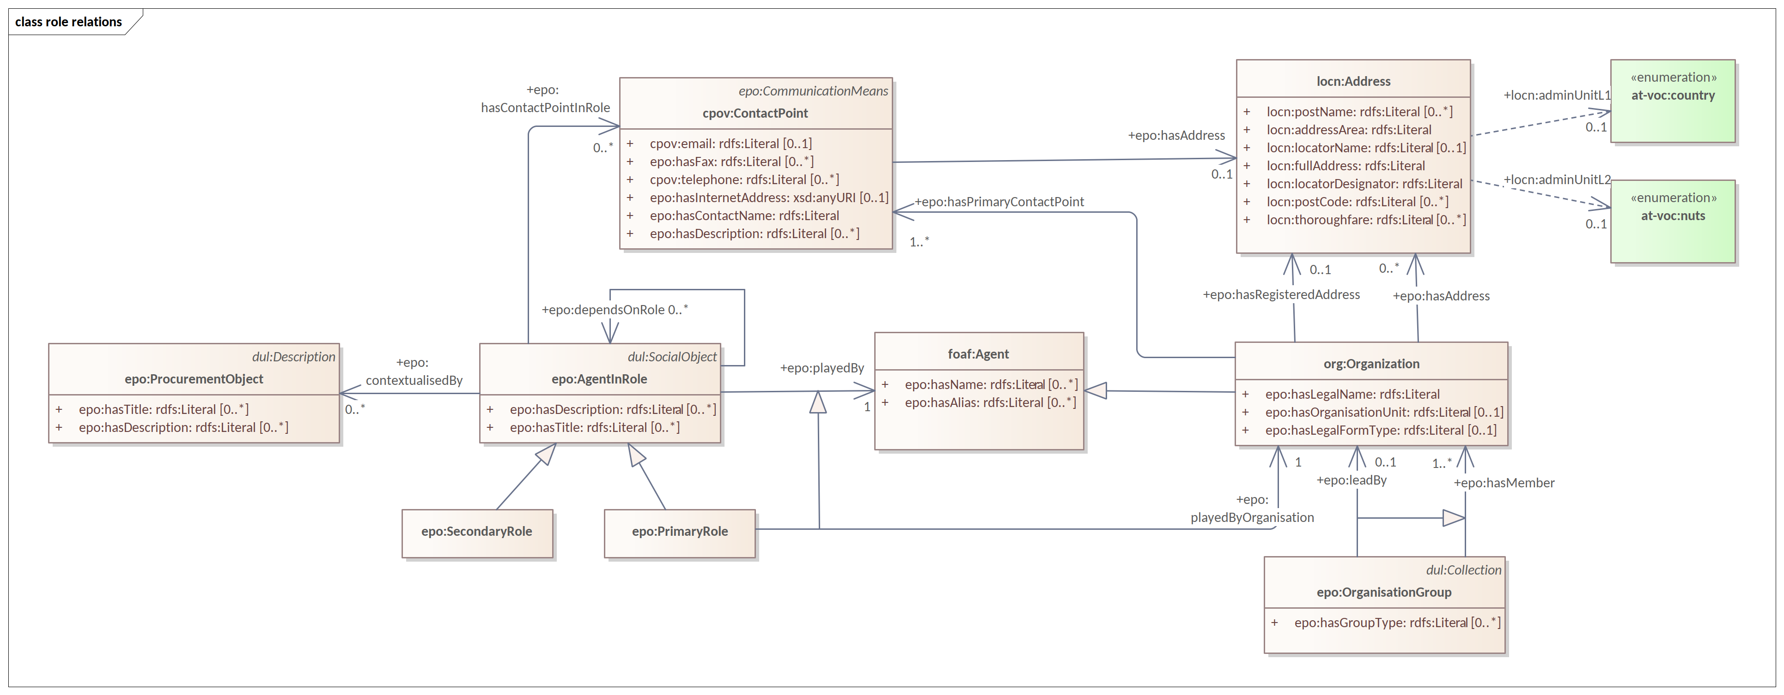
Evolution of 2.0.1 to 3.0.0
Agent in Role design pattern

Slide 30
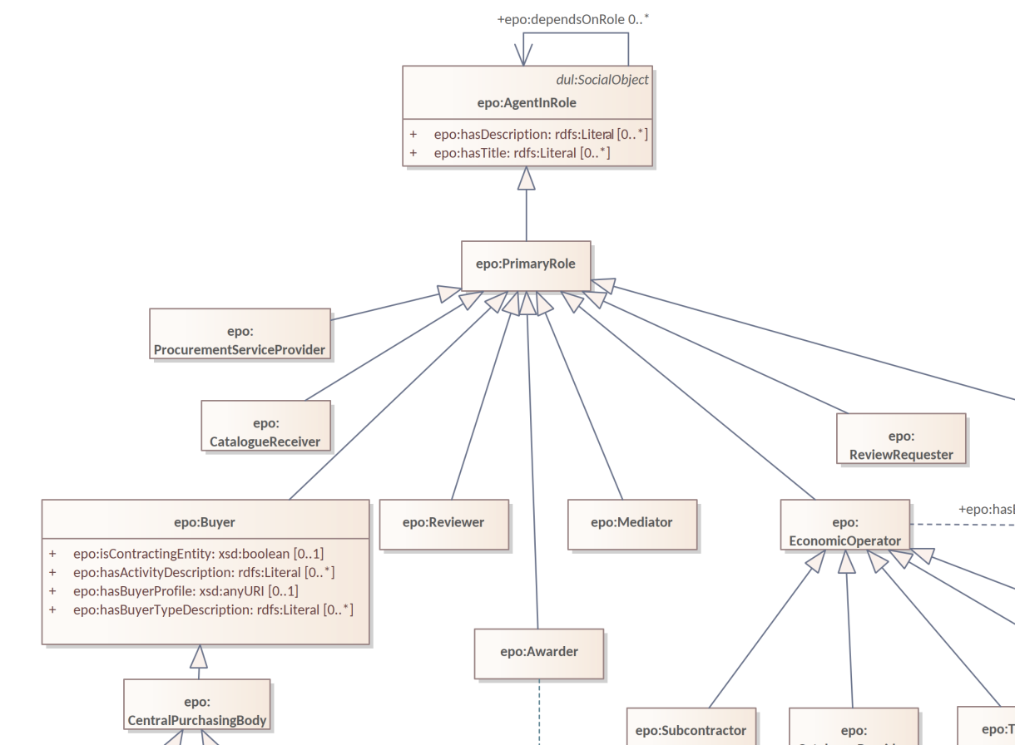
Evolution of 2.0.1 to 3.0.0
Roles hierarchy

Slide 31
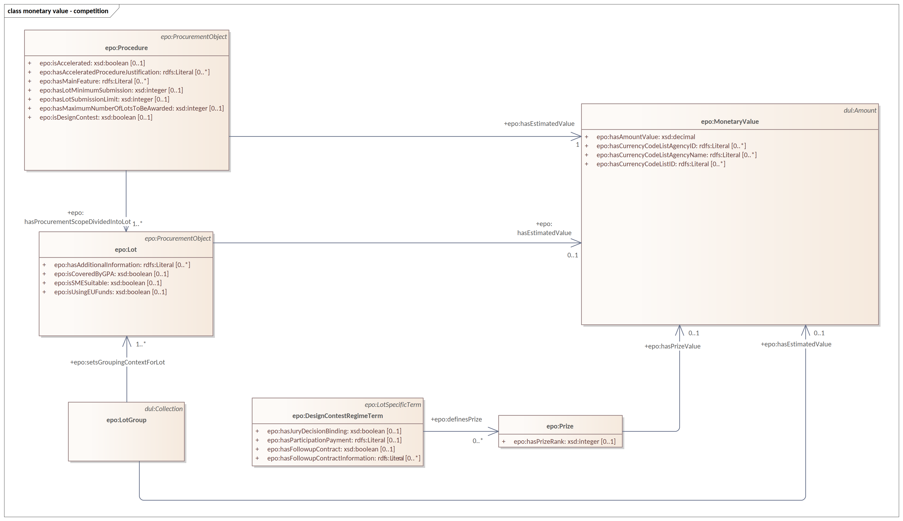
Evolution of 2.0.1 to 3.0.0
Monetary values in competition phase

Slide 32
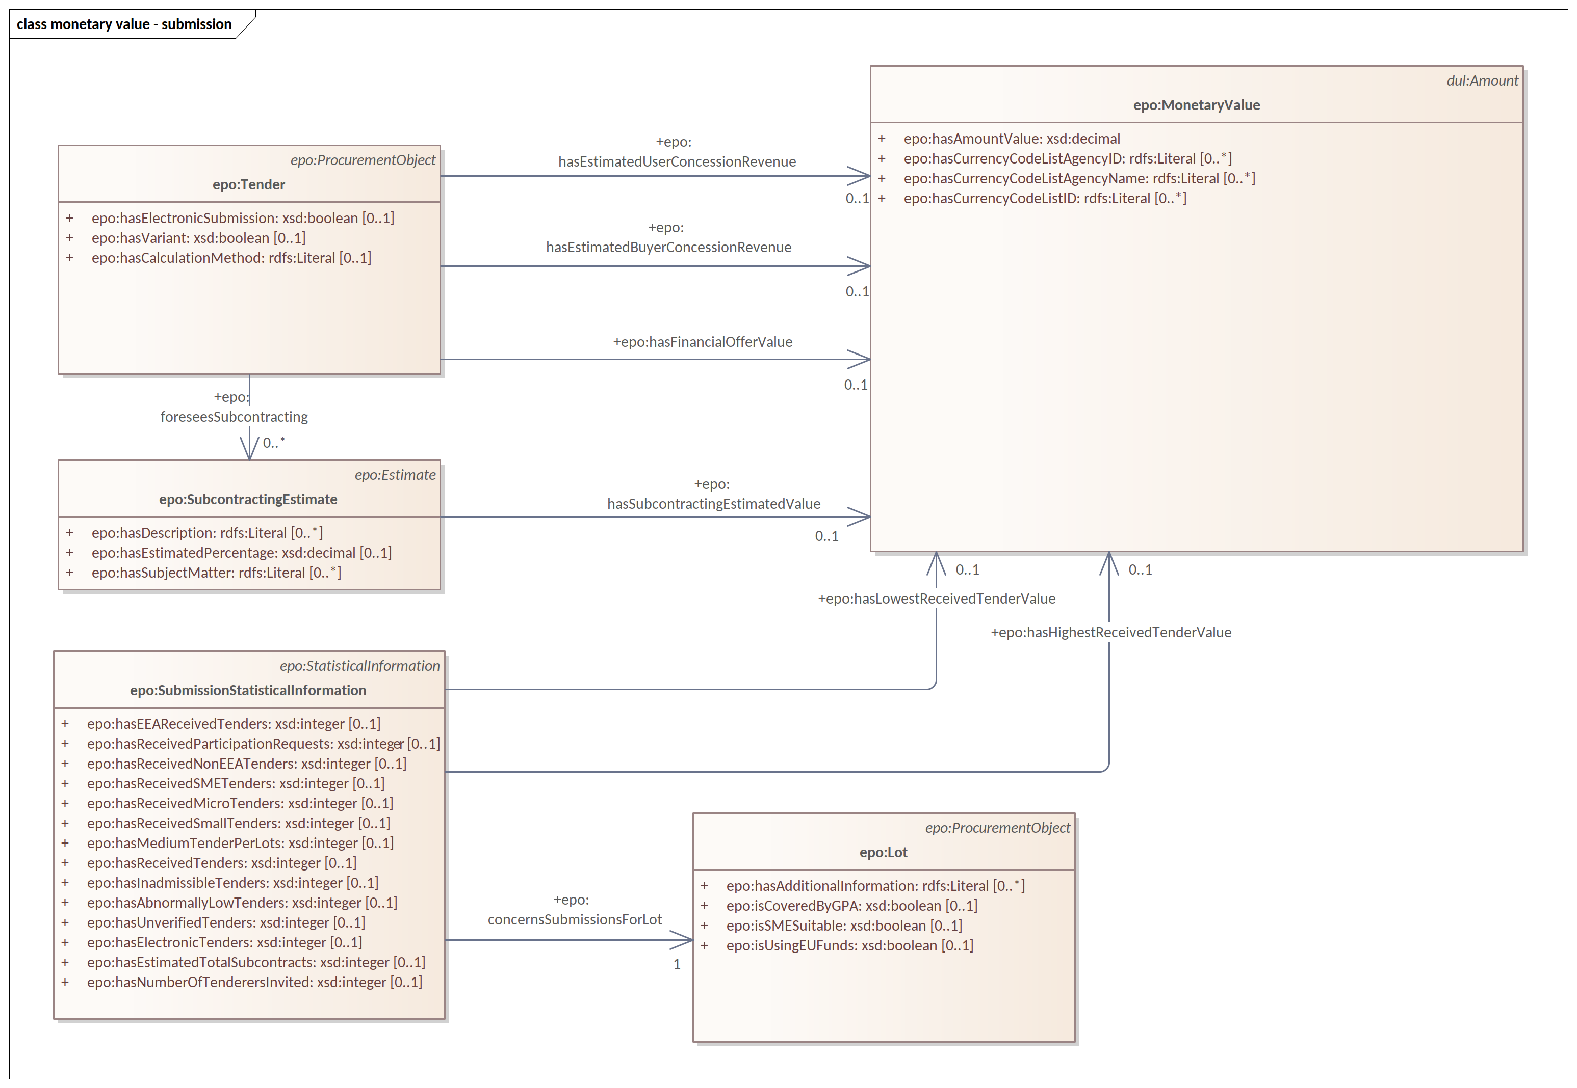
Evolution of 2.0.1 to 3.0.0
Monetary values in submission phase

Slide 33
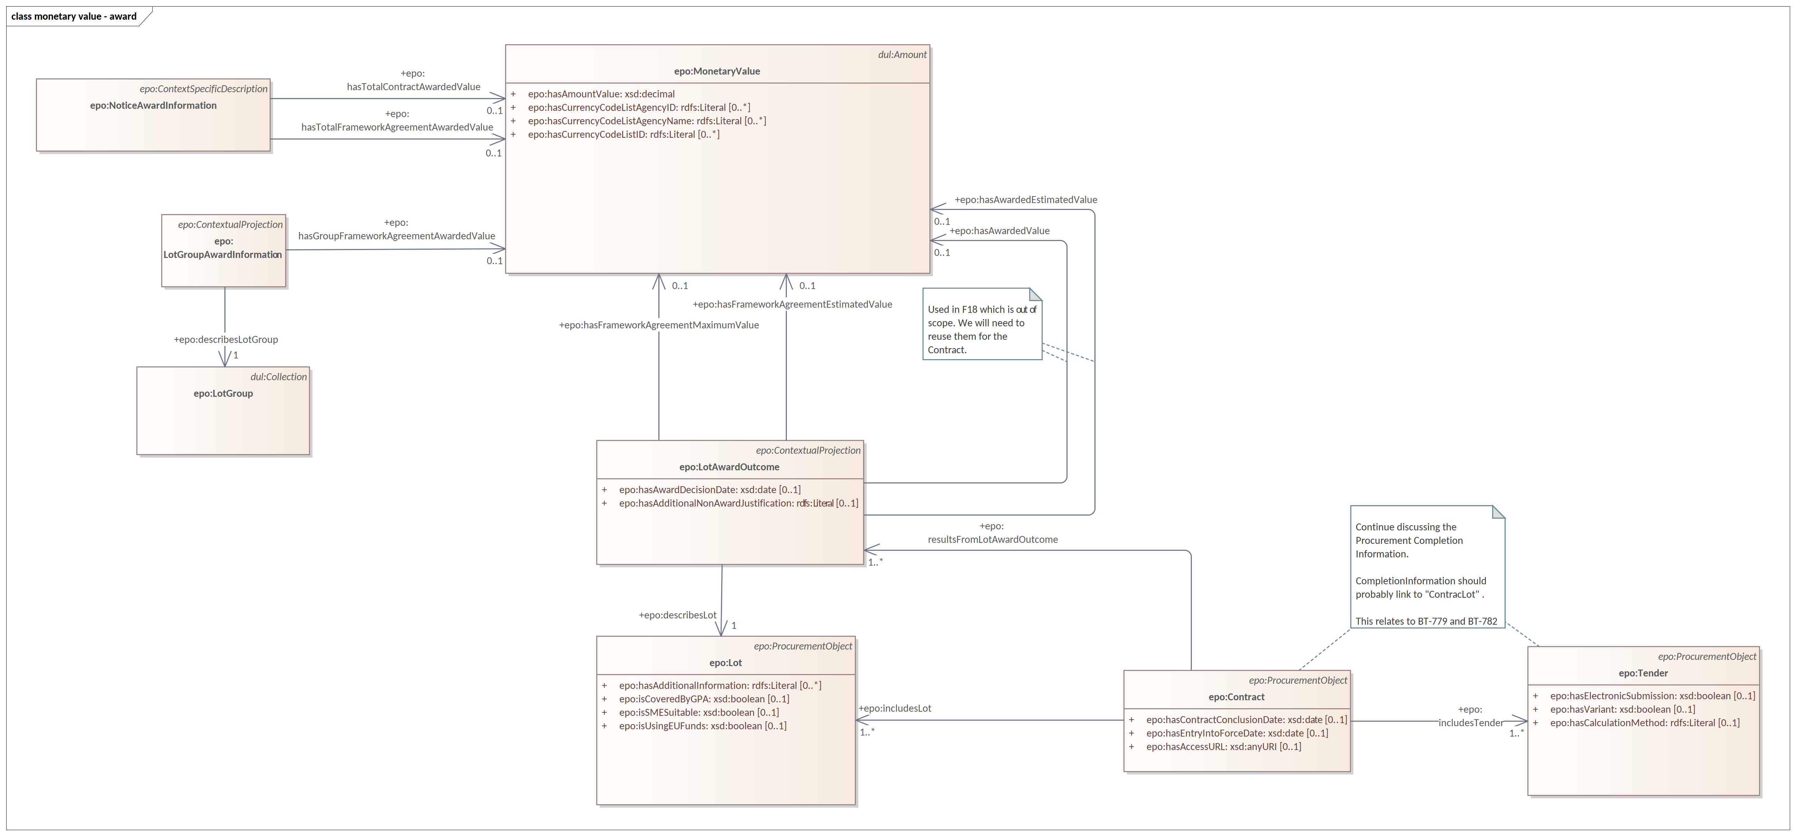
Evolution of 2.0.1 to 3.0.0
Monetary values in award phase

Slide 34
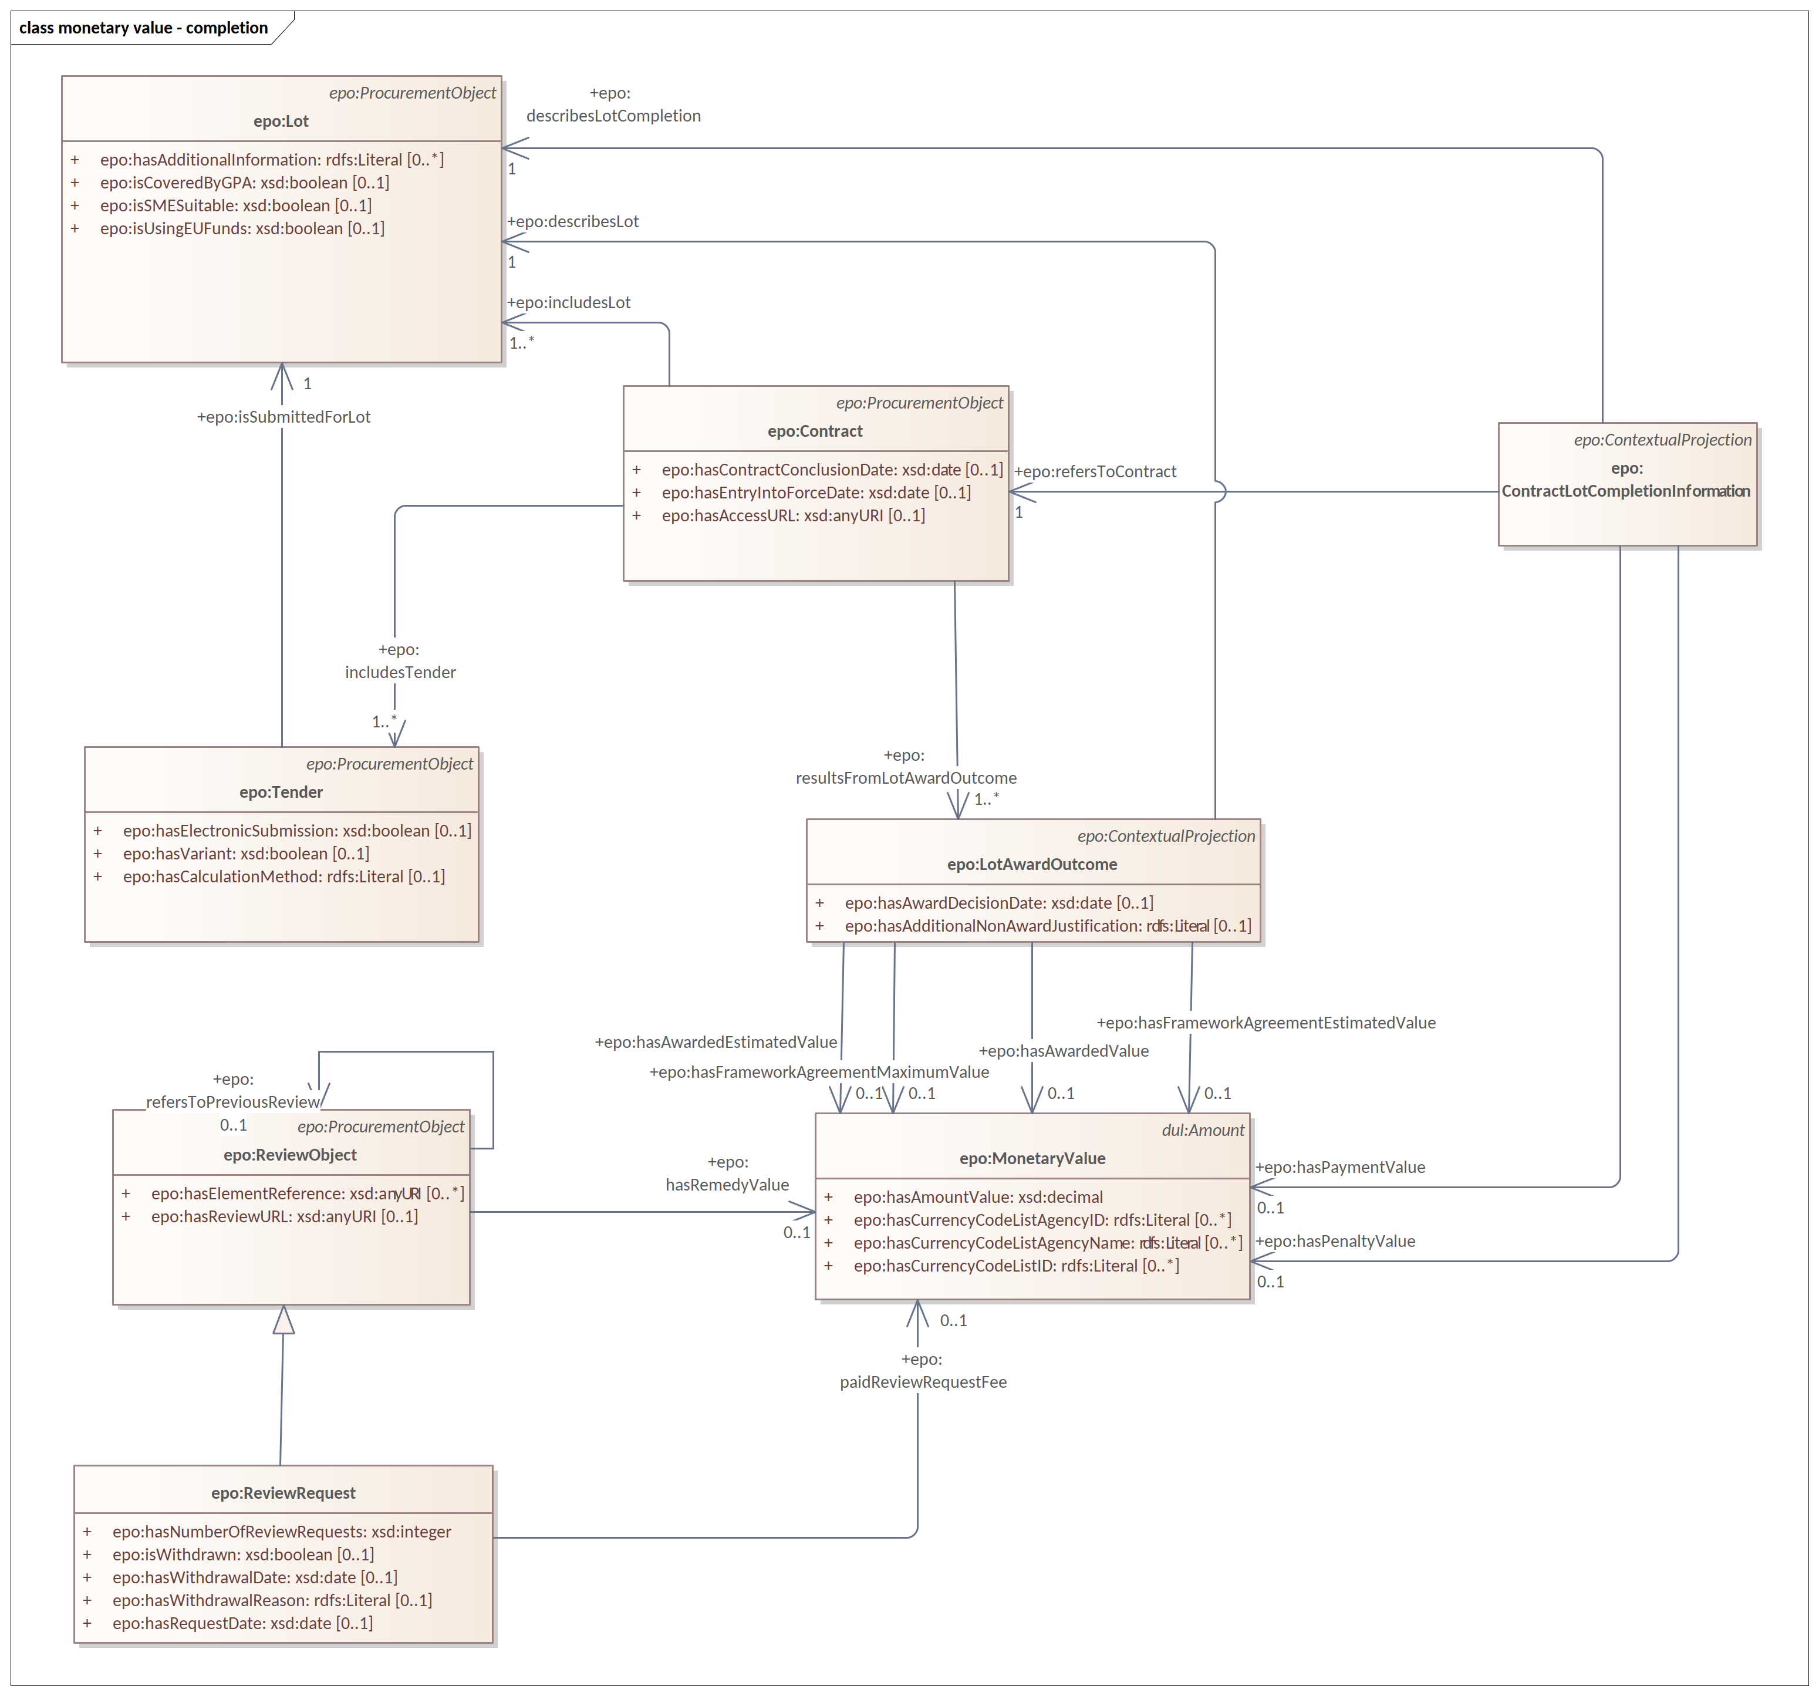
Evolution of 2.0.1 to 3.0.0
Monetary values in completion phase

Slide 35
Open discussion

Slide 36
Meeting schedule
Regular ePO Working Group meetings:
- every Tuesday from 14:30 to 16:30 (EET)
- meeting link
Specific ePO Working Group meetings:
- every other Thursday from 14:30 to 16:30 (EET)
- meeting link
Face to face meeting:
- foreseen at the end of 2022

Slide 37
Feedback and questions
Looking forward to hearing from you.
Feedback and questions can be sent via:
Github issues: https://github.com/OP-TED/ePO/issues
or alternatively via:
Email: OP-EPROCUREMENT-ONTOLOGY@publications.europa.eu
Email: natalie.muric@publications.europa.eu

Slide 38
THANK YOU

Slide 39
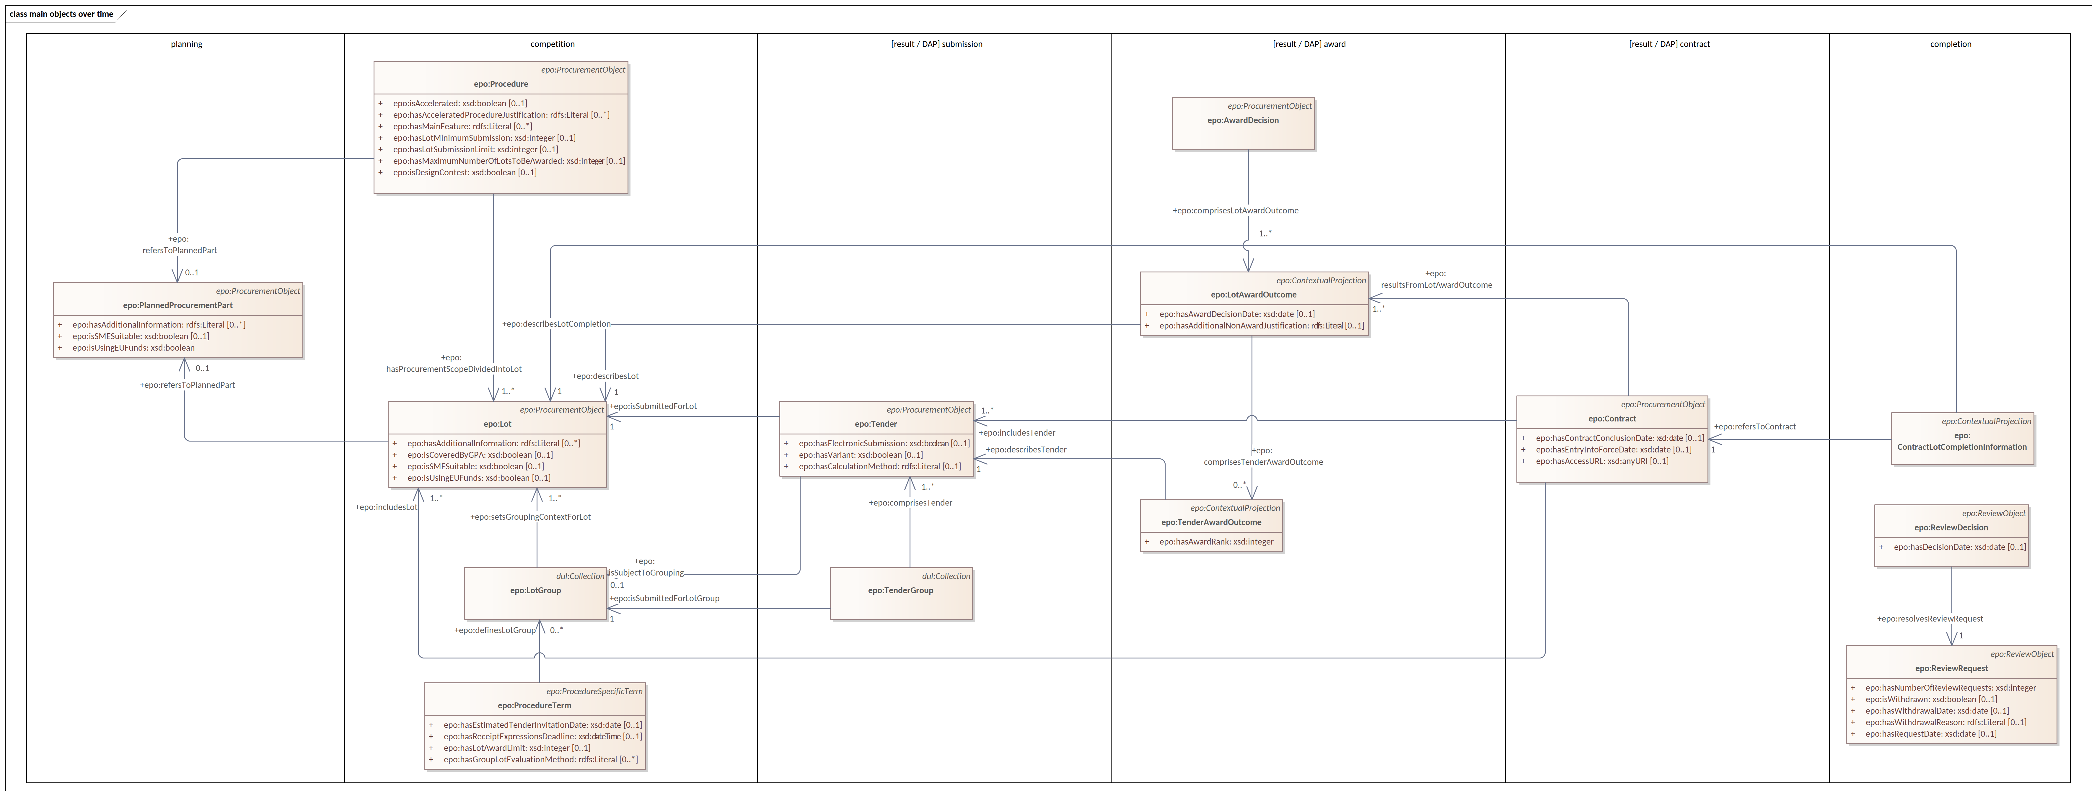
Model refactoring

Slide 40
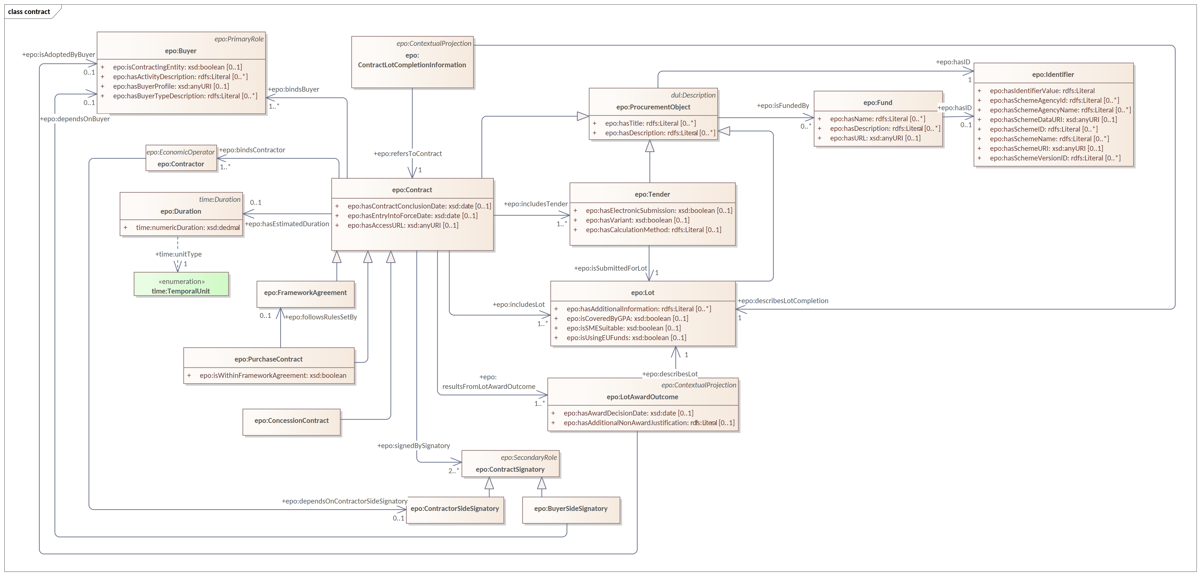
Model refactoring

Slide 41
Model refactoring

Slide 42
Model refactoring

Slide 43
Model refactoring

Slide 44
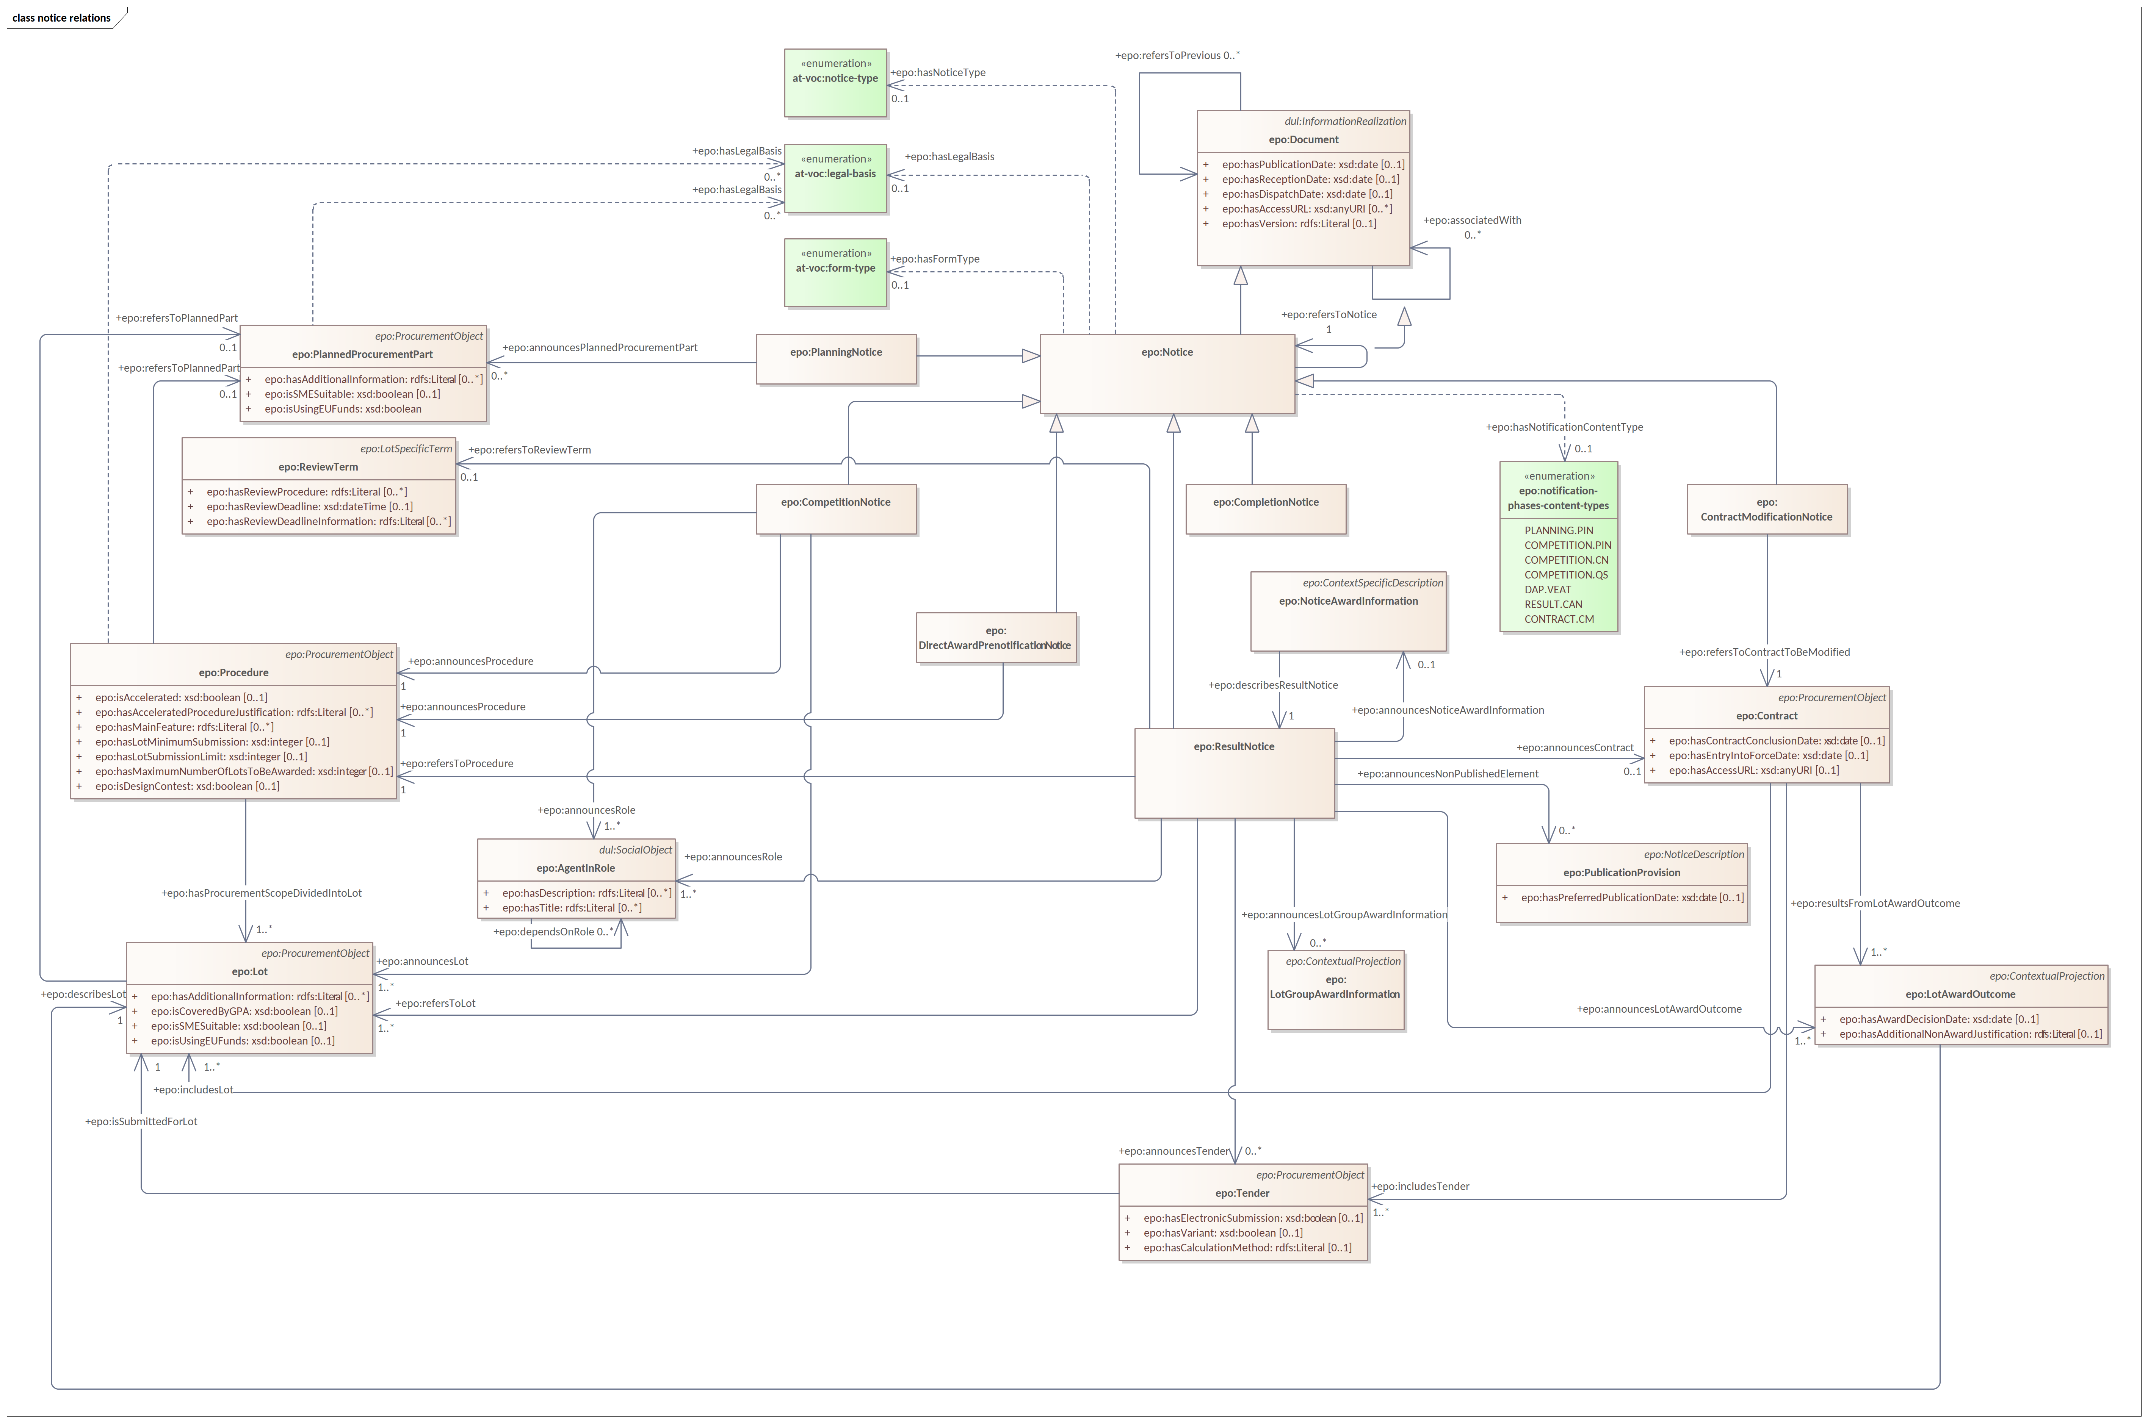
Model refactoring

Slide 45
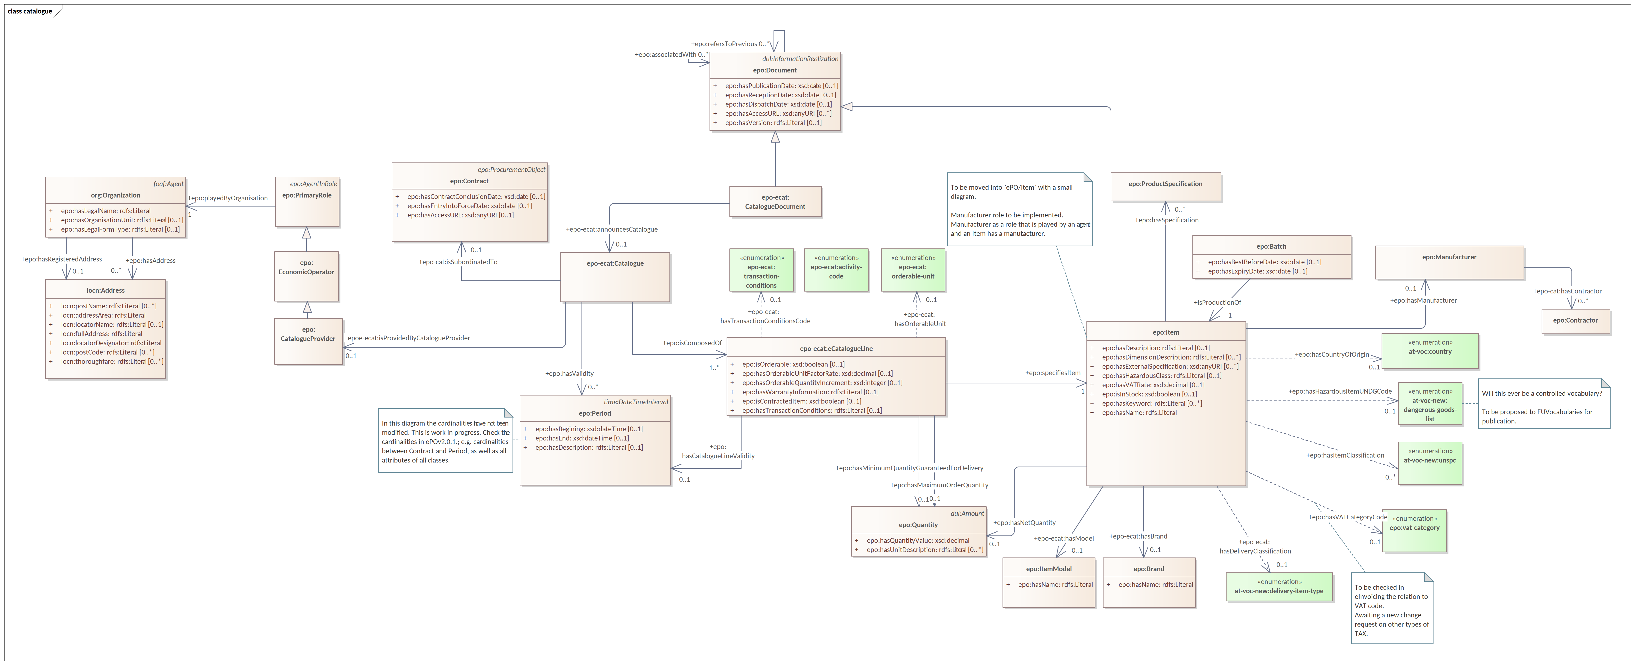
eCatalogue

