Slide 1
eProcurement Ontology
July 2024
Online Presentation 10/07/2024
Andreea Pasăre, Achilles Dougalis
Meaningfy/Infeurope

Slide 2
The goal of this meeting is to present:
(a) the work carried out in the first half of 2024
(b) the work planned for the next half of 2024.

Slide 3
Agenda
Welcome
Review of 2024
ePO 4.1.0-rc.2 (published)
ePO 4.1.0-rc.3 (in progress)
ePO 4.2.0-rc.1 (in progress)
Pre-Award updates
Future work
Updates to the documentation
Open discussion
Closing

Slide 4
Review of 2024

Slide 5
Review of 2024
Publication of ePO 4.1.0-rc.2
Work in progress:
- ePO 4.1.0-rc.3
- GitHub issue fixes
- ePO 4.2.0-rc.1
- eInvoicing module development

Slide 6
Publication of ePO 4.1.0-rc.2

Slide 7
Publication of ePO 4.1.0-rc.2
The release candidate 4.1.0-rc.2 and its corresponding technical files can be found at https://github.com/OP-TED/ePO/tree/4.1.0-rc.2 .
Release notes:
eAccess module was released.
eSubmission module was released.
Updates for the following modules were made:
- ePO core
- eCatalogue: Catalogue Response
- eOrdering
- eFulfilment: Receipt advice
- eContract
- eNotice.

Slide 8
eAccess module

Slide 9
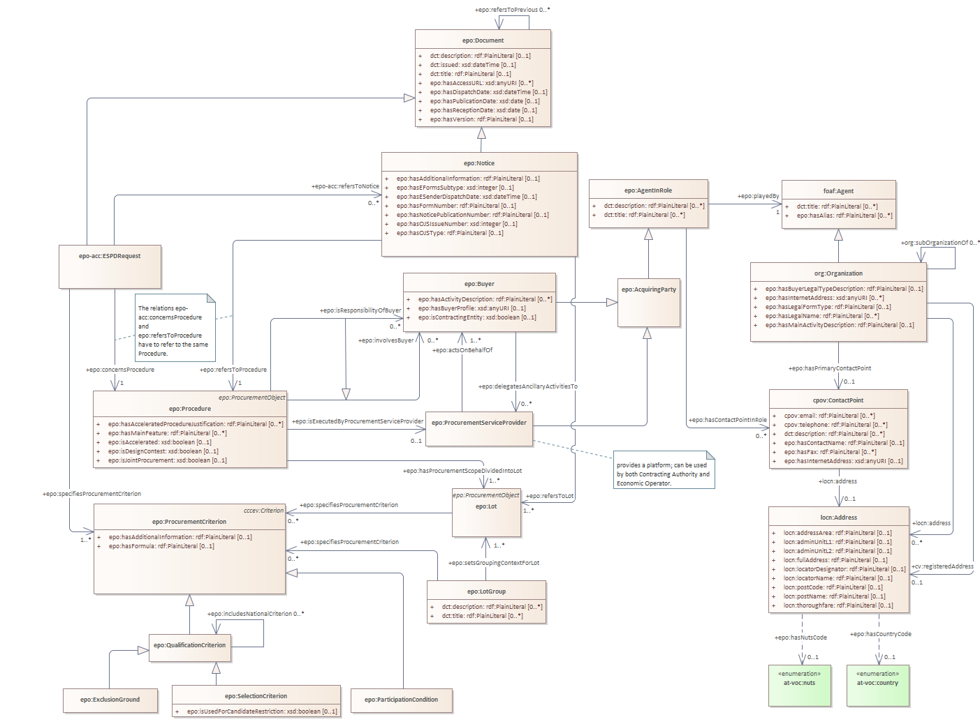
eAccess module

Slide 10
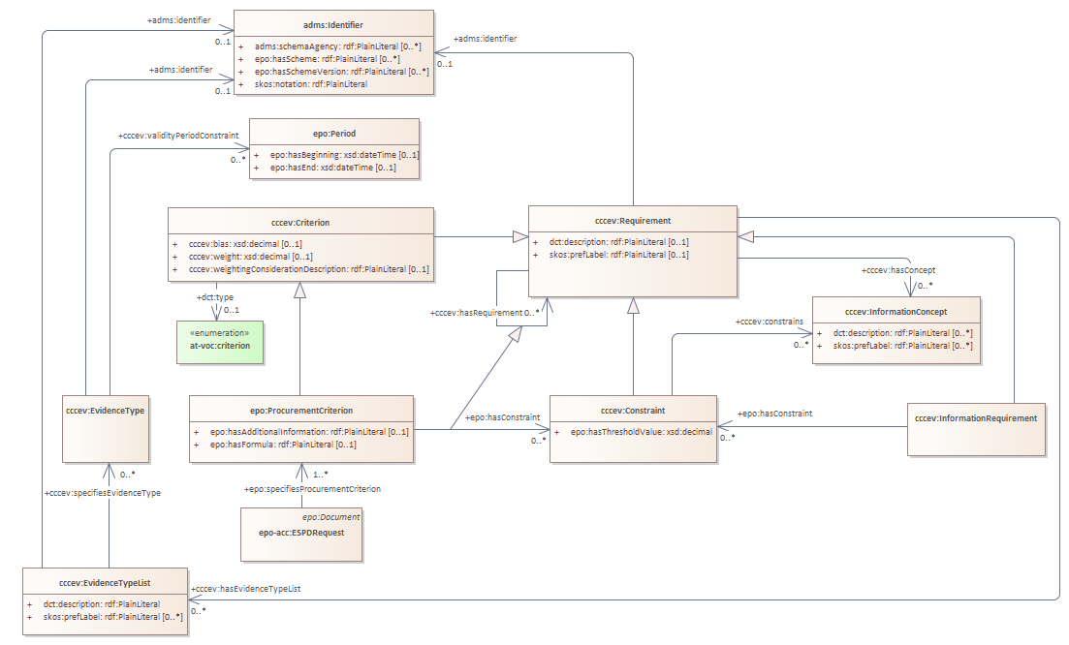
eAccess module - criterion

Slide 11
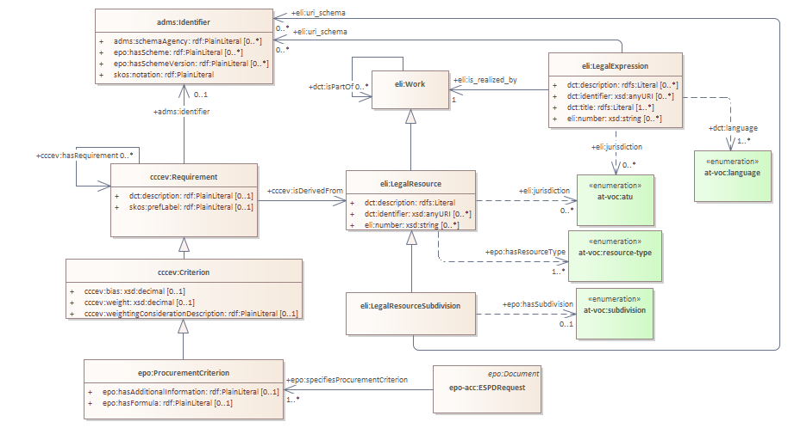
eAccess module - legislation

Slide 12
eSubmission module

Slide 13
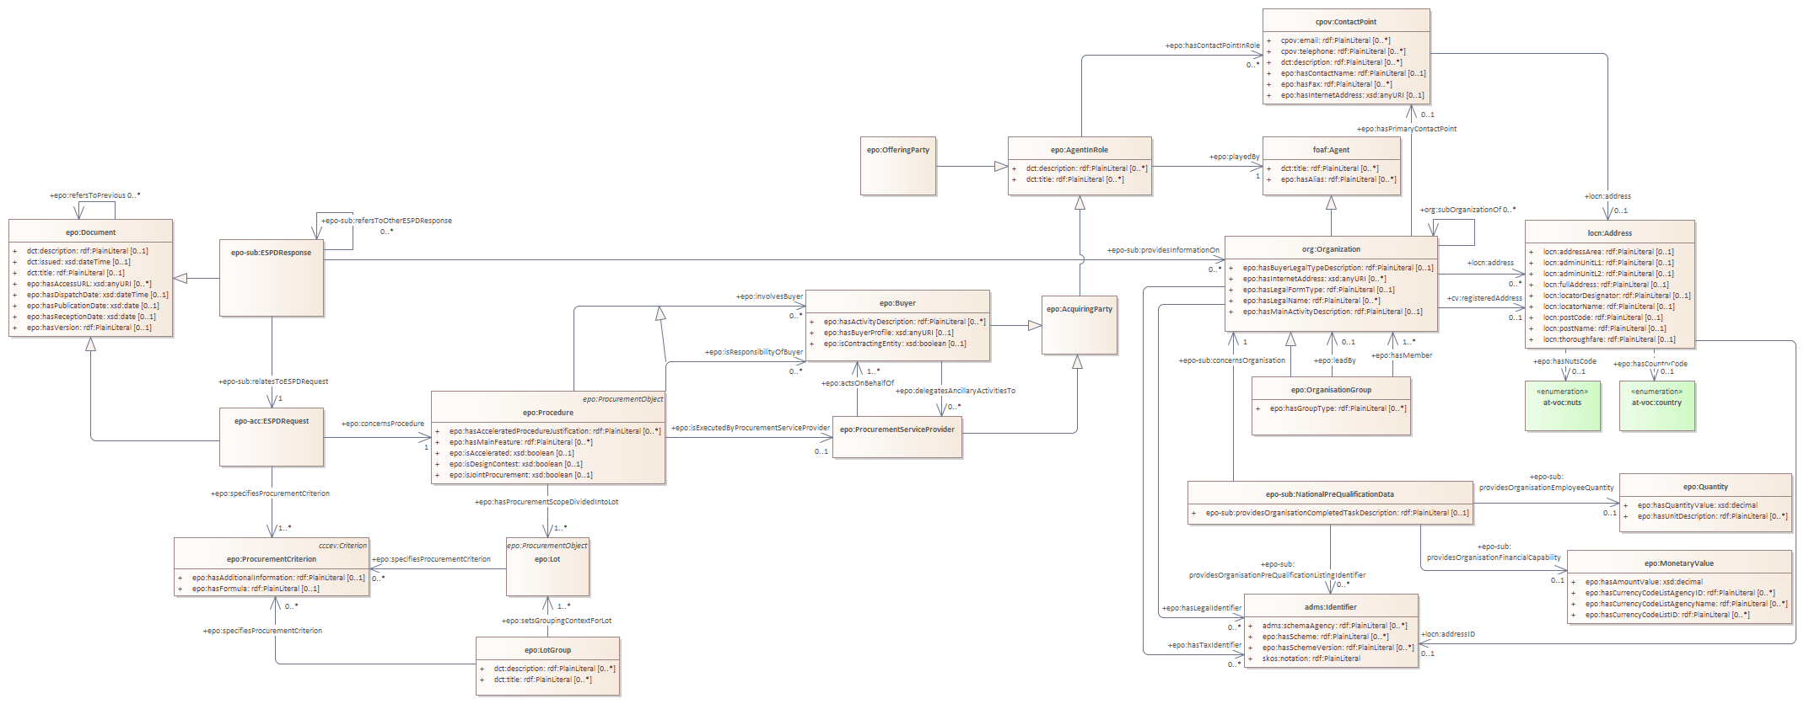
eSubmission module

Slide 14
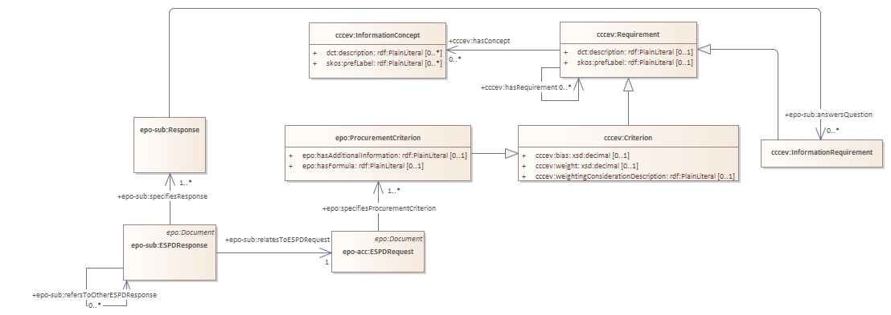
eSubmission module

Slide 15
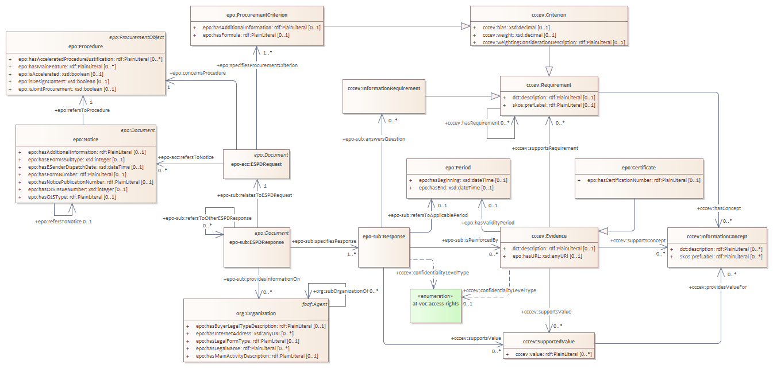
eSubmission module - response

Slide 16
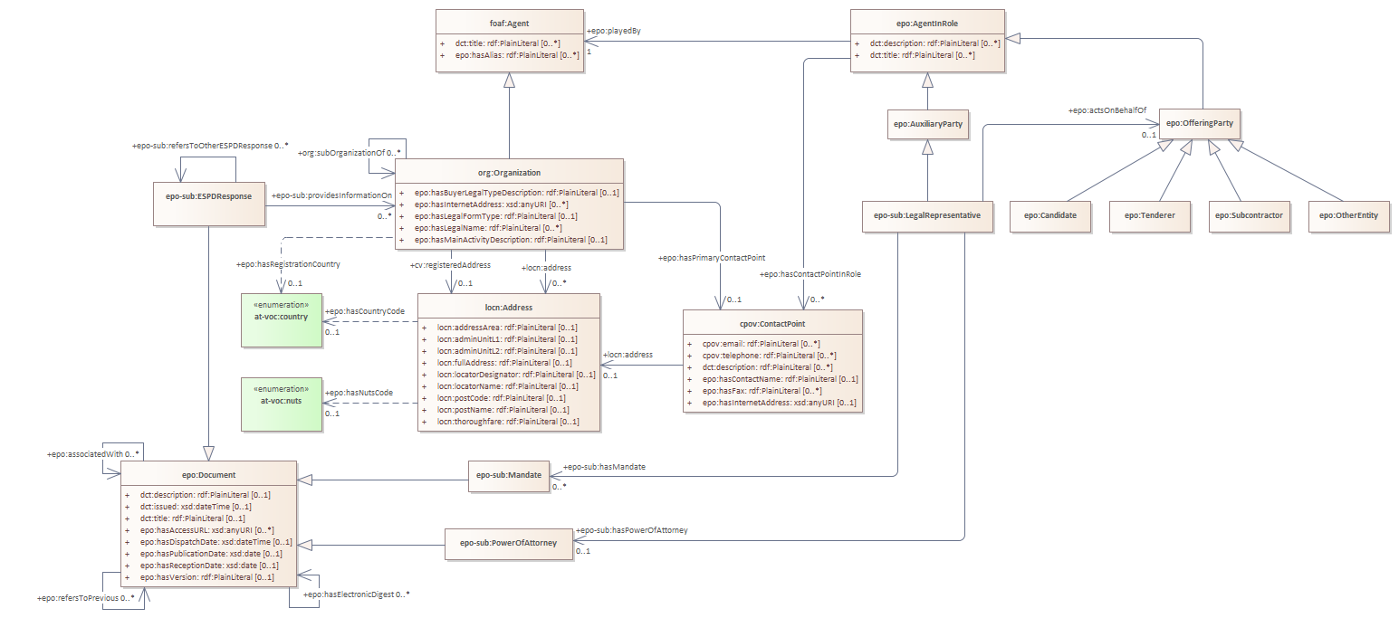
eSubmission module - Offering Party roles

Slide 17
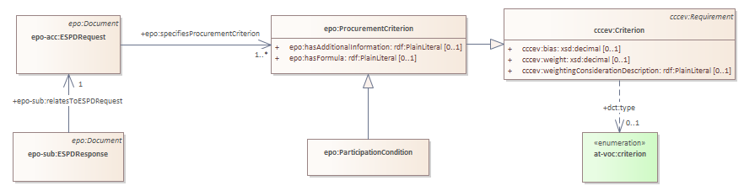
eSubmission module - Offering Party sheltered

Slide 18
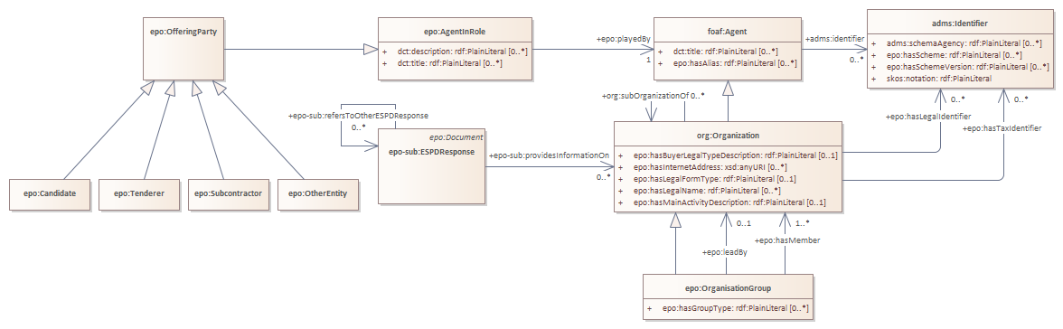
eSubmission module - Offering Party group

Slide 19
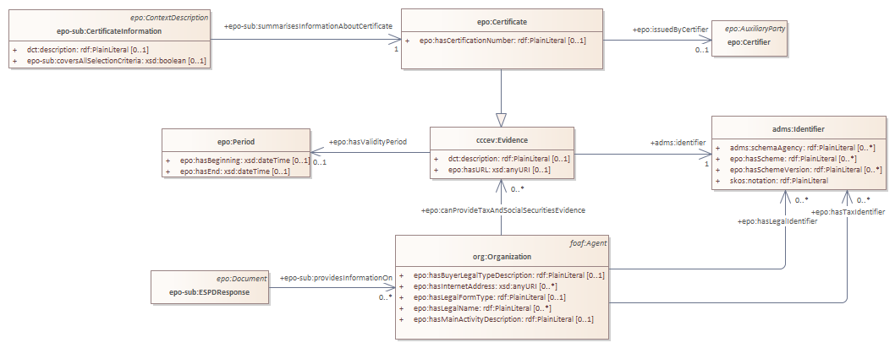
eSubmission module - Pre-Qualification System

Slide 20
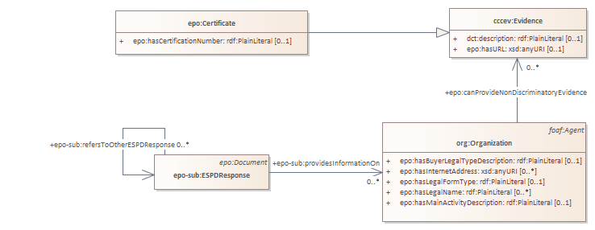
eSubmission module - Offering Party reduction

Slide 21
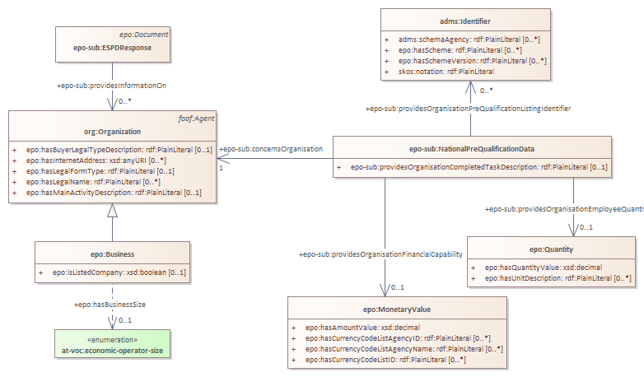
eSubmission module - Business SME

Slide 22
Towards the publication of ePO 4.1.0: ePO 4.1.0-rc.3

Slide 23
ePO 4.1.0-rc.3 - GitHub issue fixes
ESPD Response should be renamed ESPD #607
ESPD Request is a Procurement Document it is only represented in ePO as a document #598
Missing cardinality for cccev:isDerivedFrom property #625
Missing cardinality for cccev:confidentialityLevelType property #626
Missing cardinality for epo:indicatesInvoiceeContactPoint property #627
Missing cardinality for epo-cat:hasExternalSpecification property #628
predicates epo:answersExclusionGround and epo:answersSelectionCriteria may not be needed #637
predicate epo:hasRejectedQuantity should change prefix to epo-ful #638

Slide 24
5 min break

Slide 25
Towards the publication of ePO 4.2.0: ePO 4.2.0-rc.1

Slide 26
ePO 4.2.0-rc.1
eInvoicing module development:
- Ontology Requirements Specification Document (ORSD)
- Conceptual modelling
- Foreseen: publish first release candidate ePO 4.2.0-rc.1

Slide 27
eInvoicing - Roles involved
Buyer
Seller
Payee (if it is different than the Seller)
Seller Tax representative

Slide 28
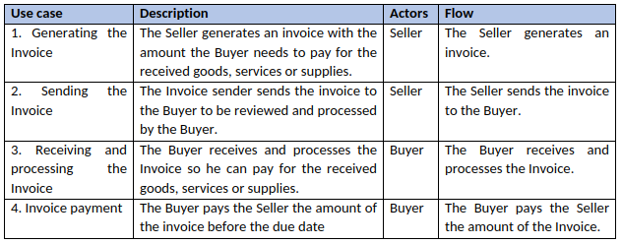
eInvoicing - Use cases

Slide 29
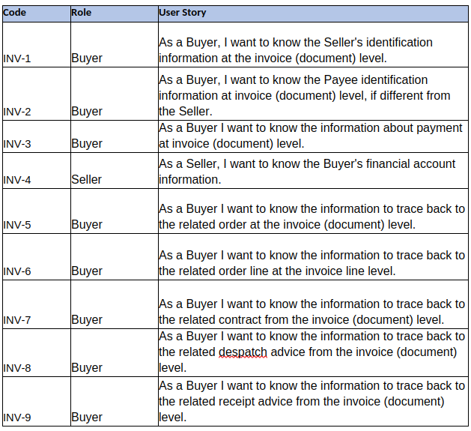
eInvoicing - User stories

Slide 30
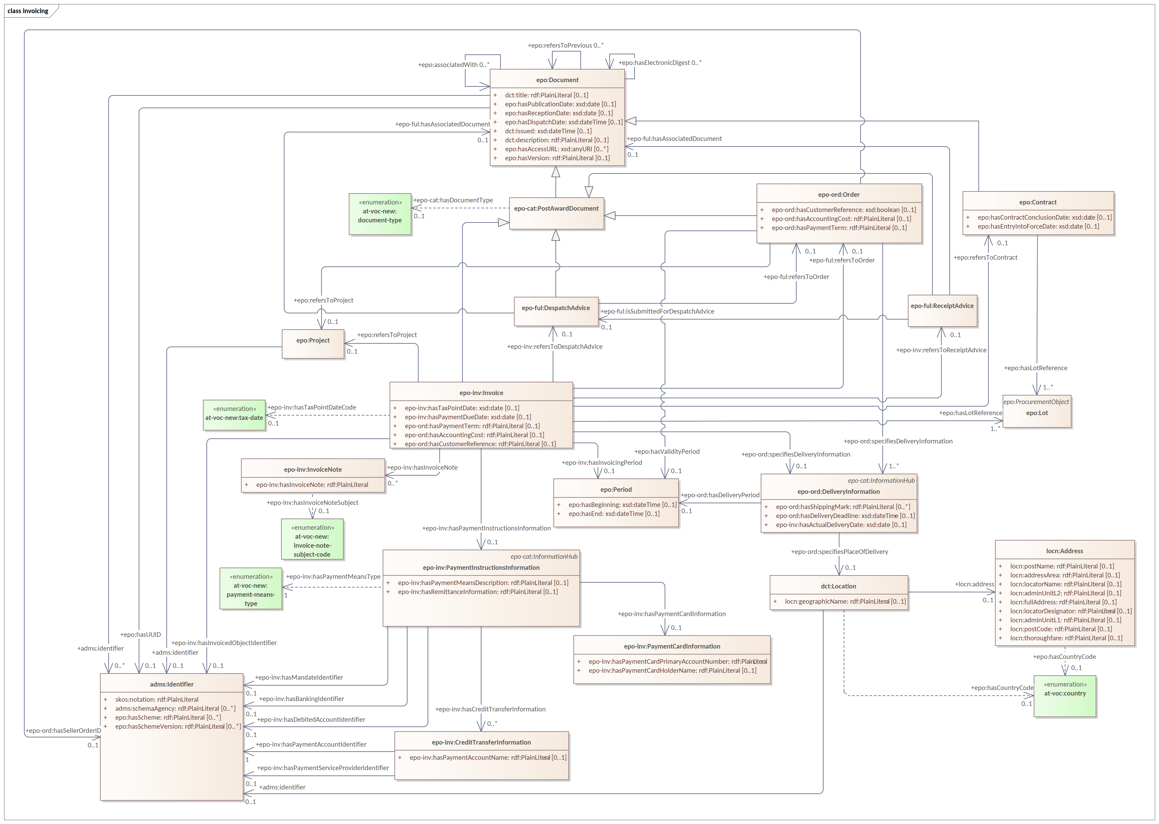
eInvoicing

Slide 31
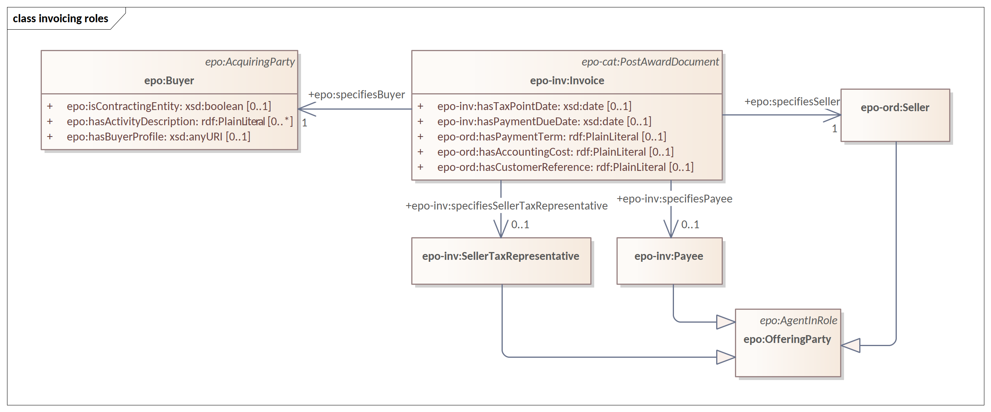
eInvoicing - roles

Slide 32
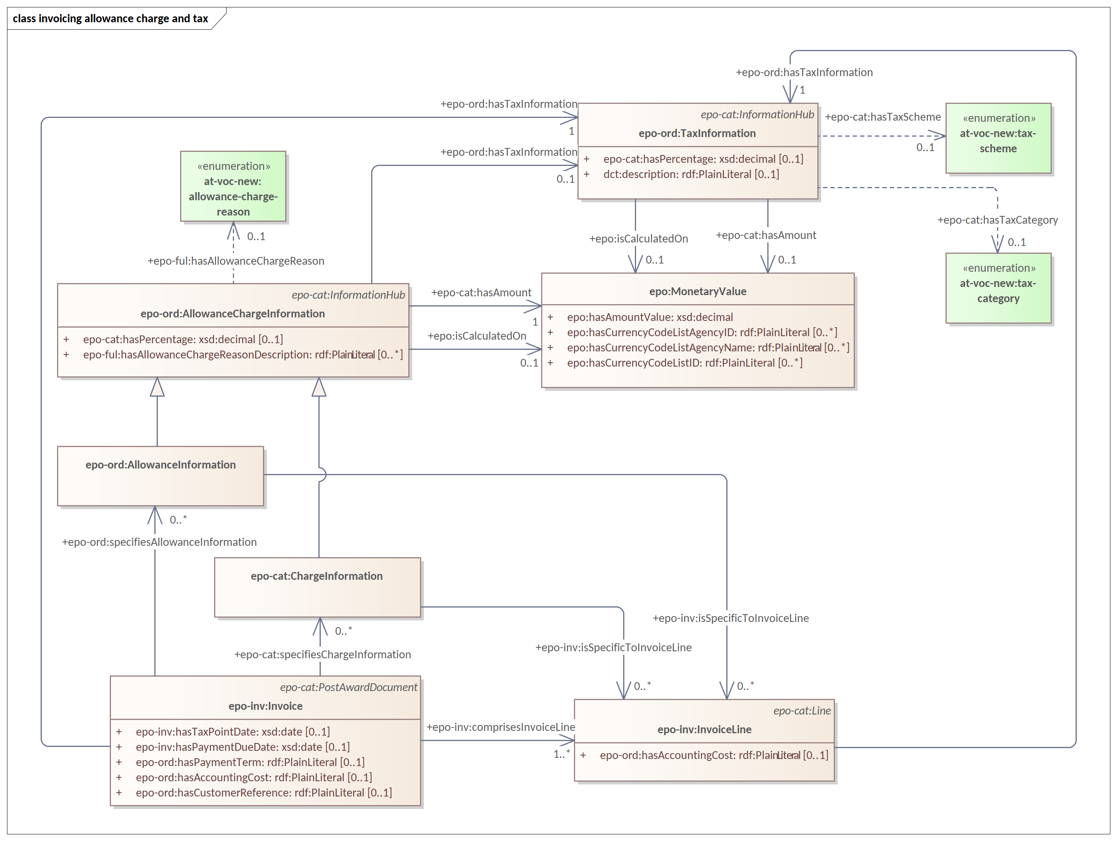
eInvoicing - allowance, charge and tax

Slide 33
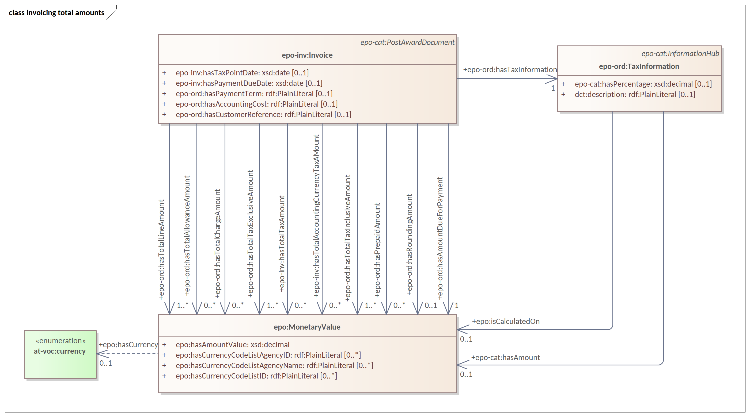
eInvoicing - total amounts

Slide 34
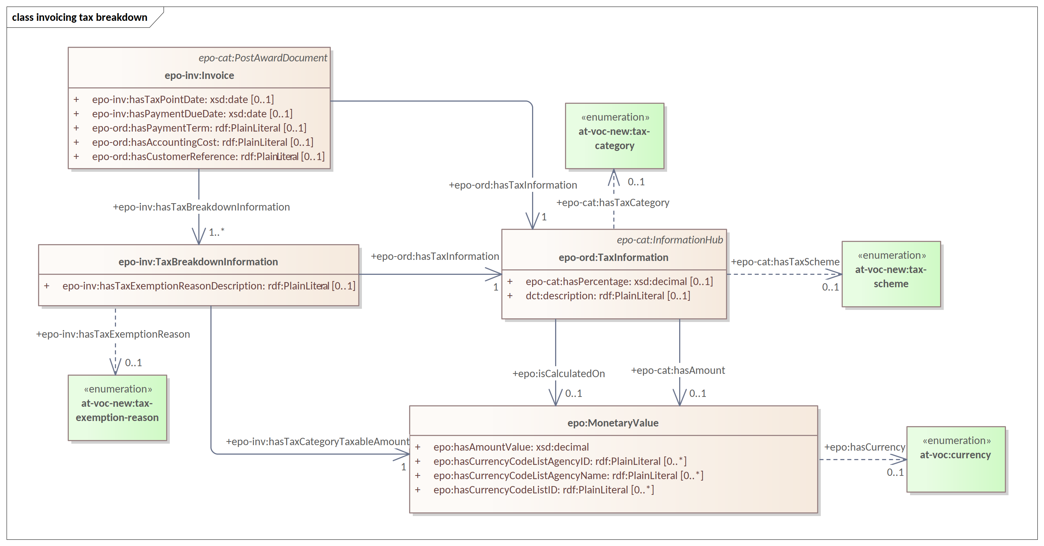
eInvoicing - tax breakdown

Slide 35
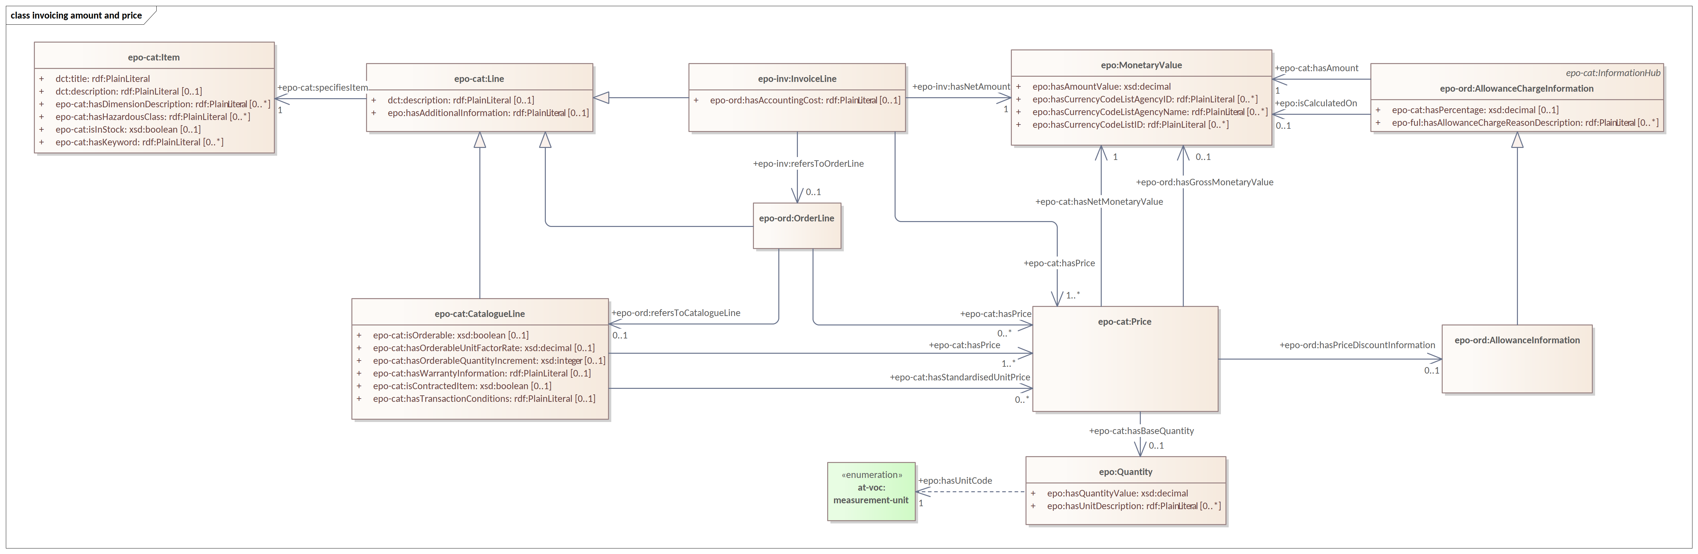
eInvoicing - amount and price

Slide 36
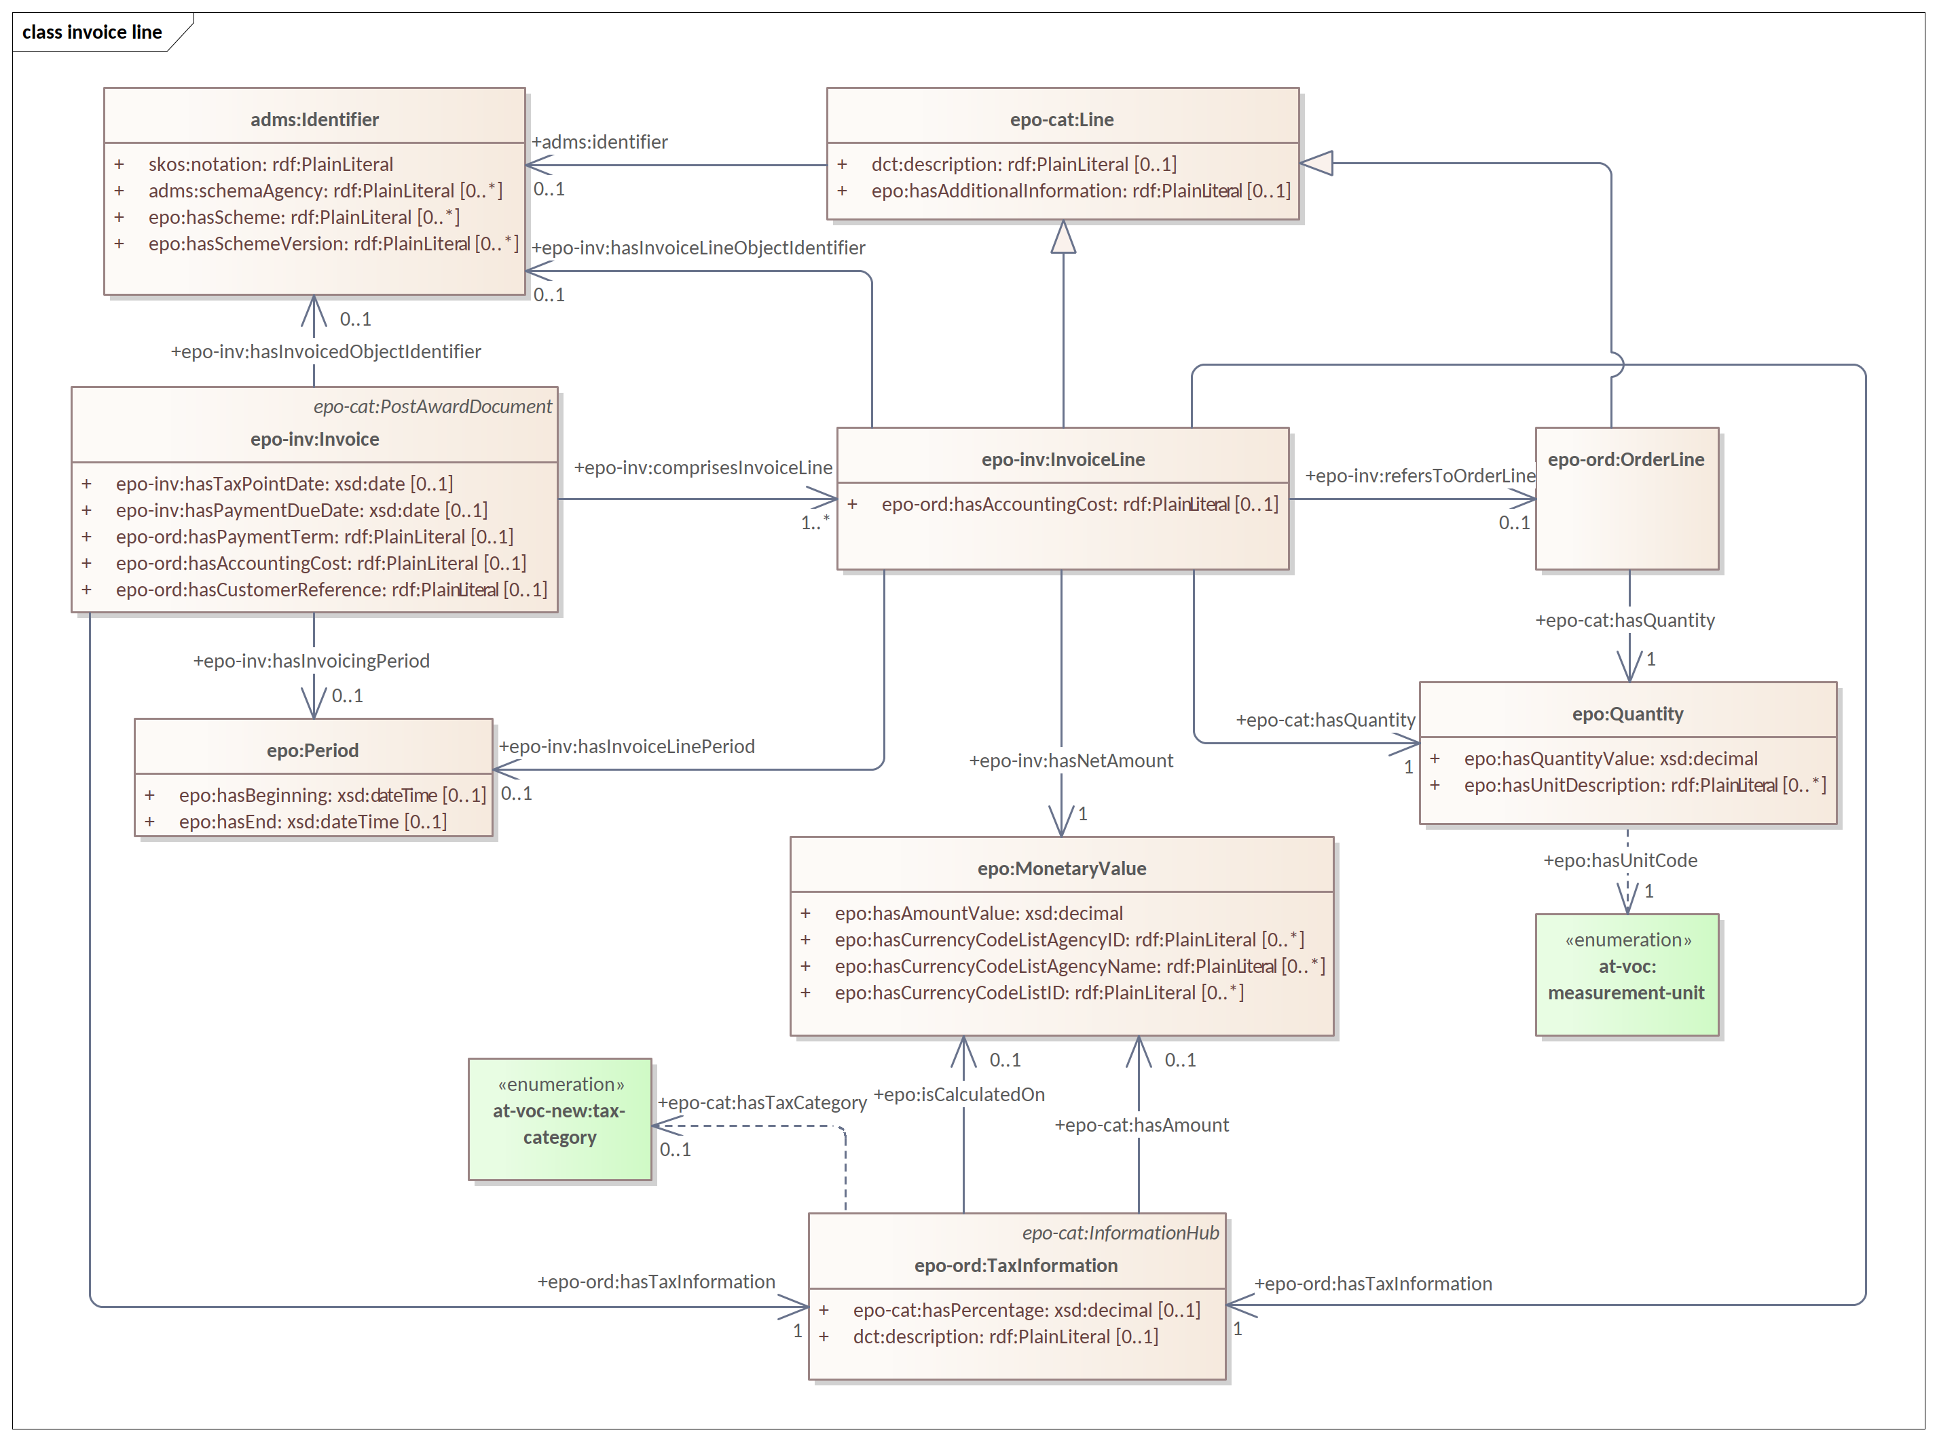
eInvoicing - invoice line

Slide 37
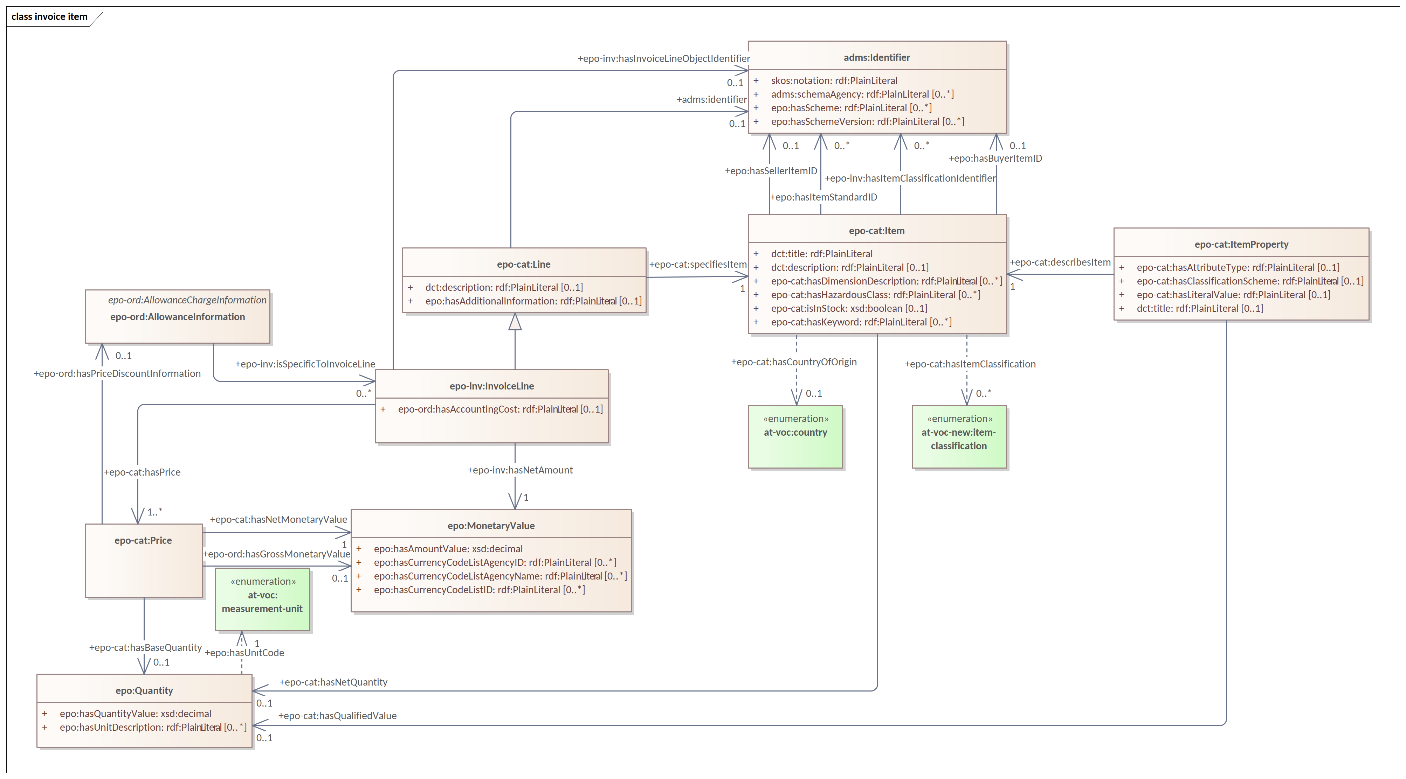
eInvoicing - invoice item

Slide 38
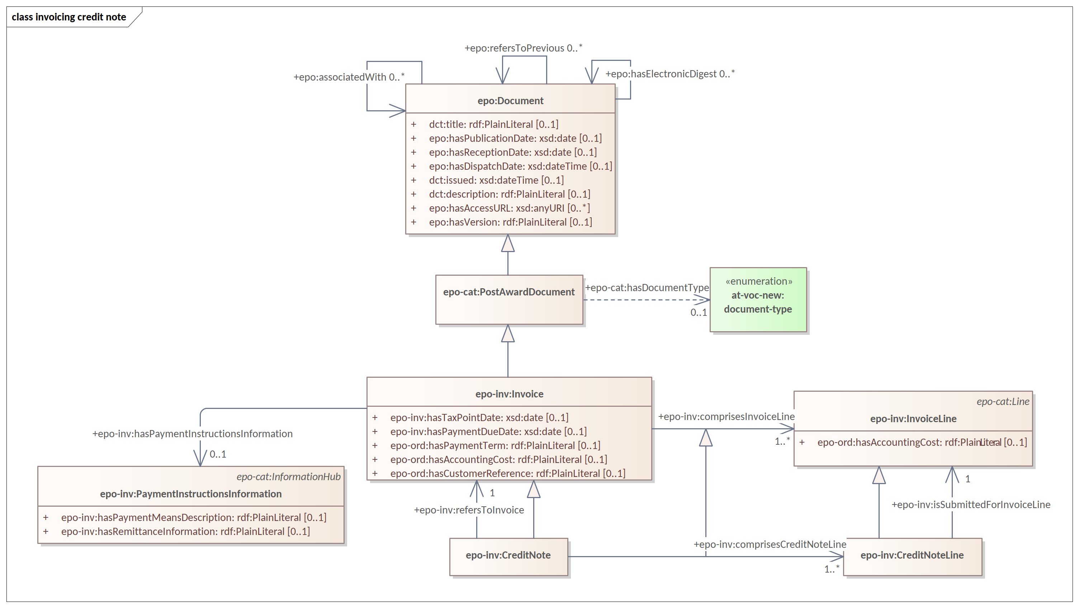
eInvoicing - credit note

Slide 39
Pre-Award updates

Slide 40
Pre-Award updates
eSubmission
Expression Of Interest Request
Expression Of Interest Response
Unsubscribe From Procedure Request
Unsubscribe From Procedure Response
Tender
Tender Receipt
eAccess
Procurement Documents Request
Procurement Documents Provision
Tendering Question
Tendering Answer
eEvaluation
Tender Clarification Request
Tender Clarification

Slide 41
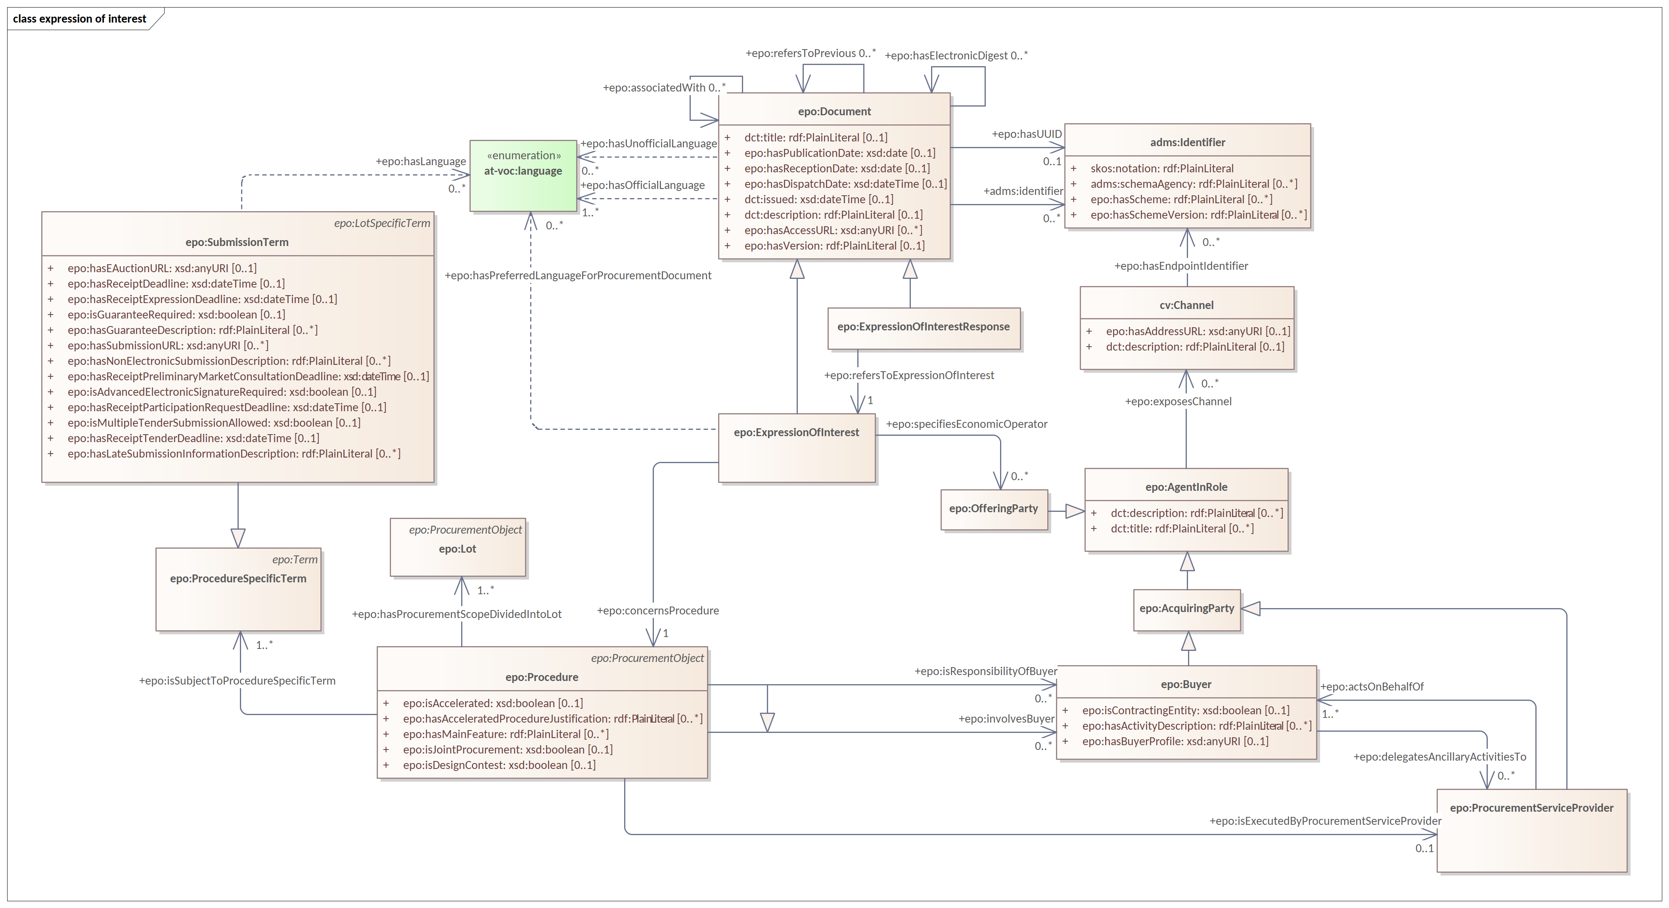
Expression Of Interest Request and Response

Slide 42
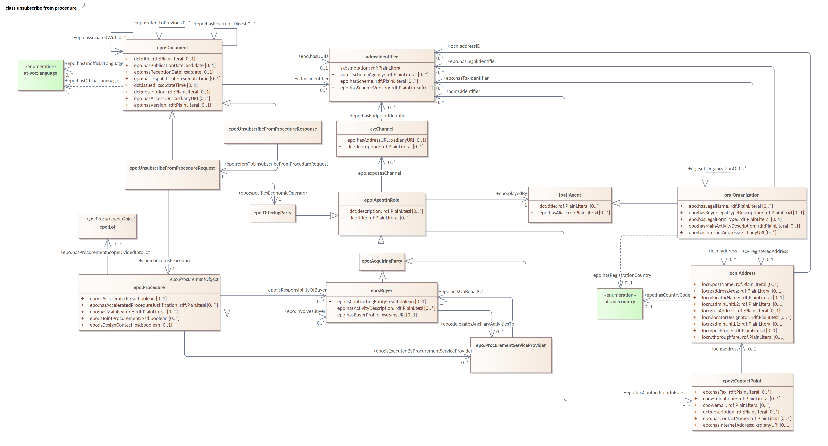
Unsubscribe From Procedure Request and Response

Slide 43
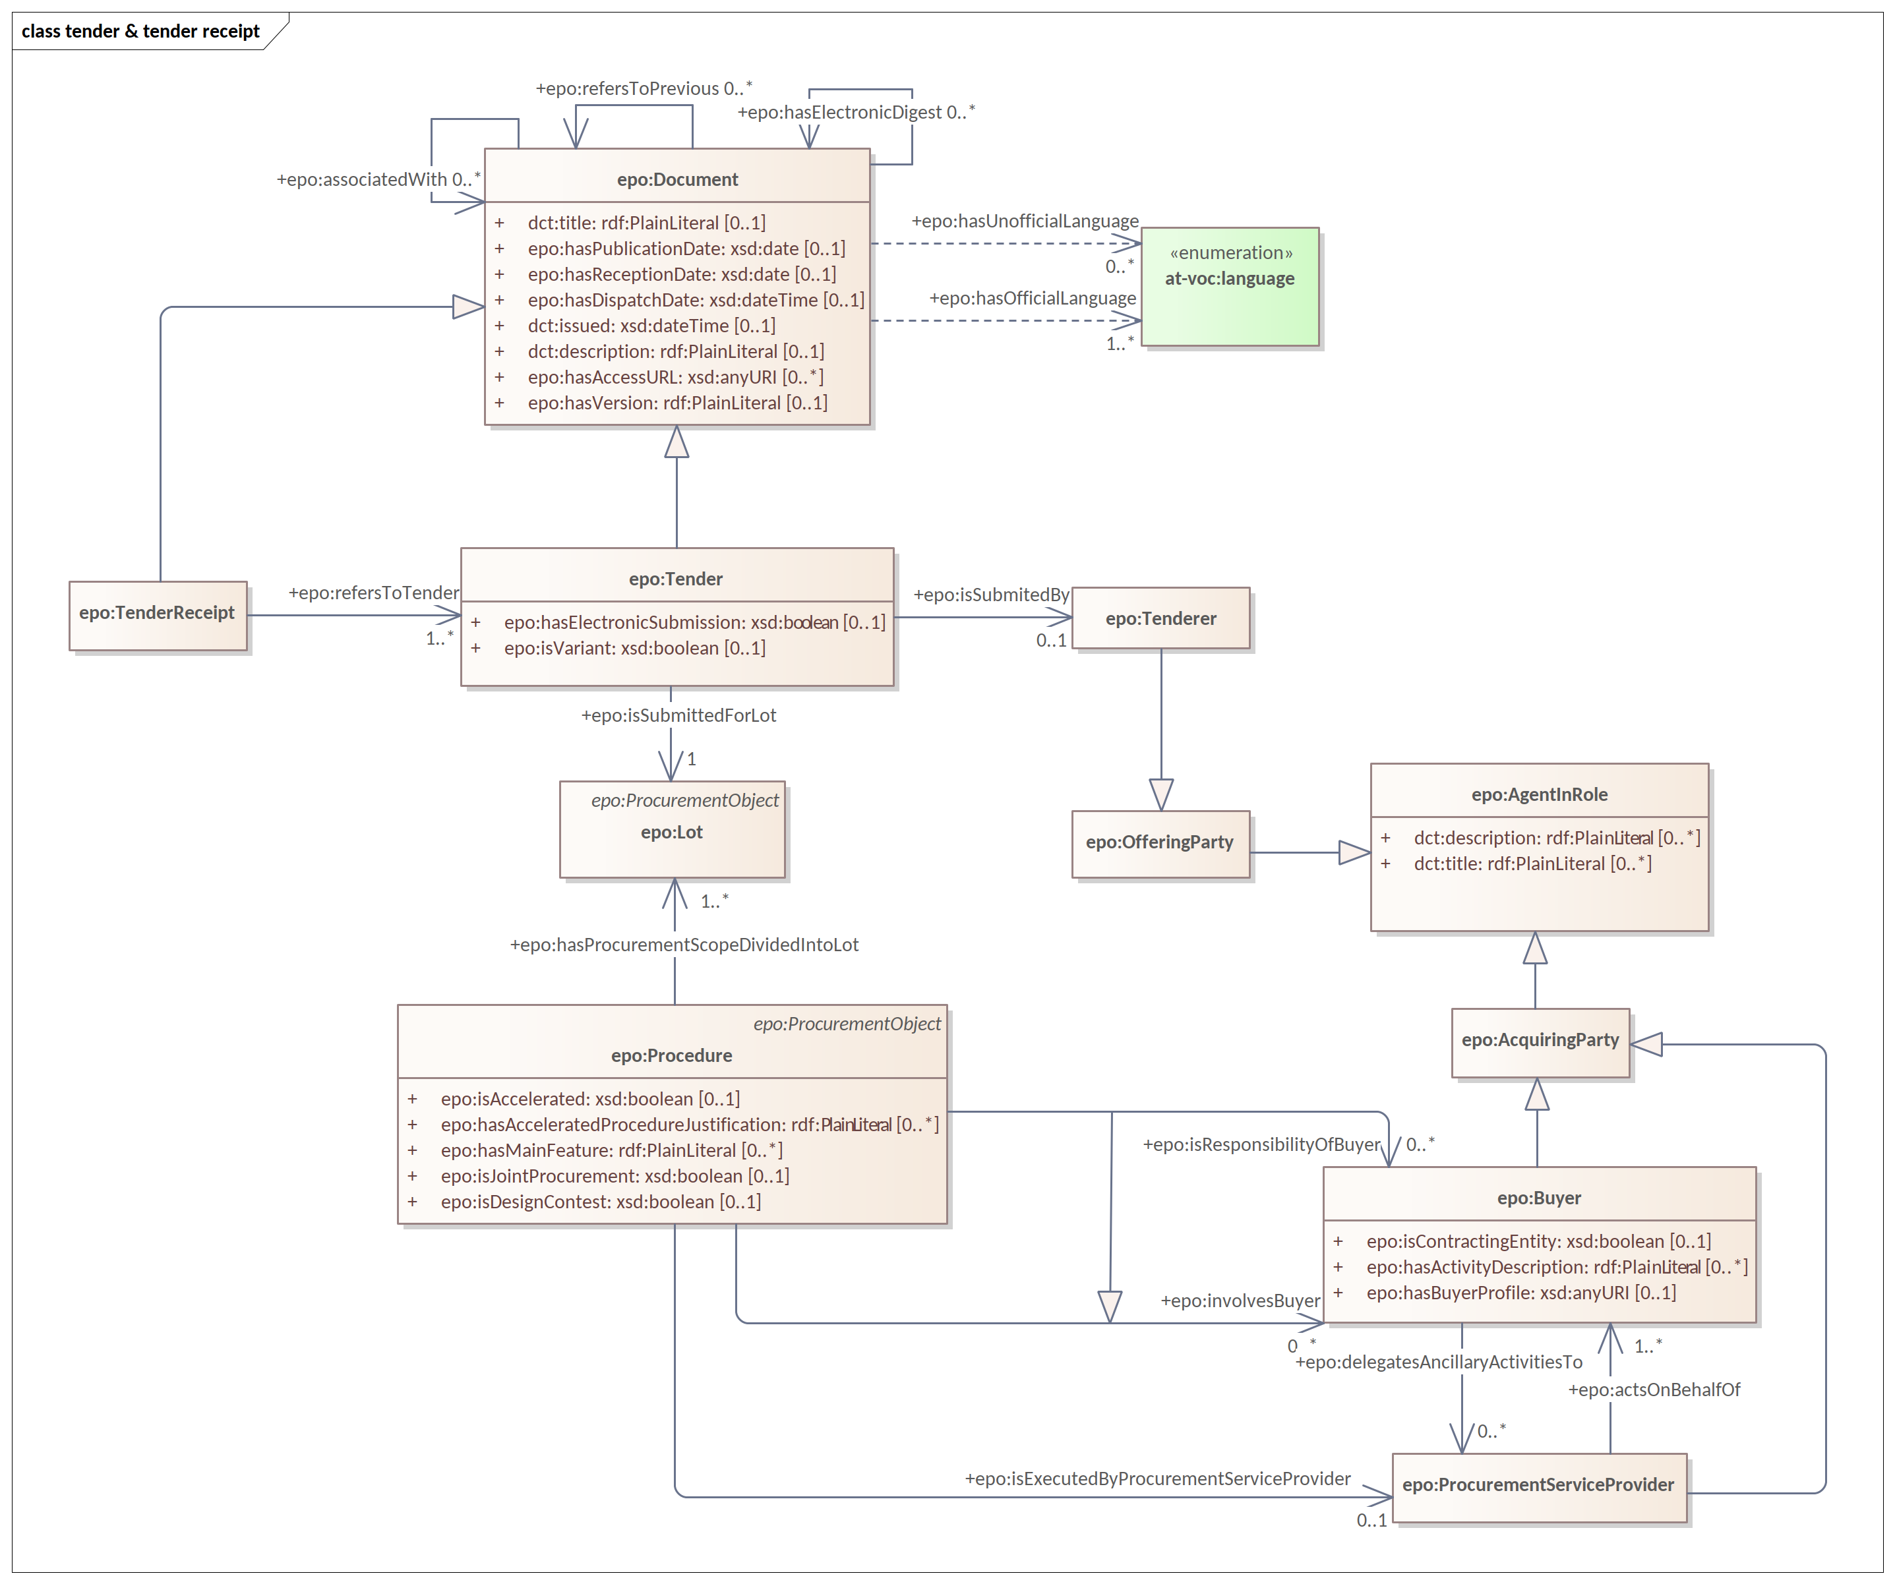
Tender and Tender Receipt

Slide 44
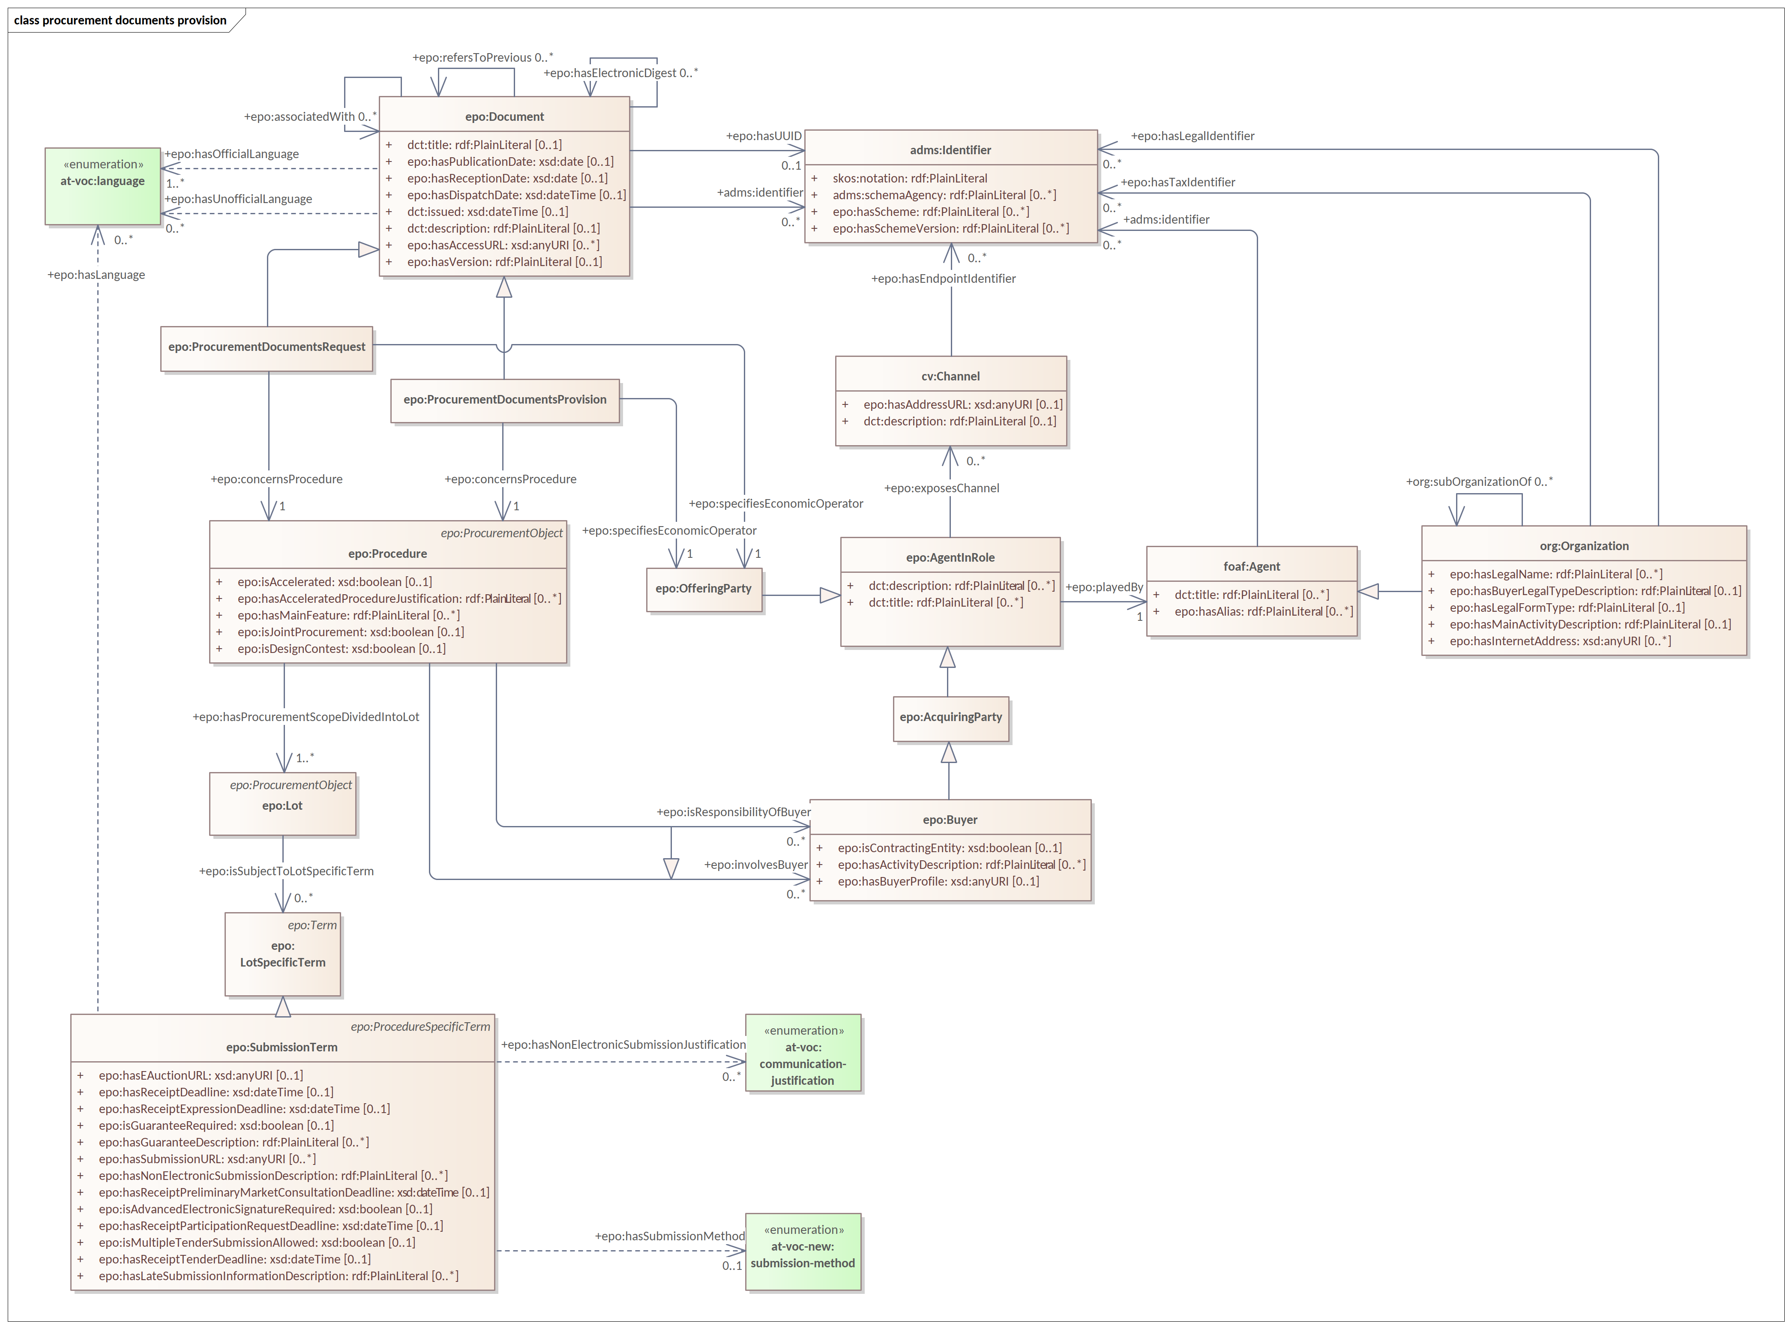
Procurement Documents Request and Provision

Slide 45
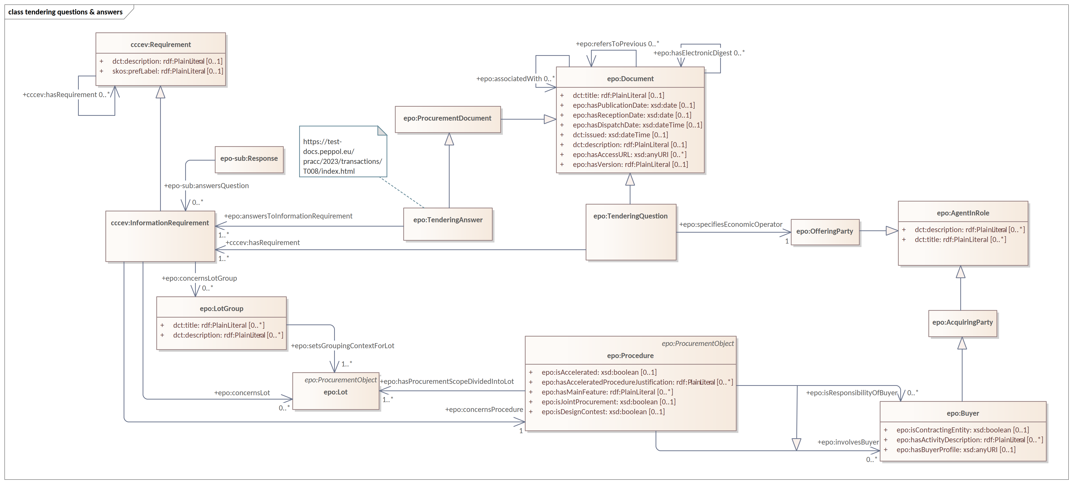
Tendering Question and Answer

Slide 46
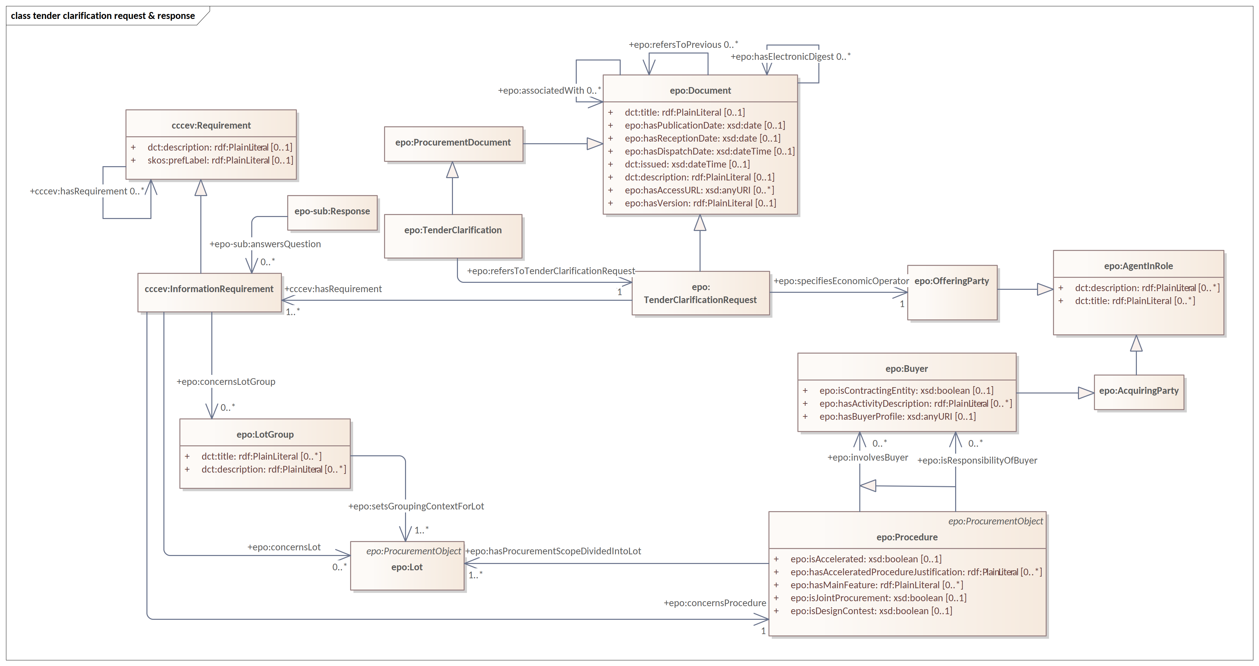
Tender Clarification Request and Tender Clarification

Slide 47
Future work

Slide 48
Future work in 2024
Publication of ePO 4.1.0-rc.3
Publication of ePO 4.2.0-rc.2
Publication of ePO 4.1.0
Post-Award module updates
Pre-Award updates
Concept definition updates
GitHub issue follow-up

Slide 49
Updates to the documentation

Slide 50
Updates to the documentation
GitHub Repository
- Readme Files on all Implementation subfolders.
- Discussions section was added.
Documentation Page update
- User Guides to the conceptual model

Slide 51
Open discussion

Slide 52
Meeting schedule
ePO Working Group meetings:
- every Tuesday from 14:30 to 16:30 (EET)
- meeting link
- every Thursday from 14:30 to 16:30 (EET)
- meeting link

Slide 53
Feedback and questions
Looking forward to hearing from you.
Feedback and questions can be sent via:
GitHub discussions: https://github.com/OP-TED/ePO/discussions
GitHub issues: https://github.com/OP-TED/ePO/issues
or alternatively via:
Email: OP-EPROCUREMENT-ONTOLOGY@publications.europa.eu
Email: natalie.muric@publications.europa.eu

