Slide 1
eProcurement Ontology
June 2025
Online Presentation 03/06/2025
Andreea Pasăre, Achilles Dougalis
Meaningfy/Infeurope

Slide 2
The goal of this meeting is to present:
(a) the work carried out from July 2024 to June 2025
(b) the work planned for the second half of 2025.

Slide 3
Agenda
Welcome
Review of work: July 2024 – June 2025
ePO v5.0.0-rc.1 (published)
Updated workflow and model2owl evolution
ePO v5.1.0-rc.1 (in progress)
Future work
Open discussion
Closing

Slide 4
Review of work: July 2024 - June 2025

Slide 5
Review of work: July 2024 - June 2025
Publication of ePO v5.0.0-rc.1:
- new module development:
- eQualification
- eEvaluation
- eAwarding
- eRequest
- evolution of the ePO:
- eForms mapping requirements
- post-award updates: eOrdering, eCatalogue, eFulfilment
Work in progress:
- ePO v5.1.0-rc.1:
- new module development: ePayment
- maintenance: GitHub issue fixes

Slide 6
Publication of ePO 5.0.0-rc.1

Slide 7
Publication of ePO v5.0.0-rc.1
The release candidate v5.0.0-rc.1 and its corresponding technical files can be found at https://github.com/OP-TED/ePO/tree/v5.0.0-rc.1.
Release notes:
The following new modules were developed:
eQualification
eEvaluation
eAwarding
eRequest
Updates for the following modules were made:
ePO core
eNotice
eCatalogue
eOrdering
eFulfilment
eContract
eSubmission
eInvoicing
GitHub issue fixes for milestone 5.0.0

Slide 8
eQualification module
New module development​

Slide 9
eQualification module
eQualification may be used in :
The qualification of Tenderers, in particular for an open Procedure.
The prequalification of economic operators, in particular for Dynamic Purchase System (DPS) and Prequalification systems (specifically for works).
Documents included in eQualification:
Evidence Request
Evidence Receipt
Evidence Submission
Qualification Response

Slide 10
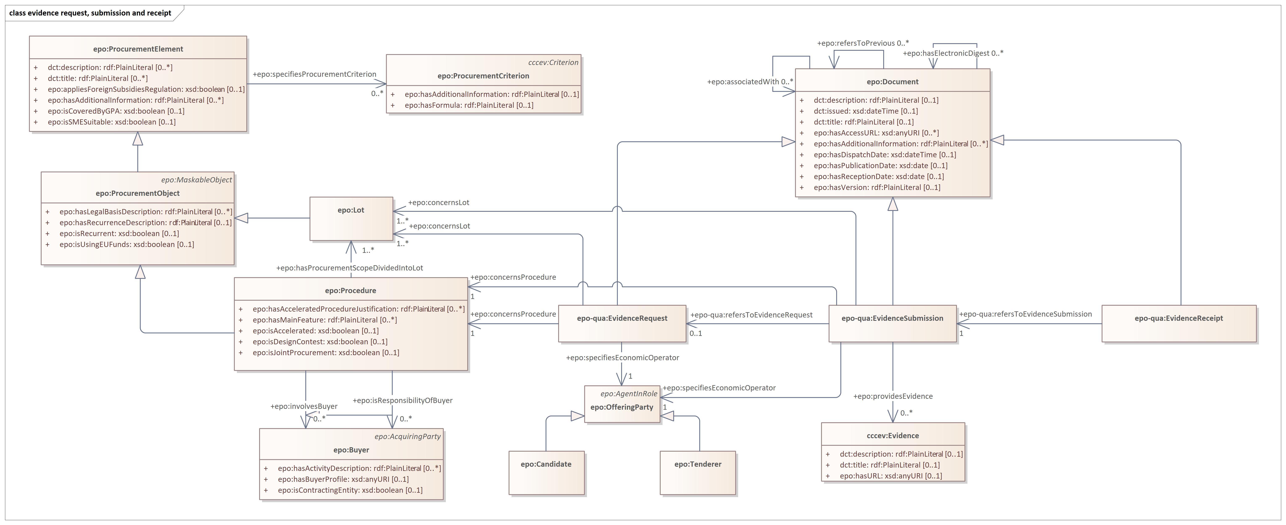
Evidence request, submission & receipt

Slide 11
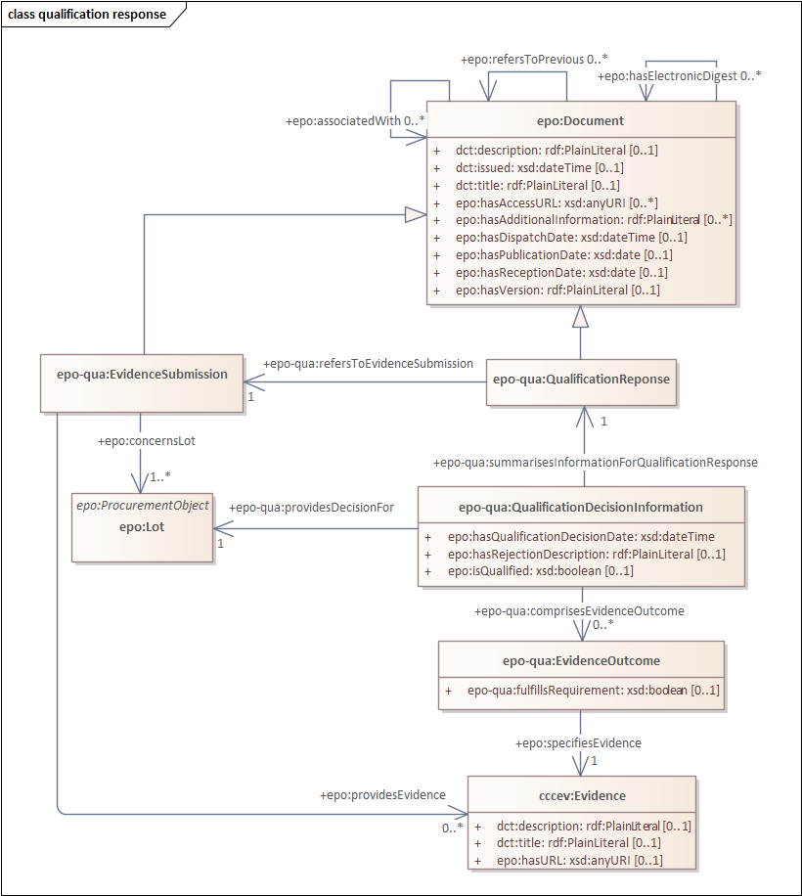
Qualification response

Slide 12
eEvaluation module
New module development​

Slide 13
eEvaluation module
eEvaluation refers to the evaluation report in digital format that evaluates the tenders submitted by tenderers or candidates (in the case of multistage procedures) depending on the procedure that is adopted, to provide input for the award decision.
Documents included in eEvaluation:
Evaluation Report
Tender Clarification Request
Tender Clarification

Slide 14
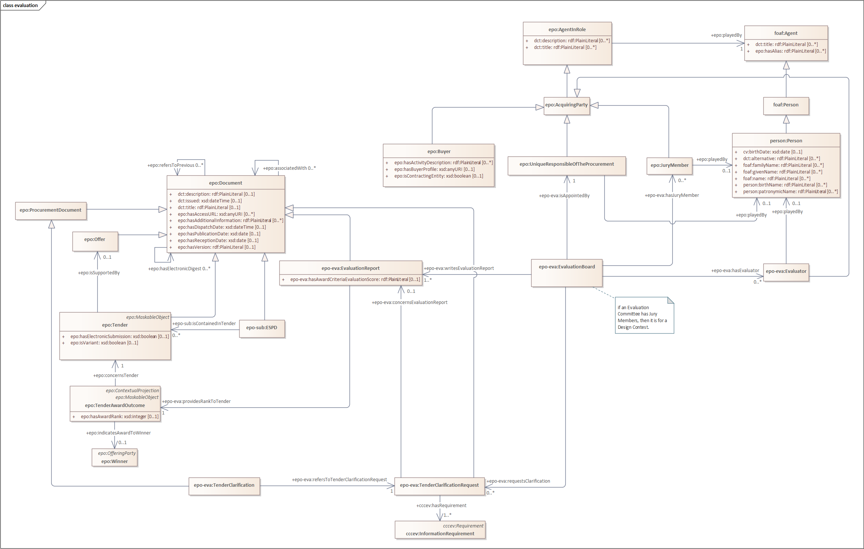
Evaluation

Slide 15
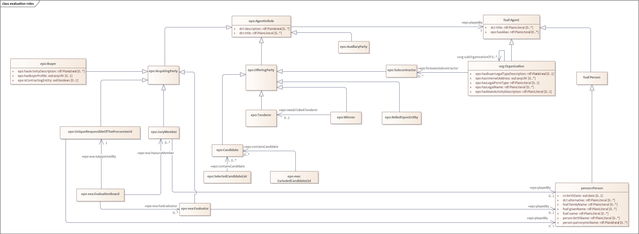
Evaluation roles

Slide 16
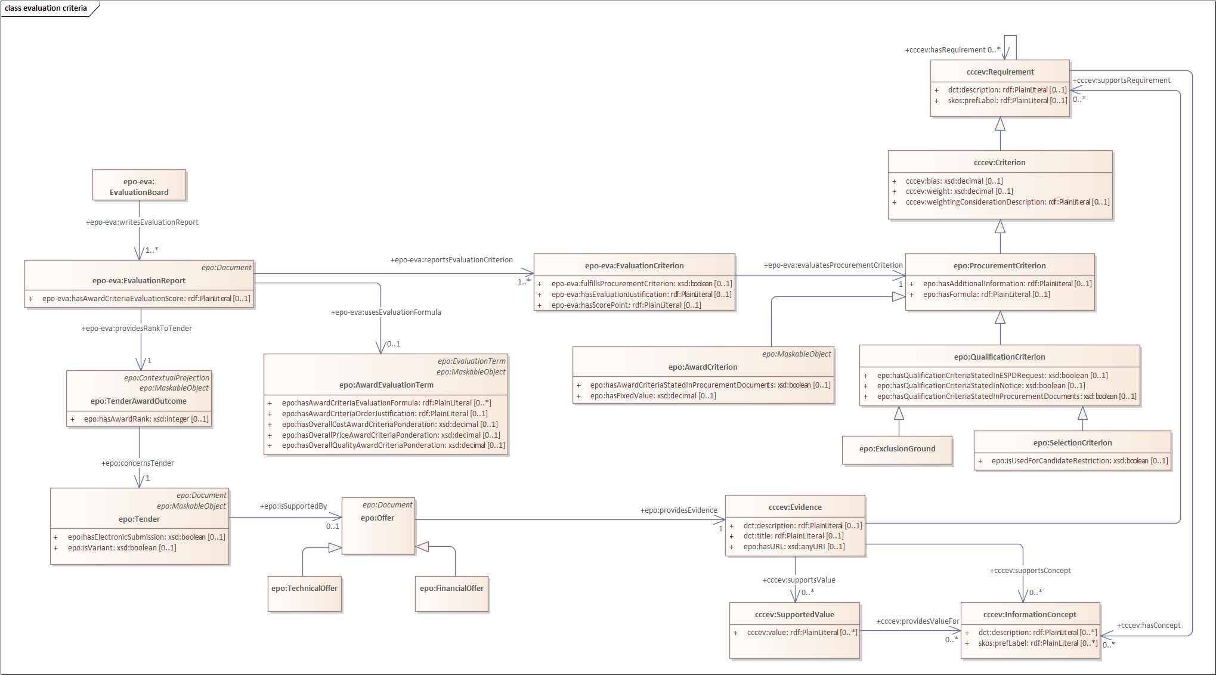
Evaluation criteria

Slide 17
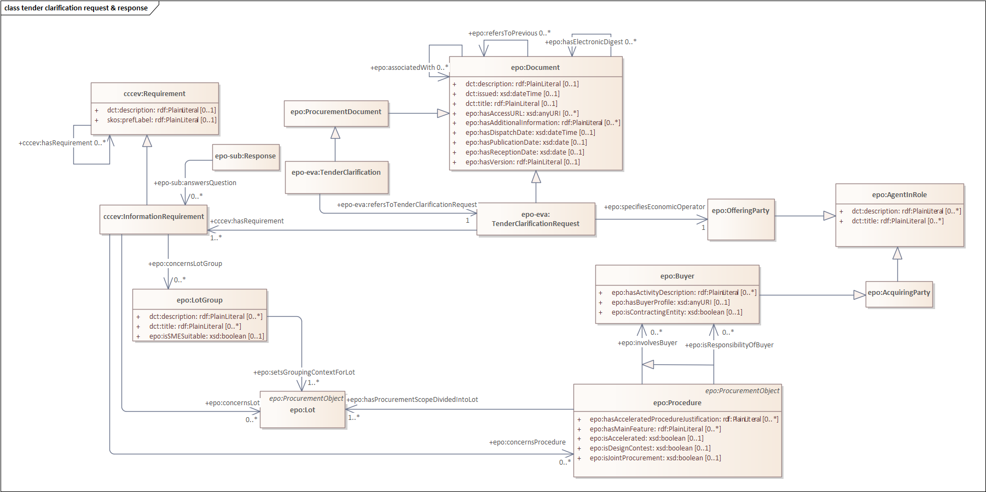
Tender clarification request & response

Slide 18
eAwarding module
New module development​

Slide 19
eAwarding module
eAwarding refers to:
The Award Decision in the digital format created and signed by the Unique Responsible of the Procurement
The notification to all Tenderers as to the result of the Procurement The Award Decision is based on the Evaluation Report. The Unique Responsible of the Procurement either accepts the findings of the Evaluation Report or takes another decision (if the Winner does not fulfill all the criteria for the award of the contract).
Documents included in eAwarding:
Award Decision Notification

Slide 20
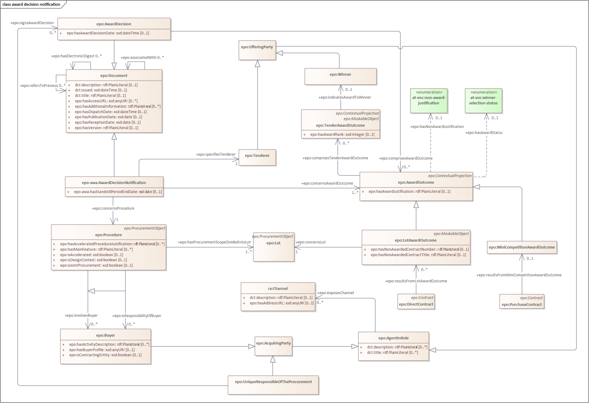
Award Decision Notification

Slide 21
eRequest module
New module development​

Slide 22
eRequest module
eRequest represents a document created by the Buyer to request an offer for goods and services from a Contractor within a Framework Agreement and direct awards for procurements below threshold (small scale procurement).
Documents included in eRequest:
Request for Offer

Slide 23
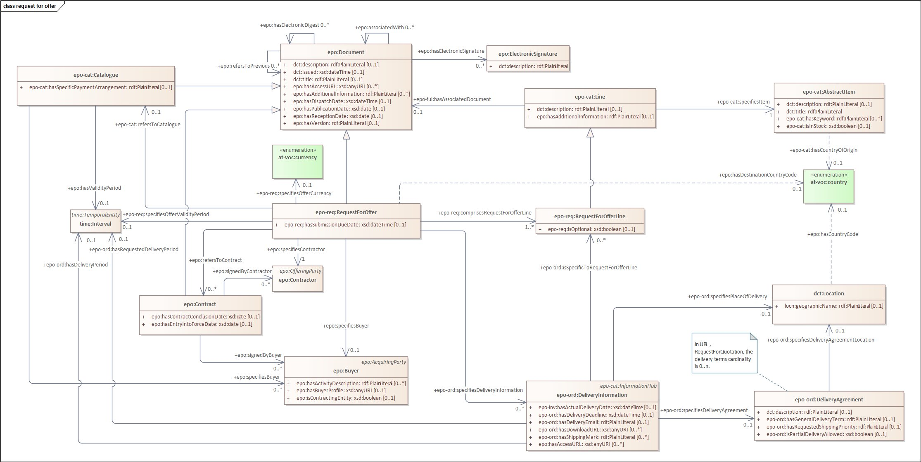
Request for offer

Slide 24
eForms mapping requirements
Evolution of the ePO

Slide 25
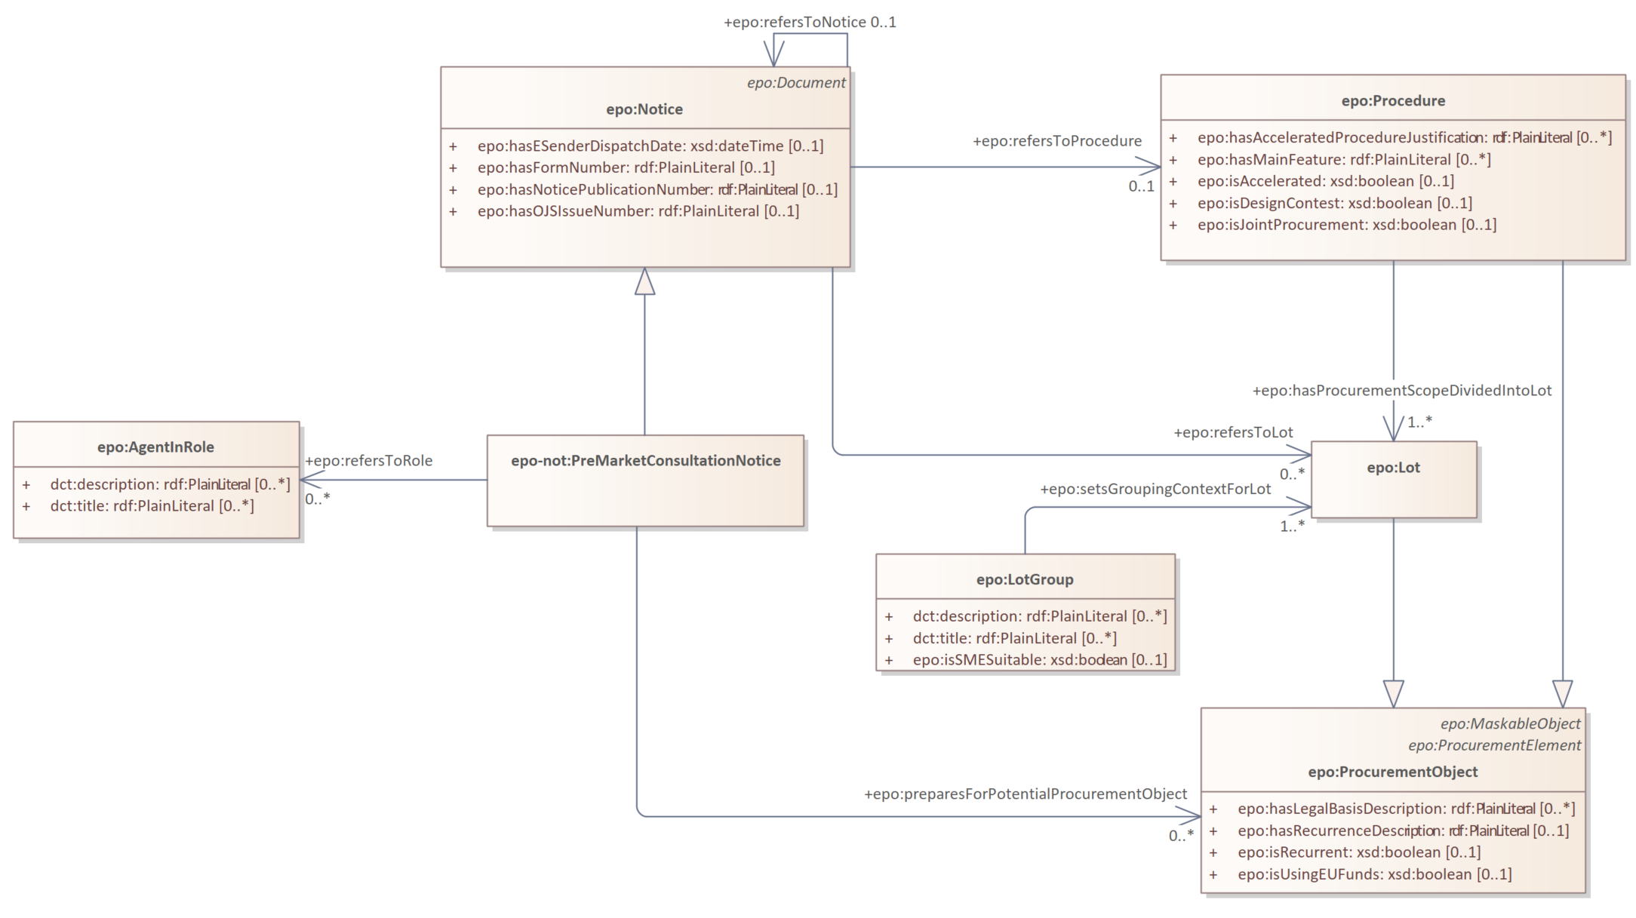
eForms mapping requirements
eForms mappings requirement as a Github issue:
Model E1 (premarket consultation) notice #785

Slide 26
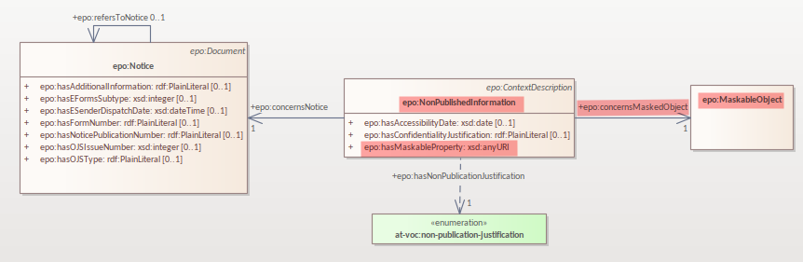
eForms mapping requirements
eForms mappings requirement as a Github issue:
how to deal with Unpublished fields #712
Maskable Objects:
1. epo:ProcedureTerm
2. epo:ProcurementObject
3. epo:MonetaryValue
4. epo:DirectAwardTerm
5. epo:ConcessionEstimate
6. epo:TenderAwardOutcome
7. epo:Tender
8. epo:AwardCriterion
9. cccev:Constraint
10. epo:AwardEvaluationTerm
11. epo:SubcontractingEstimate
12. epo:ReviewIrregularitySummary
13. epo:ReviewRequestSummary
14. epo:SubmissionStatisticalInformation
15. LotAwardOutcome

Slide 27
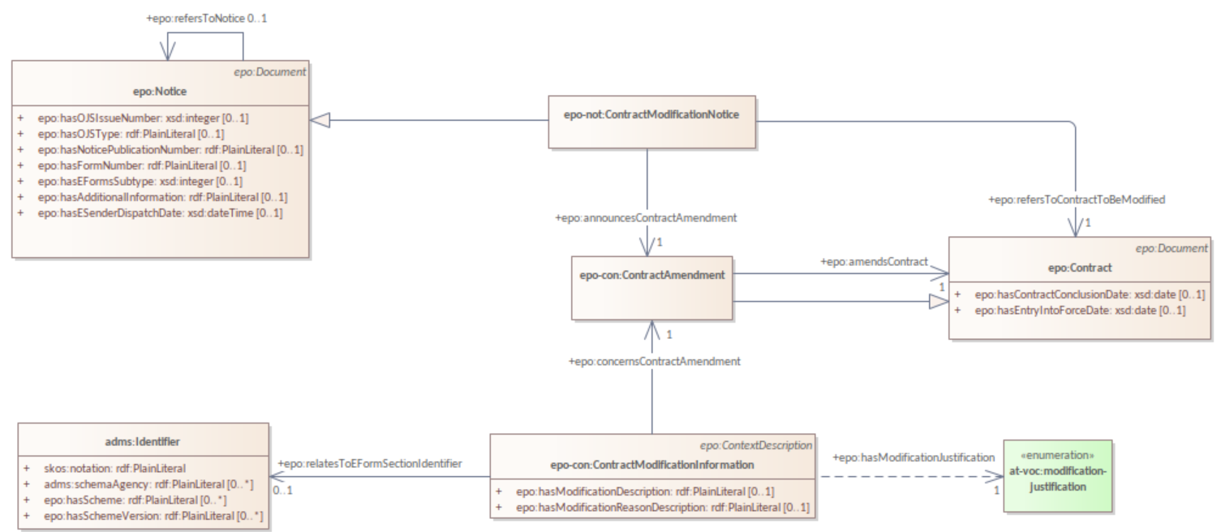
eForms mapping requirements
eForms mappings requirement as a Github issue:
Alignment between eForms and ePO representation of contract modifications #754

Slide 28
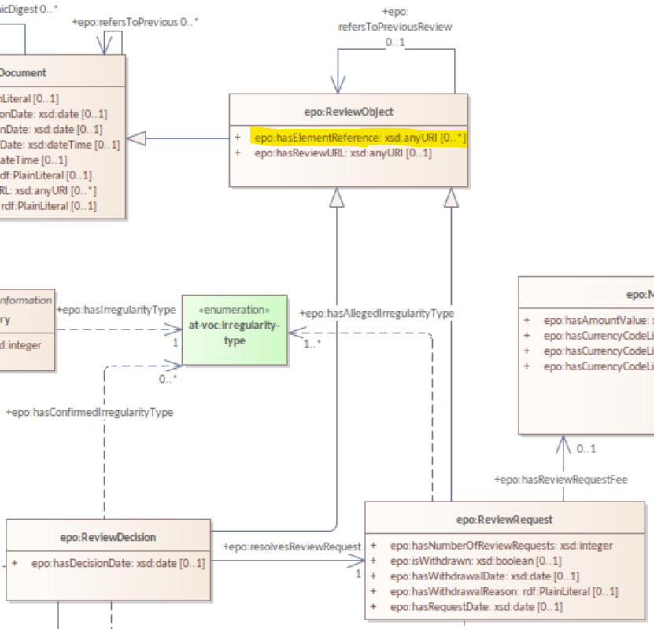
eForms mapping requirements
eForms mappings requirement as a Github issue:
Mapping of eForms field BT-786-Review (Review Notice Section Identifier) #756
ePO v4.2.0:

Slide 29
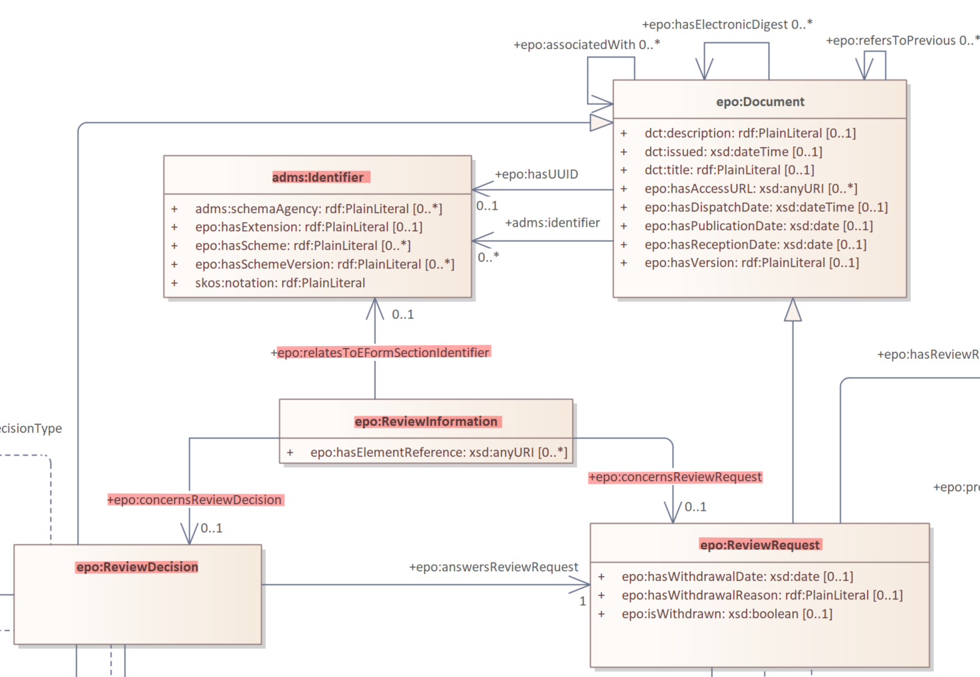
eForms mapping requirements
ePO v5.0.0:

Slide 30
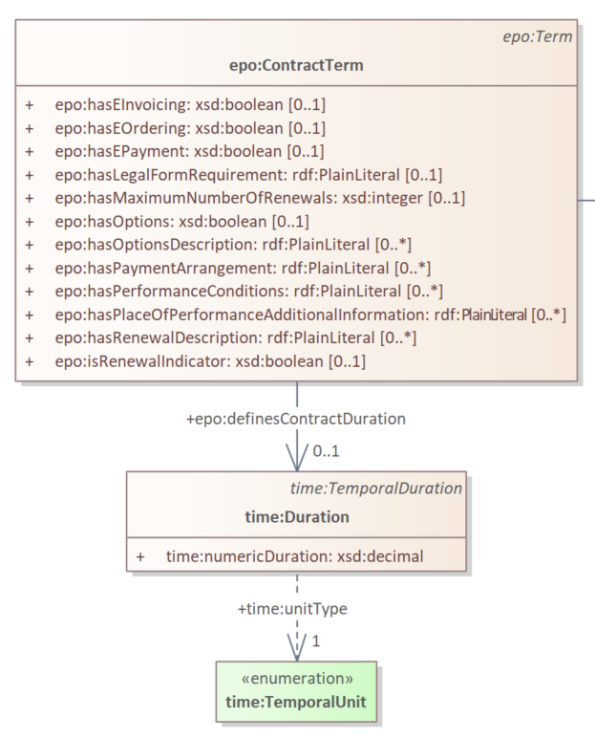
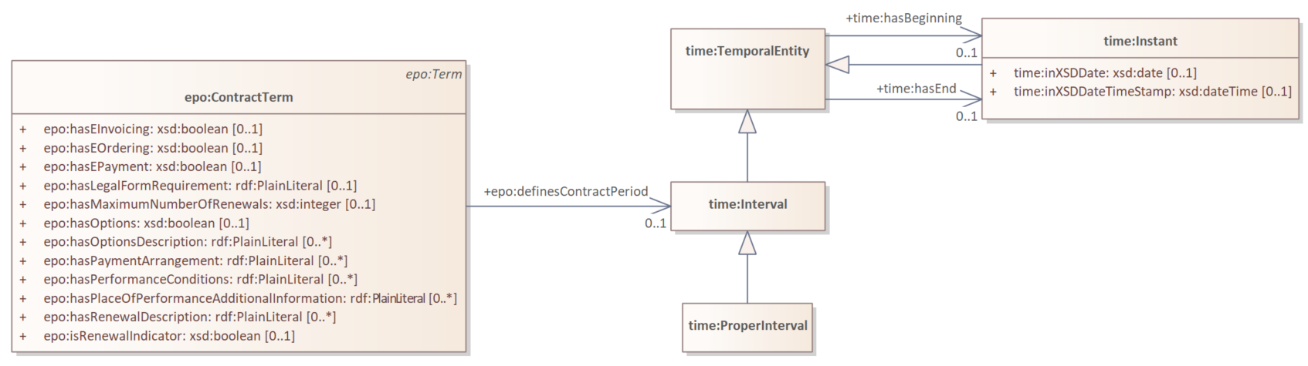
eForms mapping requirements
eForms mappings requirement as a Github issue:
Potential problem with modelling of epo:Period #529
ePO v5.0.0:

Slide 31
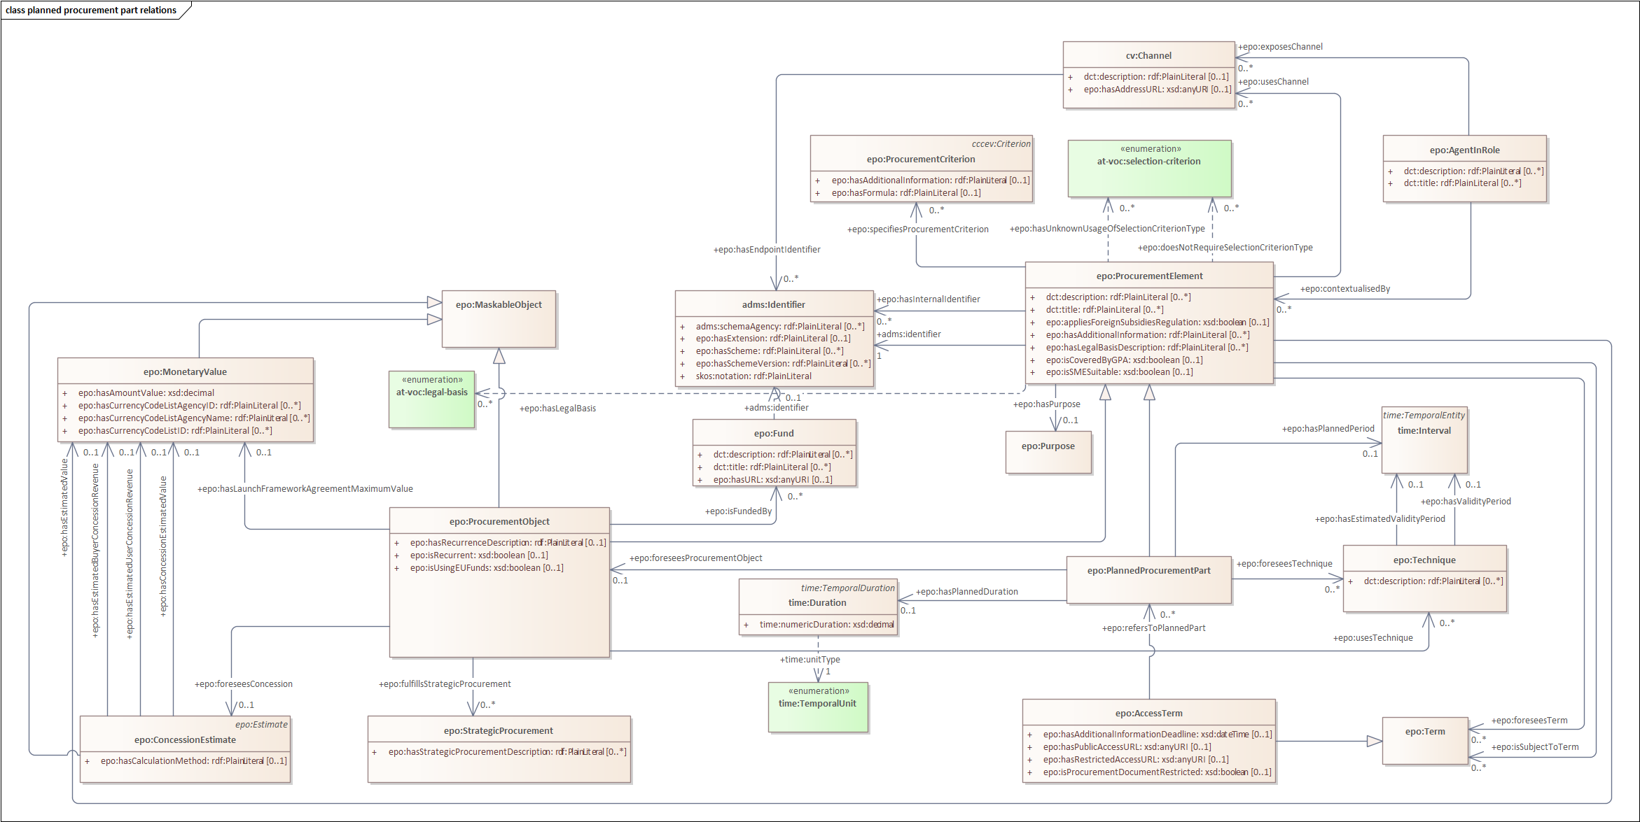
eForms mapping requirements
eForms mappings requirement as a Github issue:
Remodel epo:PlannedProcurementPart #764
Concepts moved at the level of the epo:ProcurementElement:
epo:Term
epo:isSMESuitable
epo:Purpose
epo:isCoveredByGPA
epo:AgentInRole
epo:ProcurementCriterion

Slide 32
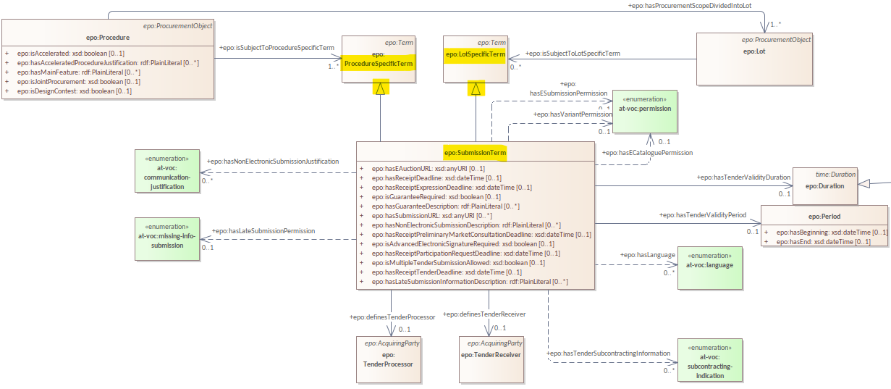
eForms mapping requirements
eForms mappings requirement as a Github issue:
epo:SubmissionTerm inheritance is wrong #762
ePO v4.2.0:

Slide 33
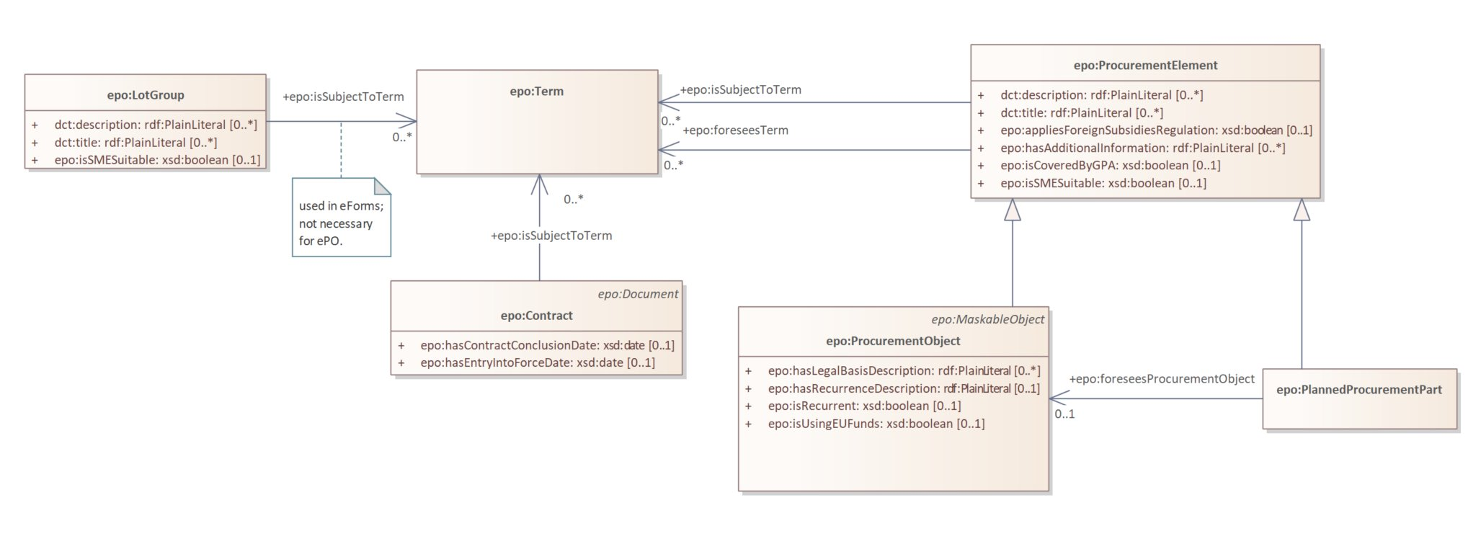
eForms mapping requirements
ePO v5.0.0:

Slide 34
eOrdering updates
Evolution of the ePO

Slide 35
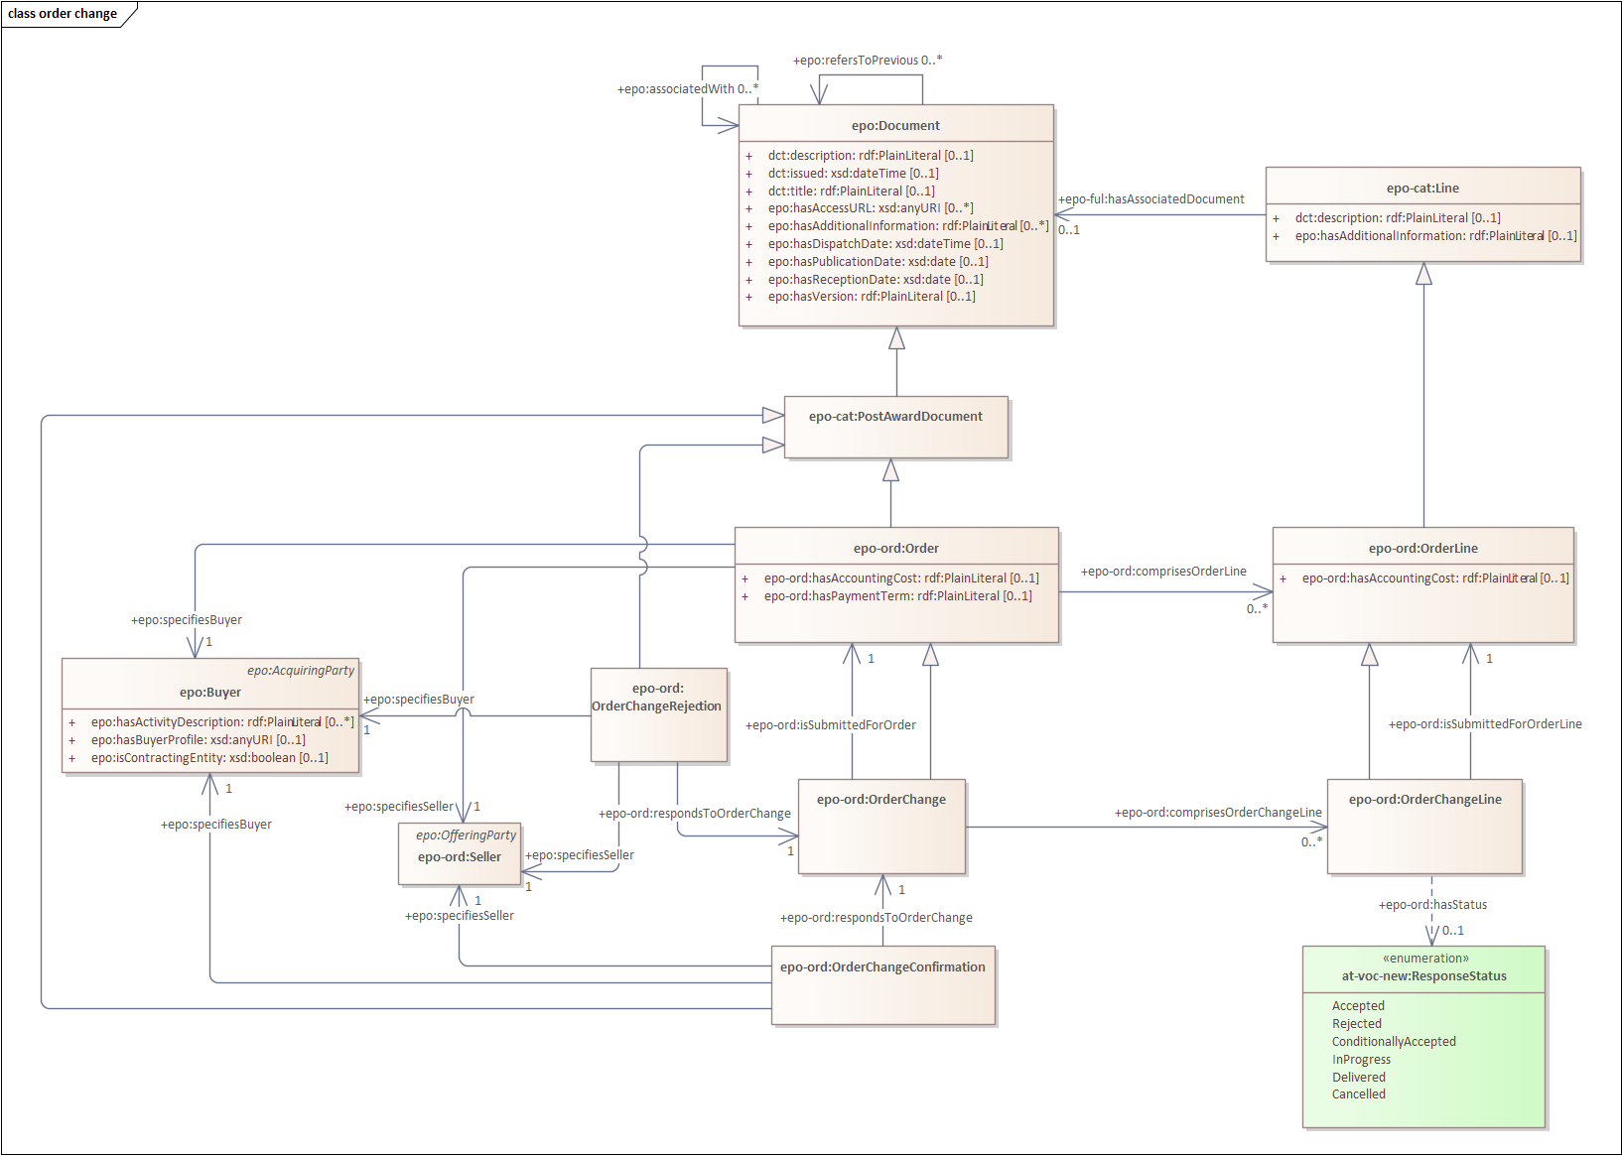
Order Change
Notes:
Order Change: A group of business terms providing information on the formal request from the Buyer to the Seller specifying the requested change in goods, services or works to be delivered in respect to a previous Order
The code shall distinguish between the following entries of UNCL 1229: - added (used in case a new line is added); - deleted; - changed; - no action; - already delivered.

Slide 36
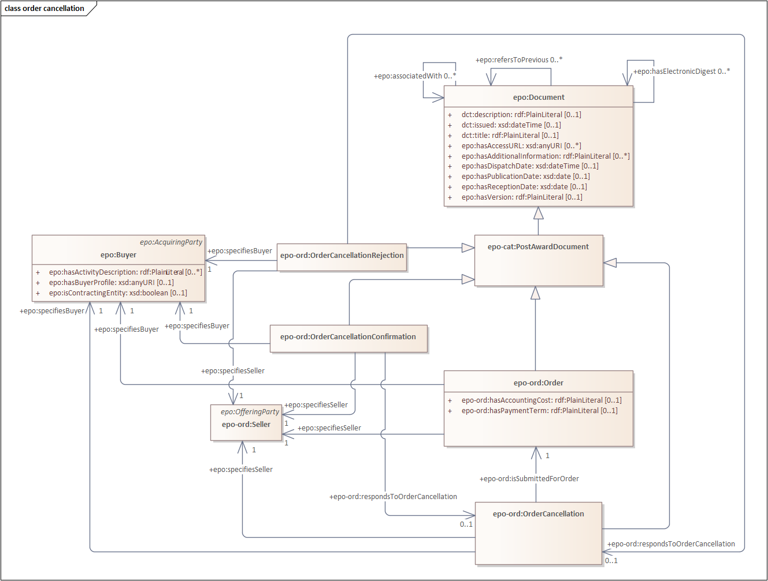
Order Cancellation
Notes:
Order Cancellation: A group of business terms providing information on the formal response from the Buyer to the Seller to cancel a previous Order or Order Change.
The code shall distinguish between the following entries of UNCL 1229: - cancelled.

Slide 37
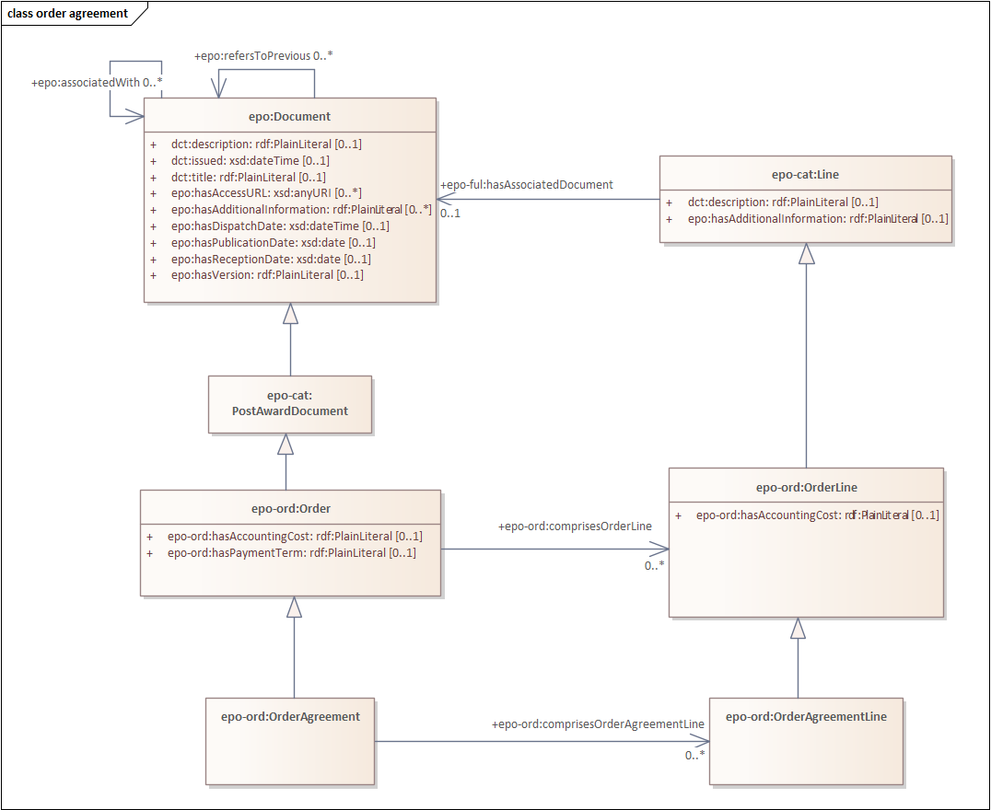
Order Agreement
Notes:
Order Agreement: A group of business terms providing information on the formal request of the Buyer to the Seller sent from the Seller to Buyer specifying the goods, services or works to be delivered.

Slide 38
eCatalogue updates
Evolution of the ePO

Slide 39
eCatalogue updates
eCatalogue Github issues implemented:
Electronic delivery of an item #746
Inconsistencies with concepts related to taxes, allowances and charges #722
Add additional properties on class epo-cat:ItemProperty or epo-cat:AbstractItem related to Range Dimension #750
Remove predicate epo-cat:hasExternalSpecification #654
Relax the cardinality of predicate epo-cat:hasAmount to [0..1] #731
Environmental-related information in the catalogue #744

Slide 40
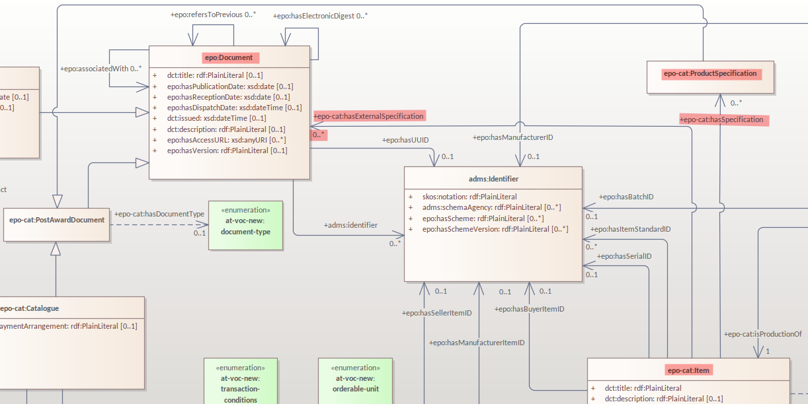
eCatalogue updates
eForms mappings requirement as a Github issue:
Remove predicate epo-cat:hasExternalSpecification #654
ePO v4.2.0:

Slide 41
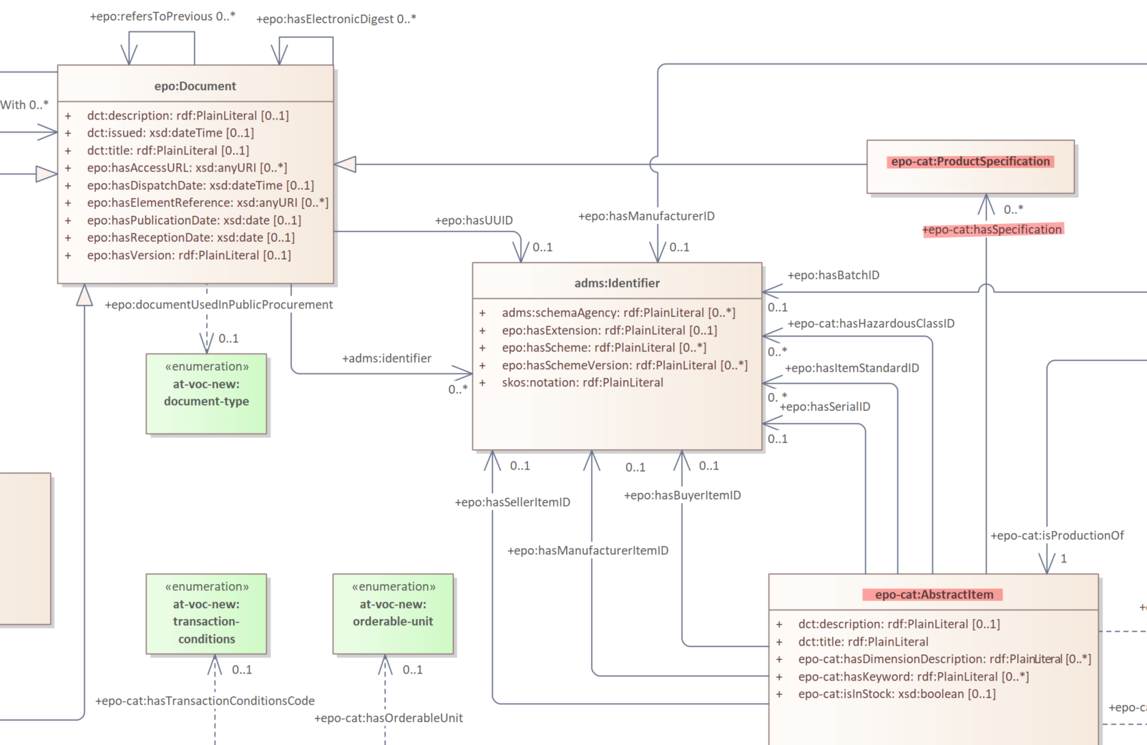
eCatalogue updates
eForms mappings requirement as a Github issue:
Remove predicate epo-cat:hasExternalSpecification #654
ePO v5.0.0:

Slide 42
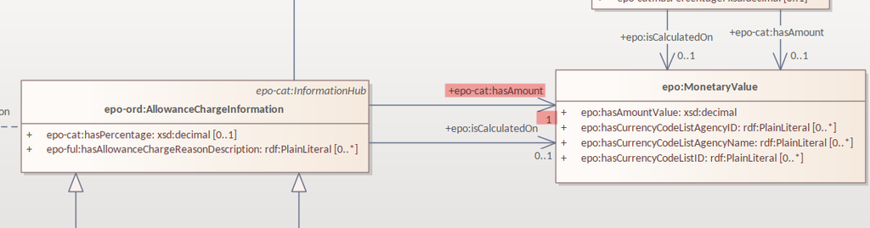
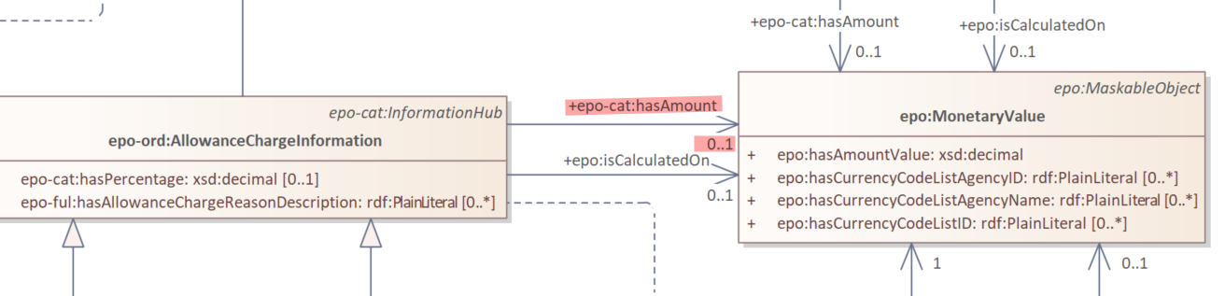
eCatalogue updates
eForms mappings requirement as a Github issue:
Relax the cardinality of predicate epo-cat:hasAmount to [0..1] #731
ePO v4.2.0:
ePO v5.0.0:

Slide 43
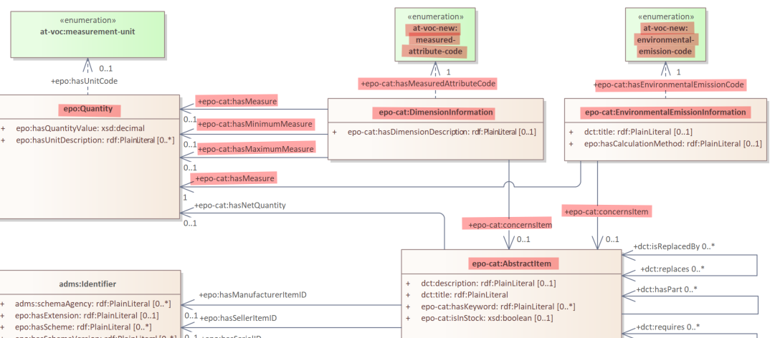
eCatalogue updates
eForms mappings requirement as a Github issue:
Environmental-related information in the catalogue #744
Add additional properties on class epo-cat:ItemProperty or epo-cat:AbstractItem related to Range Dimension #750

Slide 44
eFulfilment updates
Evolution of the ePO

Slide 45
eFulfilment updates
eFulfilment Github issues implemented:
Remove epo-ful:Notifier #620
Remove excess links from epo-ful:Consignment to epo-ful:ShipmentStage #575
Remove attribute epo-ful:isHazardousRisk from Class epo-ful:ShipmentStage #621
Remove attributes from class epo-ful:Consignment #622
Model Measurement Dimension business group from the Despatch Advice data model #661
Environmental Emission should be included in eFulfilment #576

Slide 46
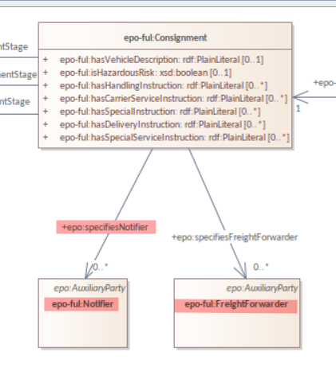
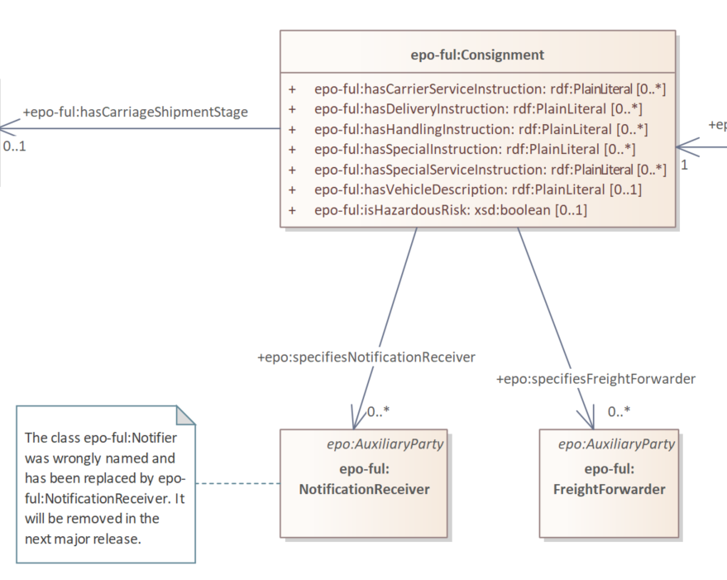
eFulfilment updates
eForms mappings requirement as a Github issue:
Remove epo-ful:Notifier #620
ePO v4.2.0:
ePO v5.0.0:
Notes:
Notification receiver: The Role of an Agent that is informed about the arrival of a Shipment at a destination.

Slide 47
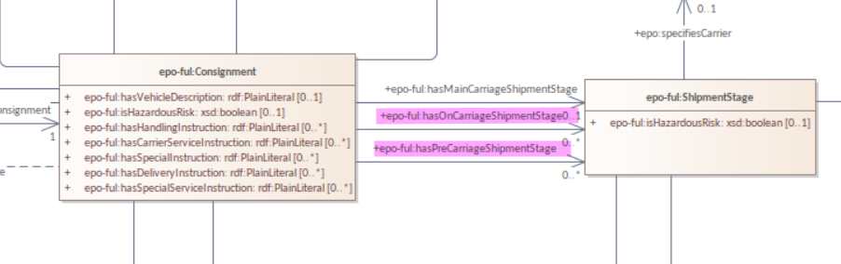
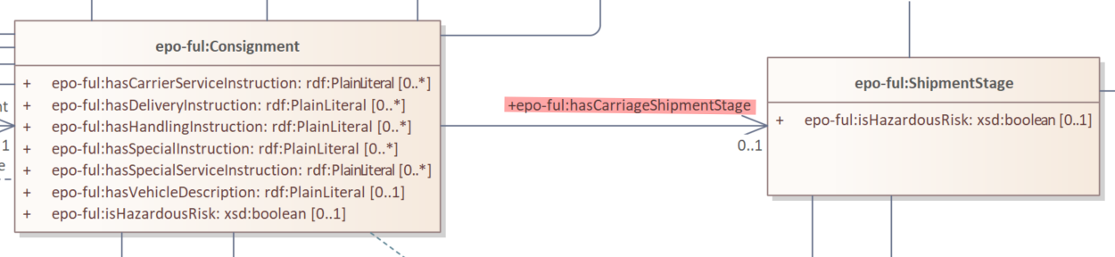
eFulfilment updates
eForms mappings requirement as a Github issue:
Remove excess links from epo-ful:Consignment to epo-ful:ShipmentStage #575
ePO v4.2.0:
ePO v5.0.0:

Slide 48
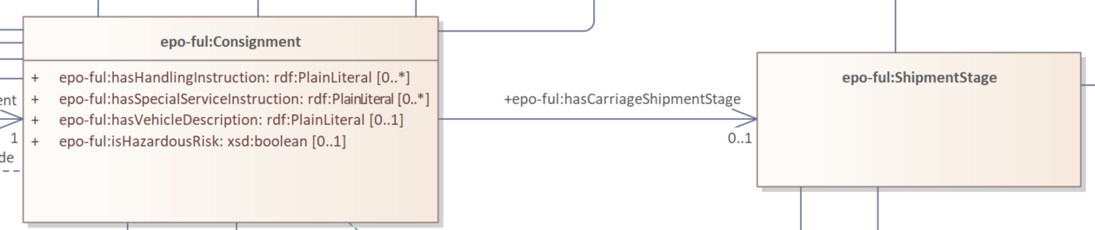
eFulfilment updates
eForms mappings requirement as Github issues:
Remove attribute epo-ful:isHazardousRisk from Class epo-ful:ShipmentStage #621
Remove attributes from class epo-ful:Consignment #622
Removed properties form ShipmentStage:
epo-ful:isHazardousRisk
Removed attributes from Consignment:
epo-ful:hasCarrierServiceInstruction
epo-ful:hasDeliveryInstruction
epo-ful:hasSpecialInstruction

Slide 49
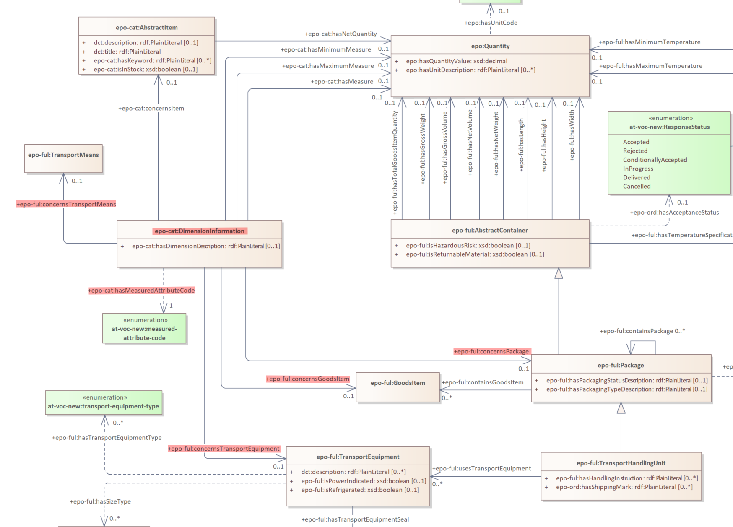
eFulfilment updates
eForms mappings requirement as a Github issue:
Model Measurement Dimension business group from the Despatch Advice data model #661

Slide 50
5 min break

Slide 51
Updated workflow and model2owl evolution

Slide 52
Updated workflow and model2owl evolution
model2owl transferred from ePO repository to epo-conceptual-model repository
Enterprise Architect file modifications:
WG approval date moved to skos:historyNote tag
eForms terms (BT/BG) references moved to skos:editorialNote tag
Added links to original definitions for external terms
Added 'proposed', 'approved' and 'implemented' statuses to epo:status tag

Slide 53
ePO v5.1.0-rc.1

Slide 54
New module development: ePayment

Slide 55
ePayment module
ePayment refers to the payment data. ePayment data is checked against the invoice data in a Contract registry.
Documents included in ePayment:
Remittance Advice

Slide 56
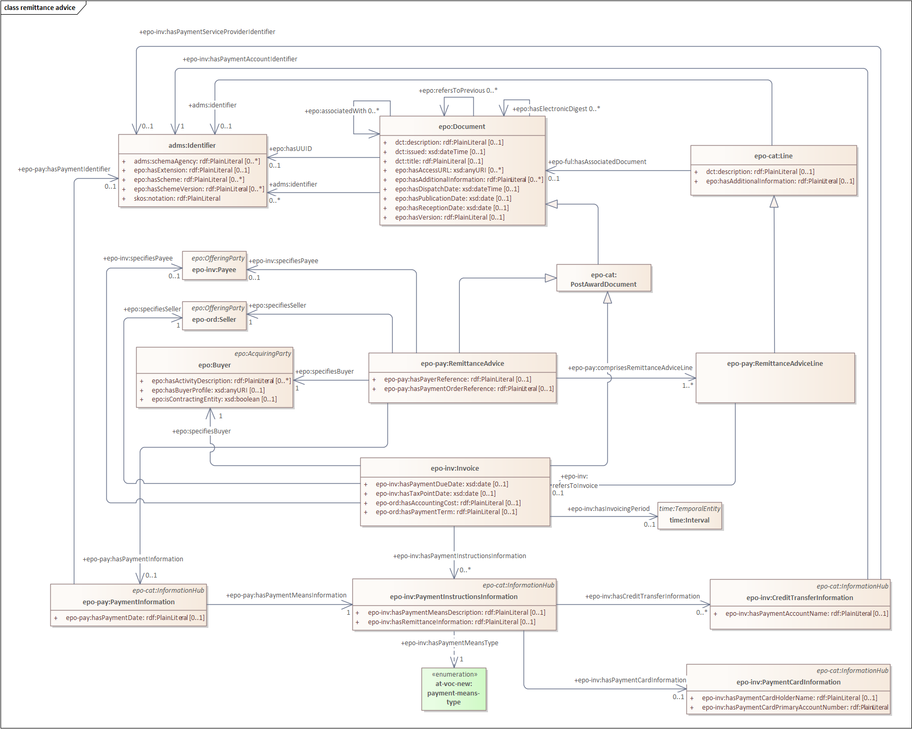
Remittance Advice

Slide 57
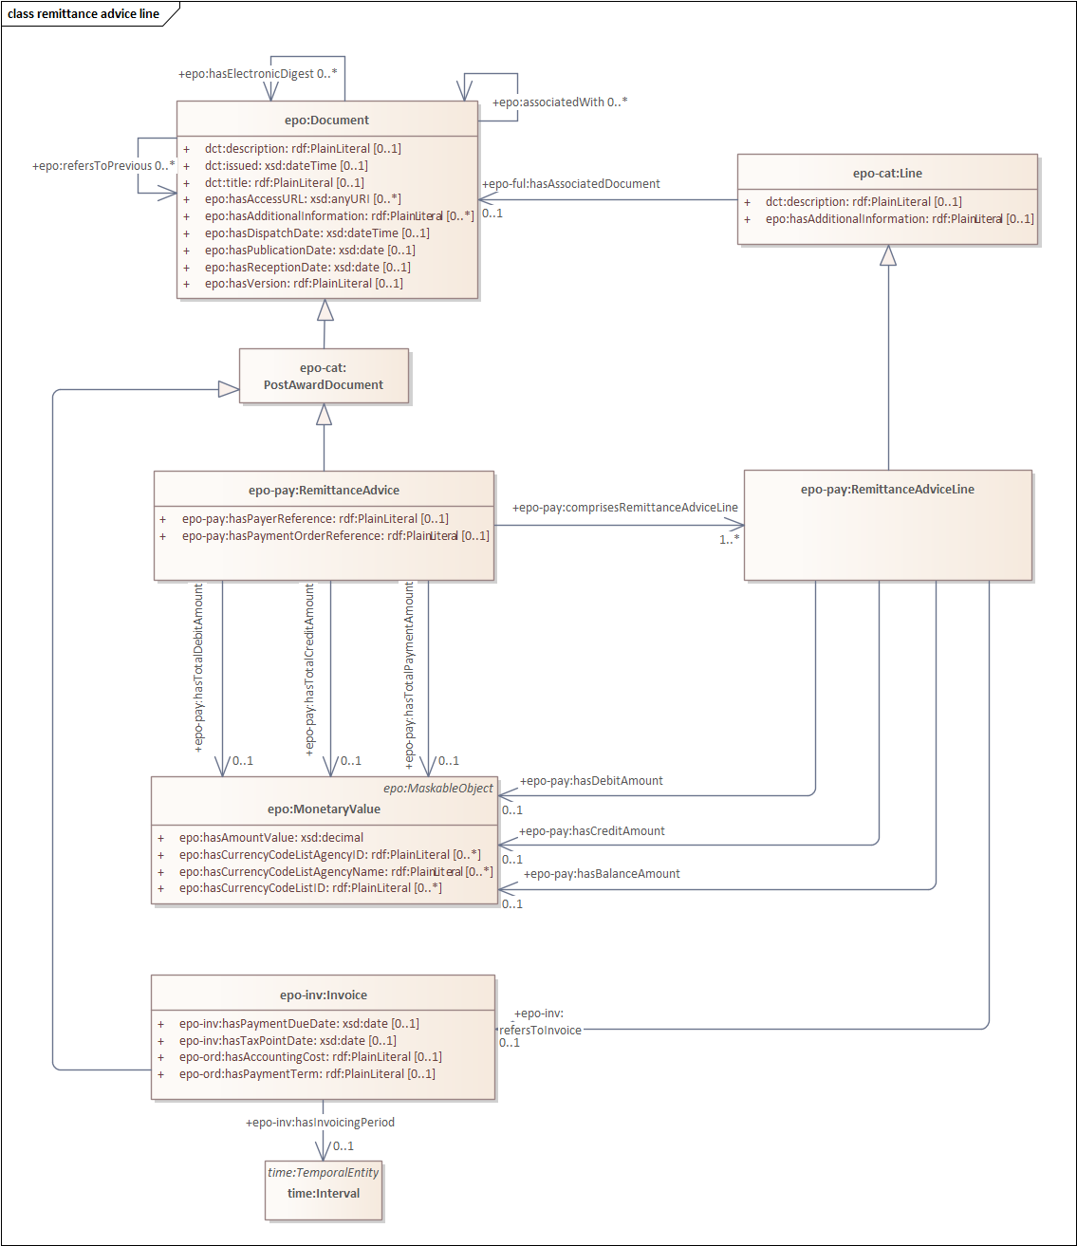
Remittance Advice Line

Slide 58
Evolution of the ePO

Slide 59
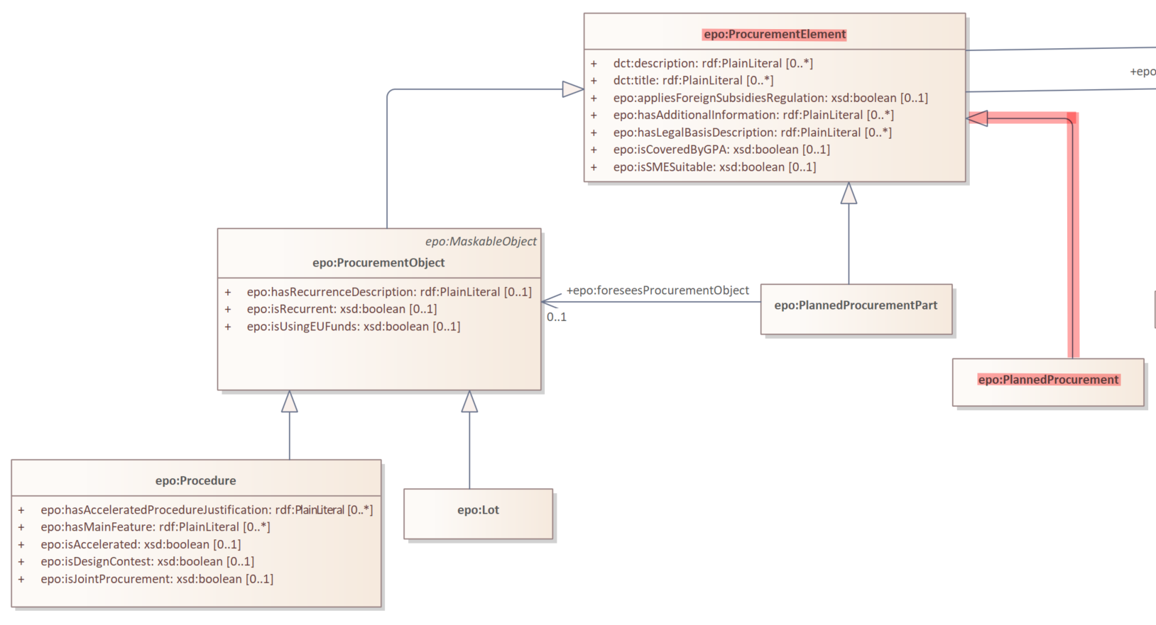
Planned Procurement within Planning notices
eForms mappings requirement as a Github issue:
Representation of Procedure-related information in planning notices #793

Slide 60
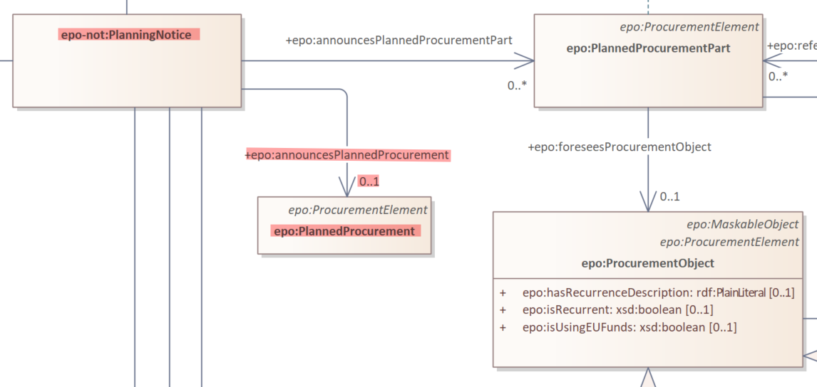
Planned Procurement within Planning notices

Slide 61
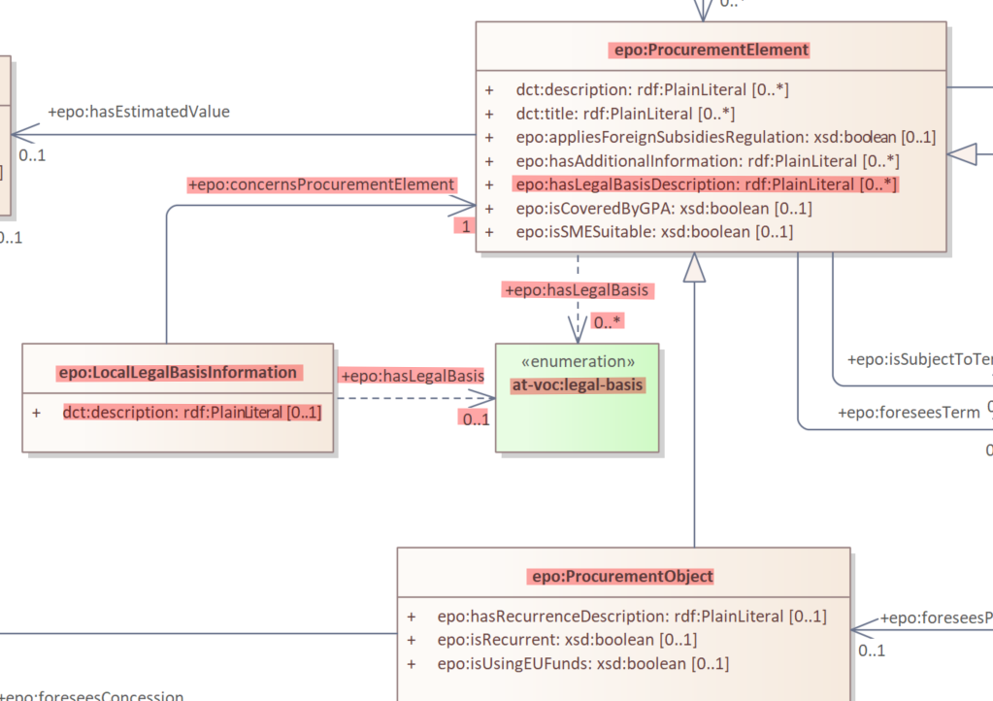
Legal basis representation

Slide 62
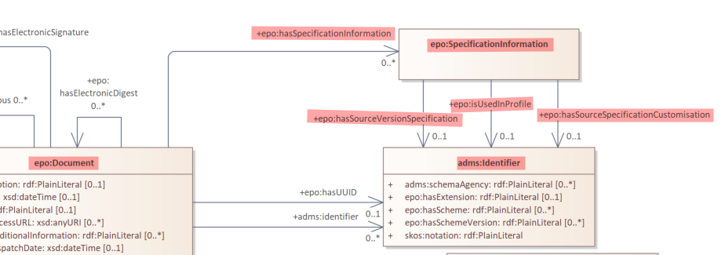
Specification information concept
eForms mappings requirement as a Github issue:
Should the Ontology Include an eforms SDK version concept #708

Slide 63
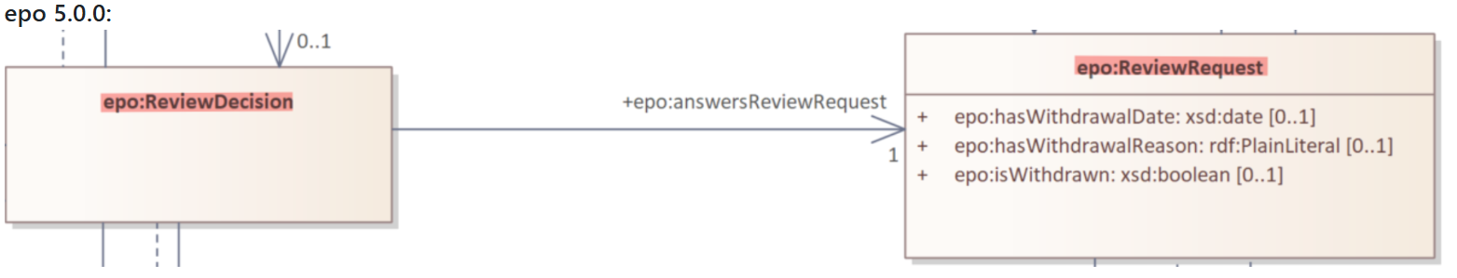
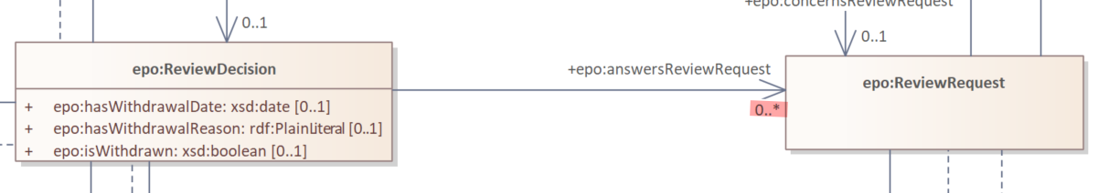
Review Request and Review Decision
eForms mappings requirement as a Github issue:
How is the relationship between epo:ReviewDecision and epo:ReviewRequest represented in eForms? #777
ePO 5.1.0:

Slide 64
Future work

Slide 65
Future work
Publish final release of ePO v5.0.0
Publish ePO v5.1.0-rc.1
Publish final release of ePO v5.1.0
ePO v5.2.0-rc.1:
Publish pre-award documents models
Minor updates for post-award modules
Finalise definition for all ePO concepts
Create simplified views of ePO

Slide 66
Open discussion

Slide 67
Meeting schedule
ePO discussions:
- every Tuesday from 14:30 to 16:30 (CET)
- meeting link
- every Thursday from 14:30 to 16:30 (CET)
- meeting link

Slide 68
Feedback and questions
Looking forward to hearing from you.
Feedback and questions can be sent via:
GitHub discussions: https://github.com/OP-TED/ePO/discussions
GitHub issues: https://github.com/OP-TED/ePO/issues
or alternatively via:
Email: OP-EPROCUREMENT-ONTOLOGY@publications.europa.eu
Email: natalie.muric@publications.europa.eu

