Slide 1
eProcurement Ontology
Q2 2023
Online Presentation 27/06/2023
Andreea Pasare, Eugeniu Costetchi
Meaningfy/Infeurope

Slide 2
The goal of this meeting is to present:
(a) the work carried out since the last meeting in March
(b) the short-term plan for the second half of 2023
(c) the next modules to be evolved, eAccess and eSubmission.

Slide 3
Agenda
Welcome
Review of Q2 2023
Plan for Q3 2023
Planned releases
Open discussion
Closing

Slide 4
Review of Q2 2023

Slide 5
Review of Q2 2023
Mini-Competition
eContract module
Conversion of Procurement Objects to Documents
Post-Award modules alignment
Standard form mapping requirements
eForm mapping requirements
model2owl updates

Slide 6
Mini-Competition

Slide 7
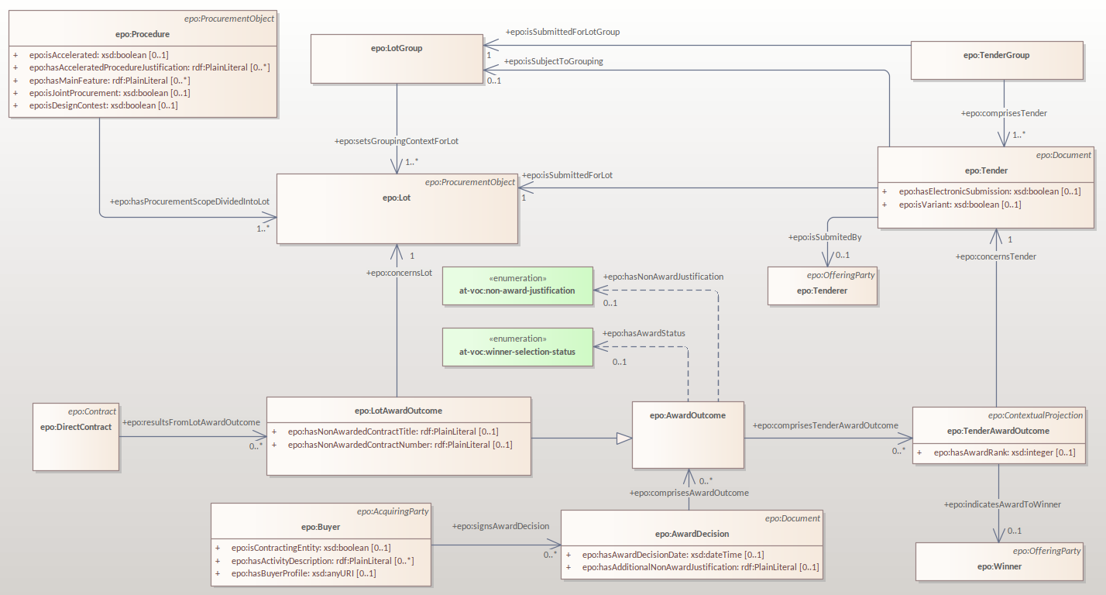
Lot Award

Slide 8
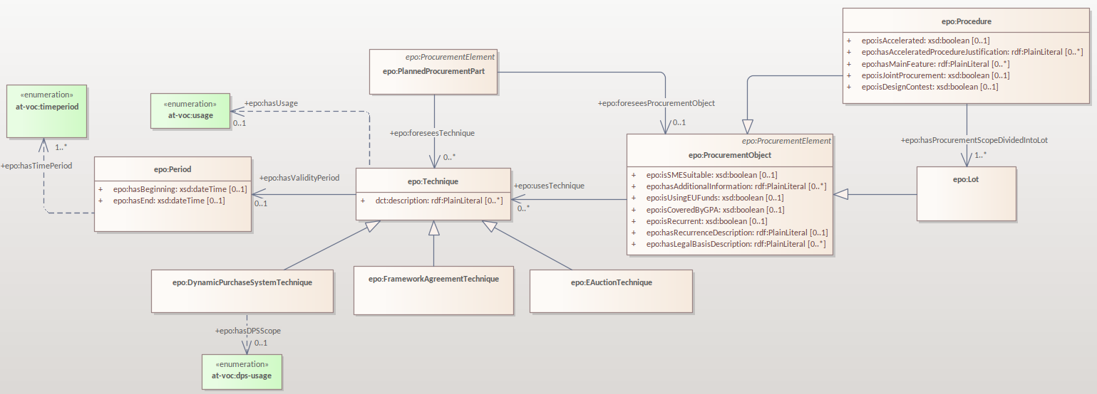
Technique

Slide 9
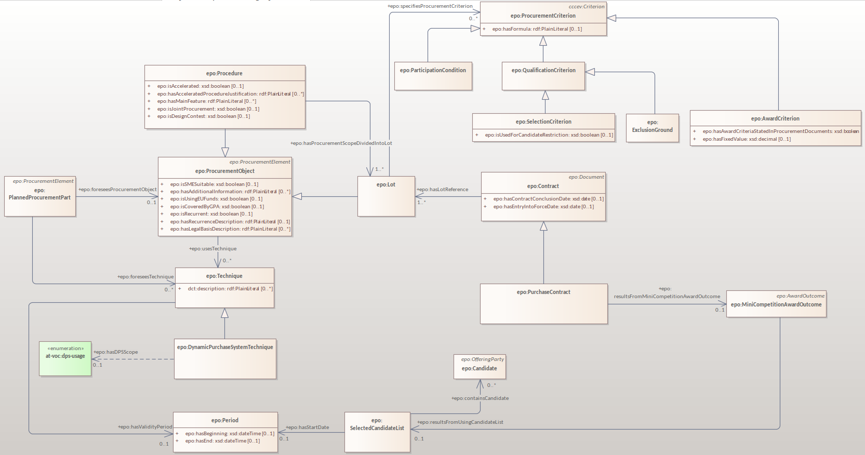
Dynamic purchasing system

Slide 10
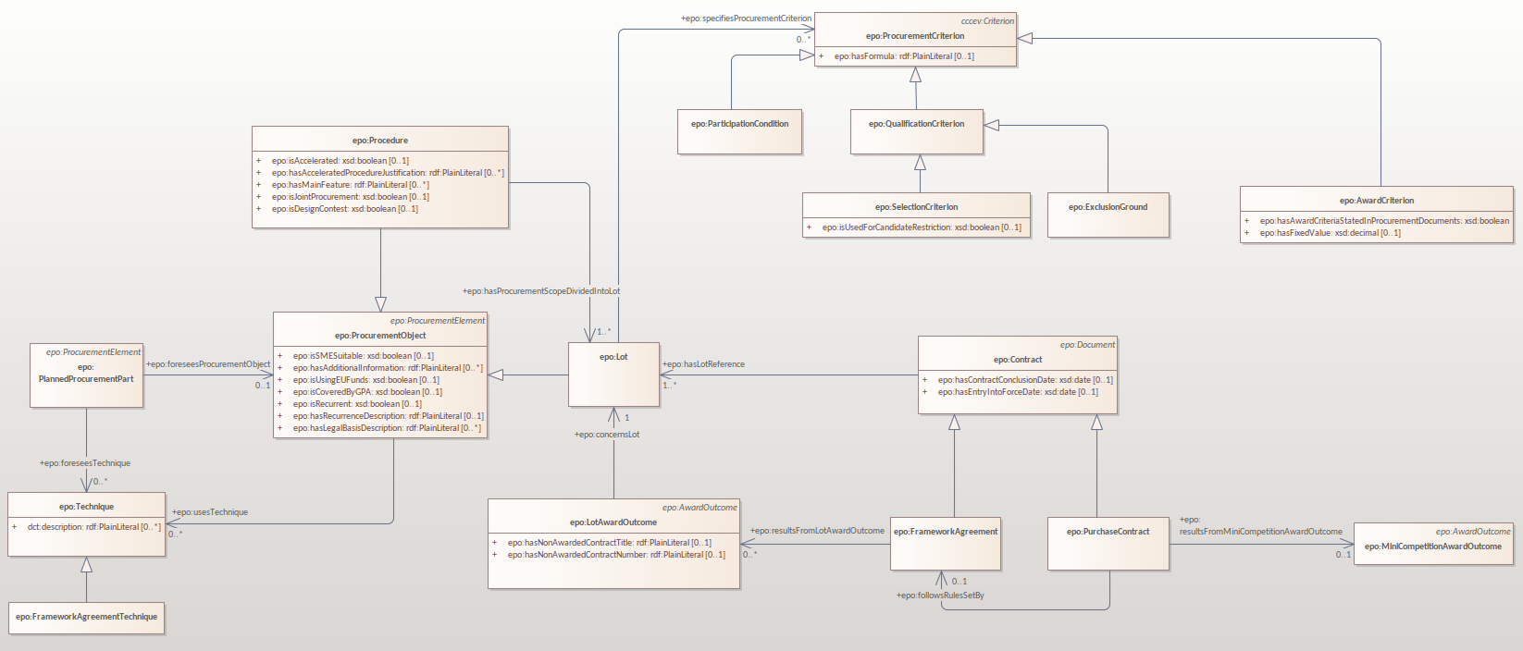
Framework Agreement

Slide 11
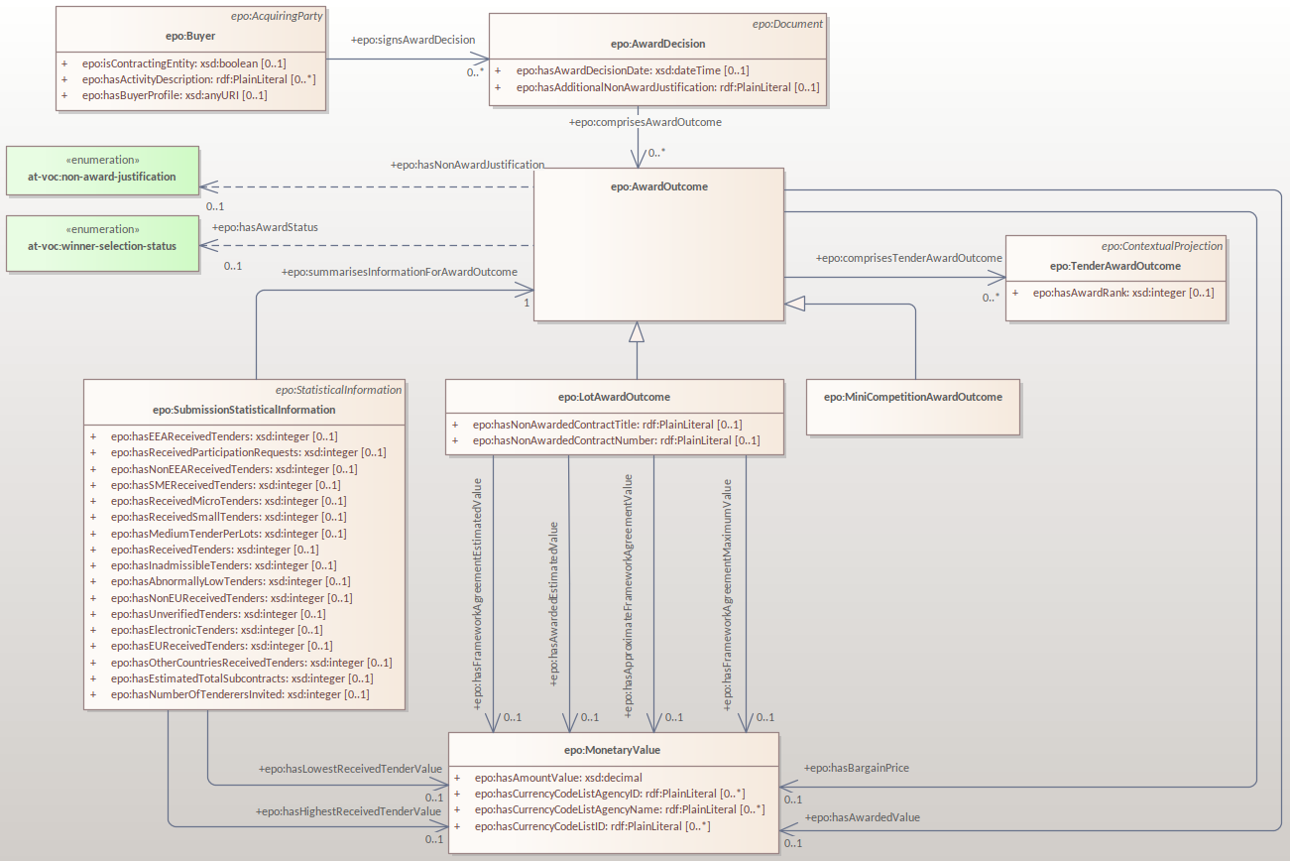
Award Decision

Slide 12
eContract module

Slide 13
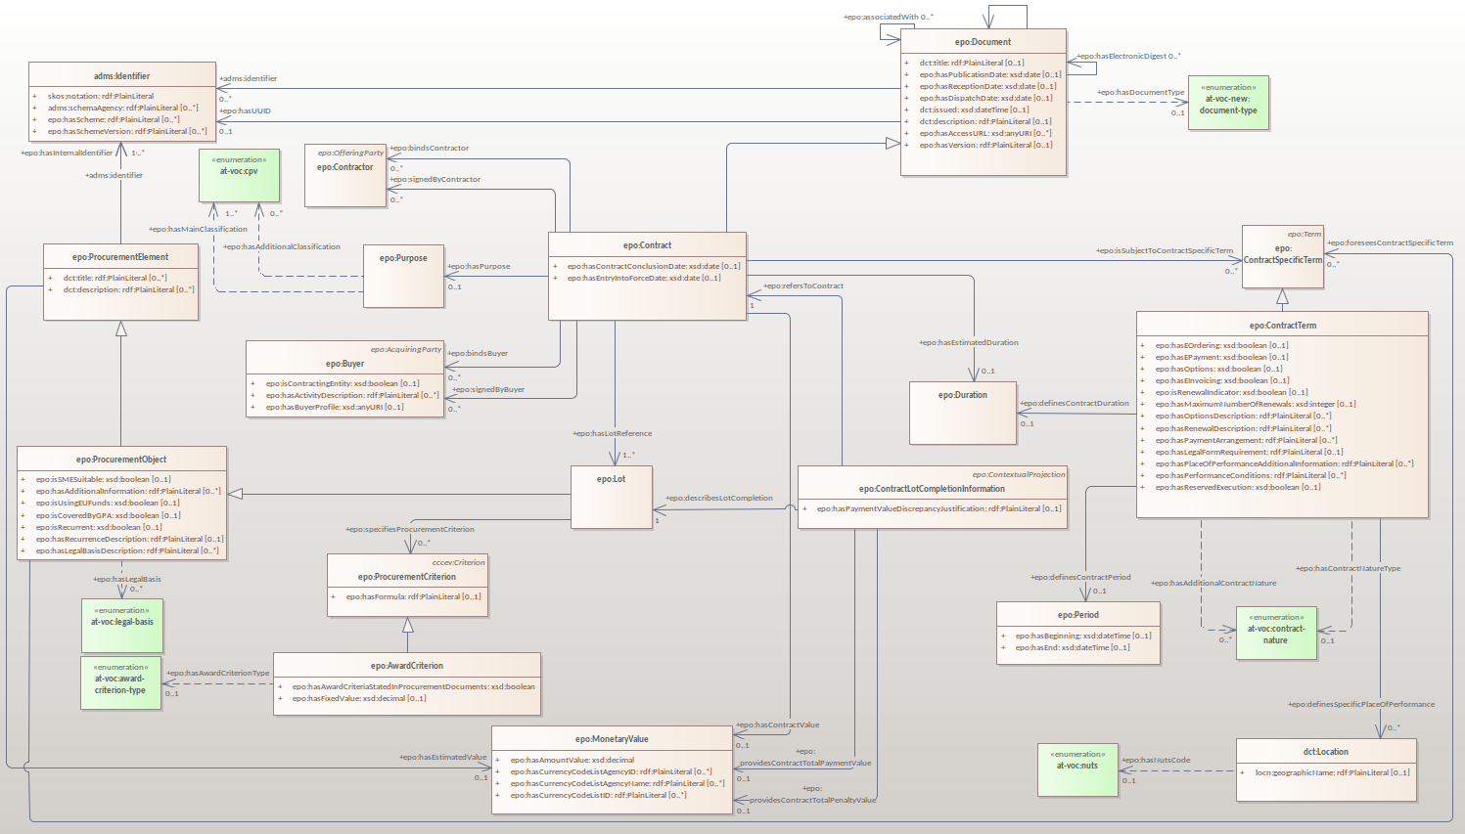
Contract

Slide 14
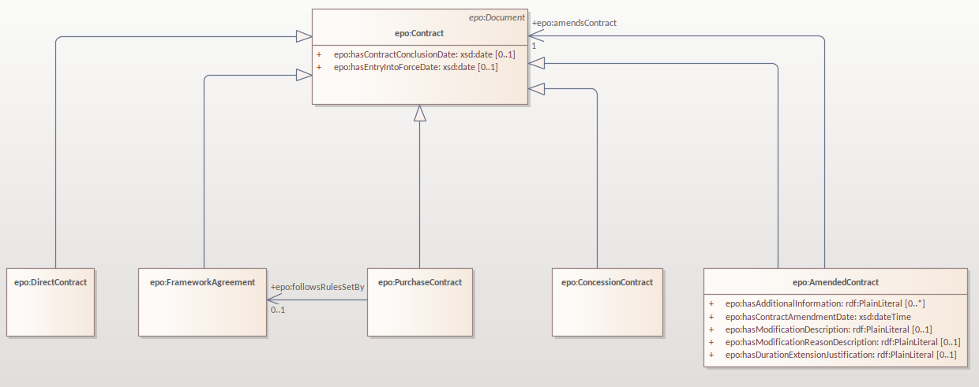
Contract hierarchy

Slide 15
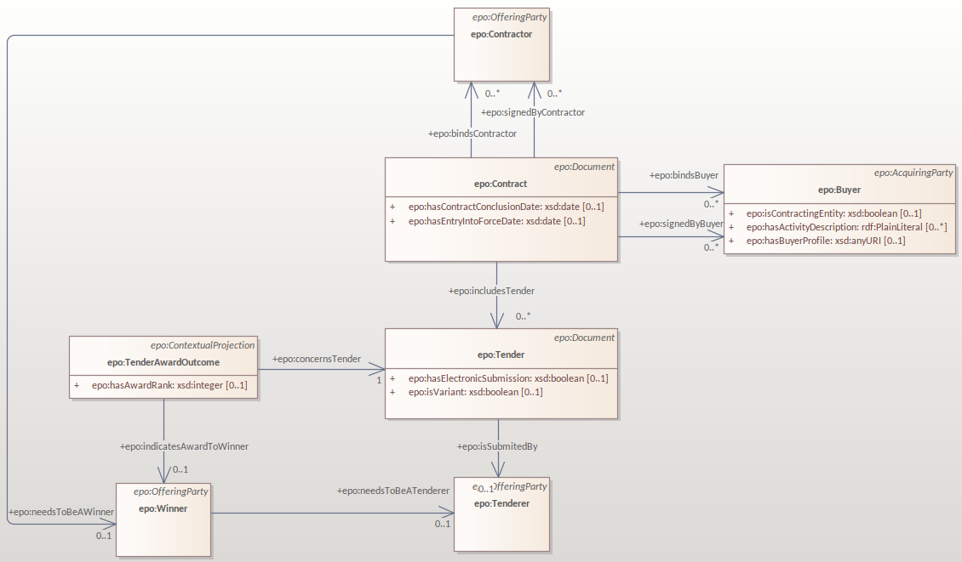
Contract roles

Slide 16
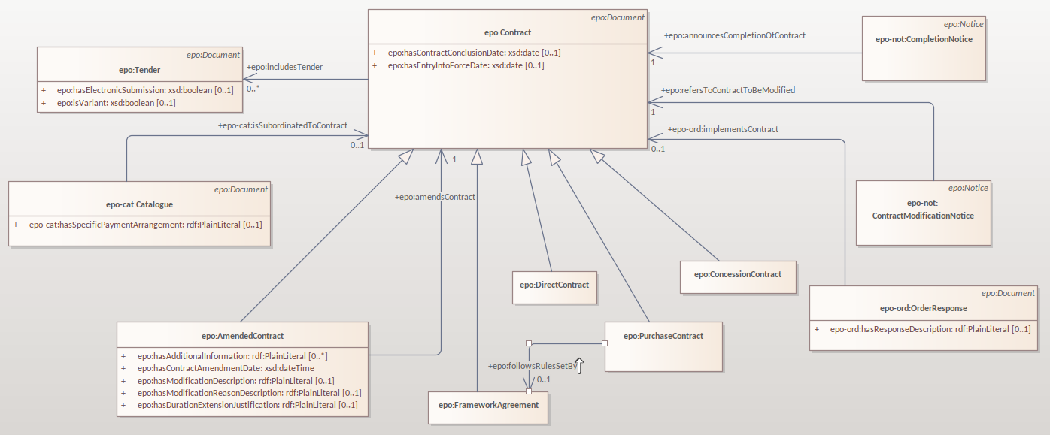
Contract documents

Slide 17
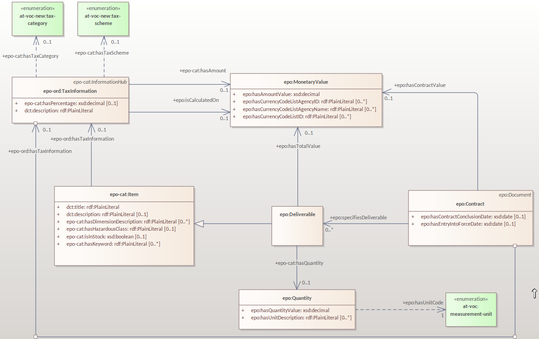
Contract deliverable

Slide 18
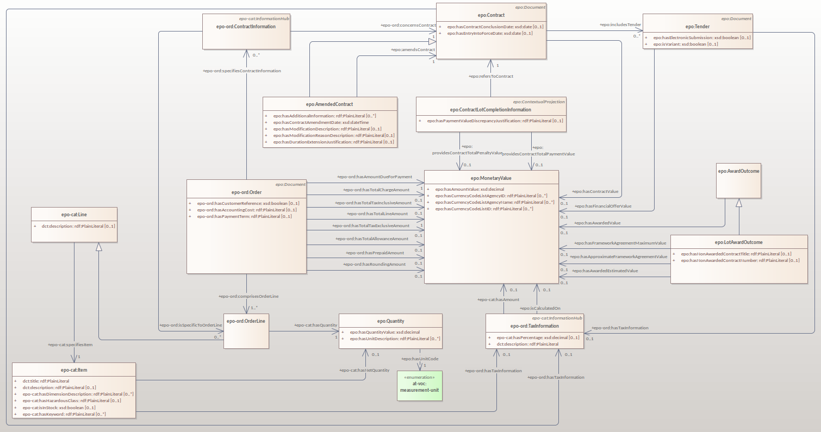
Contract monetary values

Slide 19
Conversion of Procurement Objects to Documents

Slide 20
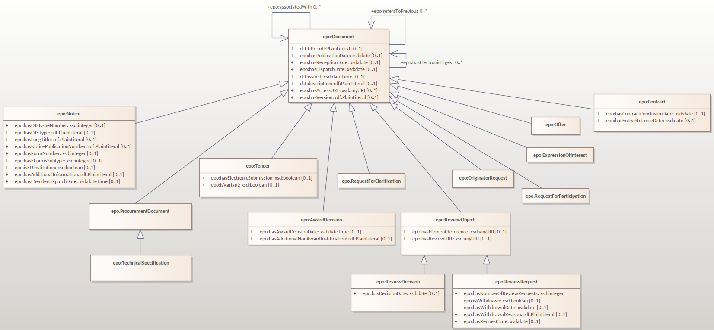
Documents hierarchy

Slide 21
Post-Award module alignment

Slide 22
Harmonisation of eCatalogue, eOrdering and eFulfilment
Creation of information hubs to allow data to be provided either at document or line level if not a combination of the two
Modelling of different charges allowing for the different requirements across the different phases​
'epo-ful:hasBaseAmount’ is replaced by 'epo:isCalculatedOn’
Deliverable becomes a subclass of the Item​
Contractor is considered to be identical to a Seller in Public Procurement​
'epo-cat:ItemDescription’ is renamed 'epo:ItemProperty​'
PostAward Objects become Documents ​

Slide 23
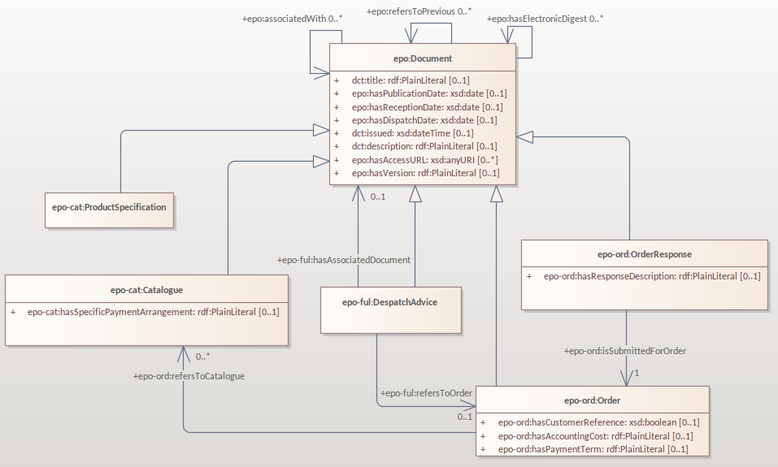
Post-award objects as documents

Slide 24
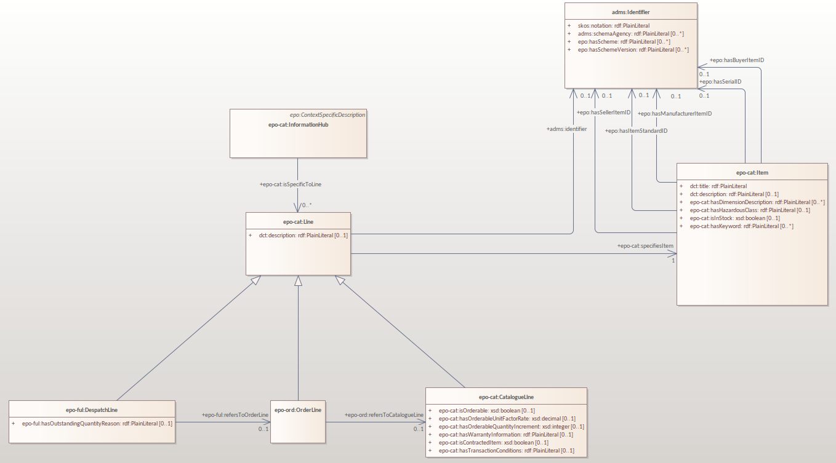
Post-award object harmonisation

Slide 25
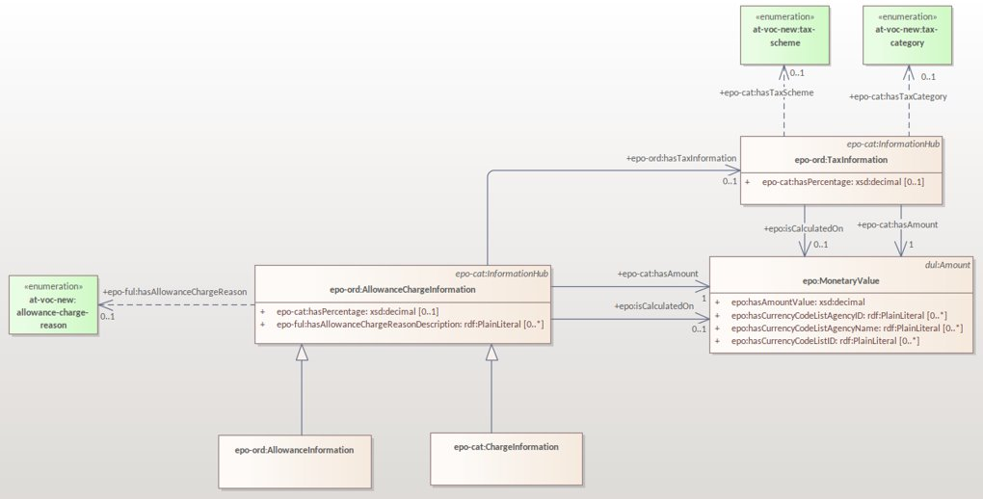
Allowance Charge Information and Tax Information

Slide 26
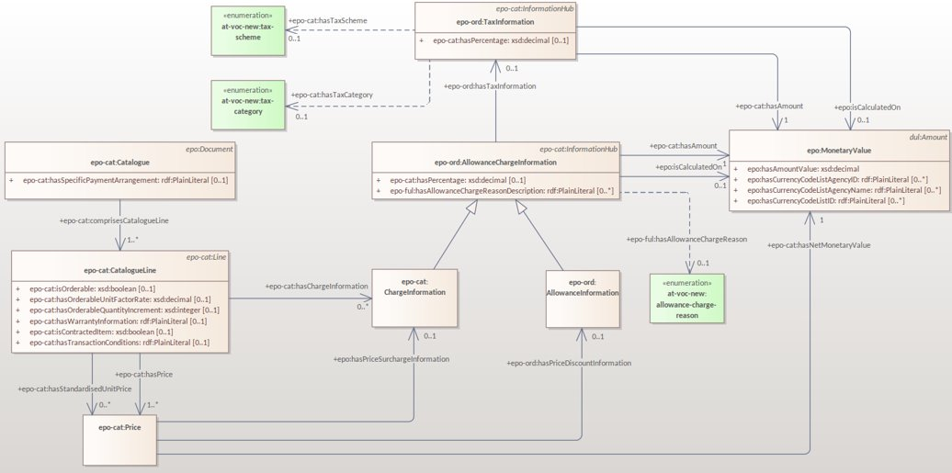
Allowance Charge Information in eCatalogue

Slide 27
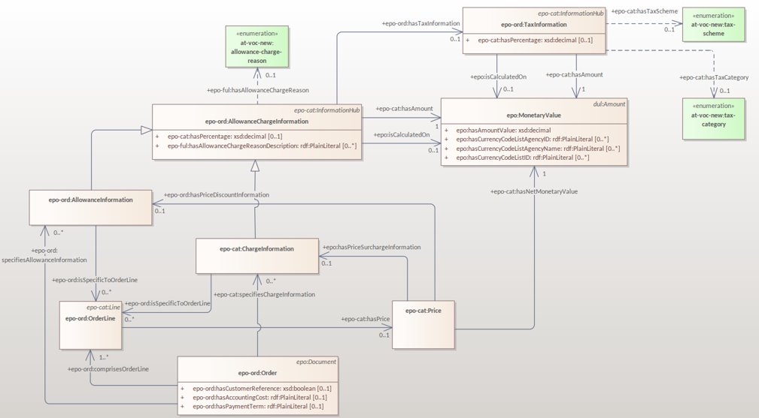
Allowance Charge Information in eOrdering

Slide 28
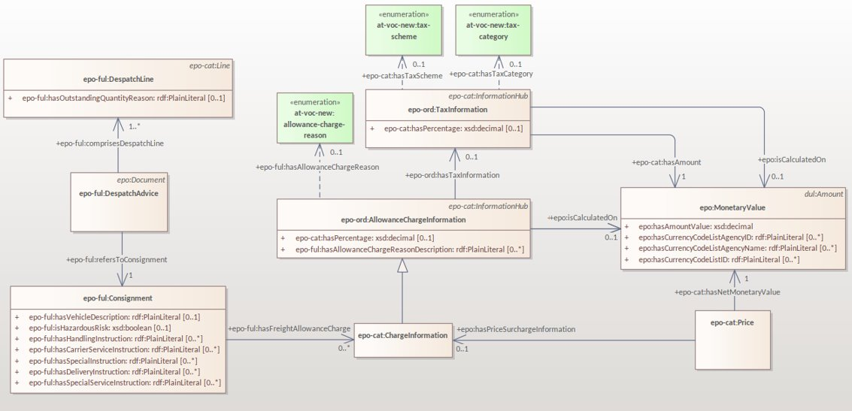
Allowance Charge Information in eFulfilment

Slide 29
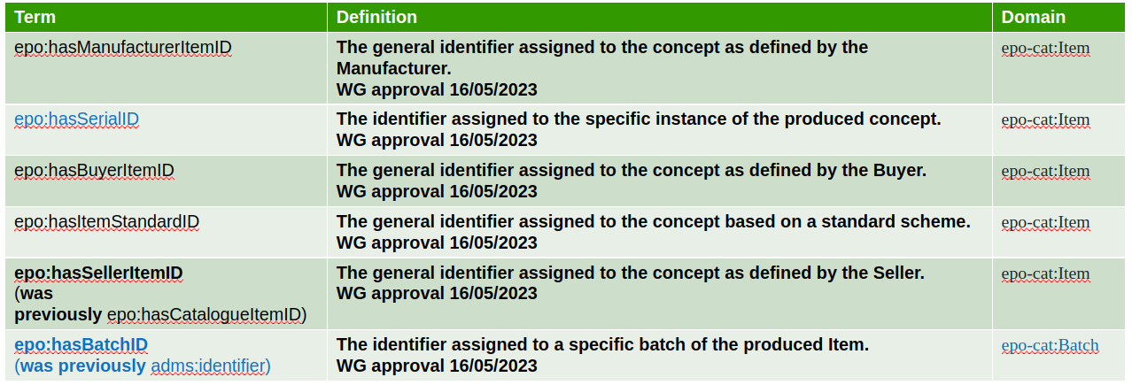
Review of Terms and definitions for Item and Batch IDs

Slide 30
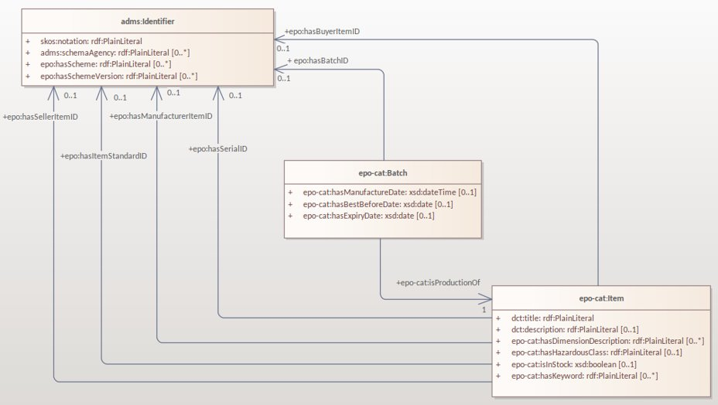
Review of Terms and definitions for Item and Batch IDs

Slide 31
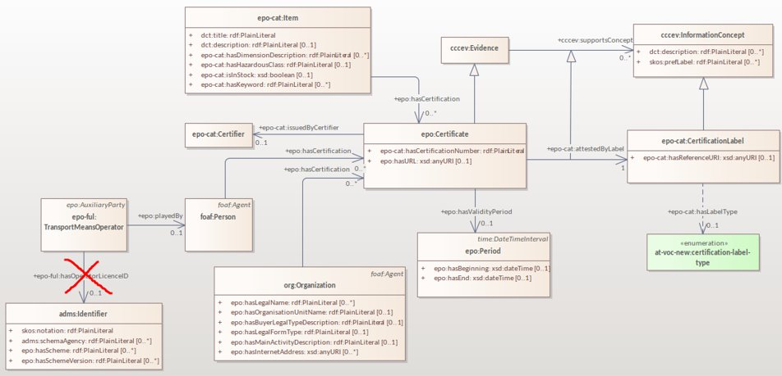
Incorporating Certificate Requirements for different concepts
epo:Certificate:
Proof of conformance of the instance of the concept to a defined set of criteria, ensuring credibility, trust and transparency.
WG approval 16/05/2023
epo:Certifier:
A Role of an Agent that issues a Certificate.
WG approval 16/05/2023

Slide 32
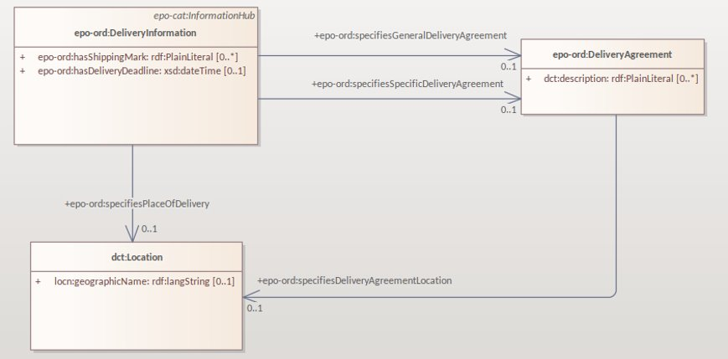
Delivery Agreement
Definition:
Term applying to the delivery of goods, services and works.
Additional Information:
Delivery terms identifier can normally be Incoterms accompanied by the description of specific conditions related to the delivery.
WG approval 16/05/2023

Slide 33
5 min break

Slide 34
Standard form mapping requirements

Slide 35
Standard form mapping requirements
Communication means
Procurement Criteria​ Summary
Notice relations harmonisation

Slide 36
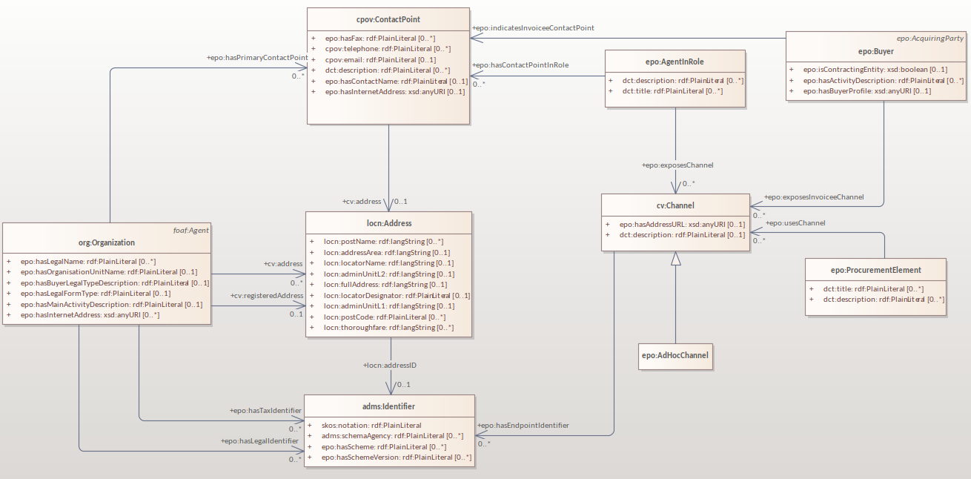
Communication means

Slide 37
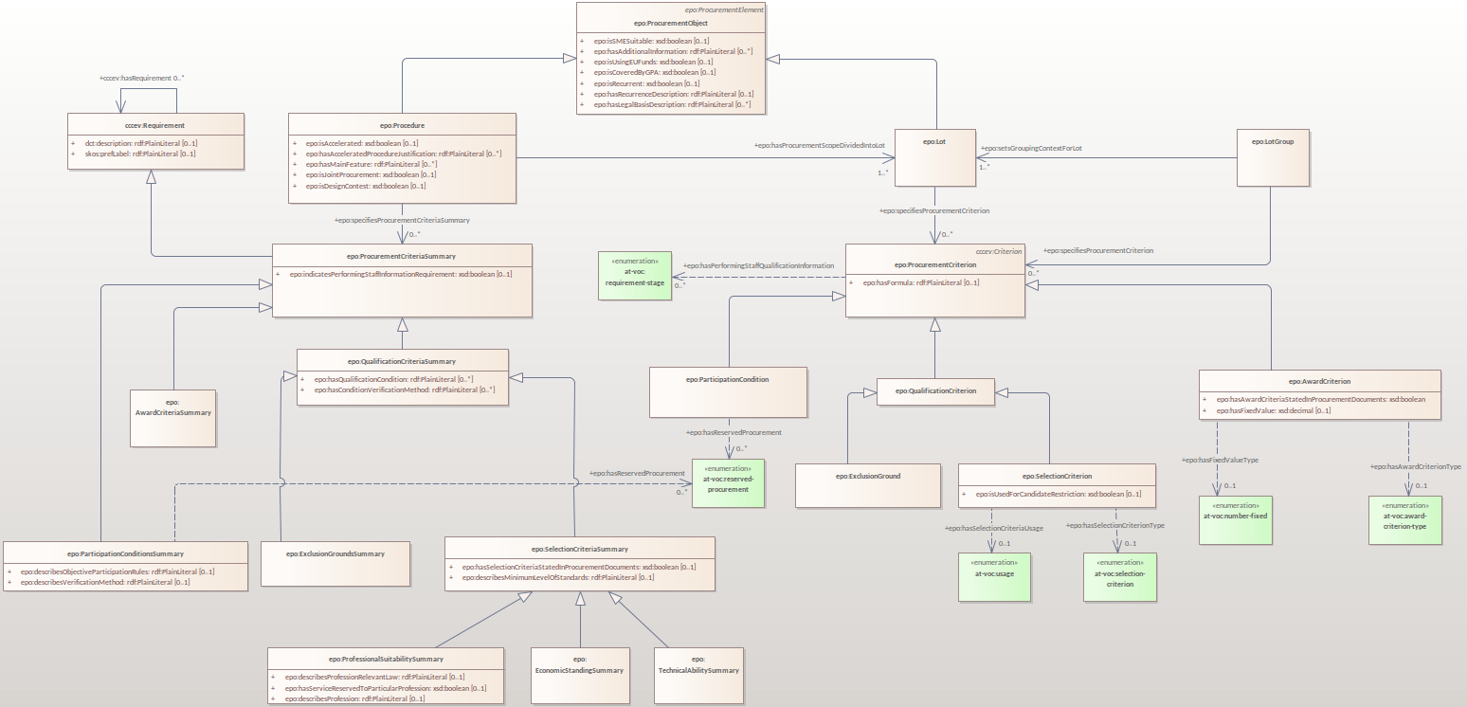
Procurement criteria summary

Slide 38
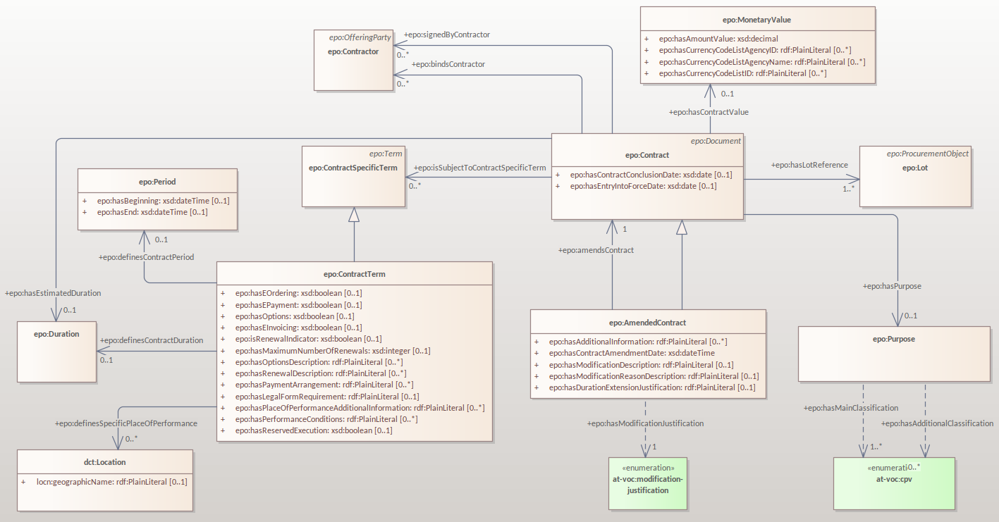
Modification Notice for standard form mappings

Slide 39
Notice relations harmonisation

Slide 40
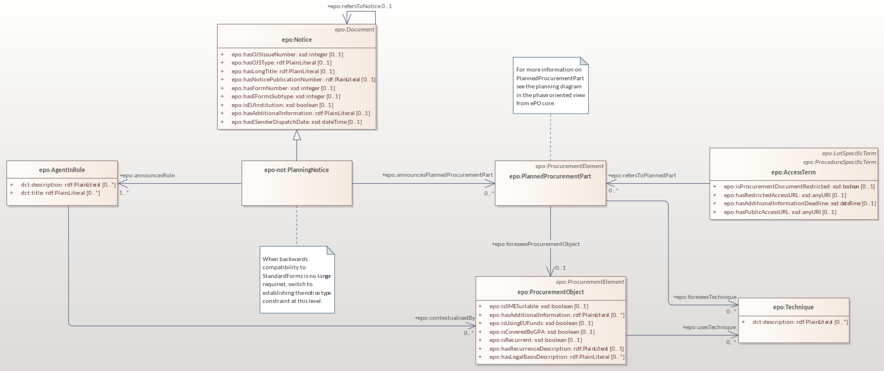
Planning Notice

Slide 41
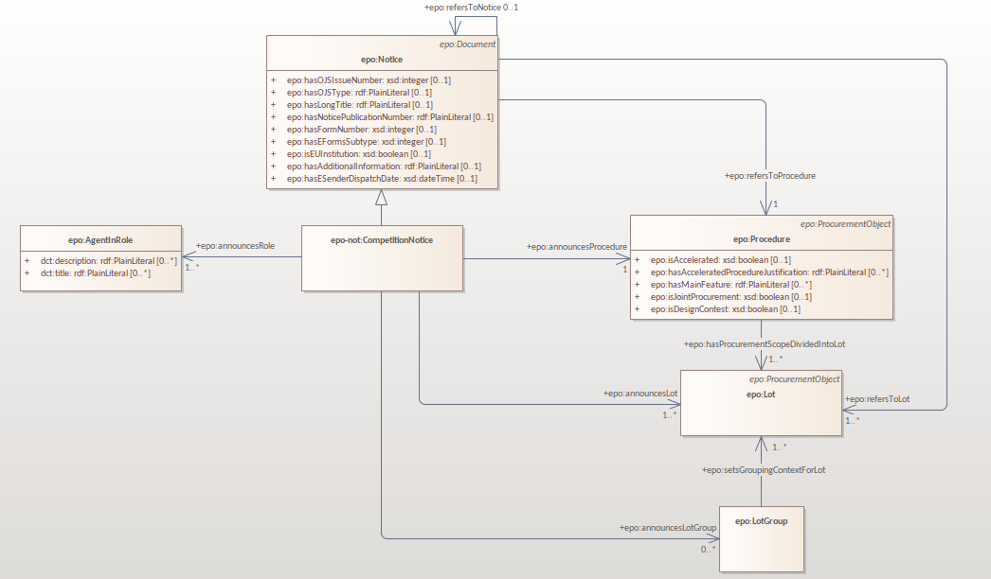
Competition Notice

Slide 42
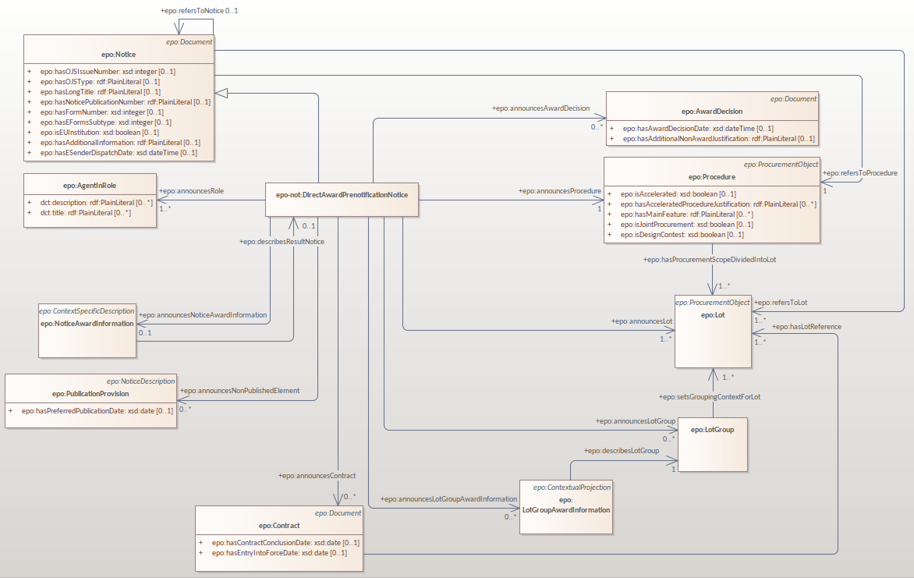
Direct Award Prenotification Notice

Slide 43
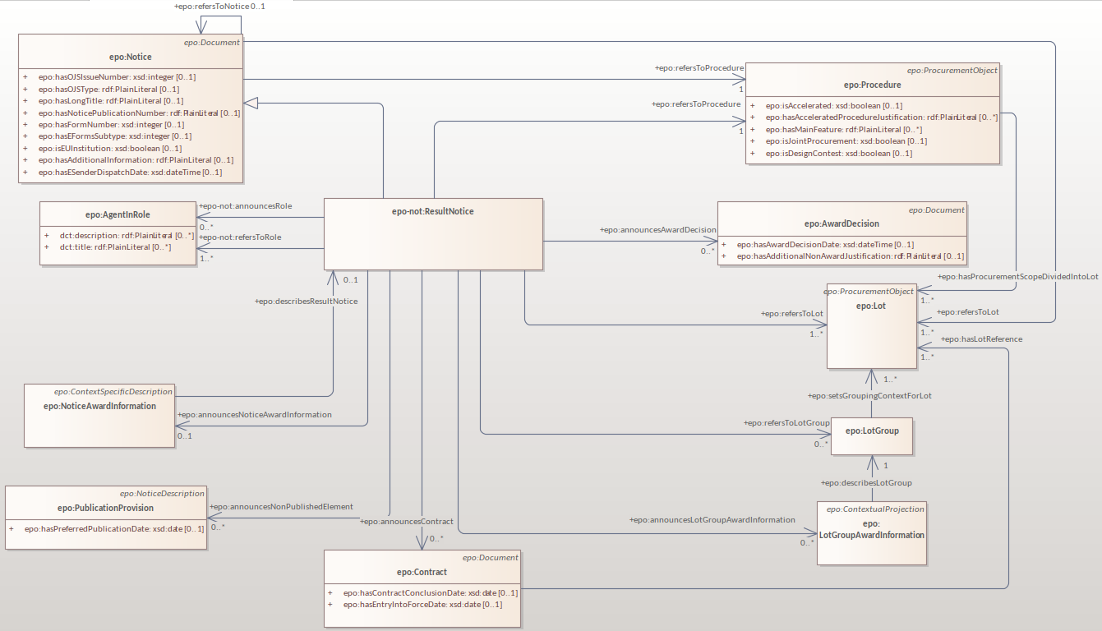
Result Notice

Slide 44
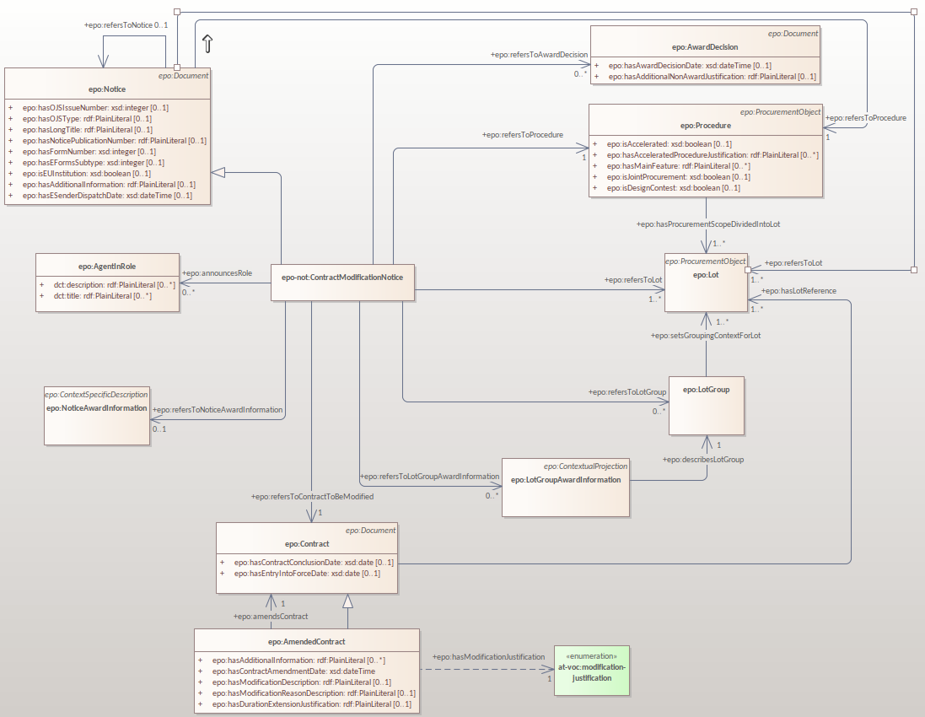
Modification Notice

Slide 45
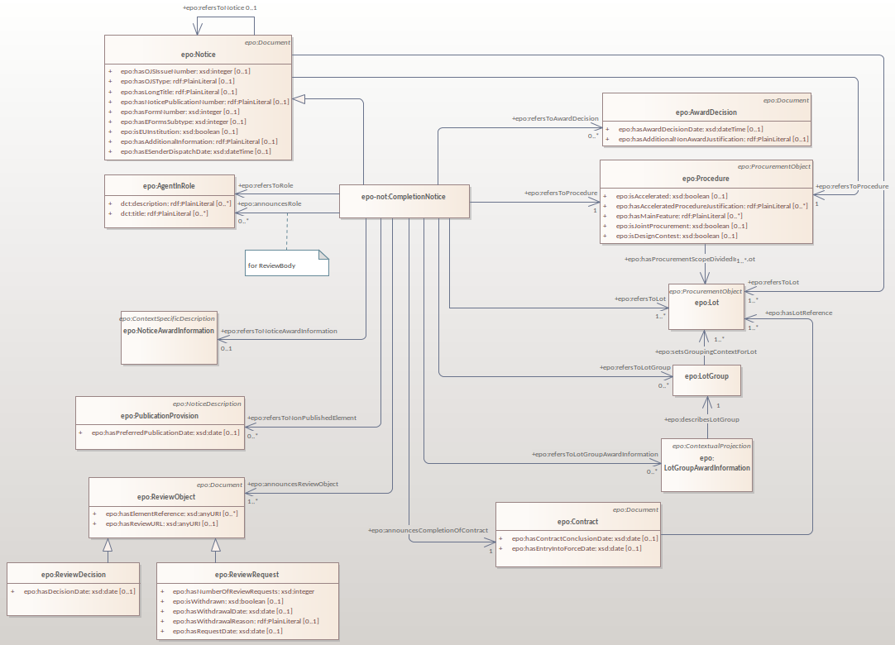
Completion Notice

Slide 46
eForm mapping requirements

Slide 47
eForm mapping requirements
Ensure coverage of all BTs from the new eForm Annex
Implemented new eForm business terms
Revision of all monetary values

Slide 48
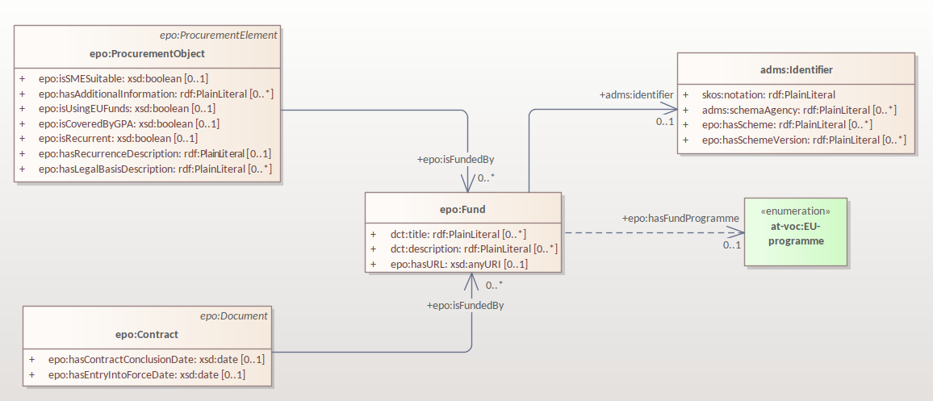
EU Funds

Slide 49
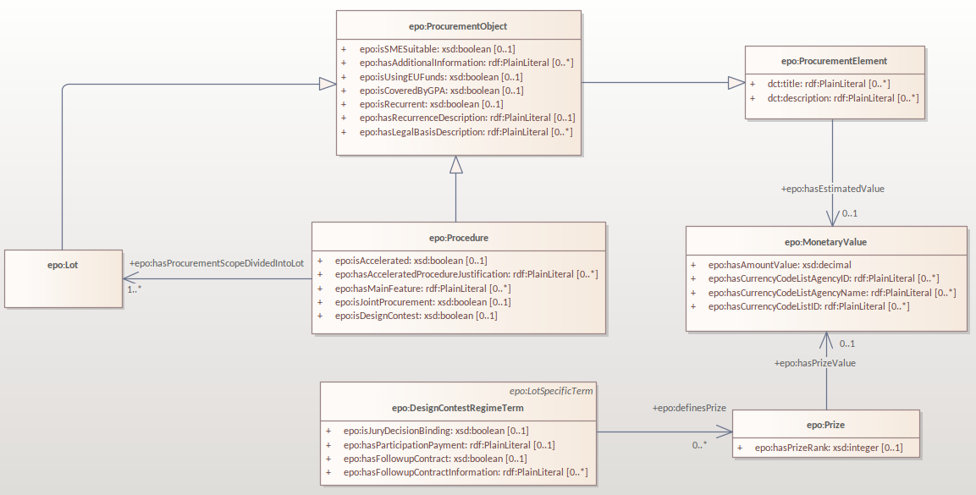
Monetary values

Slide 50
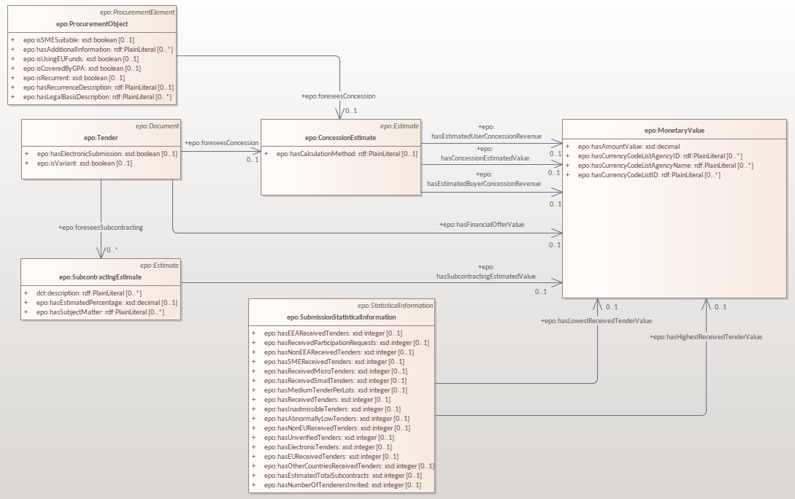
Monetary values

Slide 51
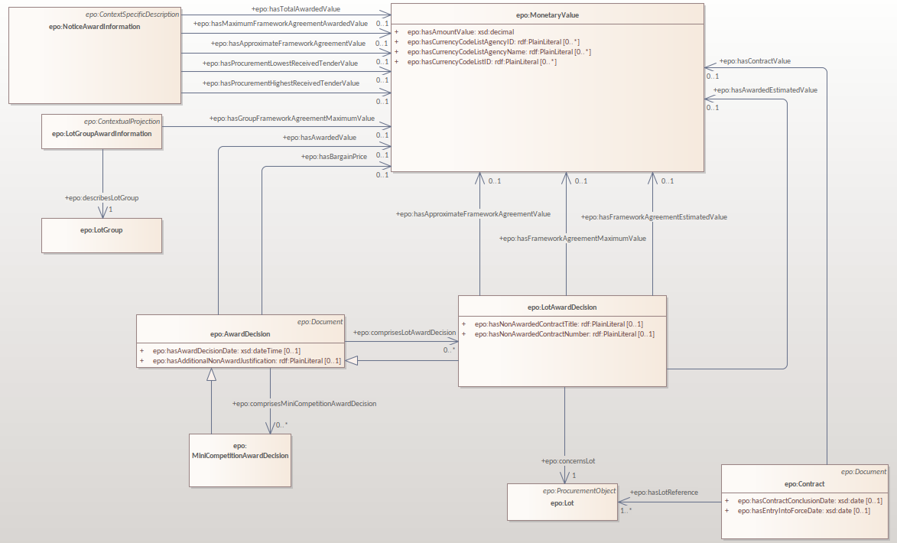
Monetary values

Slide 52
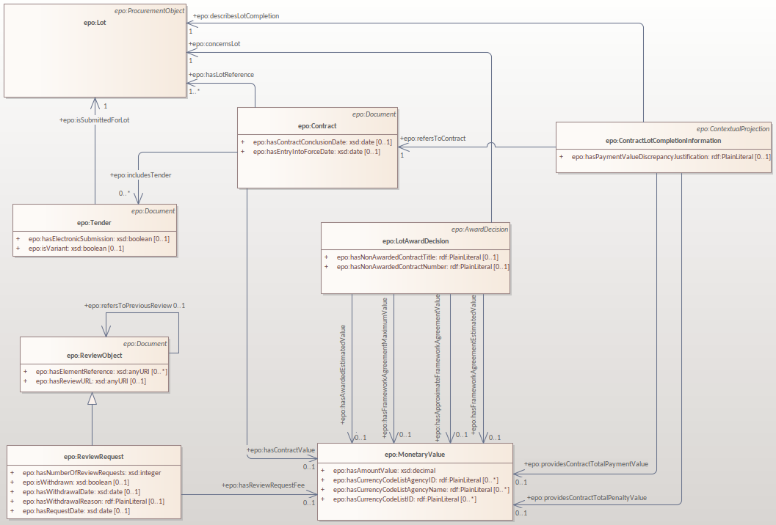
Monetary values

Slide 53
model2owl updates

Slide 54
model2owl updates
Updated the UML conventions and the related documents.​
Updated the transformation scripts based on the updates of the documentation:​
- Conventions checking ​
- OWL core generation​
- OWL restrictions generation​
- SHACL generation
Fixed the bugs and the technical debt:
- Implement automated testing
- Refactor code for modular organisation
- Fix handling of unknown prefixes
- Fix handling of multiple domains and ranges for a property
- Fix handling relations across modules
Migrated PDF documentation to AsciiDoc.

Slide 55
Plan for Q3 2023

Slide 56
Plan for Q3 2023
Preparing release candidate for ePO 4.0.0
Receiving feedback until mid of August (the sooner the better)
Feedback fixes for ePO 4.0.0 release
Preparing release of ePO 4.0.0 by end of September
GitHub issue follow-up
Completion of definitions
New module development:
- eAccess
- eSubmission

Slide 57
Planned releases

Slide 58
Planned releases
4.0.0
(September 2023)
4.1.0
(January 2024)
4.2.0
(May 2024)
4.0.0-rc.1
(July 2023)
4.1.0-rc.1
(November 2023)
4.2.0-rc.1
(March 2024)
Notes:
Change beta under the line

Slide 59
Open discussion

Slide 60
Meeting schedule
Regular ePO Working Group meetings:
- every Tuesday from 14:30 to 16:30 (EET)
- except for 11 July, 8 and 15 August
- meeting link
Specific ePO Working Group meetings:
- every other Thursday from 14:30 to 16:30 (EET)
- only on request during the months of July and August
- meeting link
Quarterly seminars:
- Thurs 7 September (afternoon)
- Tues 5 December (afternoon)

Slide 61
Feedback and questions
Looking forward to hearing from you.
Feedback and questions can be sent via:
GitHub issues: https://github.com/OP-TED/ePO/issues
or alternatively via:
Email: OP-EPROCUREMENT-ONTOLOGY@publications.europa.eu
Email: natalie.muric@publications.europa.eu

Slide 62
THANK YOU

