Slide 1
Maintenance and evolution of the ESPD-EDM Publications Office – C.3 ESPD-EDM Open User Community Meeting
11th June 2026

Slide 2
Due to the Data Protection Regulation, your name will not be published in the list of attendees of the meeting if you have an objection.
Objections can be sent during this meeting to OPESPD@publications.europa.eu

Slide 3
Table of contents
Summary OUC 2nd October 2025
GitHub status
ESPD-EDM v5.0.0 overview
Restructure of repositories
Validation improvements
Next steps
Next meetings & AOB

Slide 4
1. Summary OUC meeting on 2nd October 2025
ESPD-EDM v4.1.0
Subcriterion simplification
The relied upon entities
Evidence block moved at top level
GitHub status – open and closed tickets
Three tickets closed
Business Rules – new approach
Aligning with eForms Business Rules style
ESPD-EDM specific rules
Insights of an ESPD implementation - TED-together meeting 27-28th November 2025
Case study by Michaël DE WINNE, Federal Public Service Policy and Support (BOSA) – Belgium
Where to find?
Regular OUC meetings
docs.ted.europa.eu/espd-wgm/monthly
TED Together
op.europa.eu/en/web/ted-together 2025

Slide 5
2. ESPD-EDM - GitHub status – Closed issues (2)
Issue | Title of the issue | Scope
#431 | [Other]: Sole contractor / Lead entity in EORoleType.gc (2.1.1) appears to be deprecated after repo moved. | n/a
#356 | Inconsistency between eCertis and ESPD #interproc #356 | clarification

Slide 6
3. ESPD-EDM v5.0.0-EDM v5.0.0 overview (Paul)
ESPD-EDM model implemented in Enterprise Architect
https://github.com/OP-TED/espd-conceptual-model
Restructure of repositories
Code lists updated to align with eForms
Replacement of 'criterion' code list with 'exclusion-ground' and 'selection-criterion' code lists
Improvements to generation of validation code
Change of schema to UBL 2.4 as announced in 2025

Slide 7
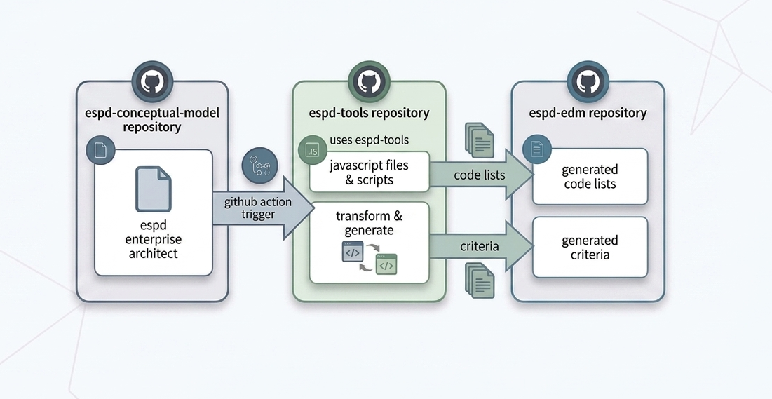
4. Restructure of repositories
ensures consistency
reduces duplication
makes future updates are much easier to manage
From conceptual model to implementation

Slide 8
4. Restructure of repositories
The espd-conceptual-model is the foundation — it defines the “what” as the single source of truth.
The espd-tools sits in the middle and provides reusable utilities.
The ESPD-EDM is the implementation layer. This is where the actual schemas, code lists, and artefacts get published in order to build the ESPD services.

Slide 9

5. Validation repository updates
The files in this repository are used to create the validation files in the ESPD-EDM repository
https://github.com/OP-TED/espd-validation-schematron
New Bash (Unix) Shell Script "validation-schematron.sh"
Equivalent of Windows MS-DOS script "validation-schematron.bat"
Runs in a bash shell window
Can be run on Windows, Macintosh, Unix computers

Slide 10

5. Validation repository updates
Updated schematron and XSLT files
Aligned with updated code lists for ESPD-EDM v5.0.0
Improved consistency of checks

Slide 11

5. Validation repository updates
Next steps – improved efficiency of process to update the code
Automated generation of all schematron from code lists
Improvements to readability of code
Checks on the order of Exclusion Ground and Selection Criterion questions automatically generated from the data model

Slide 12
6. Next steps
V5.0.0 release - Q3 2026
Data model in JSON format extracted from Enterprise Architect
New code lists
Restructure of repositories
Improved generation of validation code
UBL 2.4
Long term plan
Revamp of "relied-upon" block as agreed with DG GROW
Improved alignment with eProcurement Ontology and eForms as they evolve
UBL elements review - Other criteria

Slide 13
7. Next meetings & AOB
Bilateral meetings
Ad hoc
OUC meeting
Q4 2026 – merged with TED Together 2026
TED Together 2026
24th – 25th November 2026
Discover the TED 2026 event calendar – TED

Slide 14
Thank you FOR YOUR PRESENCE Any questions?
Please send your questions to
OPESPD@publications.europa.eu

