Slide 1


Maintenance and evolution of the ESPD EDM
Publications Office – C.3
ESPD Meeting OP-GROW with Open User Community (OUC)
28th April 2022

Slide 2
Due to the Data Protection Regulation, the list of attendees of the meeting will only be published if there are no objections from any of the participants.
Objections can be sent during this meeting to OPESPD@publications.europa.eu.

Slide 3
Table of contents
Summary of last meeting on 31st March 2022
Changes on the ESPD-EDM webpages
Code list DocRefContentType
GitHub issues
ESPD versions used
Next ESPD release
Next meetings
AOB

Slide 4
1. Summary of last meeting on 31st March 2022
Meeting report:
https://docs.ted.europa.eu/espd-ouc/20220331_OUC%20meeting%20report.html
Main topics:
Problem statement
Business requirements
Example of the current situation
Proposed solution

Slide 5
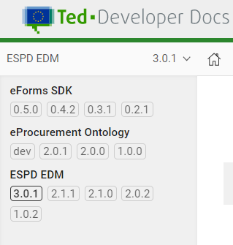
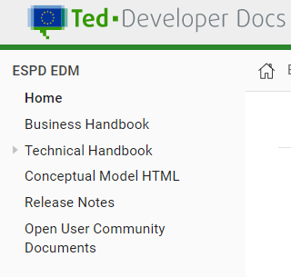
2. Changes on the ESPD-EDM webpages
For v3.0.1, lateral navigation menu has been updated:
Previous versions available through drop-down menus at the upper right corner of the screen and at the bottom of the navigation menu.
Links to eForms and EPO projects have been removed (still accessible from https://docs.ted.europa.eu/home/index.html).

Slide 6
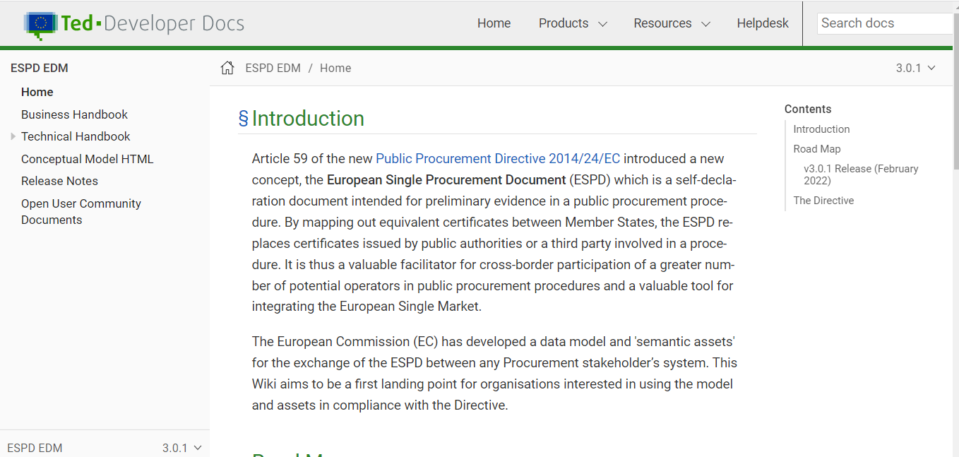
2. Changes on the ESPD-EDM webpages
ESPD EDM v3.0.1 webpage:
https://docs.ted.europa.eu/ESPD-EDM/3.0.1/index.html

Slide 7
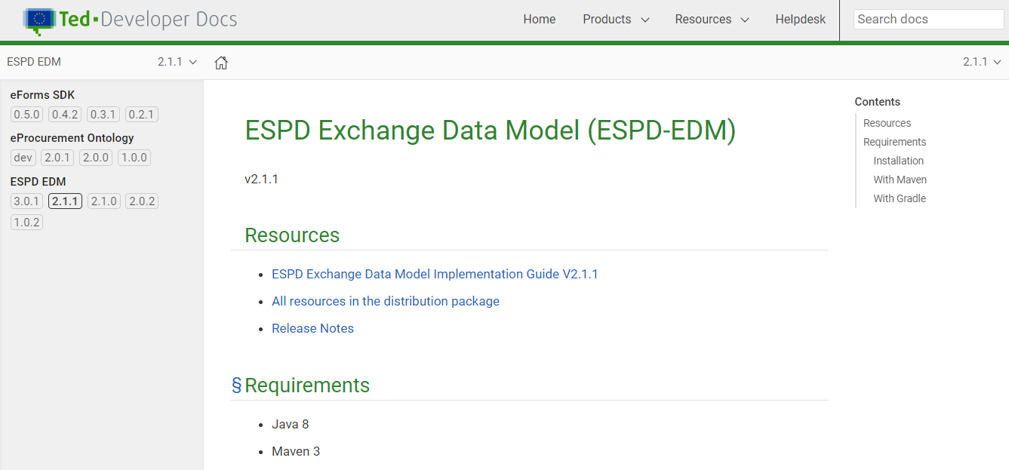
2. Changes on the ESPD-EDM webpages
Previous versions:

Slide 8
3. Code list DocRefContentType
Elements of the code list DocRefContentType:
Contract notice published in TED (Tenders Electronic Daily)
European Single Procurement Document Request issued by a CA
Letter of intent
Status of the legal entity
Notice of appointment of the persons authorised to represent the tenderer
VAT registration document
Identity document
Reason for VAT exemption
Subcontracting justification
Power of attorney
Contract notice published on a national government official journal
Contract notice published on a regional government official journal
Contract notice published on a local government official journal
Prior information notice published on a national government official journal
Prior information notice published on a regional government official journal
Prior information notice published on a local government official journal
Contract award notice published on a national government official journal
Contract award notice published on a regional government official journal
Contract notice published on a local government official journal
Prior information notice published in TED (Tenders Electronic Daily)
Other
Is this code list or any of its elements being used?

Slide 9
4. GitHub issues
Closed issues (7 issues)
Issue | Title of the issue
326 | Question of type EVIDENCE_IDENTIFIER with different cardinality
324 | ProfileID version
323 | C#59 - QUESTION of type CODE without the code list
322 | data misplacement for Criteria #52 and #53 in ESPD-criterion-V3.0.0.xlsx
321 | Questions about LOT management elements in ESPD EDM v3.0.0/v3.0.1 draft
319 | Evidences External Reference URI
196 | schemeID e schemeAgencyID

Slide 10
4. GitHub issues
Currently open issues (10 issues)
Issue | Title of the issue
330 | Compulsory attributes of the code elements (datatype=Code)
329 | Wording/Spelling issues in the technical handbook v3.0.1
328 | Cardinality issue for the element cac:ProcurementProjectLotReference/cbc:ID
327 | Groups with same UUID and different cardinality
325 | Incorrect element code in ESPD-criterion.xlsx v3.0.1 for Criterion #27
320 | Duplicate "Question Group UUID" in the same Criterion and the Question Groups have different structures
312 | Question on UUID for Repeatable Question Sub Group
307 | New Code list 'occupation'
287 | Part IV: Selection criteria, C: Technical and professional ability (CA`s)
251 | Link eCertis and ESPD

Slide 11
5. ESPD versions used
Version | Countries*
v1 | Austria (AT) Belgium (BE) Bulgaria (BG) Czechia (CZ) Germany (DE) Denmark (DK) Greece (EL) France (FR) Croatia (HR)
v2 | Austria (AT) Germany (DE) Denmark (DK) Estonia (EE) Greece (EL) España (ES)
v3
Hungary (HU)
Ireland (IE)
Lithuania (LT)
Luxembourg (LU)
Latvia (LV)
Malta (MT)
Netherlands (NL)
Norway (NO)
Poland (PL)
Sweden (SE)
Slovenia (SI)
Slovakia (SK)
Finland (FI)
Italy (IT)
Latvia (LV)
Malta (MT)
Portugal (PT)
Romania (RO)
*Source: https://webgate.ec.europa.eu/fpfis/wikis/pages/viewpage.action?spaceKey=EPROC&title=eProc+Matrix+mid-2021

Slide 12
6. Next ESPD release
New metadata validation rules for technical code lists
Validation of all mandatory fields
Use of ESCO occupation codes as genericodes in EU Vocabularies
Update of online documentation
Removal of external references from online documentation and release files
Fixes related to issues

Slide 13
7. Next meetings
Next OUC meetings:
June 16th, 10.00 – 11.30
September 22nd, 10.00-11.30

Slide 14

8. AOB
Questions
Please feel free to send any questions you have to
OPESPD@publications.europa.eu

Slide 15
Thank you!

