Slide 1
Income Inequality Near Universities
Do UNIVERSITY AREAS HAVE A HIGH-INCOME DISPARITY?
Notes:
aaron

Slide 2
introductions
Austin Calvo: Graphs
Aaron DeVore: Introduction and datasets
Paul Serna: Graphs
Chloe Valverde: Conclusions
Notes:
aaron

Slide 3
Proposal
We hypothesize that the zip codes containing prestigious universities will have higher levels of income disparity than those that are randomly selected.
Notes:
aaron

Slide 4
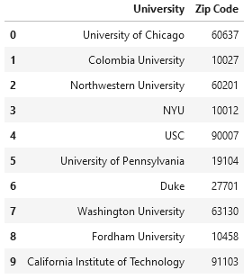
Raw datasets
Dataset of 10 random universities and their zip codes

Slide 5
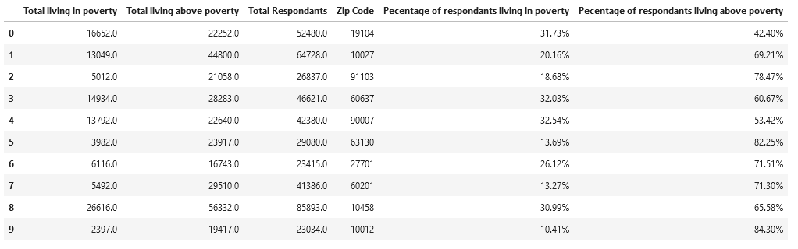
Raw dataset
Dataset of university and their adjacent zip-codes poverty level

Slide 6
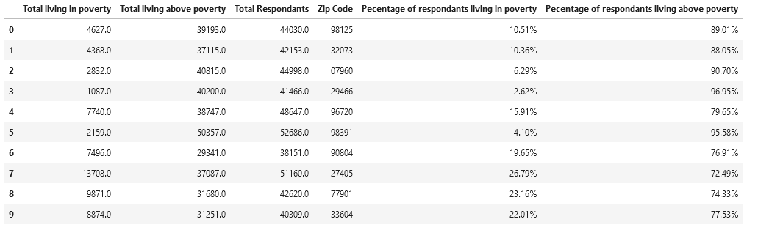
Raw dataset
Dataset of poverty level of random zip codes

Slide 7
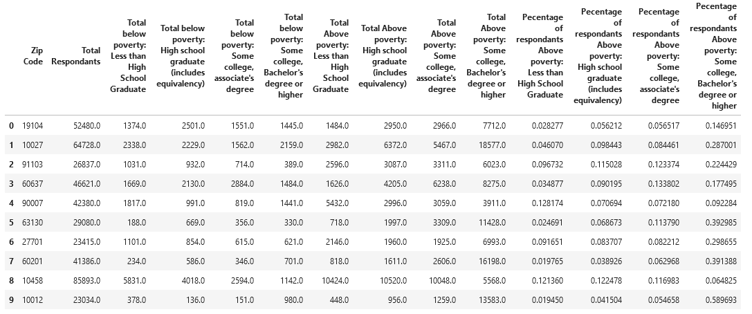
Raw dataset
Dataset of education levels with their respective poverty rates of adjacent zip-codes

Slide 8
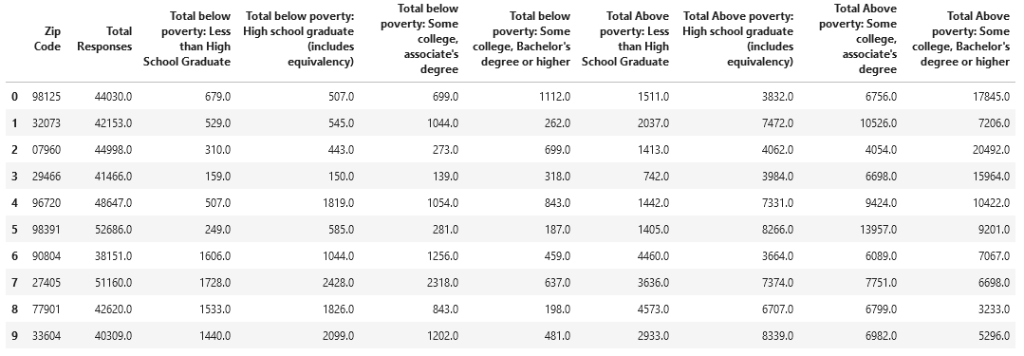
Raw dataset
Dataset of education levels with their respective poverty rates of random zip-codes

Slide 9
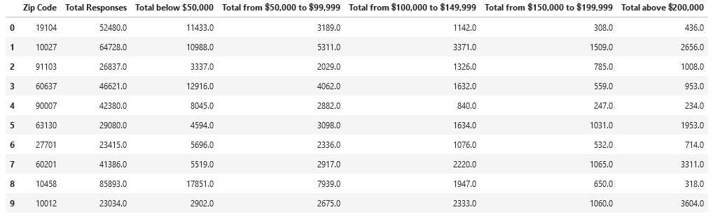
Raw dataset
DATASET OF WEALTH BRACKETS OF adjacent ZIP-CODES

Slide 10
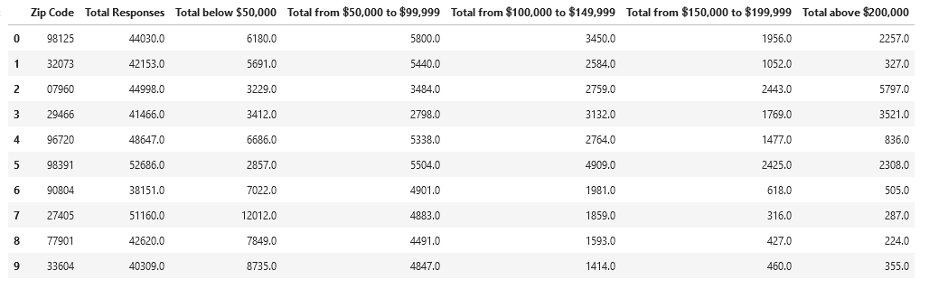
Raw datasets
Dataset of wealth brackets of random zip-codes

Slide 11
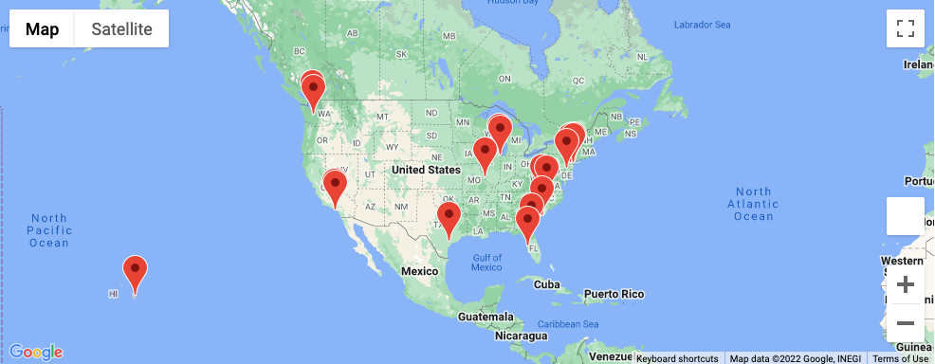
LOCATION MAP OF RANDOM CITIES USED
Notes:
Aaron last

Slide 12
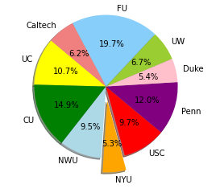
Poverty level of universities
Respondents of each university zip-code.

Slide 13
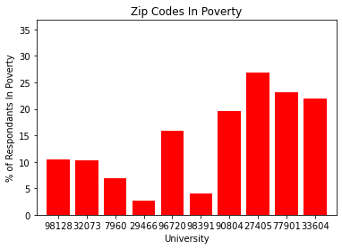
Map of poverty level of random zip-codes
Poverty level of randomly selected zip-codes

Slide 14
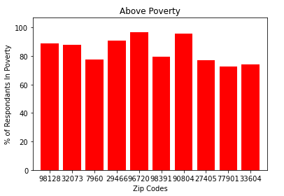
Random zip-codes above poverty

Slide 15
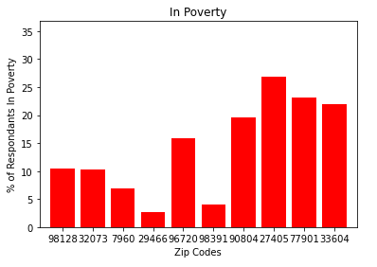
Comparing Poverty levels of random zip-codes
Notes:
Paul last

Slide 16
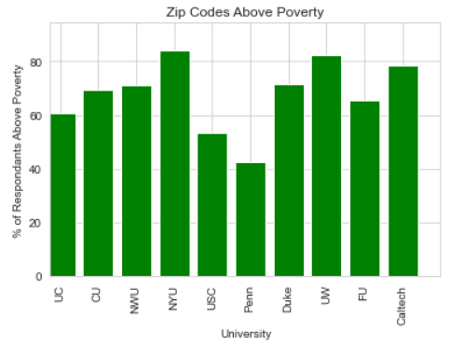
University zip-codes vs random zip-codes
Zip-codes of that live above poverty in both random samples and university zip-codes.
Notes:
Austin first

Slide 17
Chart of Above Poverty level Near University
Bar chart of above poverty level near universities.

Slide 18
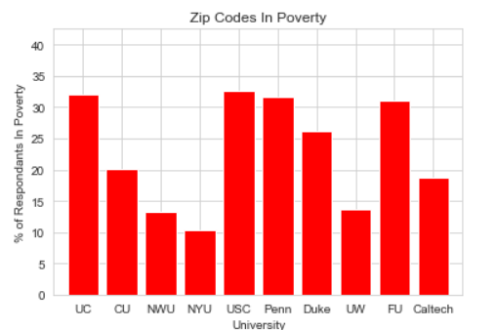
Map of poverty near universities
Poverty near universities.

Slide 19
Comparisons of Maps above and below poverty

Slide 20
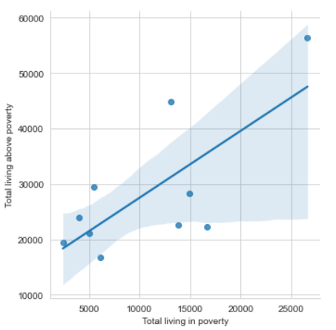
Wealth equality
When wealth rises, poverty also rises.

Slide 21
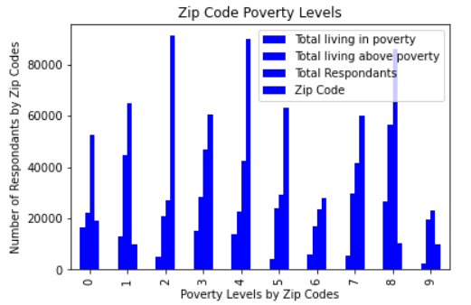
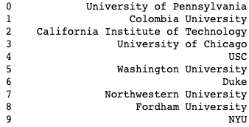
Zip code poverty levels
Notes:
Austin end

Slide 22
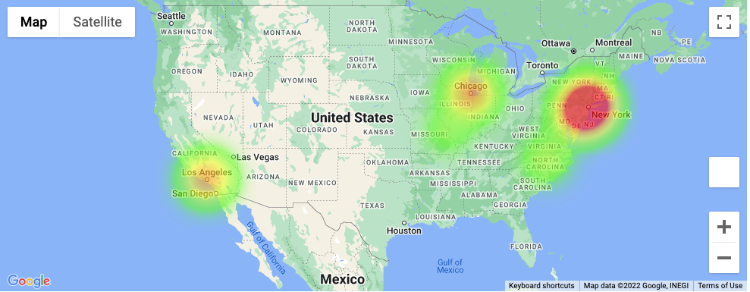
HEAT MAP OF poverty near UNIVERSITIES
Notes:
Conclusion :chloe

Slide 23
Results
The main questions
Answers
What are the areas with the greatest levels of disparity?
Which area has the greatest poverty?
Do education levels differ between zip codes containing these Universities and the randomly selected zip codes?
California has the highest rate of wealth disparity.
California has the greatest amount of poverty.
The education levels widely differ between the zip-codes.

Slide 24
Conclusions
When wealth increases, so does the poverty levels.
The disparity grows anytime wealth grows.
If a person lives near a university, they are more likely to be in poverty due to the high cost ares surrounding the universities.
If you want to go to a highly ranked university, expect to see a large amount of poverty near them.
Notes:
Chloe end

Slide 25
Citations
https://www.census.gov/programs-surveys/saipe/data/api.html
https://www.census.gov/data/developers/data-sets/acs-5year/2020.html
https://developers.google.com/maps
https://developers.google.com/maps/documentation/javascript/tutorials
https://pandas.pydata.org/
https://matplotlib.org/

