Slide 1

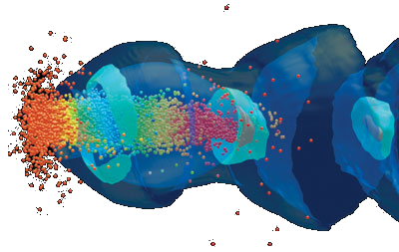
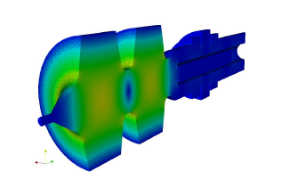
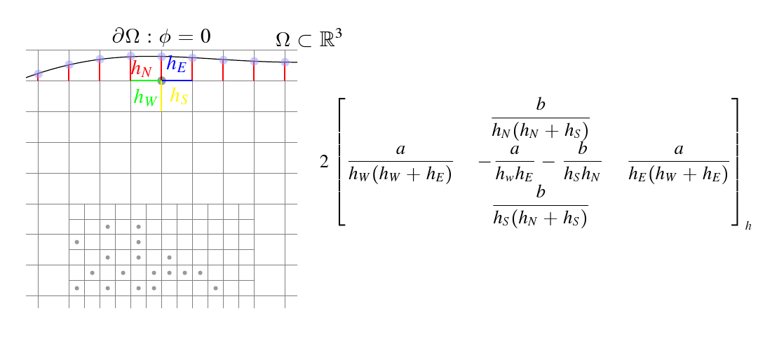
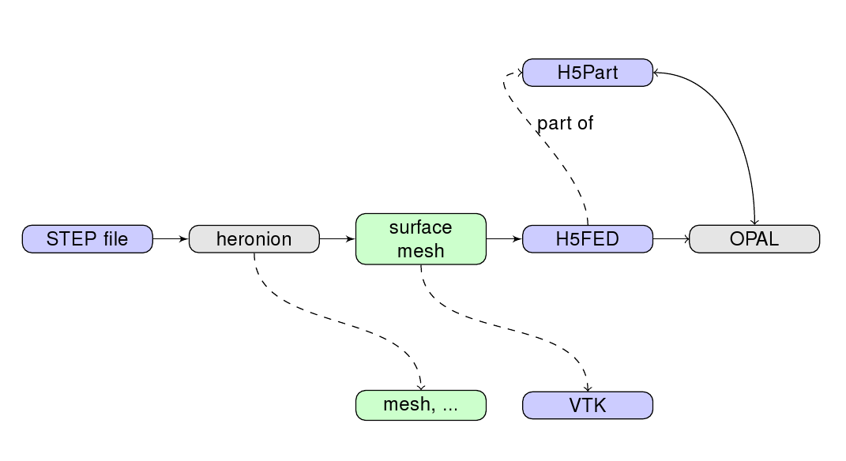
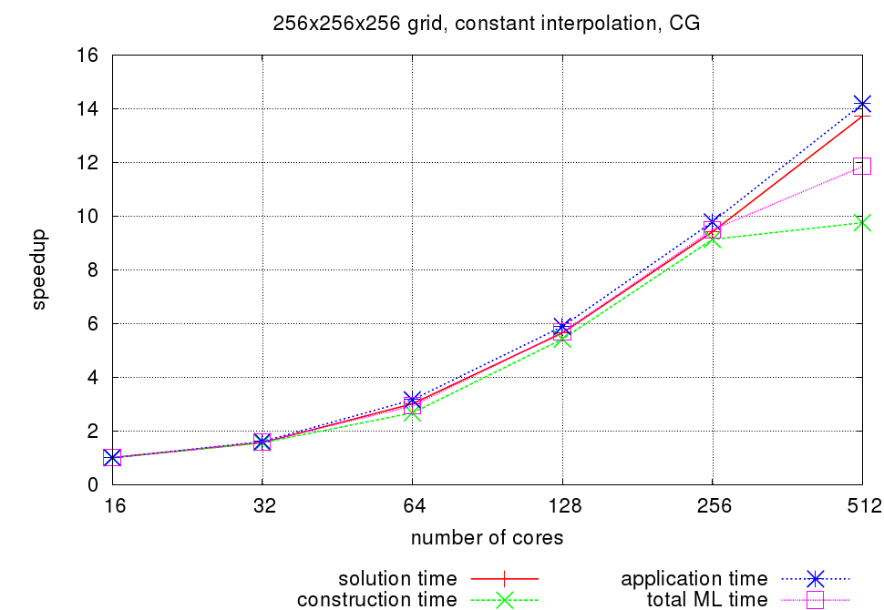
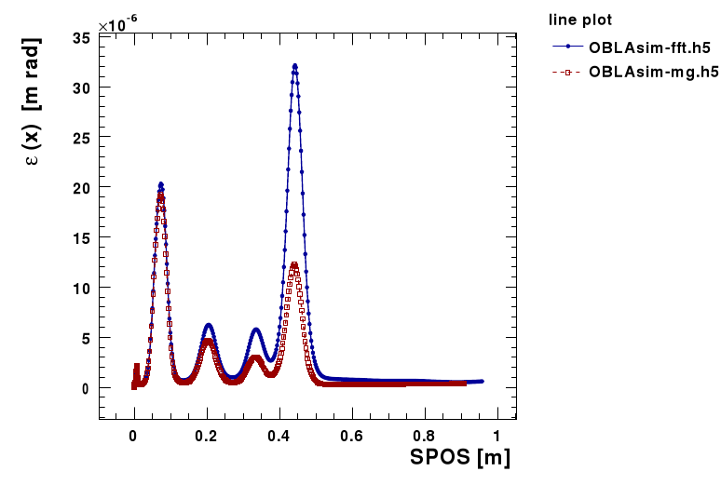
A Fast Parallel Poisson
Solver for Beam Dynamics
A. Adelmann¹, P. Arbenz², Y. Ineichen²
¹ Paul Scherrer Institut, PSI — ² ETH Zuerich
Space-Charge in the Electrostatic Approximation
Electric field caused by Coulomb repulsion
Magnetic field arising from moving particles
Lorentz transformation to obtain a electrostatic problem
Arising Poisson equation:
The electric field from electrostatic potential:
The magnetic field is calculated from the electric field by the inverse Lorentz transformation
P
I
C
Direct Solver (FFT)
Iterative Solver (Preconditioned CG)
Interpolate particle charges to a grid
Solve Poisson equation in Lorentz frame
O(n log n)
CIC interpolation with IPPL[1] providing: parallel fields, particle representation, operators on fields
Convolution with Green's function
Integrated Green's function
Shifted Green's function for image charge at cathode
Rectangular domain with free-space boundary conditions
Fast solver
State of the art method
Implemented and tested in late 2007
AMG preconditioned CG solver
Anisotropic grid in z-direction
Elliptic and arbitrary bounded domains with Dirichlet (PEC) and Robin boundary conditions
Increase accuracy of simulation
Reuse solution of previous time-step
A
M
G
Decoupled aggregation
Polynomial smoother
LU based direct solver
O(n) algorithm
Implemented with Trilinos[2] packages: ML, Amesos, AztecOO, Epetra
Implementation reuses solution of previous time-step
Added an interface between IPPL and Epetra
Reusing aggregation hierarchy
Multigrid V-Cycle Algorithm
Aggregation
1:procedure MultiGridSolve(Al,bl,xl,l)
2: if l = maxLevel-1 then
3: DirectSolve Alxl = bl
4: else
5: xl ← Sl^{pre}(Al,bl,0)
6: rl ← bl-Alxl {calculate residual}
7: bl+1 ← Rlrl {restriction}
8: vl+1 ← 0
9: MultiGridSolve(Al+1,bl+1,vl+1,l+1)
10: xl ← xl + Plvl+1 {coarse grid correction}
11: xl ← Sl^{post}(Al, bl, xl)
12: end if
13:end procedure
Convert discretization matrix into graph
Assign each vertex to one aggregate
Tentetative prolongator operator matrix
is formed:
Improve robustness by smoothing the tentative prolongator operator
B
C
Various discretization approaches O(h) and O(h²)
Depending on boundary approximation: non- symmetric discretization matrix
Workflow for arbitrary boundary geometries from STEP geometries to H5fed[3] files
Efficient intersection of grid-lines with triangulated surface mesh[4]
Boundary Problem
Shortley-Weller Approximation[5]
Workflow
is the surface of an elliptic or arbitrary beam-pipe
base areas at beginning and end of domain in z
d is the distance of the bunches centroid to the boundary
Depending on boundary approximation the resulting discretization matrix is non-symmetric
R
E
S
U
L
T
S
Speedup
MG vs. FFT solver
Solver integrated into OPAL[6]
Parallel in all directions
Roughly 50% efficiency
Validated against analytical solution
New boundary condition result in reduced space- charge effects
FFT solver 1.8x faster at the moment (MG on an elliptic bounded domain)
Small coarse level problem needs a lot communication
Iterative coarse level solver: problem is dense, limit number of iterations
We currently investigate differences between FFT and MG solver with respect to space-charge effects
References
[1] IPPL (Independent Parallel Particle Layer), Paul Scherrer Institute, http://amas.web.psi.ch/tools/IPPL
[2] Trilinos, Sandia National Laboratory, http://trilinos.sandia.gov
[3] Benedikt Oswald and Achim Gsell, H5fed, http://h5part.psi.ch
[4] T. Moeller and B. Trumbore, Fast, minimum storage ray/triangle intersection. Journal of Graphics Tools, 2(1):21–28, 1997
[5] G.H. Shortley and R. Weller, The numerical solution of Laplace’s equation, Journal of Applied Physic, 9:334–344, 1938
[6] OPAL (Object Oriented Parallel Accelerator Library), PSI-PR-08-02, Paul Scherrer Institute, http://amas.web.psi.ch/tools/OPAL
Last update on 30.11.2008

