Slide 1

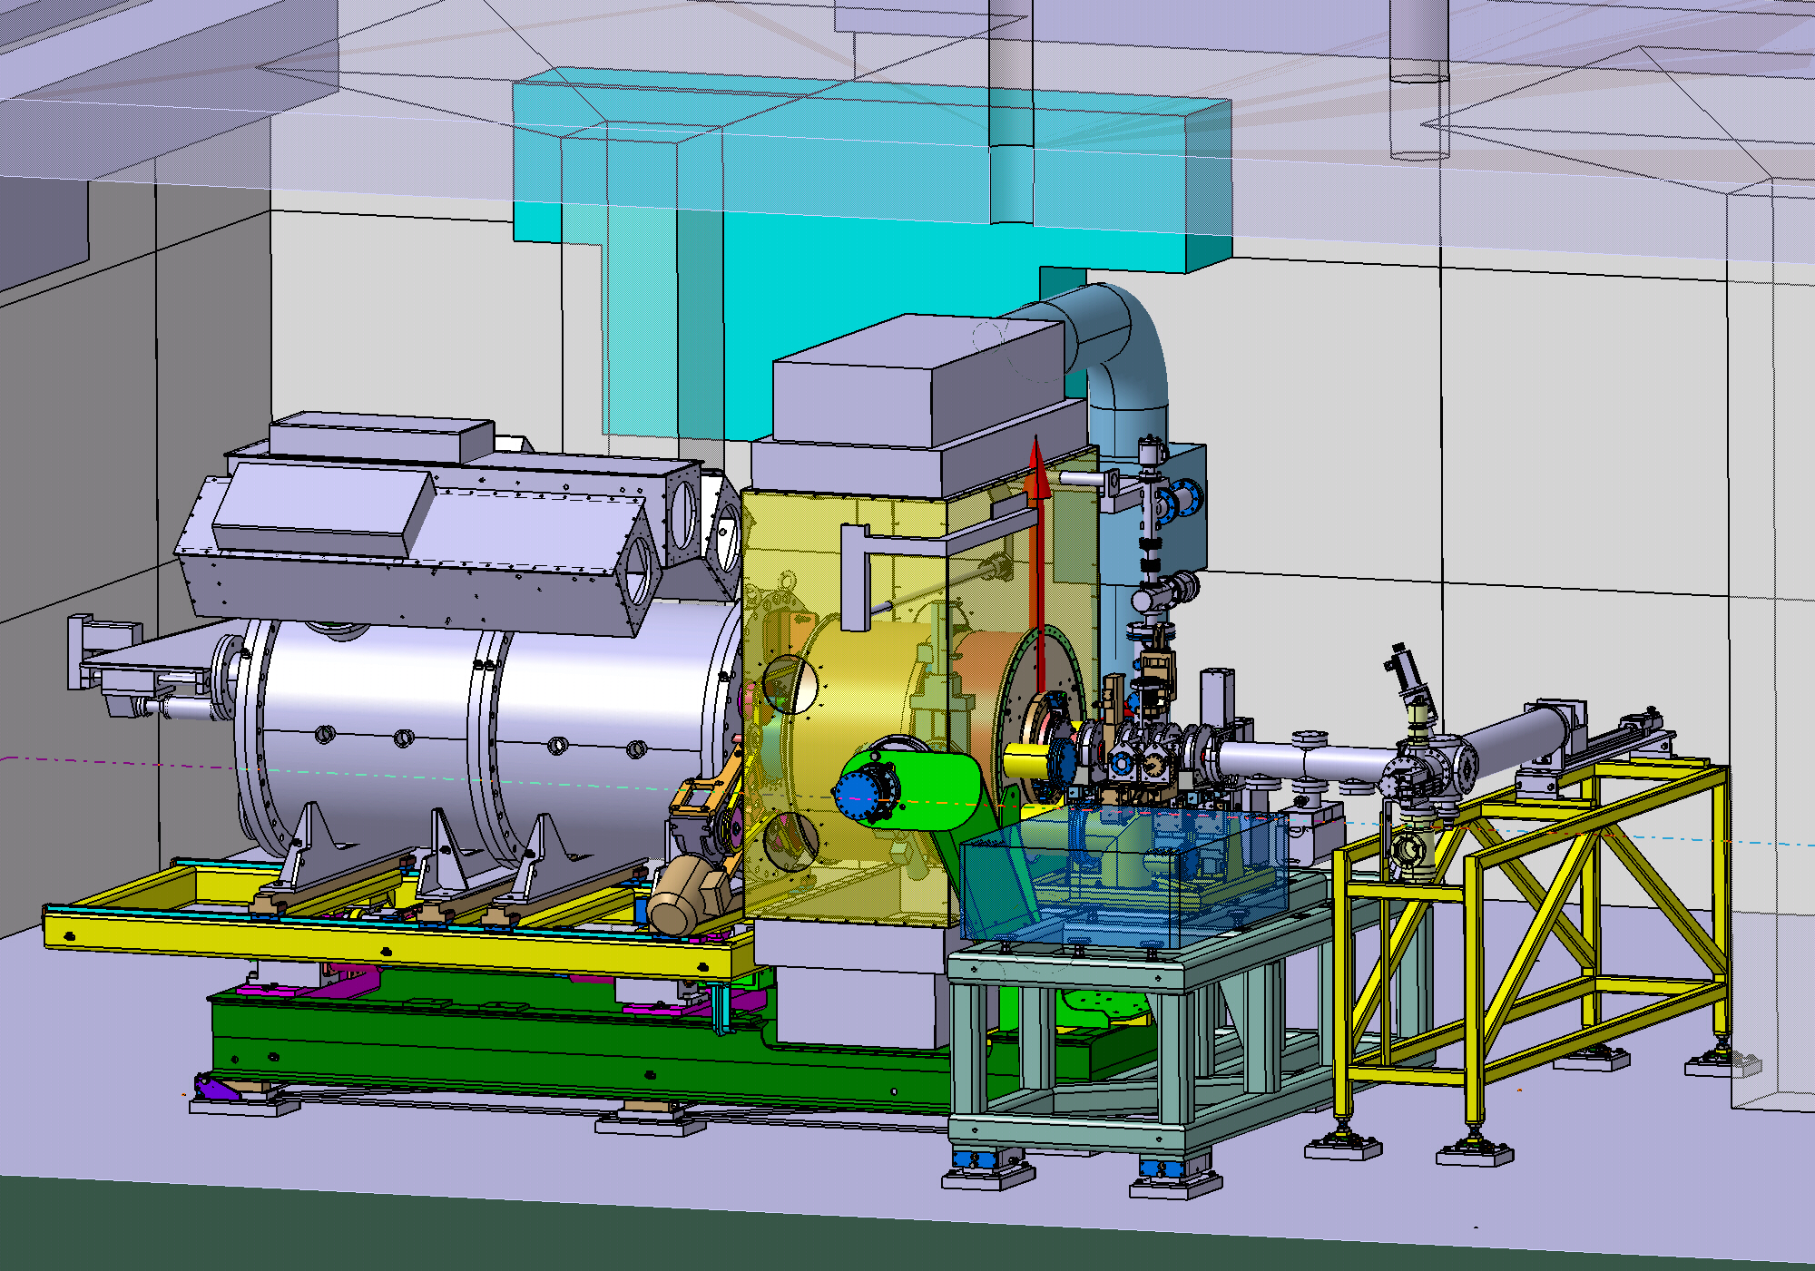
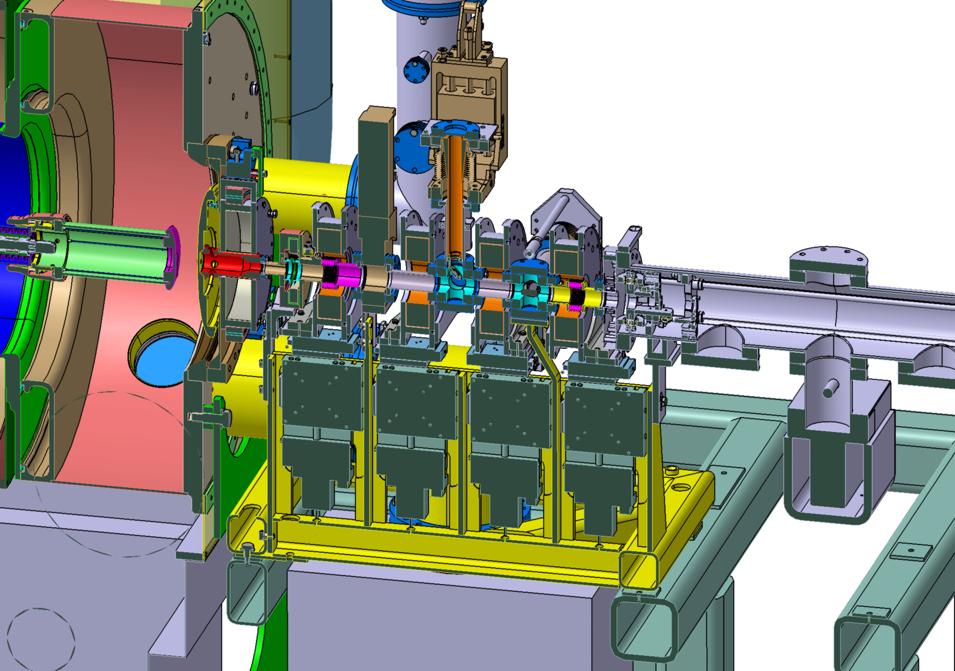


The Object Oriented Parallel Accelerator Library (OPAL)
A. Adelmann, S. Binder, Ch. Kraus, Y. Ineichen, T. Schietinger, S. Russell* and J.J. Yang**
Paul Scherrer Institut, CH-5232 Villigen PSI, Switzerland
*Los Alamos National Laboratory, Los Alamos, NM 87545
** China Institute of Atomic Energy, Beijing, 102413
Abstract
OPAL (Object Oriented Parallel Accelerator Library) is a tool for charged-particle optics calculations in accelerator structures and beam lines including 3D space charge, short range wake-fields and a 1D coherent synchrotron radiation. Built from first principles as a parallel application, OPAL admits simulations of any scale, from the laptop to the largest HPC clusters available today. Simulations, in particular HPC (High Performance Computing) simulations, form the third pillar of science, complementing theory and experiment. In this paper we present numerical and HPC capabilities such as fast direct and iterative solvers together with timings for OPAL production runs. The application of OPAL to our PSI-XFEL project will demonstrate the versatile capabilities OPAL.
Features of OPAL
Architecture of OPAL
Time-dependent 3D parallel particle tracking code
In Version 1.1.5 two flavors:
    OPAL-t – linac's (SW & TW structures), beamlines, emission w. thermal emittance
    OPAL-cycl – compact and separate sector Cyclotrons
Built from the ground up as a parallel application runs on the laptop as well as on
the largest HPC clusters (Cray XT3/4/5, IBM BG/L/P)
MAD input language
Collective effects
    space charge (3D solver: direct FFT based & iterative SA-AMG PCG),
    coherent synchrotron radiation (1D solver)
    longitudinal and transverse wake fields
OPAL is based on several frameworks, it is object oriented, and follows the ideas of design pattern. The data parallel ansatz is provided by IP²L (Independent Parallel Particle Layer), the particle accelerator physics is encapsulated in CLASSIC (Class Library for Accelerator Simulation System and Control). The parallel I/O is based on H5Part derived from parallel HDF5. Linear solvers are provided by Trilinos.
Parallel Efficiency (Production Run)
Space-charge solver based on integrated Green function (similar
to IMPACT-T) We track 10⁶ macro-particles (Gauss distributed) on
64×64×64 mesh for 200 time steps. Dynamic load balancing and
output every 10th time step.
Code Validation
We have carefully benchmarked the
code against IMAPACT-T and found very
good agreement. Compared elements:
emission including energy binning,
standing and travelling wave structures,
quadrupole and solenoid. Representative
for the benchmarks: in a C-shaped
compressor (as been foreseen in the
PSI-XFEL), the z-component of the
electric field of a CSR-Wake and the
corresponding 1D line density is shown.
Example: Input File for a Phase Scan
PSI-XFEL low-emittance electron source
This is a hard calculation, scanning the phase in 2 degree steps with (energy binned) emission and full 3D space charge.
Such calculations are only possible with parallel computing!
OPAL is currently being used to model the low-emittance electron source test stand
developed and operated in the context of the PSI-XFEL project. The electron source consists of an adjustable diode configuration subject to pulses of 250 ns (FWHM)
with amplitude up to 500 kV from an air-core transformer-based high-voltage pulser.
Execute Unix commands.
Execute Unix commands.
MSL10
Telescope (TS)
Option, SCAN=TRUE;
SYSTEM,"touch EvsPhase.dat";
Title,string="OBLA 4 MeV Gun and Beam";
Edes=1.0E-9;
gamma=(Edes+EMASS)/EMASS;
beta=sqrt(1-(1/gamma^2));
gambet=gamma*beta;
P0 = gamma*beta*EMASS;
brho = (EMASS*1.0e9*gambet) / CLIGHT;
phi = 0;
v0 = beta * CLIGHT;
TRise = 0.7e-12; TFall = 0.7e-12;
TFlatTop = 9.9e-12 - TRise * sqrt(log(4)) - TFall * sqrt(log(4));
lzRise = TRise * v0; lzFall = TFall * v0;
lzFlatTop = TFlatTop * v0;
Dist1:DISTRIBUTION, DISTRIBUTION = gungaussflattop,
sigmax = 0.000540, sigmapx = 0.0, corrx = 0.0,
sigmay = 0.000540, sigmapy = 0.0, corry = 0.0,
sigmat = lzFlatTop, pt = 1.0, sigmapt = 0.0, corrt = 0.0,
risetime = lzRise, falltime = lzFall, flattoptime = lzFlatTop,
TEMISSION = 30.0e-12, NBIN = 10, DEBIN = 30;
Fs1:FIELDSOLVER, FSTYPE=FFT, MX=32, MY=32, MT=64,
PARFFTX=true, PARFFTY=true, PARFFTT=true,
BCFFTX=open, BCFFTY=open, BCFFTT=open,
BBOXINCR=1, GREENSF=INTEGRATED;
beam1: BEAM, PARTICLE=ELECTRON, pc=P0, NPART=10, BCURRENT=0.2997912, BFREQ=1498.956e6, CHARGE=-1;
while (phi < 360) {
gun: RFCavity, L=0.008, VOLT=-98.954, FMAPFN="1T1.T7", ELEMEDGE=0.00,
TYPE="STANDING", FREQ=1.0e-6;
psl: Solenoid, L=0.12, ELEMEDGE=0.0, FMAPFN="1T2.T7", KS=0.2;
rac: RFCavity, L=0.54, VOLT=35.5, FMAPFN="1T3.T7", ELEMEDGE=0.103,
TYPE="STANDING",FREQ=1498.956e6,LAG=phi*RADDEG;
sl10: Solenoid, L=1.00, ELEMEDGE=0.334, FMAPFN="1T5.T7", KS=0.133;
sl11: Solenoid, L=1.00, ELEMEDGE=0.434, FMAPFN="1T5.T7", KS=-0.133;
sl20: Solenoid, L=1.00, ELEMEDGE=0.834, FMAPFN="1T5.T7", KS=0.08;
sl21: Solenoid, L=1.00, ELEMEDGE=0.934, FMAPFN="1T5.T7", KS=-0.08;
l1: Line = (gun,psl,rac,sl10,sl11,sl20,sl21);
Select, Line=l1;
track,line=l1, beam=beam1, MAXSTEPS=1600, DT=1.0e-12;
run, method = "PARALLEL-T", beam=beam1, fieldsolver=Fs1, distribution=Dist1;
Endtrack;
phi = (phi+2);
SYSTEM,"grep Emean OBLA4sim-OPAL.out > t";
SYSTEM,"tail -1 t >> EvsPhase.dat";
}
Quit;
with counter-coil MSL10C
YAG1 screen
YAG screen
(FSC = YAG2)
Calculations in OPAL
Pulser
WCM
MSL20
MSL30
MSL40
MSL50
Pepper- pot PPT
Faraday Cup
e– beam
Emission (Gauss 3D) with 10 energy bins and specially defined rise and fall time.
Laser
Emission (Gauss 3D) with 10 energy bins and specially defined rise and fall time.
Overview of the facility
Detail of the beamline with solenoids
The variable phi is changing (0,2,4 … 360) and used to define the phase for the tracking.
Final energy is extr-acted from the output file and added to EvsPhase.dat.
Comparison of OPAL simulation results (solid and dashed lines) with measurements (points with error bars). Note that the simulated emittance does not include contributions due to thermal emittance at
the cathode.

