Slide 1
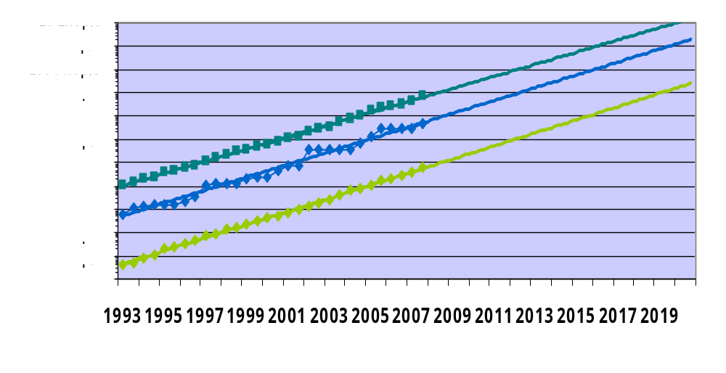
Performance Development & Projections
1 Exaflop/s
1 Pflop/s
Notebook
Source: H. Meuer, http://www.top500.org/files/TOP500_Looking_back_HWM.pdf
Page <number>
April 22, 2008

