Slide 1
Parameters used
Electron energy 245.0 MeV
Number of electrons 1.250 10¹⁰
Rms bunch length 0.600 mm
Repetition frequency 100. Hz
Normalized emittance 2.493 μm
Geometric emittance 5.200 nm
Beta at IP 0.727 mm
Rms beamsize at IP 1.94 μm
Disruption parameter 11.66
Geometric ee luminosity 3.29E+28 1/cm2s
Number of macro-particle s 400000
In the simulation the bunches have longitudinal Gaussian distribution cut at 3 σ_{z}

Slide 2
Test Particles
Test particles are not the output of BW process. They are artificially put at appropriate timing during the simulation.
12 test particles are inserted
6 e+e- pairs, right-going
With E=2m_{e}, x/σ_{x} = 1.0, x’=y=y’=0,
z=0 (bunch center)
spin=(0,0,1)
Timing at t/σ_{z} = -1.5, -1.0, -0.5, 0, 0.5, 1.0
Therefore, t/σ_{z} = -1.5 means the moment the test particle touches on-coming bunch edge
1.5σ_{z}

Slide 3
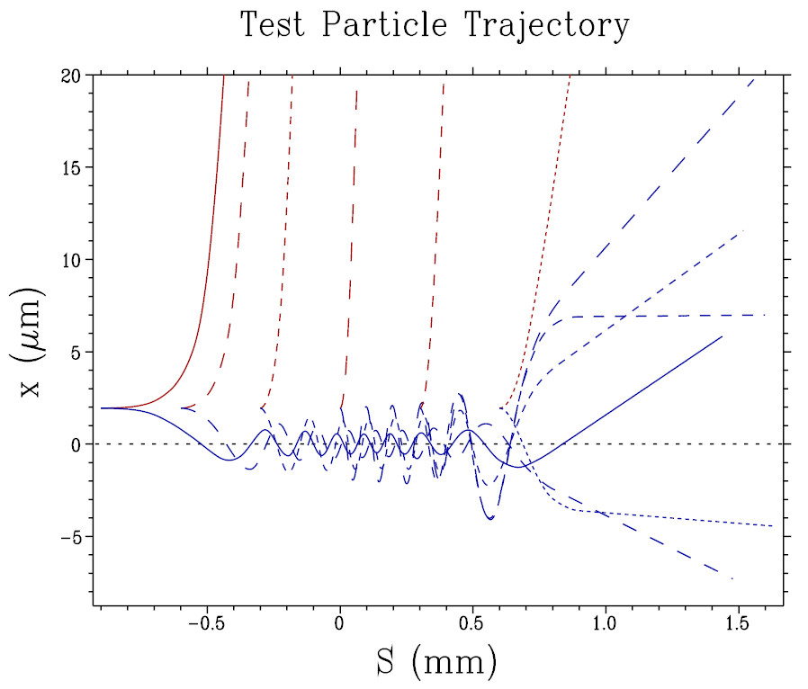
Red: electron
Blue: positron

Slide 4
File Format
File name = TestParticleOrbit.dat
The first line is like
----- Test particle Te-1 KIND=2 -----
‘Te-1’ is the name of test particle
KIND = 2 (e-), 3 (e+). This number is at 31st column
Data lines follow. Each line consists of 11 numbers
t, x, y, s in meter
E, Px, Py, Ps in eV or eV/c
Sx, Sy, Ss spin component

