Slide 1
OPAL Status – 1.1.6
Andreas Adelmann
for the OPAL development team:
Ch. Kraus (PSI), Y. Ineichen (PSI/IBM),
S.Russell (LANL) Y. Bi and J.Yang (CIAE)
ASTRA simulations A. Oppelt
On felsim: On Rosa (CSCS):
module load opal-1.1.5 export PATH=~adelmann/bin:$PATH
~adelmann/bin/opal-pre1.1.6
module load opal-1.1.6 – next week !

Slide 2
Auto-Phasing
// set autophasing flag or comment this line
AUTO = 0;
CTF3_phi= 0;
FINSB01_RAC_phi= 0;
FINSB02_RAC_phi= 0;
if (AUTO==1) {
Option, AUTOPHASE=TRUE;
} else {
call, "ctf3-ap.phases";
}
ctf3-ap.phases is generated
One core only please !

Slide 3
Auto-Phasing cont.
CTF3: RFCavity, L = 0.34986, VOLT = 100., FMAPFN = "CTF3.T7",
ELEMEDGE = -0.17493, TYPE = "STANDING", FREQ = 2997.912,
LAG = CTF3_phi + xxx ;
Dist2:DISTRIBUTION, DISTRIBUTION=fromfile, FNAME="ReferenceParticles.dat";
Usually one particle with coordinate (0,0,0)

Slide 4
Auto-Phasing cont.
if (AUTO==1) {
track, line=l1, beam=beam1, MAXSTEPS=1000000, DT=5.0e-14, ZSTOP=12.95;
run, method = "PARALLEL-T", beam = beam1, fieldsolver = Fs1,
distribution = Dist2;
endtrack;
} else {
track, line=l1, beam=beam1, MAXSTEPS=1000000, DT=1.41e-13, ZSTOP=0.18;
run, method = "PARALLEL-T", beam = beam1, fieldsolver = Fs1,
distribution = Dist1;
endtrack;
}
OPAL: E= 6.6244 (MeV)
ASTRA: E= 6.624 (MeV)
250 MeV Injector Phase 1 – but do not understand the difference in the field maps

Slide 5
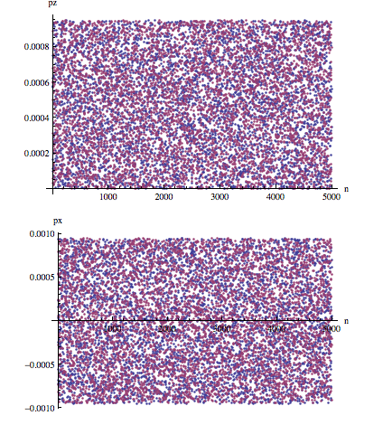
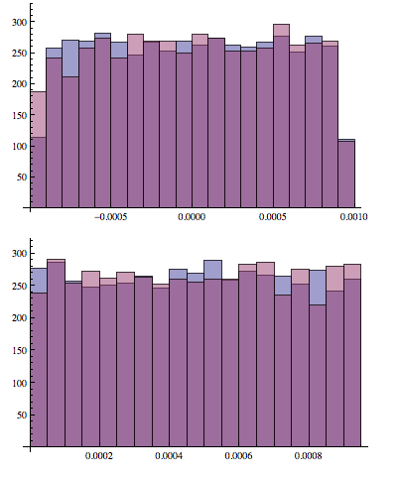
Initial Conditions
Thermal Emittance based on the Astra Model with A. Oppelt & B. Beutner
==>help, Distribution;
+1 help, Distribution;
OPAL >
OPAL > The DISTRIBUTION statement defines data for the 6D particle distr.
Attributes:
OPAL > string DISTRIBUTION Distribution type: … GUNGAUSSFLATTOPTH ...
OPAL and ASTRA
pz
z
px
x

Slide 6
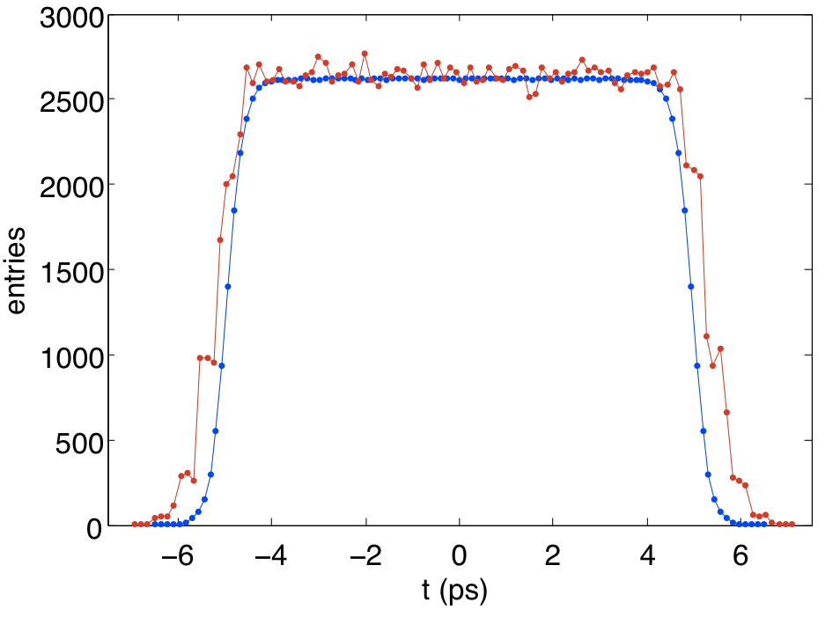
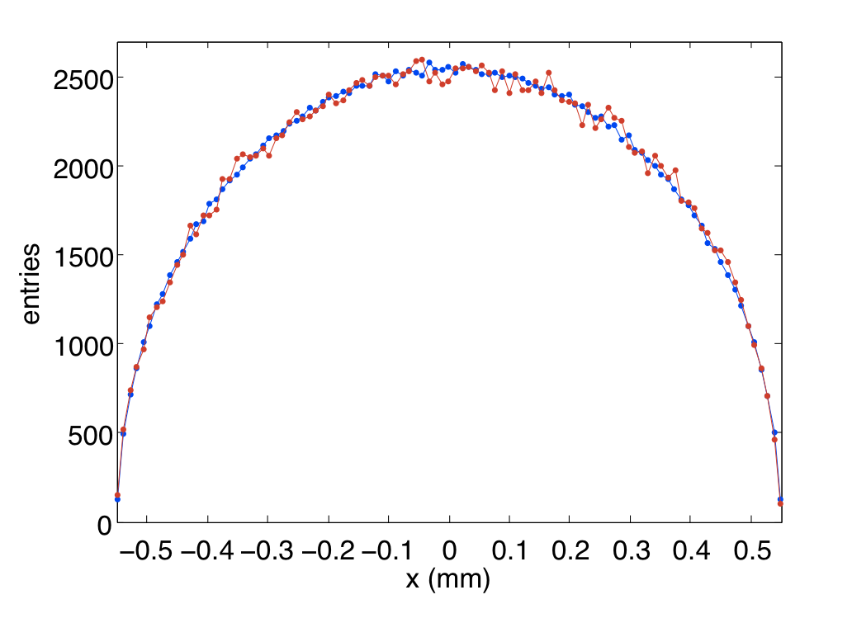
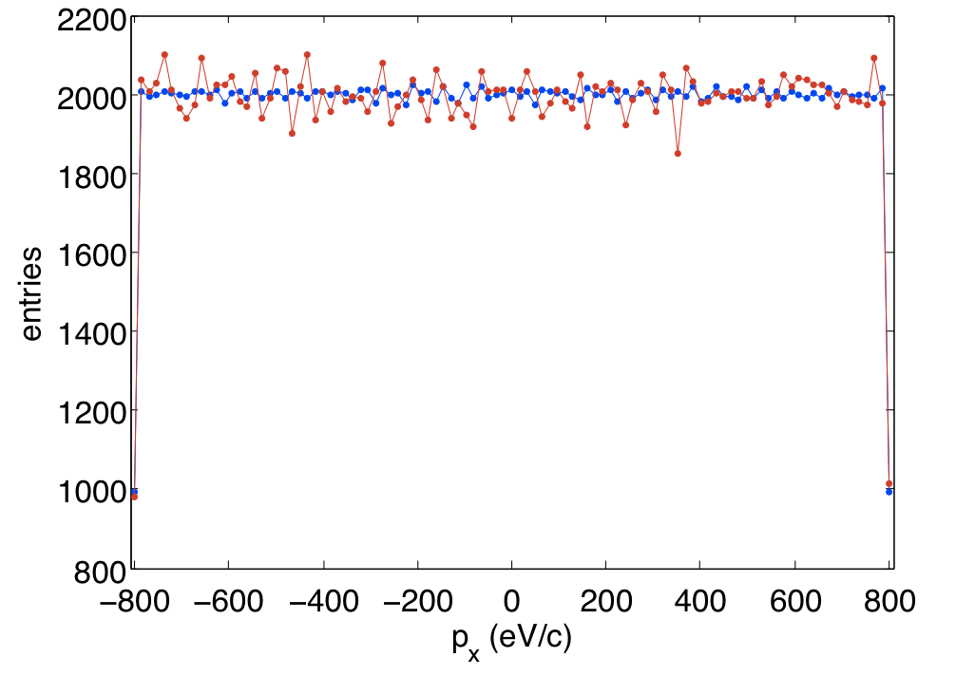
Initial Conditions cont.

Slide 7

Next Steps
OPAL / ASTRA code comparison Phase 1 & 2 of 250 MeV Injector
OPAL 1.1.6 release / updated manual !
Adaptive time stepping

