Slide 1
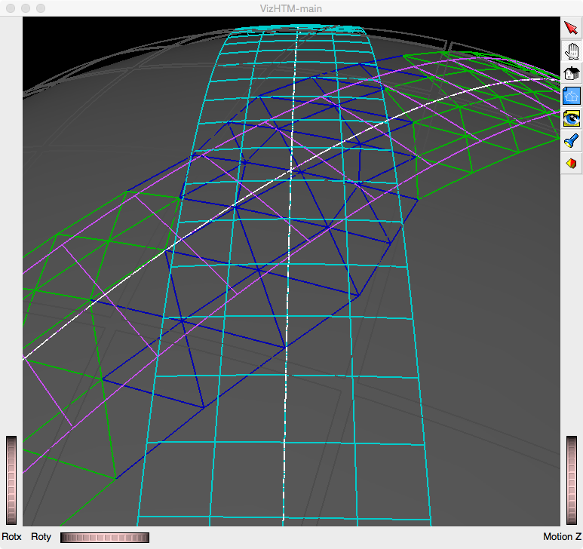
Using Hierarchical Triangular Mesh HtmRange intervals (integer intervals) to co-register & compare different data sets with different resolutions and geometry
Cyan and magenta grids are two data sets modeling spacecraft ground swaths.
Blue triangles are an HtmRange created by intersecting two HtmRanges, one for each of the data sets.
Green triangles are an HtmRange of non-intersecting data from the magenta set. Non-intersecting triangles from the cyan grid are not shown.
The fifth level of triangle refinement is shown.
Level 5
HtmRange Intersection
HtmRange intervals promise to accelerate data registration, comparison, and fusing over schemes that have to perform expensive geometric calculations for every calculation.
HtmRange supports partitioning and geometric co-location of multiple resolution data across distributed massively parallel computing platforms.
DERECHOS PIs: T.L. Clune and K.S. Kuo
M.L. Rilee, Rilee Systems Technologies, 2016 April 4
SSAI & NASA/GSFC NNG12HP96C

