Slide 1
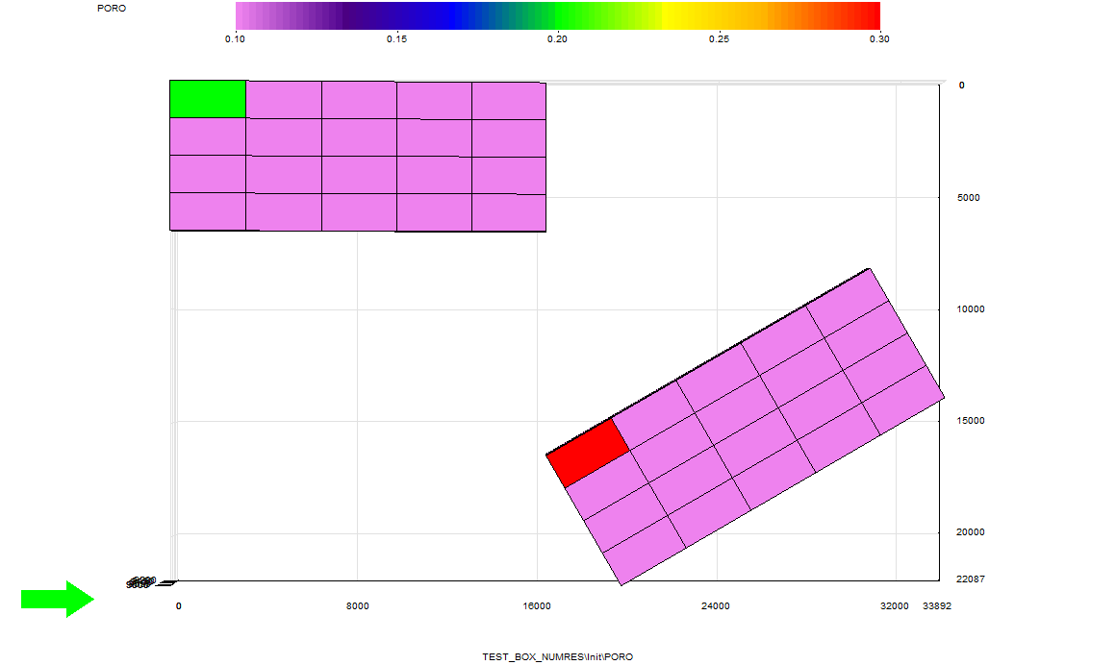
TEST_NUMRES grid (e.g. S3Graf)
Grid 1 in domain K=1..6
Grid 2 in domain K=7..10

