Slide 1
SPE Comparative Solution Project: A Comparison of Upscaling Techniques
SPE10 Validation
August 10th, 2022
COPYRIGHT
This presentation is made available under the Open Database License: http://opendatacommons.org/licenses/odbl/1.0/.
Any rights in individual contents of the database are licensed under the Database Contents License: http://opendatacommons.org/licenses/dbcl/1.0/
Copyright (C) 2022 Equinor

Slide 2

SPE10 Validation Cases
Objective
Test SPE Comparative Solution Project: A Comparison of Upscaling Techniques, SPE10 model one and two and convert three-phase version to two-phase models
Contents
Case Name | Description | Model | Status
SPE10-MOD01-01 | Three-Phase, with Cartesian regular grid. | Model 1 | Results are comparable to other vendors as presented in the paper. however, E100 fails to run to completion.
SPE10-MOD01-02 | Two-Phase, with Cartesian regular grid. | Model 1 | Results are comparable to other vendors as presented in the paper. however, E100 fails to run to completion.
SPE10-MOD01-03 | Three-Phase, with Corner-Point regular grid. | Model 1 | Results are comparable to other vendors as presented in the paper. E100 not tested.
SPE10-MOD01-04 | Two-Phase, with Corner-Point regular grid. | Model 1 | Results are comparable to other vendors as presented in the paper. E100 not tested.
All cases run with ten day time steps for comparison purposes.

Slide 3
SPE10 Validation Cases
Contents (continued)
Case Name | Description | Model | Status
SPE10-MOD02-01 |  | Model 2 | Cannot run due to numerical issues - work is ongoing
SPE10-MOD02-02 |  | Model 2 | Cannot run due to numerical issues - work is ongoing
SPE10-MOD02-03 |  | Model 2
SPE10-MOD02-04 |  | Model 2
All cases run with five day time steps for comparison purposes.

Slide 4

SPE10 Validation Cases
Current Results:
Model One:
  OPM Flow results are comparable to the results of other vendors presented in the paper.
  All four OPM Flow cases give exactly the same results.
Model Two
  Work is ongoing.

Slide 5
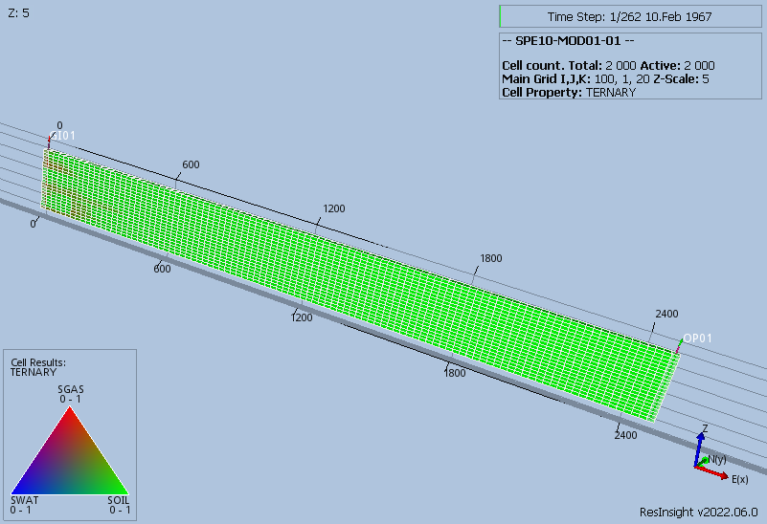
SPE10 Validation Cases
SPE10 Model One (Initial Ternary Saturation)

Slide 6
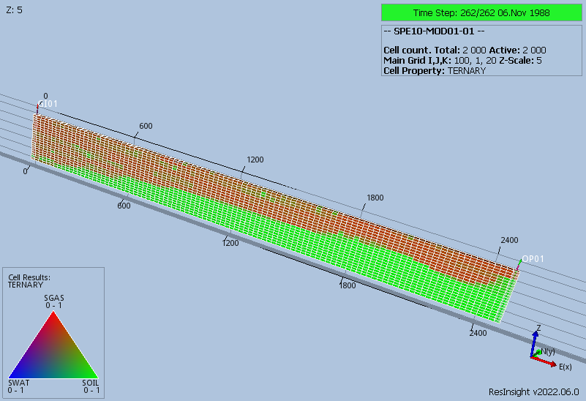
SPE10 Validation Cases
SPE10 Model One (Final Ternary Saturation)

Slide 7
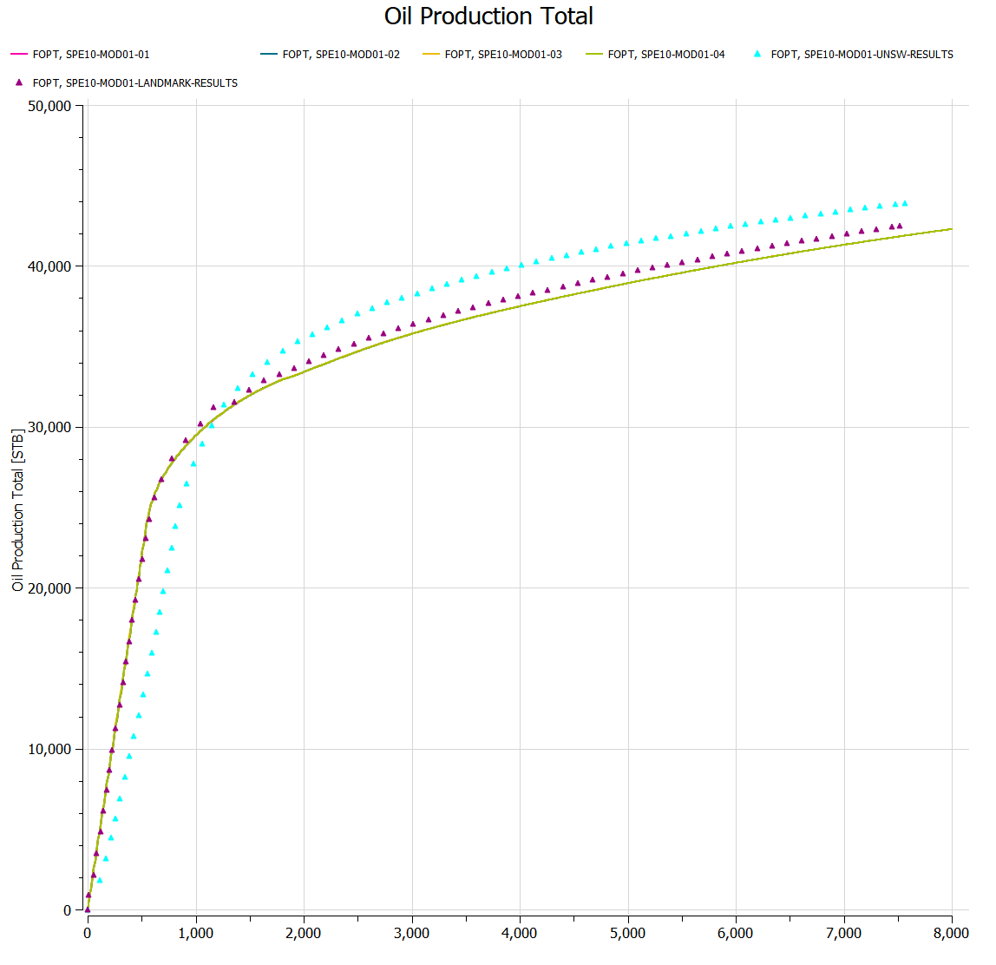
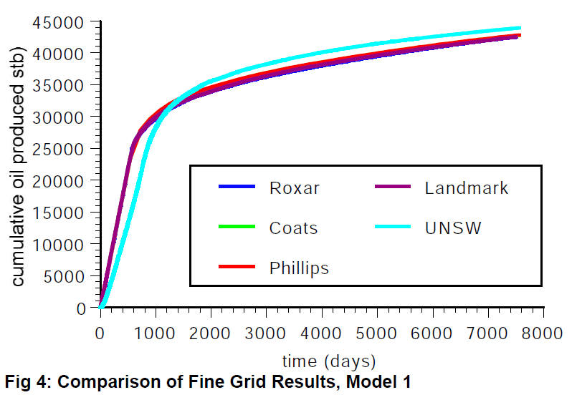
SPE10 Validation Cases
SPE10 Model One Results

Slide 8
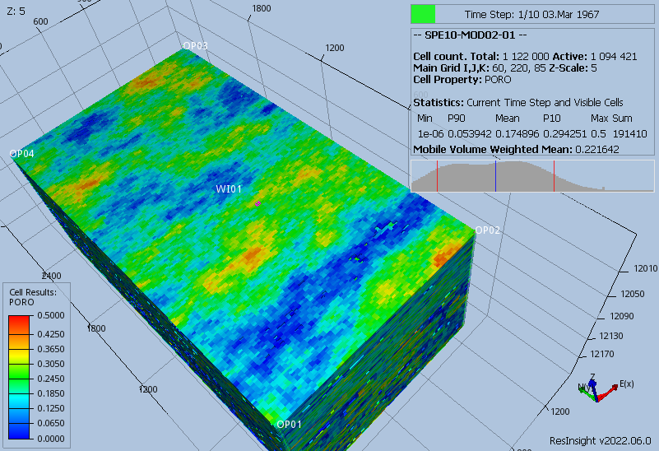
SPE10 Validation Cases
SPE10 Model Two

Slide 9
SPE10 Validation Cases
End of Presentation

