Slide 1
ACTIONX
Validation Cases
December 20th, 2021
COPYRIGHT
This presentation is made available under the Open Database License: http://opendatacommons.org/licenses/odbl/1.0/.
Any rights in individual contents of the database are licensed under the Database Contents License: http://opendatacommons.org/licenses/dbcl/1.0/
Copyright (C) 2021 Equinor

Slide 2
ACTIONX Validation Cases
Objective
Record the the results of the OPM Flow ACTIONX tests against the commercial simulator results.
Contents
No | Main Keyword | Secondary Keywords | Case Name | Run Type | Model | Results Match | Comments
1 | BOX | ENDBOX, MULTX, MULTY, MULTZ | ACTIONX_BOX | Prediction | MULT | Close | Complete. Field matches but well results are variable, some identical some much less so, mostly due to water production.
2 | COMPDAT | COMPLUMP, WELOPEN | ACTIONX_COMPDAT | History | MODEL02 | Yes | Complete and run matches commercial simulator.
3 | COMPLUMP | WELOPEN | ACTIONX_COMPLUMP | History | MODEL02 | Yes | Complete and run matches commercial simulator.
4 | ECHO | - | - | - | - | - | Not supported in deck.
5 | ENDBOX | BOX, MULTX, MULTY, MULTZ | See ACTIONX_BOX | Prediction | MULT | Close | Complete, same as ACTIONX_BOX
6 | GCONINJE | WELOPEN | ACTIONX_GCONINJE | Prediction | MODEL02 | Close | Completed and submitted to GitHub
7 | GCONPROD | UDQ | ACTIONX_GCONPROD | Prediction | MODEL02 | No | Complete: Results are inconsistent with E100, probably due to TSTEP. Also, need to check UDADIMS parameters are consistent with input deck and issue a warning if not, otherwise will create an error in the E100.
8 | GCONSUMP | GCONPROD, WCONPROD | ACTIONX_GCONSUMP | Prediction | MODEL02 | Yes | Complete. Gas Sales and Fuel Missing from SUMMARY file.
9 | GRUPNET | - | - | - | - | - | Not supported in deck.
10 | GRUPTARG | - | - | - | - | - | Not supported in deck.

Slide 3
ACTIONX Validation Cases
Content (continued)
NoN | Main Keyword | Secondary Keywords | Case Name | Run Type | Model | Results Match | Comments
11 | INCLUDE | COMPSEGS, WELSEGS | ACTIONX_WSEGVALV | Prediction | WSEGVALV | Yes | Complete and the run matches non-include version, as the commercial simulator does not support the INCLUDE keyword in an ACTIONX block.
12 | GRUPTREE | GCONPROD, GCONINJE, WCONINJE, WELOPEN, WELSSPECS, WGRUPCON | ACTIONX_GRUPTREE | Prediction | MODEL02 | Close | Completed. Results consistent at field level,but group SUMMARY vectors and production volumes are missing from SUMMARY file and Production reports (print file) if the groups are not defined upfront.
13 | GSATINJE | - | ACTIONX_ | - | - | - | Not supported in deck.
14 | GSATPROD | - | ACTIONX_ | - | - | - | Not supported in deck.
15 | MULT | BOX, ENDBOX MULTX- MULTY- MULTZ- | ACTIONX_MULT | Prediction | MULT | Yes | Base MULT run, no ACTIONX. All wells match except OP-A02 and OP-B02 water production.
16 | MULT- | BOX, ENDBOX MULTX- MULTY- MULTZ- | ACTIONX_MULT- | Prediction | MULT | Close | Regression test case. Runs okay and the results are generally close.
17 | MULT+ | BOX, ENDBOX MULTX MULTY MULTZ | ACTIONX_MULT+ | Prediction | MULT | Close | Regression test case. Runs okay and the results are generally close.
18 | MULTX- | BOX, ENDBOX | ACTIONX_MULTX- | Prediction | MULT | Close | Reference case not for regression testing. Field matches but well results are variable, some identical some much less so.
19 | MULTX | BOX, ENDBOX | ACTIONX_MULTX+ | Prediction | MULT | Close | Reference case not for regression testing. Field matches but well results are variable, some identical some much less so.
20 | MULTY- | BOX, ENDBOX | ACTIONX_MULTY- | Prediction | MULT | Close | Reference case not for regression testing. Field matches but well results are variable, some identical some much less so.

Slide 4
ACTIONX Validation Cases
Content (continued)
No | Main Keyword | Secondary Keywords | Case Name | Run Type | Model | Results Match | Comments
21 | MULTY | BOX, ENDBOX | ACTIONX_MULTY+ | Prediction | MULT | Close | Reference case not for regression testing. Field matches but well results are variable, some identical some much less so.
22 | MULTZ | BOX, ENDBOX | ACTIONX_MULTZ+ | Prediction | MULT | Close | Reference case not for regression testing. Field matches but well results are variable, some identical some much less so.
23 | MULTZ- | BOX, ENDBOX | ACTIONX_MULZ- | Prediction | MULT | Close | Reference case not for regression testing. Field matches but well results are variable, some identical some much less so.
24 | NEXT NEXTSTEP | WELTARG | ACTIONX_NEXTSTEP | Prediction | MODEL02 | No | NEXT is an alias for NEXSTEP. Numerically the fluid rates and the pressures match the commercial simulator, but the time steps defined by NEXTSTEP are not honored
25 | NOECHO | - | ACTIONX_ | - | - | - | Not supported in deck.
26 | UDQ | WCONPROD | ACTIONX_UDQ | Prediction | SPE09 | Yes | Complete and run matches commercial simulator.
27 | WCONINJE | WELOPEN | ACTIONX_WCONINJE | Prediction | MODEL02 | Yes | Complete and run matches commercial simulator.
28 | WCONPROD | GCONPROD, UDQ, WCONINJE | ACTIONX_WCONPROD | Prediction | MODEL02 | No | Complete: Runs but the the results are inconsistent with the the commercial simulator, as the field does not re-open as a gas field.
29 | WEFAC | - | ACTIONX_WEFAC | Prediction | MODEL02 | Yes | Complete and run matches commercial simulator..
30 | WELOPEN | COMPDAT COMPLUMP | See ACTIONX-COMPDAT | History | MODEL02 | Yes | Complete and run matches commercial simulator.

Slide 5
ACTIONX Validation Cases
Content (continued)
No | Main Keyword | Secondary Keywords | Case Name | Run Type | Model | Results Match | Comments
31 | WELPI | - | ACTIONX_WELPI | History | MODEL02 | Yes | Complete and run matches commercial simulator.
32 | WELSPECS | COMPDAT, WCONPROD | ACTIONX_WELSPECS | Prediction | WSEGVALV | Fails | Fails, but fix currently in progress.
33 | WELTARG | - | ACTIONX_WELTARG | Prediction | WSEGVALV | Yes | Complete and run matches commercial simulator.
34 | WGRUPCON | GCONPROD, GCONINJE, WCONINJE, WELOPEN | ACTIONX_WGRUPCON | Prediction | MODEL02 | Close | Complete, matches except WI01 for ACT-03 near the end of the run that results in a discrepancy.
35 | WINJMULT | - |  | - | - | - | Not supported in deck.
36 | WPIMULT | - | ACTIONX_WPIMULT | History | MODEL02 | Yes | Complete and run matches commercial simulator.
37 | WSEGVALV | COMPSEGS, WELSEGS | ACTIONX_WSEGVALV | Prediction | WSEGVALV | Yes | Complete and run matches commercial simulator.
38 | WTEST | WECON | ACTIONX_WTEST | Prediction | SPE09 | No | Completed: Fixed the WECON issue all the wells now flow, some are perfect matches but there are some that are way off, don’t know why at this stage – may not be an ACTIONX issue.
39 | WTMULT | - | ACTIONX_WTMULT | Prediction | MODEL05 | Yes | Complete and run matches commercial simulator.
40

Slide 6
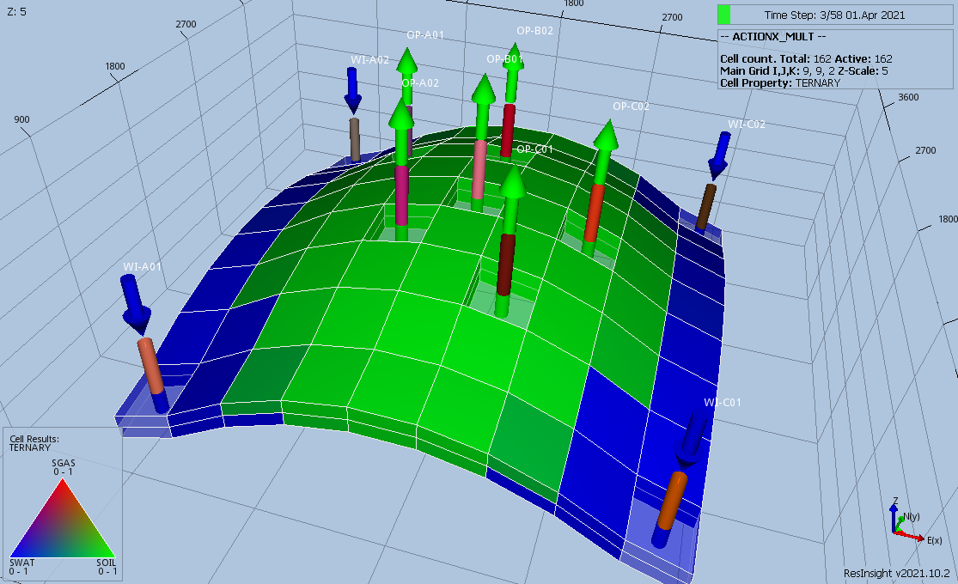
ACTIONX Validation Cases
MULT Model

Slide 7
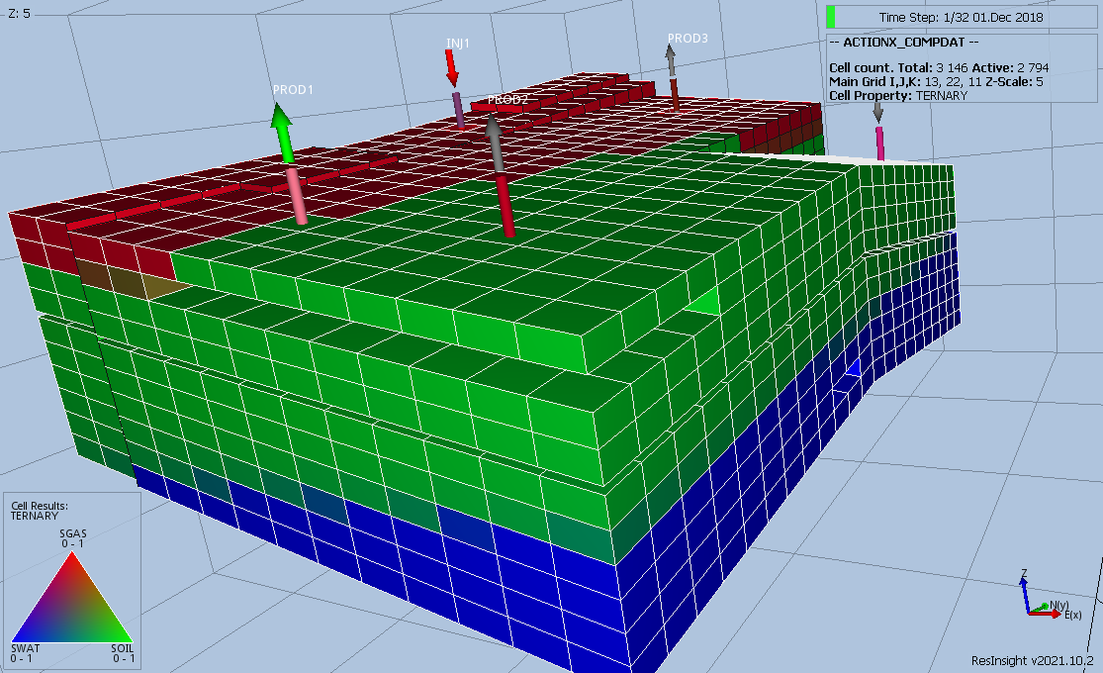
ACTIONX Validation Cases
MODEL02 Model

Slide 8
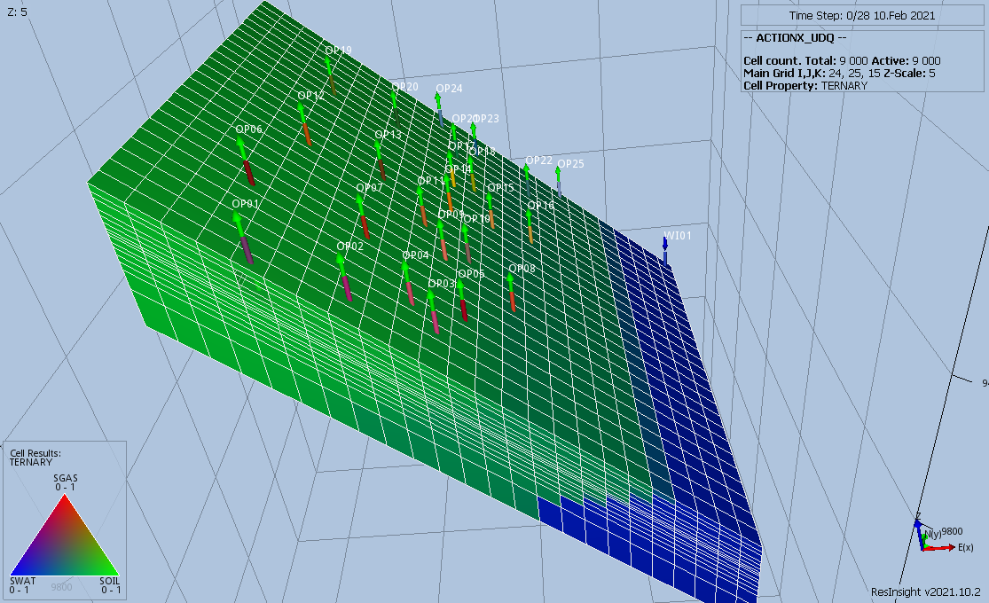
ACTIONX Validation Cases
SPE09 Model

Slide 9
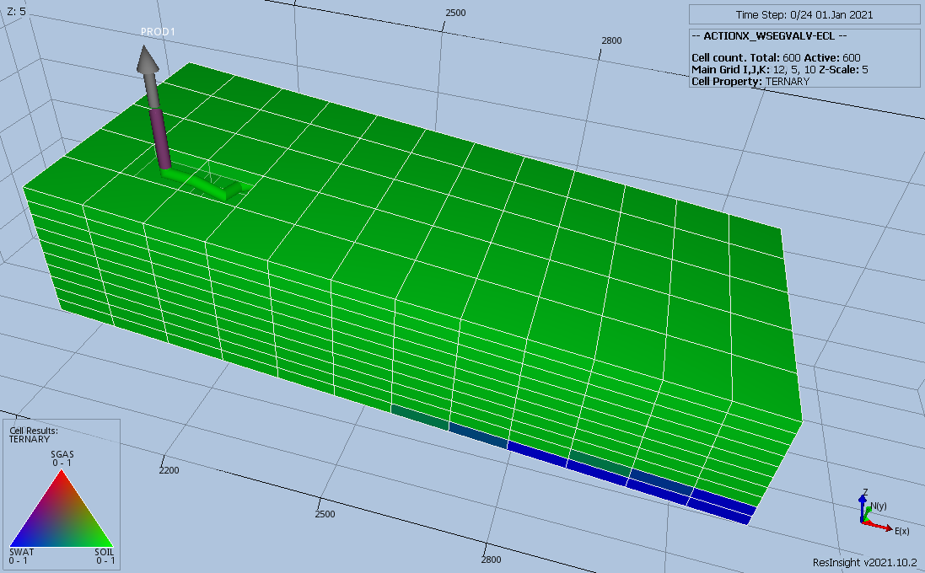
ACTIONX Validation Cases
WSEGVALV Model

Slide 10
ACTIONX Validation Cases
BOX (AND ENDBOX)

Slide 11
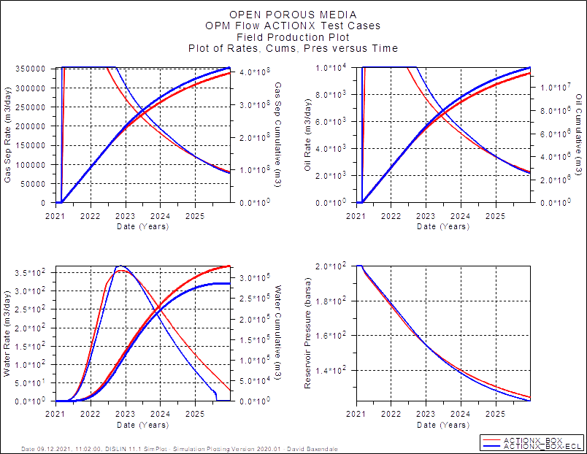
BOX & ENDBOX: Field Performance
Field matches but well results are variable, some identical some much less so, mostly due to water production.

Slide 12
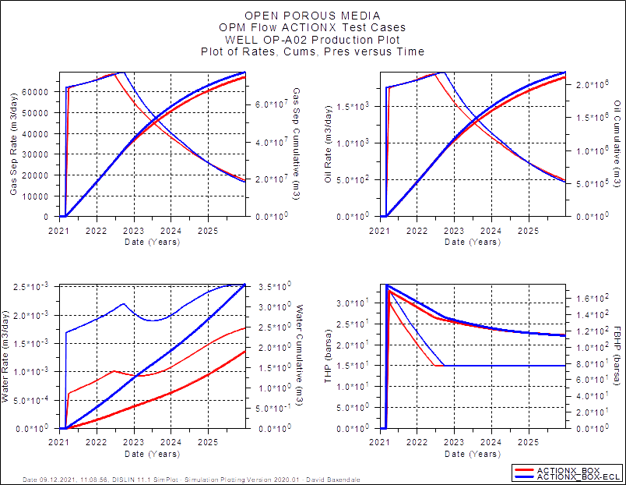
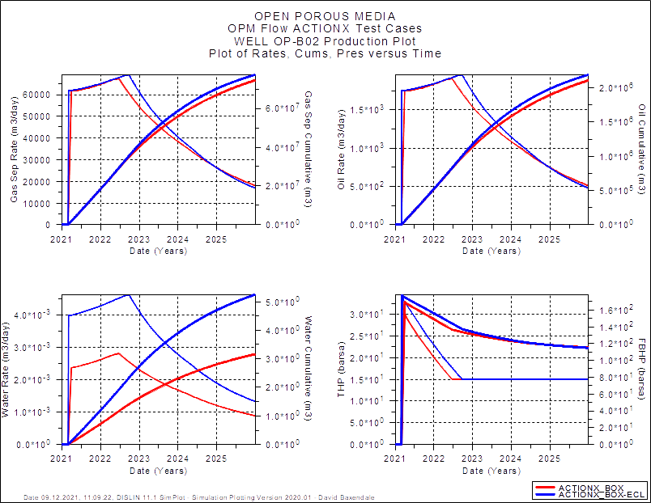
BOX & ENDBOX: Well Performance
Example of Poor Well Matches (OP-A02 and OP-B02).

Slide 13
ACTIONX Validation Cases
COMPDATA (and WELOPEN)

Slide 14
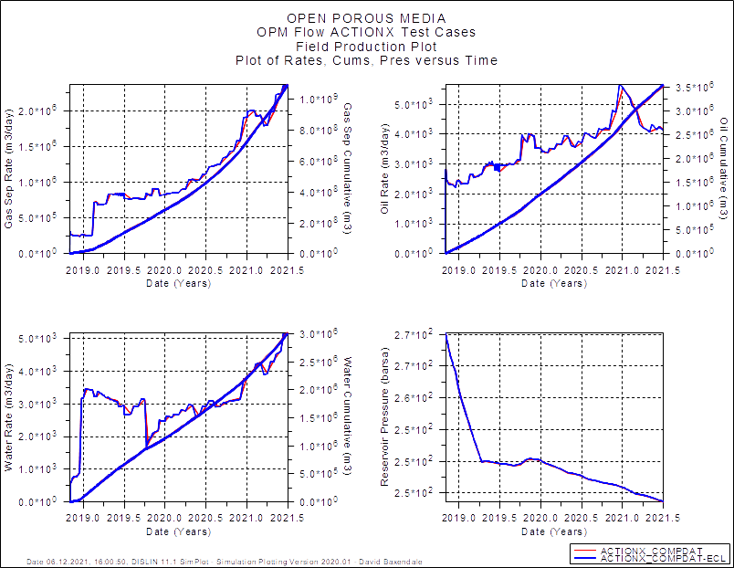
COMPDAT: Field Performance

Slide 15
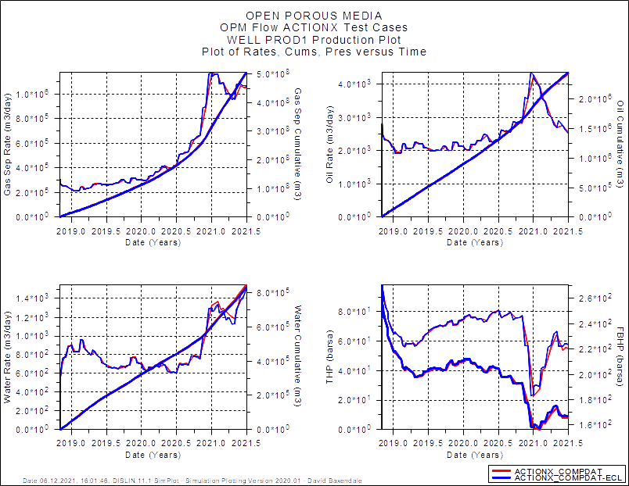
COMPDAT: Well PROD1

Slide 16
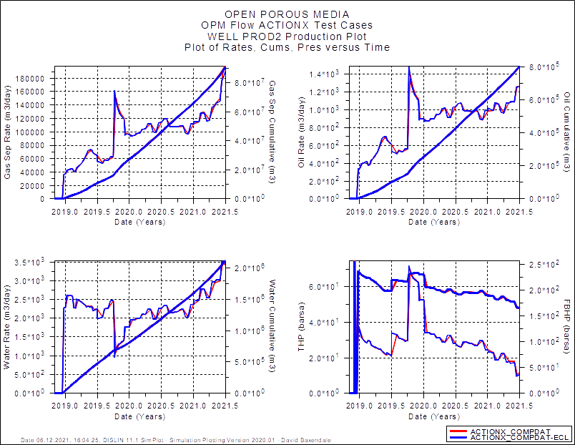
COMPDAT: Well PROD2

Slide 17
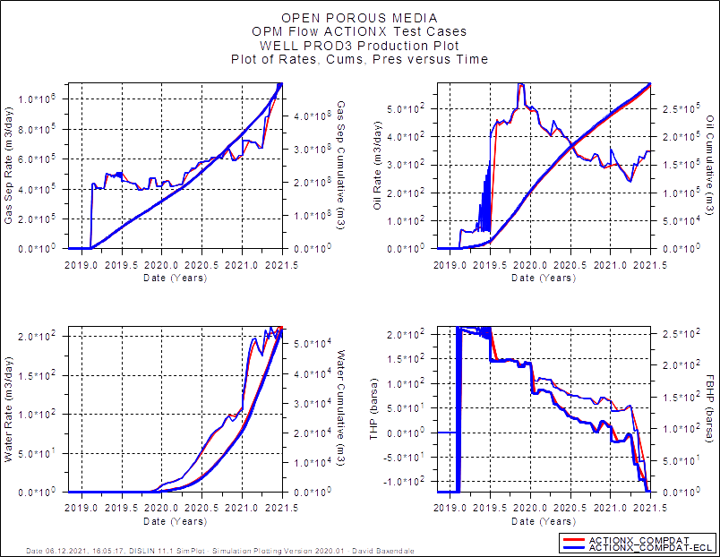
COMPDAT: Well PROD3

Slide 18
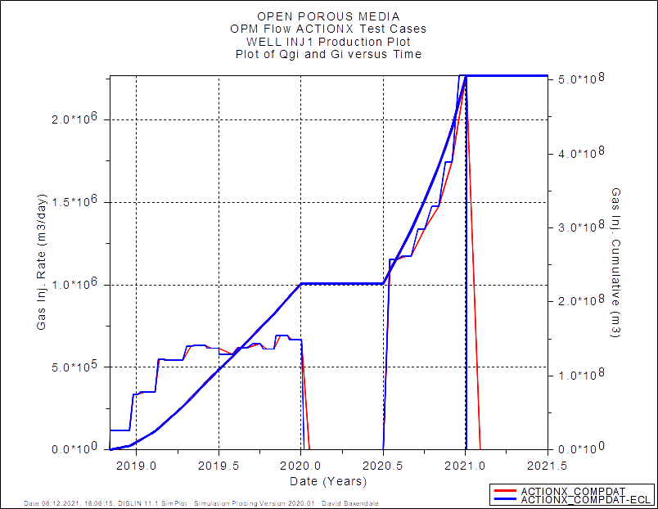
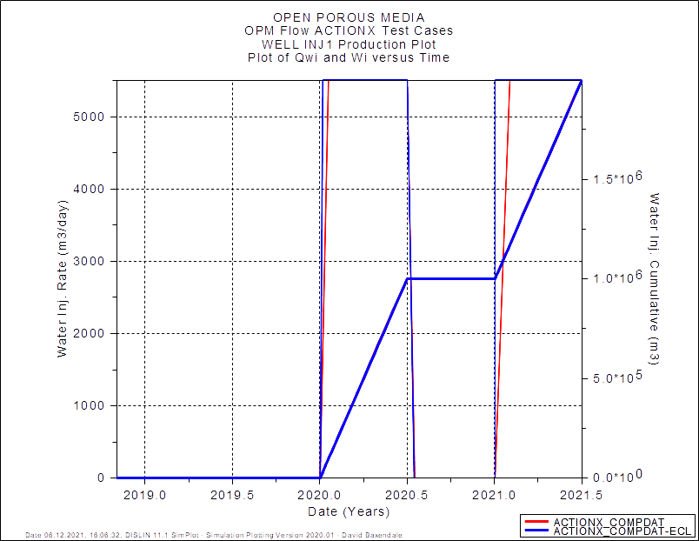
COMPDAT: Well iNJ1

Slide 19
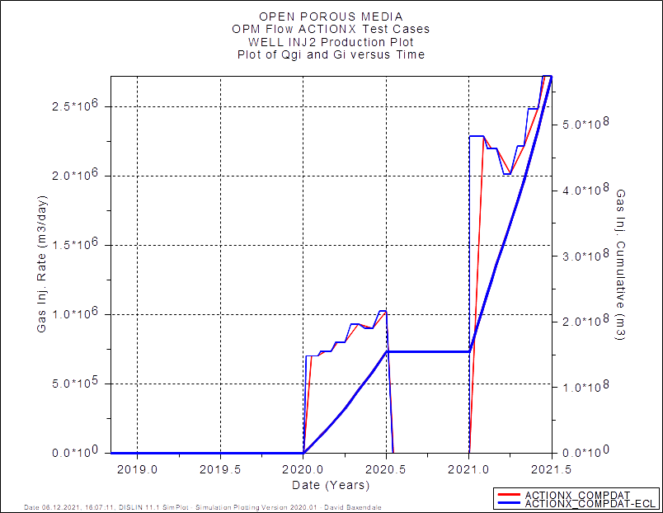
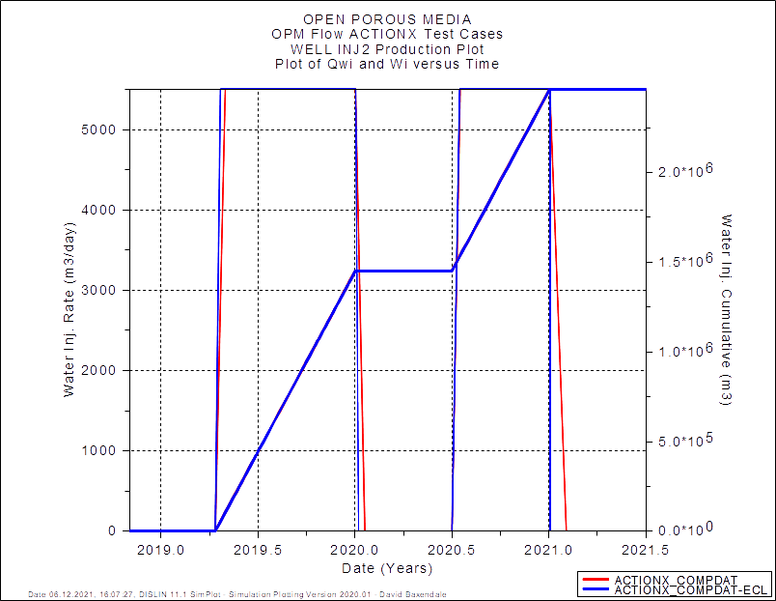
COMPDAT: Well iNJ2

Slide 20
ACTIONX Validation Cases
COMPLUMP

Slide 21
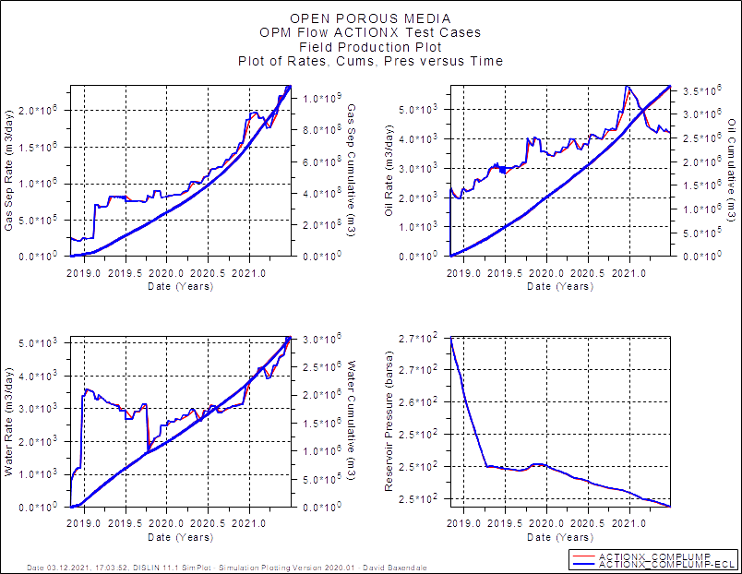
COMPLUMP: Field Performance

Slide 22
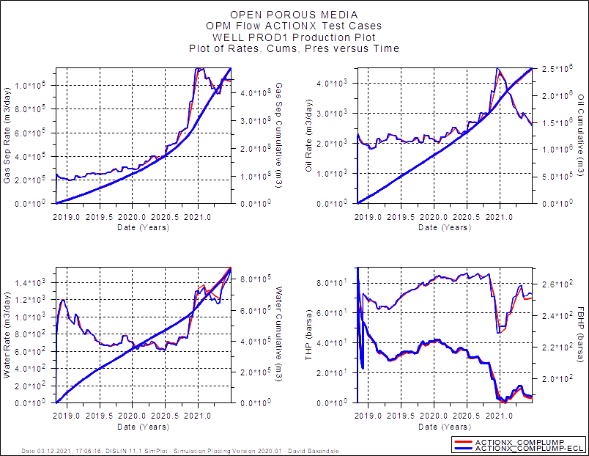
COMPLUMP: Well PROD1

Slide 23

COMPLUMP: Well PROD2

Slide 24
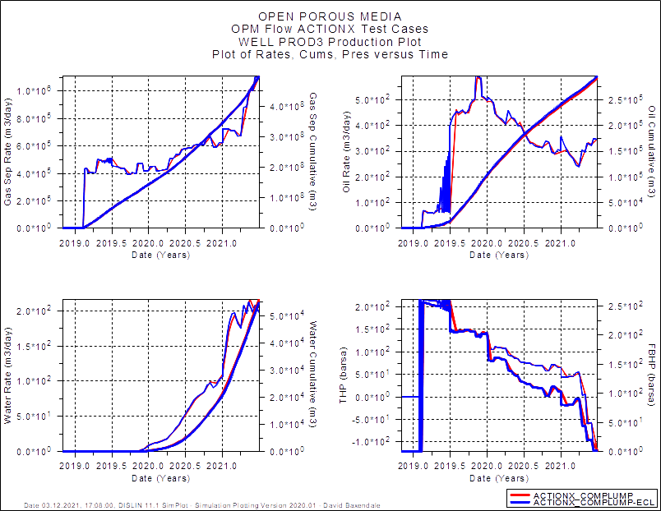
COMPLUMP: Well PROD3

Slide 25
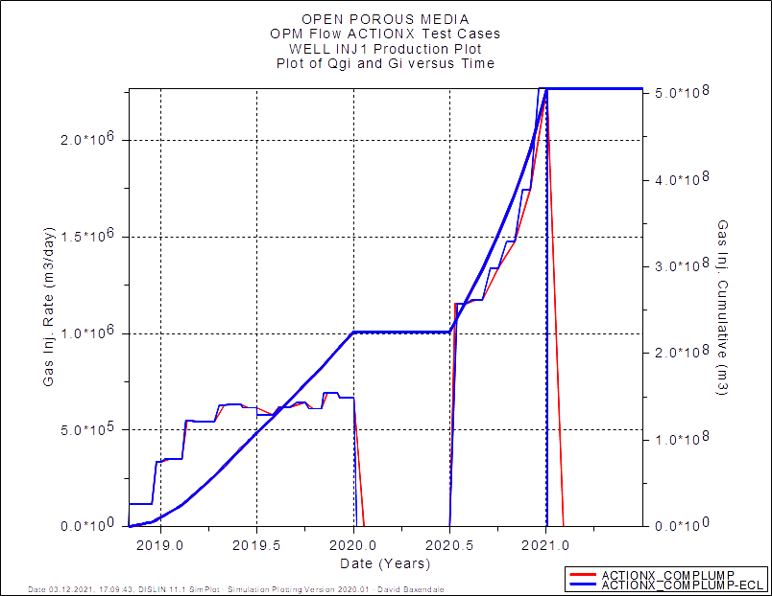
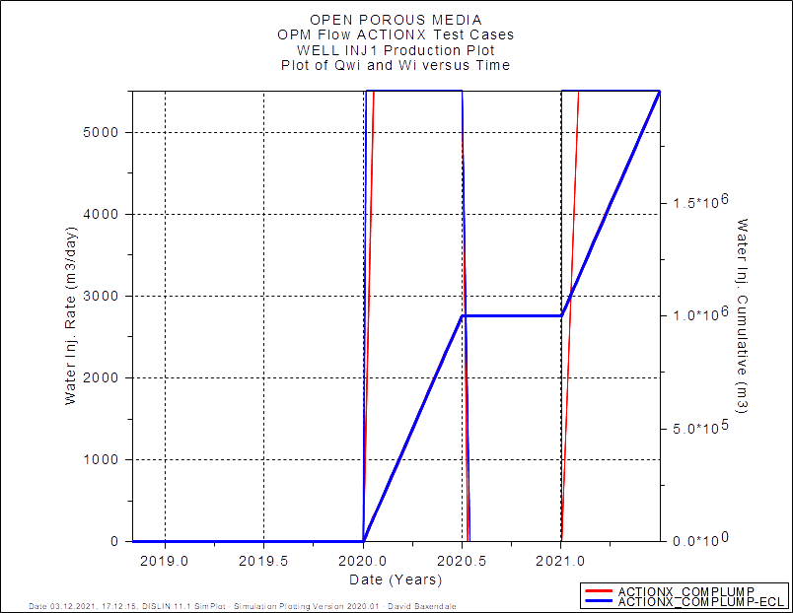
COMPLUMP: Well iNJ1

Slide 26
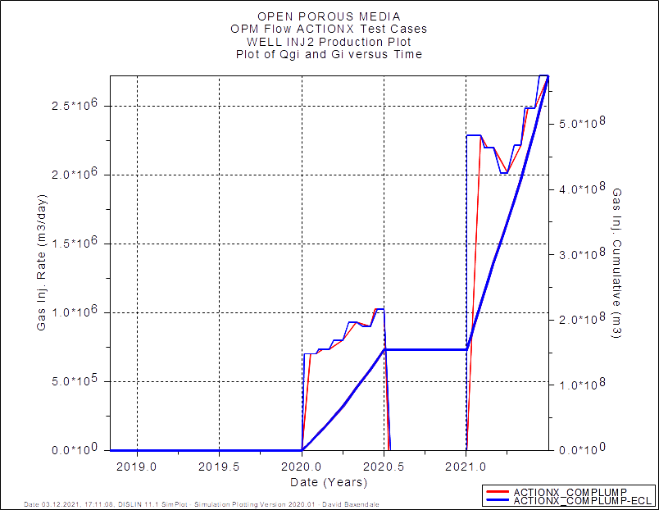
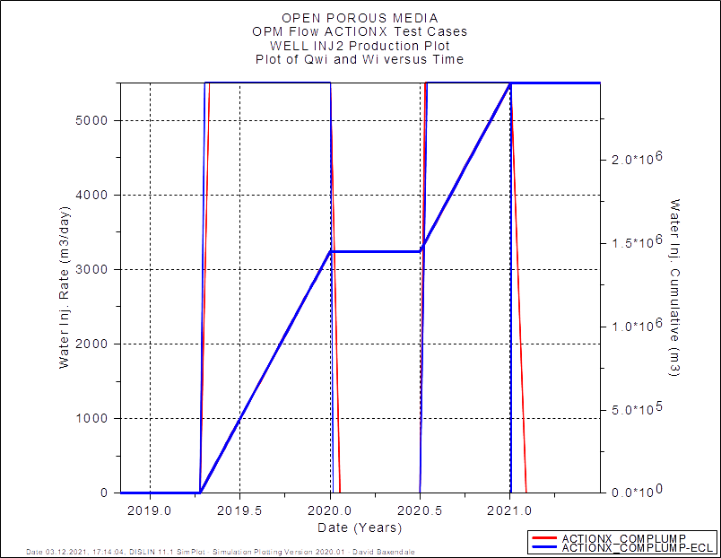
COMPLUMP: Well iNJ2

Slide 27
ACTIONX Validation Cases
GcONINJE

Slide 28
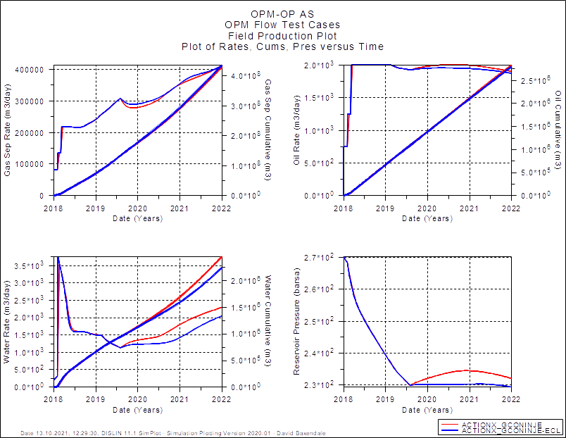
GCONINJE: Field Performance

Slide 29
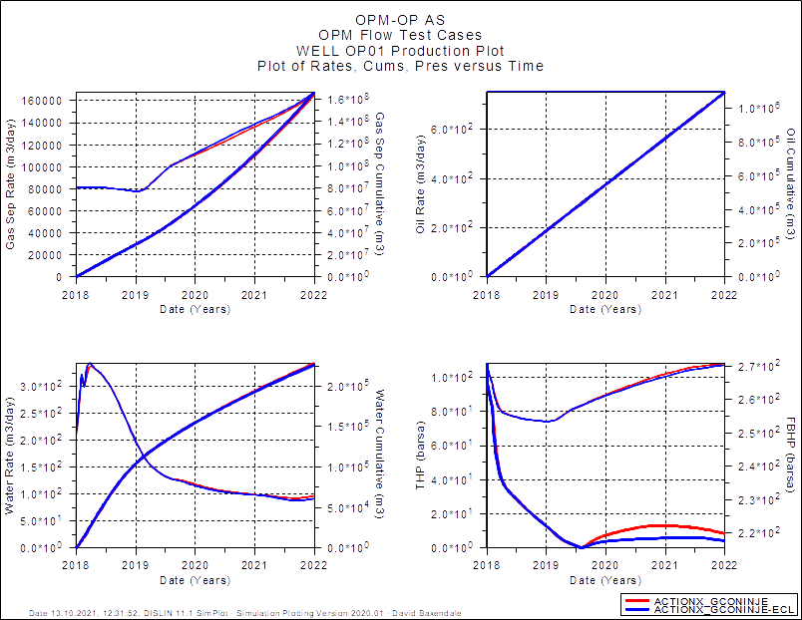
GCONINJE: Well OP01

Slide 30
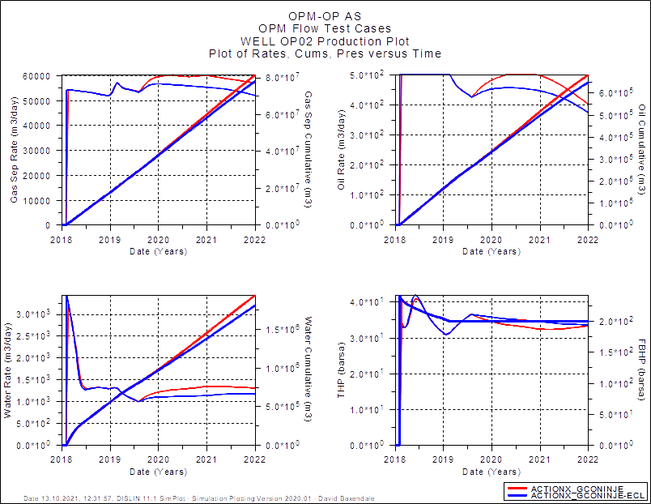
GCONINJE: Well OP02

Slide 31
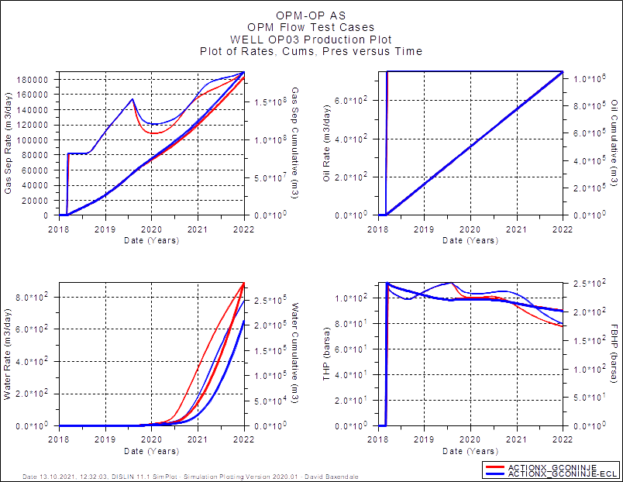
GCONINJE: Well OP03

Slide 32
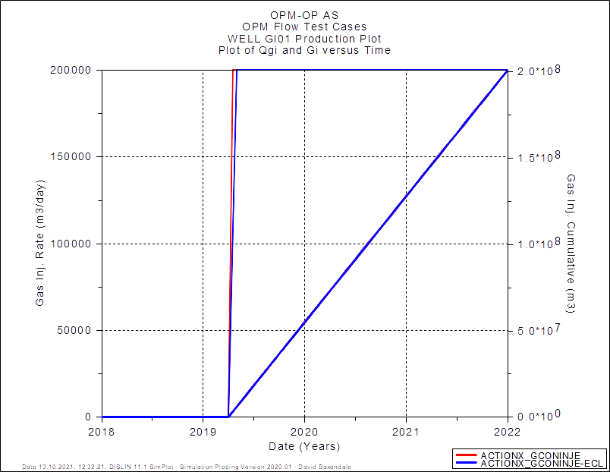
GCONINJE: Well GI01

Slide 33
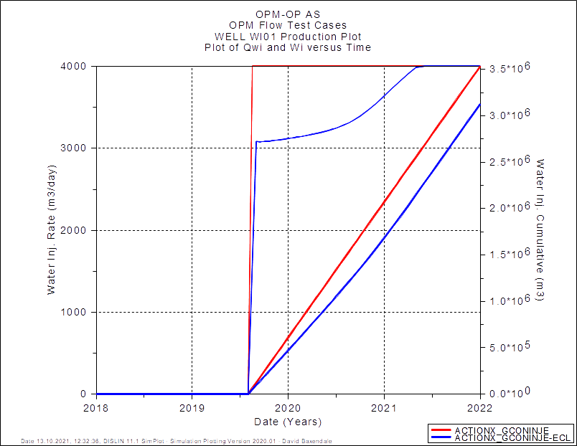
GCONINJE: Well wI01

Slide 34
ACTIONX Validation Cases
GcONPROD

Slide 35
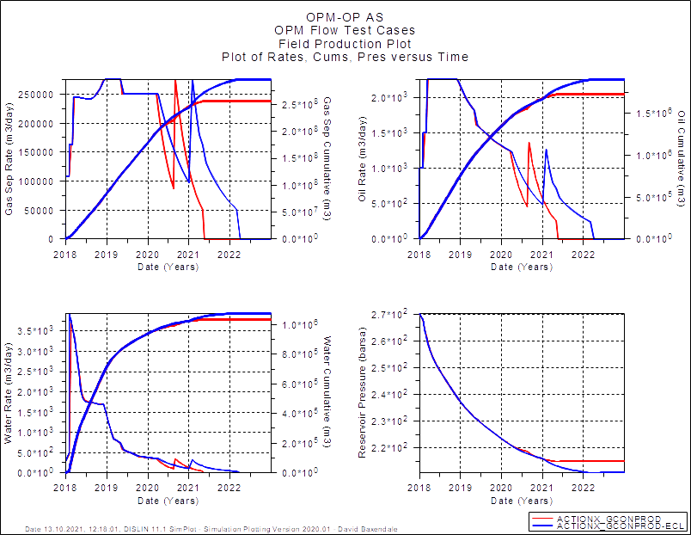
GCONPROD: Field Performance

Slide 36
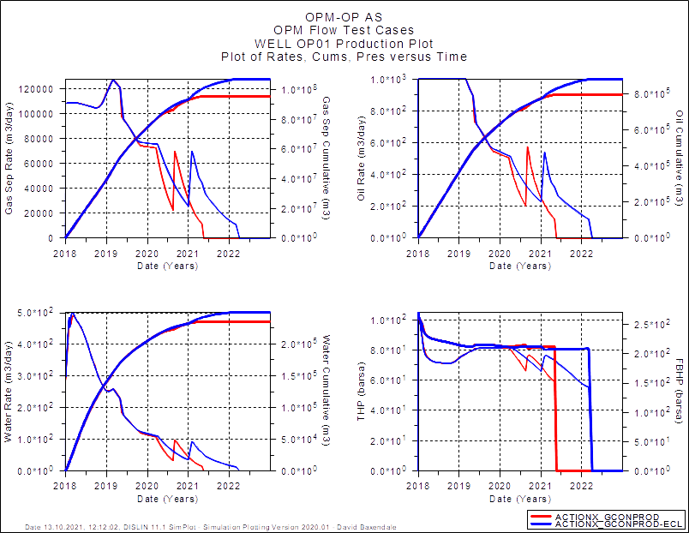
GCONPROD: Well OP01

Slide 37
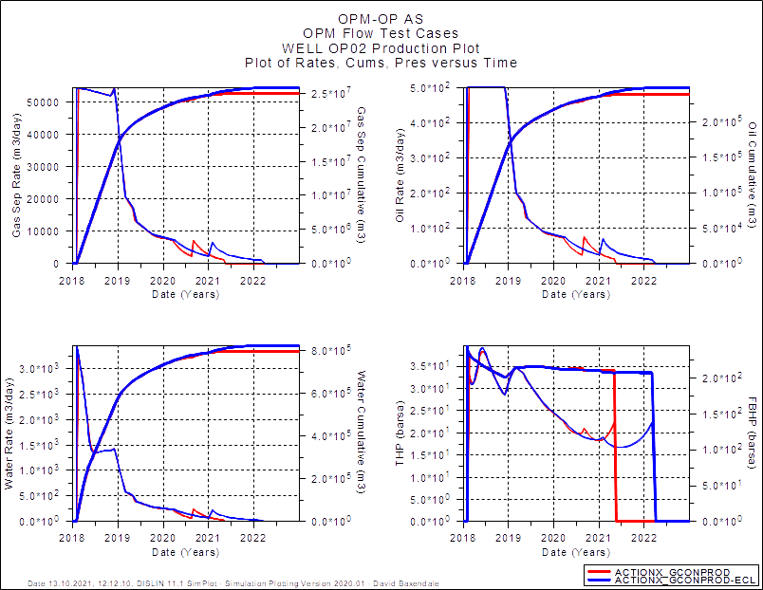
GCONPROD: Well OP02

Slide 38
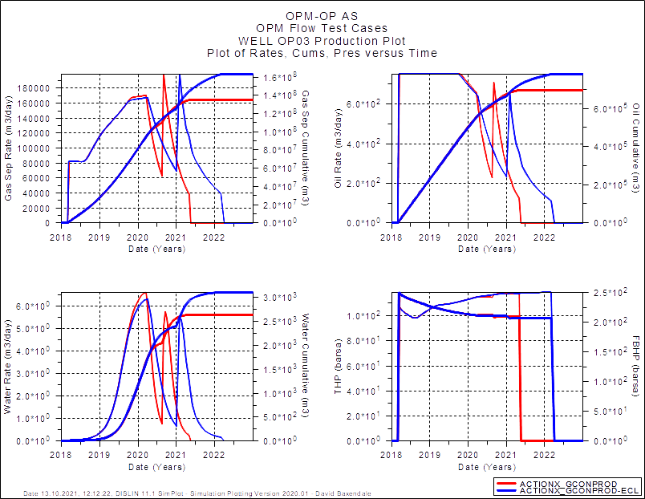
GCONPROD: Well OP03

Slide 39
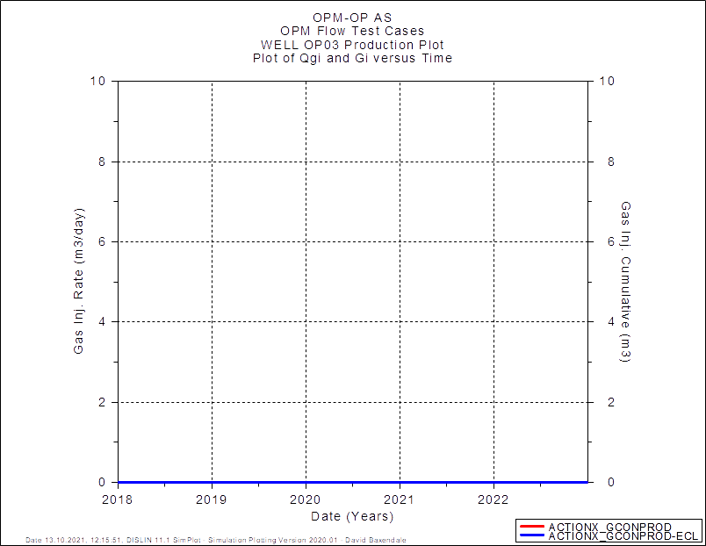
GCONPROD: Well GI01

Slide 40

GCONINJE: Well wI01

Slide 41
ACTIONX Validation Cases
GcONSUMP

Slide 42
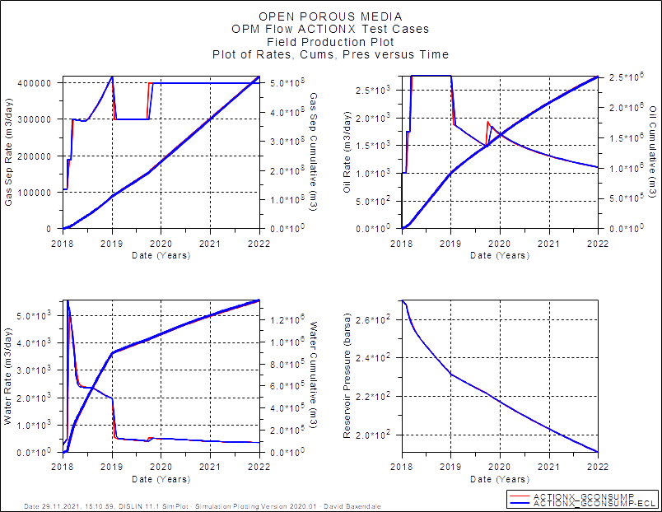
GCONSUMP: Field Performance

Slide 43
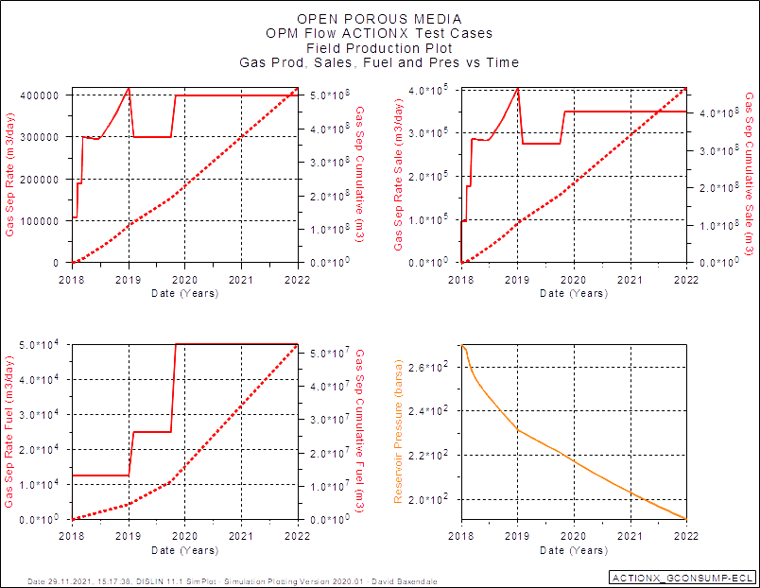
GCONSUMP: Field Performance
OPM Flow: Gas Sales and Fuel Missing from SUMMARY file.

Slide 44
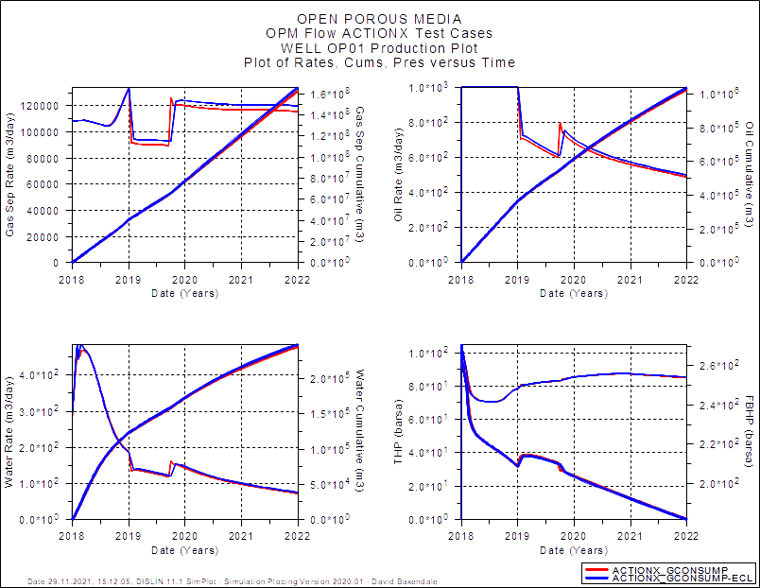
GCONSUMP: well OP01

Slide 45
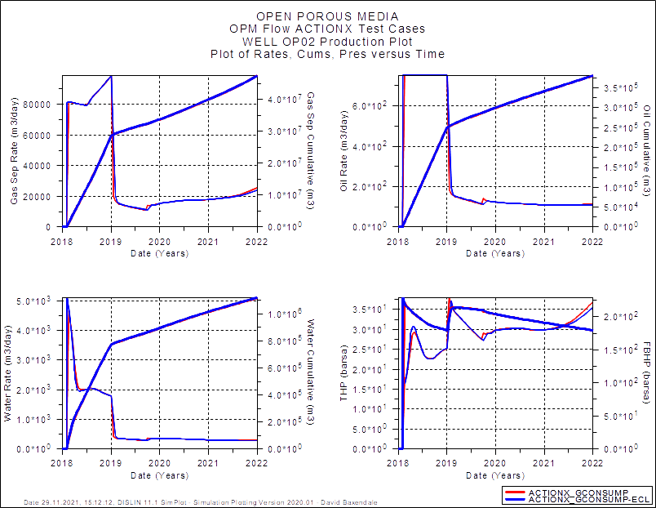
GCONSUMP: well OP02

Slide 46
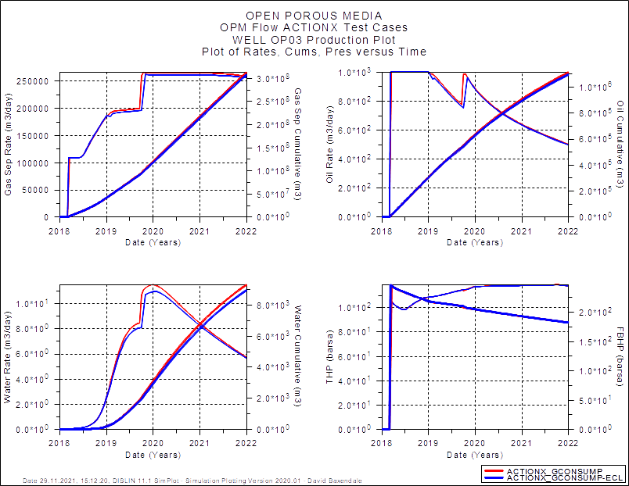
GCONSUMP: well OP03

Slide 47
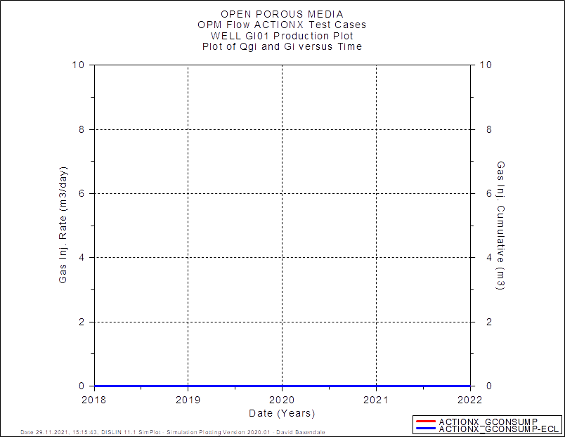
GCONSUMP: well GI01

Slide 48

GCONSUMP: well WI01

Slide 49
ACTIONX Validation Cases
include

Slide 50
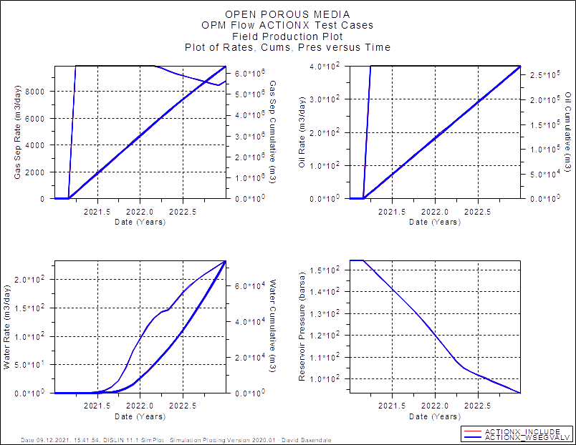
INCLUDE: Field Performance
Commercial Simulator Does Not Support INCLUDE Keyword in ACTIONX Block, Compare Against Non-Include Run.

Slide 51
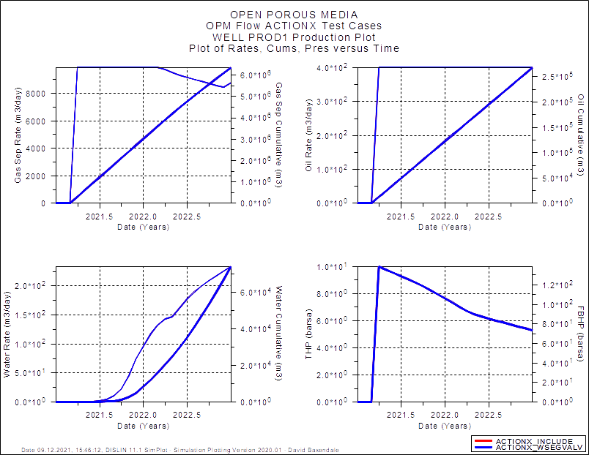
INCLUDE: Well Performance
Commercial Simulator Does Not Support INCLUDE Keyword in ACTIONX Block, Compare Against Non-Include Run.

Slide 52
ACTIONX Validation Cases
GRUPTREE

Slide 53
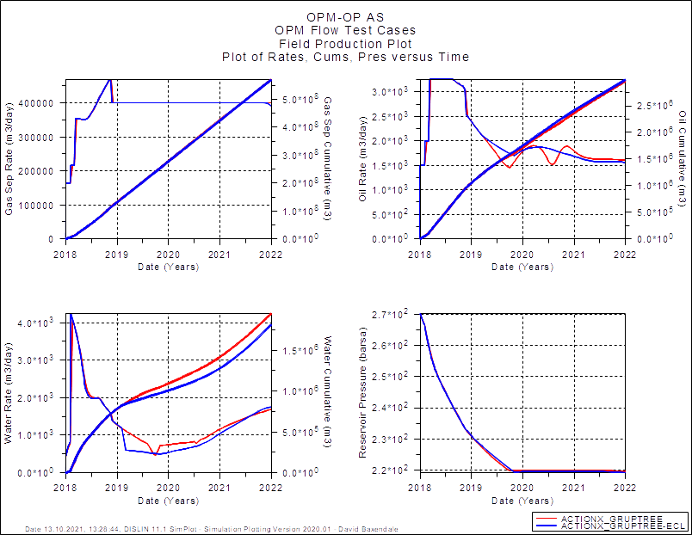
GRUPTREE: Field Performance

Slide 54
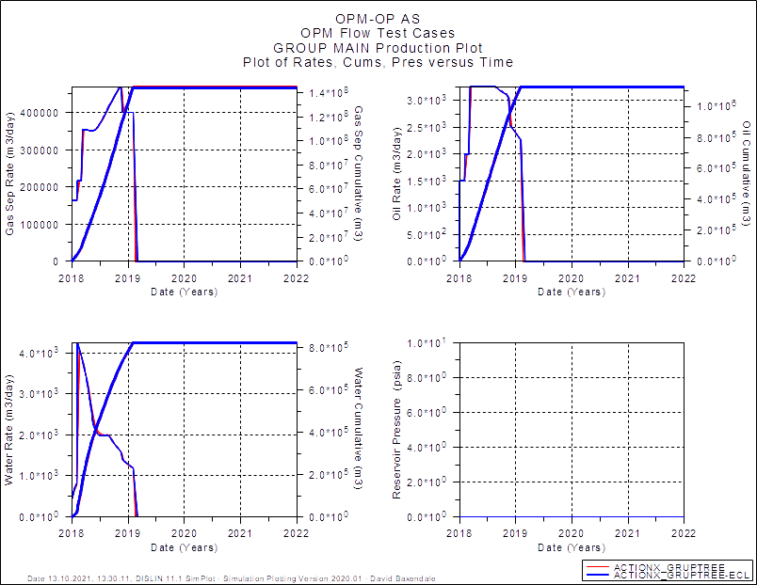
GRUPTREE: Group Main

Slide 55
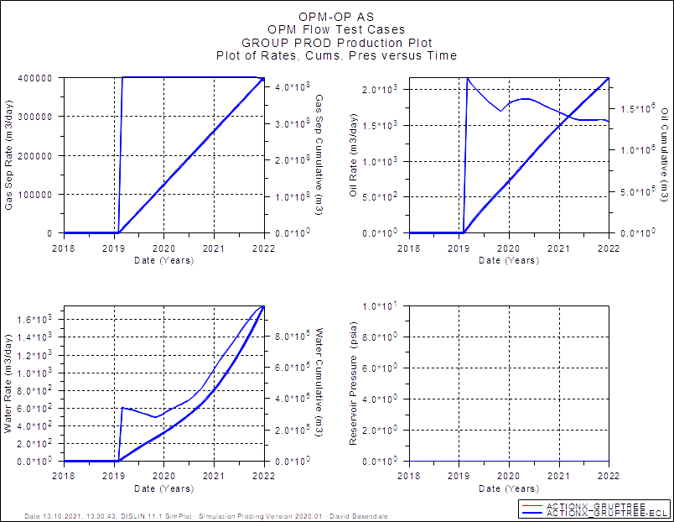
GRUPTREE: Group PROD
OPM Flow: Group Volumes Missing from SUMMARY and Report

Slide 56
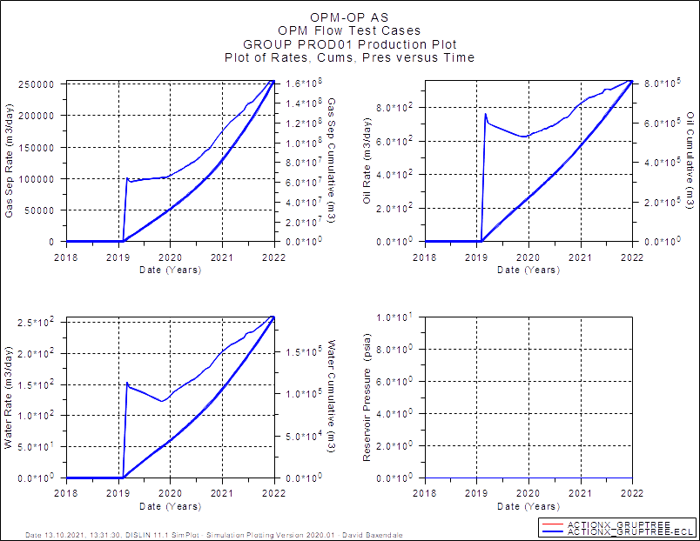
GRUPTREE: Group PROD01
OPM Flow: Group Volumes Missing from SUMMARY and Report

Slide 57
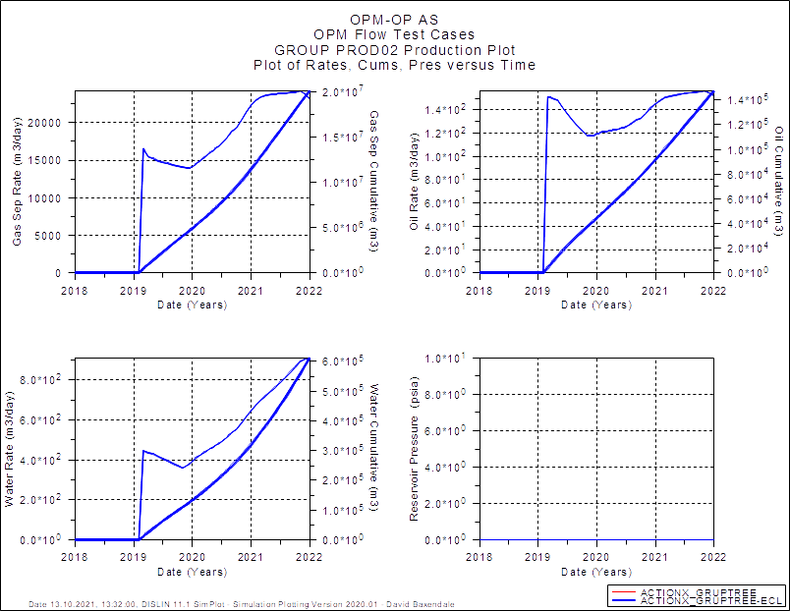
GRUPTREE: Group PROD02
OPM Flow: Group Volumes Missing from SUMMARY and Report

Slide 58
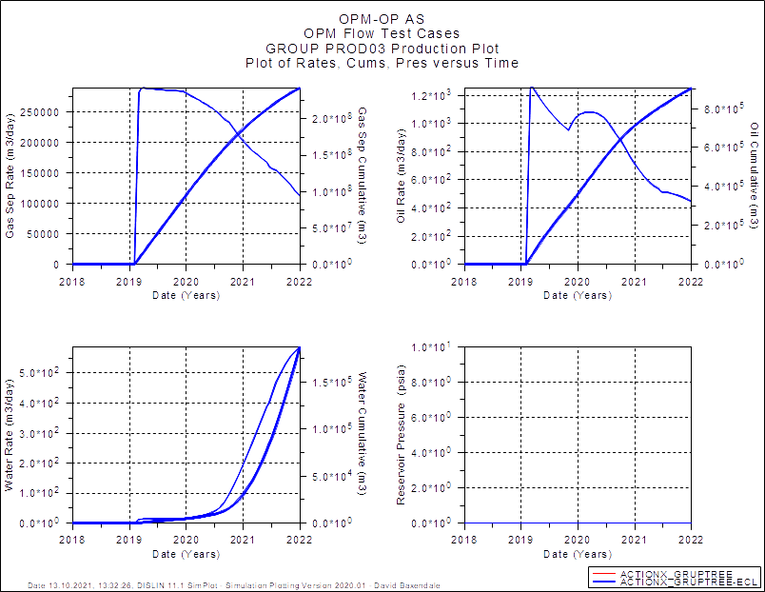
GRUPTREE: Group PROD03
OPM Flow: Group Volumes Missing from SUMMARY and Report

Slide 59
ACTIONX Validation Cases
MULT (base),
MULT- (MULTX-, MULTY-, MULTZ-) and
MULT+(MULTX, MULTY, MULTZ)

Slide 60
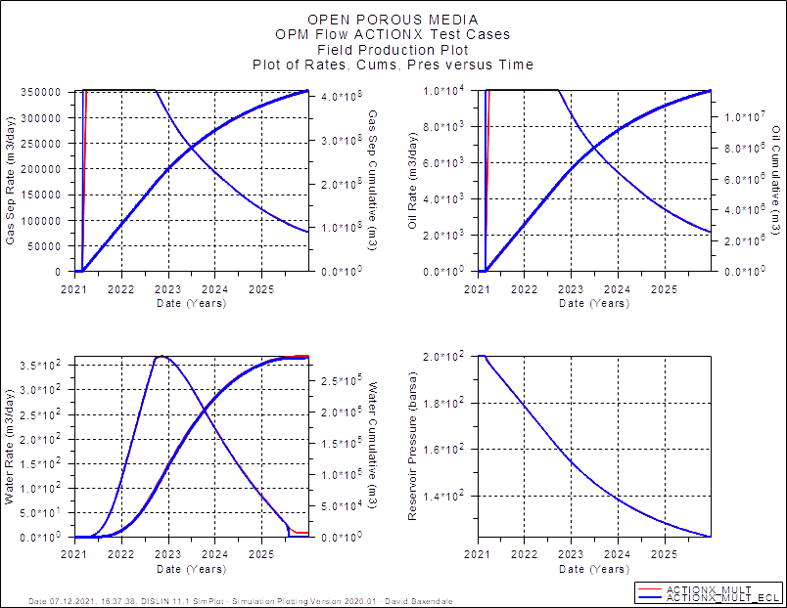
MULT (Base): Field Performance

Slide 61
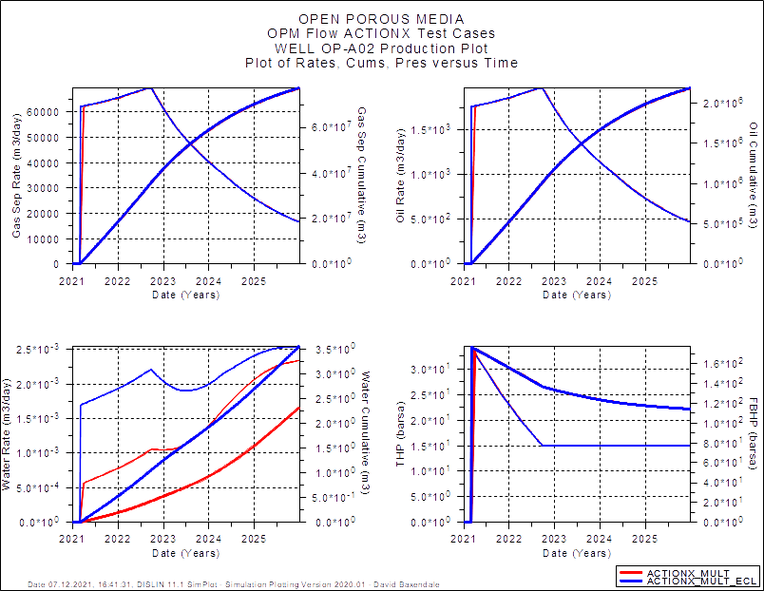
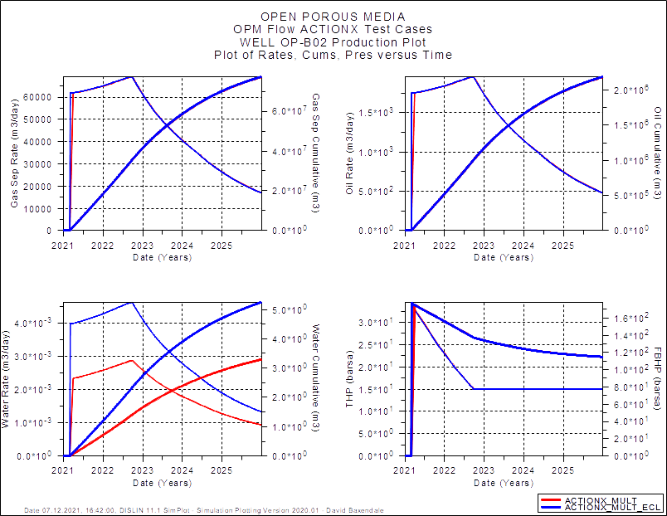
MULT (Base): Well Performance
All wells match except OP-A02 and OP-B02 Water Production

Slide 62

MULT- (X-, Y-, Z-): Field Performance

Slide 63


MULT- (X-, Y-, Z-): Well Performance
OP-A01 and OP-A02

Slide 64


MULT- (X-, Y-, Z-): Well Performance
OP-B01 and OP-B02

Slide 65


MULT- (X-, Y-, Z-): Well Performance
OP-C01 and OP-B02

Slide 66


MULT- (X-, Y-, Z-): Well Performance
WI-A01 and WI-A02

Slide 67


MULT- (X-, Y-, Z-): Well Performance
WI-C01 and WI-C02

Slide 68

MULT+ (X, Y, Z): Field Performance

Slide 69


MULT (Base): Well Performance
OP-A01 and OP-A02

Slide 70


MULT (Base): Well Performance
OP-B01 and OP-B02

Slide 71


MULT (Base): Well Performance
OP-C01 and OP-C02

Slide 72


MULT (Base): Well Performance
WI-A01 and WI-A02

Slide 73


MULT (Base): Well Performance
WI-C01 and WI-C02

Slide 74
ACTIONX Validation Cases
MULTX AND MULTX- (Reference Case)
MULTY and multy- (reference case)
MULTz and MULTZ- (reference Case)

Slide 75

MULTX: Field Performance
Field matches but well results are variable, some identical some much less so.

Slide 76

MULTX-: Field Performance
Field matches but well results are variable, some identical some much less so.

Slide 77

MULTY: Field Performance
Field matches but well results are variable, some identical some much less so.

Slide 78

MULTY-: Field Performance
Field matches but well results are variable, some identical some much less so.

Slide 79

MULTZ: Field Performance
Field matches but well results are variable, some identical some much less so.

Slide 80
MULTZ-: Field Performance
Field matches but well results are variable, some identical some much less so.

Slide 81
ACTIONX Validation Cases
NEXTSTEP (NEXT)

Slide 82

NEXTSTEP(NEXT): Field Performance
Fluid rates and the pressures match, but the time steps defined by NEXTSTEP are not honored.

Slide 83

NEXTSTEP(NEXT): well B-1H

Slide 84

NEXTSTEP(NEXT): well B-2H

Slide 85

NEXTSTEP(NEXT): well B-3H

Slide 86

NEXTSTEP(NEXT): well C-1H

Slide 87

NEXTSTEP(NEXT): well C-2H

Slide 88
ACTIONX Validation Cases
UDQ

Slide 89

UDQ: Field Performance

Slide 90

UDQ: well OP01

Slide 91

UDQ: well OP02

Slide 92

UDQ: well OP03

Slide 93

UDQ: well OP04

Slide 94

UDQ: well OP05

Slide 95

UDQ: well OP06

Slide 96

UDQ: well OP07

Slide 97

UDQ: well OP08

Slide 98

UDQ: well OP09

Slide 99

UDQ: well OP10

Slide 100

UDQ: well OP11

Slide 101

UDQ: well OP12

Slide 102

UDQ: well OP13

Slide 103

UDQ: well OP14

Slide 104

UDQ: well OP15

Slide 105

UDQ: well OP16

Slide 106

UDQ: well OP17

Slide 107

UDQ: well OP18

Slide 108

UDQ: well OP19

Slide 109

UDQ: well OP20

Slide 110

UDQ: well OP21

Slide 111

UDQ: well OP22

Slide 112

UDQ: well OP23

Slide 113

UDQ: well OP24

Slide 114

UDQ: well OP25

Slide 115

UDQ: well WI01

Slide 116
ACTIONX Validation Cases
WCONINJE

Slide 117

WCONINJE: Field Performance

Slide 118

WCONINJE: well OP01

Slide 119

WCONINJE: well OP02

Slide 120

WCONINJE: well OP03

Slide 121

WCONINJE: well GI01

Slide 122

WCONINJE: well wI01

Slide 123
ACTIONX Validation Cases
WCONPROD

Slide 124

WCONPROD: Field Performance

Slide 125

WCONPROD: well OP01

Slide 126

WCONPROD: well OP02

Slide 127

WCONPROD: well OP03

Slide 128

WCONPROD: well GI01

Slide 129

WCONPROD: well wI01

Slide 130
ACTIONX Validation Cases
WEFAC

Slide 131

WEFAC: Field Performance

Slide 132

WEFAC: well OP01

Slide 133

WEFAC: well OP02

Slide 134

WEFAC: well OP03

Slide 135

WEFAC: well GI01

Slide 136

WEFAC: well WI01

Slide 137
ACTIONX Validation Cases
WELPI

Slide 138

WELPI: Field Performance

Slide 139

WELPI: well pROD1

Slide 140

WELPI: well pROD2

Slide 141

WELPI: well pROD2

Slide 142


WELPI: Well iNJ1

Slide 143


WELPI: Well iNJ2

Slide 144
ACTIONX Validation Cases
WELTARG

Slide 145

WELTARG: Field Performance

Slide 146

WELTARG: well pROD

Slide 147

WELTARG: well pROD

Slide 148
ACTIONX Validation Cases
WGRUPCON

Slide 149

WGRUPCON: Field Performance

Slide 150

WGRUPCON: well OP01

Slide 151

WGRUPCON: well OP02

Slide 152

WGRUPCON: well OP03

Slide 153

WGRUPCON: well GI01

Slide 154

WGRUPCON: well WI01
OPM Flow: ACT-03 Discrepancy Near the End of the Run

Slide 155
ACTIONX Validation Cases
WPIMULT

Slide 156

WPIMULT: Field Performance

Slide 157

WPIMULT: well PROD1

Slide 158

WPIMULT: well PROD2

Slide 159

WPIMULT: well PROD3

Slide 160


WPIMULT: well INJ1

Slide 161


WPIMULT: well INJ2

Slide 162
ACTIONX Validation Cases
WSEGVALV

Slide 163

WSEGVALV: Field Performance

Slide 164

WSEGVALV: Well Performance

Slide 165
ACTIONX Validation Cases
WTEST

Slide 166

WTEST: Field Performance

Slide 167

WTEST: well OP01

Slide 168

WTEST: well OP02

Slide 169

WTEST: well OP03

Slide 170

WTEST: well OP04

Slide 171

WTEST: well OP05

Slide 172

WTEST: well OP06

Slide 173

WTEST: well OP07

Slide 174

WTEST: well OP08

Slide 175

WTEST: well OP09

Slide 176

WTEST: well OP10

Slide 177

WTEST: well OP11

Slide 178

WTEST: well OP12

Slide 179

WTEST: well OP13

Slide 180

WTEST: well OP14

Slide 181

WTEST: well OP15

Slide 182

WTEST: well OP16

Slide 183

WTEST: well OP17

Slide 184

WTEST: well OP18

Slide 185

WTEST: well OP19

Slide 186

WTEST: well OP20

Slide 187

WTEST: well OP21

Slide 188

WTEST: well OP22

Slide 189

WTEST: well OP23

Slide 190

WTEST: well OP24

Slide 191

WTEST: well OP25

Slide 192

WTEST: well WI01

Slide 193
ACTIONX Validation Cases
WTMULT

Slide 194

WTMULT: Field Performance

Slide 195

WTMULT: well B-1H

Slide 196

WTMULT: well B-2H

Slide 197

WTMULT: well B-3H

Slide 198

WTMULT: well C-1H

Slide 199

WTMULT: well C-2H

Slide 200


WTMULT: well F-1H and F-2H

Slide 201


WTMULT: well G-3H and F-2H

Slide 202
ACTIONX Validation Cases
End of Presentation

