Slide 1
Gas Lift
Validation Cases
November 23rd , 2021
COPYRIGHT
This presentation is made available under the Open Database License: http://opendatacommons.org/licenses/odbl/1.0/.
Any rights in individual contents of the database are licensed under the Database Contents License: http://opendatacommons.org/licenses/dbcl/1.0/
Copyright (C) 2021 Equinor

Slide 2

Gas Lift Validation Cases
Objective
Generate various Gas Lift tests to validate OPM Flow’s implementation against the commercial simulator results.
Contents
Case Name | Description | Model | Status
GASLIFT-01 | Two-Phase, Cartesian regular, with variable GLIFT | GASLIFT | Two-Phase not supported
GASLIFT-02 | Two-Phase, Corner-Point, with variable GLIFT | GASLIFT | Two-Phase not supported
GASLIFT-03 | Three-Phase, Corner-Point, variable GLIFT, MODEL05 PVT | GASLIFT | Three-Phase. Gas Lift not working when only GOR in VFP table (no ALQ)?
GASLIFT-04 | Three-Phase, Corner-Point, variable GLIFT, MODEL05 PVT/VFP | GASLIFT
GASLIFT-05 | Base Run | MODEL05
GASLIFT-06 | Base Run with group ORAT=6000 | MODEL05
GASLIFT-07 | Base Run with group LIFTOPT(OPTLIFT)=NO | MODEL05 | Completely different, convergence issues. Should be similar to GASLIFT-05.
GASLIFT-08 |  | MODEL05
GASLIFT-09 |  | MODEL05
GASLIFT-10

Slide 3
Gas Lift Validation Cases
GASLIFT-01

Slide 4
GASLIFT-01: Two-Phase Test
OPM-Flow threw an exception: Could not initialize the problem: TableContainer does not have any table in the range 0...0
Two-Phase (Oil-Water) Not Supported

Slide 5
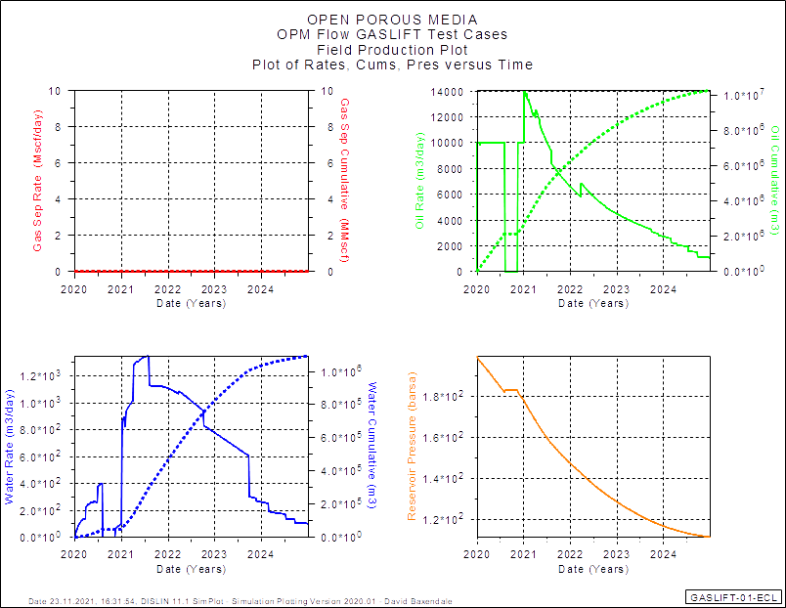
GASLIFT-01: Field Performance

Slide 6
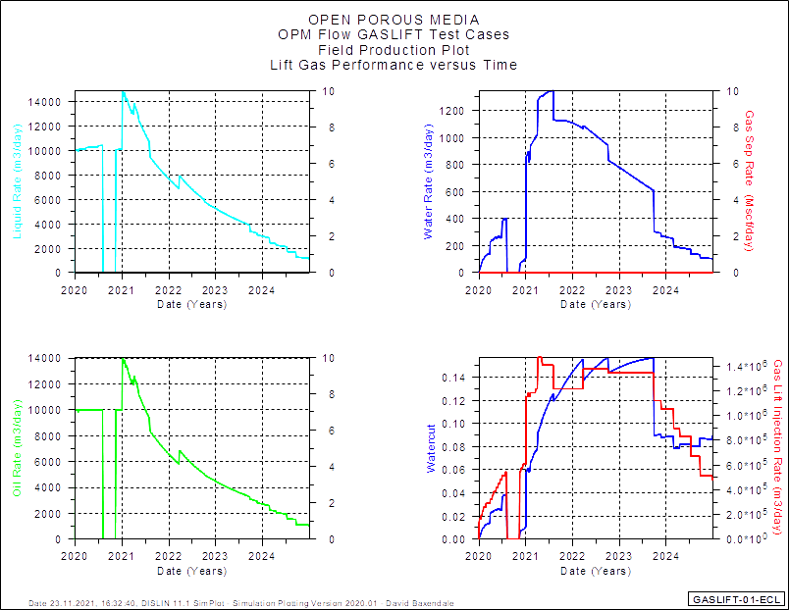
GASLIFT-01: Field Performance

Slide 7
Gas Lift Validation Cases
GASLIFT-02

Slide 8
GASLIFT-02: Two-Phase Test
OPM-Flow threw an exception: Could not initialize the problem: TableContainer does not have any table in the range 0...0
Two-Phase (Oil-Water) Not Supported

Slide 9
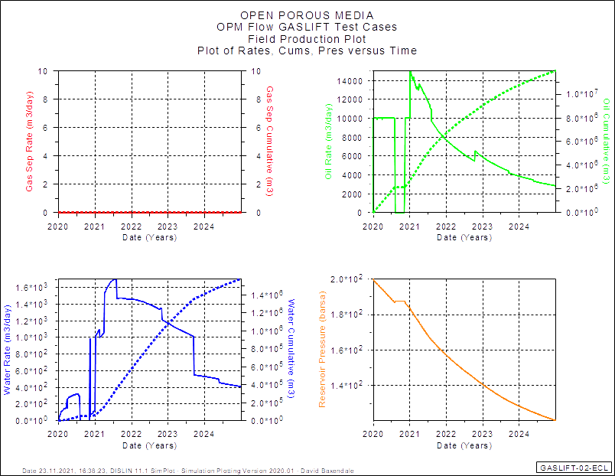
GASLIFT-02: Field Performance

Slide 10
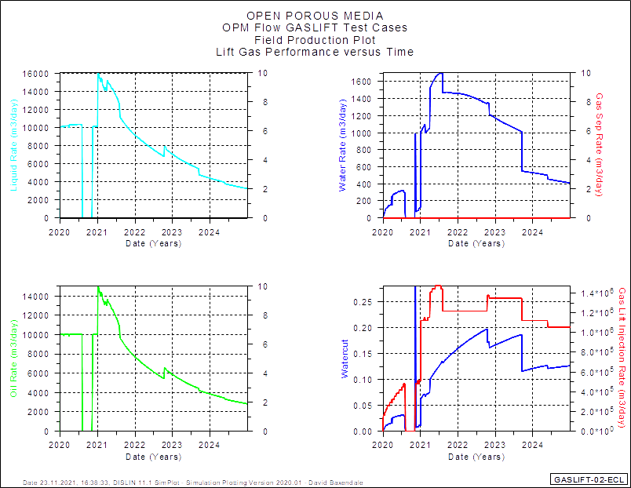
GASLIFT-02: Field Performance

Slide 11
Gas Lift Validation Cases
GASLIFT-03

Slide 12
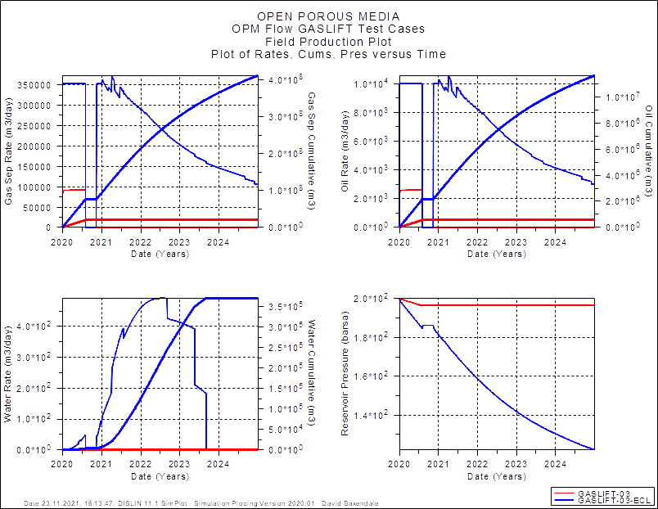
GASLIFT-03: Field Performance

Slide 13
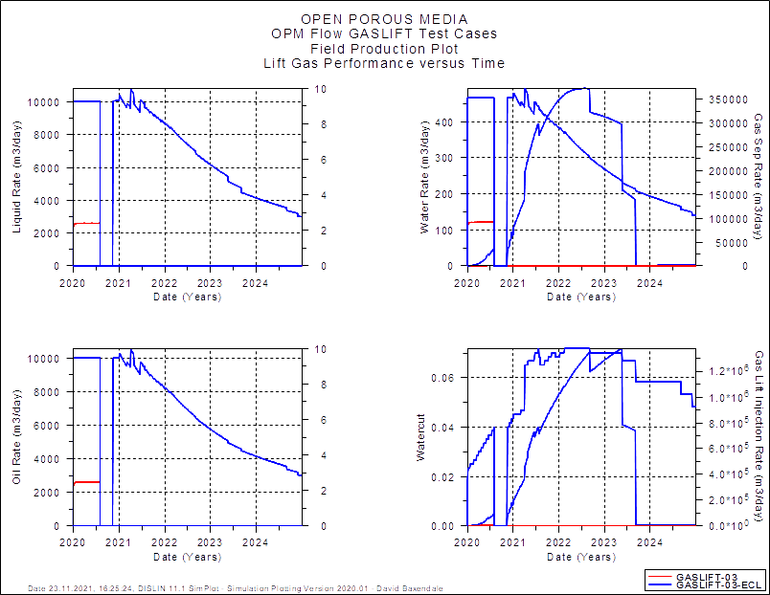
GASLIFT-03: Field Performance

Slide 14
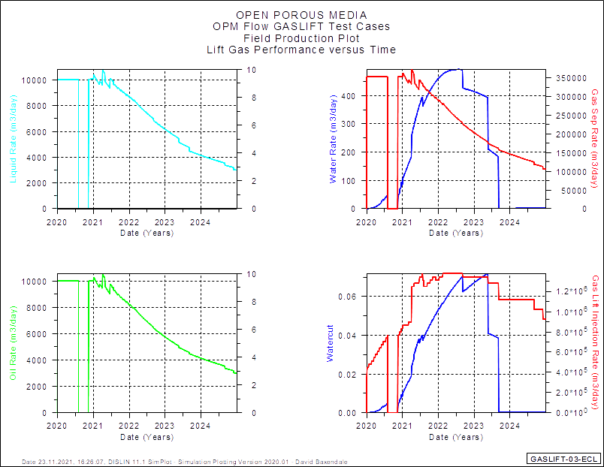
GASLIFT-03: Field Performance

Slide 15
Gas Lift Validation Cases
GASLIFT-04

Slide 16
Gas Lift Validation Cases
GASLIFT-05

Slide 17
Gas Lift Validation Cases
GASLIFT-06

Slide 18
Gas Lift Validation Cases
GASLIFT-07

Slide 19
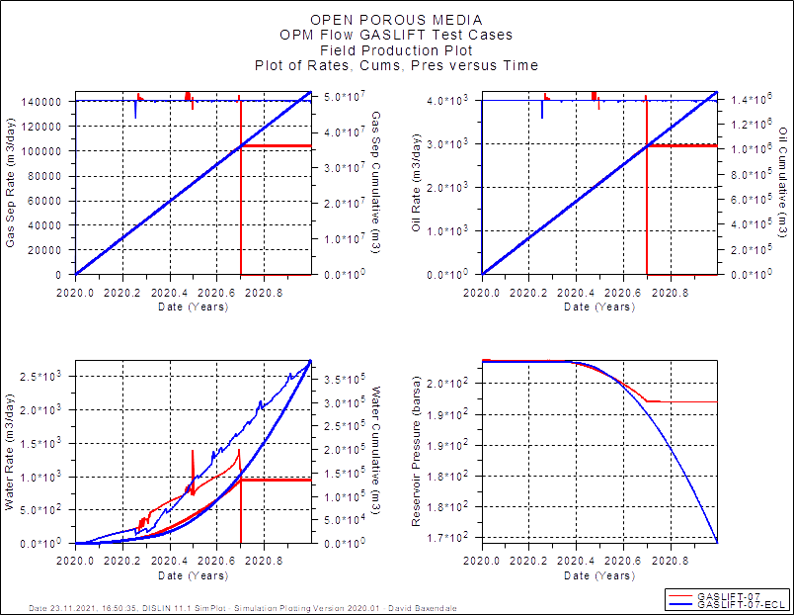
GASLIFT-07: Field Performance
OPM Flow: Well Convergence Issue

Slide 20
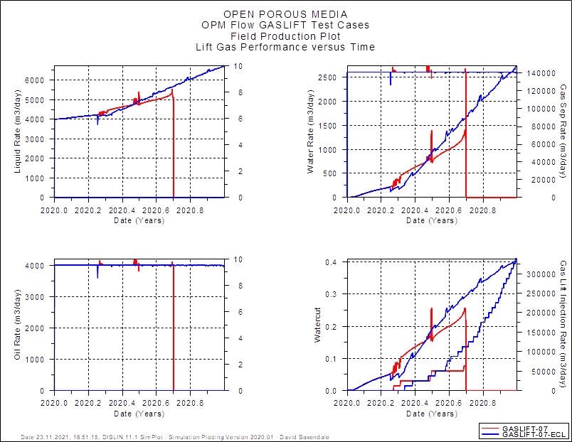
GASLIFT-07: Field Performance
OPM Flow: Well Convergence Issue

Slide 21
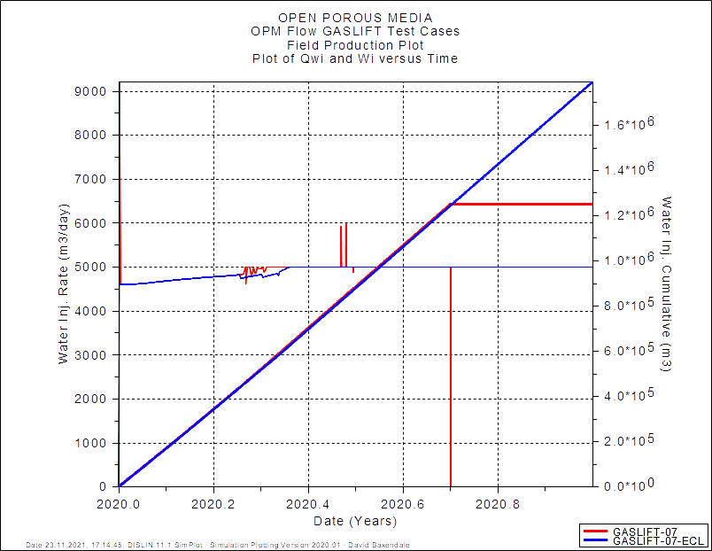
GASLIFT-07: Field Performance
OPM Flow: Well Convergence Issue

Slide 22
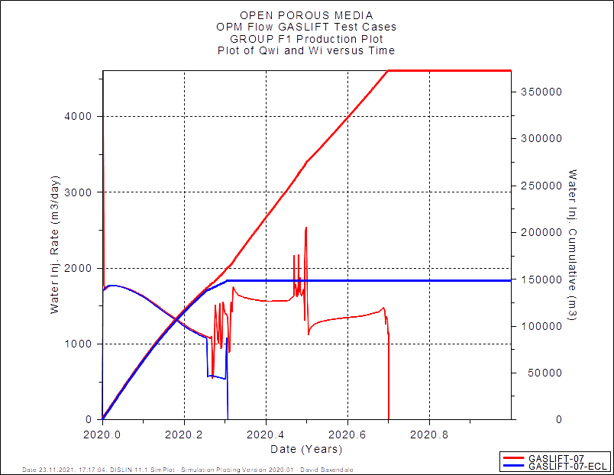
GASLIFT-07: Group Performance
OPM Flow: Well Convergence Issue

Slide 23
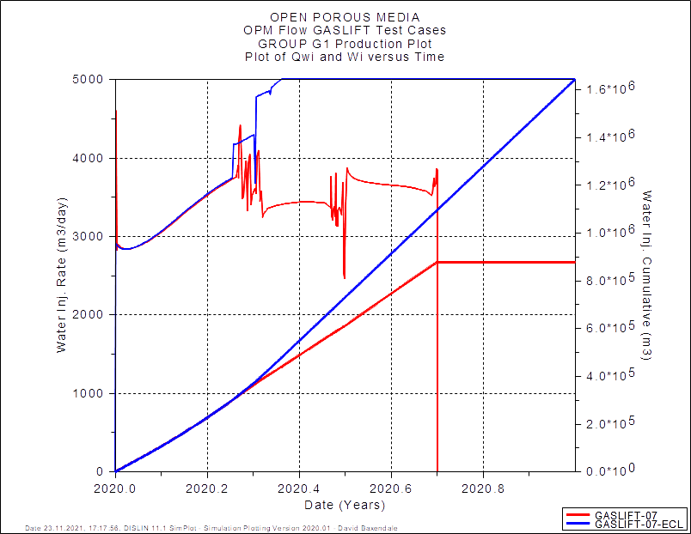
GASLIFT-07: Group Performance
OPM Flow: Well Convergence Issue

Slide 24
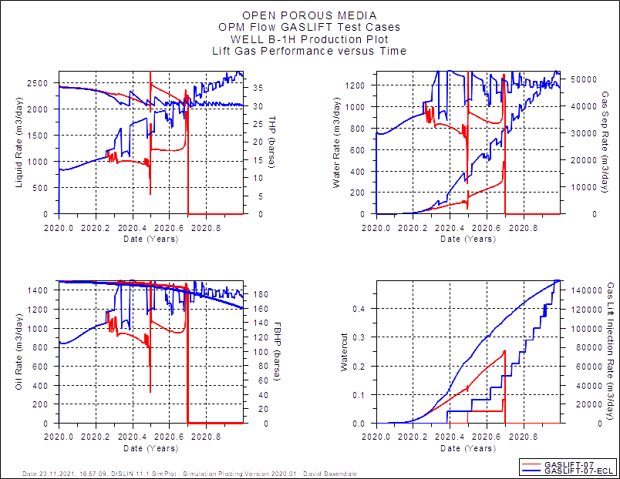
GASLIFT-07: well B-1H

Slide 25
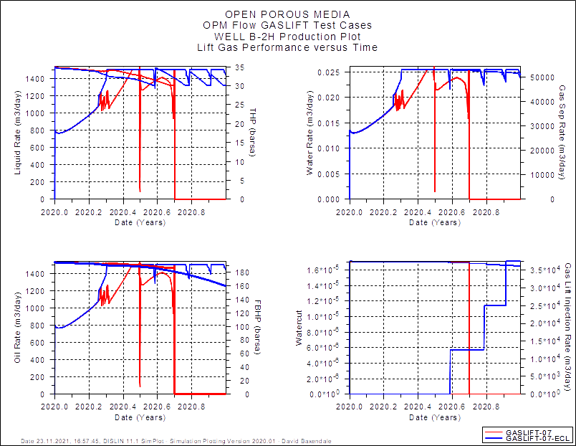
GASLIFT-07: well B-2H

Slide 26
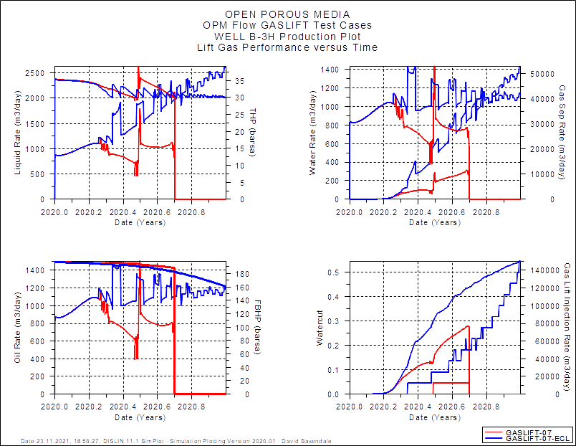
GASLIFT-07: well B-2H

Slide 27
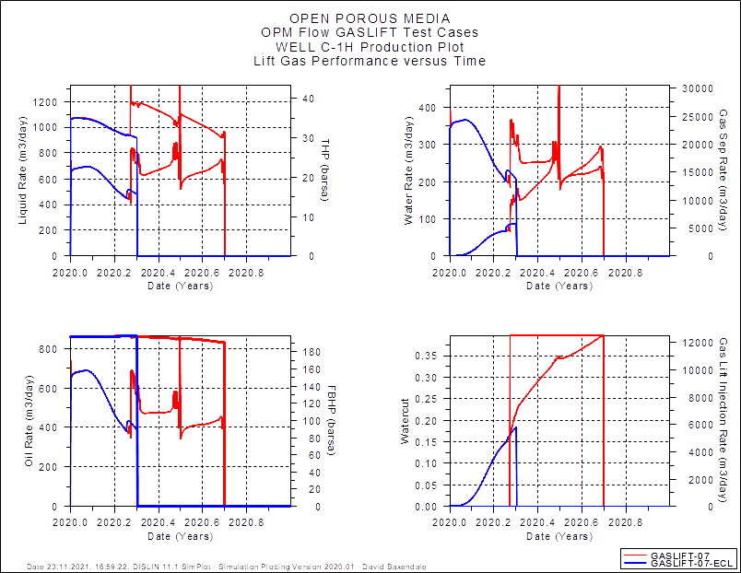
GASLIFT-07: well C-1H

Slide 28
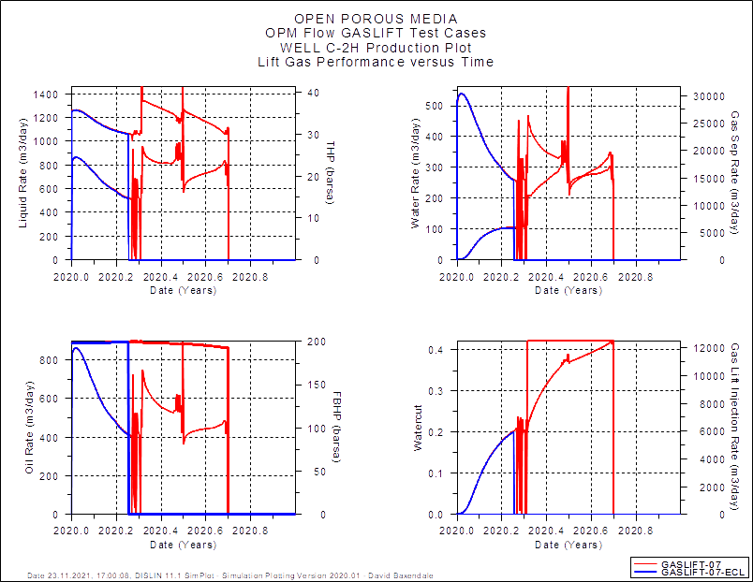
GASLIFT-07: well C-2H

Slide 29
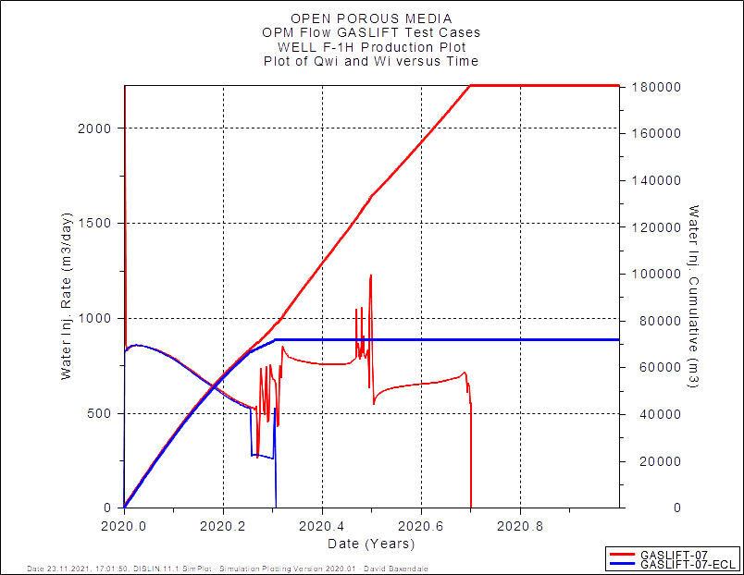
GASLIFT-07: well F-1H

Slide 30

GASLIFT-07: well F-2H

Slide 31
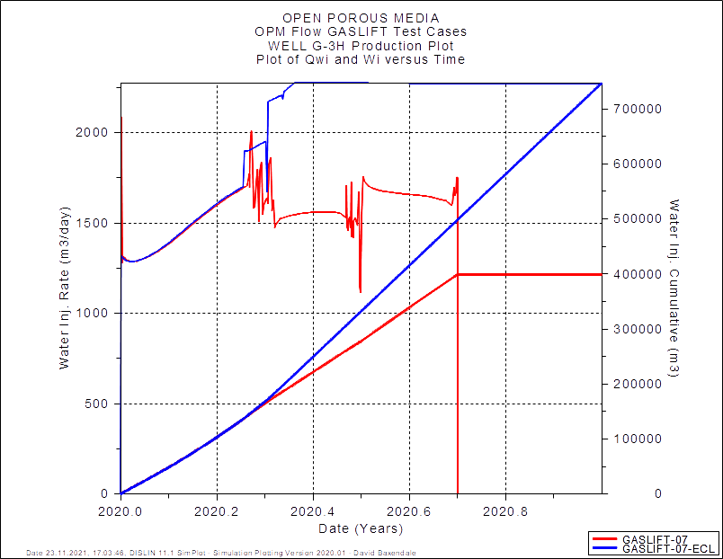
GASLIFT-07: well G-3H

Slide 32
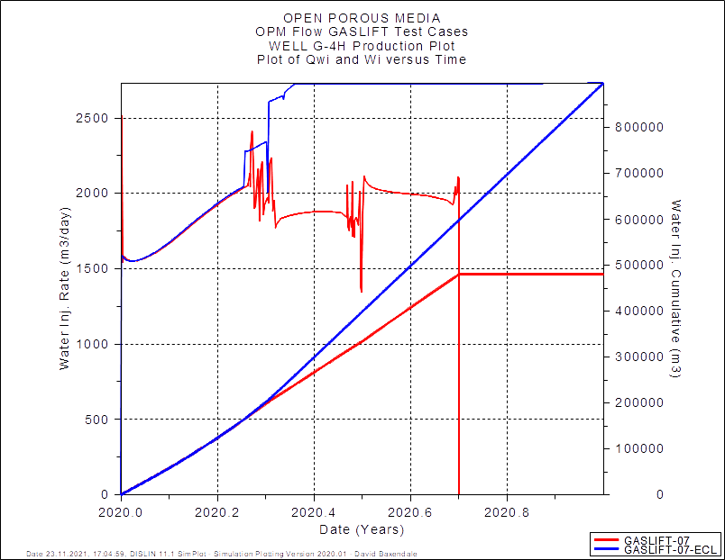
GASLIFT-07: well G-4H

Slide 33
Gas Lift Validation Cases
GASLIFT-08

Slide 34
Gas Lift Validation Cases
GASLIFT-09

Slide 35
Gas Lift Validation Cases
GASLIFT-10

Slide 36
Gas Lift Validation Cases
End of Presentation

