Slide 1
WPIMULT
Validation Cases
August 16th, 2022
COPYRIGHT
This presentation is made available under the Open Database License: http://opendatacommons.org/licenses/odbl/1.0/.
Any rights in individual contents of the database are licensed under the Database Contents License: http://opendatacommons.org/licenses/dbcl/1.0/
Copyright (C) 2022 Equinor

Slide 2

WPIMULT Validation Cases
Objective
Generate various WPIMULT tests to validate OPM Flow’s implementation against the commercial simulator results.
Contents
Case Name | Description | Model | Status
WPIMULT | Based model with the number of layers increased to nine, using the same properties of the original three layers. | WPIMULT | Results are identical to E100.
WPIMULT-01 | WPIMULT(WELPI) set to 0.5 after 30 days, then at the next time step set to 0.5 and 2.0 in the same report step. | WPIMULT | Results are identical to E100.
WPIMULT-02 | OP01 layers 3, 6, and 9 are open and the well productivity is initially set to 0.3333 by WPIMULT with layers set by 1* at the start of the run. One report step later, layers 6 and 9 are shut. One report time step later, the well productivity is increased by 3.0. | WPIMULT | Results are identical to E100.
WPIMULT-03 | Same as WPIMULT-02 except use 0 (zero) for selection of connections. | WPIMULT | Results are identical to E100.

Slide 3
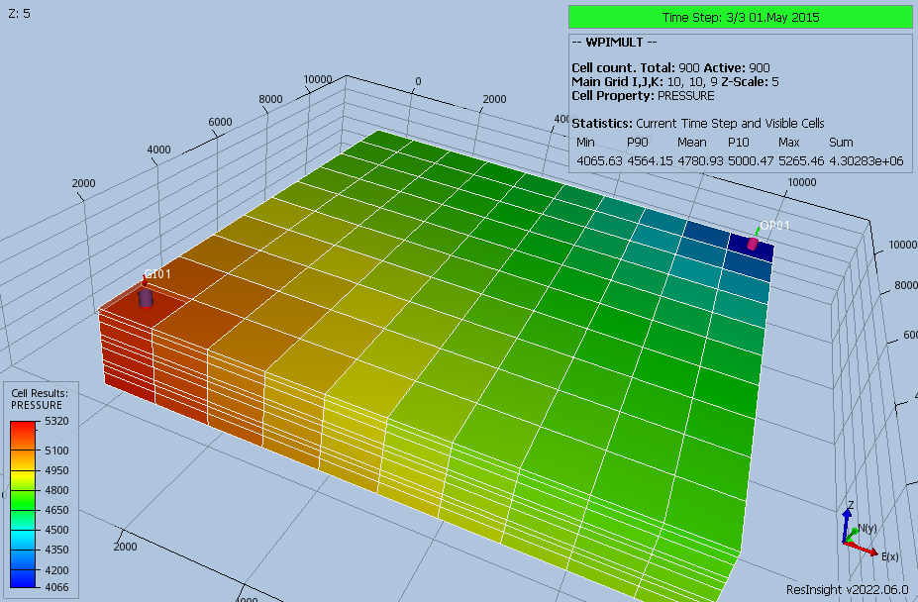
WPIMULT Validation Cases
WPIMULT Model (Base on SPE01 Case 2)
Number of layers has been increased to nine, using the same properties of the original three layers.

Slide 4
WPIMULT Validation Cases
WPIMULT - Results

Slide 5

WPIMULT Validation Cases
Results:
OPM Flow behaves the same as E100 and the results are identical to the commercial simulator.

Slide 6
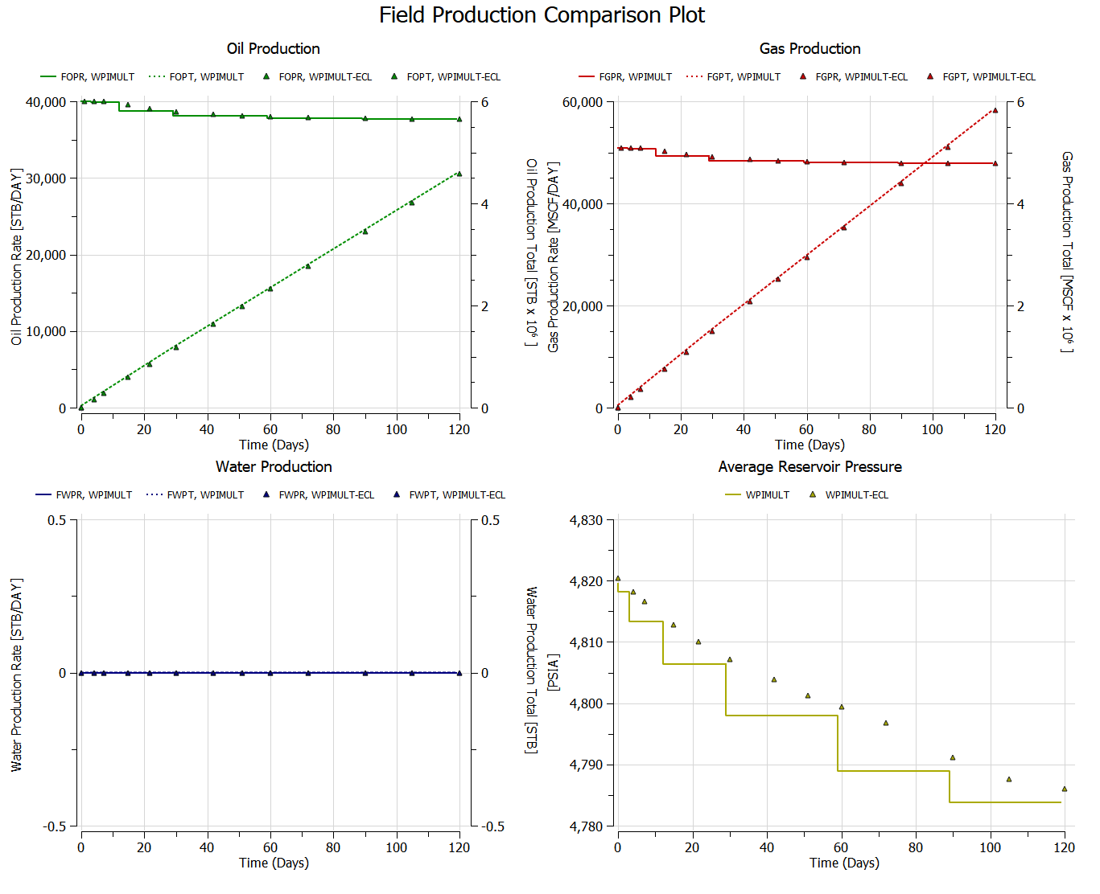
WPIMULT Field Performance
Pressure difference due to time steps.

Slide 7
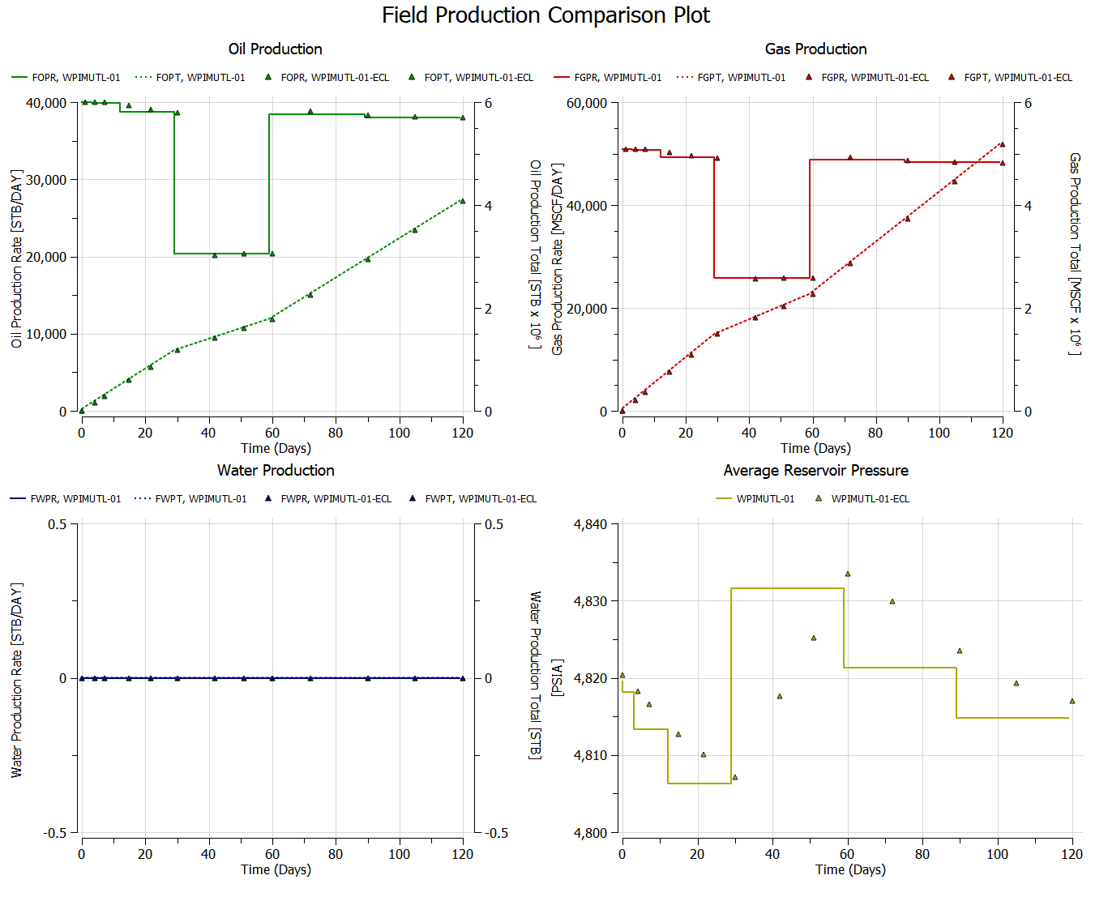
WPIMULT-01 Field Performance
Pressure difference due to time steps.

Slide 8
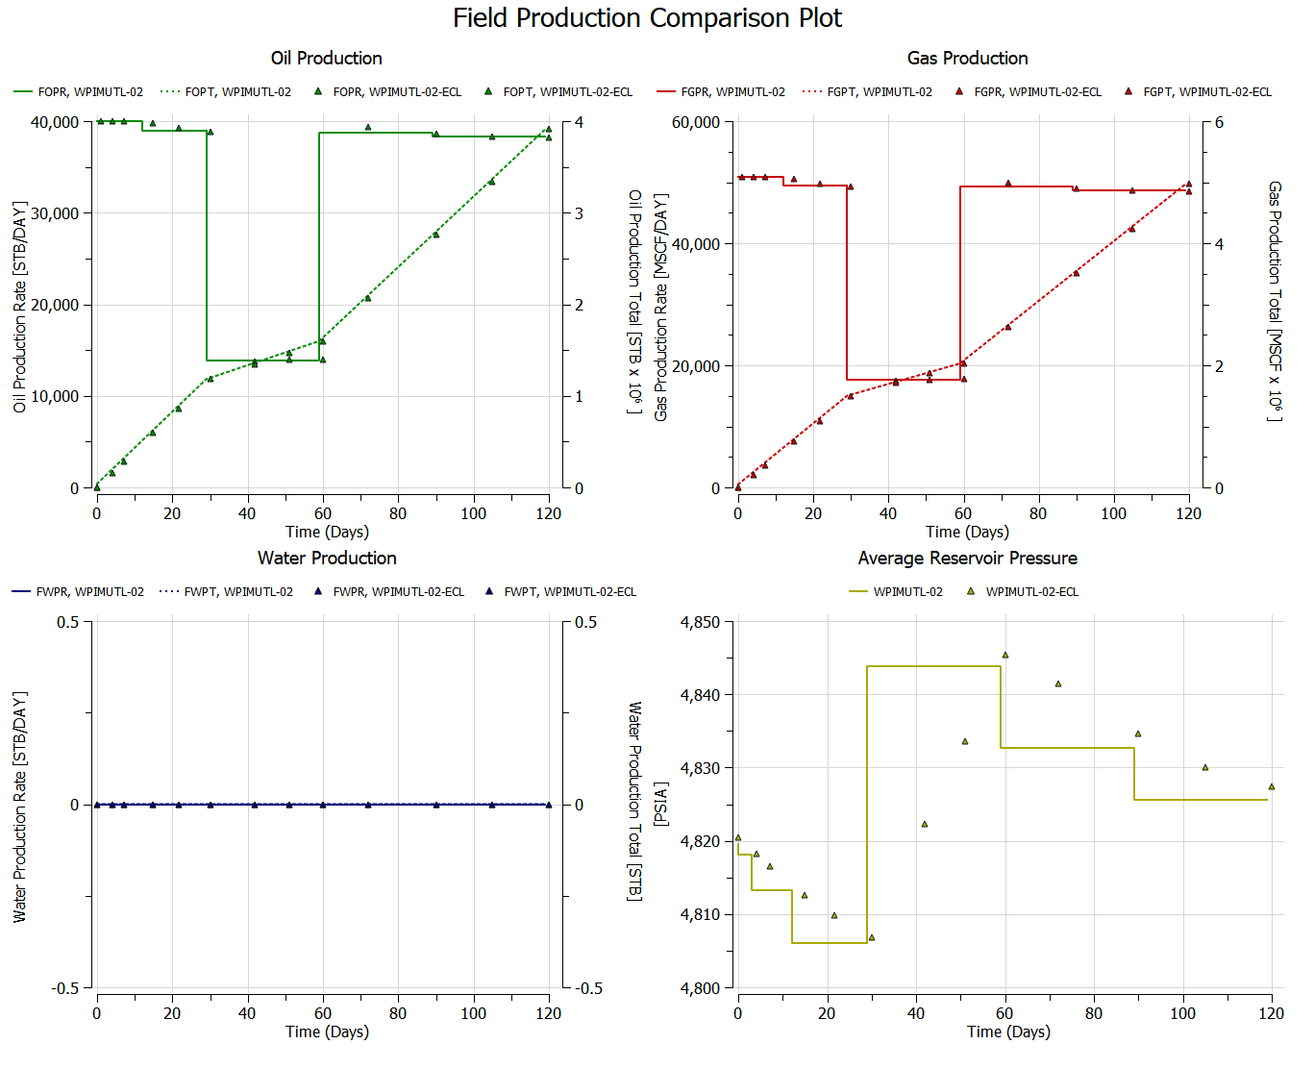
WPIMULT-02 Field Performance
Pressure difference due to time steps.

Slide 9

WPIMULT-03 Field Performance
Pressure difference due to time steps.

Slide 10
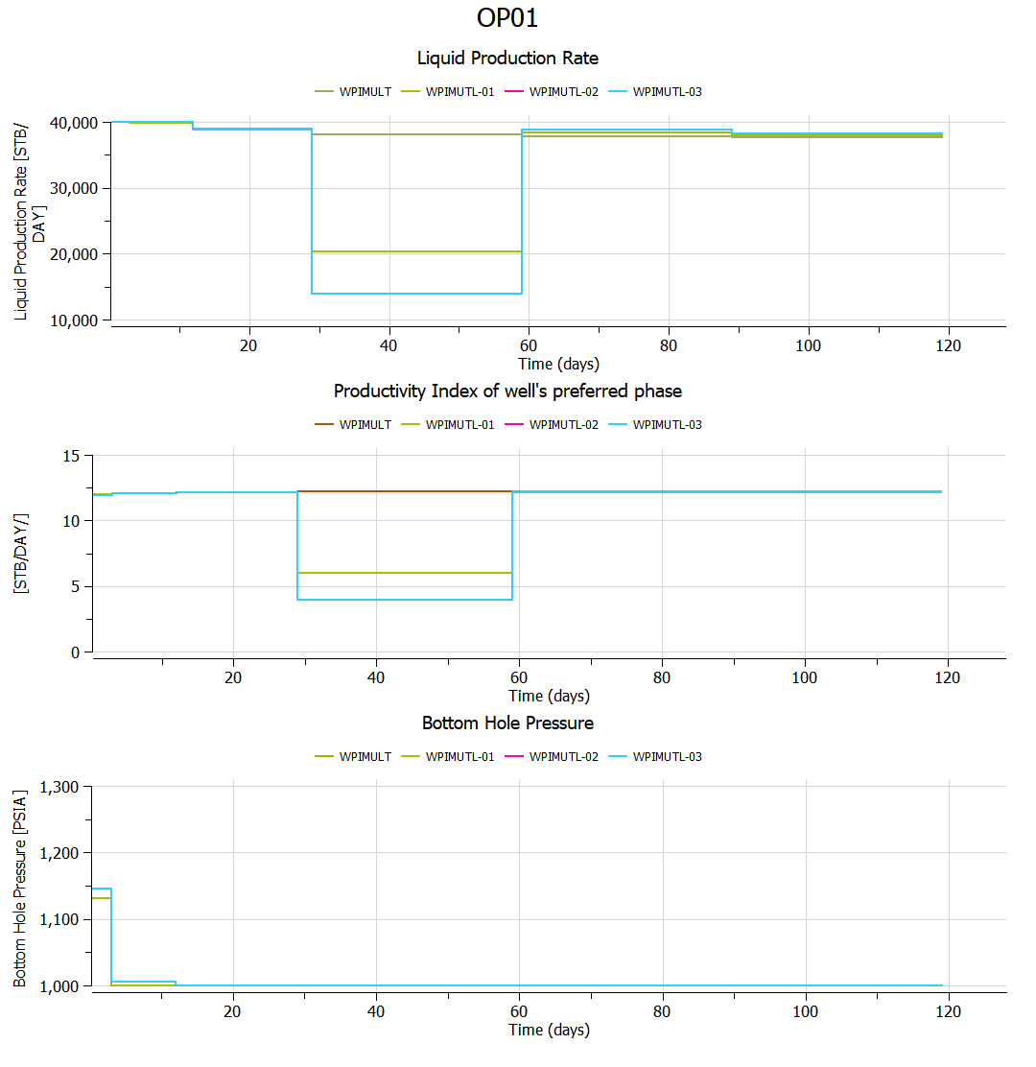
WPIMULT: Well OP-01 Performance
Results are consistent

Slide 11
WPIMULT Validation Cases
End of Presentation

