Slide 1
WVFPEXP
Validation Cases
May 25th , 2022
COPYRIGHT
This presentation is made available under the Open Database License: http://opendatacommons.org/licenses/odbl/1.0/.
Any rights in individual contents of the database are licensed under the Database Contents License: http://opendatacommons.org/licenses/dbcl/1.0/
Copyright (C) 2022 Equinor

Slide 2

WVFPEXP Validation Cases
Objective
Generate various WVFPEXP tests to validate OPM Flow’s implementation against the commercial simulator results.
Contents
Case Name | Description | Model | Status
WVFPEXP-01 | Base tartan anticline model with WVFPEXP default values | WVFPEXP | Results different to E100.
WVFPEXP-02 | WVFPEXP(CONTROL) set to YES2 | WVFPEXP | Results different to E100.
GASLIFT-03 | Three-Phase, Corner-Point, variable GLIFT, MODEL05 PVT | GASLIFT | Three-Phase. Gas Lift not working when only GOR in VFP table (no ALQ)?
GASLIFT-04 | Three-Phase, Corner-Point, variable GLIFT, MODEL05 PVT/VFP | GASLIFT | Completely different, various gas lift optimization warnings.
GASLIFT-05 | Base | MODEL05 | Completely different, wells shut-in that should be flowing, convergence issues.
GASLIFT-06 | Base and group ORAT=6000 | MODEL05 | Completely different, all wells shut-in except C-2H.
GASLIFT-07 | Base and group LIFTOPT(OPTLIFT)=NO | MODEL05 | Completely different, convergence issues. Should be similar to GASLIFT-05.
GASLIFT-08 | Base and group ORAT=6000, Max ALQ from VFP | MODEL05 | Completely different, convergence issues, no gas lift on several wells.
GASLIFT-09 | Base and group ORAT=6000, Max ALQ from VFP, TSTEP=15 | MODEL05 | Completely different, convergence issues, no gas lift on several wells.
All cases run with five day time steps for comparison purposes.

Slide 3
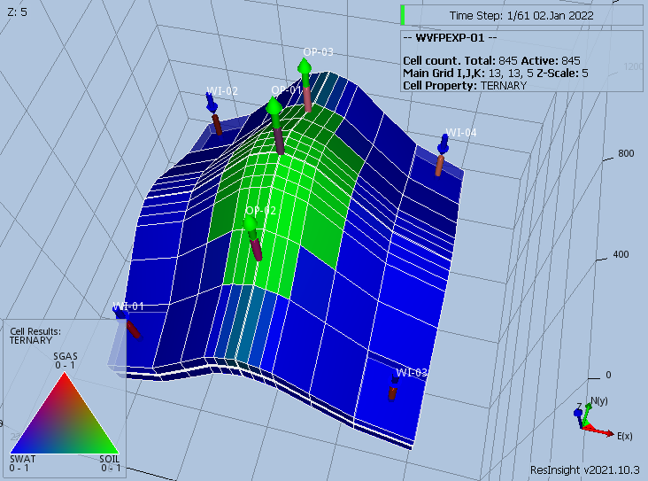
WVFPEXP Validation Cases
WVFPEXP Model (Irregular Corner-Point)

Slide 4
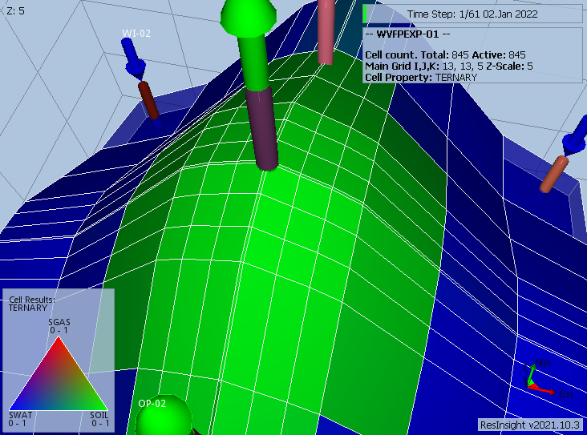
WVFPEXP Validation Cases
WVFPEXP Model (Irregular Corner-Point)
Fine grid in the center of model to induce inter-well inter-actions.

Slide 5
WVFPEXP Validation Cases
WVFPEXP-01
Base tartan anticline model with WVFPEXP default values

Slide 6
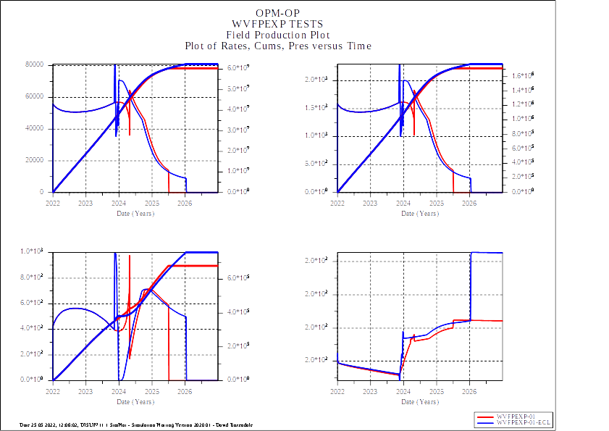
WVFPEXP-01: Field Performance

Slide 7
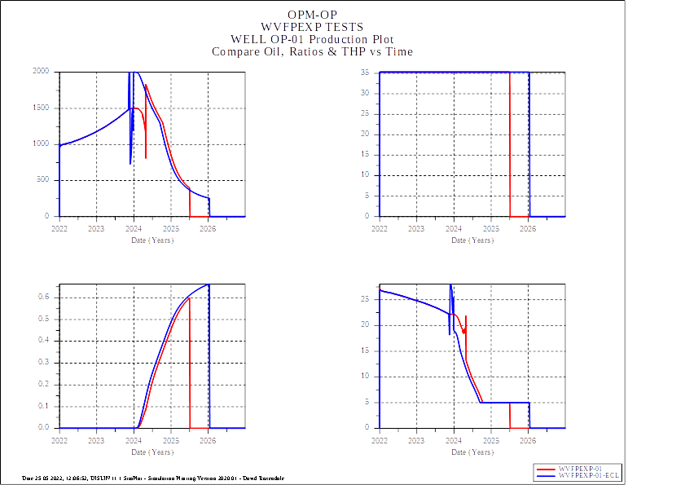
WVFPEXP-01: Well OP-01 Performance
Reasonable Match

Slide 8
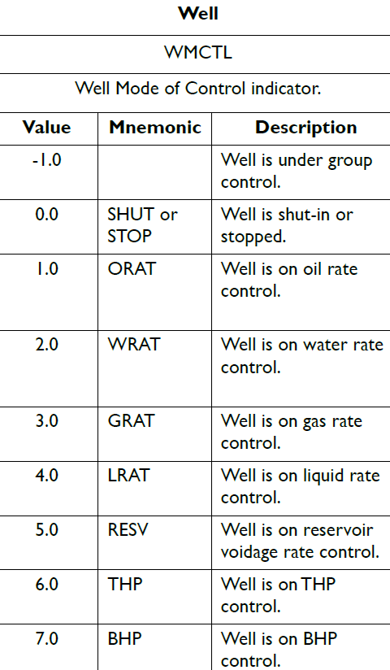
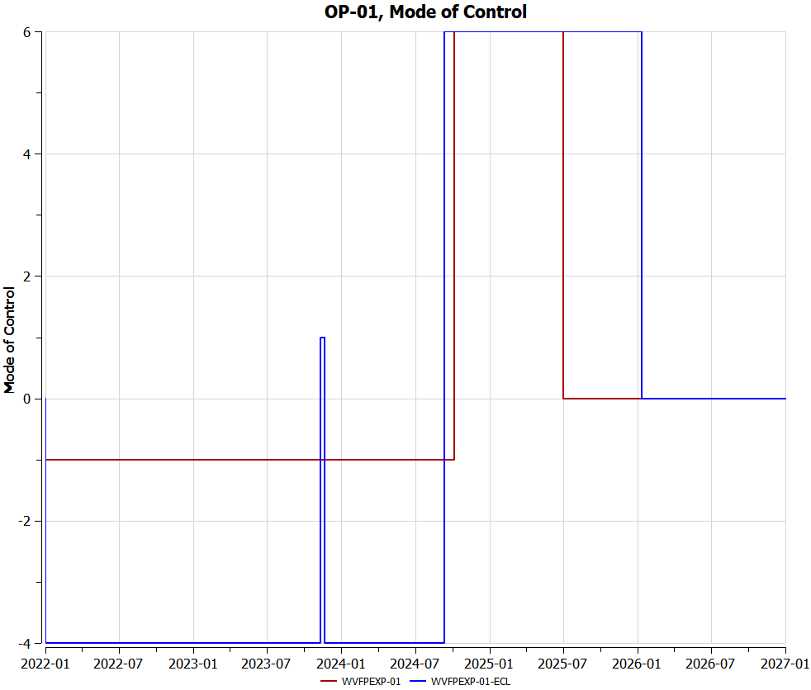
WVFPEXP-01: Well OP-01 Control
Incorrect Control Mode

Slide 9
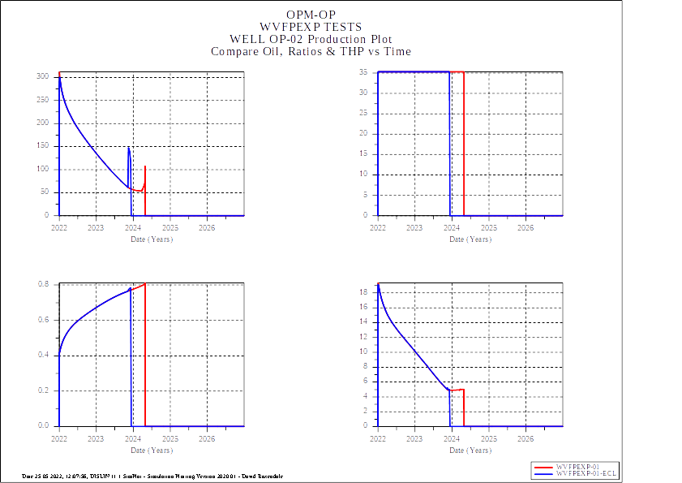
WVFPEXP-01: Well OP-02 Performance
Reasonable Match

Slide 10
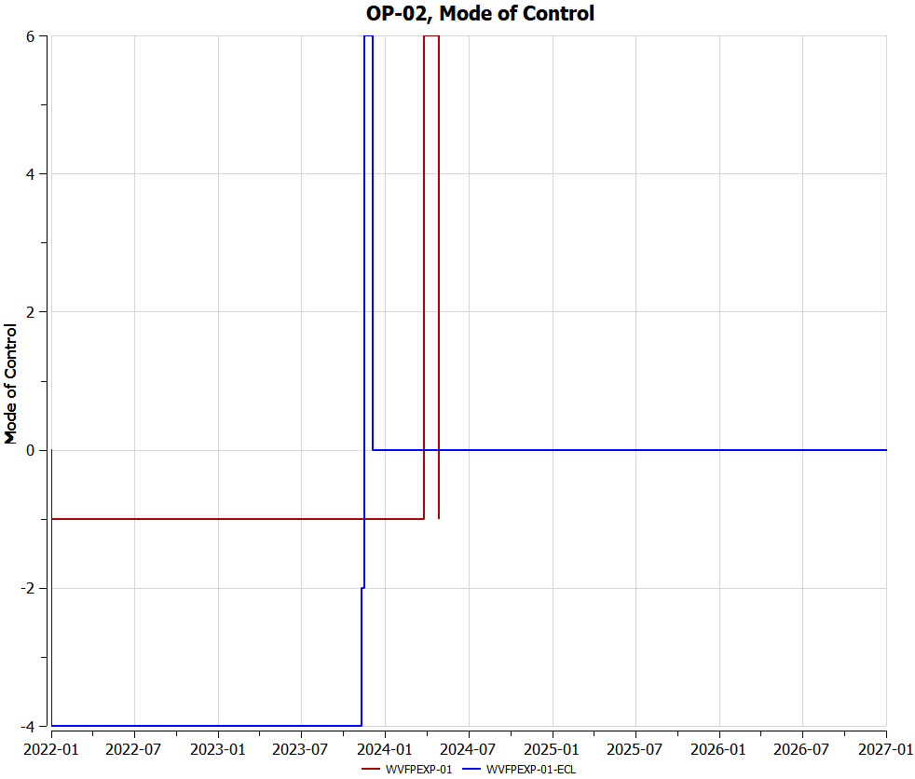
WVFPEXP-01: Well OP-02 Control
Incorrect Control Mode

Slide 11
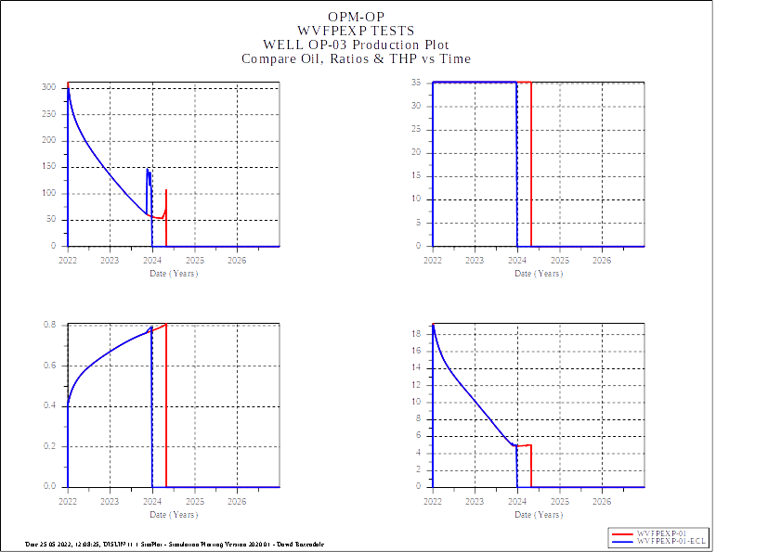
WVFPEXP-01: Well OP-03 Performance
Reasonable Match

Slide 12

WVFPEXP-01: Well OP-02 Control
Incorrect Control Mode

Slide 13
WVFPEXP Validation Cases
WVFPEXP-02
WVFPEXP(CONTROL) set to YES2

Slide 14
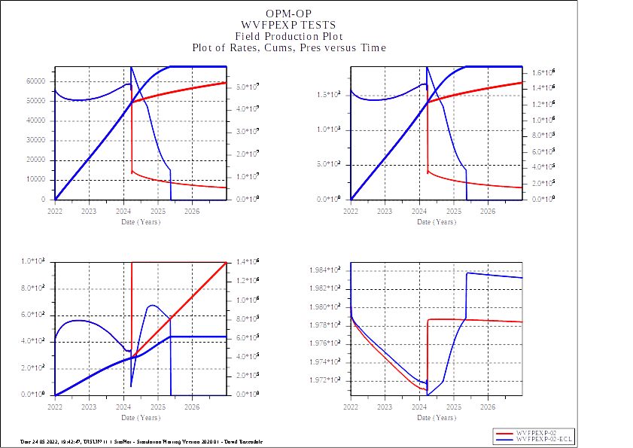
WVFPEXP-02: Field Performance
No Match

Slide 15
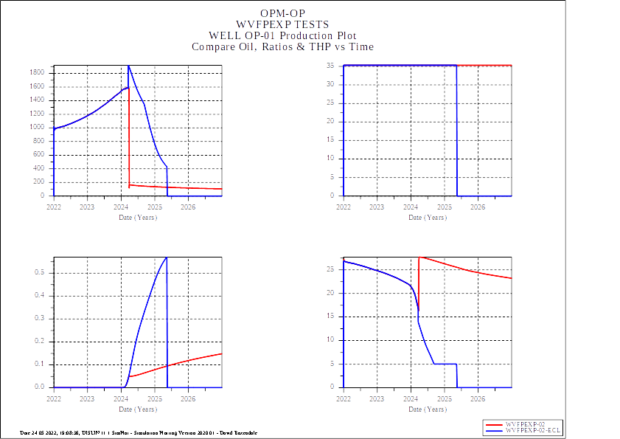
WVFPEXP-02: Well OP-01 Performance
No Match

Slide 16
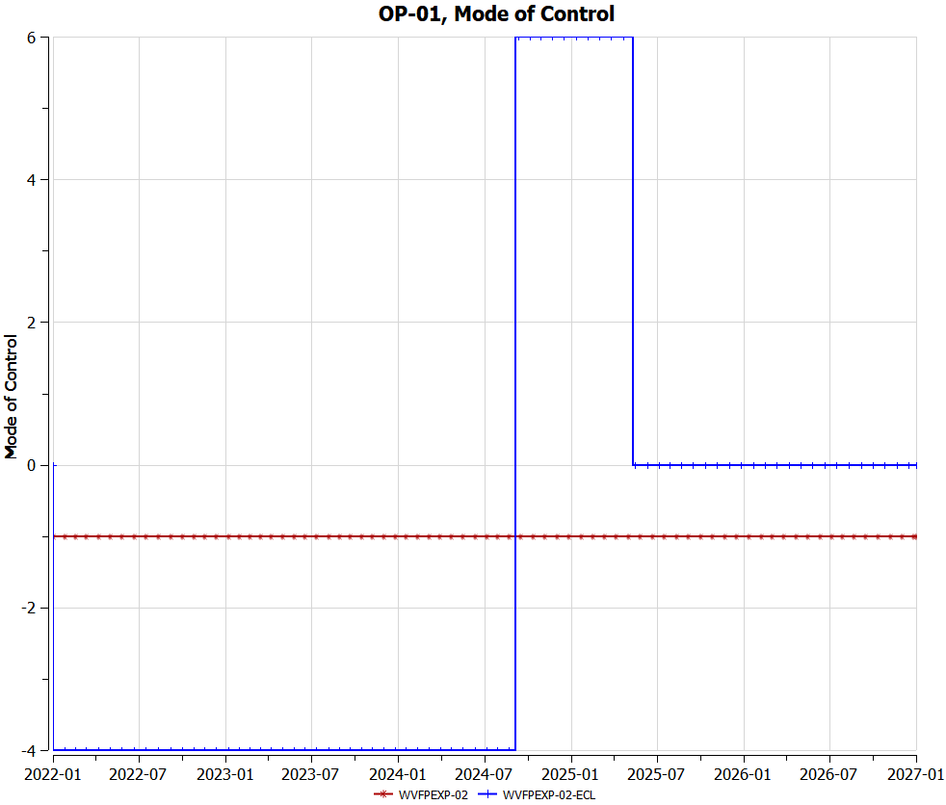
WVFPEXP-02: Well OP-01 Control
Incorrect Control Mode

Slide 17
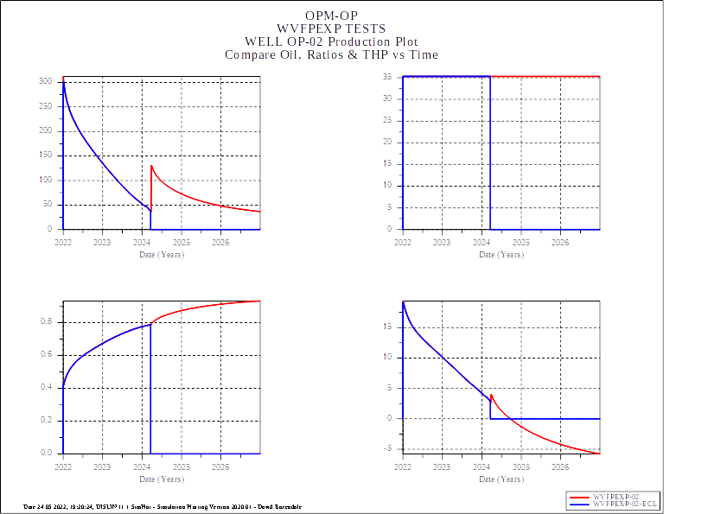
WVFPEXP-02: Well OP-02 Performance
Well should be stopped/shut-in if IPR does not intersect VFP

Slide 18
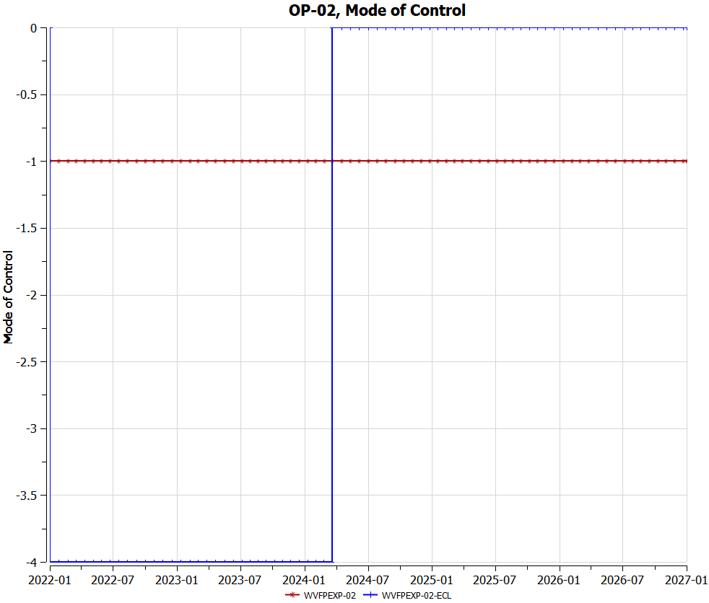
WVFPEXP-02: Well OP-02 Control
Incorrect Control Mode

Slide 19
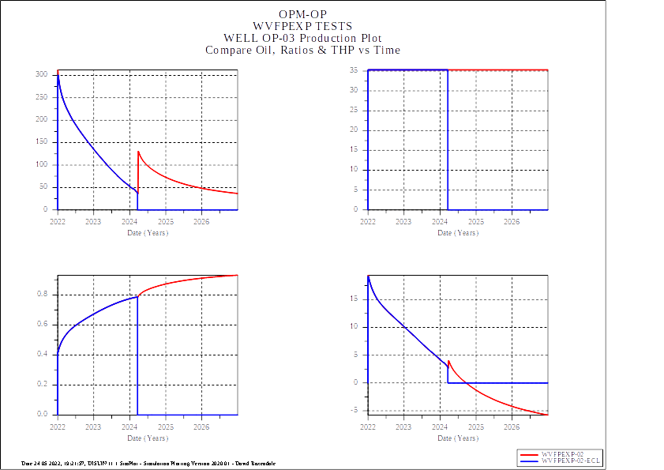
WVFPEXP-02: Well OP-03 Performance
Well should be stopped/shut-in if IPR does not intersect VFP

Slide 20

WVFPEXP-02: Well OP-03 Control
Incorrect Control Mode

Slide 21
WVFPEXP Validation Cases
End of Presentation

