Slide 1
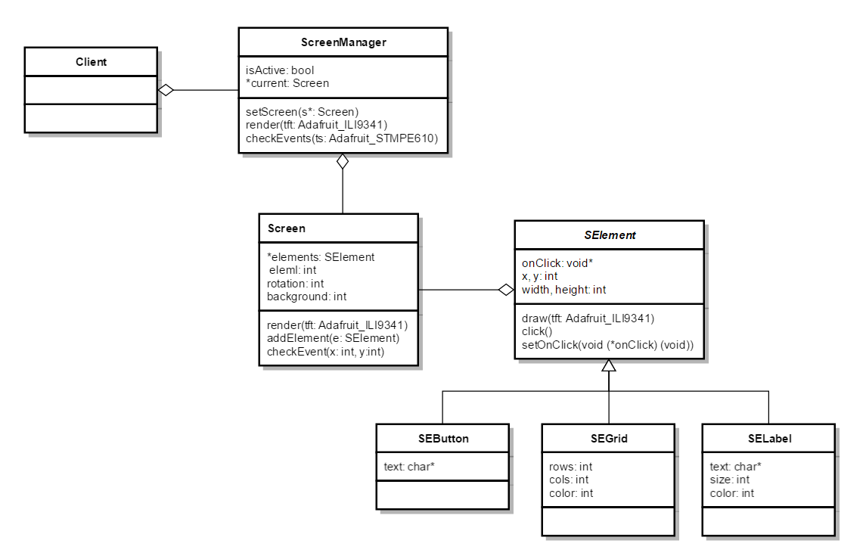
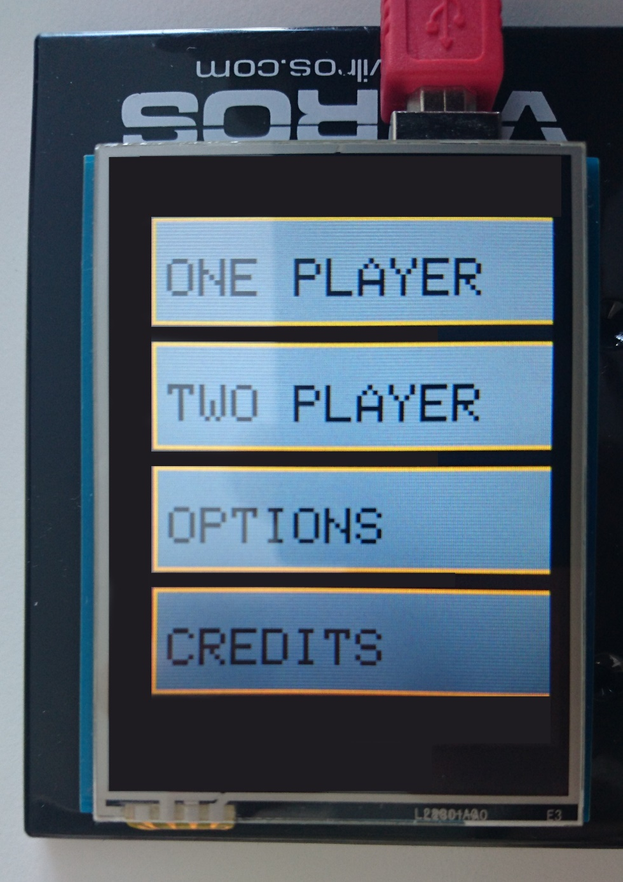
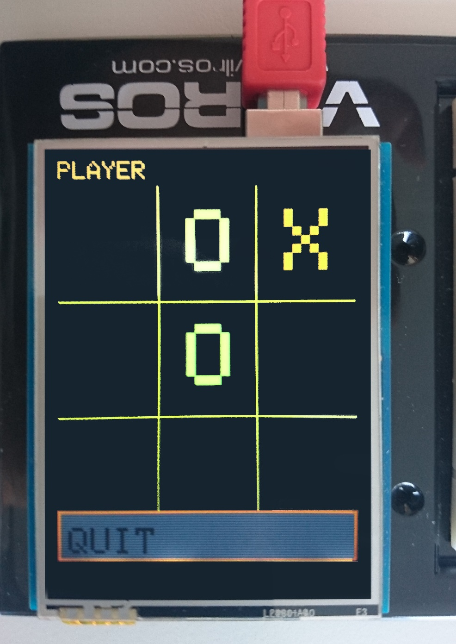
TicTacToe
Arduino Project
Lukas Luschin, Julian Altmeyer
luluschi@htwg-konstanz.de
jualtmey@htwg-konstanz.de
What is the project about?
Our project was about implementing the well known game “TicTacToe” on an Arduino Uno microcontroller board. The game as itself is controlled with a small display on top, which allows users input over touch. You can play the game versus another human. A single player mode where you can play against a computer was not implemented yet.
How we made it
We used the Arduino Uno board with a 2.8“ TFT resistive touch display. The game was implemented in C++ with the Arduino Software IDE. To control the display, like basic drawing and receiving touch input, we applied the provided library from the display manufacturer.
We decided to build a standard GUI architecture (Fig. 1). This gives us the possibility to add GUI elements to the screen, like buttons, labels, etc.
After that was done, we created a controller which is responsible for the game logic (Fig. 2). Both the GUI and the controller are completely separated by an observable like pattern.
Figure 1: GUI Architecture
What it looks like
When you start the Arduino, you can see an intro screen first. After that you get straight to the main menu. You can choose between four different options:
Singleplayer, Multiplayer, Options and Credits.
To start the game quickly you can select e.g. “Multiplayer”. This will cause the Arduino to initiate a new two player TicTacToe game.
Figure 2: Game Logic Flowchart

