Slide 1

GRIDGUARD AI
Situational Awareness & Automated Revenue Recovery
A Project by NofluxGiven

Slide 3
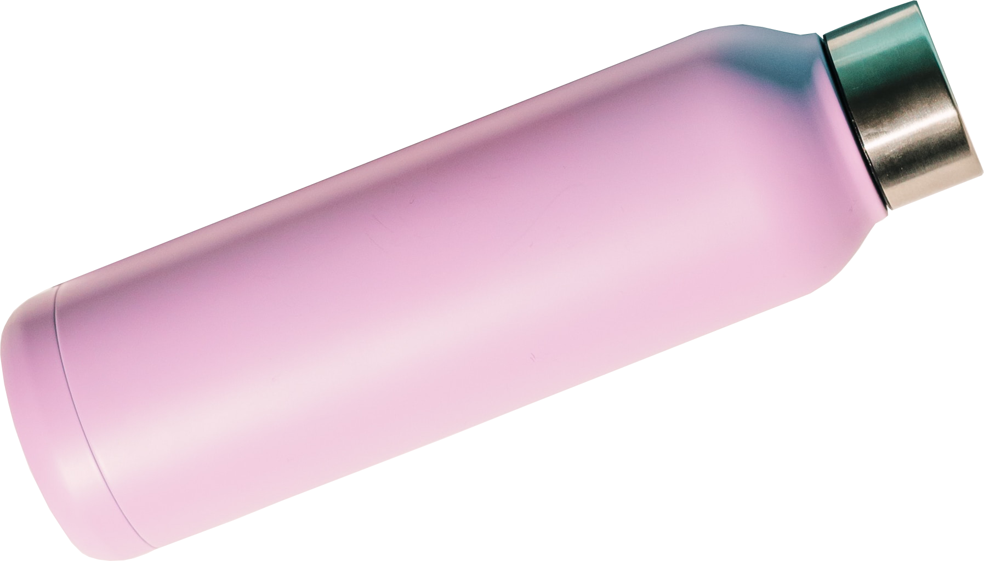
GridGuard AI
May 2026
NofluxGiven

Slide 4
GridGuard AI
May 2026
NofluxGiven
13.9TWh lost to theft.
Direct connections cause
thermal overload and
catastrophic transformer
explosions (R150,000+).
THE BLEED
Eskom's R23 Billion
Annual Loss.

Slide 5
THE SENTINEL
& THE BRAIN.
GridGuard AI
May 2026
NofluxGiven
Rogowski Coil
Linear Rogowski Coil
detects 1-Amp theft just as
clearly as 1000-Amp faults.
TinyML running locally
infers entirely offline.
Harmonic Restraint:
Filters 2nd & 5th harmonics
to ignore transient surges.
CNN-LSTM AI:
Quantized to 8-bit,
runs entirely on the edge.

Slide 6
SURGICAL
ISOLATION.
GridGuard AI
ACTIVE - FORENSIC - CELLULAR
NofluxGiven
GRIDGUARD DUAL-MODE DEPLOYMENT
ACTIVE - FORENSIC - CELLULAR
Instantly severs the thief
connection using a 12V
relay in under 3 seconds.
Paying customers keep
their lights on.
< 3s
-100%

Slide 7
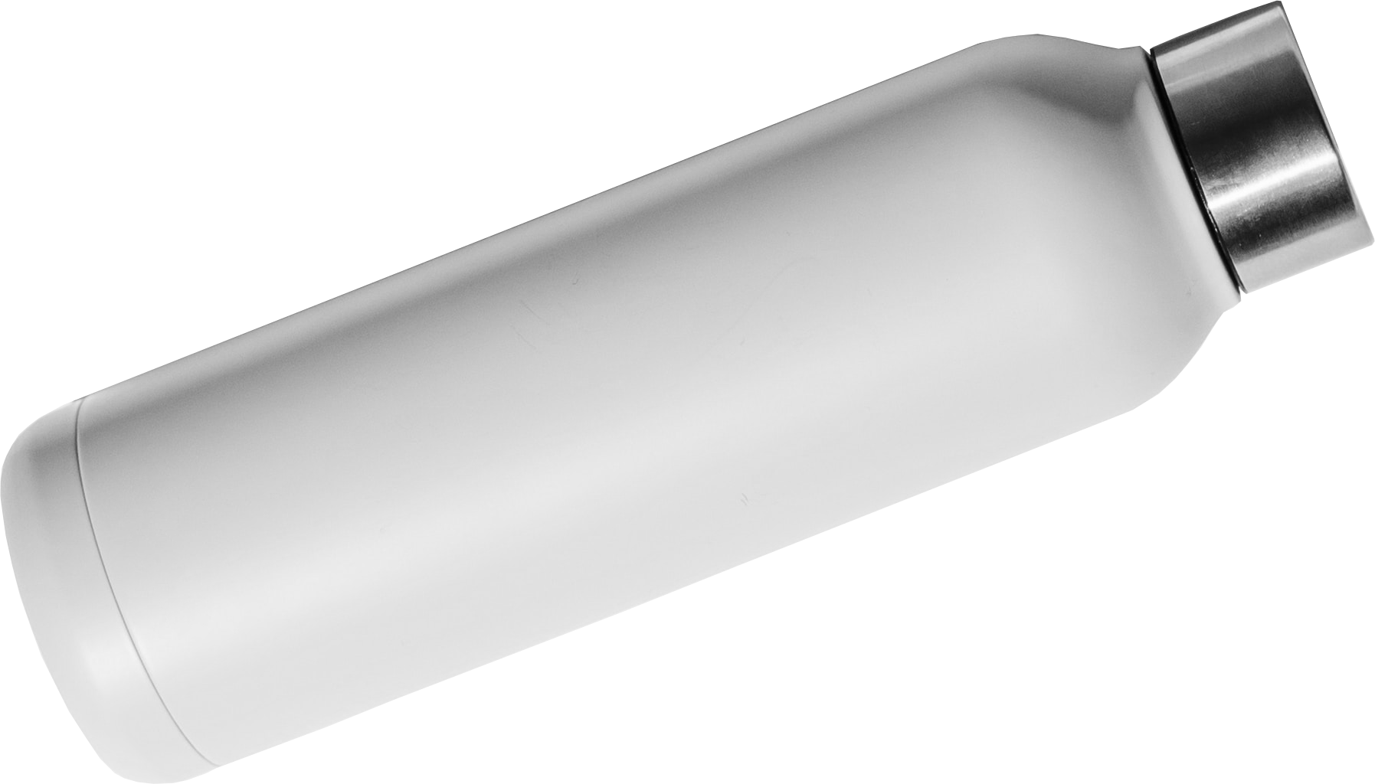
3.4 Months Payback
Surgical Infrastructure Enforcement
R150,000 Saved Per Pole
Protecting South Africa's Power Grid
R23 Billion Revenue Saved

