Slide 1


Tech Tips from the EXCIT Meetings Presented by GRIT

Slide 2
Introduction
This slide deck includes “Tech Tips” for modules within the Huron Research Suite (HRS) presented by the Graduate and Research IT (GRIT) team at the monthly EXCIT meetings.
Tech Tips are based on feedback and common questions from the Office of Research and the Research Community
Tech Tips are compiled from each of the EXCIT meetings and made available for reference on the Project Wahoo site at https://wahoo.research.ucf.edu.

Slide 3
Tech Tips – Huron Grants
Administrative Changes to Record States
In department review, Department Admin will need to “Request Changes” so proposal is editable.
Copy proposal and withdraw the original. Copy is in “Draft” state
Uploading Attachments/Documents
Use “Add Attachment” Activity in Proposals
Use “Upload Award Documents” Activity in Awards
Notes:
Asking to have proposal states changed back to draft
Used to do it in ARGIS but this is not a business practice Huron will support going forward due to a variety of unintended consequences that affect different record states, metrics and versioning.
In cases like this, department reviewers will need to request a change and follow that defined business process. This will assign the proposal back to the PI and will allow them to make changes. The proposal will then need to be sent back to department approval.
If a user does not want to assign it back to the PI, they will need to copy the proposal, which creates a new proposal in draft state of the same information as the original and withdraw the original one.
Uploading attachments
They are only editable when uploaded through Add Attachments on proposal and Upload Award Documents on an Award.
For Ancillary reviews, ask reviewers to “Refer to “5 Day Rule Test Data) and then attach using indicated method.

Slide 4
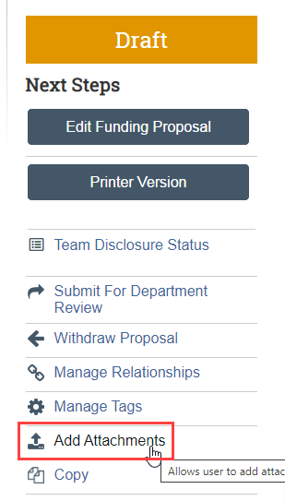
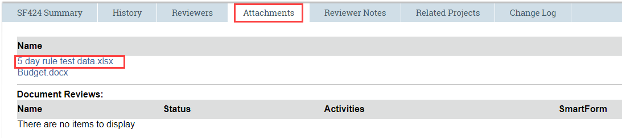
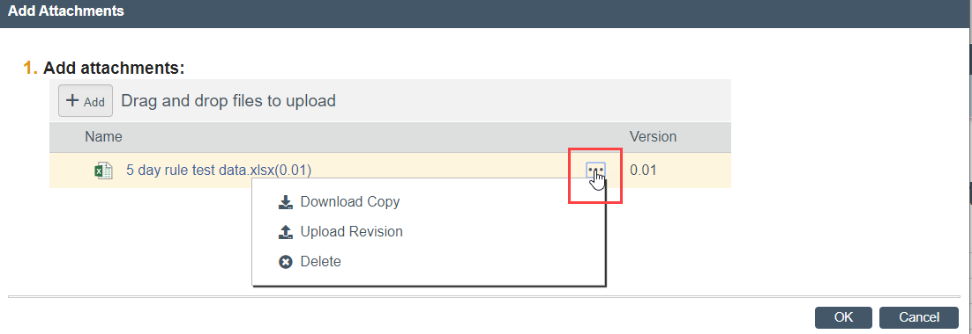
Tech Tips – Huron Grants
Presented on 2/19/20
Proposal Attachments/Documents

Slide 5
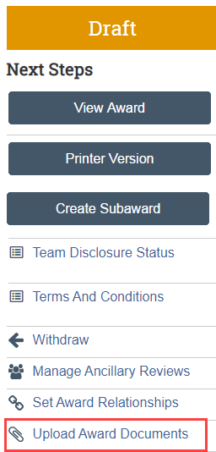
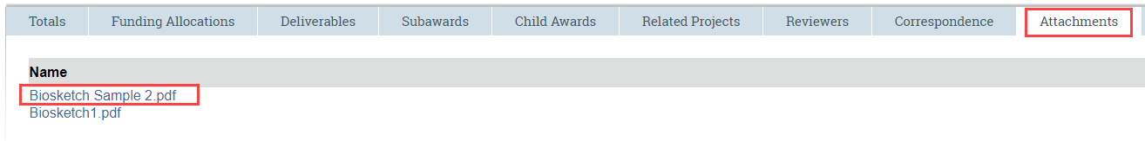
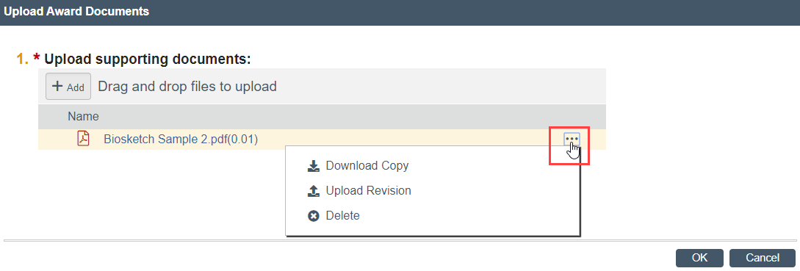
Tech Tips – Huron Grants
Presented on 2/19/20
Award Attachments/Documents

Slide 6
Tech Tips – Huron Grants
Presented on 2/19/20
Department Reviewer/Chair Workflow Changes
Applied to new records created after the change is implemented
Provide Proposal ID for any in-progress records to be updated
When requesting these changes, please specify ALL of the departments that need to be changed
Award End Date Mod Request
Use No Cost Extension (NCE) Mod Type
This updates per allocation
Last allocation date will update the award end date
Notes:
Reminder that changing workflow affects new records and not those that were already in progress. Monique example. We need to submit a support request to Huron to have those updated.
Award End Date Update – When users selected Award Mod “Other Changes” the Award Date Changes page is provided and from where the end date was pulled. If they use NCE award mod to change award end date, no issues.

Slide 7
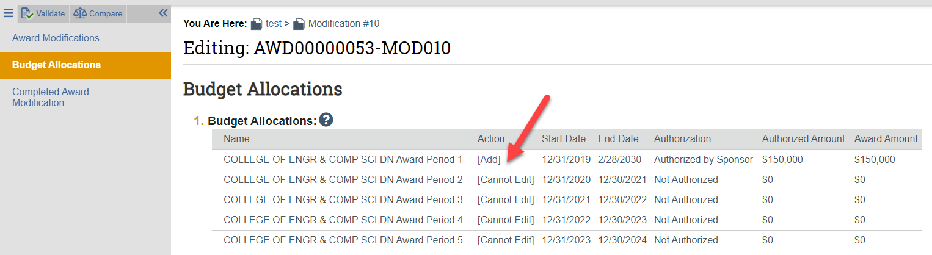
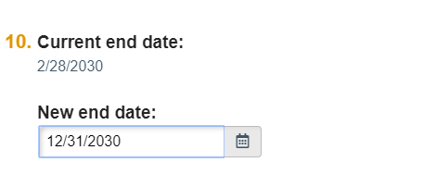
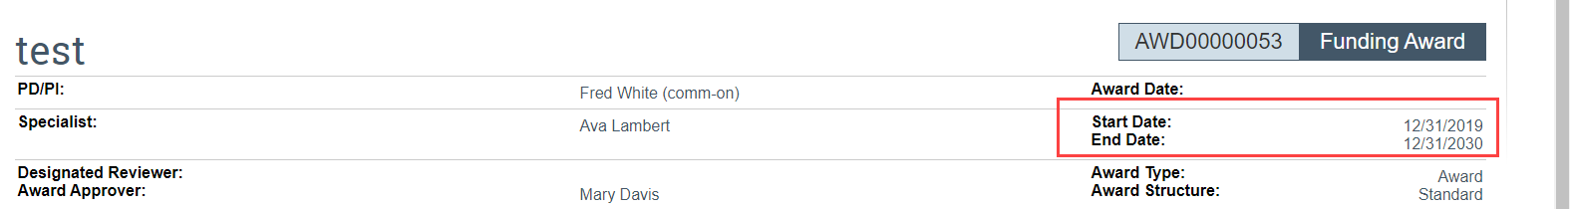
Tech Tips – Huron Grants
Presented on 2/19/20
Award End Date Modification

Slide 8
Tech Tips – Huron Grants
Presented on 2/19/20
Record IDs vs. RIDs
ARGIS single RID #
Huron Record IDs
New
Unique Proposal ID (FP00000555)
Unique Award ID (AWD00000123)
Project ID 1 – Financial account for spending
Project ID 2 – Financial account for spending
Etc.
Converted Awards
Identified as digits only or start with CONV or RF followed by numbers (0000068555, CONV0003465, RF00000345)
Both the Proposal AND the Award have the SAME ID on converted award records
Notes:
People are having trouble finding their awards in Huron.
ARGIS had a single RID to which all of the information about research proposals and grants was associated.

Slide 9
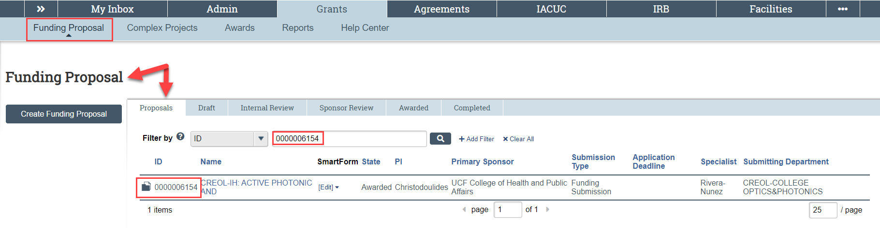
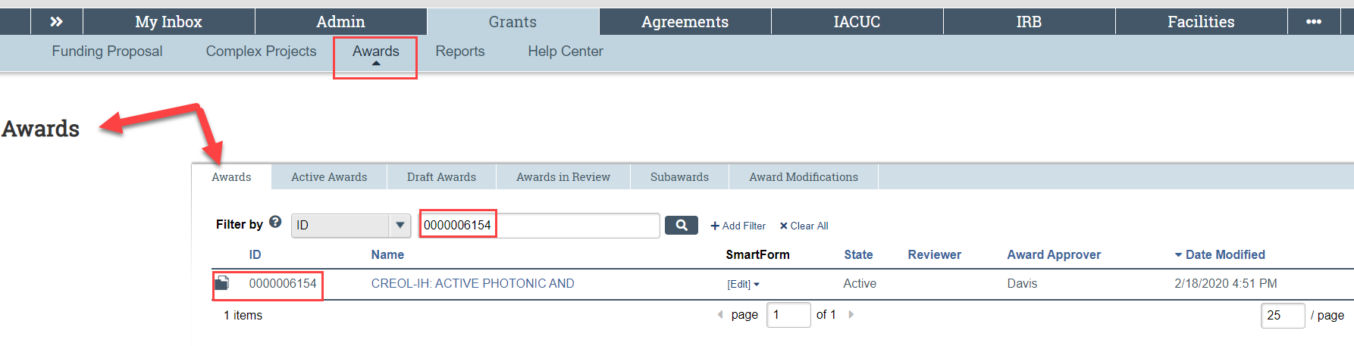
Tech Tips – Huron Grants
Presented on 2/19/20
Searching for your award in Huron on a Converted Record
Make Sure you are on the correct tab in Huron Grants
Notes:
Default is to proposals. Make sure you are on Awards if looking for your converted award.
Converted Record ID: 0000006154

Slide 10
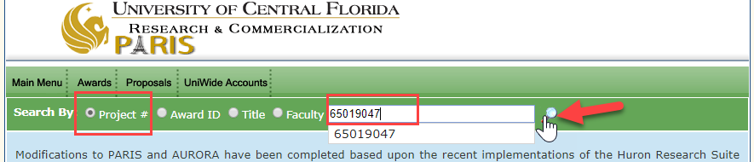
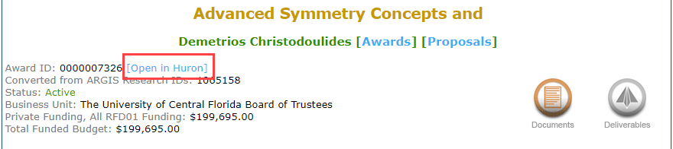
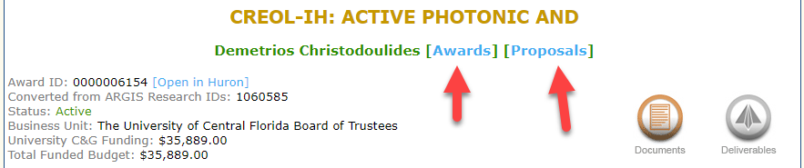
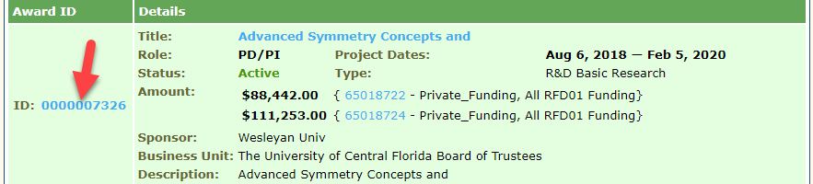
Tech Tips – Huron Grants
Presented on 2/19/20
Searching for your Award in Huron on a Converted Record
Can only search by Proposal or Award ID, NOT by Project ID.
If you only have the project ID, go to PARIS, search for project ID, Choose award or proposal, click ID and click option to Open in Huron.
Notes:
Project ID: 65019047

Slide 11
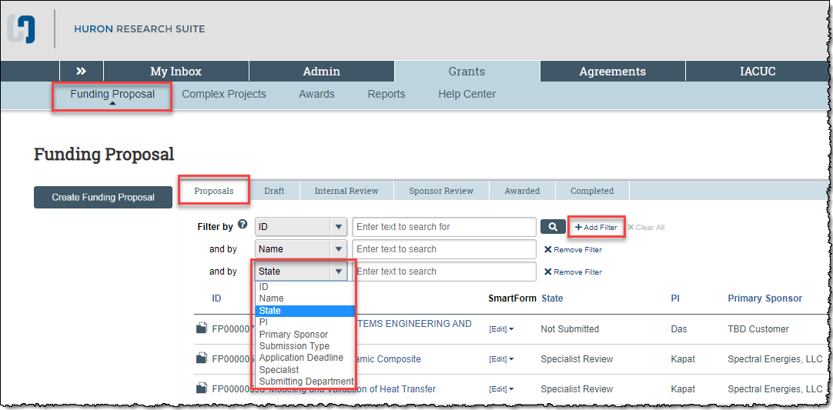
Huron Grants – Tech Tips
Presented on 2/19/20
How to check the status of Funding Proposals
Notes:
This slide was added per feedback from Office Hours facilitated as part of the Post-Award Training on 1/28/20.
Many questions are asked about how to check the status of a record in HRS. The first instinct is to use a report, however the Proposal and Award tabs in Huron Grants provide lots of information as well.
Make sure to search on the appropriate tab – either Proposals or Awards. Keep in mind you can search using multiple filters to find the information you’re looking for.

Slide 12
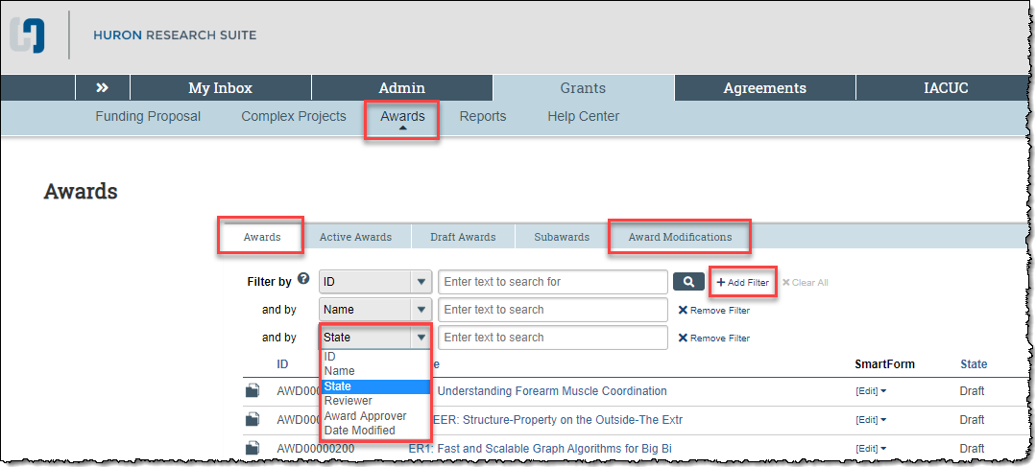
Huron Grants – Tech Tips
Presented on 2/19/20
How to check the status of Awards
Notes:
This slide was added per feedback from Office Hours facilitated as part of the Post-Award Training on 1/28/20.
Many questions are asked about how to check the status of a record in HRS. The first instinct is to use a report, however the Proposal and Award tabs in Huron Grants provide lots of information as well.
Make sure to search on the appropriate tab – either Proposals or Awards. Keep in mind you can search using multiple filters to find the information you’re looking for.

Slide 13
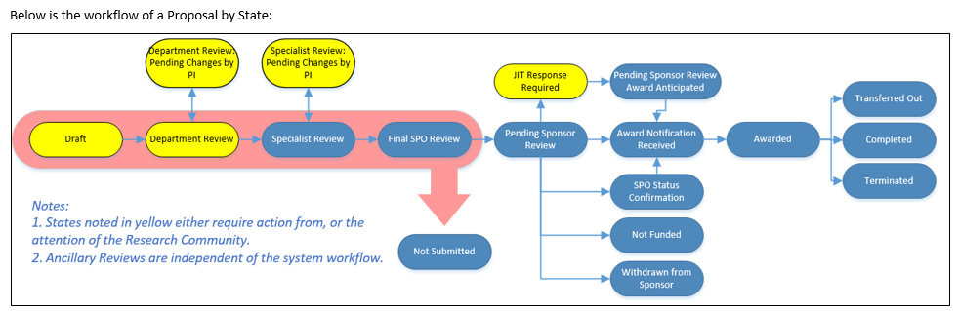
Huron Grants – Tech Tips
Presented on 2/19/20
Revised workflow diagrams in the reference guides
See Section 11.1 of the Research Community Reference Guide in the Help Center
Notes:
This slide was added per feedback from Office Hours facilitated as part of the Post-Award Training on 1/28/20.
If you have questions about the what the different states mean, please see the Appendix in the reference guides available in the Help Center in Huron Grants. Workflow diagrams were recently revised to be more user friendly and easier to understand.

Slide 14
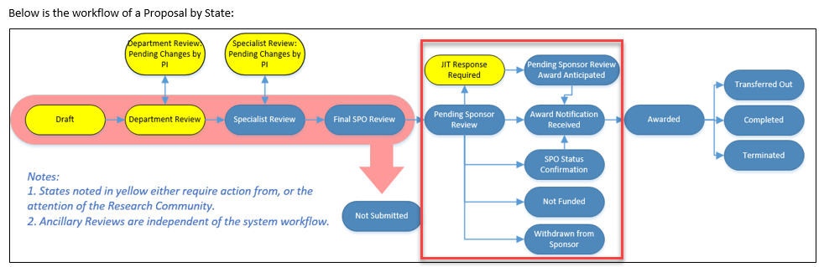
Huron Grants – Tech Tips
Presented on 2/19/20
Updating the Proposal with the Sponsor Decision
Notes:
This slide was added per feedback from Office Hours facilitated as part of the Post-Award Training on 1/28/20.
We’ve received several questions about how to tell if a proposal has been updated when an award notice has been received – this is because the notice could be sent to the Office of Research, the PI, or the Department Administrator.
When the proposal is sent to the sponsor, it is updated to the “Pending Sponsor Review” status. When the proposal is updated, the status is also updated to one of the statuses noted in the red box in the image above. The next slide explains how you can update the proposal if it is still in the “Pending Sponsor Review” status.

Slide 15
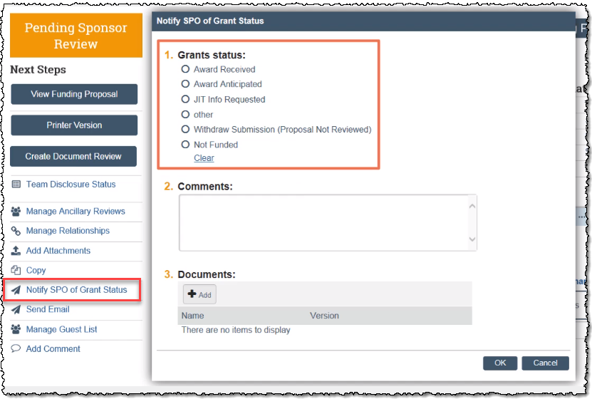
Huron Grants – Tech Tips
Presented on 2/19/20
Updating the Proposal with the Sponsor Decision
Use the “Notify SPO of Grant Status” activity to notify the Office of Research of the decision
Email notification is sent to the assigned specialist
State is updated to “SPO Status Confirmation”
Based on the decision, the Specialist will update the proposal to the next state (Award Notification Received, Withdrawn, Not Funded)
See Section 4 of the Research Community Reference Guide in the Help Center
Notes:
This slide was added per feedback from Office Hours facilitated as part of the Post-Award Training on 1/28/20.
If the PI or Department Administrator needs to update the proposal with the sponsor decision, use the “Notify SPO of Grant Status” activity to do so. Executing this activity sends an email notification to the assigned Specialist and the state is updated.

Slide 16
Huron Grants – Tech Tips
Presented on 3/25/20
Deleting documents copied when the “Copy” activity is used
If a document was added when the specialist sent the proposal to the sponsor, it will show on the copied proposal and cannot be removed in the “Upload Documents” activity. Specialist can delete this document when choosing to submit the copied proposal and upload the correct one.
Requesting Access to Huron for New and Moved Users
Open a ticket GRITServiceDesk@ucf.edu and indicate to which systems the user requires access
New users are automatically added to Huron once there are provided through the PeopleSoft HR data feed
Huron Grants BA assigns access levels depending on what the user will need to do
Please provide employee name, ID and intended job function/role (Contract Manager, Department Admin., OR or Dept. student assistants, etc.)
Note: We cannot add Huron access levels until the user is available through the HR feed

Slide 17
Huron Grants – Tech Tips
Presented on 3/25/20
Adding New Department Administrators to Workflows
Requires a Huron support ticket
Provide all departments within the college to which the department admin will need to be added
New users will be added to workflow for all new records created
Adding Users to Records in Departments and Colleges
New users in departments will need access to the existing records
Use the “Manage Guest List” activity to add or remove people to specific records
Can use Huron Support to add people with a bulk upload but this is reserved to large amounts of records (50 or more).

Slide 18
Huron Grants – Tech Tips
Presented on 5/27/20
GRIT Information Systems Access
Access to HRS, AURORA, PARIS, TERA.
Available in training materials and on the Project Wahoo Website https://wahoo.research.ucf.edu
Access to systems controlled by SSO and NID
Requested by hiring or sponsoring department
Access types
New employees who need access on their start date
New employees who need access before their start date
Users paid by a third party (Arecibo) or unpaid users (courtesy faculty or volunteers

Slide 19
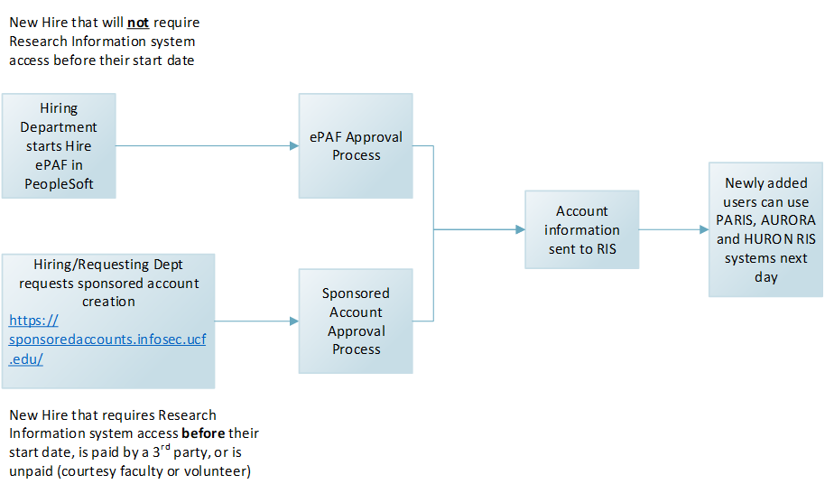
Huron Grants – Tech Tips
Presented on 5/27/20

Slide 20
Huron Grants – Tech Tips
Presented on 5/27/20
TBD Sponsor Manual Adjustment
Updating the TBD Direct Sponsor may revert an indirect rate to default so check this when making manual adjustments.
Adding Editors and Readers to Proposals and Awards
GRIT Administrative users do not have this ability
Need to have someone on the record use the manage guest list functionality to add as editors.
Specific users are department admins for different colleges. They should be able to add editors and readers to records.

Slide 21
Huron Grants – Tech Tips
Presented on 7/22/20
Award Deliverables
'Responsible Party' and 'Additional staff' assigned to award deliverables need to be added as readers on the parent award.
Co-PIs
Add as editors on a Proposal
Updates made in Huron, ARGIS, PeopleSoft
Show in PARIS and AURORA the following day

