Slide 1
Yet Another Text Adventure
Mark Burrell and Adam Walker

Slide 2
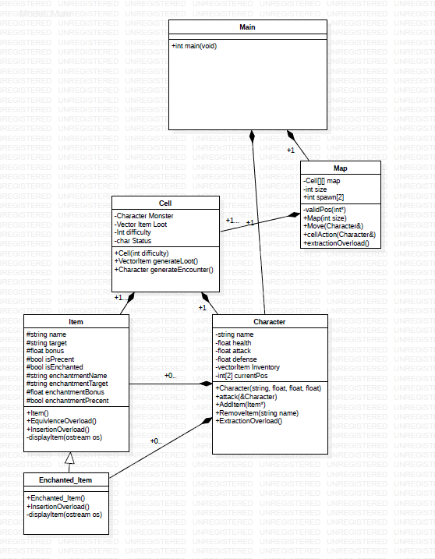
UML Diagram

Slide 3
Style Guide
Defines:
All defines must have a define guard to reduce system overhead
User-defined files shall be defined after System defines to prevent conflicts
Coding style:
Use camelCase for variable names
Variable names shall be verbose to provide self-documenting code
source files shall contain related classes and subclasses only
Use Eclipse formatting
Comment headers
Ctrl+Shift+F all final code
Use IfDef, not pragma

Slide 4
Outside Concept
Vectors
Indefinite size
Multi-dimensional arrays
maps

Slide 5
GitHub
Work on same files across different machines
Source-Tree
Keep master files up to date
Version Control
https://github.com/ORFMark/CS225_Group_Project

Slide 6
Demo
https://github.com/ORFMark/CS225_Group_Project

