Slide 1
INDEXES
Knowledge sharing on indexes in sql server

Slide 2
Agenda
What is Indexes in SQL Server?
Types of Indexes in SQL Server
Indexes Design
How Indexes improve performance?

Slide 3
What is Indexes in SQL Server?
Indexes play a key role in SQL Server performance.
A database index has an ordered list of values (made up of one or more table columns), with pointers to the row in which the value and its corresponding data reside.
A single well-placed index can shorten your query time from dozens of minutes to under a second.

Slide 4
Types of Indexes in SQL Server
Basically, the index is classified into two categories: Clustered Index and Non-Clustered Index
Clustered Index
Non-Clustered Index

Slide 5
Types of Indexes in SQL Server
To add to the two basic types of Index, Clustered Index and Non-Clustered Index, we can expand the Index type in the following ways:
Unique Index
Index with included columns
Covering Index

Slide 6
Indexes Design
If a table has a large volume of data but a low frequency of data updates, you should use many indexes needed to improve query performance.
For Clustered Index, try to keep the length of the indexed columns as short as possible. Ideally, create a Clustered Index on a column with a Unique attribute and do not allow Null values.
If the values ​​of a certain column in a table are unique, then you should create a unique index on that column.

Slide 7
Indexes Design
Few hard and fast rules for indexing
Each table should have a clustered index that is (ideally) small, selective, ever increasing, and static. (Note that a table without a clustered index is called a heap.)
Implement non-clustered indexes on foreign key relationships – in other words, on columns that are likely to be used in JOINs.
Implement non-clustered indexes on columns that are frequently used in WHERE clauses.
Do not implement single-column indexes on every column in a table. This will take up space unnecessarily and cause high overhead on INSERTs and UPDATEs.
In multi-column indexes, list the most selective (nearest to unique) first in the column list. For example, when indexing an employee table for a query on social security number (SSN) and last name (LastName), your index declaration should be
CREATE NONCLUSTERED INDEX ix_Employee_SSN ON dbo.Employee (SSN, LastName);

Slide 8
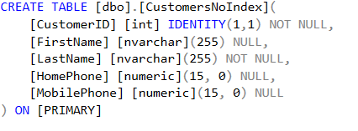
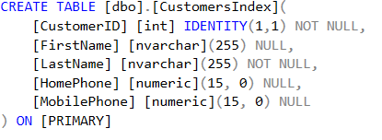
How Indexes improve performance?
First, let’s create two new table, [dbo].[CustomersNoIndex] and [dbo].[CustomersIndex

Slide 9

How Indexes improve performance?
And create an index on the CustomerID field for the [dbo].[CustomersUsingIndex] table:
Execute two SELECT statements to query two tables:
The same result

Slide 10
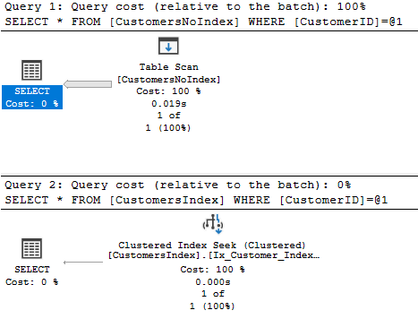
How Indexes improve performance?
When we view the estimated execution plan, we can see:

Slide 11
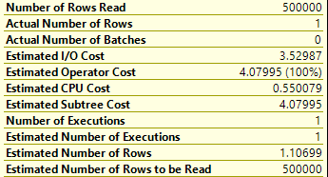
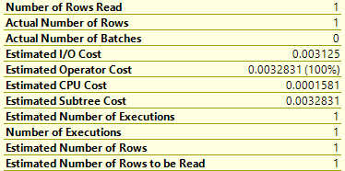
How Indexes improve performance?
On the first statement
On the second statement

Slide 12
How Indexes improve performance?
Thus, Index helped the amount of data the system needs to process to find the result to a minimum and improve query performance.
Reference for more information
https://docs.microsoft.com/sql/relational-databases/indexes

Slide 13
THANKS YOU FOR WATCHING THIS SHARING

