Slide 1
Entity Framework Core

Slide 2
Agenda
Setting some context
Introducing EF Core
EF Core and EF6.x
Demos
Next steps

Slide 3
Setting some context

Slide 4
Definitions
EF = Entity Framework
EF Core = Entity Framework Core
EF6.x = Entity Framework 6
O/RM = Object/Relational Mapper
EF is an O/RM for .NET development

Slide 5
Entity Framework Project Status
Entity Framework 6.2
Entity Framework Core 2.0
Entity Framework 6.1
Entity Framework Core 1.1
Runtime on NuGet
Tooling on Microsoft Download Center
Latest version included in Visual Studio
Entity Framework 6.0
Entity Framework Core 1.0
Entity Framework 5.0
New runtime components on NuGet
Core runtime components in .NET
Tooling in Visual Studio
Entity Framework 4.1 – 4.3
Entity Framework 4
Runtime in .NET Framework
Tooling in Visual Studio
Entity Framework 3.5 SP1

Slide 6
Naming history
Entity Framework Everywhere
Entity Framework 7 (EF7)
Entity Framework Core (EF Core) 1.0

Slide 7
Introducing EF Core

Slide 8
“Entity Framework Core is a lightweight, extensible, and cross-platform version of Entity Framework”

Slide 9
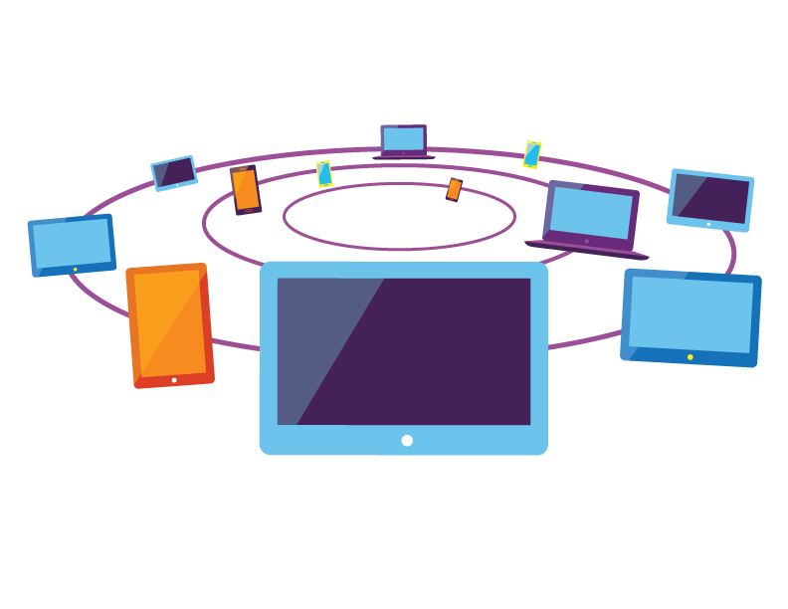
New platforms

Slide 10


New Platforms
.NET FRAMEWORK
TOOLS
WINDOWS APPLICATIONS
CROSS-PLATFORM SERVICES
MOBILE APPLICATIONS
.NET CORE
XAMARIN
Visual Studio
.NET STANDARD LIBRARY
Visual Studio Code
COMMON INFRASTRUCTURE
Xamarin Studio
Compilers
Languages
Runtime components
EF6.x
EF Core

Slide 11
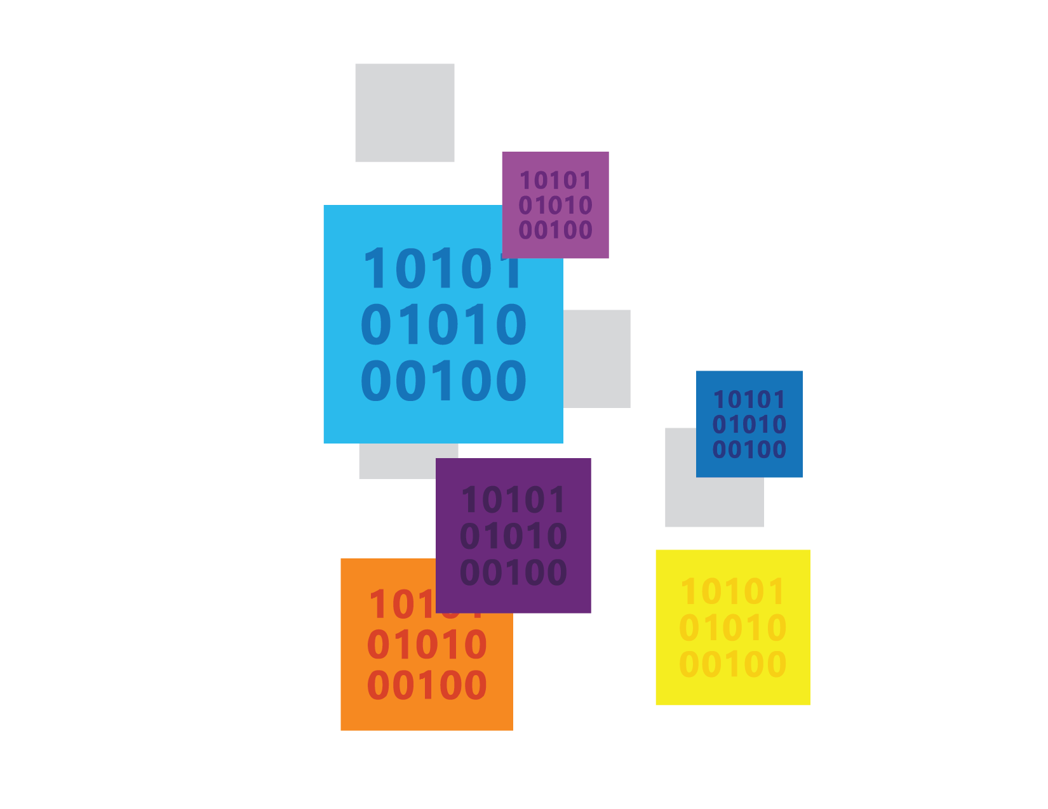
New data stores

Slide 12
New data stores
Relational & non-relational
Not a magic abstraction
High level services that are useful on all/most stores
Non-common concerns handled by provider extensions
Example providers
Relational (SQL Server, SQLite, Postgres, SQL Compact, etc.)
Azure Table Storage (prototype)
Redis (prototype)
In Memory (for testing)
Just relational providers for v1

Slide 13



New features

Slide 14
New features
Batching During SaveChanges
Mapping to Fields
Client Evaluation in LINQ Queries
Key Generators
Shadow Properties
Database Sequences
Alternate Keys
Memory-Optimized Table Support

Slide 15
Lightweight & extensible

Slide 16
Lightweight & extensible
Top level API built over low level services
Services = SQL generation, change tracking, etc.
Follows dependency injection principles
Easy to use/replace/extend individual services
Pay-per-play components
E.g. if your not using a relational provider, the relational components are not referenced or deployed

Slide 17
EF Core & EF6.x

Slide 18
EF Core
Mindful of our past…
Same top level experience as EF6.x
Not changing things just for the sake of it
…but not constrained by it
New code base
Completely different core
Not all features from EF6.x will be implemented

Slide 19
EF Core & EF6.x
EF6.x is the mature data stack
8 years of RTM releases = features and stability
Rich ecosystem of database providers
Patch and minor releases will continue
EF Core is a true v1
Basic feature set shipping in v1
Limited set of early adopter database providers

Slide 20
EF Core & EF6.x
EF6.x will be the right choice for many applications
Carefully evaluate requirements if considering EF Core
Many features not implemented in 1.0.0 (e.g. lazy loading, stored procedure mapping, etc.)
Less mature code base (e.g. LINQ translator has limitations)
EF6.x to EF Core is “port” not “upgrade”
Very basic code will port easily
Many APIs have changed drastically
Beware of behavior differences in similarly named APIs
Detailed guidance at docs.microsoft.com/ef
See “EF Core & EF6.x” section

Slide 21
Demos

Slide 22

Demo EF Core 101

Slide 23

Demo Performance improvements

Slide 24

Demo Simplified metadata API

Slide 25

Demo Extensible services

Slide 26
Extensible services
Top Level API DbContext, DbSet, ChangeTracker, Database, etc.
Core Services StateManager, CompiledQueryCache, etc.
Database Provider Services SqlServerTypeMapper, SqlServerSqlGenerationHelper, etc.

Slide 27

Demo Same model, multiple platforms

Slide 28
Demo Same model, multiple databases

Slide 29
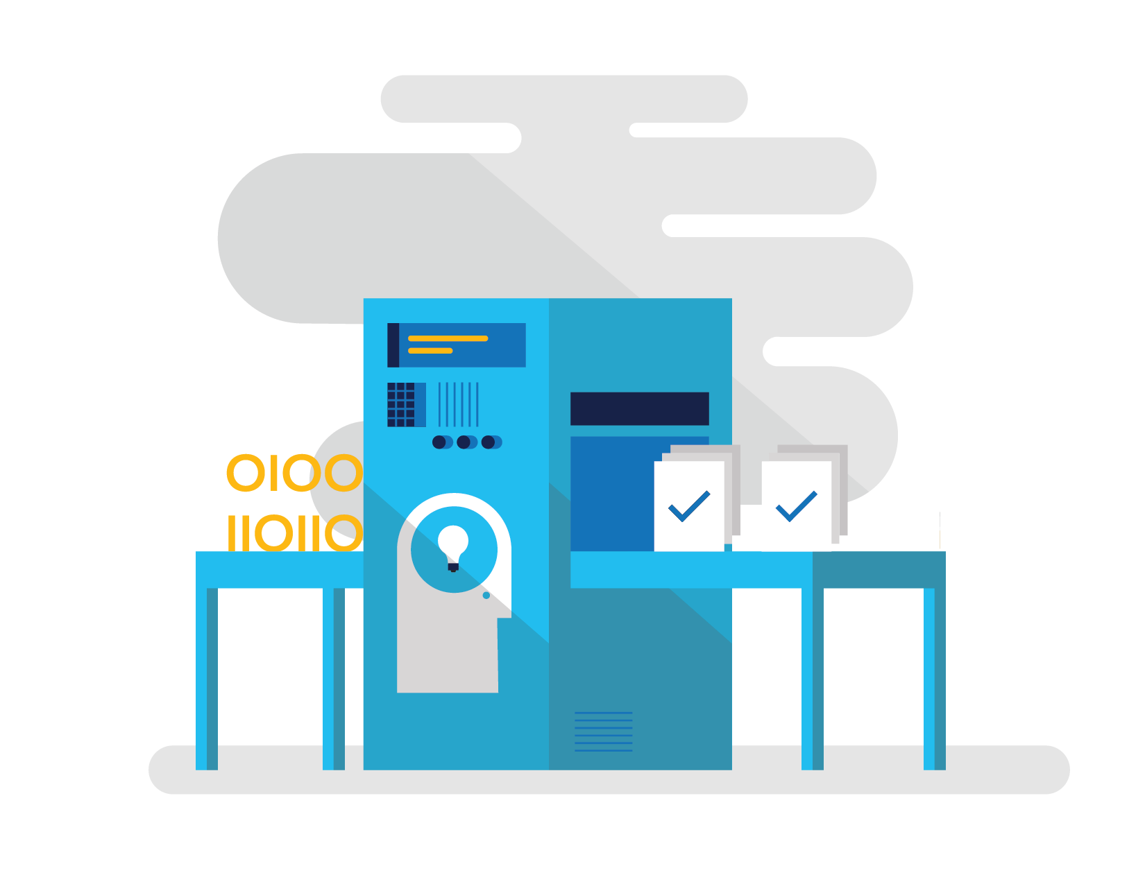
Demo SQL generation improvements

Slide 30
Demo Field mapping

Slide 31
Demo Memory-optimized table support

Slide 32
Next steps

Slide 33
Next steps
Learn about EF Core
docs.efproject.net
Contribute to product or docs
github.com/aspnet/EntityFramework
github.com/aspnet/EntityFramework.Docs
Demo source
github.com/rowanmiller/Demo-EFCore

