Slide 1
To save images as .png:
File -> Export -> File format: .png -> Save current slide only -> 1280x720
Notes:
1280 x 720 px

Slide 2
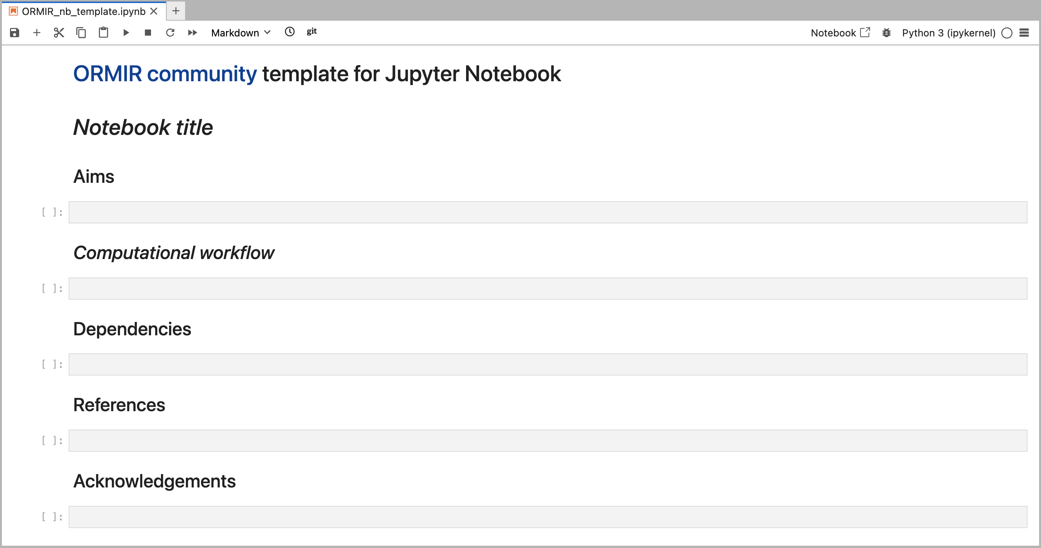

Slide 3
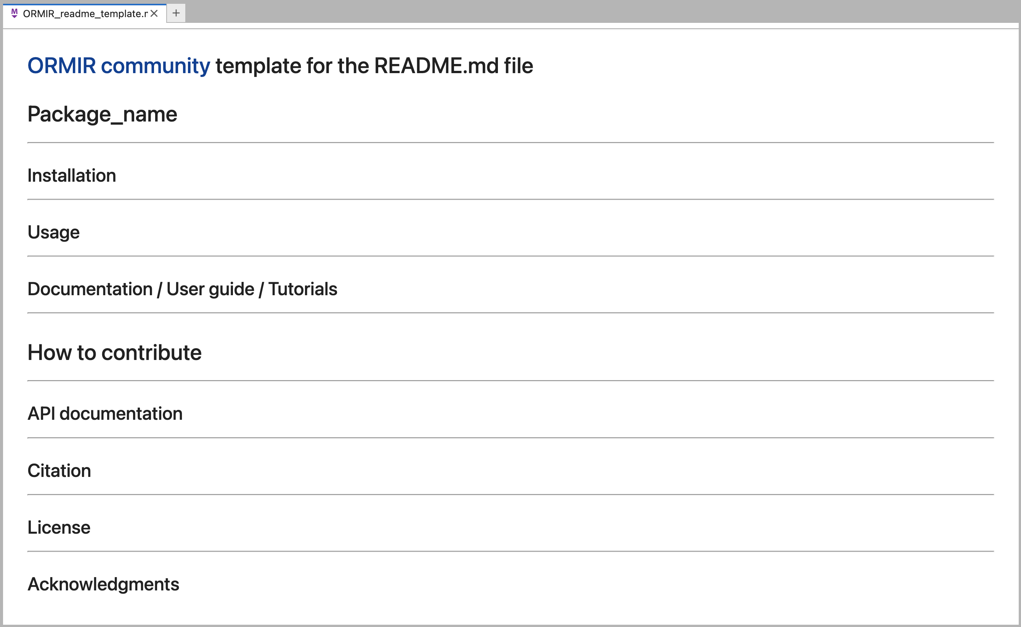

Slide 4



Website

Slide 5

study_name
data
raw
mids
derivatives
results
data_docs
code
src
notebooks
batch_scripts
code_docs
publication

