Slide 1
Sputter yields of Al2O3 by D and H
K. Schmid
07.07.22

Slide 2
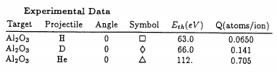
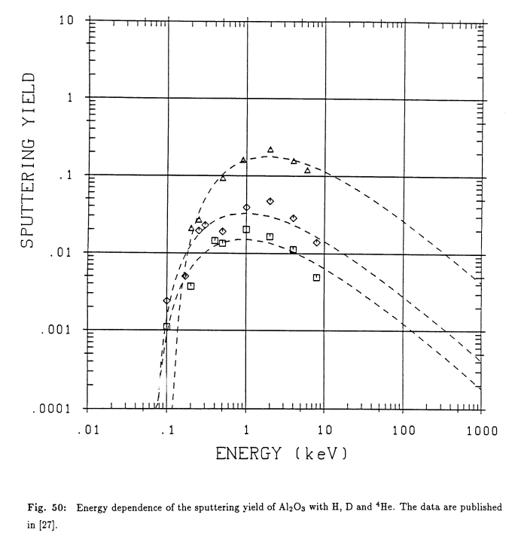

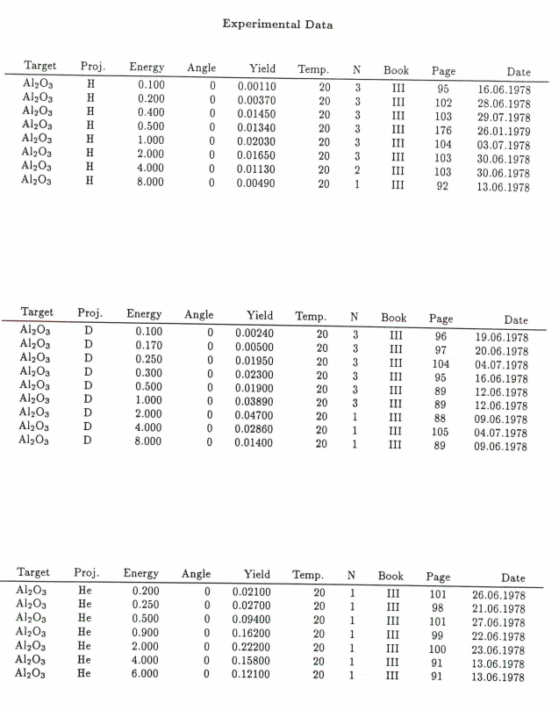
A short literature review
J. Bodhansky et al J. Nucl. Mat 85&86 (1979) p. 1145
Out of the box SDTrim.SP
Table of measured data
Question:
Which yield is this, i.e. what is M2?
Al, O, both?
Seems like M2 = 0.4*MAl + 0.6 *MO

Slide 3
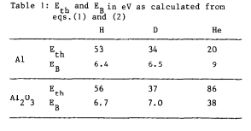
A short literature review
J. Bodhansky et al J. Nucl. Mat 85&86 (1979) p. 1145
For D and H:
Same Eth and EB for Al and Al2O3
For He:
Eth (Al) << Eth (Al2O3)
For H and D oxide is reduced
Al2O3 sputters like Al

Slide 4
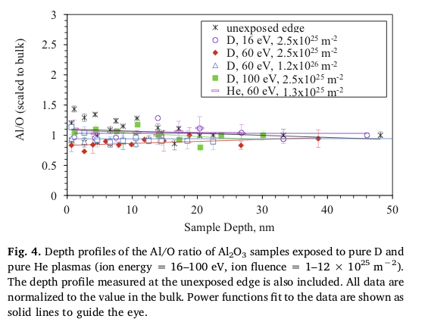
A short literature review
M.I. Patino, et al, Nucl. Mat. Energy 23 (2020) p. 100753
Erosion of AlN and Al2O3 by D, He in PISCES-A
Depth profile does not suggest reduction of oxide
Could be hidden since this is a Ar-sputter depth profile
Surface is in Ar-sputter yield equilibrium
Depends on partial yields of Al and O by Ar and the thickness of reduced oxide

Slide 5
A short literature review
V Orlinov, et al, Vacuum Vol. 32 No. 12 (1982) p747
40keV Ar sputtering of Al vs Al2O3
Capture sputtered species on plate
Derive angular distribution
Deposit stoichiometry: AlO2
Preferential sputtering of O

Slide 6
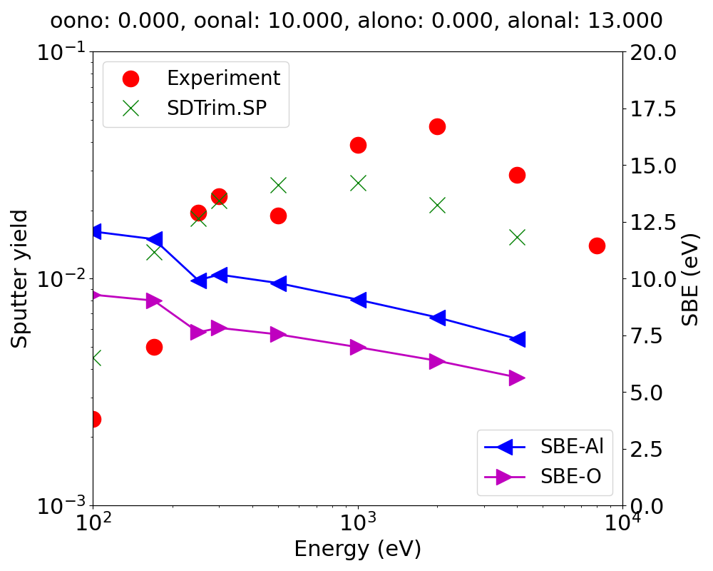
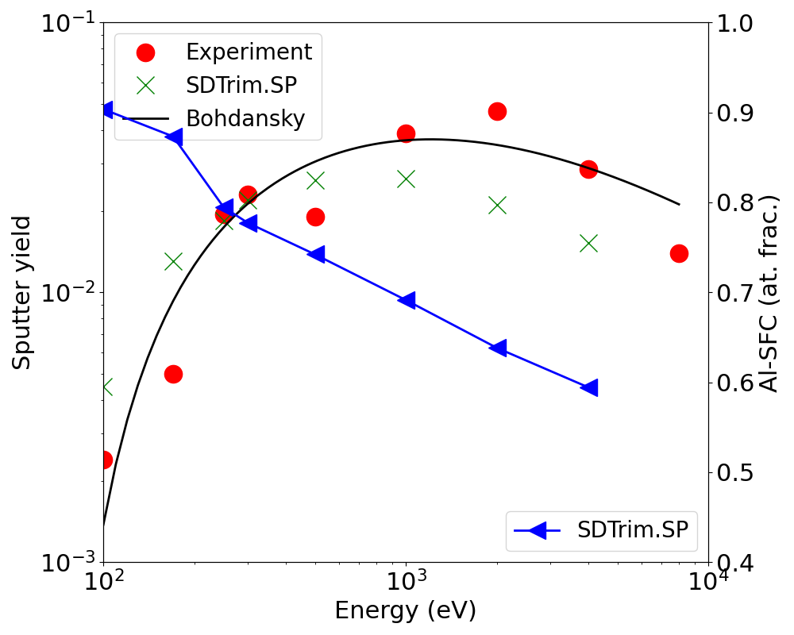
SDTrim.SP simulations
Perform dynamic SDTrim.SP simlulations starting from stoichiometric Al2O3
Vary surface binding energies to match data from: J. Bodhansky et al J. Nucl. Mat 85&86 (1979) p. 1145

Slide 7

First WallDYN simulations

Slide 8
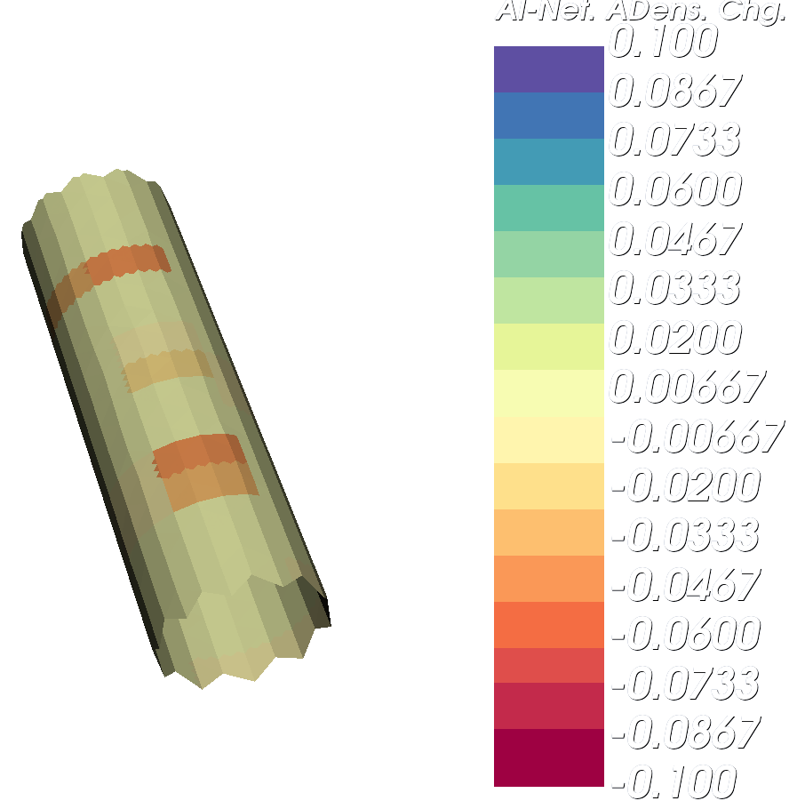
First WallDYN simulations
Erosion at high potential regions
NET areal density change of Al
< 0: net erosion
> 0: net deposition

Slide 9
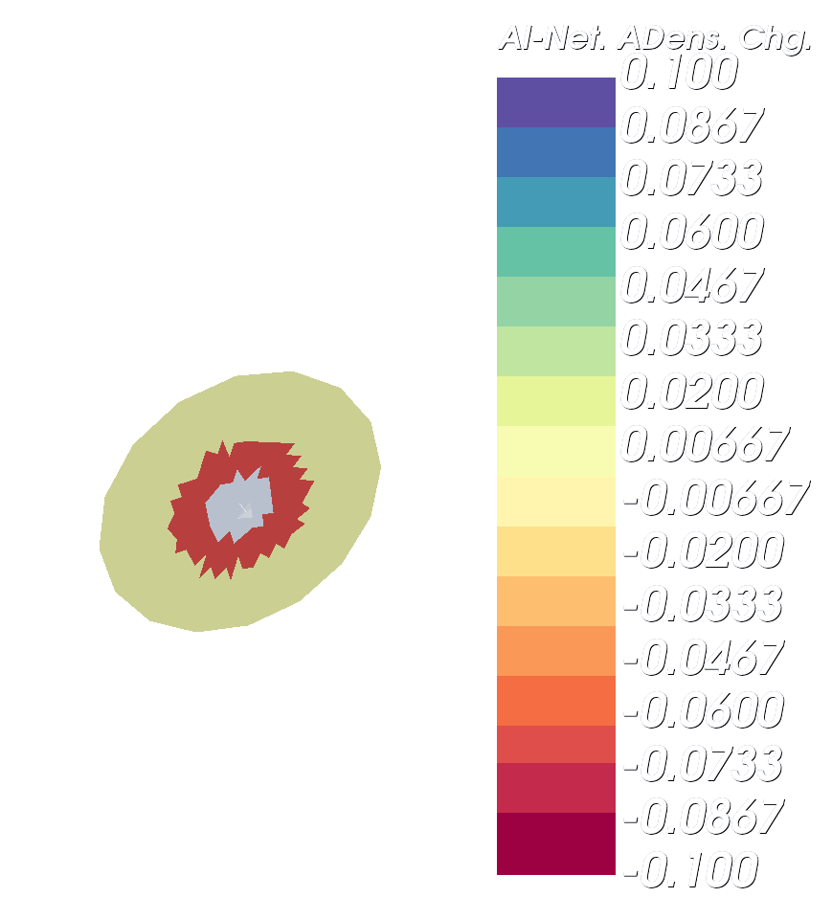
First WallDYN simulations
Al deposition in the center
Al erosion around it
NET areal density change of Al
< 0: net erosion
> 0: net deposition

