Slide 2
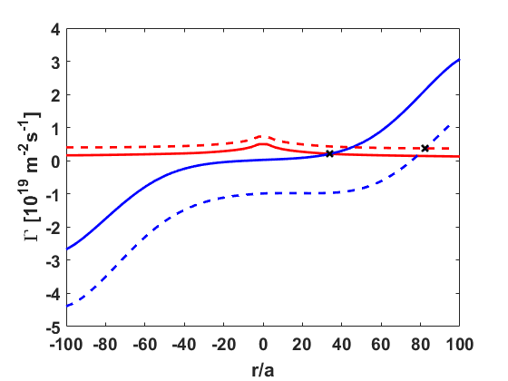
Γ_{e}
No beam
With beam
Γ_{i}
Shift of ambipolar root

