Slide 1
Grimison_tubeArrangement
Tube Arrangement
Aligned
Staggered
S_{L} = S_{D}
S_{L}
S_{D}
S_{T}
S_{T}
D
D
nRows = 3
Flow Direction
nRows = 4
Flow Direction

Slide 2

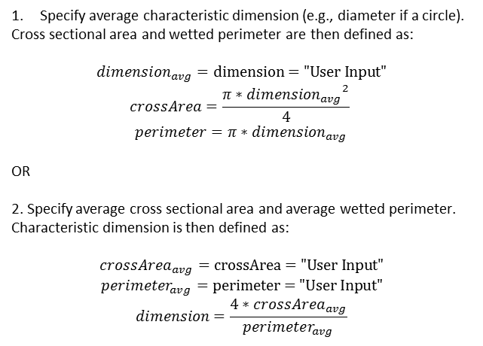


Resistences_Geometry_PipeLoss_Circle
Specify average characteristic dimension (e.g., diameter if a circle).
Cross sectional area and wetted perimeter are then defined as:
$$dimension_{avg}=\text{dimension}\text{ = "}\text{User} \text{Input}\text{"}$$
$$crossArea=\frac{π∗{dimension_{avg}}^{2}}{4}$$
$$perimeter=π∗dimension_{avg}$$
OR
2. Specify average cross sectional area and average wetted perimeter.
Characteristic dimension is then defined as:
$$crossArea_{avg}=\text{crossArea}\text{ = "}\text{User} \text{Input}\text{"}$$
$$perimeter_{avg}=\text{perimeter}\text{ = "}\text{User} \text{Input}\text{"}$$
$$dimension=\frac{4∗crossArea_{avg}}{perimeter_{avg}}$$
$$dimension_{avg}$$
$$crossArea_{avg}$$
$$perimeter_{avg}$$

Slide 3


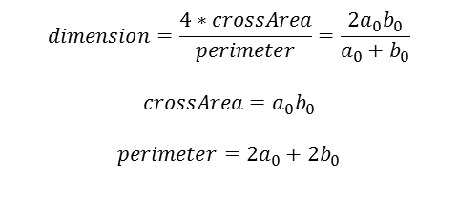
Resistences_ Geometry_PipeLoss_Rectangle
$$a_{0}$$
$$dimension=\frac{4∗crossArea}{perimeter}=\frac{2a_{0}b_{0}}{a_{0}+b_{0}}$$
$$crossArea=a_{0}b_{0}$$
$$perimeter=2a_{0}+2b_{0}$$
$$b_{0}$$

Slide 4


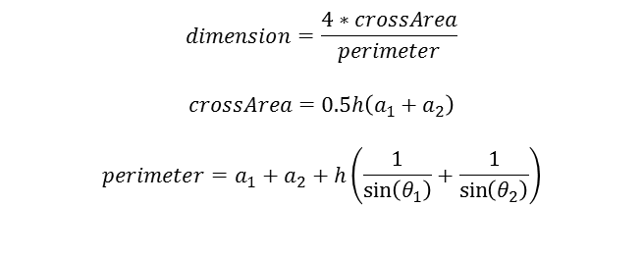



Resistences_ Geometry_PipeLoss_Trapezoid
$$a_{1}$$
$$dimension=\frac{4∗crossArea}{perimeter}$$
$$crossArea=0.5h\left(a_{1}+a_{2}\right)$$
$$perimeter=a_{1}+a_{2}+h\left(\frac{1}{\sin\left(θ_{1}\right)}+\frac{1}{\sin\left(θ_{2}\right)}\right)$$
$$h$$
$$θ_{1}$$
$$θ_{2}$$
$$a_{2}$$

Slide 5

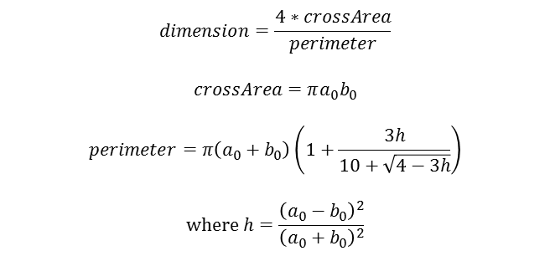

Resistences_ Geometry_PipeLoss_Ellipse
$$a_{0}$$
$$dimension=\frac{4∗crossArea}{perimeter}$$
$$crossArea=πa_{0}b_{0}$$
$$perimeter=π\left(a_{0}+b_{0}\right)\left(1+\frac{3h}{10+\sqrt{4−3h}}\right)$$
$$where h=\frac{{\left(a_{0}−b_{0}\right)}^{2}}{{\left(a_{0}+b_{0}\right)}^{2}}$$
$$b_{0}$$

Slide 6
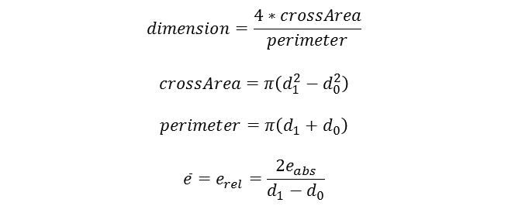



Resistences_ Geometry_PipeLoss_Annulus
$$e_{abs}$$
$$dimension=\frac{4∗crossArea}{perimeter}$$
$$crossArea=π\left(d_{1}^{2}−d_{0}^{2}\right)$$
$$perimeter=π\left(d_{1}+d_{0}\right)$$
$$\overline{e}=e_{rel}=\frac{2e_{abs}}{d_{1}−d_{0}}$$
$$d_{0}$$
$$d_{1}$$

Slide 7

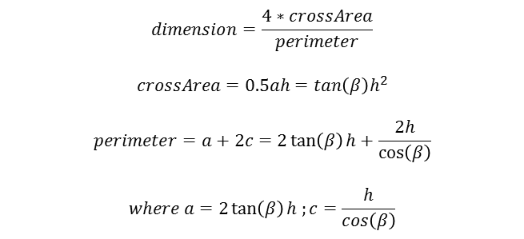




Resistences_ Geometry_PipeLoss_Triangle
$$dimension=\frac{4∗crossArea}{perimeter}$$
$$crossArea=0.5ah=tan\left(β\right)h^{2}$$
$$perimeter=a+2c=2\tan\left(β\right)h+\frac{2h}{\cos\left(β\right)}$$
$$where a=2\tan\left(β\right)h ;c=\frac{h}{cos\left(β\right)}$$
$$c$$
$$β$$
$$c$$
$$h$$
$$a$$

Slide 8
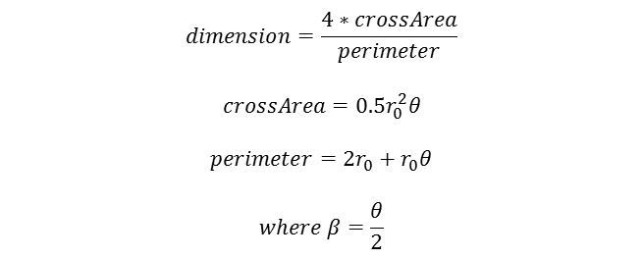




Resistences_ Geometry_PipeLoss_CircleSector
$$dimension=\frac{4∗crossArea}{perimeter}$$
$$crossArea=0.5r_{0}^{2}θ$$
$$perimeter=2r_{0}+r_{0}θ$$
$$where β=\frac{θ}{2}$$
$$r_{0}$$
$$θ$$
$$r_{0}$$
$$β$$

Slide 9




Geometry_PrintedCircuitHX
$$length$$
$$pitch$$
$$r$$
th_{wall} is estimated from the distance from modified distance between hot and cold channels and the pitch between channels of the same.
$$th$$

Slide 10


Connectors_flowAndnonflow
Lumped Model
Recommended
Flow Connector
Non-Flow Connector
?
Discretized Model
Flow Connector
Non-Flow Connector

Slide 11
spliceSigmoid
pos
y
larger k
smaller k
neg
x

Slide 12
sigmoid
1
y
larger k
smaller k
0
x

Slide 13


spliceTanh
pos
y
larger k
smaller k
neg
x
$$Δx$$
$$Δx$$

Slide 14

smoothMax
x₂
y
x₁
x
$$Δx$$
$$Δx$$

Slide 15
systemNumbering_1

Slide 16
discretizedModels_1D
1D
port_a1
crossAreas_1[i]
crossAreas_1[i+1]
port_b1
surfaceAreas along dimensions 2 and 3
[i-1]
[i]
[i+1]
2
3
1

Slide 17
discretizedModels_2D
2D
port_b2[n1]
[i-1, j+1]
[i, j+1]
[i+1, j+1]
crossAreas_2[i, j+1]
port_a1[n2]
crossAreas_1[i, j]
crossAreas_1[i+1, j]
port_b1[n2]
surfaceAreas along dimension 3
[i-1, j]
[i, j]
[i+1, j]
crossAreas_2[i, j]
[i-1, j-1]
[i, j-1]
[i+1, j-1]
2
3
port_a2[n1]
1

Slide 18
discretizedModels_3D
3D
port_b3[n1,n2]
port_b2[n1,n3]
No additional surfaceArea variable
Dimension numbering is consistent with the 2D geometry but with the additional dimension (i,j,k)
port_b1[n2,n3]
port_a1[n2,n3]
port_a3[n1,n2]
port_a2[n1,n3]
2
3
1

Slide 19


easing
pos
startTime
y
neg
offset
$$Δt$$
$$Δt$$

