Slide 1
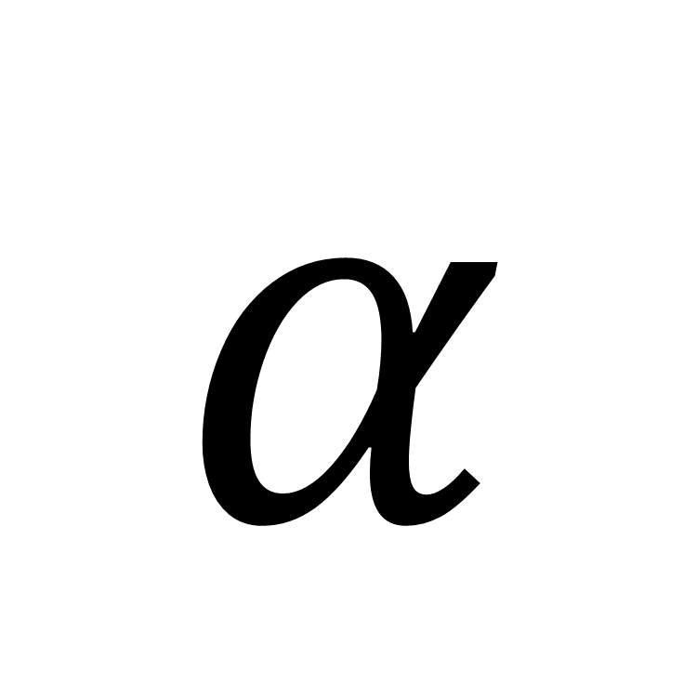
HeatTransfer_alphas
$$α$$

Slide 2
PowerSource

Slide 3
FrequencySource

Slide 4
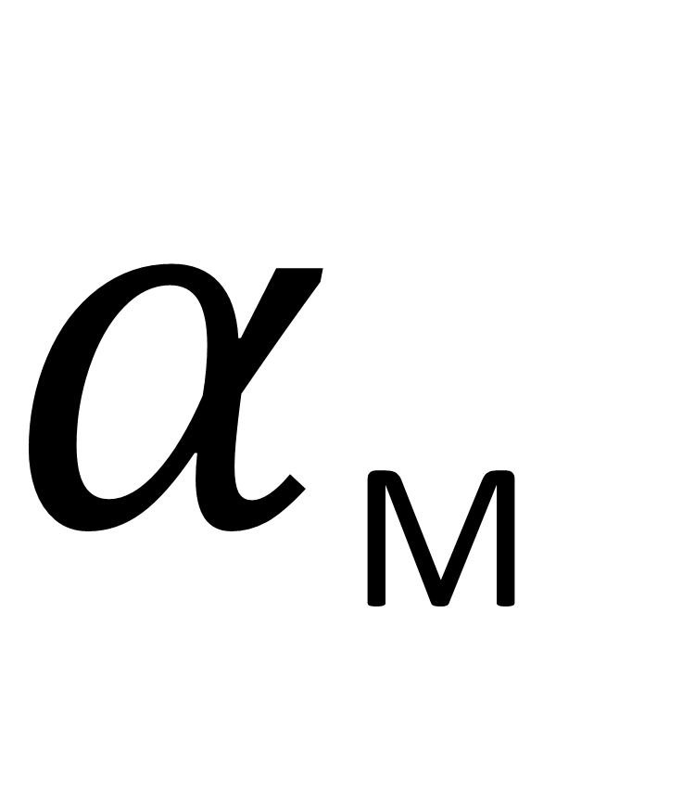
MassTransfer_alphas
$α$_{M}

Slide 5
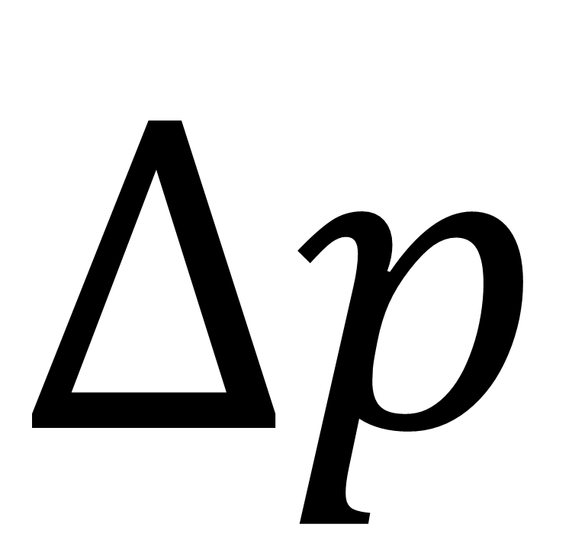
FlowModel_dps
$$Δp$$

Slide 6
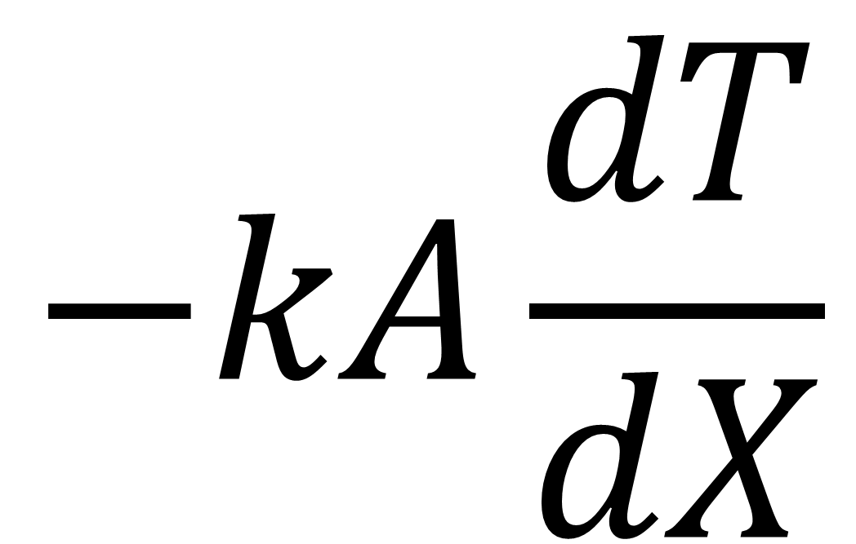
FlowModel_dTdx
$$−kA\frac{dT}{dX}$$

Slide 7
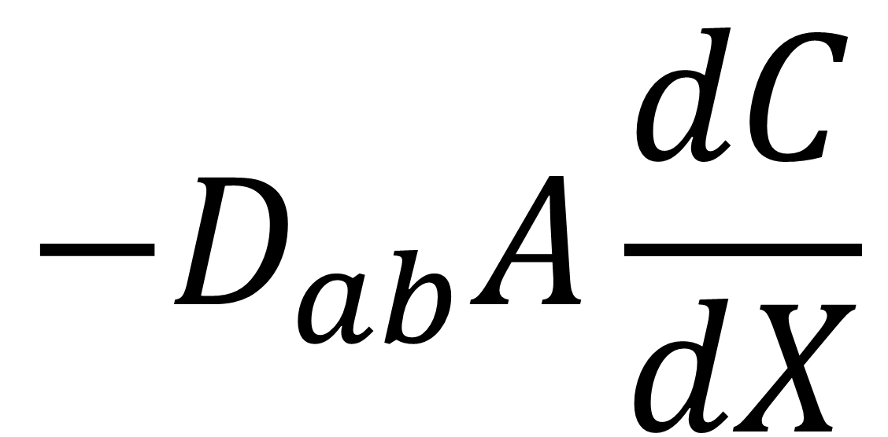
FlowModel_dCdx
$$−D_{ab}A\frac{dC}{dX}$$

Slide 8
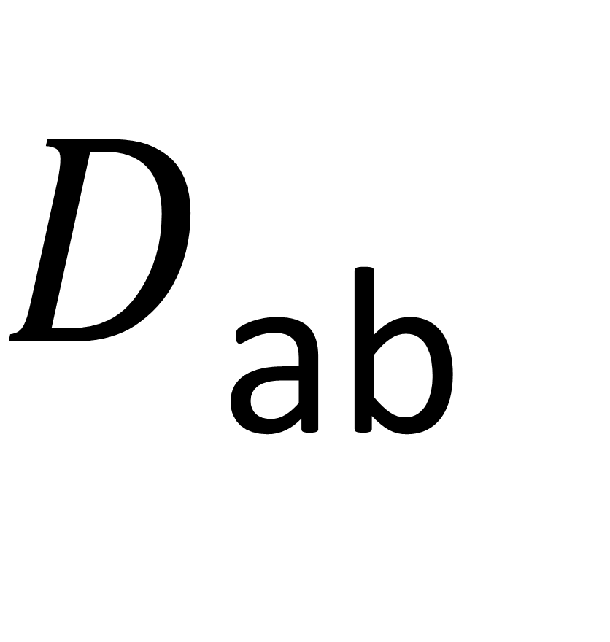
diffusionCoeffient
$D$_{ab}

Slide 9

HenrysLawCoefficient
k$henry$

Slide 10

SievertsLawCoefficient
k$sievert$

Slide 11
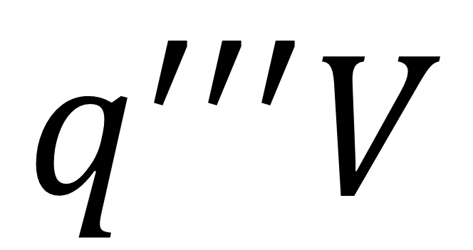
ClosureModel_Qgen
$$q^{′′′}V$$

Slide 12
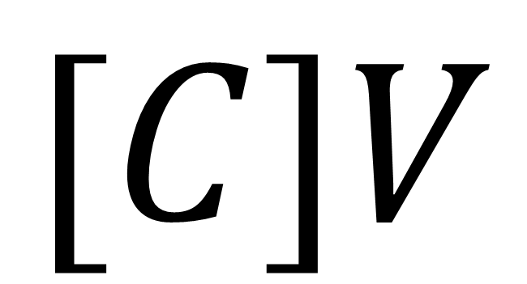
ClosureModel_Ngen
$$[C]V$$

Slide 13

Geometry_genericVolume
$$V$$
Volume

Slide 14
Geometry_genericFlow
$$V$$
Flow

Slide 15
Conduction_xyz
y
z
x

Slide 16
Conduction_xy
y
x

Slide 17
Conduction_yz
y
z

Slide 18
Conduction_xz
z
x

Slide 19
Conduction_x
x

Slide 20
Conduction_y
y

Slide 21
Conduction_z
z

Slide 22
Plane_3D

Slide 23
Cylinder_3Dvertical

Slide 24
Cylinder_3Dhorizontal

Slide 25
Sphere_3D

Slide 26
nParallel_fluid

Slide 27
nParallel_thermal

Slide 28
nParallel_ElecPower

Slide 29
nParallel_mass

Slide 30
nParallel_real

Slide 31
counterFlow_false

Slide 32
counterFlow_true

Slide 33
counterFlow_mass_false

Slide 34
counterFlow_mass_true

Slide 35
recordSummary

Slide 36
subSystem

Slide 37
controlSystem

Slide 38
eventDriver

Slide 39
GenericAdiabaticFin

Slide 40
GenericConvectiveFin

Slide 41
StraightRectangular
th
W
L

Slide 42
StraightTriangular
th
W
L

Slide 43
StraightParabolic
th
W
L

Slide 44
SpineRectangular
D
L

Slide 45
SpineTriangular
D
L

Slide 46
RectangularAnnular
th
r_{inner}
r_{outer}

Slide 47
Resistance_Heat

Slide 48
Resistance_Mass

Slide 49
Resistance_Fluid

Slide 50
Resistance_Mass_nonFlow

Slide 51
Plane

Slide 52
Plane_Infinite

Slide 53
Cylinder

Slide 54
Sphere

Slide 55
Convection

Slide 56
SolubilityInterface

Slide 57
Contact

Slide 58
Radiation

Slide 59
Fin

Slide 60
CHF
B
D
C
A
ONB
q”_{CHF}
q”_{Leid}
FB

Slide 61
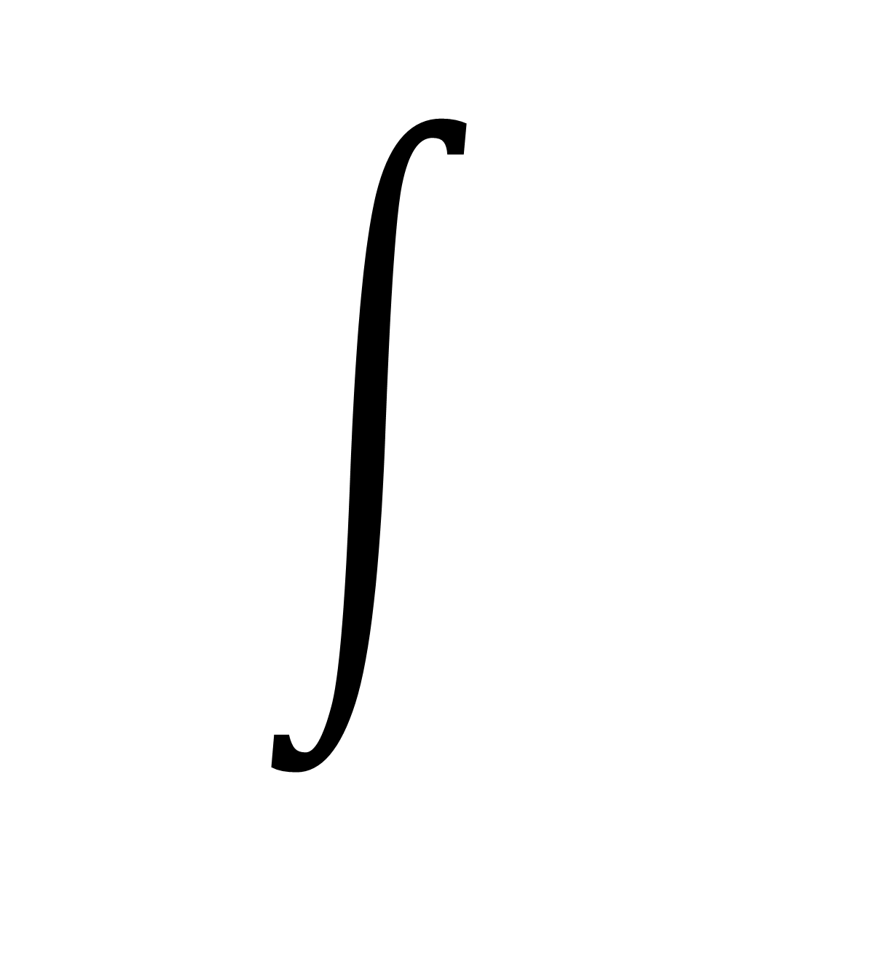
Integral

Slide 62
BatemanEquations

Slide 63
Supercomputer_train
CPU_{1:i}
GPU_{1:j}

Slide 64
Supercomputer_node
CPU_{1,1:i}
GPU_{1,1:j}
m
CPU_{m,1:i}
GPU_{m,1:j}

Slide 65
Supercomputer_rack
1
2
.
.
.
n

Slide 66
Supercomputer_cluster

Slide 67
Supercomputer_system

