Slide 1
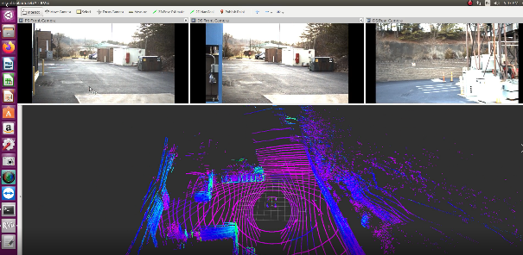
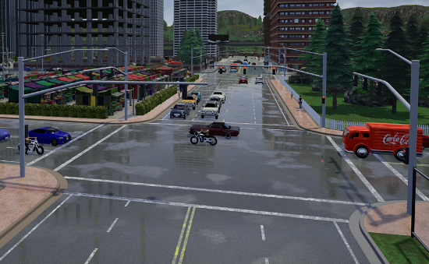


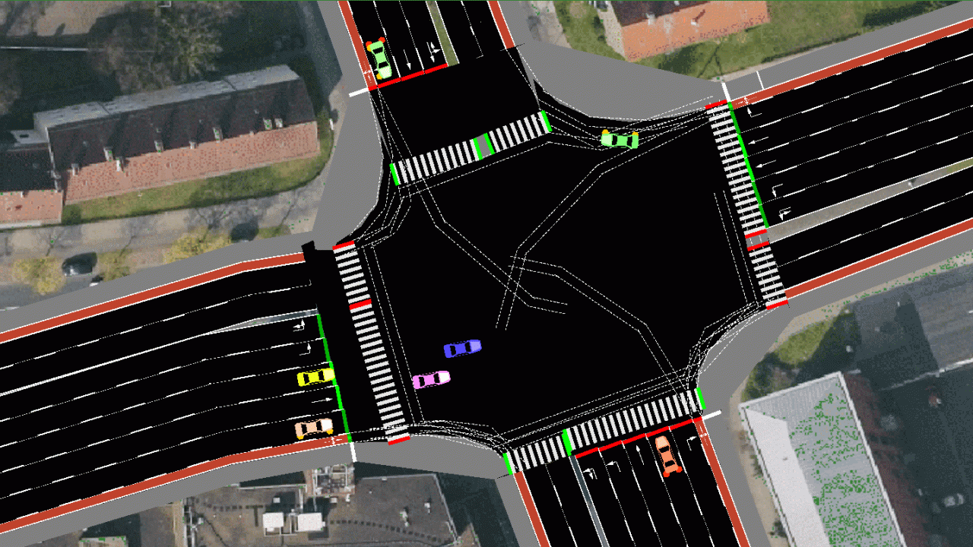
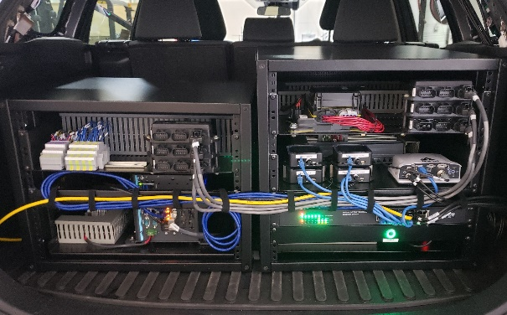

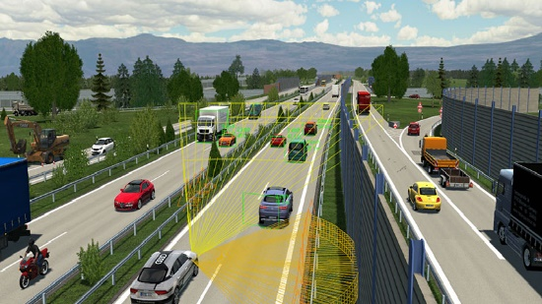


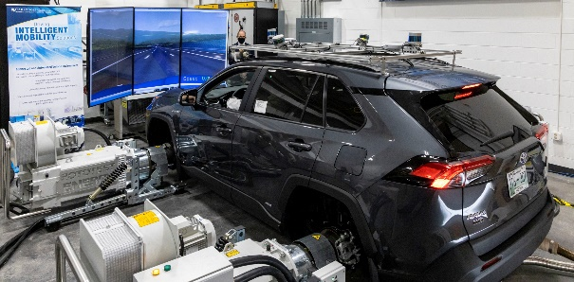
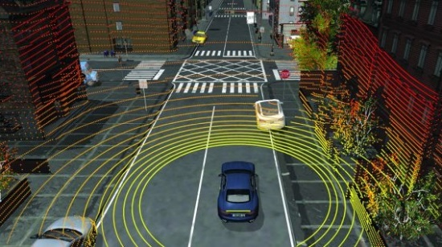
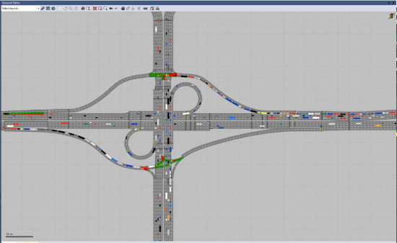



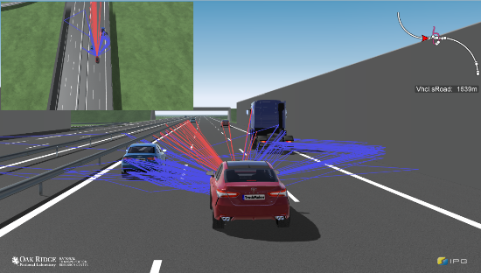

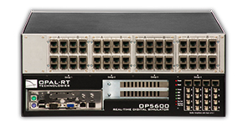
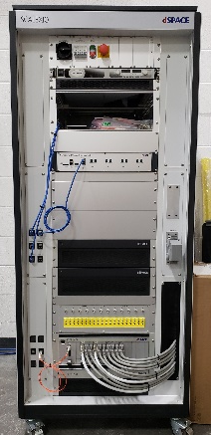


Co-Simulation and Integration – Current Focus
Flexible Interface
Image courtesy of CARLA
Flexible Interface
(Virtual Test Drive, 2017)
Image courtesy of dSPACE

Slide 2
Debate: Existing interface VS Fully customized interface
Existing interface is Eclipse MOSAIC.
It is pretty heavy and based on JAVA.
It is not originally designed for integration with real-time control system. The synchronization may need significant modifications [double check this]. e.g. SUMO should wait for command from ego vehicle/dSPACE.
We don’t have full control on the codes.
The performance is not fully tested.
It does not support VISSIM, CARLA, VTD, IPG, ASM. i.e. we need to develop interfaces following their architecture to integrate these tools. No well established API for this yet.
If we are clear about all the components we want to integrate, e.g. traffic, communication, control, virtual environment, sensors, XIL, and all the information flow, I believe we could come up with a solution.

Slide 3
Basic Structure
With Communication
Traffic Simulator
Traffic Simulator
6
6
Ego (k+1)
Traffic Cmd (k+1)
Traffic (k)
Ego (k)
1
Ego (k+1)
Traffic Cmd (k+1)
Traffic (k)
Ego (k)
1
Manager
Traffic (k)
Ego (k)
2
Manager
Ego (k+1)
Traffic Cmd (k+1)
.config
Ego (k+1)
Traffic Cmd (k+1)
.config
Traffic (k)
Ego (k)
2
5
2
Request
Cmd (k+1)
Communication
5
Traffic Received at (k)
CAV Controller
CAV Controller
event based
Traffic (k)
Ego Cmd (k+1)
Traffic (k)
Ego Cmd (k+1)
4
3
3
Ego (k+1)
Ego (k+1)
4
Virtual Environment/Vehicle
Virtual Environment/Vehicle
CAV Controller can be a separate module (updates 0.1 seconds) or integrated with Vehicle (updates faster)
.config defines for each controller and communication, what’s the ROI of vehicles to extract
TCP/IP
XIL
XIL

Slide 4
With Sensors
HPC Potential
Traffic Simulator
Traffic Simulator
Ego (k+1)
Traffic Cmd (k+1)
Traffic (k)
Ego (k)
Ego (k+1)
Traffic Cmd (k+1)
Traffic (k)
Ego (k)
Manager
.config
Manager
Ego (k+1)
(Traffic Cmd (k+1))
.config
Traffic (k)
Ego (k)
Ego (k+1)
Ego (k+1)
Traffic (k)
Ego (k)
Ego (k+1)
CAV Controller
Traffic (k)
Ego (k)
Traffic (k)
Ego (k)
CAV Controller
CAV Controller
CAV Controller
Environment Info
Traffic (k)
Ego Cmd (k+1)
Ego (k+1)
Ego (k+1)
Traffic (k)
Ego Cmd (k+1)
Ego (k+1)
Traffic (k)
Ego Cmd (k+1)
Ego (k+1)
Traffic (k)
Ego Cmd (k+1)
Sensors
Virtual Environment/Vehicle
Virtual Environment/Vehicle
Virtual Environment/Vehicle
Virtual Environment/Vehicle
XIL

Slide 5
Basic Structure
With Communication
Traffic Simulator
Traffic Simulator
6
6
Ego (k+1)
Traffic Cmd (k+1)
Traffic (k)
Ego (k)
1
Ego (k+1)
Traffic Cmd (k+1)
Traffic (k)
Ego (k)
1
Manager
Traffic (k)
Ego (k)
2
Manager
Ego (k+1)
Traffic Cmd (k+1)
.config
Ego (k+1)
Traffic Cmd (k+1)
.config
Traffic (k)
Ego (k)
2
2
Request
Cmd (k+1)
Traffic Received at (k)
5
5
Communication
CAV Controller
CAV Controller
event based
Traffic (k)
Ego Cmd (k+1)
Traffic (k)
Ego Cmd (k+1)
4
3
3
Ego (k+1)
Ego (k+1)
4
Virtual Environment/Vehicle
Virtual Environment/Vehicle
CAV controller within vehicle, i.e. in Simulink
XIL
XIL

Slide 6
Further notes
Define a way to define information we extracted from SUMO, depends on application ROI
region of interest around a ego vehicle
particular parts of a road, i.e. for centralized controller
around traffic light
Can be based on subscription of SUMO data, essentially specify objID, domain,
Define message sets
traffic, i.e. vehicle information
signal lights, phase and timing, detectors
Need to assign unique id for different message sets
Potential components: traffic, control/application, virtual environment/vehicle, HIL, communication, sensor, signal controller. What else?
Design everything is SUMO, then adapt VISSIM message structure as SUMO.

Slide 7
What’s included
Signal controller in the loop (SCIP) is within the scope. Basically, needs to define ROI, i.e. intersections, and message set of phase and timing and detectors.
Naturally, it supports multiple clients/vehicles, so has potential for larger scale
With this setup, CAV controller can be in different languages with appropriate: a) TCP/IP interface b) parser for messages.
Thus, possibly avoid the need to convert VISSIM COM to .dll.

Slide 8
Traffic Simulator
Ego (k+1)
Traffic Cmd (k+1)
Traffic (k)
Ego (k)
Manager
Traffic Cmd (k+1)
Traffic (k)
Ego (k)
Ego (k+1)
Traffic (k)
CAV Controller
Ego Cmd (k+1)
Virtual Environment/Vehicle
An alternative approach, directly send traffic to Vehicle.
-Traffic data can be updated more timely
-Might be challenging to extend to HPC application, since more connections to the Manager

Slide 10
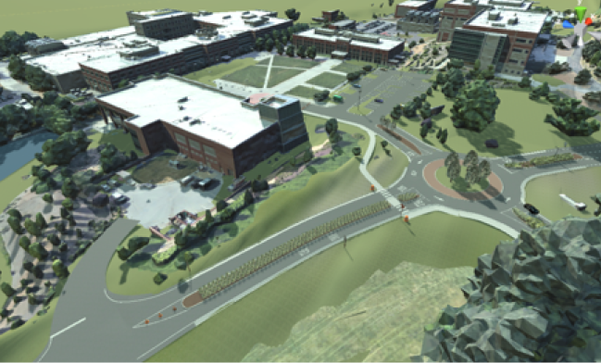




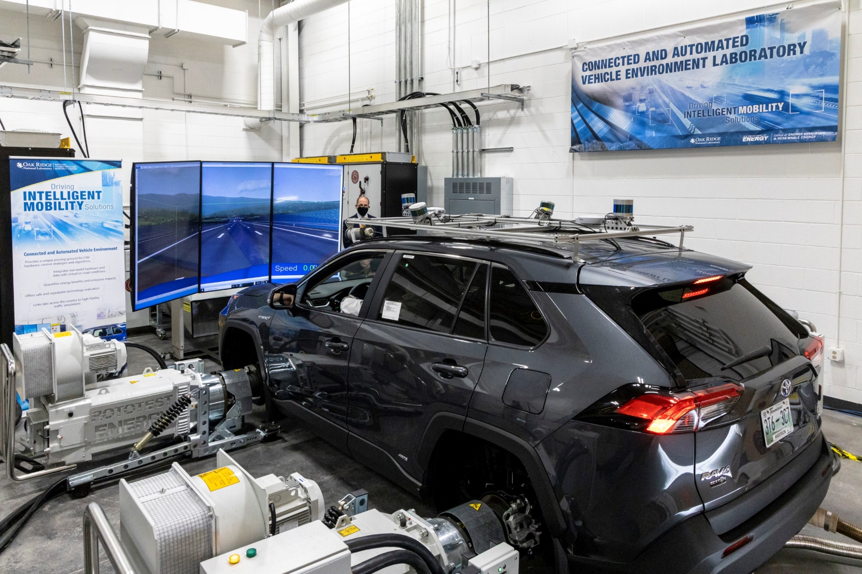




Vehicle Simulator
3D Digital Twin
FIXS Liaison
Traffic Simulator
FIX_Core.exe
Application Layer
Ego CAV
XIL
FIXS Liaison
Speed Cmd.
Driver
dll
VISSIM Liaison
Message
& Socket Handler
FIXS Liaison
or
Pedal & Brake Cmd.
SUMO Liaison
Vehicle Dynamics Model
CAV Controller
config.yaml
Real-Sim Interface
Preceding Vehicles Info. $\left(k\right)$
Ego Command $\left(k+1\right)$
Ego Actual $\left(k+1\right)$

Slide 11


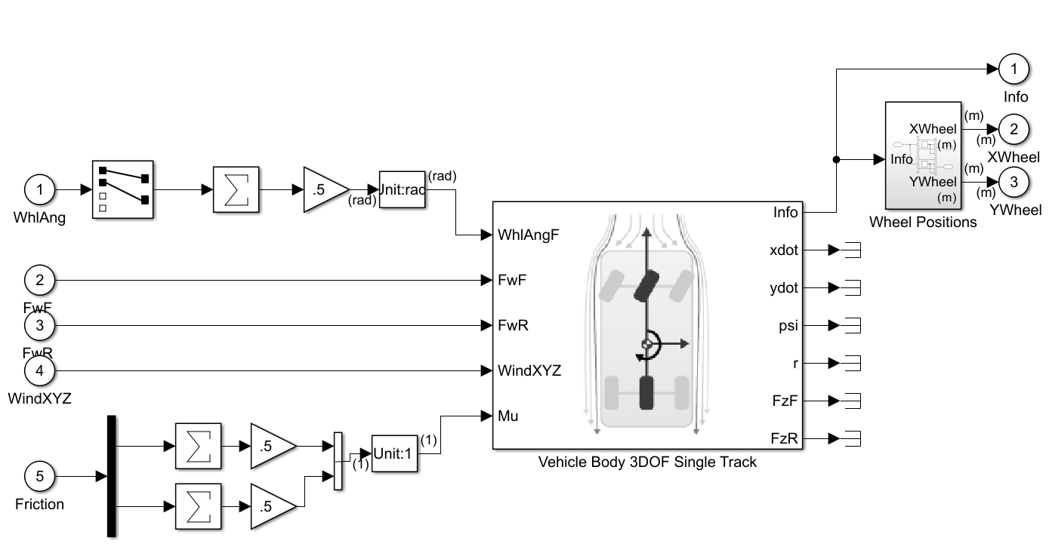

Real-Sim Approach
Conventional Approach
Traffic Microsimulation
CAV Control
XIL
Traffic Microsimulation
CAV Control
XIL

Slide 12
Server
Client
Server
Client
Server
Client
Server
Client
Traffic Simulator
Traffic Layer
Coord Merge
Comms
Ego
127.0.0.1
1337
YAML ApplicationSetup
YAML XilSetup
Embedded in source code
Server
Client
Server
Client
Server
Client
Client
Server
Server
Client
Traffic Simulator
Traffic Layer
Coord Merge
Comms
RSU
OBU
Ego
127.0.0.1
1337
YAML ApplicationSetup
YAML XilSetup
Embedded in source code
Switch Flag
192.168.0.54
50067
XX
XX

Slide 13
Traffic Simulator
Flexible Real-Sim Interface
CAV Application Client
Traffic Simulator
Flexible Real-Sim Interface
CAV Application Client
Traffic Layer
Application Layer
Traffic Layer
Application Layer
Traffic States $(t)$
$$t$$
$$t$$
$$t$$
Hold last states
$$t$$
Traffic States $(t)$
Simulate one step
Simulate one step
Hold last states
Cmd
$$(t+Δt)$$
Cmd$(t+Δt)$
$$t+Δt$$
$$t+Δt$$
Idle
Cmd
$$v(t+Δt)$$
Interpolation
Idle
Interpolation
Actual
$$v(t+Δt)$$
Actual
$$a\left(t+Δt\right)$$
$$t+Δt$$
$$t+Δt$$
$$t+Δt$$
Traffic States $(t+Δt)$
Hold last states
$$t+Δt$$
Hold last states
Simulate one step
Simulate one step
Traffic States
$$v(t+Δt)$$
Cmd
$$(t+2Δt)$$
Cmd
$$v(t+2Δt)$$
$$t+2Δt$$
$$t+2Δt$$
$$⋯$$
$$⋯$$
$$⋯$$
$$⋯$$
$$⋯$$
$$⋯$$
$$⋯$$
$$⋯$$

Slide 14
VISSIM:
Receive cmd acceleration a(t)
Receive actual ego acceleration a(t)
FOR each vehicle:
Get actual v(t)
Set desired acceleration a(t)
Send v(t)
Receive cmd acceleration a(t+dt)
Receive actual ego acceleration a(t +dt)
FOR each vehicle:
Get actual v(t +dt)
Set desired acceleration a(t +dt)
Send v(t +dt)
Traffic Layer:
Receive v(t)
Send v(t)
$$⋮$$
WAIT
$$⋮$$
Receive Control v(t+dt), a(t+dt)
Send v(t+dt) to ego
Get actual ego a(t+dt)
Send cmd a(t+dt)
Send actual ego a(t+dt)
Control Layer
Receive v(t)
Get Control v(t+dt), a(t+dt)
Send cmd ego v(t+dt)
Recv actual ego a(t+dt)
Send actual ego a(t+dt), cmd a(t+dt)
Ego Model
Receive cmd ego v(t+dt)
Send actual ego a(t+dt)

Slide 15
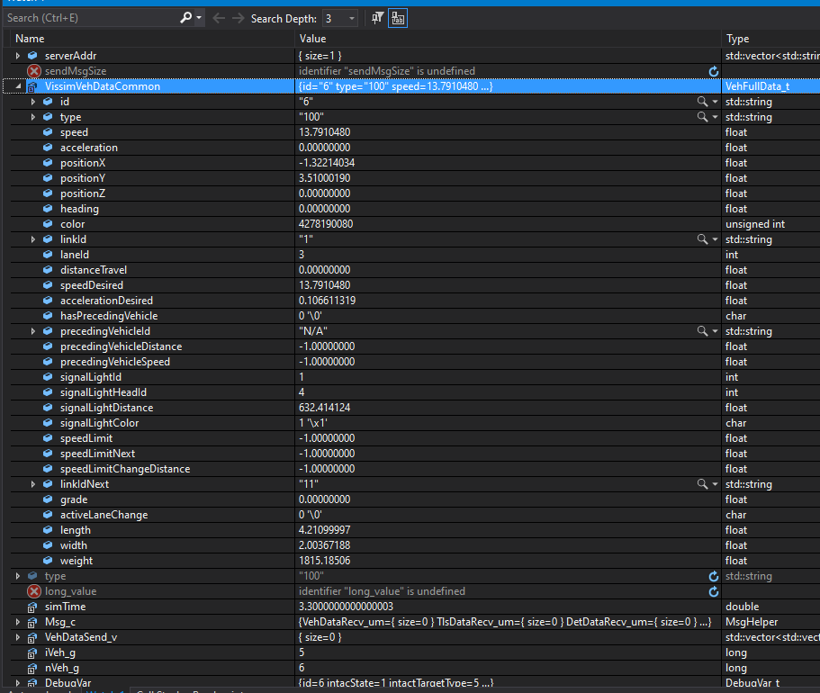
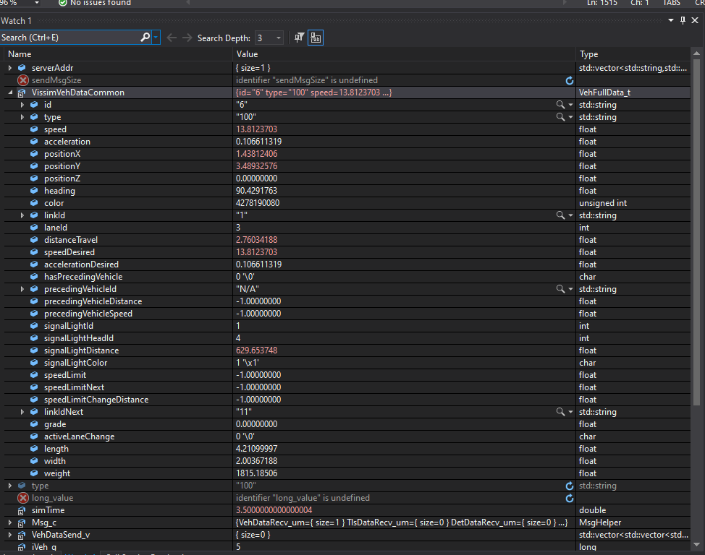
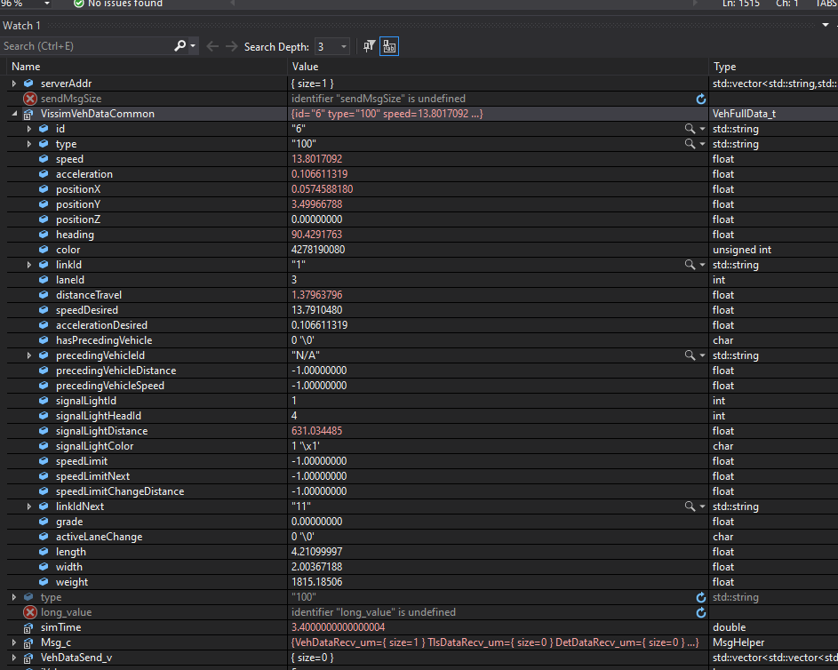
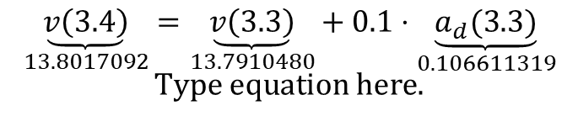
$$\underset{13.8017092}{\underbrace{v\left(3.4\right)}}=\underset{13.7910480}{\underbrace{v\left(3.3\right)}}+0.1⋅\underset{0.106611319}{\underbrace{a_{d}(3.3)}}$$

Slide 16
SUMO:
Send v(t)
Receive v(t+dt)
Simulate next step
Traffic Layer:
Receive v(t)
Send v(t)
$$⋮$$
WAIT
$$⋮$$
Receive v(t+dt)
Send v(t+dt)
Control Layer
Receive v(t)
Get Control v(t+dt), a(t)
Send cmd ego v(t+dt)
Recv actual ego v(t+dt)
Send actual ego v(t+dt), cmd traffic v(t+dt)
Ego Model
Receive cmd ego v(t+dt)
Send actual ego v(t+dt)
Traffic Simulator
Flexible Real-Sim Interface
CAV Application Client
Traffic Layer
Application Layer
Traffic States $(t)$
$$t$$
$$t$$
Hold last states
Cmd$(t+Δt)$
Idle
Interpolation
Actual
$$a\left(t+Δt\right)$$
$$t+Δt$$
$$t$$
Hold last states
Simulate one step
$$t+Δt$$
Traffic States
$$v(t+Δt)$$
Cmd
$$v(t+2Δt)$$
$$⋯$$
$$⋯$$
$$⋯$$
$$⋯$$

Slide 17
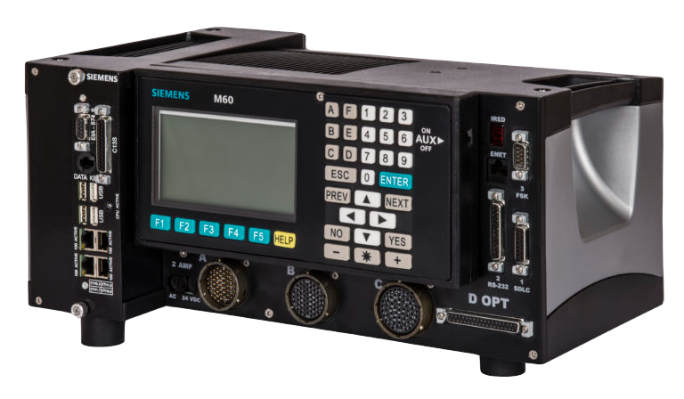
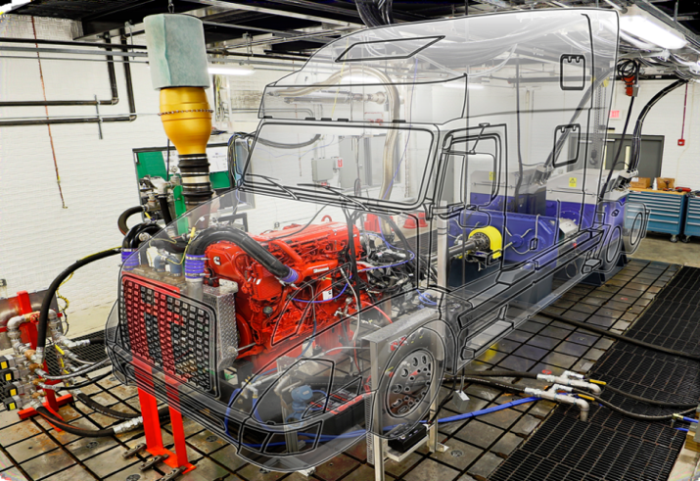
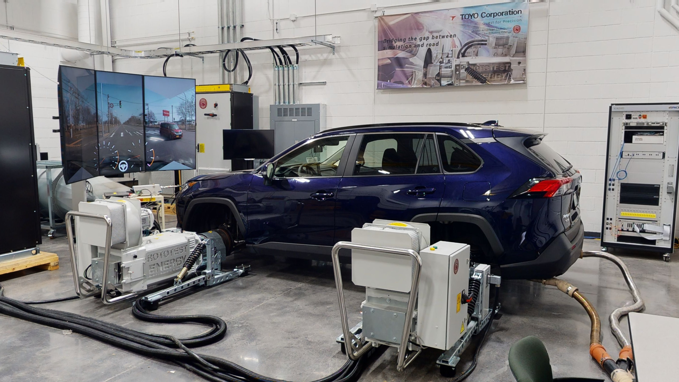
Flexible Real-Sim Interface
Detector All
Tls All
Signal Controller
CAV Application Clients
Traffic Simulator
Application Layer
Detector All
Tls All
Traffic Layer
Vehicle[0]
Detector[0]
Tls[0]
Tls dll
Combined
Vehicle All
Detector All
Tls All
Ego CAV 1
Combined
Vehicle All
Detector All
Tls All
Vehicle Simulator
HIL Testbed
Application Layer
drivermodel dll
Vehicle[1]
Detector[1]
Tls[1]
Vehicle All
Vehicle All
Detector All
Tls All
Ego CAV 2
Vehicle Simulator
HIL Testbed
Application Layer
Vehicle[2]
Detector[2]
Tls[2]
$$⋯$$
$$⋯$$
Combined received data is on the Traffic Layer side
Traffic Layer distribute combined data to Application Layer and to two VISSIM dlls
VISSIM dlls need to know all Application Layer needs and send out message
(b) Distributed Architecture

Slide 18
simState | simTime [float] |  |  |  | TotalMessageSize [uint32]
 | MessageSize |  | identifier | String size | f | l | o
w | _ | 0 | . | 0
MessageSize |  | identifier | String size

Slide 19
Data Body
Simulation State (1 byte)
Data Body
Simulation Time
(4 bytes)
Total Message Size
(4 bytes)
Data ID (1 byte)
Data ID (1 byte)
Data Length
(2 bytes)
Data Length
(2 bytes)
2 bytes (0-65535/-32768-32767)
$$⋯$$
Header
Data Frame 1
Data Frame 2
String Length (1 byte)
String Length (1 byte)
String Length (1 byte)
String Signal State
String Body
String Signal Name
Signal ID
(2 bytes)
Vehicle Data Body
Signal Data Body
Data ID (1 byte)
String Length (1 byte)
String Length (1 byte)
String Length (1 byte)
Data Length
(2 bytes)
String Signal Name
Signal ID
(2 bytes)
String Detector Name
ID
(1 bytes)
State
(1 bytes)
String Detector Name
ID
(1 bytes)
State
(1 bytes)
$$⋯$$
Signal Identifier
Detector 1
Detector 2
Detector Data Body

Slide 20
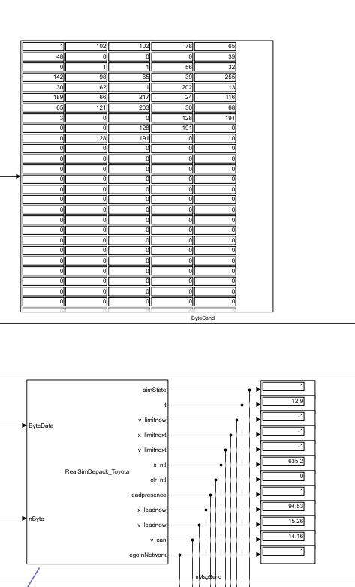
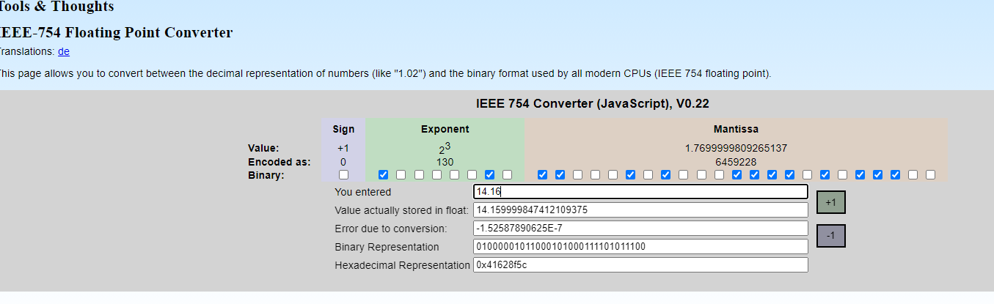
id, speed, accelerationDesired, hasPrecedingVehicle, precedingVehicleDistance, precedingVehicleSpeed, signalLightDistance, signalLightColor, speedLimit, speedLimitNext, speedLimitChangeDistance
Little Endian, i.e., need to fliplr to get correct bit
Conversion:
The value of a IEEE-754 number is computed as:
sign 2exponent mantissa
The sign is stored in bit 32. The exponent can be computed from bits 24-31 by subtracting 127. The mantissa (also known as significand or fraction) is stored in bits 1-23. An invisible leading bit (i.e. it is not actually stored) with value 1.0 is placed in front, then bit 23 has a value of 1/2, bit 22 has value 1/4 etc. As a result, the mantissa has a value between 1.0 and 2. If the exponent reaches -127 (binary 00000000), the leading 1 is no longer used to enable gradual underflow.

Slide 21
Current support vehicle data list
std::string id;
std::string type;
float speed;
float acceleration;
float positionX;
float positionY;
float positionZ;
float heading;
uint32_t color; // r,g,b,a
std::string linkId;
int32_t laneId;
float distanceTravel;
float speedDesired;
float accelerationDesired;
bool hasPrecedingVehicle;
std::string precedingVehicleId;
float precedingVehicleDistance; // distance to preceding vehicle
float precedingVehicleSpeed; // absolute speed of preceding vehicle
float signalLightDistance; // distance to next signal light
int8_t signalLightColor; // color of next signal light
float speedLimit;
float speedLimitNext;
float speedLimitChangeDistance;
std::string linkIdNext;
float grade; // angle in radians, positive climbing up hill
[id, type, speed, acceleration, positionX, positionY, positionZ, heading, color, linkId, laneId, distanceTravel, speedDesired, accelerationDesired, hasPrecedingVehicle, precedingVehicleId, precedingVehicleDistance, precedingVehicleSpeed, signalLightDistance, signalLightColor, speedLimit, speedLimitNext, speedLimitChangeDistance, linkIdNext, grade]

Slide 22
If no preceding vehicle, should ignore the id, distance, speed,
If no signal, signallight distance will be negative
If no speed limit, speed limit will be negative

Slide 23
Color rgba
first 8 bits r
second 8 bits g

Slide 24
traffic signal data
string id
phase
detector list
detector vehicle

Slide 25
Sensor data

Slide 26
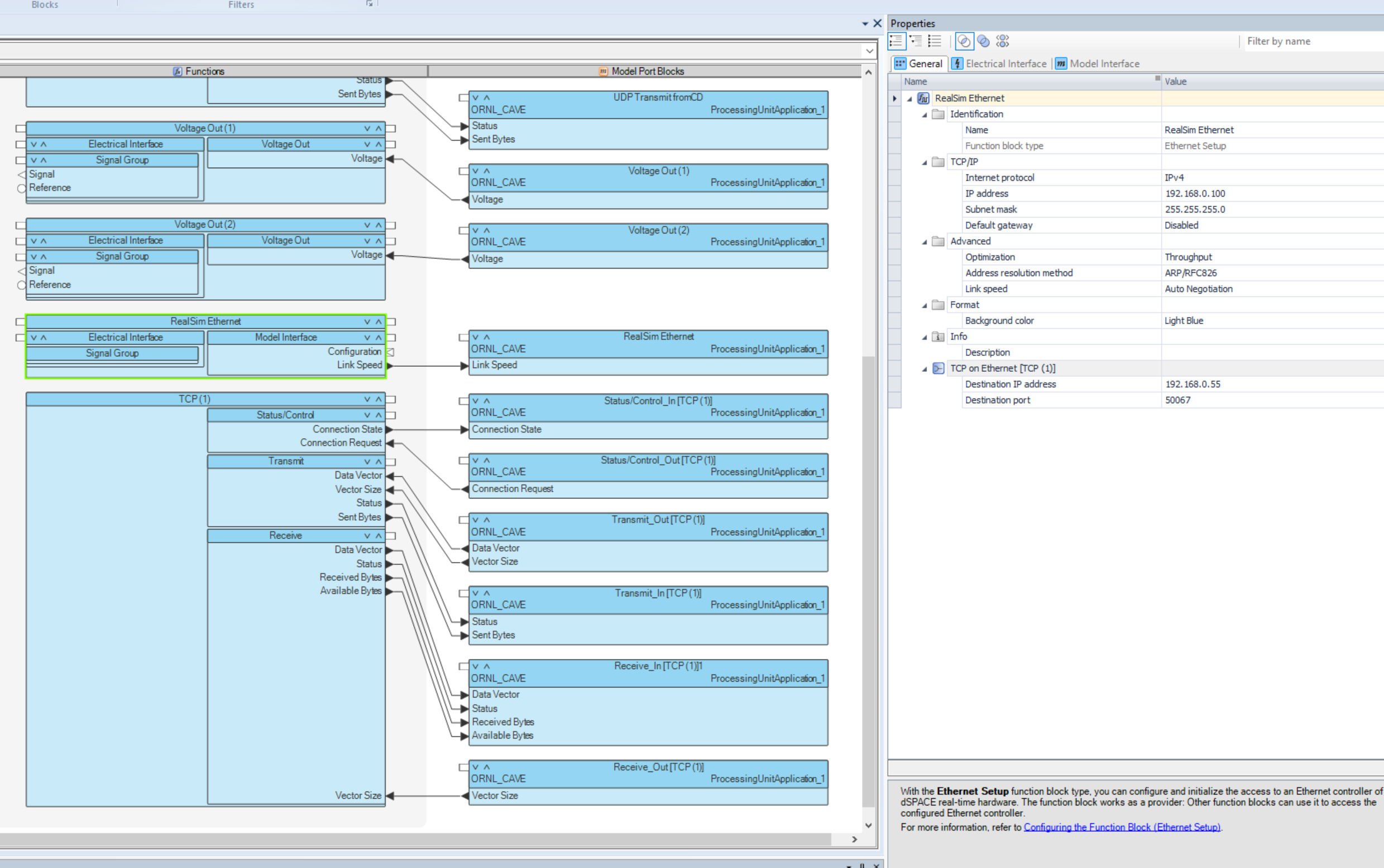

Slide 27
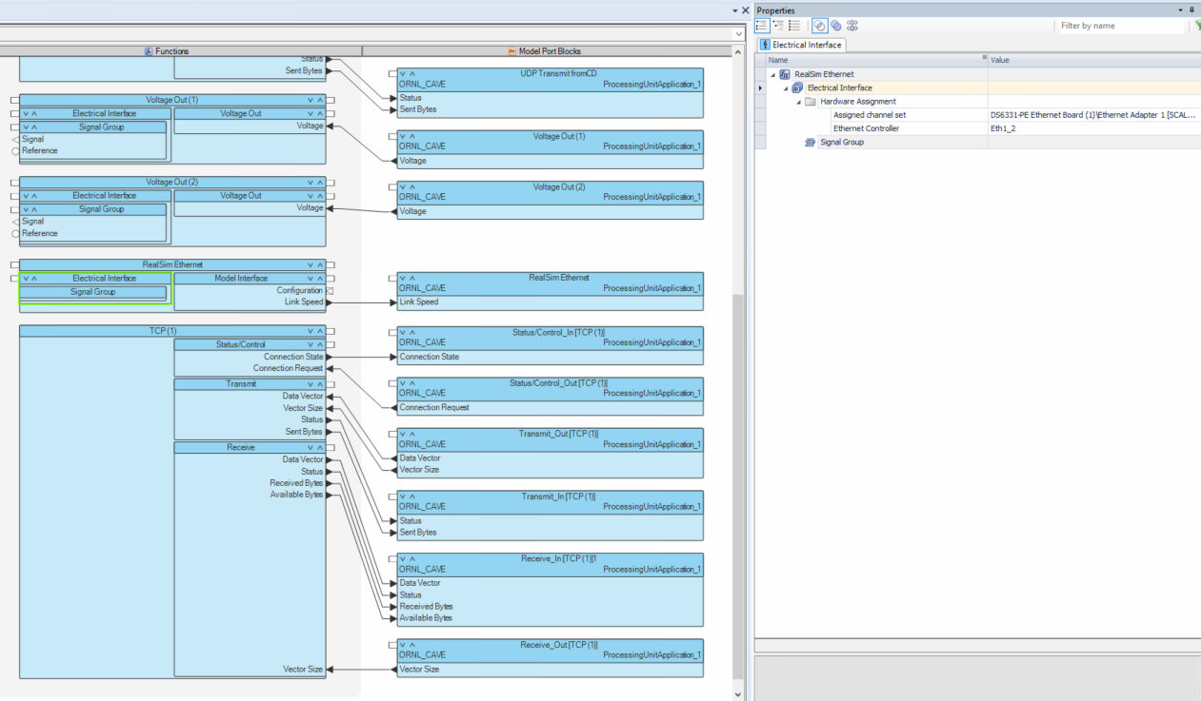

Slide 28
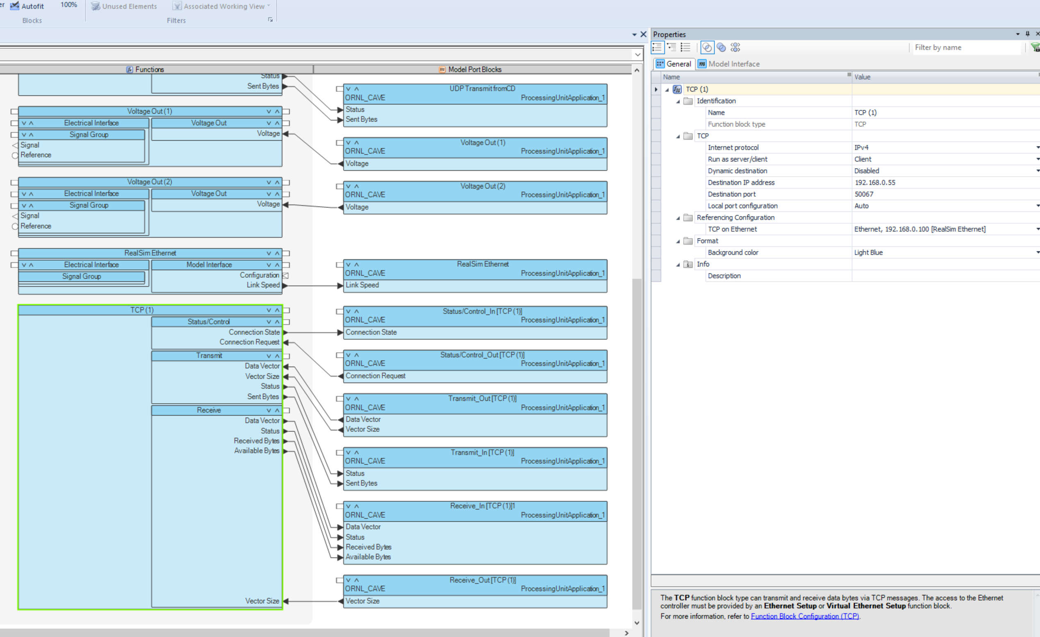

Slide 29
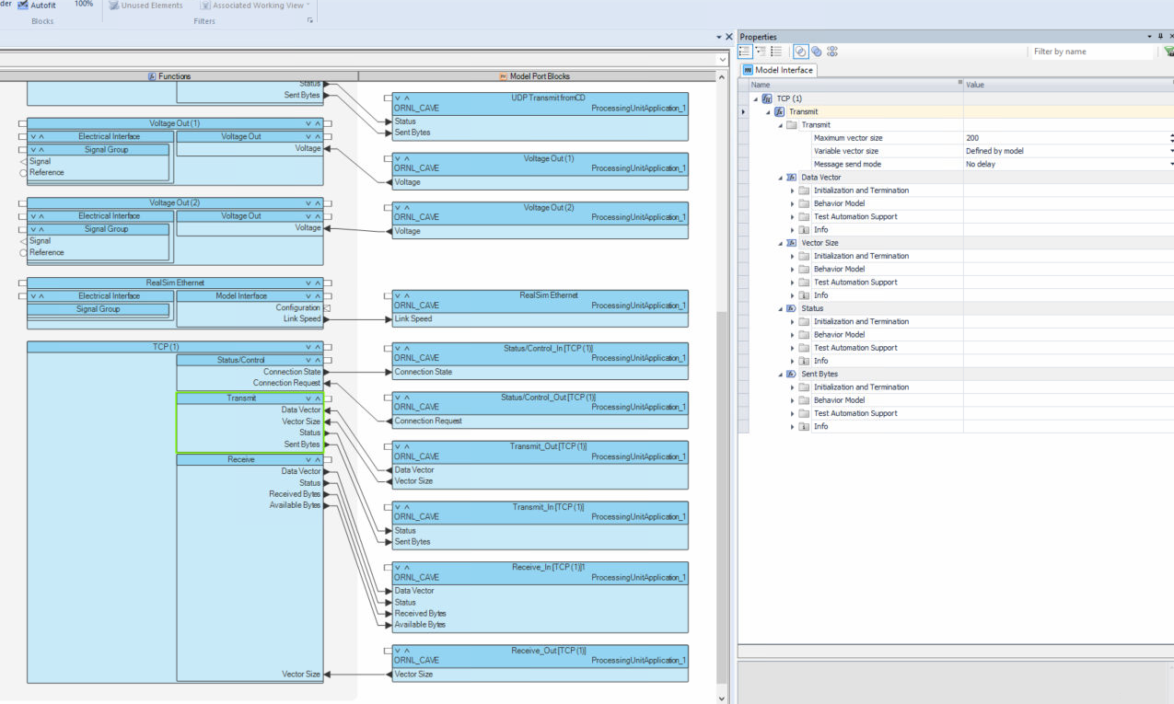

Slide 30
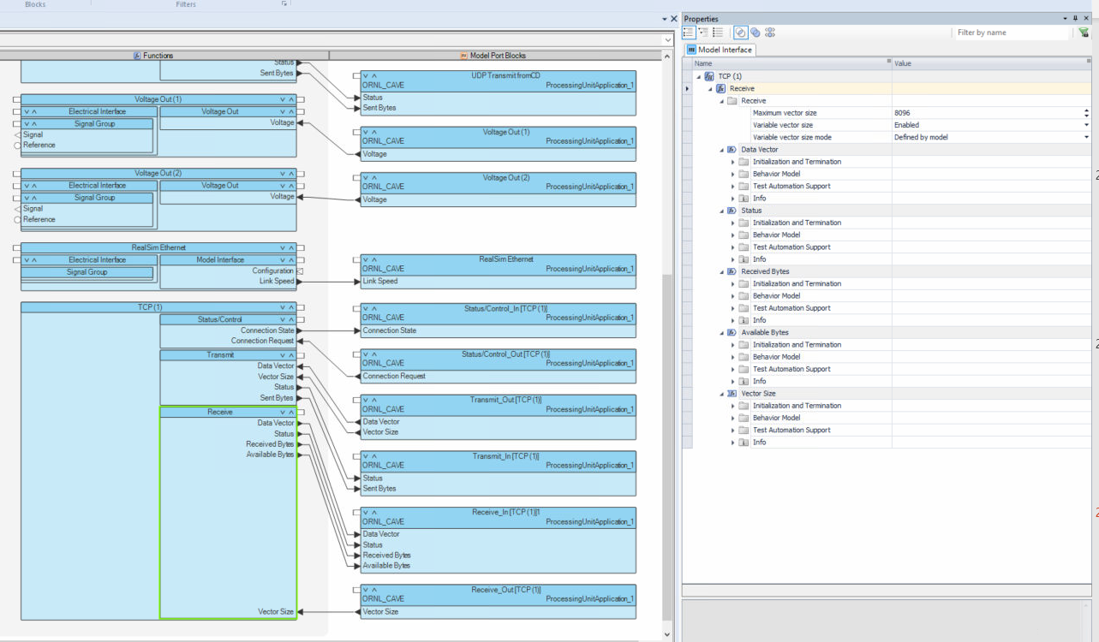

Slide 31
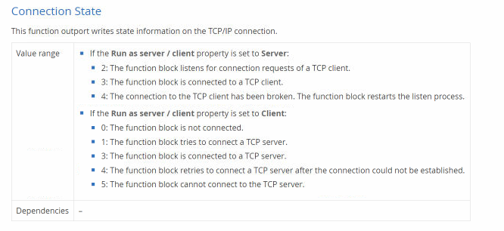

Slide 32






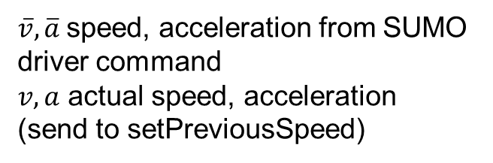


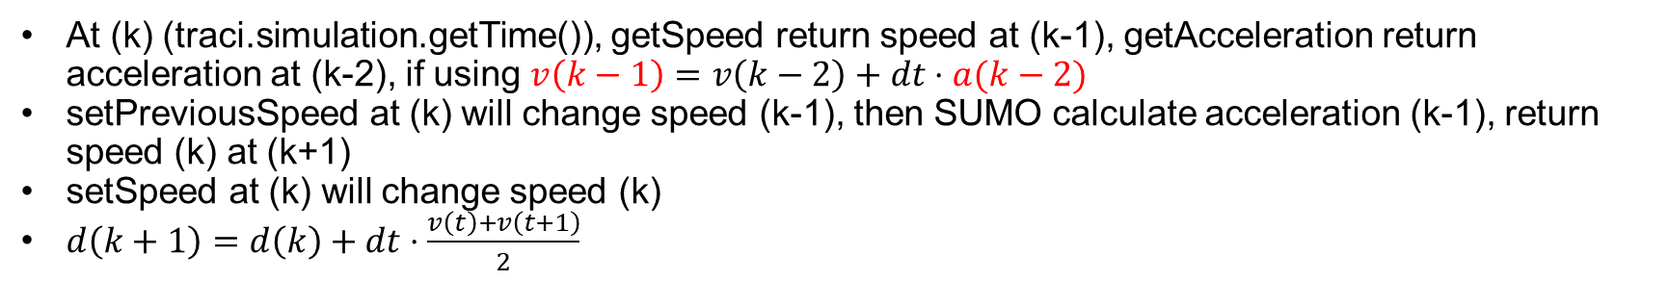





Actual
$$\overline{v}(k)$$
Command
$$\overline{a}(k−1)$$
$$v(k)$$
$$a(k)$$
$$v(k+1)$$
$$a(k−1)$$
$$v(k−1)$$
$\overline{v},\overline{a}$ speed, acceleration from SUMO driver command
$v,a$ actual speed, acceleration (send to setPreviousSpeed)
$$\overline{a}(k)$$
$$\overline{v}(k−1)$$
$$\overline{v}(k+1)$$
$$k−1$$
$$k$$
$$k+1$$
At (k) (traci.simulation.getTime()), getSpeed return speed at (k-1), getAcceleration return acceleration at (k-2), if using $v\left(k−1\right)=v\left(k−2\right)+dt⋅a(k−2)$
setPreviousSpeed at (k) will change speed (k-1), then SUMO calculate acceleration (k-1), return speed (k) at (k+1)
setSpeed at (k) will change speed (k)
$d\left(k+1\right)=d\left(k\right)+dt⋅\frac{v\left(t\right)+v\left(t+1\right)}{2}$

Slide 33











SUMO
Simulink
0
$v_{des}\left(0\right)$
placeholder, not used
0
Send $v_{act}(0)$
Send $v_{act}(0.1)$
Run one-step
Wait
0.1
0.1
$$v_{act}(0)$$
Run one-step
Receive $t(0.3), v_{des}(0.2)$
0.2
$$v_{des}(0.1)$$
Receive $t(0.1), v_{des}(0)$
Receive $t(0.2), v_{des}(0.1)$
Roundtrip delay
Wait
$$v_{act}(0.1)$$
0.1
0.2
Roundtrip delay
Run one-step
$$v_{des}(0.2)$$
0.3
Wait
$$v_{act}(0.2)$$
0.2
0.3

Slide 34
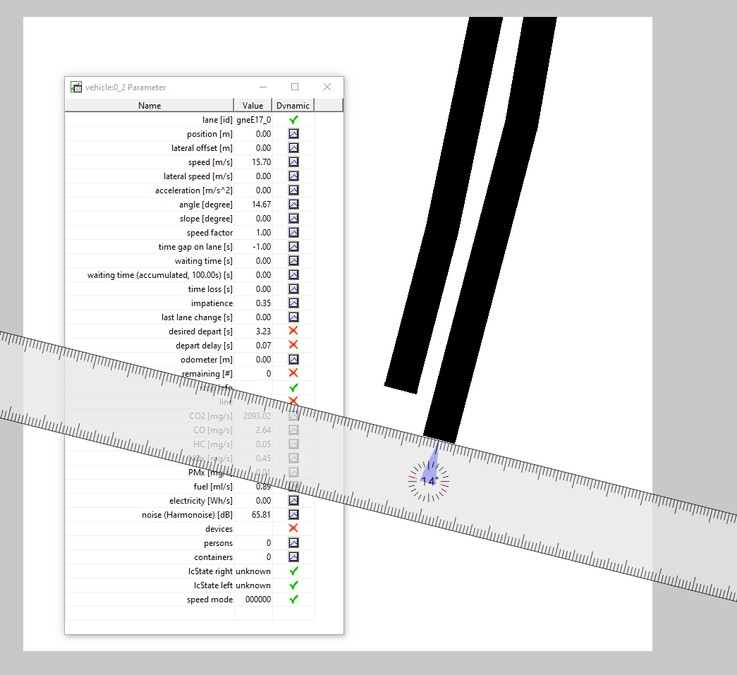
SUMO angle

Slide 35
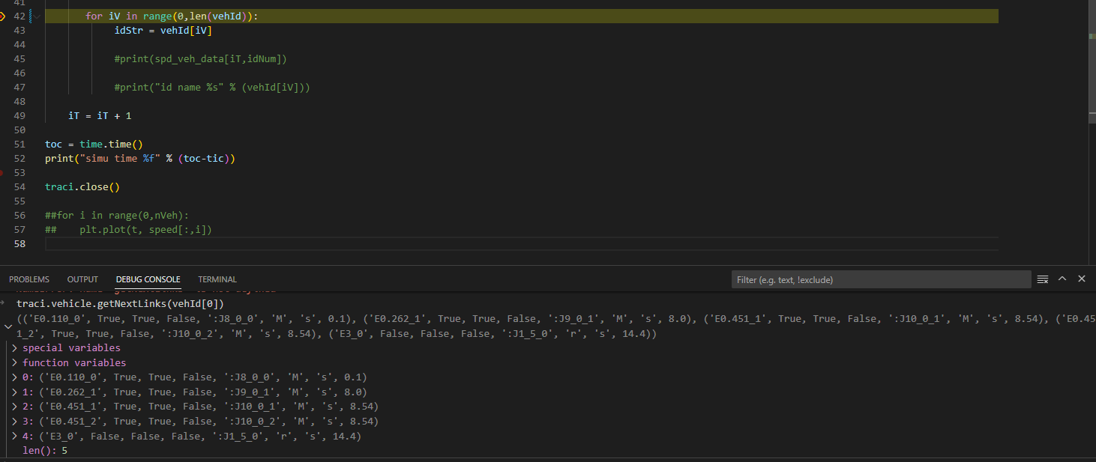
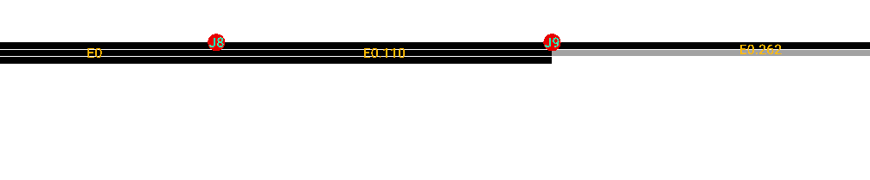


Vehicle will be gone after E3. so we only need getNextLinks once then can store the speed limit

Slide 36
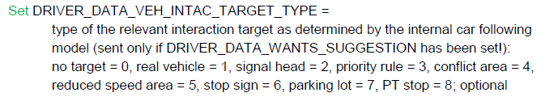
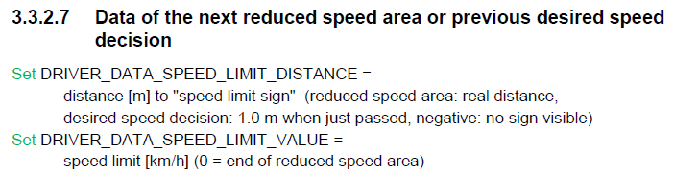
To properly get a normal speed limit,
First need a python script to get a table of desired speed decision locations with regarding each link
a link can have multiple DSD
Then in dll, based on current link information and position, can find out what is next DSD
Then based on next link information, can find out the first DSD of the next link
Thus, we will have three data fields:
float speedLimit;
float speedLimitNext;
float speedLimitChangeDistance;
Need to check if we force an ego vehicle, will next link information messed up
VISSIM does not have a typical speed limit information.
When there’s a reduced speed area, it will show the distance to that RSA.
When there’s desired speed decision, there’s no distance information until vehicle on the DSD
RSA change desired speed temporarily (only when within RSA). But vehicle will decelerate way ahead of RSA
DSD will permanently change desired speed, but vehicle will only change desired speed when passing DSD

Slide 37
If in VISSIM you define a 3D road, the speed position, etc. will still follow the 2D projected road
Next link only return when a vehicle enter the route decision regions
VISSIM will return each of the next links one by one for each vehicle
VISSIM combine static route, the two decisions have to be on the same link
// there will be next link only when the vehicle is in static decision areas
// the next links will contain all links within the static decision areas
// if used combine route, then will be able to see longer future routes
Speed limit connect to next has to guess
since do not know the link connection topology and route selection information
Next link information may not known
Initial speed limit may not known
Distance has to be distinct
Need to add UDA position on link, make sure no such no and name
Challenges:
Need both next link and lane, but may not have such information
Desired speed defined as a distribution
Desired speed decision defined for each class of vehicle
Desired speed decision define for each lane
No link topology (length, connection, lanes, etc.) information in dll. Need another lookup table
No initial speed limit

Slide 38
Signal light, where do you want to get? Matlab or Simulink

Slide 39
whether time of adding these CAV is known ahead of simulation or will be determined during the simulation? if latter, will simulink make the decision? what if want matlab to make the decision?

Slide 40
Doing vehicle signal control, need extract information using dll.
Grade and 3D length, speed, position question
Speed limit how to properly obtain, since no route of a vehicle
Designate route when adding a vehicle, or change a route
Dll, position on network
Dll, add remove a vehicle
October PTV America's 23rd Annual User Group Meeting in Denver, CO!
Grade seems that still not right

Slide 41
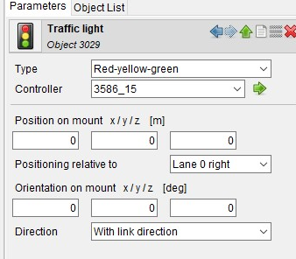
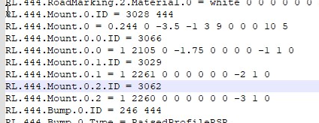

Mapping

Slide 42















Actual
$$\overline{v}(k)$$
$$\overline{a}(k−1)$$
$\overline{v},\overline{a}$ speed, acceleration computed by SUMO
$v,a$ speed, acceleration external control
SUMO computed
$$\overline{v}(k−1)$$
$$v(k)$$
$$a(k)$$
$$v(k+1)$$
$$\overline{a}(k−2)$$
$$a(k−1)$$
$$v(k−1)$$
$$\overline{a}(k)$$
$$v(k−2)$$
$$a(k−2)$$
$$\overline{v}(k+1)$$
$$\overline{v}(k−2)$$
Integration step
$$v\left(k\right)=v\left(k−1\right)+dt⋅a(k−1)$$
$$k−1$$
$$k$$
$$k+1$$
At (k) (traci.simulation.getTime()), getSpeed return speed at (k-1), getAcceleration return acceleration at (k-2), if using $v\left(k−1\right)=v\left(k−2\right)+dt⋅a(k−2)$
setPreviousSpeed at (k) will change speed (k-1), then SUMO calculate acceleration (k-1), return speed (k) at (k+1)
setSpeed at (k) will change speed (k)
$d\left(k+1\right)=d\left(k\right)+dt⋅\frac{v\left(t\right)+v\left(t+1\right)}{2}$

