Slide 1
Real-Twin Monthly Meeting
August 25, 2026
Ross Wang¹, Guanhao Xu¹, Abhilasha Saroj¹, Roy Luo¹, Jinghui Yuan¹, Yunli Shao²
¹ Oak Ridge National Laboratory; ² University of Georgia

Slide 2
Current Milestone(s)
Milestone Name/Description* | Criteria* | End Date* | Type*
Develop and demonstrate the Real-Twin advanced automation workflow and functionality with at least 2 example microscopic simulators. Subtask 3.2 | Presentation documenting and demonstrating Real-Twin automation workflow in 1 additional simulator (VISSIM). | 8/31/2026 | Go/No Go Decision

Slide 3
Real-Twin Automation Workflow for Vissim
Real-Twin Automation Workflow Overview
1
2
3
4
5
Step 1
Step 2
Step 3
Step 4
Step 5
Network Generation & Import
Matchup Table Generation
Demand Import
Signal Import
Simulation Generation and Calibration
Import an existing network or generate a network for the area of interest using OpenStreetMap data
Generate mapping tables that align real-world network elements with their corresponding simulator object IDs
Convert field traffic counts into simulator-ready demand inputs matched to the network
Import signal timing and control data, then automatically configure the corresponding signal plans in the traffic simulator
Generate simulation scenarios and calibrate the model (e.g., demand and driving behavior) against field observations
Output: calibrated traffic scenarios for SUMO / Aimsun / VISSIM

Slide 4

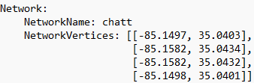

Real-Twin Automation Workflow for Vissim vs SUMO
Step 1 Network Generation & Import
SUMO’s netconvert
Real-Twin network input:
lat and long of bounding box vertices for area of interest
SUMO ‘net.xml’ network file
Download data
from OpenStreetMap
Intermediate ‘.xodr’ file
Vissim network import function
Vissim ‘.inp’ file
For both Vissim and SUMO, Real-Twin can automatically generate an OpenDRIVE (.xodr) network from user-defined geographic coordinates using OpenStreetMap data.
The generated .xodr network is then imported into Vissim through its COM interface (and into SUMO through netconvert).
Notes:
Both simulators start from the same OpenDRIVE file that netconvert writes; only the import differs.
Two things had to be solved for Vissim. Georeferencing: netconvert parks the true origin in the OpenDRIVE header, which Vissim's importer ignores, dropping the network next to (0,0) -- so the network is shifted back to true UTM before export. And renumbering: Vissim assigns its own link numbers on import, so OpenDRIVE roads 390-575 become Vissim links 1-186 and no upstream ID survives.
Chattanooga: 186 links and 255 connectors from 186 drivable roads.

Slide 5
Real-Twin Automation Workflow for Vissim
Step 2 Matchup Table Generation
Matchup table links demand and signal data to the correct intersections in the simulation network.
Both tables serve the same purpose and share the same layout -- one row per turning movement, columns A-N in the same order -- so they can be read side by side. On Chattanooga they agree on all 104 movements, 34 approaches and 10 junctions.
The differences are structural, not just how the data are accessed. SUMO's network file names junctions, connections and turn directions outright. Vissim has no junction object at all, renumbers every link on import, and spreads one movement across several internal links, so junctions have to be worked out again:
  Pair each Vissim link with its OpenDRIVE road by comparing three things: the Vissim link polyline against the OpenDRIVE road's planView geometry, the Vissim link length against the OpenDRIVE road length, and the lane count on each. Solved as a one-to-one assignment, since Vissim imports one Vissim link per drivable OpenDRIVE road.
  Read the junction id off the paired OpenDRIVE road: every <road> element carries a junction attribute holding the id of the junction it lies inside, or -1 when it does not. Grouping the Vissim links by that id gives each junction; the Vissim links feeding one from outside are its approaches, and the Vissim connectors through it give the turns.
Notes:
Why "structural" rather than "how the data are accessed".
SUMO's network file names junctions, connections and turn directions outright: a
junction is an element, a turn is a <connection>, and its direction is the dir
attribute. None of that exists on the Vissim side. Vissim assigns its own link
numbers on import, so no upstream identifier survives -- OpenDRIVE roads 390-575
become Vissim links 1-186. It has no junction object at all, only links and
connectors. And every OpenDRIVE road becomes a link, junction interiors
included, so one movement is a path -- approach, connector, internal link(s),
connector, exit -- rather than a single connection. Chattanooga's 186 links are
59 road links and 127 junction-internal ones.
How junctions are recovered.
Every <road> in an OpenDRIVE file carries a junction attribute: the id of the
junction it belongs to, or -1. Both that and the junction's own id are required
by the standard, so any conforming file has them. Matching each Vissim link back
to its road therefore brings the grouping across. Approaches are then the links
feeding an interior link from outside, filtered to groups with at least three --
17 groups become 10 intersections on Chattanooga. Bearings come from the link
polylines, and turns from the bearing change, using SUMO's own rule ported from
NBNode::getDirection so both pipelines label a movement the same way.
Default, alternative, and last resort.
By default each link is matched to its road by GEOMETRY. Three attributes are
compared: the Vissim link polyline (LinkPolyPts, resampled to six points evenly
by arc length) against the OpenDRIVE road's <planView> geometry evaluated in
closed form; the Vissim link's Length2D against the OpenDRIVE road's length
attribute; and the Vissim link's NumLanes against the OpenDRIVE road's count of
type="driving" lanes. Vissim shifts the whole network on import, so a constant
offset is removed first by aligning centroids -- no Vissim link name is read
anywhere in this route.
It is solved as a one-to-one assignment rather than a nearest-neighbour search,
because Vissim imports exactly one Vissim link per drivable OpenDRIVE road. On
the OSM test that was 516 Vissim links against 516 OpenDRIVE roads with a driving
lane, the other 516 OpenDRIVE roads being sidewalk and restricted ways which
Vissim correctly skipped. Solved greedily, several Vissim links claim the same
OpenDRIVE road and it collapses -- an early attempt scored 33%.
The geometry primitives have to be evaluated properly: these files are almost
entirely paramPoly3 (1278 of 1407 records on Chattanooga, with no arcs at all),
and approximating them as straight chords misplaces precisely the short curved
roads inside junctions. Done correctly the match is exact on Chattanooga and the
synthetic grid.
The ALTERNATIVE is the link NAME: Vissim writes the OpenDRIVE road id into it,
so link 101 is named '490: :18_0-0-Right' and the 490 can simply be read off.
Available as --junction-source name.
Both were built and compared. They give identical junction assignments on all
786 links across three networks -- Chattanooga 186, a synthetic grid 84, an OSM
extract 516. Geometry is the default only because the naming convention is PTV's
rather than the OpenDRIVE standard's: nothing guarantees it survives a version
change, whereas the junction attribute is mandatory.
If neither can run -- no .xodr supplied, or no names parse -- the code falls back
to clustering short links within 30 m. That is a guess, and it says so.
What is confirmed, and what is not.
Confirmed on netconvert-produced OpenDRIVE imported into Vissim 2026, across
three networks. Expected to hold for any conforming file that models its
intersections as classic junctions with connecting roads, but not tested against
RoadRunner, CARLA or a survey export. Direct and virtual junctions (OpenDRIVE
1.7+) have no connecting roads at all, so no road points at them and they would
be invisible to this grouping; netconvert does not emit them.

Slide 6
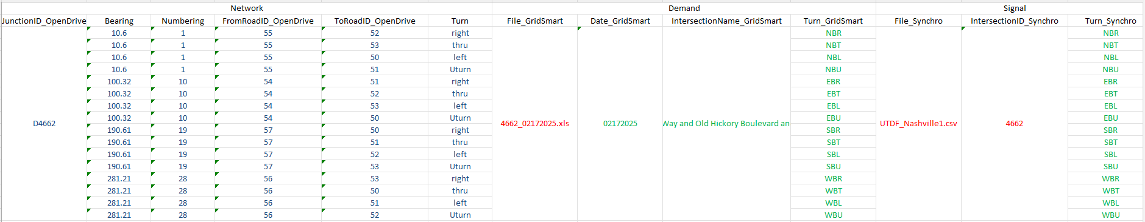
Real-Twin Automation Workflow for Vissim vs SUMO
Step 2 Matchup Table Generation
Matchup table links demand and signal data to the correct intersections in the simulation network.
Both tables serve the same purpose and share the same layout -- one row per turning movement, columns A-N in the same order -- so they can be read side by side. On Chattanooga they agree on all 104 movements, 34 approaches and 10 junctions.
The differences are structural, not just how the data are accessed. SUMO's network file names junctions, connections and turn directions outright. Vissim has no junction object at all, renumbers every link on import, and spreads one movement across several internal links, so junctions have to be worked out again:
  Pair each Vissim link with its OpenDRIVE road by comparing three things: the Vissim link polyline against the OpenDRIVE road's planView geometry, the Vissim link length against the OpenDRIVE road length, and the lane count on each. Solved as a one-to-one assignment, since Vissim imports one Vissim link per drivable OpenDRIVE road.
  Read the junction id off the paired OpenDRIVE road: every <road> element carries a junction attribute holding the id of the junction it lies inside, or -1 when it does not. Grouping the Vissim links by that id gives each junction; the Vissim links feeding one from outside are its approaches, and the Vissim connectors through it give the turns.
Blue: information obtained from the network file (e.g., turning movement road ids)
Red: signal and demand user input.
Green: information obtained from user input that links demand and signal data to the simulation network.
Notes:
Why "structural" rather than "how the data are accessed".
SUMO's network file names junctions, connections and turn directions outright: a
junction is an element, a turn is a <connection>, and its direction is the dir
attribute. None of that exists on the Vissim side. Vissim assigns its own link
numbers on import, so no upstream identifier survives -- OpenDRIVE roads 390-575
become Vissim links 1-186. It has no junction object at all, only links and
connectors. And every OpenDRIVE road becomes a link, junction interiors
included, so one movement is a path -- approach, connector, internal link(s),
connector, exit -- rather than a single connection. Chattanooga's 186 links are
59 road links and 127 junction-internal ones.
How junctions are recovered.
Every <road> in an OpenDRIVE file carries a junction attribute: the id of the
junction it belongs to, or -1. Both that and the junction's own id are required
by the standard, so any conforming file has them. Matching each Vissim link back
to its road therefore brings the grouping across. Approaches are then the links
feeding an interior link from outside, filtered to groups with at least three --
17 groups become 10 intersections on Chattanooga. Bearings come from the link
polylines, and turns from the bearing change, using SUMO's own rule ported from
NBNode::getDirection so both pipelines label a movement the same way.
Default, alternative, and last resort.
By default each link is matched to its road by GEOMETRY. Three attributes are
compared: the Vissim link polyline (LinkPolyPts, resampled to six points evenly
by arc length) against the OpenDRIVE road's <planView> geometry evaluated in
closed form; the Vissim link's Length2D against the OpenDRIVE road's length
attribute; and the Vissim link's NumLanes against the OpenDRIVE road's count of
type="driving" lanes. Vissim shifts the whole network on import, so a constant
offset is removed first by aligning centroids -- no Vissim link name is read
anywhere in this route.
It is solved as a one-to-one assignment rather than a nearest-neighbour search,
because Vissim imports exactly one Vissim link per drivable OpenDRIVE road. On
the OSM test that was 516 Vissim links against 516 OpenDRIVE roads with a driving
lane, the other 516 OpenDRIVE roads being sidewalk and restricted ways which
Vissim correctly skipped. Solved greedily, several Vissim links claim the same
OpenDRIVE road and it collapses -- an early attempt scored 33%.
The geometry primitives have to be evaluated properly: these files are almost
entirely paramPoly3 (1278 of 1407 records on Chattanooga, with no arcs at all),
and approximating them as straight chords misplaces precisely the short curved
roads inside junctions. Done correctly the match is exact on Chattanooga and the
synthetic grid.
The ALTERNATIVE is the link NAME: Vissim writes the OpenDRIVE road id into it,
so link 101 is named '490: :18_0-0-Right' and the 490 can simply be read off.
Available as --junction-source name.
Both were built and compared. They give identical junction assignments on all
786 links across three networks -- Chattanooga 186, a synthetic grid 84, an OSM
extract 516. Geometry is the default only because the naming convention is PTV's
rather than the OpenDRIVE standard's: nothing guarantees it survives a version
change, whereas the junction attribute is mandatory.
If neither can run -- no .xodr supplied, or no names parse -- the code falls back
to clustering short links within 30 m. That is a guess, and it says so.
What is confirmed, and what is not.
Confirmed on netconvert-produced OpenDRIVE imported into Vissim 2026, across
three networks. Expected to hold for any conforming file that models its
intersections as classic junctions with connecting roads, but not tested against
RoadRunner, CARLA or a survey export. Direct and virtual junctions (OpenDRIVE
1.7+) have no connecting roads at all, so no road points at them and they would
be invisible to this grouping; netconvert does not emit them.

Slide 7
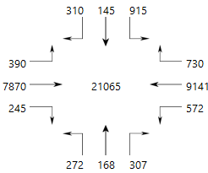
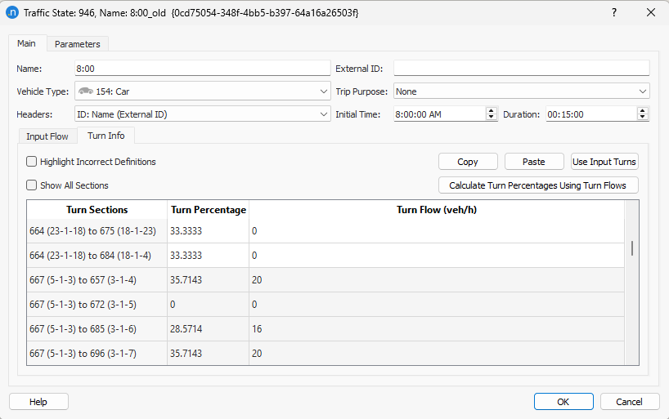
Real-Twin Automation Workflow for Vissim vs SUMO
Step 3 Demand Import
SUMO flow file (‘.flow.xml’)
Real-Twin
SUMO’s
jtrrouter
SUMO route file (‘.rou.xml’)
Field traffic counts
SUMO turn file (‘.turn.xml’)
Real-Twin
For SUMO, Real-Twin converts turning movement counts into flow and turn files, then uses SUMO’s jtrrouter to generate the final demand file (.rou.xml).
For Vissim, Real-Twin writes vehicle inputs on the network entry links and one static routing decision per approach, carrying the turning movement counts as relative flows. Vissim normalises them itself, so no router is needed and the counts stay traceable to the field data.
Vissim vehicle inputs
and routing decisions
Notes:
Vissim has no router, so the turning movement counts go in directly: a vehicle input per entry link, and one routing decision per approach carrying a route to every exit.
The relative flows are the raw counts rather than ratios, because Vissim normalises them itself. That makes the model checkable against the camera file: 13, 0, 30, 55 on an approach appears in the SUMO turn file as 0.1327, 0, 0.3061, 0.5612 -- the same numbers after division.
Decisions are placed as far upstream as the ordering rules allow, which gains 778 m of extra warning across the corridor. Approaches with a single exit get no decision at all: it would decide nothing, and a vehicle already on a route ignores the next decision until that route ends.
Chattanooga, 08:00-09:00: 16 entry links, 4,061 vehicles, 30 routing decisions, 100 routes.

Slide 8
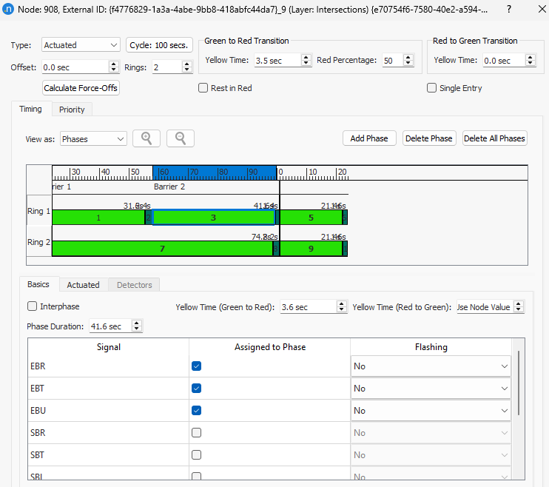
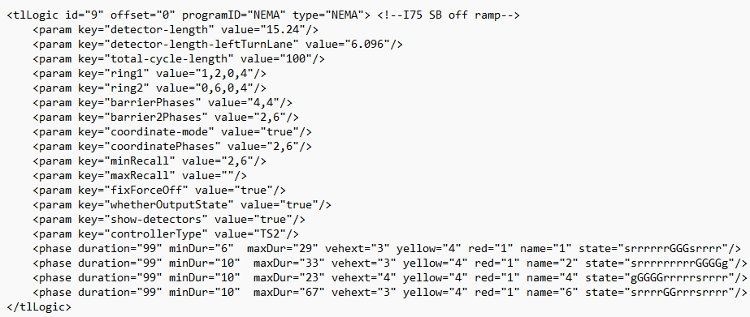
Real-Twin Automation Workflow for Vissim vs SUMO
Step 4 Signal Import
For SUMO, Real-Twin converts UTDF signal plans directly into NEMA settings and automatically places the detectors.
For Vissim, Real-Twin translates the UTDF data into Ring Barrier Controller files (.prbc), keeping the plan actuated, and places the signal heads, detectors, conflict areas and right-turn-on-red stop signs over the COM API.
SUMO NEMA Signal
(fixed-time; actuation is lost in translation)
Vissim Ring Barrier Controller
(keeps actuation: min/max green, extensions, recalls)
Notes:
The key difference is that the plan stays actuated. SUMO has no equivalent of a ring-barrier controller, so RealTwin flattens Synchro to a fixed-time tlLogic; Vissim's RBC runs the real thing, so minimum and maximum greens, vehicle extensions and recalls survive into the model.
The .prbc file is JSON with every duration in tenths of a second. Synchro does not store the split -- it is MaxGreen + Yellow + AllRed -- and the rings of a barrier must agree on that sum while the barriers add to the cycle. That arithmetic is the check that works on a corridor with no reference controller to compare against.
Protected, permissive and protected-permissive turns come straight from Synchro's Phase1 and PermPhase1: the permitted phase becomes the signal head's Or signal group, so it shows green on either. Right-turn-on-red uses Vissim's own mechanism, a stop sign bound to the turn's signal group.
Chattanooga: 6 controllers, 101 signal heads, 63 detectors, 22 right-turn-on-red stop signs. Audited over a 900 s run -- every detector registers, phase order follows each controller's sequence, and no two phases sharing a ring or crossing a barrier are ever green together.

Slide 9
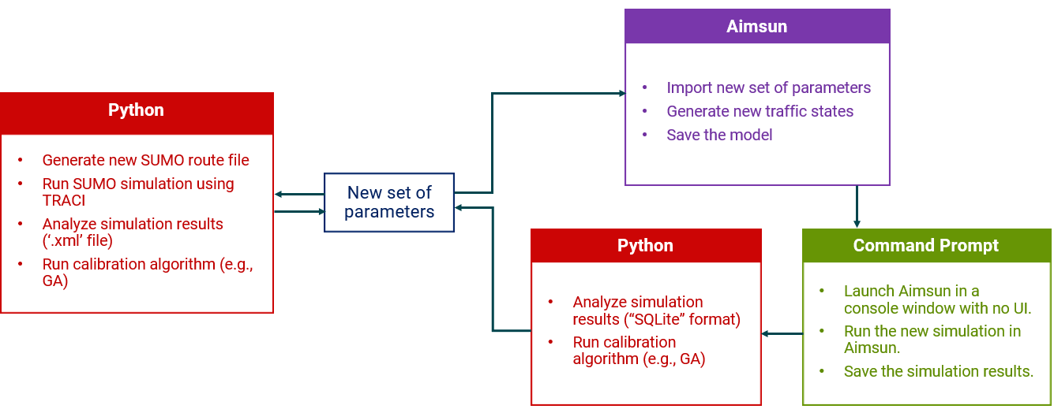
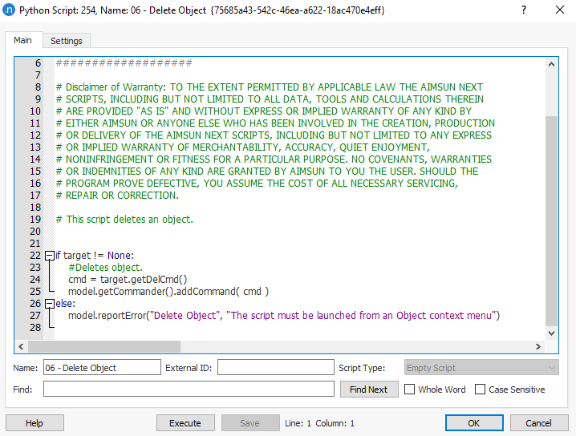

Real-Twin Automation Workflow for Vissim vs SUMO
Step 5 Simulation Generation and Calibration
SUMO calibration can be completed entirely in Python.
Vissim calibration can also be driven from Python: the COM API updates parameters, runs the simulation and reads the results back, so the whole loop stays in one place.
RealTwin.Calibration.SUMO
RealTwin.Calibration.Vissim
Notes:
Calibration for Vissim is not built yet; this slide states the intended shape rather than completed work.
The COM API can update parameters, run the simulation and read results back, so unlike Aimsun the loop does not need the command line or the GUI. Node evaluation already gives per-movement volumes, delay and queues, which is the resolution calibration needs.

Slide 10
Real-Twin Automation Workflow for VISSIM
Real-Twin Automation Workflow Overview
1
2
3
4
5
Step 1
Step 2
Step 3
Step 4
Step 5
Network Generation & Import
Matchup Table Generation
Demand Import
Signal Import
Simulation Generation and Calibration
Import an existing network or generate a network for the area of interest using OpenStreetMap data
Generate mapping tables that align real-world network elements with their corresponding simulator object IDs
Convert field traffic counts into simulator-ready demand inputs matched to the network
Import signal timing and control data, then automatically configure the corresponding signal plans in the traffic simulator
Generate simulation scenarios and calibrate the model (e.g., demand and driving behavior) against field observations
Output: calibrated traffic scenarios for SUMO / Aimsun / VISSIM

Slide 11
Next Steps
Complete the development of automation functions for VISSIM in the Real-Twin tool.
  Vissim license access was confirmed, and the purchase order was processed late July.
  Development of VISSIM-specific automation functions on track to complete by end of August.
Integrate Aimsun and VISSIM automation functions into the Real-Twin tool.
Release a new Real-Twin version on GitHub/GitLab.

Slide 12
Other Updates
Presented 5 posters at ASCE ICTD; 2 papers from this published.
Submitted 3 papers for 2027 TRB Annual Meeting:
  “LaneTop: Agentic Vision-Language Extraction of Lane-Level Intersection Topology”
  “Evaluating Agentic Artificial Intelligence in Transportation: A Multidimensional Framework and Reproducible Benchmark for AI-Assisted Traffic Simulation”
  “Control-Aware Capacity-Constrained Route-Flow Estimation for Microscopic Traffic Simulation”

Slide 13
Next Milestone
Milestone Name/Description* | Criteria* | End Date* | Type*
Develop and demonstrate the Real-Twin advanced automation workflow and functionality with at least 2 example microscopic simulators. Subtask 3.2 | Presentation documenting and demonstrating Real-Twin automation workflow in 1 additional simulator (AIMSUN). | 6/30/2026 | Go/No Go Decision
Develop and demonstrate the Real-Twin advanced automation workflow and functionality with at least 2 example microscopic simulators. Subtask 3.2 | Presentation documenting and demonstrating Real-Twin automation workflow in 1 additional simulator (VISSIM). | 8/31/2026 | Go/No Go Decision
Integrated advanced Real-Twin automation workflow for additional simulators into Real-Twin Python package. Subtask 2.3 | Release of new Real-Twin version on GitHub/GitLab. | 09/30/2026 | Quarterly Progress Measure (Regular)

Slide 14
Real-Twin Automation Workflow for Vissim
Step 5 Simulation Generation and Calibration
Red = SUMO, blue = Vissim. Same loop and the same algorithms; only the interface differs.
SUMO (TraCI)
Vissim (COM)
Write turn ratios and inflows to XML
Build routes with jtrrouter
Run the simulation
Set volumes and turn ratios
Set driving behavior parameters
Run the simulation
New set of parameters
Python | SUMO
Python | Vissim
Read counts from EdgeData.xml
Run calibration algorithm (e.g., GA, SA, TS)
Read counts and travel times over COM
Run calibration algorithm (e.g., GA, SA, TS)
Notes:
The loop is the same two-stage shape on both sides: turn ratios and inflows first, then driver behavior on top of the calibrated demand. Both use the same three algorithms -- GA, SA and TS -- selected from the config file, and both run the simulator with no UI and do the optimisation in Python. The figure is drawn symmetrically because the pipelines really are symmetric.
What differs is the interface, and it is the bullets rather than the boxes that show it.
SUMO talks in files and processes. Each evaluation writes the turn and flow XML, shells out to jtrrouter to rebuild the route file, starts SUMO under TraCI and steps it to the end, then reads EdgeData.xml back off disk. Vissim talks in attributes. The same Python process sets Volume and RelFlow, sets the driving behavior record, calls RunContinuous, and reads the results straight back -- no file is written, parsed or cleaned up between iterations, and the network is loaded once and stays loaded for every evaluation.
Worth contrasting with the Aimsun slide earlier in the deck: Aimsun needs a third box, a console window launched from the command line, because its API cannot run the simulation itself. Vissim's COM API can, so that box disappears.
What gets set, and what gets read.
Stage 1, turn and inflow. Vissim: VehicleInputs Volume(n) and the RelFlow of each static routing decision -- the same two objects stage 3 writes when it builds the demand. Read back from DataCollectionMeasurements and scored by GEH, the same objective SUMO uses on EdgeData.xml.
Stage 2, behavior. Vissim: the DrivingBehaviors record -- Wiedemann 74 (W74ax, W74bxAdd, W74bxMult), acceleration and deceleration for the own and trailing vehicle, the deceleration reduction distances, plus SafDistFactLnChg and MinFrontRearClear for lane changing. Read back from VehicleTravelTimeMeasurements and scored by mean absolute error against observed corridor travel times. SUMO calibrates six car-following parameters here -- minGap, accel, decel, sigma, tau, emergencyDecel -- against the same kind of travel-time error, so the objective transfers even though the parameter set does not.
Status. This is the intended design, not finished code. RealTwin.Calibration.Vissim is still a stub and algo_vissim holds only an __init__. The prior art is real, though: the earlier ORNL notebooks ran exactly this loop over COM on the Shallowford corridor, with GA, SA and TS implemented for both stages, so the work is folding them into the package rather than starting from nothing.
Reproducibility. RandSeed and SimRes are set on every evaluation, so two runs of the same parameter set give the same answer and the search measures the parameters rather than the seed.

