Slide 1
Real-Twin Monthly Meeting
August 10, 2026
Ross Wang¹, Guanhao Xu¹, Abhilasha Saroj¹, Roy Luo¹, Jinghui Yuan¹, Yunli Shao²
¹ Oak Ridge National Laboratory; ² University of Georgia

Slide 2
Current Milestone(s)
Milestone Name/Description* | Criteria* | End Date* | Type*
Develop and demonstrate the Real-Twin advanced automation workflow and functionality with at least 2 example microscopic simulators. Subtask 3.2 | Presentation documenting and demonstrating Real-Twin automation workflow in 1 additional simulator (VISSIM). | 8/31/2026 | Go/No Go Decision

Slide 3
Real-Twin Automation Workflow for Vissim
Real-Twin Automation Workflow Overview
1
2
3
4
5
Step 1
Step 2
Step 3
Step 4
Step 5
Network Generation & Import
Matchup Table Generation
Demand Import
Signal Import
Simulation Generation and Calibration
Import an existing network or generate a network for the area of interest using OpenStreetMap data
Generate mapping tables that align real-world network elements with their corresponding simulator object IDs
Convert field traffic counts into simulator-ready demand inputs matched to the network
Import signal timing and control data, then automatically configure the corresponding signal plans in the traffic simulator
Generate simulation scenarios and calibrate the model (e.g., demand and driving behavior) against field observations
Output: calibrated traffic scenarios for SUMO / Aimsun / VISSIM

Slide 4

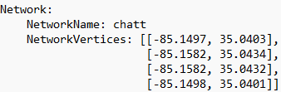

Real-Twin Automation Workflow for Vissim vs SUMO
Step 1 Network Generation & Import
SUMO’s netconvert
Real-Twin network input:
lat and long of bounding box vertices for area of interest
SUMO ‘net.xml’ network file
Download data
from OpenStreetMap
Intermediate ‘.xodr’ file
Vissim network import function
Vissim ‘.inp’ file
For both Vissim and SUMO, Real-Twin can automatically generate an OpenDRIVE (.xodr) network from user-defined geographic coordinates using OpenStreetMap data.
The generated .xodr network is then imported into Vissim through its COM interface (and into SUMO through netconvert).

Slide 5
Real-Twin Automation Workflow for Vissim
Step 2 Matchup Table Generation
Matchup table links demand and signal data to the correct intersections in the simulation network.
Matchup table generation functions for SUMO and Vissim are similar: both identify junctions and roads, calculate approach bearings, and extract turning movements information.
The main difference lies in how the network data are accessed. SUMO data can be read directly from its editable network file, while Vissim data must be retrieved through APIs.

Slide 6
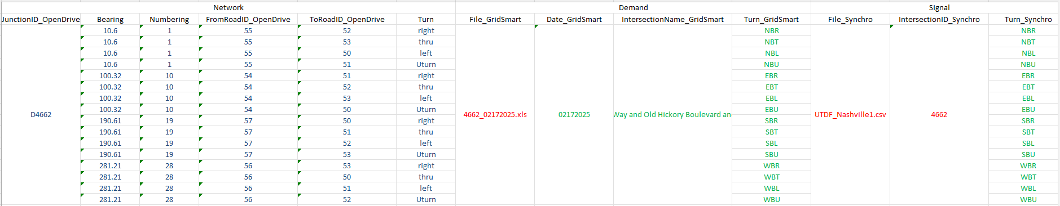
Real-Twin Automation Workflow for Aimsun vs SUMO
Step 2 Matchup Table Generation
Matchup table links demand and signal data to the correct intersections in the simulation network.
Matchup table generation functions for SUMO and Aimsun are similar: both identify junctions and roads, calculate approach bearings, and extract turning movements information.
The main difference lies in how the network data are accessed. SUMO data can be read directly from its editable network file, while Aimsun data must be retrieved through APIs.
Blue: information obtained from the network file (e.g., turning movement road ids)
Red: signal and demand user input.
Green: information obtained from user input that links demand and signal data to the simulation network.

Slide 7
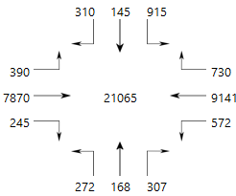
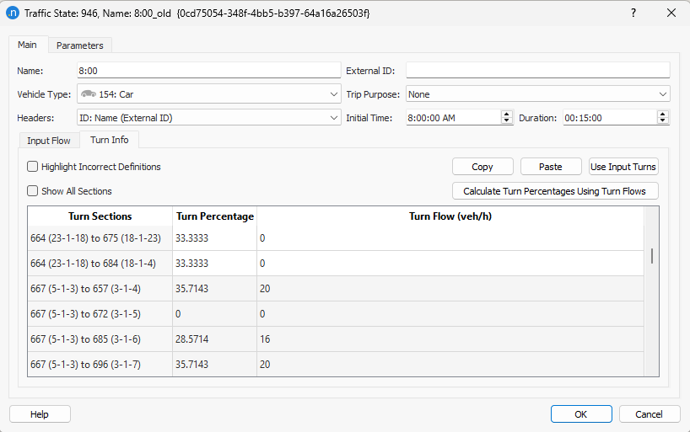
Real-Twin Automation Workflow for Aimsun vs SUMO
Step 3 Demand Import
SUMO flow file (‘.flow.xml’)
Real-Twin
SUMO’s
jtrrouter
SUMO route file (‘.rou.xml’)
Field traffic counts
SUMO turn file (‘.turn.xml’)
Real-Twin
For SUMO, Real-Twin converts turning movement counts into flow and turn files, then uses SUMO’s jtrrouter to generate the final demand file (.rou.xml).
For Aimsun, Real-Twin directly imports the turning movement counts into the model as traffic states, which serve as the final demand input.
Aimsun traffic states

Slide 8
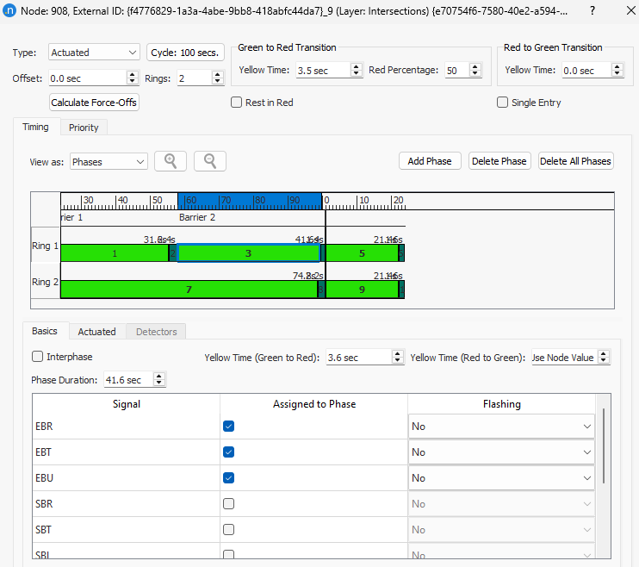
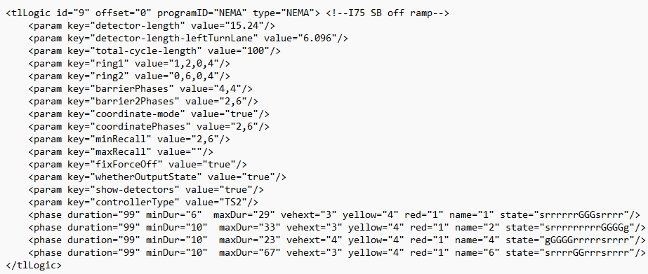
Real-Twin Automation Workflow for Aimsun vs SUMO
Step 4 Signal Import
For SUMO, Real-Twin converts UTDF signal plans directly into NEMA settings and automatically places the detectors.
For Aimsun, Real-Twin translates the UTDF data into Aimsun signal definitions and places and connects detectors to the corresponding phases by calling multiple Aimsun APIs.
SUMO NEMA Signal
(easy to config, limited visual transparency)
Aimsun Signal
(complex to config, good visualization of signal logic)

Slide 9
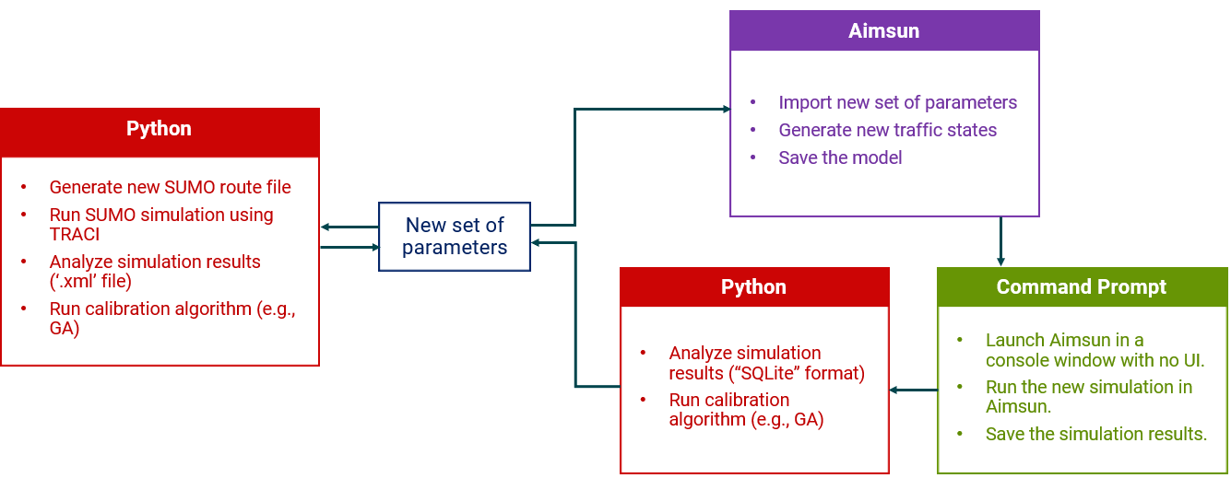
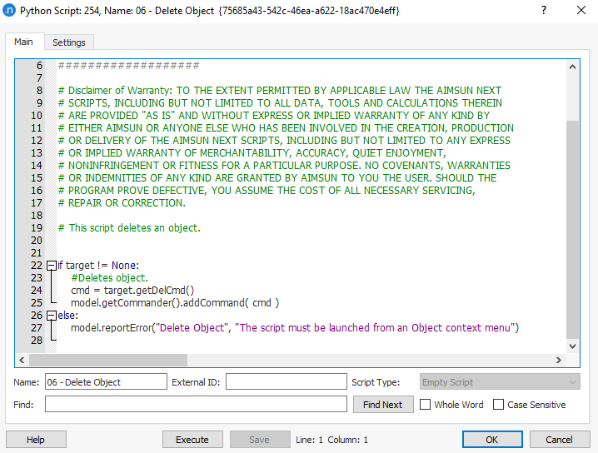

Real-Twin Automation Workflow for Aimsun vs SUMO
Step 5 Simulation Generation and Calibration
SUMO calibration can be completed entirely in Python.
Aimsun calibration requires coordinated use of the Aimsun API for parameter updates, the command line for simulation execution, and Python for result analysis, calibration, and generation of new parameter sets.
RealTwin.Calibration.SUMO
RealTwin.Calibration.Aimsun

Slide 10
Real-Twin Automation Workflow for VISSIM
Real-Twin Automation Workflow Overview
1
2
3
4
5
Step 1
Step 2
Step 3
Step 4
Step 5
Network Generation & Import
Matchup Table Generation
Demand Import
Signal Import
Simulation Generation and Calibration
Import an existing network or generate a network for the area of interest using OpenStreetMap data
Generate mapping tables that align real-world network elements with their corresponding simulator object IDs
Convert field traffic counts into simulator-ready demand inputs matched to the network
Import signal timing and control data, then automatically configure the corresponding signal plans in the traffic simulator
Generate simulation scenarios and calibrate the model (e.g., demand and driving behavior) against field observations
Output: calibrated traffic scenarios for SUMO / Aimsun / VISSIM

Slide 11
Next Steps
Complete the development of automation functions for VISSIM in the Real-Twin tool.
  Vissim license access was confirmed, and the purchase order was processed late July.
  Development of VISSIM-specific automation functions on track to complete by end of August.
Integrate Aimsun and VISSIM automation functions into the Real-Twin tool.
Release a new Real-Twin version on GitHub/GitLab.

Slide 12
Other Updates
Presented 5 posters at ASCE ICTD; 2 papers from this published.
Submitted 3 papers for 2027 TRB Annual Meeting:
  “LaneTop: Agentic Vision-Language Extraction of Lane-Level Intersection Topology”
  “Evaluating Agentic Artificial Intelligence in Transportation: A Multidimensional Framework and Reproducible Benchmark for AI-Assisted Traffic Simulation”
  “Control-Aware Capacity-Constrained Route-Flow Estimation for Microscopic Traffic Simulation”

Slide 13
Next Milestone
Milestone Name/Description* | Criteria* | End Date* | Type*
Develop and demonstrate the Real-Twin advanced automation workflow and functionality with at least 2 example microscopic simulators. Subtask 3.2 | Presentation documenting and demonstrating Real-Twin automation workflow in 1 additional simulator (AIMSUN). | 6/30/2026 | Go/No Go Decision
Develop and demonstrate the Real-Twin advanced automation workflow and functionality with at least 2 example microscopic simulators. Subtask 3.2 | Presentation documenting and demonstrating Real-Twin automation workflow in 1 additional simulator (VISSIM). | 8/31/2026 | Go/No Go Decision
Integrated advanced Real-Twin automation workflow for additional simulators into Real-Twin Python package. Subtask 2.3 | Release of new Real-Twin version on GitHub/GitLab. | 09/30/2026 | Quarterly Progress Measure (Regular)

Slide 14
Real-Twin Automation Workflow for Aimsun
Step 5 Simulation Generation and Calibration
Aimsun
Import new set of parameters
Generate new traffic states
Save the model
Python
Generate new SUMO route file
Run SUMO simulation using TRACI
Analyze simulation results (‘.xml’ file)
Run calibration algorithm (e.g., GA)
New set of parameters
Python
Command Prompt
Analyze simulation results (“SQLite” format)
Run calibration algorithm (e.g., GA)
Launch Aimsun in a console window with no UI.
Run the new simulation in Aimsun.
Save the simulation results.

