Slide 1
Real-Twin Monthly Meeting
October 27, 2026
Ross Wang¹, Guanhao Xu¹, Abhilasha Saroj¹, Roy Luo¹, Jinghui Yuan¹, Yunli Shao²
¹ Oak Ridge National Laboratory; ² University of Georgia

Slide 2





Vissim Automation in Real-Twin
Six stages, one script each: a city's dataset folder in, a running Vissim model out
Stage 1
Stage 2
Stage 3
Stage 4
Stage 5
Stage 6
Network import
MatchupTable
Demand
Signals
Check run
Calibration
Network to OpenDRIVE, imported into Vissim over COM; records the dataset it came from
Recovers junctions, approaches and turns; same layout as SUMO's table
GridSmart counts become entry inputs and routing decisions, per 15 min
Synchro timings become actuated ring-barrier controllers (.prbc), heads, detectors
Runs the model, reads Vissim's log, compares ingested vs simulated counts
Fits the inflows and turn splits no camera measured
01_import_opendrive.py
02_matchup_table.py
03_write_demand.py
04_write_signals.py
05_check_run.py
06_calibrate_turn_inflow.py
Chattanooga
186 links · 255 connectors · 10 junctions · 12 counted entries · 4,061 veh/h · 30 routing decisions · 6 signal controllers · 69 signal heads · 68 detectors
Phoenix (new)
1,191 links · 1,687 connectors · 70 junctions · 15 counted entries · 9,843 veh/h · 226 routing decisions · 13 signal controllers · 151 signal heads · 151 detectors
Standalone: runs without SUMO; SUMO's files are used only to check the result
Notes:
The Vissim pipeline is standalone: it reads the city's dataset folder (network, GridSmart counts, Synchro timings) and needs no SUMO run. SUMO's own outputs are used only to check against. Stage 1 records which dataset it came from (dataset.json), so every later stage reads that city's own Traffic and Control folders. The one manual step is the same as SUMO's: naming the GridSmart and Synchro file for each counted junction in the MatchupTable. Phoenix is new this month and was built from scratch by following the README.

Slide 3
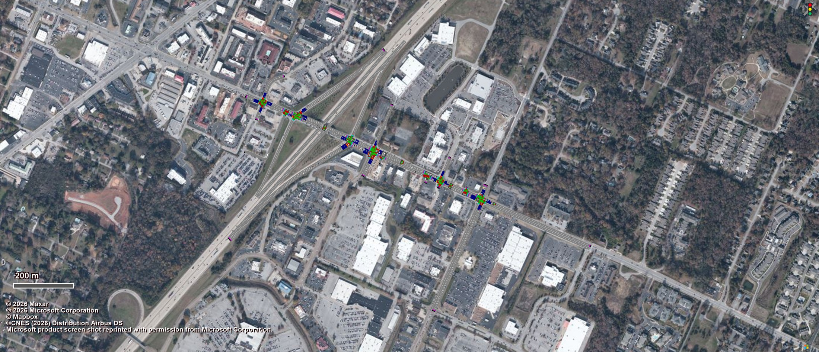
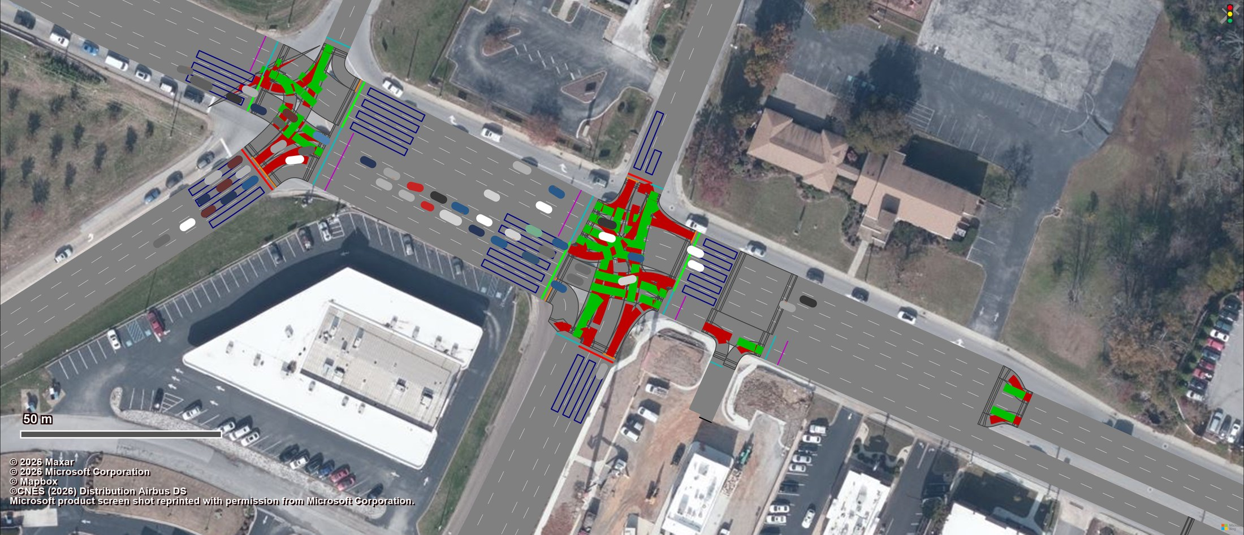

Chattanooga Running in Vissim
Shallowford Rd corridor, 08:00–09:00: built by the pipeline, simulated in Vissim 2026
Whole network, 25 min into the run
Napier Rd / Hamilton Place Blvd: queues at red, platoon released
Green / red = conflict areas (right of way) · blue boxes = detectors · bars at stop lines = signal heads
Network
186 links, 255 connectors, 606 conflict areas
Demand
12 counted entries, 4,061 veh/h in 15-min intervals
Routing
30 static decisions, 109 routes (lane-pinned where needed)
Signals
6 RBC controllers, 69 heads, 68 detectors, 24 RTOR stop signs
Notes:
Snapshots are of the model the pipeline wrote, running in Vissim 2026, 25 minutes into the run, on the satellite background. Everything visible was written by stages 1-4: links and connectors from the OpenDRIVE import, vehicle inputs and routes from the GridSmart counts, ring-barrier controllers, signal heads and detectors from Synchro, conflict areas and right-turn-on-red stop signs.

Slide 4
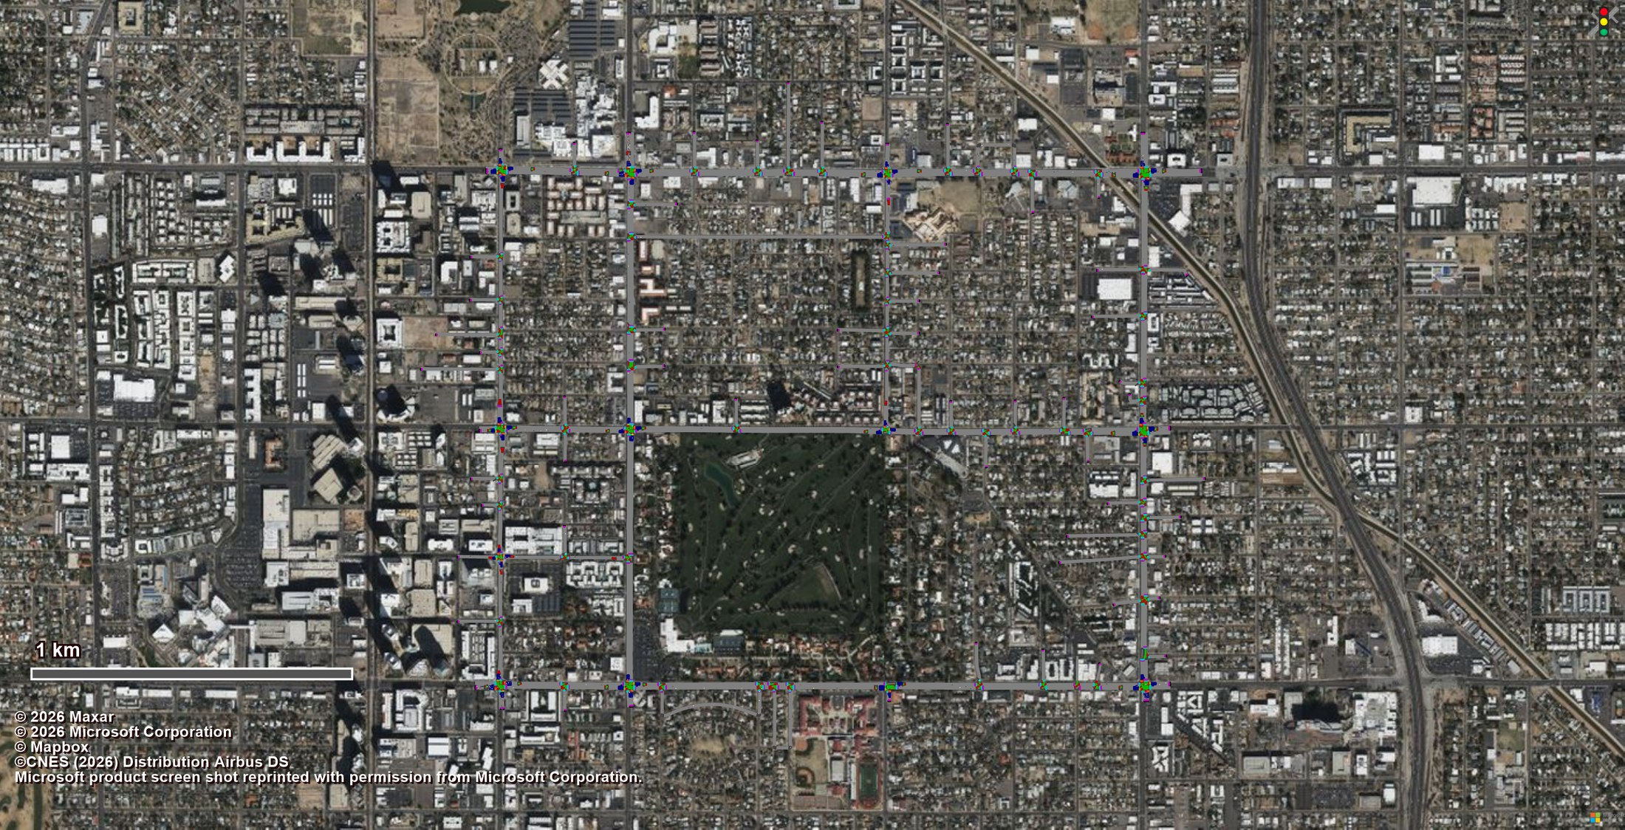
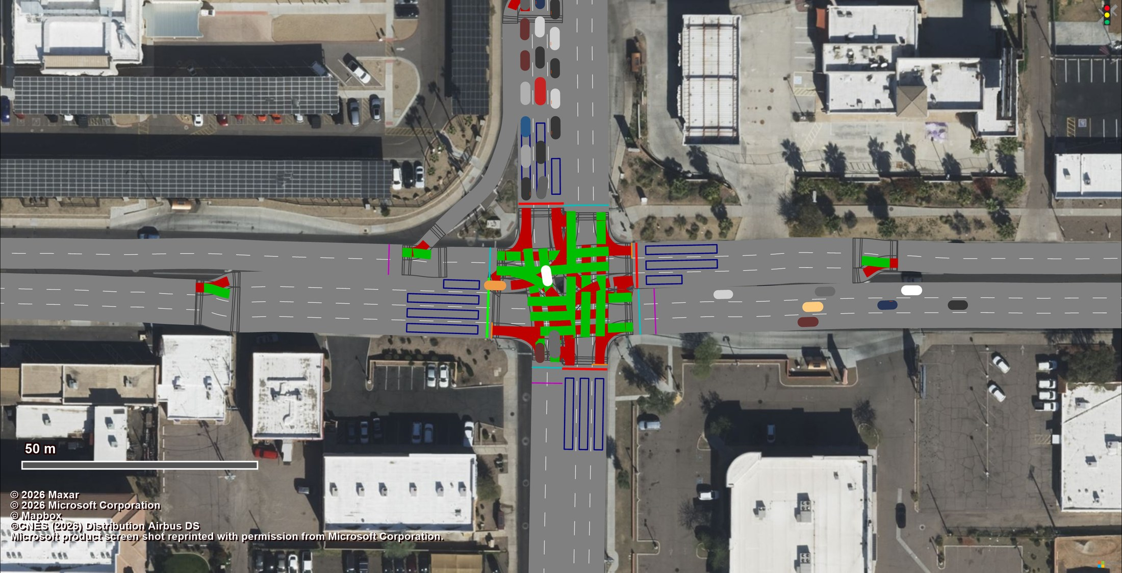
Phoenix Running in Vissim
New this month: second network, built from scratch with the same scripts, 08:00–09:00
Whole network, 25 min into the run
Indian School Rd @ 7th St: southbound queue at red
Green / red = conflict areas (right of way) · blue boxes = detectors · bars at stop lines = signal heads
Network
1,191 links, 1,687 connectors, 4,805 conflict areas
Demand
15 counted entries, 9,843 veh/h in 15-min intervals
Routing
226 static decisions, 740 routes (lane-pinned where needed)
Signals
13 RBC controllers, 151 heads, 151 detectors, 47 RTOR stop signs
Notes:
Phoenix is the first network the pipeline had never seen. It exposed assumptions Chattanooga never tested (GridSmart zero legs, a non-numeric Synchro id, detectors with no placement in Synchro), which are now handled in the code. The 13 counted junctions are signalised; the other 57 junctions are unsignalised and carry routing only.

Slide 5
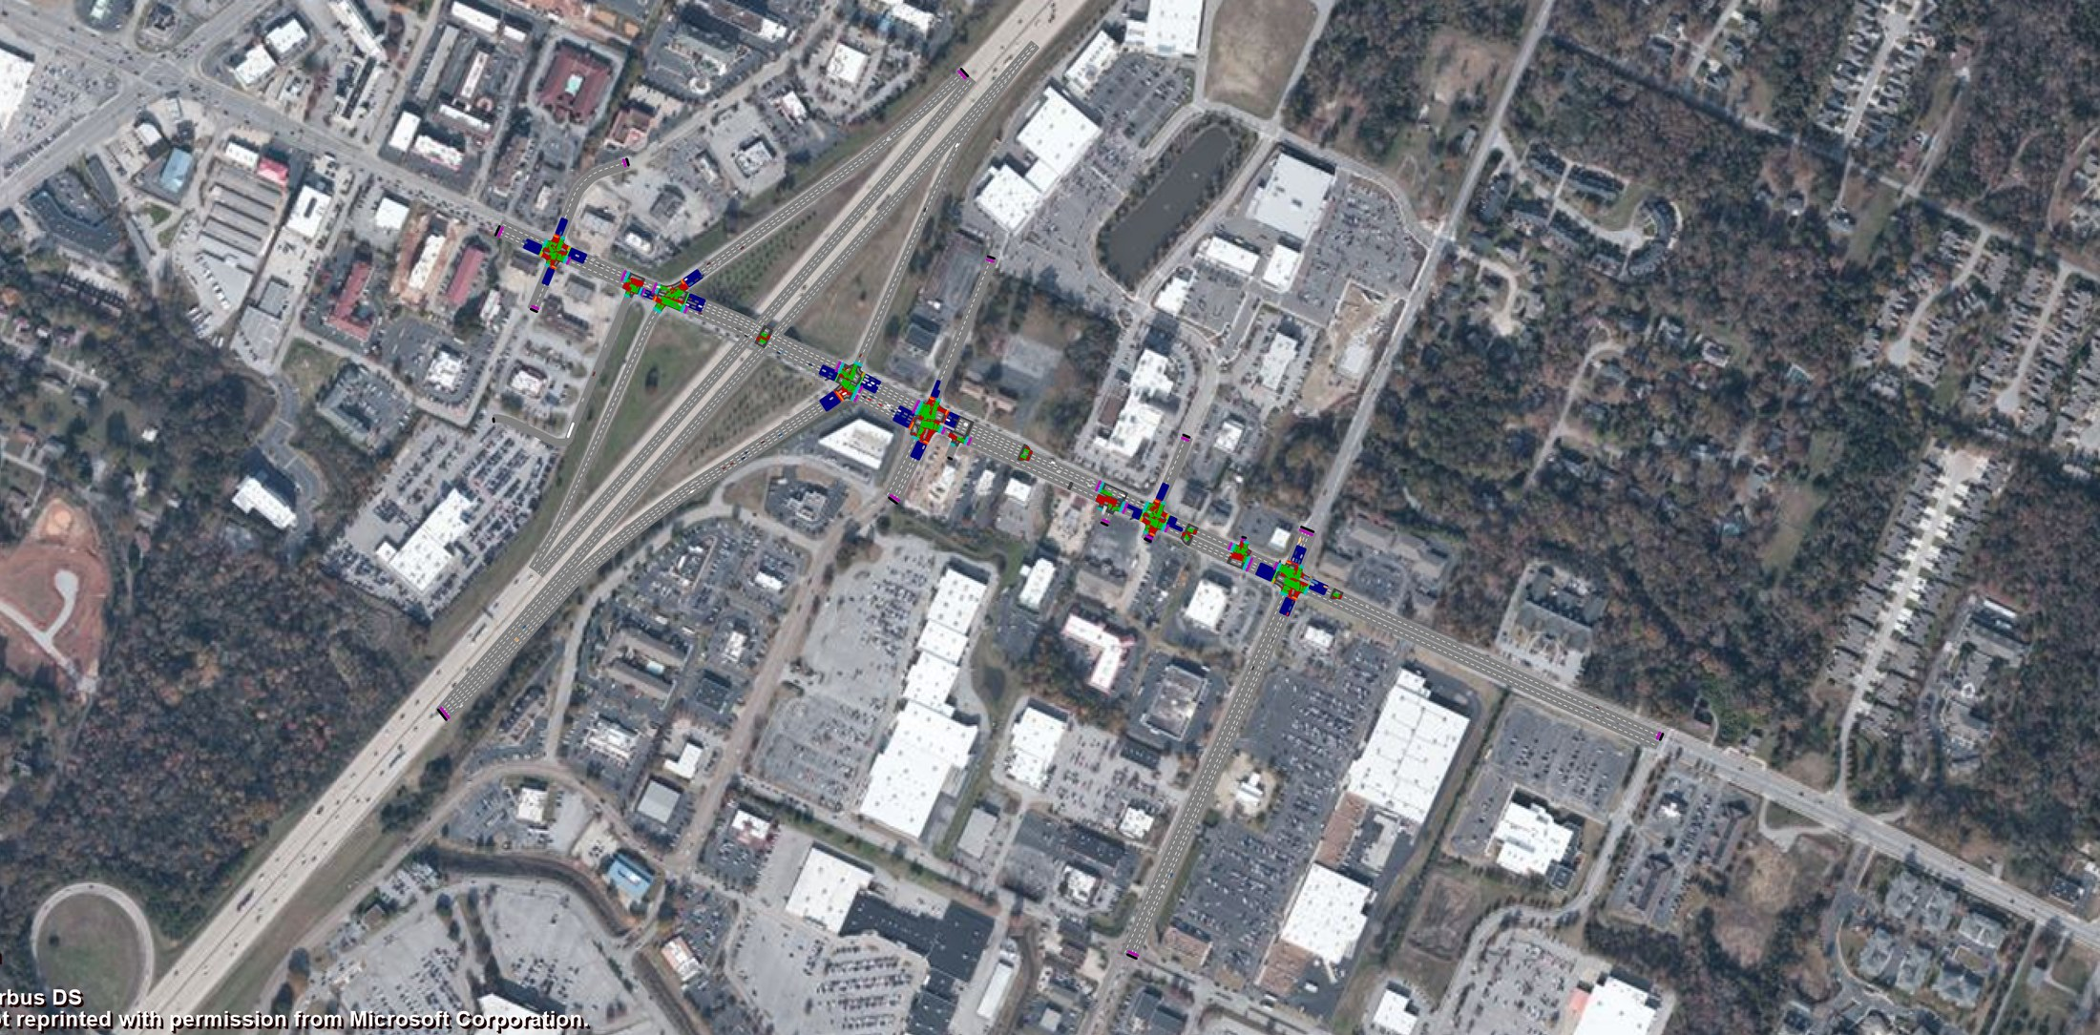
Demand: Vissim vs SUMO at Every Entry
Chattanooga: Vissim vehicle inputs against SUMO's flow file, 08:00–09:00, per 15 minutes
6
# | Entry approach | SUMO flow | Vissim input | 15-min
1 | I-75 NB · NB (off-ramp) | 765 | 765 | 4/4 ✓
2 | Shallowford Village Dr / Amin Dr · EB | 531 | 531 | 4/4 ✓
3 | Shallowford Village Dr / Amin Dr · NB | 43 | 43 | 4/4 ✓
4 | Shallowford Village Dr / Amin Dr · SB | 122 | 122 | 4/4 ✓
5 | Napier Rd · NB | 167 | 167 | 4/4 ✓
6 | I-75 SB · SB (off-ramp) | 690 | 690 | 4/4 ✓
7 | Napier Rd · SB | 22 | 22 | 4/4 ✓
8 | Gunbarrel Rd · NB | 417 | 417 | 4/4 ✓
9 | Lifestyle Way · NB | 49 | 49 | 4/4 ✓
10 | Lifestyle Way · SB | 107 | 107 | 4/4 ✓
11 | Gunbarrel Rd · SB | 363 | 363 | 4/4 ✓
12 | Gunbarrel Rd · WB | 785 | 785 | 4/4 ✓
 | Total, 08:00–09:00 | 4,061 | 4,061
4
2
7
3
10
5
9
11
1
12
8
Purple markers: the 12 counted entries (vehicle inputs)
Vehicles 08:00–09:00; junction · direction as GridSmart names them. SUMO: flow numbers per 15 min; Vissim: input volume per interval. Paired by approach, not by name.
16 of 16 SUMO entry flows reproduced exactly in all four 15-min intervals (12 carry traffic, 4 are empty in both)
Notes:
Each numbered marker is a Vissim vehicle input, placed where the pipeline put it. The table pairs it with the SUMO flow edge feeding the same approach (followed through SUMO's own connections where the flow sits one edge upstream). Both come from the same GridSmart files but through independent code; they agree vehicle for vehicle in all four 15-minute intervals. The four entries with no counts are empty in both.

Slide 6
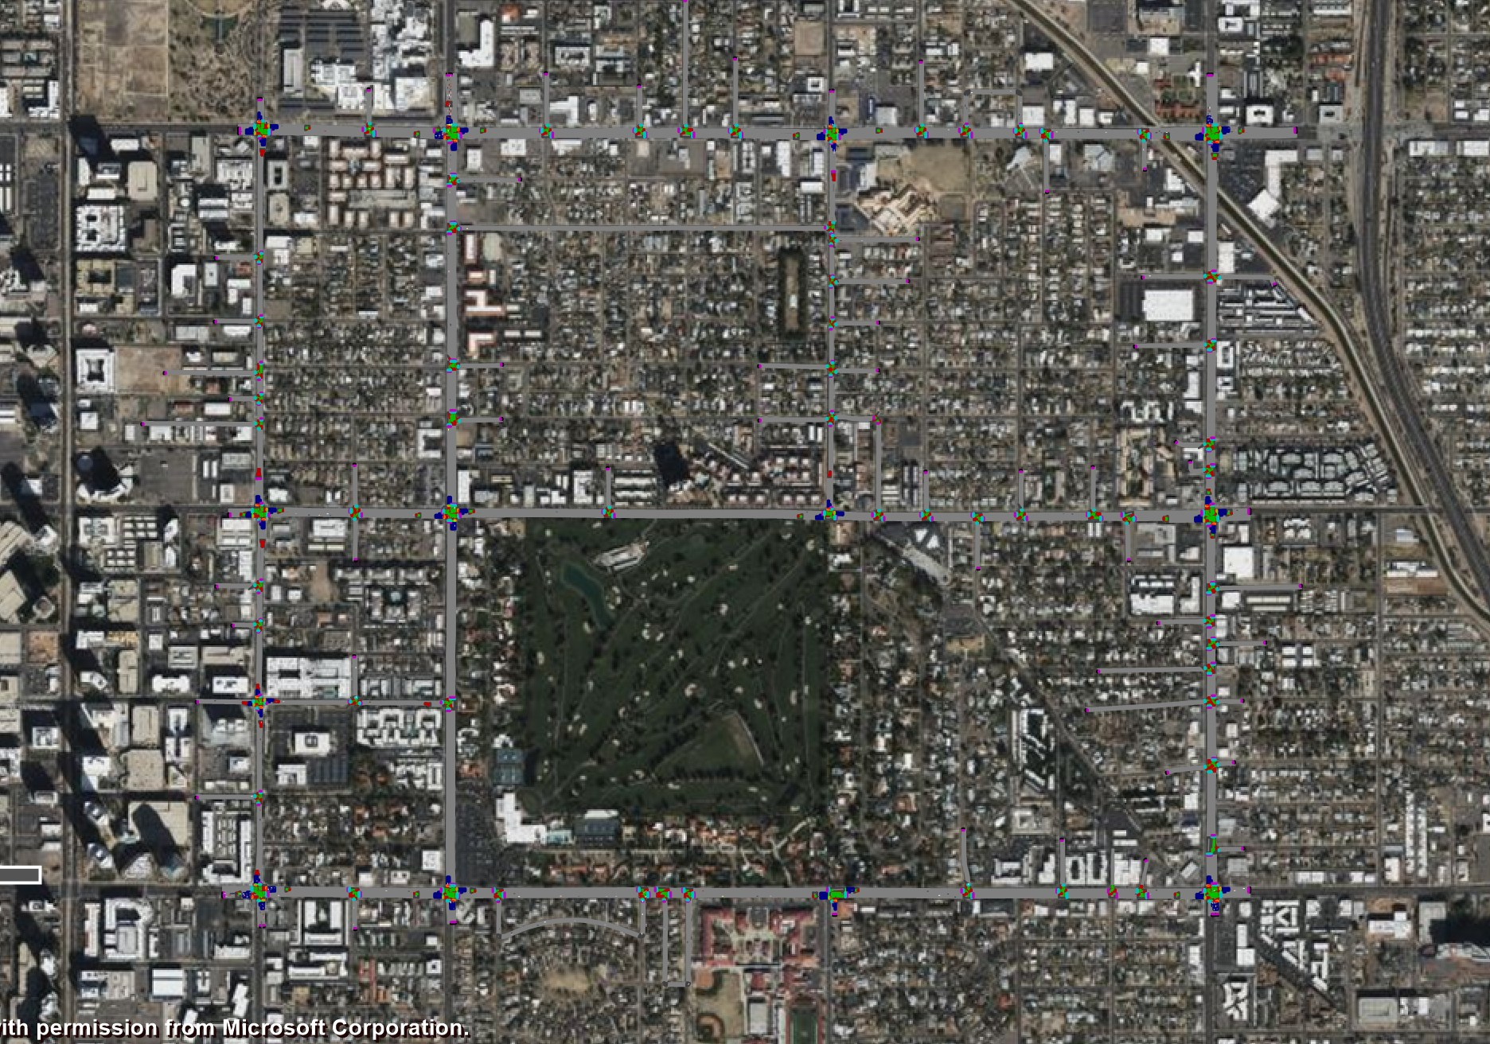
Demand: Vissim vs SUMO at Every Entry
Phoenix: Vissim vehicle inputs against the vehicles SUMO releases, 08:00–09:00, per 15 minutes
# | Entry approach | SUMO | Vissim | 15-min
1 | Indian School Rd @ 3rd St · EB | 1,184 | 1,184 | 4/4 ✓
2 | Indian School Rd @ 3rd St · SB | 24 | 24 | 4/4 ✓
3 | Indian School Rd @ 7th St · SB | 528* | 1,499 | calibrated
4 | Indian School Rd @ 12th St · SB | 381 | 381 | 4/4 ✓
5 | Indian School Rd @ 16th St · SB | 587 | 587 | 4/4 ✓
6 | Indian School Rd @ 16th St · WB | 1,313 | 1,313 | 4/4 ✓
7 | Osborn Rd @ 3rd St · EB | 675 | 675 | 4/4 ✓
8 | Osborn Rd @ 16th St · WB | 591 | 591 | 4/4 ✓
9 | Earll Rd @ 3rd St · EB | 59 | 59 | 4/4 ✓
10 | Thomas Rd @ 3rd St · EB | 1,097 | 1,097 | 4/4 ✓
11 | Thomas Rd @ 3rd St · NB | 428 | 428 | 4/4 ✓
12 | Thomas Rd @ 7th St · NB | 436 | 436 | 4/4 ✓
13 | Thomas Rd @ 12th St · NB | 157 | 157 | 4/4 ✓
14 | Thomas Rd @ 16th St · NB | 531 | 531 | 4/4 ✓
15 | Thomas Rd @ 16th St · WB | 881 | 881 | 4/4 ✓
2
3
4
5
1
6
7
8
9
10
11
12
13
14
15
Purple: the 15 counted entries (vehicle inputs); orange: calibrated in SUMO
Vehicles 08:00–09:00. SUMO: vehicles departing on the entry edge (Phoenix.rou.xml); Vissim: input volume. *SUMO's calibrated 132 per 15 min.
14 of 15 Phoenix entries identical to SUMO in every 15-min interval; the 15th was changed by SUMO's calibration
Notes:
SUMO's Phoenix has no flow file of its own, only the route file jtrrouter wrote from the calibrated flows: 30,024 vehicles. Counting the vehicles that depart on each entry edge per 15 minutes gives SUMO's inflow. At 14 of the 15 counted entries it is the GridSmart count, vehicle for vehicle, in every interval - the same numbers Vissim's inputs carry. The 15th is 7th St southbound at Indian School: SUMO's calibrated model releases a flat 132 per 15 minutes (528 veh/h) where 1,499 were counted. That entry cannot take the counted demand (SUMO with counted demand leaves 295 uninserted, Vissim 294), and the calibration evidently set it to what the network delivers. Vissim keeps the count, as the pipeline ingests what is measured.

Slide 7
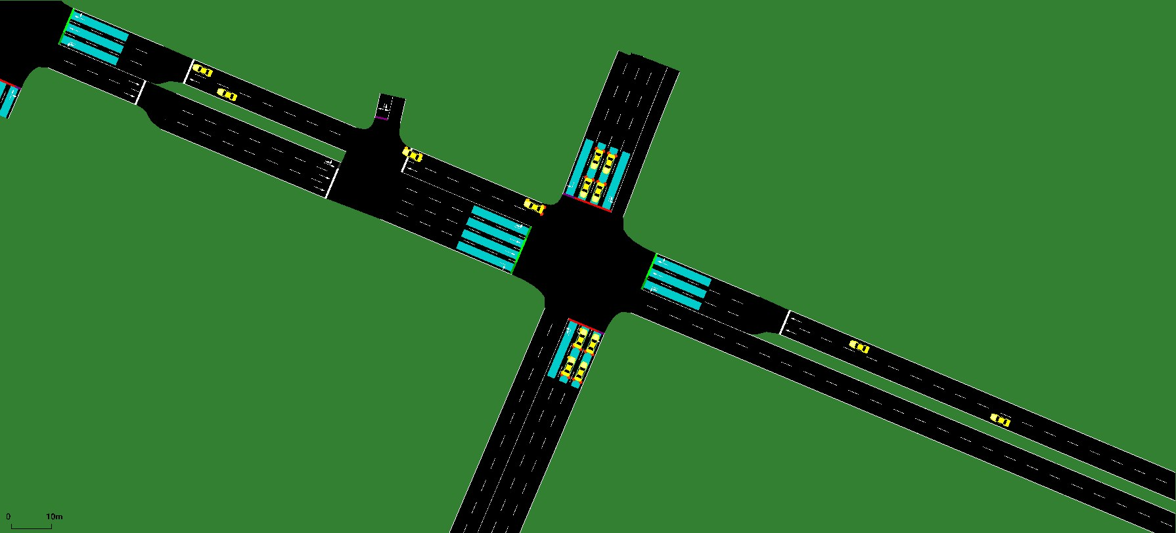
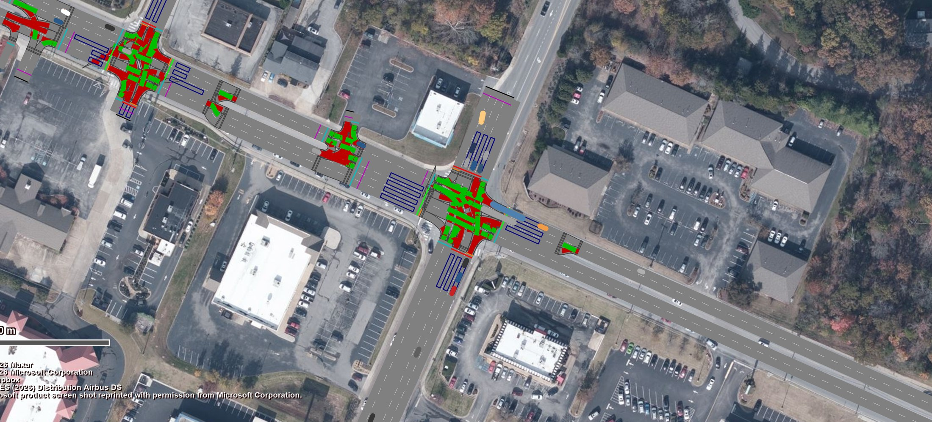
Vehicle Inputs, Side by Side: Chattanooga
Shallowford Rd @ Gunbarrel Rd: the same approaches and the same counts in SUMO and Vissim
SUMO
sumo-gui 1.24, RealTwin's SUMO model
Vissim
Vissim 2026, model written by this pipeline
3
3
2
4
2
4
1
1
# | Approach | 08:00 | 08:15 | 08:30 | 08:45 | Hour
1 | Gunbarrel Rd NB (counted entry) | 98 | 98 | 105 | 105 | 114 | 114 | 100 | 100 | 417 | 417
2 | Shallowford Rd EB | fed from the neighbouring junction
3 | Gunbarrel Rd SB (counted entry) | 72 | 72 | 90 | 90 | 95 | 95 | 106 | 106 | 363 | 363
4 | Shallowford Rd WB (counted entry) | 186 | 186 | 192 | 192 | 211 | 211 | 196 | 196 | 785 | 785
Each cell: SUMO | Vissim, vehicles per 15 min (hour total). SUMO: vehicles released on the entry edge; Vissim: vehicle input on the entry link.
Counted entries identical in SUMO and Vissim in every 15 minutes: all 16 in Chattanooga
Notes:
Left, SUMO's model in sumo-gui; right, the Vissim model this pipeline wrote, at the same moment (1,500 s after 08:00) and the same 300 m view. Numbered markers sit on the same approach stop lines in both, placed from each tool's own geometry. Purple approaches are fed directly by a counted entry: their vehicles per 15 minutes are the table. Grey ones are fed by the neighbouring junction, so their volume is what arrives from upstream.

Slide 8
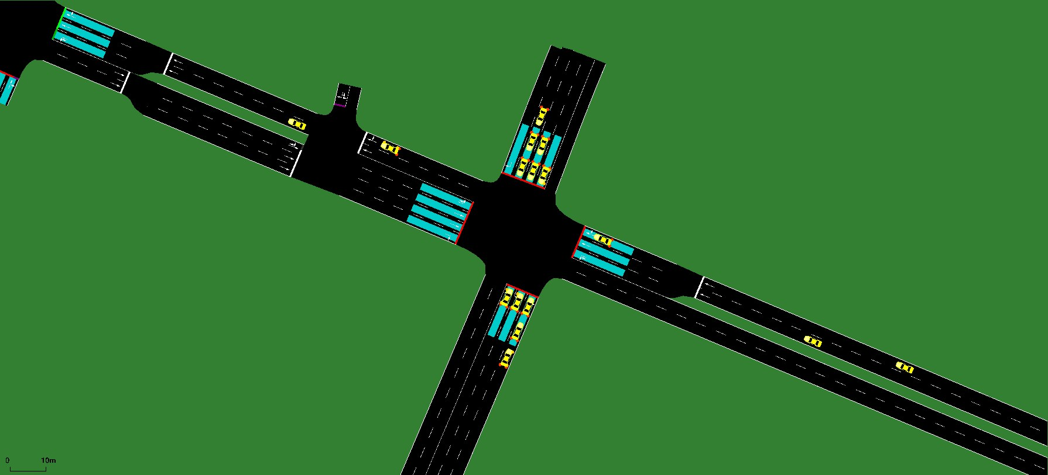
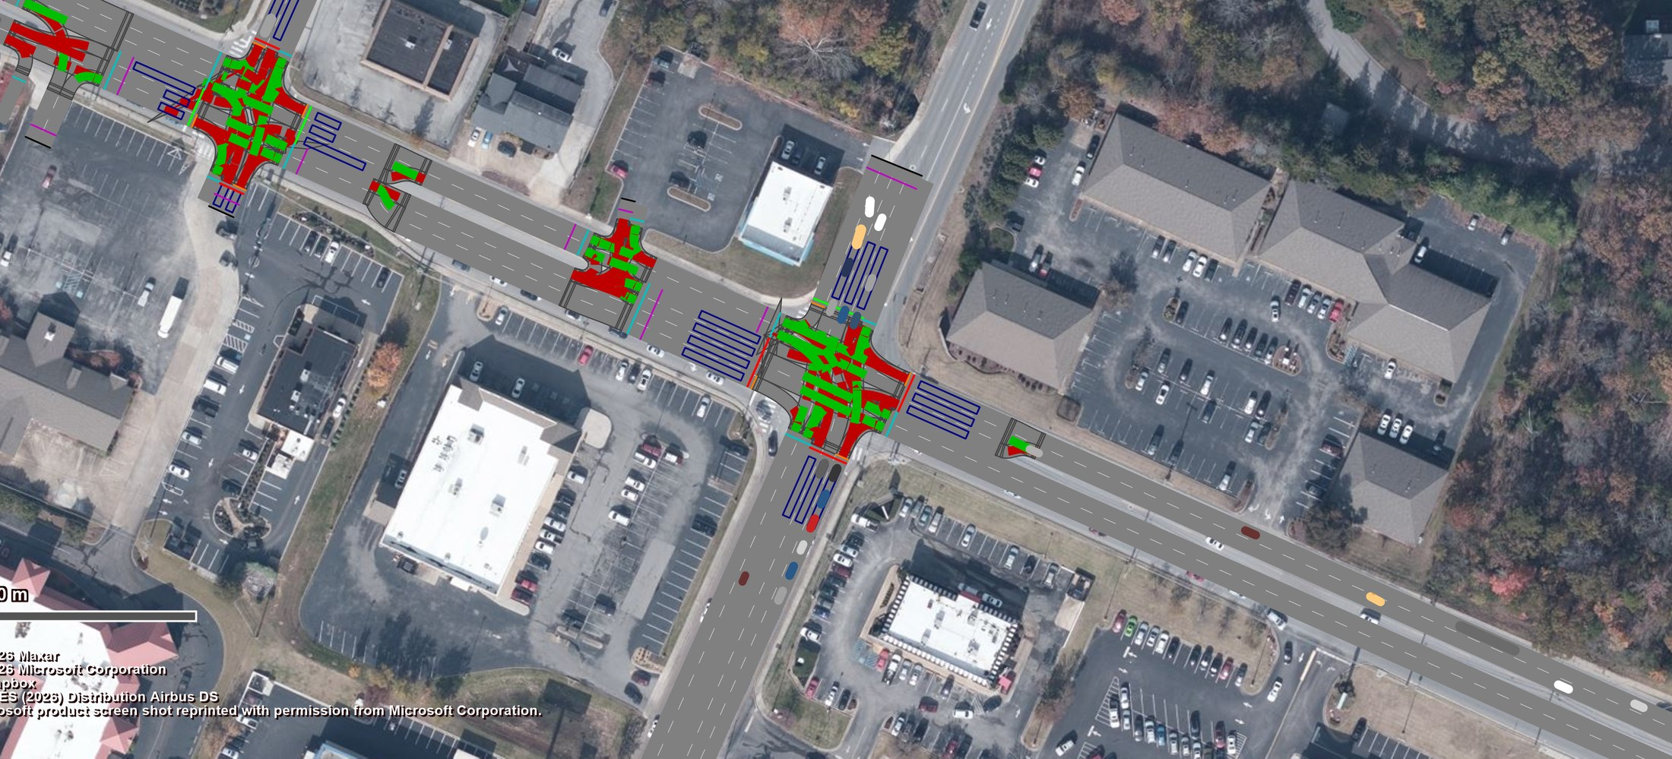
Turns, Side by Side: Chattanooga
Shallowford Rd @ Gunbarrel Rd: SUMO's turn split against Vissim's routing decisions, 08:00–08:15
SUMO
sumo-gui 1.24, RealTwin's SUMO model
Vissim
Vissim 2026, model written by this pipeline
3
3
2
4
2
4
1
1
# | Approach | Right | Thru | Left | U-turn
1 | Gunbarrel Rd NB | 0.133 | 0.133 | 0.306 | 0.306 | 0.561 | 0.561 | 0.000 | 0.000
2 | Shallowford Rd EB | 0.429 | 0.429 | 0.468 | 0.468 | 0.103 | 0.103 | 0.000 | 0.000
3 | Gunbarrel Rd SB | 0.403 | 0.403 | 0.514 | 0.514 | 0.083 | 0.083 | 0.000 | 0.000
4 | Shallowford Rd WB | 0.054 | 0.054 | 0.850 | 0.850 | 0.097 | 0.097 | 0.000 | 0.000
Each cell: SUMO | Vissim turn share, as each model is given it (inputs, not run results). Identical in all four 15-min intervals. Corridor-wide 76 of 80 identical; the other 4 (≤ 0.007, at I-75 SB) are 4 counted vehicles on movements that junction lacks.
Every turn share at this junction identical in SUMO and Vissim, in all four intervals
Notes:
SUMO's turn file holds a probability per approach and exit; Vissim's routing decision holds the counted vehicles as relative flows, and the share is each route's flow over the decision total. At this junction all shares are identical to three decimals in all four 15-minute intervals; the table shows the first. Corridor-wide 76 of 80 are identical; the other 4, at I-75 SB, differ by at most 0.007 because 4 counted vehicles sit on movements that junction does not have.

Slide 9
Signals, Side by Side: Chattanooga
Shallowford Rd @ Gunbarrel Rd: SUMO NEMA controller and Vissim ring-barrier controller, same timings
SUMO
sumo-gui 1.24, RealTwin's SUMO model
Vissim
Vissim 2026, model written by this pipeline
SUMO
NEMA
ϕ1 12 s
ϕ2 28 s
ϕ4 24 s
ϕ3 36 s
Vissim
RBC
ϕ1 12 s
ϕ2 28 s
ϕ4 24 s
ϕ3 36 s
ϕ5 14 s
ϕ6 26 s
ϕ5 14 s
ϕ6 26 s
Phase | ϕ1 | ϕ2 | ϕ3 | ϕ4 | ϕ5 | ϕ6
Min green | 5 | 5 | 10 | 10 | 6 | 6 | 6 | 6 | 5 | 5 | 10 | 10
Max green | 6.3 | 6.3 | 21.9 | 21.9 | 30.4 | 30.4 | 18.3 | 18.3 | 7.7 | 7.7 | 20.3 | 20.3
Yellow | 3 | 3 | 4.3 | 4.3 | 3.8 | 3.8 | 3.6 | 3.6 | 3.4 | 3.4 | 3.6 | 3.6
All-red | 2.7 | 2.7 | 1.8 | 1.8 | 1.8 | 1.8 | 2.1 | 2.1 | 2.9 | 2.9 | 2.1 | 2.1
Extension | 2 | 2 | 3 | 3 | 3 | 3 | 2 | 2 | 2 | 2 | 3 | 3
Recall | no | no | yes | yes | no | no | no | no | no | no | yes | yes
Each cell: SUMO | Vissim, seconds. Cycle 100 | 100 s, offset 0 | 0 s. All identical; all 6 controllers in Chattanooga: 204 of 204 values identical.
Notes:
Both simulators read the same Synchro export through independent code: SUMO's NEMA tlLogic and the Vissim ring-barrier controller (.prbc). Under each screenshot is that tool's own controller, drawn from its own file. Both are actuated, so at the same moment the phase showing can differ with arrivals; the timings they work within are identical. All 6 Chattanooga controllers: 204 of 204 values identical.

Slide 10
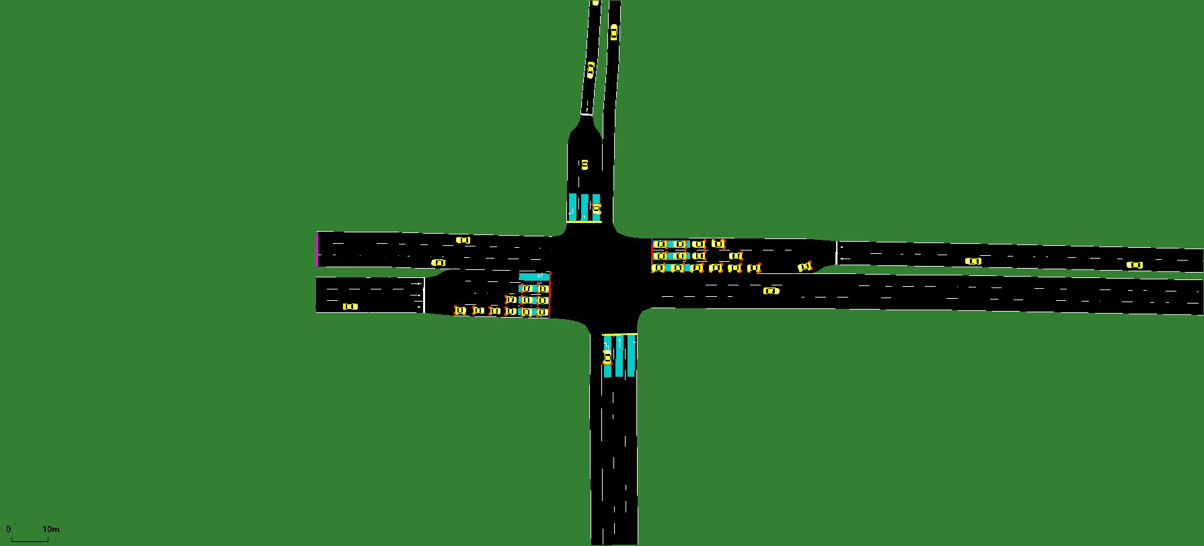
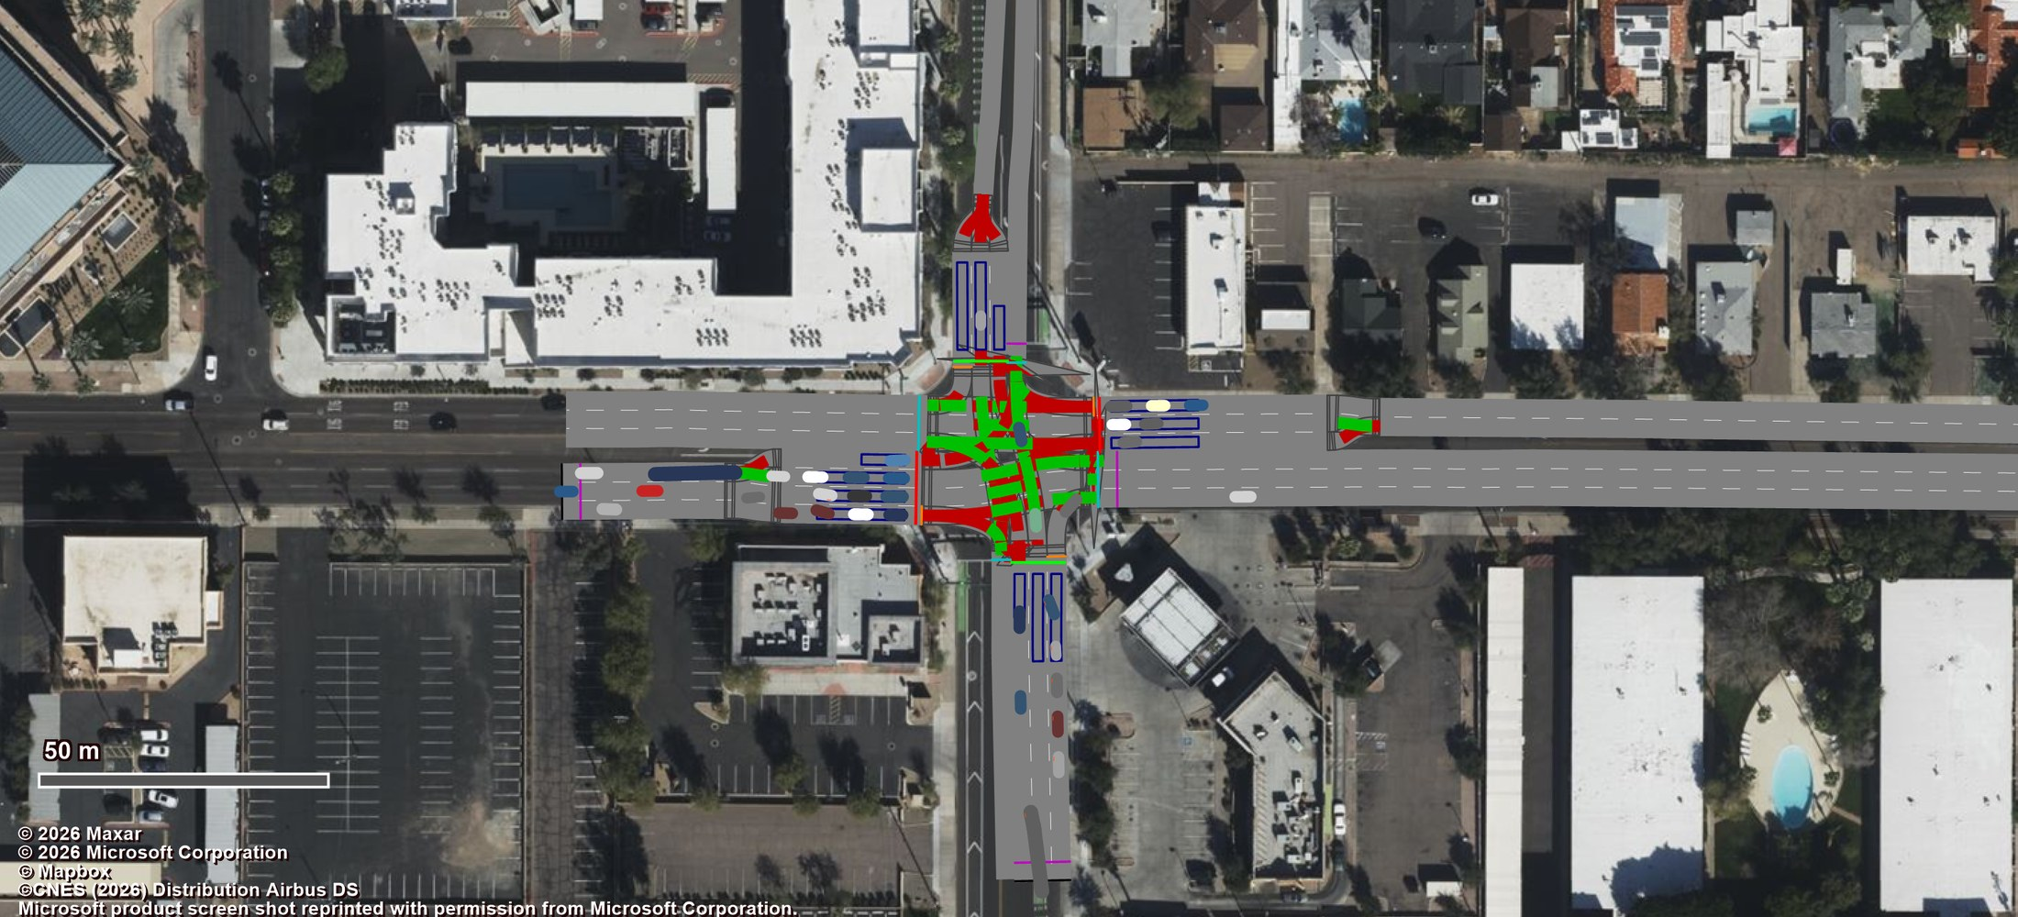
Vehicle Inputs, Side by Side: Phoenix
Thomas Rd @ 3rd St: the same approaches and the same counts in SUMO and Vissim
SUMO
sumo-gui 1.24, colleague's SUMO model (signals as Synchro)
Vissim
Vissim 2026, model written by this pipeline
3
4
3
4
2
1
2
1
# | Approach | 08:00 | 08:15 | 08:30 | 08:45 | Hour
1 | 3rd St NB (counted entry) | 109 | 109 | 110 | 110 | 108 | 108 | 101 | 101 | 428 | 428
2 | Thomas Rd EB (counted entry) | 303 | 303 | 300 | 300 | 232 | 232 | 262 | 262 | 1097 | 1097
3 | 3rd St SB | fed from the neighbouring junction
4 | Thomas Rd WB | fed from the neighbouring junction
Each cell: SUMO | Vissim, vehicles per 15 min (hour total). SUMO: vehicles released on the entry edge; Vissim: vehicle input on the entry link.
Counted entries identical in SUMO and Vissim in every 15 minutes: 14 of 15 in Phoenix
Notes:
Left, SUMO's model in sumo-gui; right, the Vissim model this pipeline wrote, at the same moment (1,500 s after 08:00) and the same 300 m view. Numbered markers sit on the same approach stop lines in both, placed from each tool's own geometry. Purple approaches are fed directly by a counted entry: their vehicles per 15 minutes are the table. Grey ones are fed by the neighbouring junction, so their volume is what arrives from upstream.

Slide 11
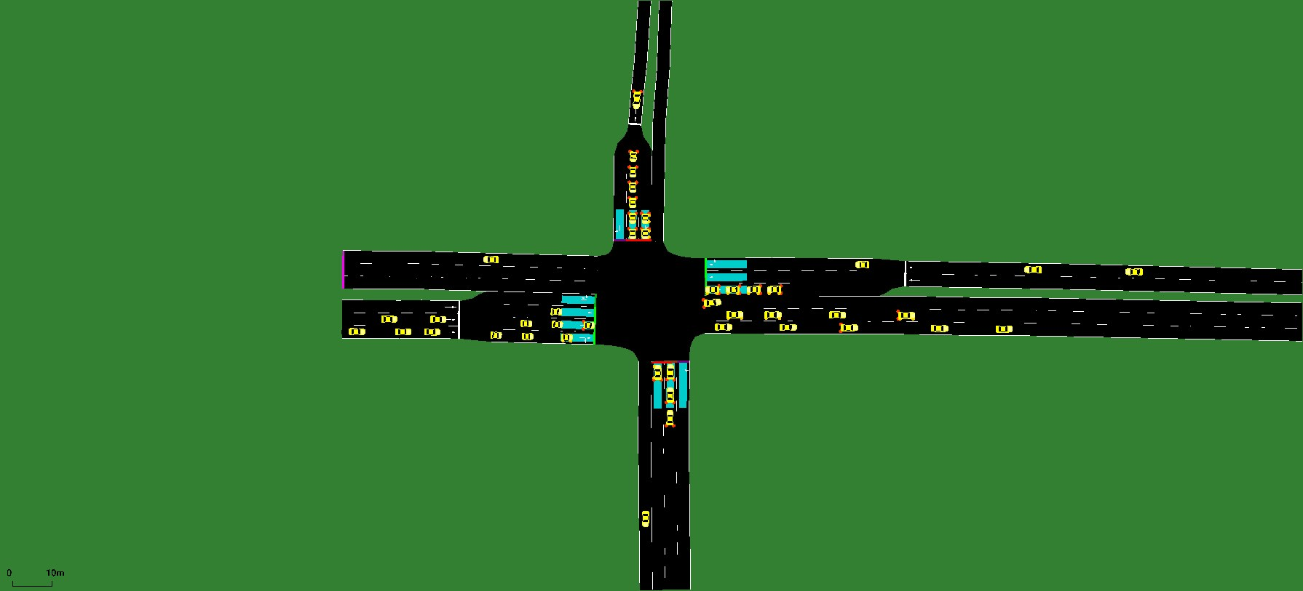
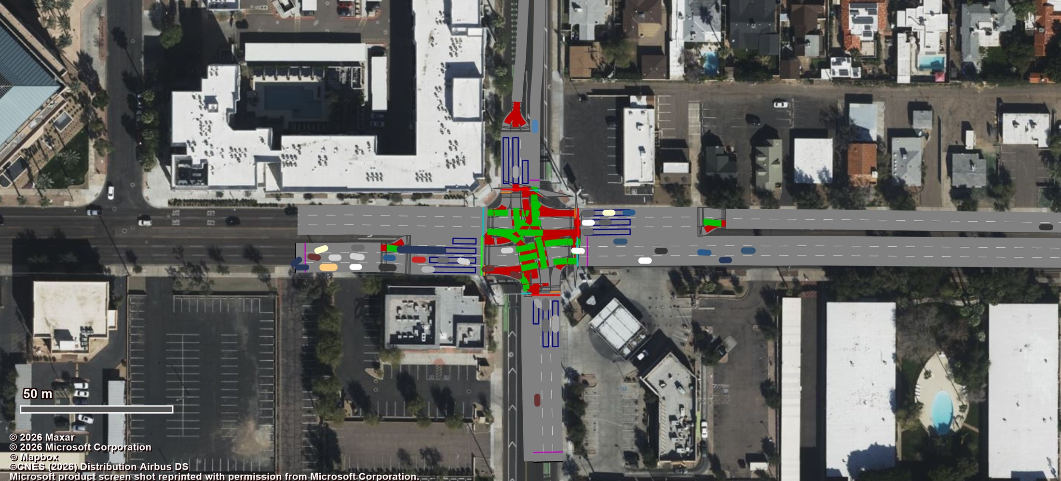
Turns, Side by Side: Phoenix
Thomas Rd @ 3rd St: SUMO's turn split against Vissim's routing decisions, 08:00–09:00 (model inputs)
SUMO
sumo-gui 1.24, colleague's SUMO model (signals as Synchro)
Vissim
Vissim 2026, model written by this pipeline
3
4
3
4
2
1
2
1
# | Approach | Right count | SUMO | Vissim | Thru count | SUMO | Vissim | Left count | SUMO | Vissim | U-turn count | SUMO | Vissim
1 | 3rd St NB | 0.15 | 0.15 | 0.15 | 0.57 | 0.54 | 0.57 | 0.29 | 0.30 | 0.29 | 0.00 | 0.00 | 0.00
2 | Thomas Rd EB | 0.10 | 0.12 | 0.10 | 0.85 | 0.84 | 0.85 | 0.04 | 0.04 | 0.04 | 0.00 | 0.00 | 0.00
3 | 3rd St SB | 0.07 | 0.07 | 0.07 | 0.66 | 0.67 | 0.66 | 0.28 | 0.26 | 0.28 | 0.00 | 0.00 | 0.00
4 | Thomas Rd WB | 0.11 | 0.11 | 0.11 | 0.71 | 0.72 | 0.71 | 0.18 | 0.16 | 0.18 | 0.00 | 0.00 | 0.00
Judged against the source: count = the GridSmart file (347.xls), 08:00–09:00. Vissim equals it in all 16 movements. Both model columns are inputs, before any run.
Why SUMO's differ: its route file was made by jtrrouter, which draws each vehicle's turn at random, so the split scatters ±0.01–0.02 around the count. SUMO's turn file from before jtrrouter is not in the dataset.
Here that is all it is: all 16 gaps are within 1.8 standard deviations of the draw.
Network-wide: entry-fed approaches all within 2 standard deviations; only Osborn Rd @ 12th St SB differs beyond chance (left 0.22 vs 0.46).
Every turn share at this junction within SUMO's sampling spread of the counts Vissim carries
Notes:
SUMO's Phoenix holds individual vehicles that jtrrouter sampled from the turn probabilities, so its shares are realised ones: on an approach with 1,000 vehicles a share moves by about 0.01-0.02 from the draw alone. Vissim's are the GridSmart counts exactly. At this junction every share agrees within 0.024; across the 13 counted junctions the median difference is 0.006 and 179 of 192 are within 0.05.

Slide 12
Signals, Side by Side: Phoenix
Thomas Rd @ 3rd St: SUMO NEMA controller and Vissim ring-barrier controller, same timings
SUMO
sumo-gui 1.24, colleague's SUMO model (signals as Synchro)
Vissim
Vissim 2026, model written by this pipeline
SUMO
NEMA
ϕ1 15 s
ϕ2 49 s
ϕ3 15 s
ϕ4 41 s
Vissim
RBC
ϕ1 15 s
ϕ2 49 s
ϕ3 15 s
ϕ4 41 s
ϕ5 15 s
ϕ6 49 s
ϕ7 15 s
ϕ8 41 s
ϕ5 15 s
ϕ6 49 s
ϕ7 15 s
ϕ8 41 s
Phase | ϕ1 | ϕ2 | ϕ3 | ϕ4 | ϕ5 | ϕ6 | ϕ7 | ϕ8
Min green | 5 | 5 | 15 | 15 | 5 | 5 | 5 | 5 | 5 | 5 | 15 | 15 | 5 | 5 | 5 | 5
Max green | 11 | 11 | 43.4 | 43.4 | 11 | 11 | 35.4 | 35.4 | 11 | 11 | 43.4 | 43.4 | 11 | 11 | 35.4 | 35.4
Yellow | 3 | 3 | 3.6 | 3.6 | 3 | 3 | 3.6 | 3.6 | 3 | 3 | 3.6 | 3.6 | 3 | 3 | 3.6 | 3.6
All-red | 1 | 1 | 2 | 2 | 1 | 1 | 2 | 2 | 1 | 1 | 2 | 2 | 1 | 1 | 2 | 2
Extension | 3 | 3 | 3 | 3 | 3 | 3 | 3 | 3 | 3 | 3 | 3 | 3 | 3 | 3 | 3 | 3
Recall | no | no | yes | yes | no | no | no | no | no | no | yes | yes | no | no | no | no
Each cell: SUMO | Vissim, seconds. Cycle 120 | 120 s, offset 96 | 96 s. All identical; all 13 controllers in Phoenix: 554 of 554 values identical.
Notes:
Both simulators read the same Synchro export through independent code: SUMO's NEMA tlLogic and the Vissim ring-barrier controller (.prbc). Under each screenshot is that tool's own controller, drawn from its own file. Both are actuated, so at the same moment the phase showing can differ with arrivals; the timings they work within are identical. All 13 Phoenix controllers: 554 of 554 values identical.

Slide 13
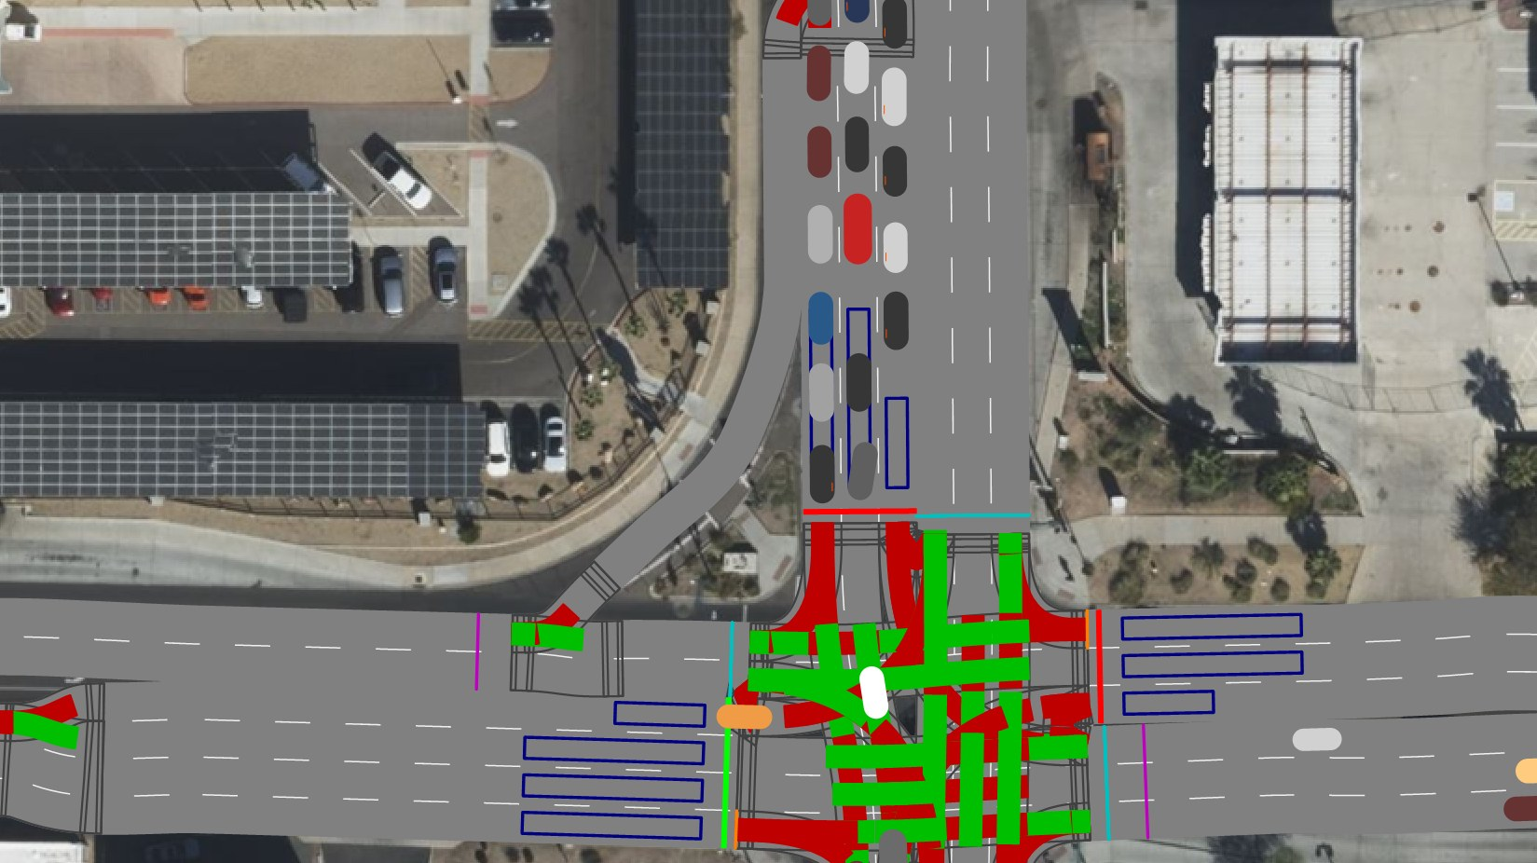
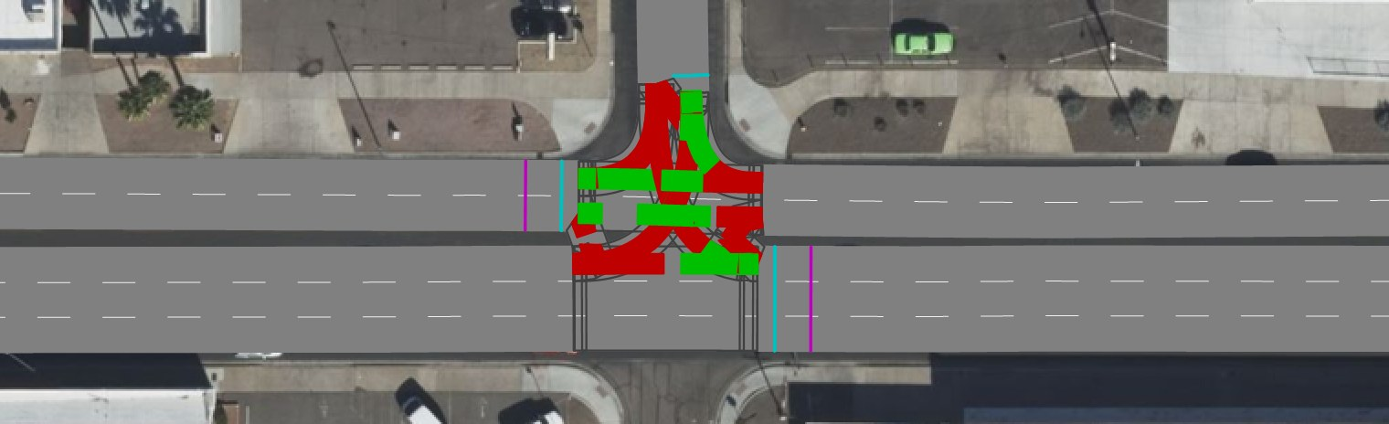
Conflict Areas: US Right of Way
Stage 4 decides who yields wherever two movements meet, the same rule at every intersection
# | Where two movements meet | Who has right of way
1 | Two movements leave the same approach. | Neither yields: both sides are red, so the vehicles see each other and keep their order.
2 | Two movements merge into the same street. | The turning movement yields: a through goes before a right, a right before a left.
3 | Two movements cross. | The left turn yields to the oncoming through and to the oncoming right (UVC 11-401).
4 | A slip lane, ramp or dropped lane joins a road. | The narrower stream yields to the road with more lanes, as at a yield sign.
5 | Two movements meet at a junction with no signal. | The minor road yields to the major road, the one with more lanes (UVC 11-403). Where the roads are equally wide and the two movements rank equally, the vehicle on the right goes first (UVC 11-401).
6 | A U-turn meets any other movement, or joins its exit street. | The U-turn yields to every other movement, including one from a minor road and the traffic already on the street it joins.
1
1
4
2
6
3
Signalised: Indian School Rd @ 7th St (rules 1–4, 6)
5
Kept as Vissim set them. At a signal, two movements of equal rank, such as two throughs, never have green together, so the signal separates them. Areas Vissim made passive, a movement against its own approach (a diverge, already both red) and other conflicts on an approach or exit link carry no interaction to decide.
Changed from Vissim's import: 599 of 4,805 conflict areas in Phoenix and 90 of 606 in Chattanooga. Every conflict between two movements of one intersection now has a rule; none is left to Vissim's default.
6
Unsignalised: a side street meets Indian School Rd (rules 5, 6)
Notes:
Vissim detects every conflict area on import and picks a status for each. Its diverges are right (both red: vehicles see each other and keep their order), but many of its merges and crossings are not US rules: Phoenix came back with 353 right turns ahead of the through they merge into, 117 lefts ahead of the cross street's through, 39 U-turns ahead of other traffic, and the 7th St southbound slip lane at Indian School Rd ahead of the westbound through. Stage 4 now re-decides every conflict between two movements of one intersection, and every merge outside an intersection. Left as Vissim set them: two movements of equal rank (two throughs at a signal are separated by the signal), areas Vissim made passive, and conflicts on an approach or exit link. One static status cannot be right in both phases for a right and the opposing left merging into the same street: on a permissive green the left yields, on the left's protected arrow the right-on-red yields. Stage 4 gives the right priority, the busier case; the RTOR stop sign still makes the right stop first.

Slide 14
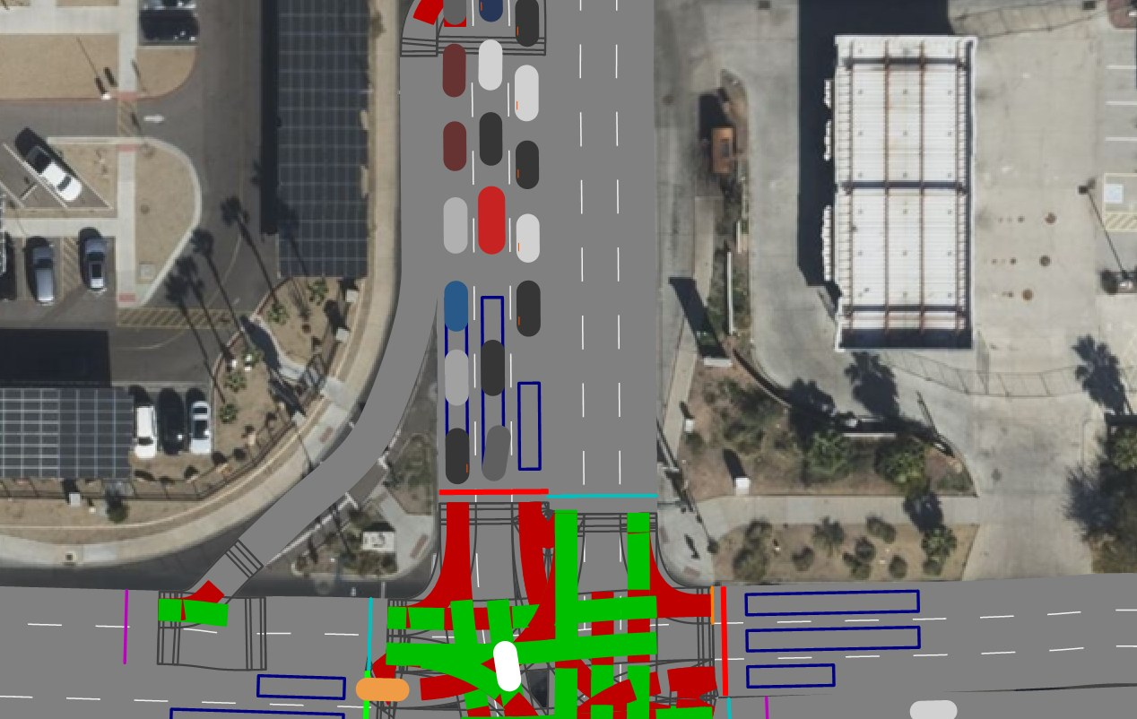
Phoenix: Ingested vs Simulated
Does the running model deliver what the counts put in? Entry-fed approaches, 08:00–09:00
14 of 15
entry-fed approaches within GEH 5
95.7%
of 9,843 counted veh/h delivered
7th St SB at Indian School: the one exception
1,499 counted, 1,130 enter: the entry's capacity. SUMO with the same demand leaves 295 uninserted, Vissim 294.
Upstream-fed approaches: turn shares within 5 points on 26 of 30; their volume is stage 6's job.
Uncalibrated model already delivers the counted demand wherever the counts enter it directly
Notes:
Stage 5 with --compare-counts places a data-collection counter on every counted movement, runs the count period and compares. Entry-fed approaches, where the counted volume is the input itself, must deliver it, and do: 14 of 15 within GEH 5. The exception is 7th St southbound at Indian School, where 1,499 veh/h is more than the entry can take; SUMO, given the same counted demand, leaves 295 vehicles uninserted there and Vissim 294, so it is a property of the network, not of either tool. Approaches fed from upstream junctions also depend on mid-block sources the counts do not see; their volume is what stage 6 calibration is for, but their turn shares must already agree, and 26 of 30 judged are within 5 points. No calibration applied.

Slide 15
Chattanooga: Stage 6 Calibration
Inflows and turn splits no camera measured, fitted with SUMO's algorithm and settings, 08:00–09:00
Mean GEH per approach (lower is better)
Approaches under GEH 5 (of 22)
Searched: 12 variables
4 entry inflows (0–200 veh/h) and 8 turn splits (0–1) on approaches with no counts
Measured: 80 counted movements
Data collection on every lane, 22 approaches, 13,786 vehicles
Algorithm: GA at SUMO's settings
10 generations × 10 candidates + 10 initial = 110 one-hour Vissim runs
Vissim, by method | Simulations | GEH / approach | Approaches < 5 | GEH / movement | Movements < 5
As built | – | 8.85 | 13 / 22 | 3.69 | 77.5%
GA | 110 | 3.84 | 17 / 22 | 1.75 | 90.0%
SA | 12 (check) | 8.38 | 13 / 22 | 3.48 | 80.0%
TS | 12 (check) | 7.78 | 14 / 22 | 3.24 | 81.3%
SUMO, calibrated | – | 4.28 | 17 / 22 | – | –
Objective: mean GEH per approach
Scored per approach, as SUMO scores its own calibration
Other methods: SA and TS, SUMO's other two algorithms, run through the same script (--algo sa|ts). After 12 simulations each they gain little; a full 110-run comparison is next.
Both models miss the same five approaches.
Same model, same seeds, same 12 variables. SA and TS ran only 12 simulations each as an end-to-end check, so they are not yet comparable with GA's 110. SUMO judges per approach only.
Calibrated Vissim matches SUMO's calibrated model: mean GEH 3.84 vs 4.28, 17 of 22 approaches under GEH 5 in both
Notes:
Stage 6 is RealTwin's TurnInflowCali method in Vissim. The variables are the ones the counts leave open: 4 entry inflows that stage 3 wrote at zero and 8 splits on approaches with no counts. Each counted movement is measured by data collection points on every lane of the junction link that carries it, because node evaluation drops edges more than three branchings away and reported five of the busiest approaches as empty. The genetic algorithm runs with the GA block of realtwin_config.yaml, the same file SUMO reads: epoch 10 and pop_size 10, so 10 generations of 10 candidates after an initial population of 10, 110 simulations in all, each a full one-hour Vissim run (163 minutes of computing on the final model). The score is mean GEH per approach, judged as SUMO's result_analysis_on_EdgeData judges it, so the two calibrated models are compared on the same measure. SUMO reports per approach only, so its per-movement cells are empty. Both models miss the same five approaches, which points to the counts or the network there rather than to either tool. Simulated annealing and tabu search, the other two methods SUMO's calibration offers, run through the same script with --algo sa|ts and --budget to give them the same number of simulations. Both were verified end to end with 12 simulations each on the previous build: SA 8.86 to 8.38 per approach (13 of 22), TS to 7.78 (14 of 22). Twelve simulations is a check, not a search, so these are not comparable with GA's 110. A full-budget run of all three (6 October) was scored by node evaluation, before the data-collection fix, so it is superseded; the full-budget SA and TS runs on the current model are the next step.

Slide 16
Verification Summary
What each pipeline stage ingested, and how it compares with SUMO (uncalibrated, 08:00–09:00)
Check | Chattanooga | Phoenix (new)
Network: links / junctions | 186 links, 10 junctions | 1,191 links, 70 junctions
MatchupTable vs SUMO's | 104 / 104 movements | 227 / 227 approaches, 191 / 192 turn codes
Counts ingested | 12 entries, 4,061 veh/h | 144 / 144 movement counts, 15 / 15 entries
Entry inflows vs SUMO | 16 / 16 identical, every 15 min | 14 / 15 identical, every 15 min (7th St SB calibrated in SUMO)
Turn shares vs SUMO | 76 / 80 identical (4 differ ≤ 0.007) | 179 / 192 within 0.05, median 0.006 (SUMO sampled)
Signal timings vs SUMO | 204 / 204 identical, 6 controllers | 554 / 554 identical, 13 controllers
Heads / detectors / RTOR signs | 69 / 68 / 24 | 151 / 151 / 47
Run delivers entry counts | not run here (demand compared with SUMO) | 14 / 15 GEH < 5, 95.7%
Green = matches exactly / passes. Next: stage 6 calibration on Phoenix (unmeasured inflows and splits), and SUMO's speeds and vehicle mix carried into Vissim.
Notes:
Chattanooga is compared with RealTwin's SUMO build of the same corridor; Phoenix with the colleague's SUMO network, whose signals are Synchro's originals and whose demand is calibrated, so Phoenix demand is checked against the GridSmart counts instead. Signal heads: 4 Phoenix lanes share one head with a neighbouring movement, a Vissim limit.

