Slide 1
EventGraD: Event-Triggered Communication in Parallel Stochastic Gradient Descent
Soumyadip Ghosh and Vijay Gupta
University of Notre Dame
Machine Learning in HPC Environments (MLHPC) workshop
November 2020

Slide 2
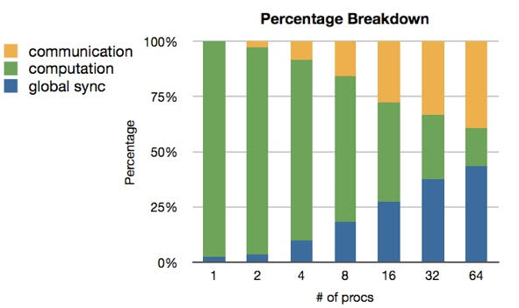
Communication in Parallel Machine Learning slow!
Communication between processing elements takes more time!

Slide 3
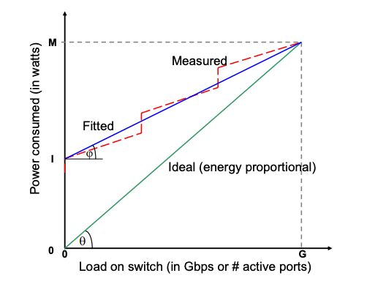
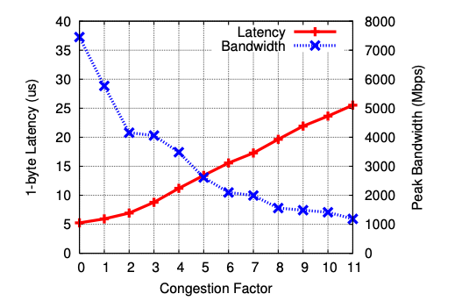
Other Communication Overhead
Communication of messages consumes energy*
Communication may lead to congestion in HPC interconnects#
*P. Mahadevan et al, “A Power Benchmarking Framework for Network Devices”, Springer, 2009.
#T. Hoefler et al, “Multistage Switches are not Crossbars: Effects of Static Routing in High-Performance Networks, IEEE, 2008.

Slide 4
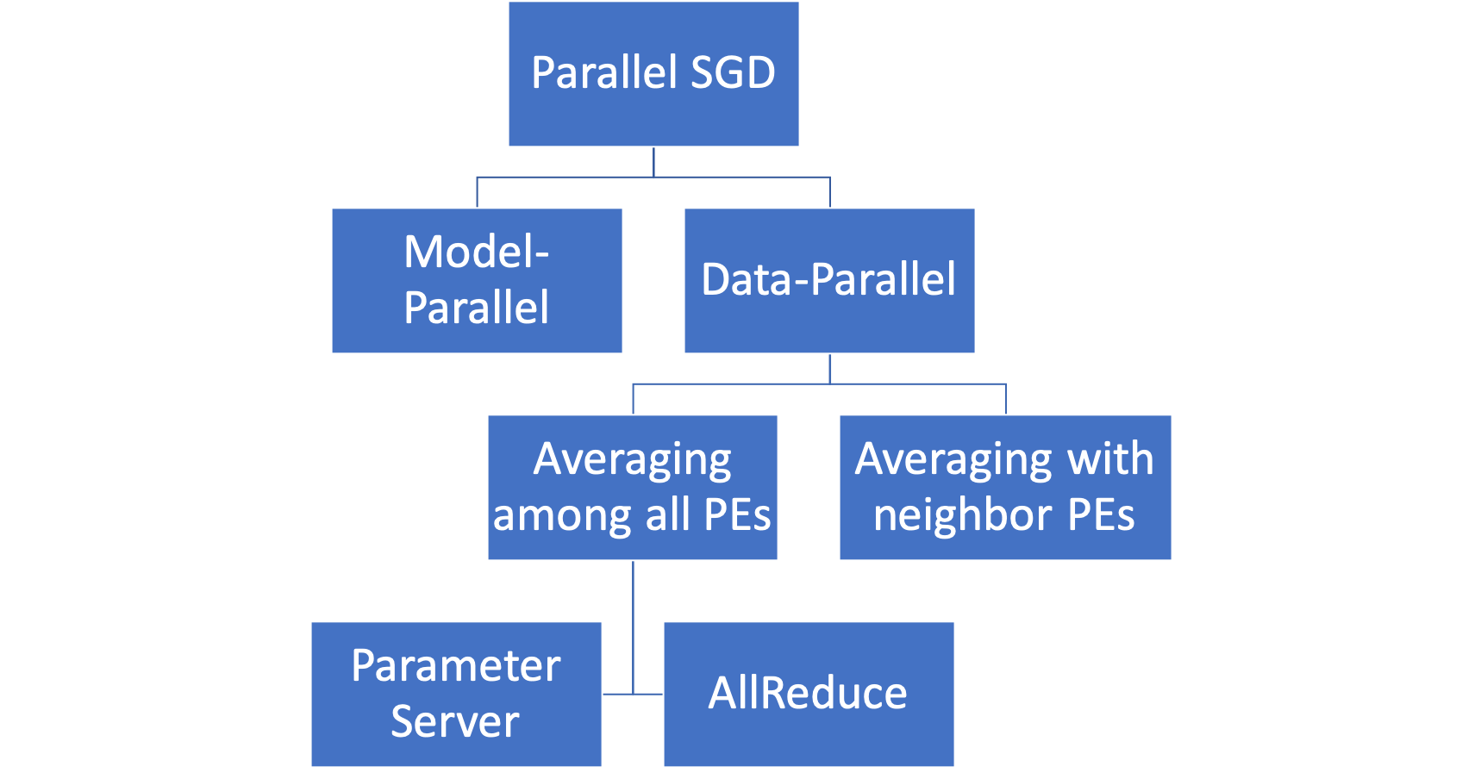
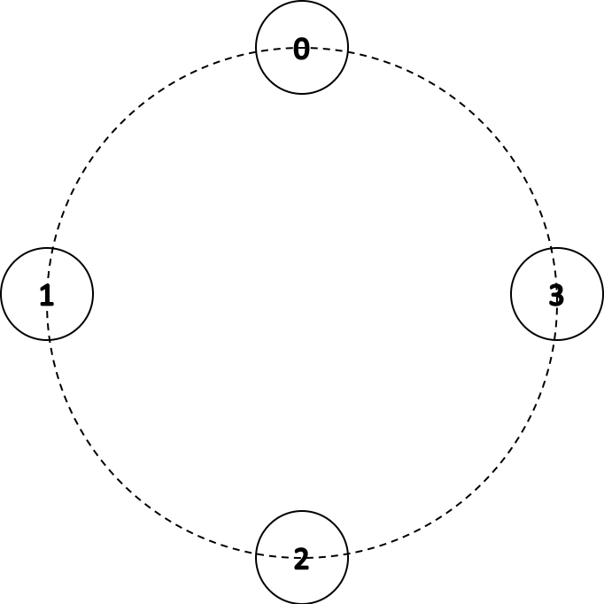
Communication in Parallel Neural Network Training
Strategies of parallelizing neural networks
X. Lian et al. "Can decentralized algorithms outperform centralized algorithms? a case study for decentralized parallel stochastic gradient descent." Advances in Neural Information Processing Systems. 2017.

Slide 5
Existing Approaches vs Our Approach to Reduce Communication
Concentrated on averaging among all processors
Parameter Server approach
Hogwild! (Recht et al. 2011)
Elastic Averaging SGD (Zhang et al. 2015)
AllReduce approach
Quantization in gradients – One bit (Seide et al. 2014), Threshold (Strom et al. 2015), Mixed (Dryden et al. 2016)
Sparsification in gradients – Top-K significant (Alistarh et al. 2018), Deep Gradient Compression (Lin et al. 2018)
Changed precision – Low (Gupta et al. 2015), Mixed (Micikevicius et al. 2018)
We focus on averaging with neighbors and communicate in an event-triggered fashion

Slide 6
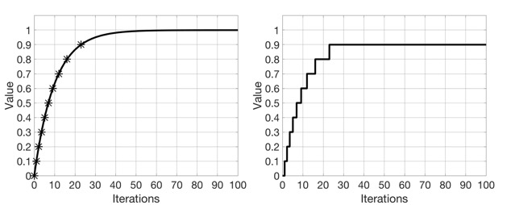
Our Proposed Algorithm
Communicate model parameters (weights and biases) in events only when necessary
Sender sends a parameter only when the change in its norm exceeds a threshold
Receiver continues computation using the last received values

Slide 7
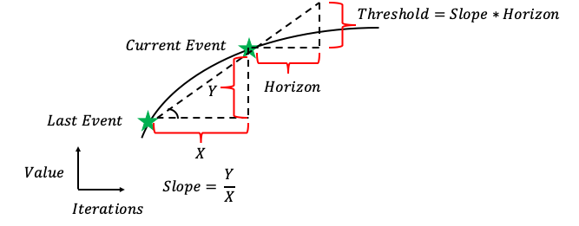
How to choose the threshold?
Choosing the threshold for communication is a design problem
Simplest option is to choose a constant threshold
Better option is an adaptive threshold based on the slope of the parameters

Slide 8


Implementation : Need for One-Sided Communication
Event of communication is triggered based on parameters at the sender
Receiver is not aware when event is triggered at sender
MPI_Send
MPI_Recv
Sender PE knows when to send
Receiver PE knows when to receive
MPI Two-sided Communication
MPI_Put
Sender PE knows when to send
Receiver PE not involved
MPI One-sided Communication

Slide 9
Implementation : Framework
Distributed Modules in PyTorch, TensorFlow, CNTK, Horovod provide either the Parameter Server or AllReduce approach
No module supports training involving averaging with just neighbors
We implement using primitives from PyTorch and MPI
PyTorch has a C++ frontend (Libtorch) which we combine with MPI one-sided functions

Slide 10
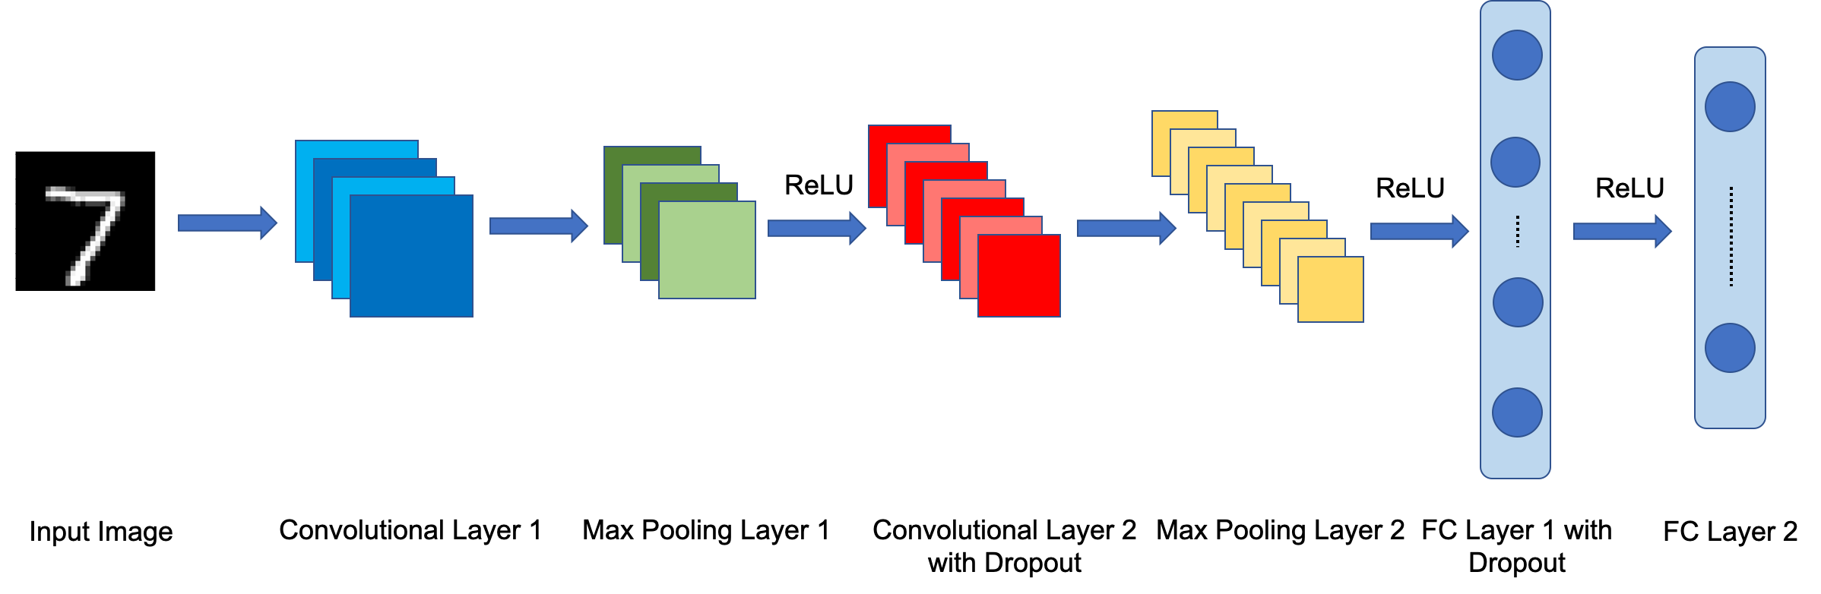
Experiments
We train a popular convolutional network on the MNIST dataset
Libtorch MNIST example. https://github.com/pytorch/examples/blob/master/cpp/mnist/mnist.cpp. Accessed: 07-11-2020.

Slide 11
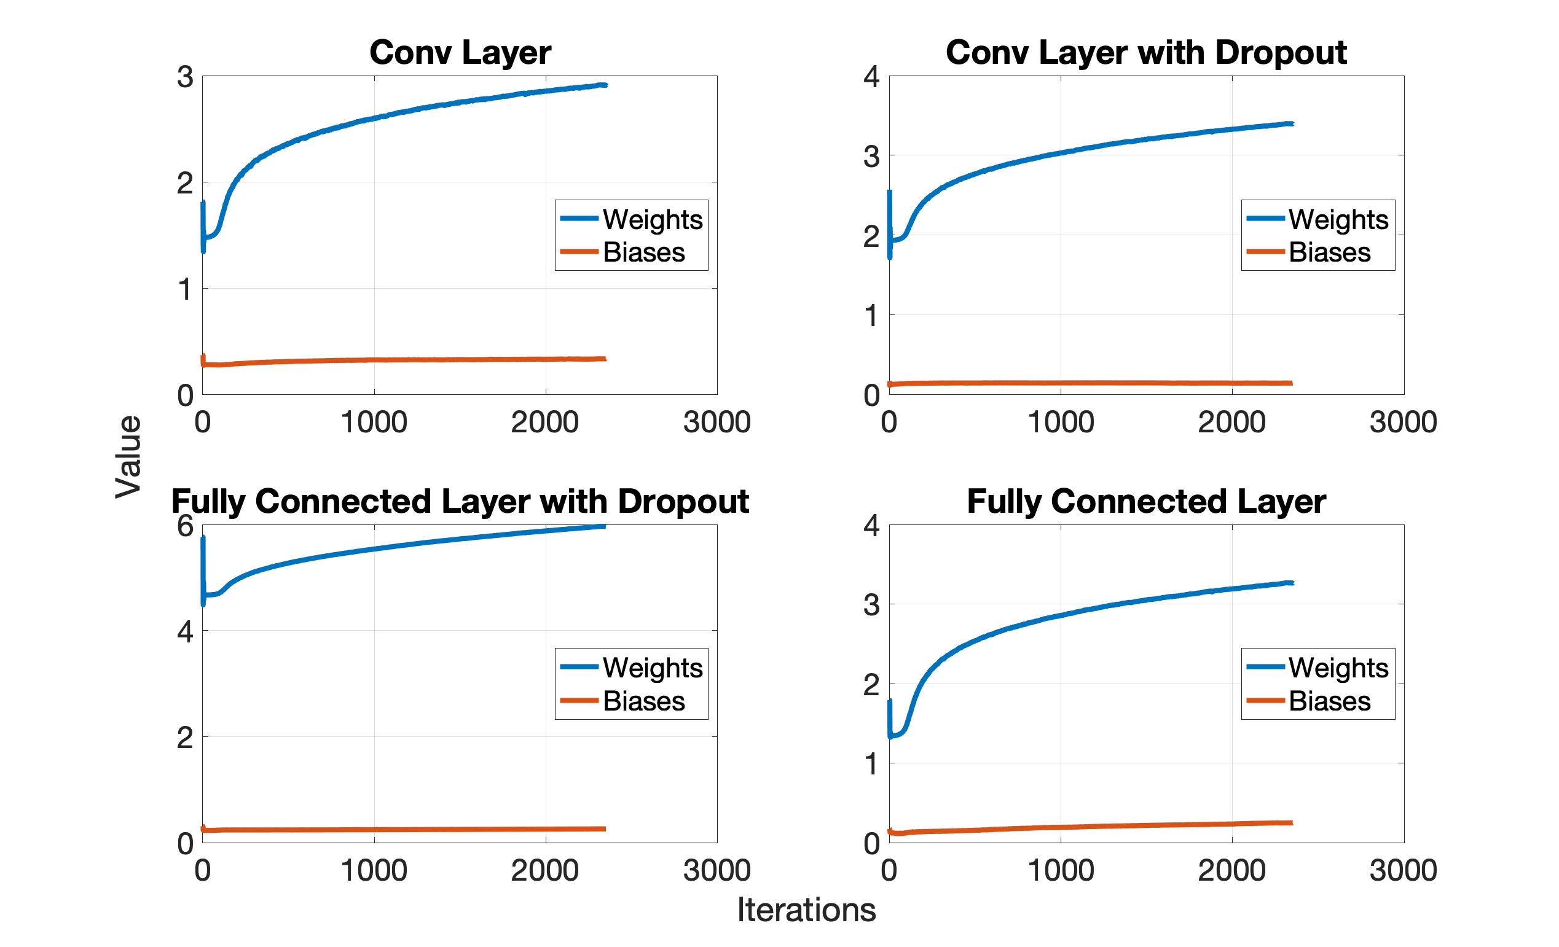
Evolution of Norm of Parameters
Euclidean norm of parameters in our model over iterations in one processor
After initial oscillations, weights have a gradual change while bias stays almost flat

Slide 12
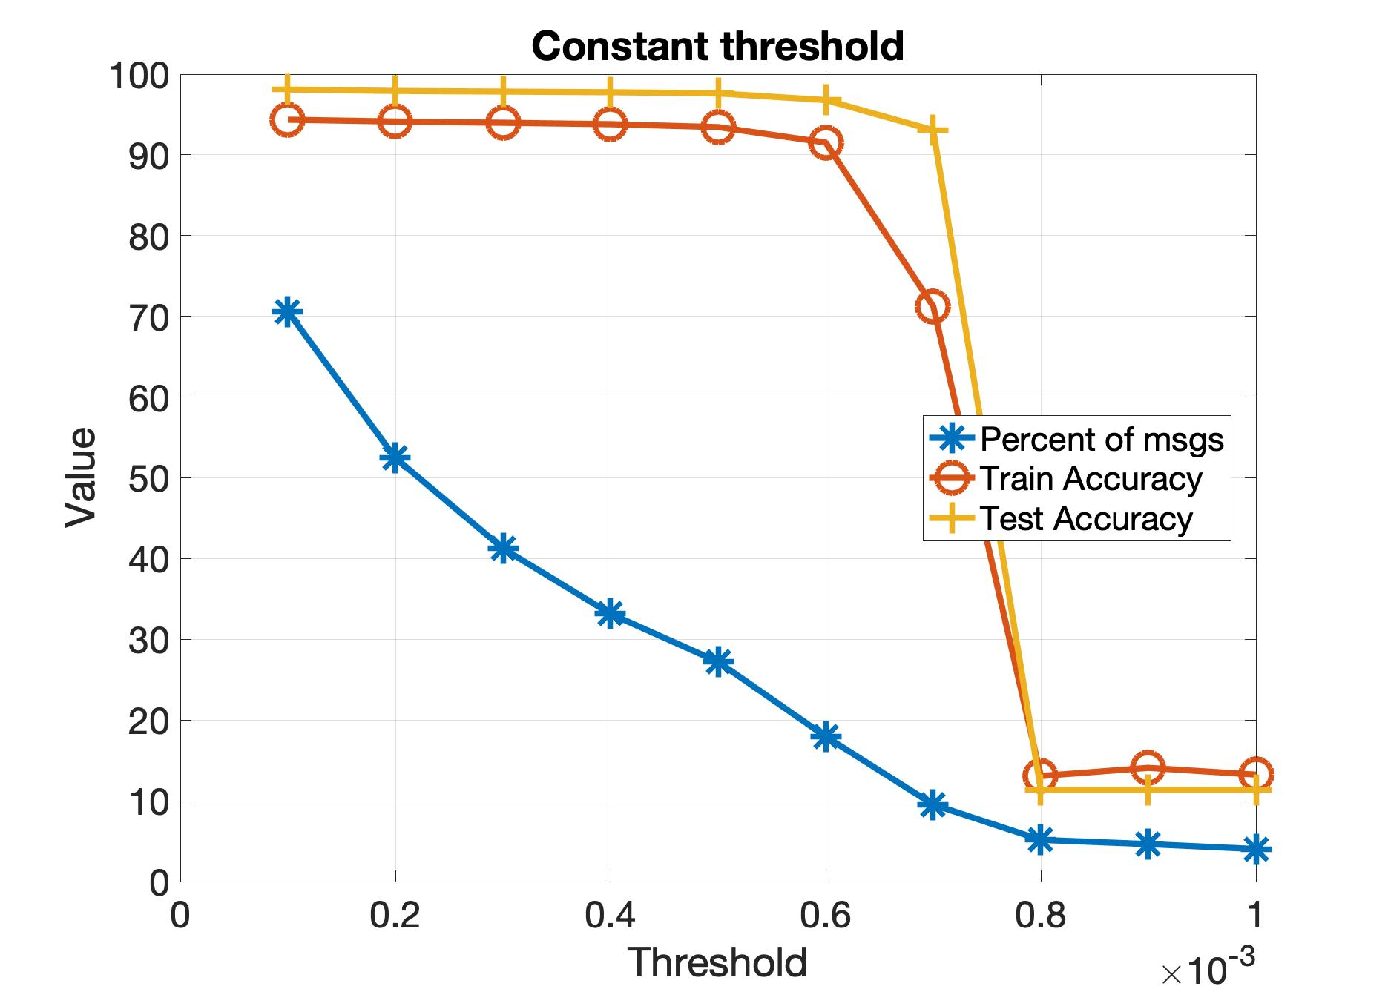
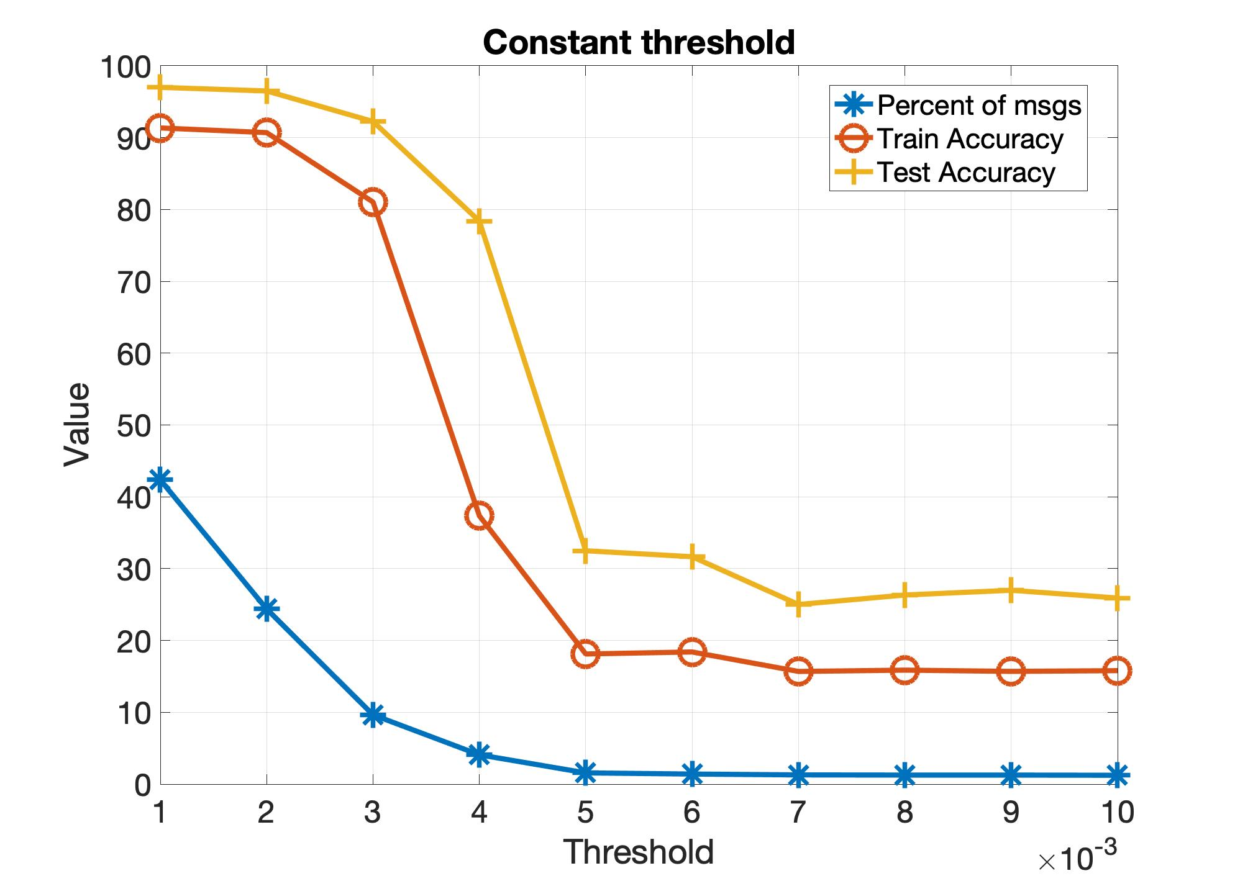
Evaluation using a constant threshold
Choosing a constant threshold for triggering events
Changing the model changes the range of acceptable thresholds which has to be found before training
Kernel size of convolutional layers = 5
Kernel size of convolutional layers = 3

Slide 13
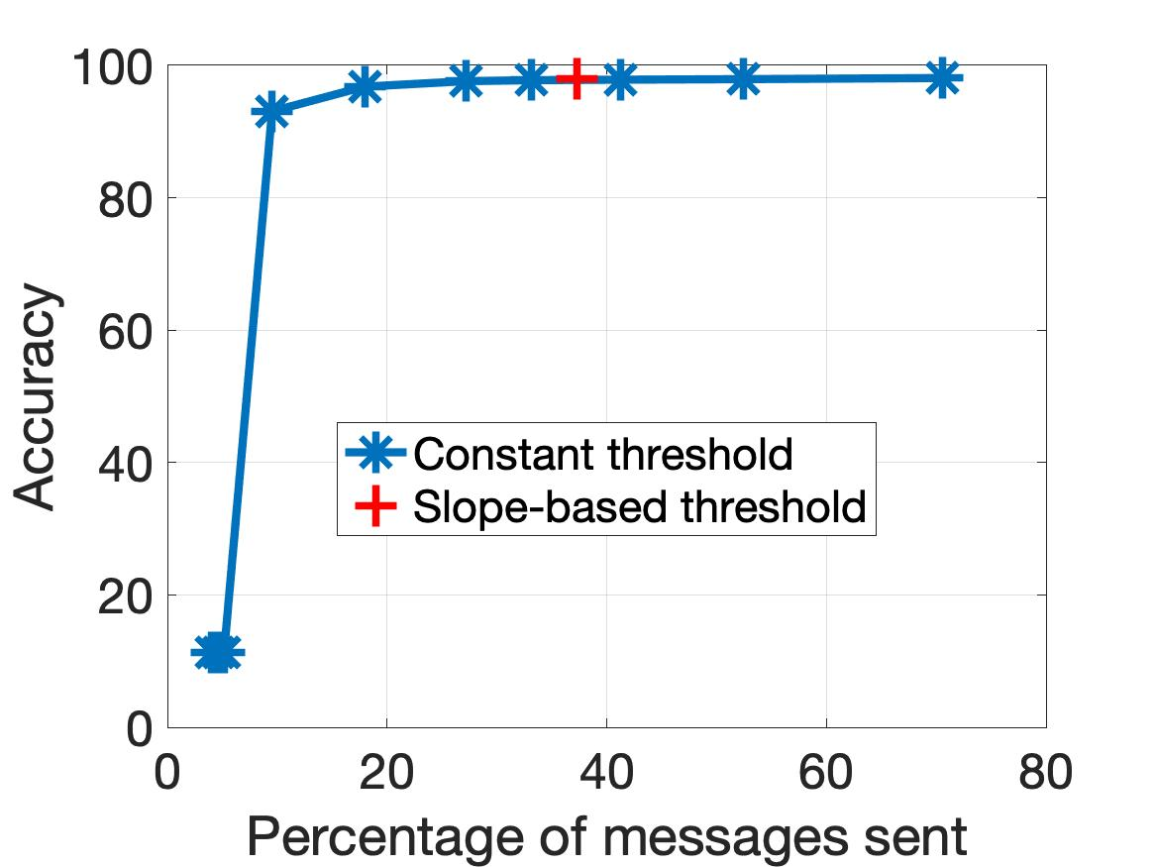
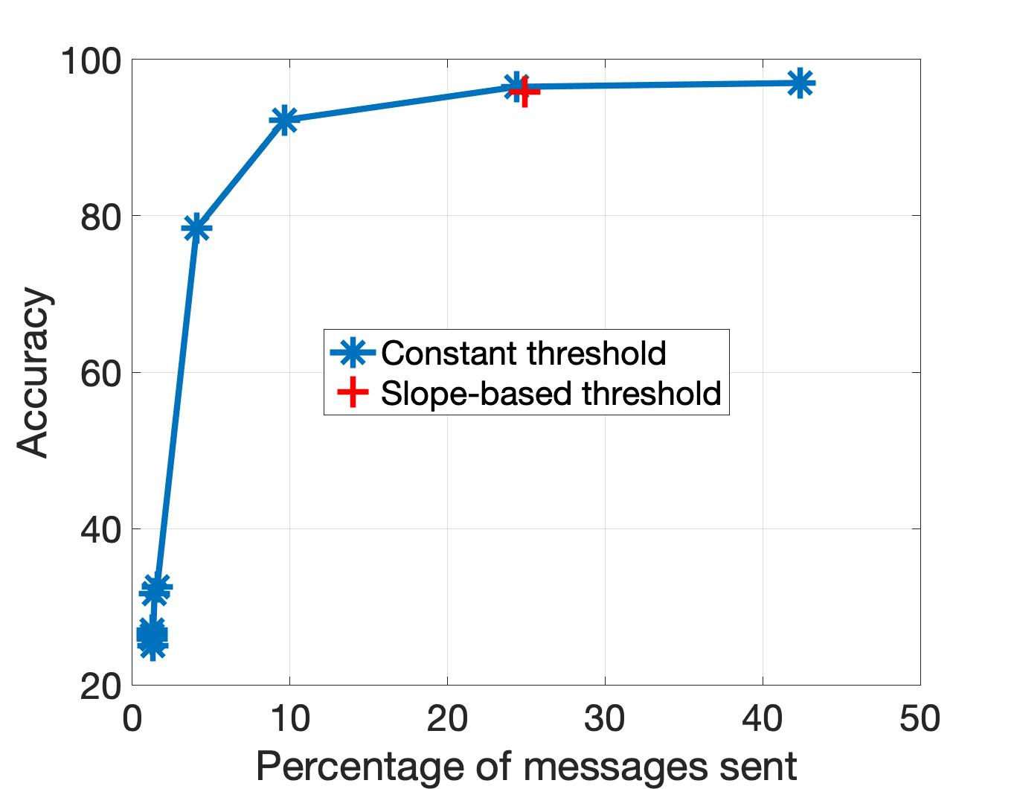
Comparison between constant and adaptive threshold
Slope-based adaptive threshold does not require extensive tuning
However adaptive threshold might be sub-optimal
Using horizon = 1 for the adaptive threshold for both
Kernel size of convolutional layers = 5
Kernel size of convolutional layers = 3

Slide 14
Future Work
We need to do more experiments of larger models on larger datasets
Resnet-50 on ImageNet
Extend code to GPUs
Investigate theoretical properties such as rate of convergence and optimal way to choose the adaptive threshold

Slide 15
Source Code and Secondary Objectives
Check https://github.com/soumyadipghosh/eventgrad
Combines PyTorch C++ API and MPI to implement parallel machine learning in general
Also implemented AllReduce based training and decentralized training with neighbors
Add to PyTorch examples repository - https://github.com/pytorch/examples/pull/809
PyTorch C++ API is still in beta – coverage of models and datasets is quite limited!

Slide 16
Summary
Propose a novel communication algorithm for decentralized machine learning based on events
Event-Triggered Communication reduces the number of messages, thereby saving on communication time and energy
Emphasize on an adaptive threshold dependent on the slope of parameters
Can be extended to training algorithms other than SGD and model-parallel configurations
http://sites.nd.edu/sghosh/
sghosh2@nd.edu

