Slide 1
Determining optimal restaurant type and location to serve in Amazon HQ2 location

Slide 2
Introduction
Amazon announced that they will open second headquarter in Arlington, Virginia bringing up to 25,000 new employees. In addition, there can be 2 to 3 times that number indirectly supporting Amazon HQ2. For any potential entrepreneur, this provides a great opportunity to open new business (say a restaurant) supporting the influx of new employees. What restaurant and where in Arlington will provide the greatest potential for earning? This topic is of interests to any potential entrepreneurs wishing to open business around Amazon HQ2 catering to the future demand increase.

Slide 3
Data
Based on the definition of our problem, factors that will influence our decision are:
Number of existing restaurant types in the neighborhood.
Distance of neighborhood from the Amazon HQ2 center.
Following data sources will be used to extract/generate the required information:
Centers of candidate areas will be generated algorithmically using Google Maps API reverse geocoding.
Number of restaurants types and locations in each neighborhood will be obtained using Foursquare API.
Coordinate of Amazon HQ2 will be obtained using Google Maps API geocoding of National Landing.

Slide 4
Methodology
This project will look for the potential restaurant location within 1,500 meters (comfortable walking distance accomodating lunch outing) from proposed Amazon HQ2 in National Landing in Crystal City, Virginia.
The optimal restaurant type will be defined as the most frequent type between 1500 to 6000 meters from Amazon HQ2 that is not located within 1500 meters.
Each neighborhood within the 1,500 meters and 6,000 meters from proposed Amazon HQ2 will be segmented by 300 meter radius.
Once the optimal restaurant type is identified, the optimal location will be identified as the one with fewest restaurants.

Slide 5
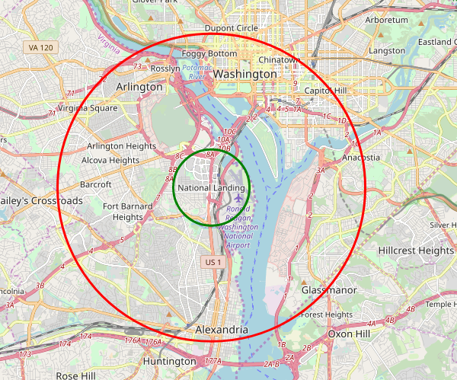
Methodology - Continued

Slide 6
Results and Discussion
Top 6 types of restaurants that were not present within 1,500 meters from Amazon HQ2.
Category | Count
French | 28
Tacos | 27
Latin American | 26
Southern/Soul | 16
Korean | 13
Vegetarian / Vegan | 13

Slide 7
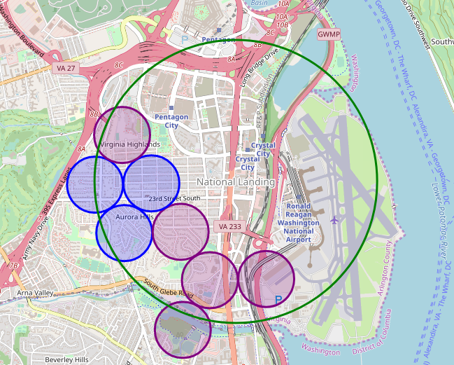
Results and Discussion
Potential Sites for restaurants

Slide 8
Conclusion
Purpose of this project was to first identify an optimal type of restaurants to open to cater to the potential influx of up to 75,000 people moving into National Landing area to either directly or indirectly work at Amazon HQ2. Secondly, this project was to identify the optimal location to open said restaurant. This study had narrowed the type of restaurant down to 5 and potential location to 8 different neighborhood sections within 1,500 meters from proposed Amazon HQ2 location. Ultimately, the stakeholders must make decision based on their specific needs.

