Slide 1
When do Words Matter ?
Zhao Wang and Aron Culotta
Illinois Institute of Technology
Notes:
As humans, …to communicate and convey our thought.
So that, our word choice could impact the perception of people who we are communicating with.

Slide 2
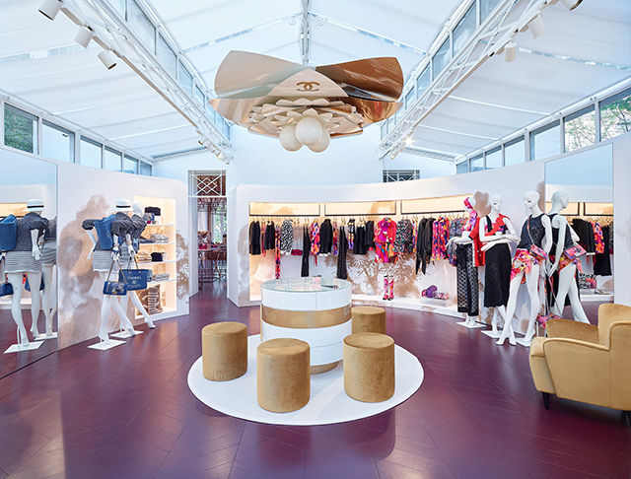
Motivating example
There are plenty of boutiques near my house.
精品店
2 / 30
Notes:
For example, if I tell you….

Slide 3
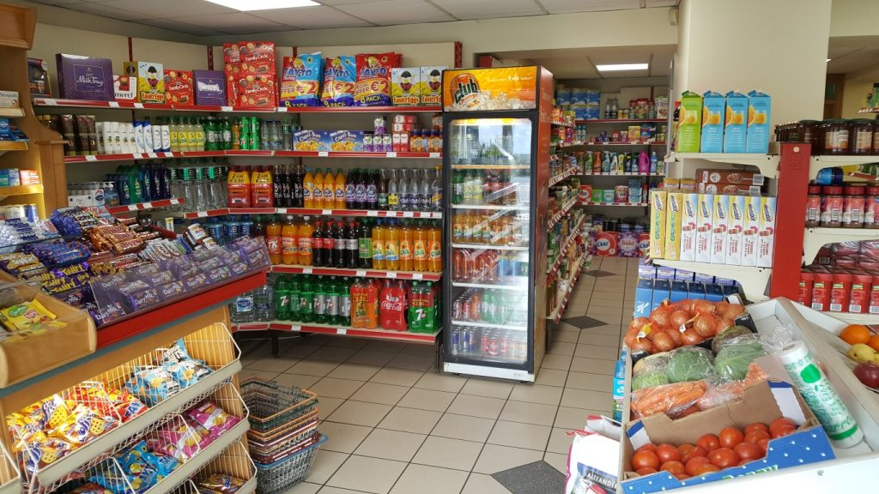
Motivating example
There are plenty of shops near my house.
Notes:
However if…
…less desirable neighborhood, comparing with …

Slide 4
Motivating example
There are plenty of boutiques near my house.
There are plenty of shops near my house.
Notes:
For these 2 sentences, by substituting … to …
I conveyed different levels of desirability of the house.
So, see? the power! of word choice!

Slide 5
Related work
Wording effect [Hovland, Janis, and Kelley, 1953]
Message propagation [Tan, Lee, and Pang, 2014]
Memorability of movie quotes [Danescu, 2012]
Story sharing rates [Berger and Milkman, 2012]
Infer user attribute [Ungar, 2016, 2017]
Gender obfuscation [Reddy and Knight, 2016]
……
5 / 30
Notes:
From academic standpoint, studies…
Recent research includes: the effect of word choice on …
In``fer user attributes
Obfuscating gender by lexical substitutions.

Slide 6
Causal effect
(1) A single word change
(2) In a specific sentence
Desirability
0.3
0.7
There are plenty of shops near my house.
There are plenty of boutiques near my house.
6 / 30
Notes:
However, despite the prior works, what I am really….
…quantifying the effect on perception caused by …
For example, as the 2 sentences …, how much does changing … in this sentence…increase …of the house?
Studying the impact of word choice on human perception from sentence level help us identify which specific word should be changed.

Slide 7
Applications
Optimize presentation for marketing purpose
Advertisement
Protect privacy
Detecting personal information leak when talking online.
7 / 30
Notes:
This technique could benefit applications such as:
…For example, companies could choose suitable words to customize their advertisement to perception goals, and thus attracting more consumers.
Additionally, on the flip side, this application could help protect privacy.
As we might leak personal information when we are talking online, such as gender, age, location.
Detecting which word leaks what kind of information help us be more careful to use words.

Slide 8
Understanding the Impact of Lexical Choice on Audience Perception using Individual Treatment Effect Estimation
8 / 30
Notes:
So the thing I am going to show in our paper is: …

Slide 9
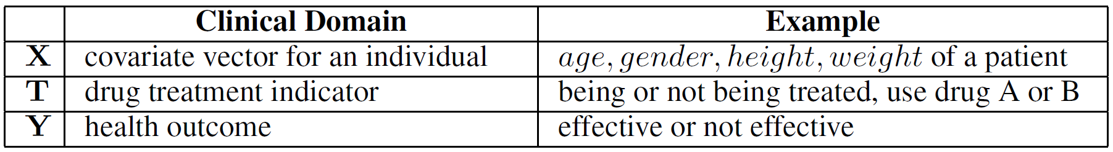
ITE: Individual Treatment Effect estimation [Rubin, 1974]
9 / 30
Notes:
As a type of causal ``inference…
…to estimate how effective a drug will be for a specific patient.
This problem is formulated by…
Will call … as ITE for short

Slide 10
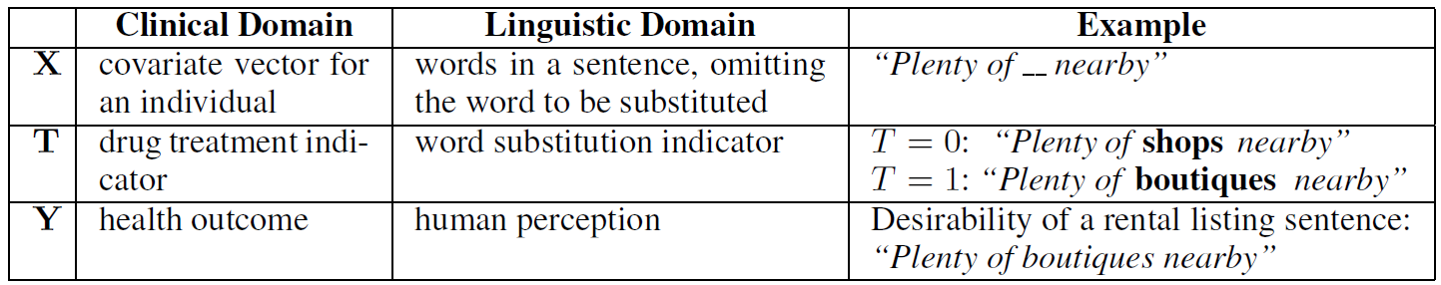
ITE → LSE (Lexical Substitution Effect estimation)
10 / 30
Notes:
In our paper, we formulate our problem as a type of ITE, which we call…
I will use LSE for short.
Correspondingly, X…
To solve our problem, we propose 2 types of LSE estimators.

Slide 11

Methods
$${(s, w}_{i} ,w_{j}) → \hat{τ}$$
Quasi-experiment with observational data
KNN --> K-Nearest Neighbor matching [Rubin, 1973]
VT-RF --> Virtual Twins Random Forest [Foster, Taylor, and Ruberg, 2011]
CF-RF --> Counterfactual Random Forest [Foster, et al., 2011; Dasgupta et al. 2014]
CSF --> Causal forest [Wager and Athey, 2017]
11 / 30
Notes:
The first type of estimator builds upon…that only require…
We adapt algorithms from previous ITE estimation to our task of LSE estimation, including: KNN….
Specifically, we first fit each model with observational data annotated by reality measures.
And then, for a new sentence and a pair of substitution words, the models will directly calculate the estimated LSE.
No desirability, surrogate true gender as proxy labels, no human perception.

Slide 12
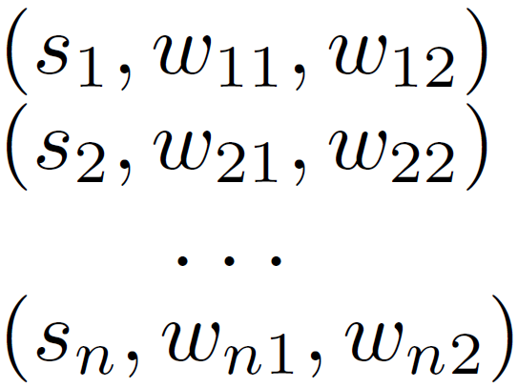

Methods
$${(s, w}_{i} ,w_{j}) → \hat{τ}$$
Quasi-experiment with observational data
KNN --> K-Nearest Neighbor matching
VT-RF --> Virtual Twins Random Forest
CF-RF --> Counterfactual Random Forest
CSF --> Causal forest
Classification [Lopez-Paz, 2015]
Causal perception classifier (RCT)
12 / 30
Notes:
The second type of estimator frames the causal `in`ference as a…
We first conduct RCTs to collect human judgement for a small set of instances,
and then fit a perception classifier to predict LSE for future samples.

Slide 13
Methods
$${(s, w}_{i} ,w_{j}) → \hat{τ}$$
Quasi-experiment with observational data
KNN --> K-Nearest Neighbor matching
VT-RF --> Virtual Twins Random Forest
CF-RF --> Counterfactual Random Forest
CSF --> Causal forest
Classification
Causal perception classifier (RCT)
13 / 30
Notes:
In the following slides, I will show detailed flow of the two types of LSE estimators.
But due to time limit, for 1st type, I will choose VT-RF as a representative estimator to talk in detail.

Slide 14
Methods
$${(s, w}_{i} ,w_{j}) → \hat{τ}$$
Quasi-experiment with observational data
KNN --> K-Nearest Neighbor matching
VT-RF --> Virtual Twins Random Forest
CF-RF --> Counterfactual Random Forest
CSF --> Causal forest
Classification
Causal perception classifier (RCT)
Running example:
Plenty of shops nearby.
boutiques
Desirability
14 / 30
Notes:
As a …, I will consider changing …in the sentence….
The following algorithm will calculate how much does substituting … in … increase the perceived desirability of the house.

Slide 15
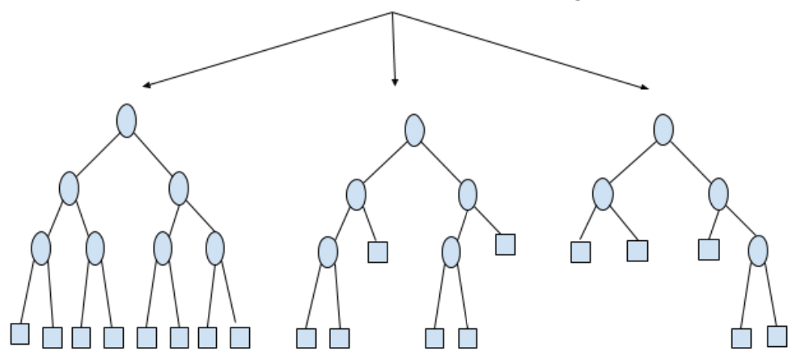
VT-RF: Virtual Twins Random Forest
shops
boutiques
15 / 30
Notes:
The VT-RF is a two step approach, ….
Here, every node represents a word feature.

Slide 16
VT-RF: Virtual Twins Random Forest
Virtual Twin:
“Plenty of shops nearby”
“Plenty of boutiques nearby”
16 / 30
Notes:
Then for our running example: …. ,we generate a vt sentence….
Since… alike …. except… , we call them …

Slide 17
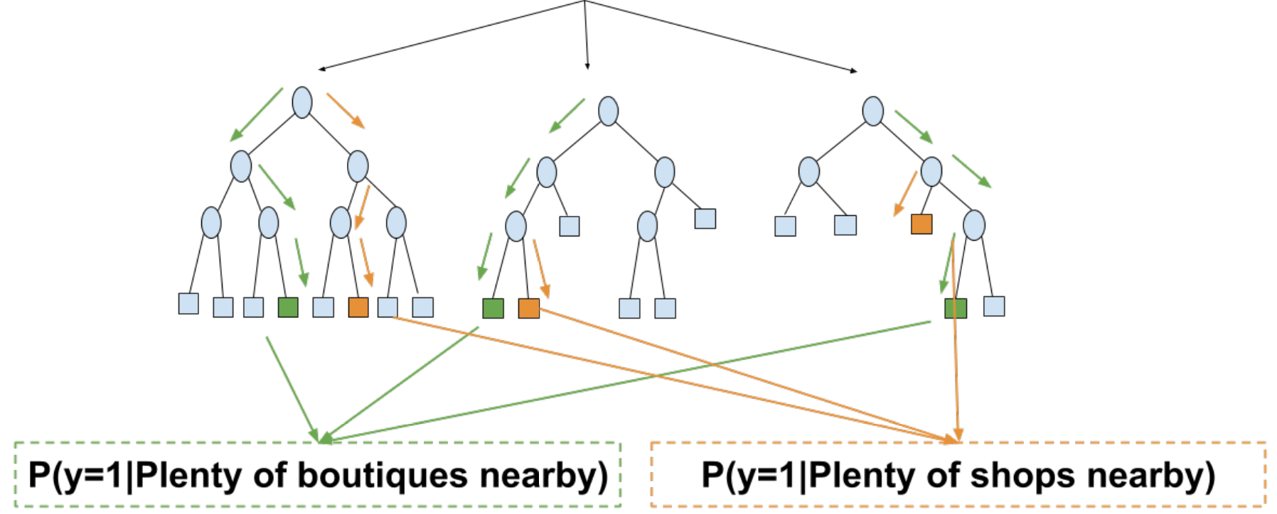

VT-RF: Virtual Twins Random Forest
Virtual Twin:
“Plenty of shops nearby”
“Plenty of boutiques nearby”
17 / 30
Notes:
By running down…
…conditional probability of being desirable given each sentence.
As the formula shows, …. of the sentence containing the substitution word “boutiques”, and… original…
The difference between … estimated Lexical Substitution Effect.

Slide 18
Causal Perception Classifier
AMT workers
18 / 30
Notes:
The second type of estimator is a causal …
We first conduct RCTs to collect human judgement for a small set of sample.
For each selected sentence and the substitution word pair, we show 2 versions of the sentences to different AMT workers.
and ask their perception of neighborhood desirability based on each sentence.
Perception differences are then converted to labels for each tuple.

Slide 19
Causal Perception Classifier: Feature representation
Generalizable features | Example
Context probability: | P(y=desirable | Plenty of … nearby)
Control word probability: | P(y=desirable | shops)
Treatment word probability: | P(y=desirable | boutiques)
19 / 30
Notes:
Then, we use non-lexical features to represent each tuple, that is: …
E.g., the conditional probability of being perceived as desirable given only context words.
The advantage for……is that they can generalize across domains.
As it is painful to have people sit down and label, so the hope is that we can label in one domain, and predict for other domains.

Slide 20
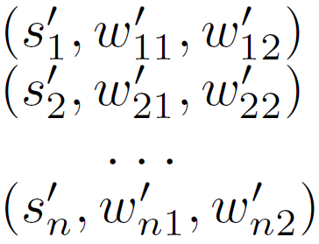
Causal Perception Classifier
Train
Predict
Classifier
20 / 30
Notes:
Finally, we build… and predict…

Slide 21
Experimental dataset
Twitter and Yelp [Reddy and Knight, 2016]
Perception of gender
Airbnb [http://insideairbnb.com/]
Perception of neighborhood desirability
21 / 30
Notes:
With the 2 types of estimators, we experiment with…
For sentences in …
…a subsample from the listed authors.

Slide 22
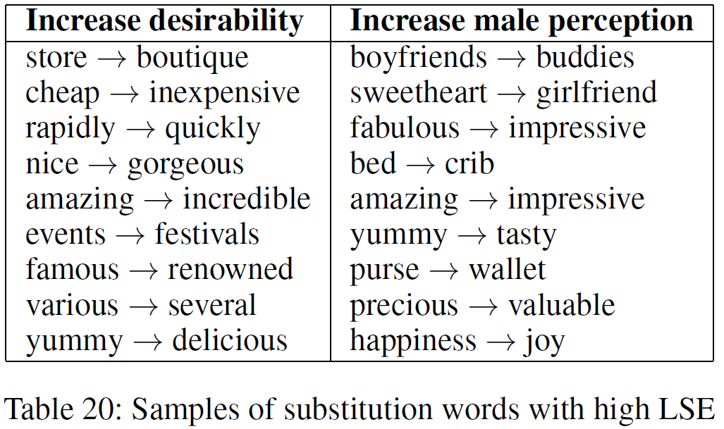
Substitutable Word Pairs
22 / 30
Notes:
We first apply NLP technique to discover …
For example, next page
For RCTs purpose, we select (s,w1,w2) rated high by at least one of the four LSE estimators.

Slide 23
Substitutable Word Pairs
23 / 30
Notes:
We can change ….
Increase male perception of the author of a message

Slide 24
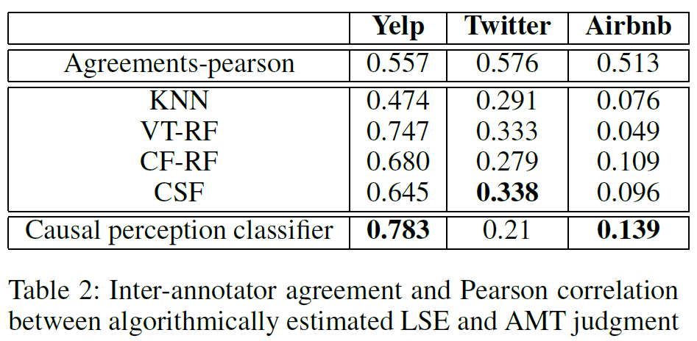
Evaluations
24 / 30
Notes:
To evaluate the performance of LSE estimators, we compare …… with human derived LSE.
For causal perception classifier, we fit the model using samples of two datasets and making out of domain prediction for the third dataset.
This table shows the Pearson correlation.
Page down

Slide 25
Evaluations
25 / 30
Notes:
First, we observe that the causal … outperforms the other 4 LSE estimators for Yelp and Airbnb.
The good performance of the out of domain results produced by causal perception classifier suggests the importance of the three generalizable features we mentioned in previous slides.

Slide 26
Evaluations
26 / 30
Notes:
Additionally, we see that the performance of 4 LSE estimators vary across datasets.
Yelp, formal…with full sentences, so the 4 estimators perform the best.
Comparing with Yelp, Twitter contains more grammatical errors and incomplete sentences, decreases the performance.

Slide 27
Evaluations
Gender
Desirability
27 / 30
Notes:
We observe that the more subjective the perceptual attribute is, the lower both human agreement and algorithmic accuracy will be.
As for Yelp and Twitter, …consider perception of gender, objective.
But for Airbnb, …perception of desirability, subjective, increase the difficulty of the task.

Slide 28
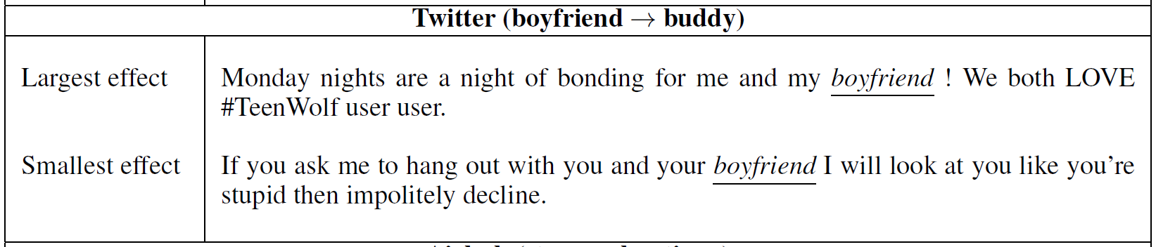
Same substitution but different treatment effect
28 / 30
Notes:
As a concluding example, here is the case where … caused …
For example, changing … in the sentence .. is estimated to have a larger effect on gender perception than in the sentence …

Slide 29
Same substitution but different treatment effect
29 / 30
Notes:
The reason is that the use of possessive noun "my" reveals more about the possible gender of the author than the pronoun "your".

Slide 30
Conclusion
Words matter:
Context (same substitution, different effects)
Words to be substituted
Substitution words (different substitution, different effects)
Paper & appendix:
Archive: https://arxiv.org/pdf/1811.04890.pdf
Code & data:
https://github.com/tapilab/aaai-2019-words
Perception based on one sentence --> Perception based on documents
30 / 30
Notes:
To conclude: …
Context: as same word substitution would cause different effects in different contexts, as the concluding example shows;
: different word substitutions in the same context would also cause different effects.
For an extended version of the paper, please check …
And we also public our code on github.

Slide 31

Notes:
Last but the most importantly…
……strong support and continuous encouragement…

Slide 33
Randomized Controlled Trails
A type of scientific (often medical) experiment which aims to reduce bias when testing a new treatment.
Participants are randomly allocated to :
either the group receiving the treatment under investigation;
or to a group receiving standard treatment (or placebo treatment) as the control.
Randomization minimizes selection bias and the different comparison groups allow the researchers to determine any effects of the treatment when compared with the no treatment group, while other variables are kept constant.

Slide 34
Possible questions
What is desirability?
Worth renting
Train
Predict
${(s, w}_{i} ,w_{j}) τ−−→Classifier −−−→{(s^{′}, w^{′}}_{i} ,{w^{′}}_{j})$

Slide 35
Samples for RCTs
First, calculate LSE for all (s,w1,w2) using 4 LSE estimators.
Then, select (s,w1,w2) rated high by at least one of the four LSE estimators.
11 / 26

Slide 36
Running example
Plenty of shops nearby. | Control word | Control samples
boutiques | Treatment word | Treatment samples
11 / 26

Slide 37

Substitutable Word Pairs
Representative words
Moderately correlated
LogisticRegression coefficient
Semantic substitutability
Paraphrase Database (PPDB 2.0)
Syntactic substitutability
Part-of-speech tag
Substitutability for a specific sentence
N-grams
$${(w}_{i} ,w_{j} , s)$$
37 / 26

Slide 38
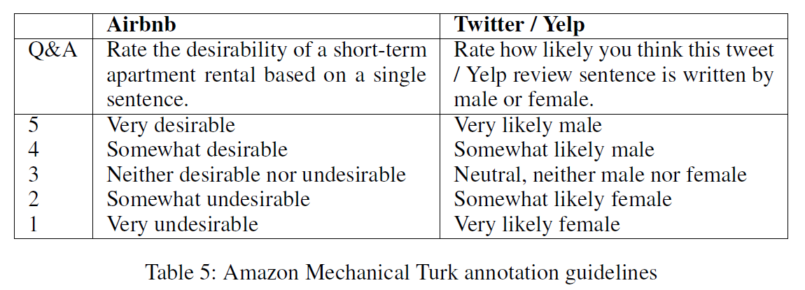
Human-derived LSE estimates (AMT)
“There are plenty of shops nearby” → “There are plenty of boutiques nearby”
38 / 26

Slide 39
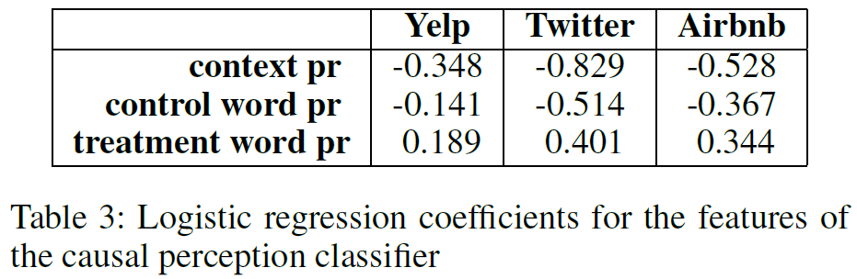
Causal perception classifier
39 / 26

Slide 40
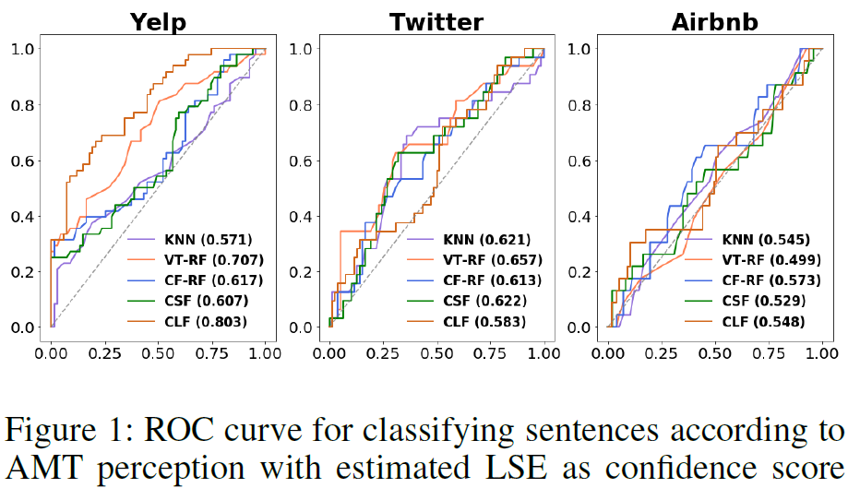
Comparisons
40 / 26

Slide 41
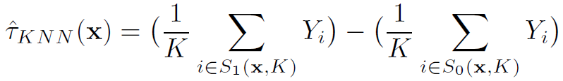
KNN: K-Nearest Neighbor matching
boutiques
shops
Desirable
Undesirable
“Plenty of __ nearby”
41 / 26

Slide 42
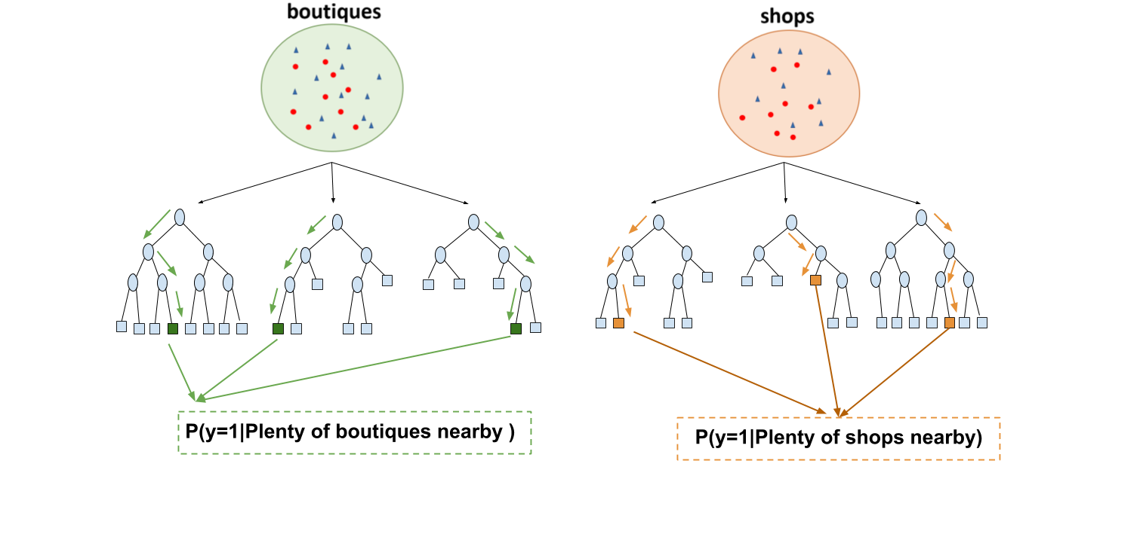

CF-RF: Counterfactual Random Forest
42 / 26

Slide 43
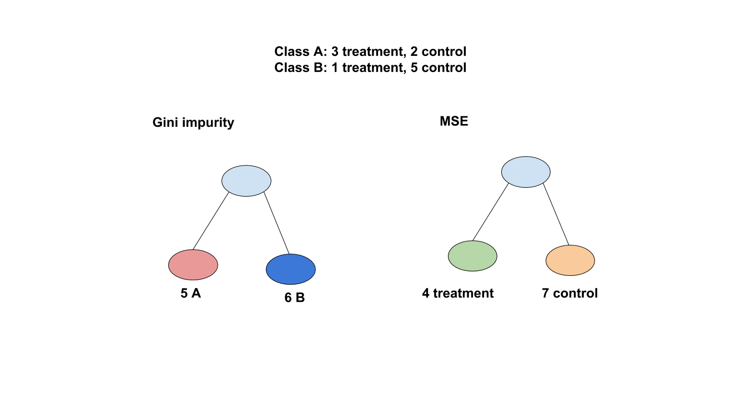
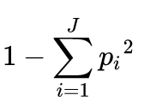
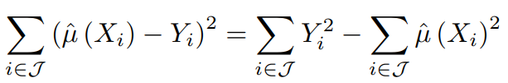
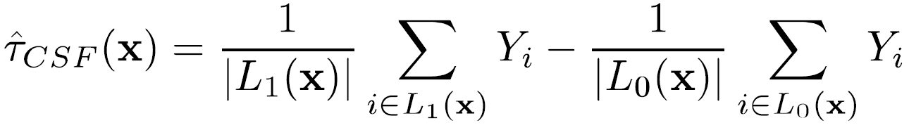
CSF: Causal Forest
43 / 26

Slide 44
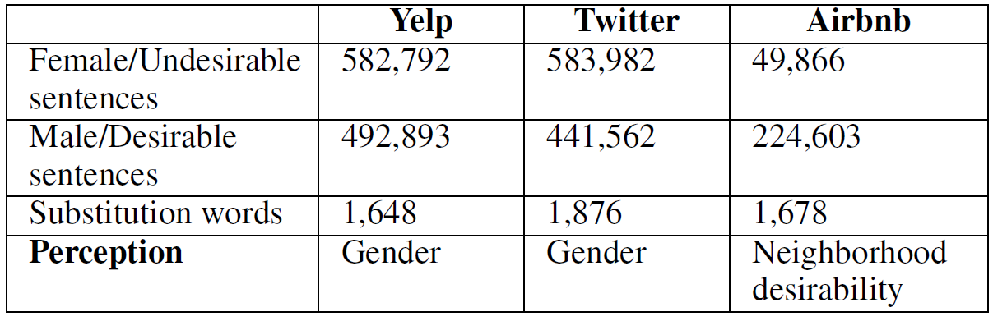
Datasets
44 / 26

Slide 45
Limitations
Crime rate as desirability
Single word substitution --> multiple word substitutions
Perception based on one sentence --> Perception based on documents

Slide 46
Conclusion example
Monday nights are a night of bonding for me and my boyfriend
Monday nights are a night of bonding for me and my buddy
If you ask me to hang out with you and your boyfriend, I will ... decline.
46 / 26

Slide 47
ITE: Individual Treatment Effect estimation
Treatment Effect Estimation:
RCT (A,B) test
Whether a drug is effective for a patient?
Can only observe one outcome per individual
Fundamental problems in observational study
47 / 26

Slide 48
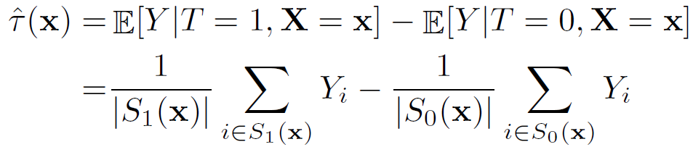

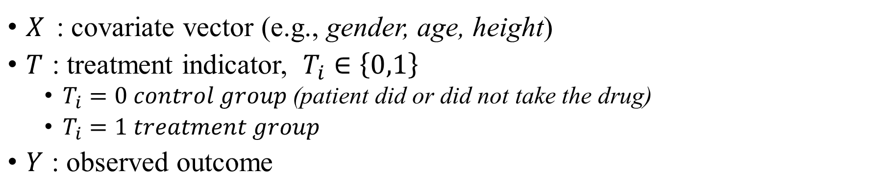
ITE: Individual Treatment Effect estimation
$X_{ }$ : covariate vector (e.g., gender, age, height)
$T_{ }$ : treatment indicator, $T_{i}∈\left\{0,1\right\}$
$T_{i}=0 control group$(patient did or did not take the drug)
$T_{i}=1 treatment group$
$Y_{ }$ : observed outcome
Strongly Ignorable Treatment Assignment (SITA):
48 / 26

