Slide 1
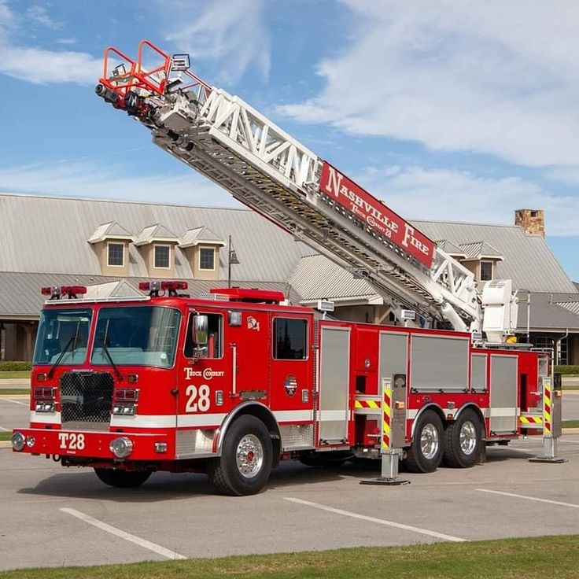
Barangay Vehicle
Management System
Evidence review and defense preparation
Illustrative vehicle mockup
24 October 2026
Notes:
Purpose: explain the seven evaluation criteria using evidence available as of 24 October 2026. Current application revision: 72d754c. This is a preparation deck, not a claim of completed field validation. Source: README.md; VMS Docs/Sample-Data.md; VMS Docs/System-Audit-2026-10-24.md. Cover photo: existing project mockup, backend-api/public/mockups/vehicles/firetruck-03-ladder-28.jpg. Asset licensing remains part of the documentation review.

Slide 2
Current assessment
Criterion | Current assessment
Originality and relevance | Relevant design. Community evidence still needed.
Research quality | Literature review, method and dataset unverified.
Technical quality | Local functionality demonstrated. Six findings remain open.
Results and validation | Technical evidence exists. Field effectiveness unverified.
Documentation and ethics | Technical references exist. Manuscript and permissions unverified.
Presentation and defense | Evidence available. Team understanding needs rehearsal.
Practical impact | Potential benefit. Deployment and adoption need validation.
2
Notes:
Use supported, partly supported and unverified as evidence descriptions, not numerical grades. Unverified means the reviewed materials did not establish the claim. It does not mean that the team has no such evidence elsewhere. Source: repository review at 72d754c; pasted assessment supplied by the user; VMS Docs/Must-Haves.md; System-Audit-2026-10-24.md.

Slide 3
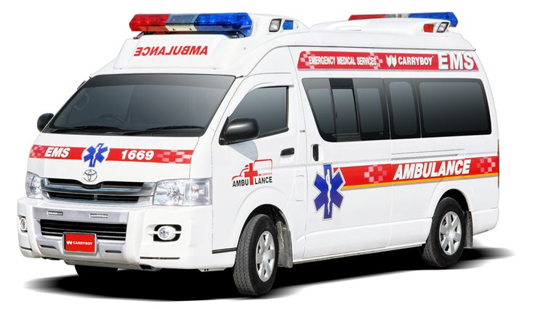
The problem and the intended users
System objective
Keep a current record of emergency-vehicle readiness and accountable maintenance.
Direct users
Barangay Admins, Custodians and Maintenance Personnel.
Evidence still needed
Interviews, current forms and real examples that establish the local problem.
Illustrative vehicle mockup
3
Notes:
Answer criteria 1b, 1c, 7a and 7b. Residents are potential indirect beneficiaries. Do not claim documented downtime or response delays unless the team has actual records. The repository defines the intended problem but does not establish how often it occurs in the community. Sources: README.md purpose and scope; VMS Docs/Documentation.md sections 1 and 3. Photo: bundled project mockup ambulance-01-hiace-carryboy.jpg.

Slide 4
A meaningful design contribution
Indicator | What it tells the user
Availability | Whether the vehicle is available or undergoing maintenance.
Physical condition | Whether it is Good, Needs Inspection or Needs Repair.
Verified readiness | Whether a recent checklist supports readiness for use.
The workflow also records repair responsibility and independent verification.
4
Notes:
Answer criterion 1a. These indicators describe different questions. Available alone does not certify verified readiness. A passing readiness check normally expires after 24 hours. Explain the contribution as an application suited to a barangay workflow. Do not claim global novelty or measured improvement over an existing process without comparative evidence. Source: System-Capabilities.md sections 3.1 and 3.7. Caveat: the stale-readiness finding after parts removal remains open, AUD-24-04.

Slide 5
Maintenance responsibility
Step | Responsible person | Recorded result
Proposal | Custodian | Pending Approval ticket with repair details.
Review | Admin | Approval, assignments or a decline reason.
Repair | Assigned mechanic | Repair log and supporting evidence.
Verification | Assigned Custodian | Independent check or return for rework.
Closure | System after approval | Closed ticket and maintenance history.
For external-shop repairs, the Admin handles the shop work. The handler cannot verify it.
5
Notes:
Explain the current ticket lifecycle. The proposing Custodian may later verify if independent of the repair. A second Custodian is not mandatory. A repairer cannot verify their own work. Different in-house sub-issues may have different assigned mechanics. External-shop handling stays within maintenance scope. Sources: TicketController.php; config/permissions.php; System-Capabilities.md section 5. The slide describes intended workflow guards and does not claim every authorization path is defect-free.

Slide 6
Related literature
Research theme | What the review must establish
Maintenance management | How comparable systems document repair and preventive work.
Emergency-fleet readiness | How studies distinguish availability from readiness.
Access and accountability | Why ownership checks and independent verification matter.
Research gap | What the barangay needs that existing approaches do not address.
A complete literature review was unavailable for verification.
6
Notes:
Answer criterion 2a. These are proposed review themes, not citations to studies already reviewed. The team needs authentic literature, a comparison matrix and a synthesis that connects evidence to its design. Do not invent studies or describe vendor pages as empirical evidence. The current review did not find a complete assessable manuscript in the supplied materials.

Slide 7
Research methodology
Part of the method | Evidence the team needs
Requirements gathering | Participants, interview guide and confirmed requirements.
Development process | Actual iterations, changes and reasons for design decisions.
Evaluation design | Representative roles, tasks, instruments and sampling rationale.
Data analysis | Scoring rules, task measures, dataset and stated limitations.
This is a proposed evidence plan. The team must document the method it actually followed.
7
Notes:
Answer criteria 2b and 2c. Do not label the project Agile or prototyping merely because it underwent revisions. Separate the software-development method from the research-evaluation method. Dashboard statistics are system output, not a substitute for research analysis. Choose analysis appropriate to the measures and participants, and justify the choices with the adviser.

Slide 8
System architecture
Component | Verified role or current status
React and Vite frontend | Role-based workspaces and maintenance interfaces.
Laravel API | Validation, permissions and workflow transitions.
Sanctum authentication | Bearer tokens identify authenticated accounts.
SQLite | Demonstrated local database and demo setup.
PostgreSQL and cloud storage | Deployment targets requiring target-host acceptance.
Maintainability limitation: much of the interface remains in one large Workspace component.
8
Notes:
Answer criterion 3a. Architecture, ERD and use-case files exist. Their existence does not certify complete alignment with current code. PostgreSQL/Supabase deployment is not established by the local SQLite demonstration. Sources: backend-api/composer.json; frontend-spa/package.json and package-lock.json; README.md; System-Architecture.svg; ERD.svg; Use-Case-Diagram.svg. Workspace.jsx remains a substantial maintenance concern.

Slide 9
Technical testing evidence
489
2,339
11
Backend tests passed
Assertions
Demo photo files matched
The frontend build passed in a separate checkout after dependency installation.
Recorded results at revision 72d754c. Existing tests do not close the six audit findings.
9
Notes:
Answer criterion 3d and the technical part of criterion 4a. These are recorded results from the preceding verification, not a newly conducted field study. Nine focused setup/sample checks contributed 94 assertions. A separate checkout installed locked Composer/npm dependencies, migrated and seeded SQLite, matched the semantic demo data and all 11 photo files, preserved environment files on rerun and created valid backups. Earlier reports include targeted browser checks. Sources: VMS Docs/Sample-Data.md verification section; backend-api/tests/Feature/SampleFleetSeederTest.php; SyncDemoTest.php. Test counts do not establish uptime, security completeness or user effectiveness.

Slide 10
Six open audit findings
ID | Priority | Finding
01 | High | A response can sign an inaccessible managed-file reference.
02 | High | Direct issue details bypass list visibility restrictions.
03 | High | Shared catalog edits affect other barangays and history.
04 | High | Parts removal leaves an earlier readiness pass current.
05 | Medium | CSV exports retain formula-leading untrusted text.
06 | Medium | Schedule completion accepts future dates.
Security and workflow acceptance remain incomplete until fixes pass rejection-based tests.
10
Notes:
Answer criterion 3c accurately. IDs abbreviate AUD-24-01 through AUD-24-06. Findings were reproduced in isolated investigation and remain open. Six passing investigation tests asserted defective behavior and therefore did not establish fixes. CSV spreadsheet behavior depends on the receiving application. Do not claim cross-barangay file access from the same-barangay signing probe. Source: VMS Docs/System-Audit-2026-10-24.md. Recent sample/setup changes do not resolve these issues.

Slide 11
Usability and error handling
Available evidence
Evaluation still needed
Role-focused workspaces and assigned tasks
Observe representative users completing tasks
Search, filters and inline field validation
Record errors, completion and help required
Server-side refusals for invalid actions
Explain failure messages and recovery paths
11
Notes:
Answer usability and error handling in criteria 3c and 3d. Existing features suggest attention to usability, but only actual evaluation can establish usability for target users. Use representative devices and accessibility needs. Test incorrect input, denied access, network loss and retry behavior as appropriate. Do not convert a developer walkthrough into a user satisfaction result. Sources: System-Capabilities.md interface conventions; backend feature tests; Must-Haves.md acceptance section.

Slide 12
Results and validation
Supported claim | Evidence still needed for stronger claims
Core maintenance workflows run locally. | User acceptance with representative roles and records.
The shared demo can be recreated. | A deployment pilot with actual operating constraints.
SQLite backup creation was demonstrated. | Restore verification and recovery on the target host.
Tests check selected controls and failures. | Coverage of open findings, load and service interruptions.
Reduced downtime, faster response and higher productivity remain unmeasured outcomes.
12
Notes:
Answer criteria 3b and 4a. Technical operation differs from effectiveness in a real barangay. For example, compare how long staff need to locate current vehicle readiness using the existing process versus the system. Predefine tasks and metrics before gathering results. Keep raw anonymized data, expected/actual test results and participant feedback. Never invent UAT respondents, scores or improvement percentages. Source: Must-Haves.md acceptance checks; Sample-Data.md; System-Audit-2026-10-24.md.

Slide 13
Documentation, permissions and privacy
Current position
Required evidence
Technical references and diagrams exist
Align manuscript, slides, manuals and code
The full manuscript and citation list remain unverified
Confirm data and image-use authorization
Permission and participant records remain unverified
Define lawful basis, access, retention and deletion
Technical access controls alone do not establish privacy compliance.
13
Notes:
Answer criteria 5a, 5b and 5c. Review every citation against the reference list and verify that the source supports the claim. Older impersonation descriptions remain inconsistent with the current dedicated Account Switcher permission. Obtain the relevant barangay/institutional authorization and participant information/consent where appropriate. A permission letter does not replace lawful processing requirements. Philippine data privacy principles include transparency, legitimate purpose and proportionality. Consent is one lawful basis, not the only one. Official source: https://privacy.gov.ph/data-privacy-act/ sections 11, 12 and 20, checked 24 October 2026. Have the adviser and responsible barangay official confirm the applicable arrangements. Also verify asset licensing.

Slide 14
AI assistance and accountability
AI assistance contributed to code, debugging, tests and documentation.
Disclosure
Identify the tools, their actual uses and the affected work.
Team responsibility
Explain what each proponent personally reviewed and verified.
Academic requirements
Follow the institution's disclosure policy and keep supporting records.
14
Notes:
Answer criterion 5d. AI assistance is confirmed by this work session. Do not claim that all code was manually authored, or that the proponents personally reviewed every contribution, without evidence. Automated tests and AI review do not replace the team understanding its work. This slide discloses actual categories of assistance, while the team still needs to complete a full tool/use/verification record according to school policy.

Slide 15
Presentation and defense
Panel question | Evidence the team should use
Why separate availability and readiness? | Explain the three indicators using a sample vehicle.
Who may verify a repair? | Show assignment and self-verification restrictions.
How did you evaluate the system? | Show test results, coverage limits and any actual UAT.
What remains unfinished? | Show the open audit, research gaps and deployment checks.
Every member should explain the method and results in their own words.
15
Notes:
Answer criteria 6a through 6d. A clear opening: Barangay VMS supports emergency-fleet readiness and maintenance accountability through reported defects, approved repair work and independent verification. Follow this with evidence of the actual community problem. Rehearse a maintenance demonstration with expected states and a return-for-rework branch. The existence of this presentation cannot establish the proponents understanding or their live delivery.

Slide 16
Staffing and operational feasibility
Situation | Current workflow response
One mechanic and one Custodian | The mechanic repairs. The Custodian independently verifies.
Mechanic unavailable | Admin assigns another qualified mechanic or repair work waits.
Custodian unavailable | Admin reassigns to another Custodian or verification waits.
One person holds both roles | That person cannot verify their own repairs.
The Admin cannot use impersonation to perform work under an absent employee's name.
16
Notes:
Answer practical feasibility and likely defense questions. Admin alone does not hold impersonation.start. The separate Account Switcher can switch accounts for demonstration/support. Its impersonation writes are blocked outside local development. A genuinely authorized backup Custodian may be a multi-role account, but the system still requires assignment and independence from the repair or external handling. Sources: config/permissions.php; AuthController.php canImpersonate; RestrictImpersonatedToReadOnly.php; TicketController.php verifier guards.

Slide 17

Practical impact and scope
Intended benefit
Traceable maintenance work and clearer readiness information for barangay staff.
Adoption requirements
Connectivity, suitable devices, training, support ownership and backup staff.
Current scope
Fleet readiness and maintenance. Dispatch, compliance expiry and mileage planning remain outside scope.
Illustrative vehicle mockup
17
Notes:
Answer criteria 7a through 7d. Residents may indirectly benefit from better maintained vehicles, but the project has not measured that outcome. Cost, hosting, connectivity and training must be assessed for the intended deployment. No offline operation has been demonstrated. Real target-host storage and restoration acceptance remain open. Sources: README.md scope; Must-Haves.md acceptance section; System-Audit-2026-10-24.md. Photo: bundled project mockup ambulance-02-sprinter.jpg.

Slide 18
Work required before acceptance
Priority | Deliverable
1. Known defects | Fix the six findings and retain tests that reject the failures.
2. Research foundation | Verify the local problem, literature synthesis and actual method.
3. User evaluation | Collect representative task results and feedback.
4. Deployment evidence | Demonstrate storage, persistence, restore and failure recovery.
5. Defense package | Align the manuscript, citations, permissions and AI disclosure.
The prototype has technical evidence. Research and deployment acceptance still need evidence.
18
Notes:
Suggested preparation order, not a promise that no other defects exist. Resolve safety and authorization findings before collecting sensitive real operational records. Do not expand features to avoid the current gaps. The team and adviser should approve an achievable evaluation plan and acceptance criteria. Sources: System-Audit-2026-10-24.md retest order; Must-Haves.md acceptance checks; Sample-Data.md verification results.

Slide 19
Evidence and references
Technical evidence
Sample-Data.md: setup reproduction and 489-test result
backend-api/tests/Feature/: workflow and failure tests
Current limitations
System-Audit-2026-10-24.md: six open findings
Must-Haves.md: outstanding acceptance criteria
Design references
README.md, Documentation.md and System-Capabilities.md
Architecture, ERD and use-case diagrams
Privacy source
National Privacy Commission, Republic Act No. 10173
privacy.gov.ph/data-privacy-act/
19
Notes:
All repository paths refer to the V2-VMS project at revision 72d754c unless a dated audit specifies its earlier reviewed revision. Living documents and old generated PDFs may differ. Use current code and dated evidence to resolve disagreement. External source: National Privacy Commission, Republic Act 10173, https://privacy.gov.ph/data-privacy-act/, checked 24 October 2026. Speaker notes identify the source and limits for each substantive slide. The complete research manuscript, literature bibliography, signed UAT dataset and permission records were not available to this review.

