Slide 1
Cost Overview for Planning Ideas and Logical Organization Tool (CO-PILOT): Overview and User’s Guide
January 2015

Slide 2
Outline
Background
Purpose
Tool Scope
Methodology Summary
Scope and Assumptions Details
Detailed User Instructions
Contact Information
Privacy Policy

Slide 3
Background
In March 2014, the U.S. Department of Transportation (USDOT) published a Request for Information (RFI) for the Connected Vehicle Pilot Deployment Program, to seek comments and innovative ideas from the public sector, private sector, and academic communities on the program.
The pilot deployments combine connected vehicle and mobile device technologies innovations to improve traveler mobility and system productivity, while reducing environmental impacts and enhancing safety.
The Department's Intelligent Transportation Systems Joint Program Office (ITS JPO) in conjunction with the Federal Highway Administration (FHWA) anticipates a procurement action for one or more pilot deployment concepts in 2015
Notes:
See http://www.its.dot.gov/press/2014/vehicle_pilot.htm and https://www.federalregister.gov/articles/2014/03/12/2014-05414/connected-vehicle-pilot-deployment-program-request-for-information for more information.

Slide 4
Purpose
The USDOT is developing a high-level cost estimation tool called the Cost Overview for Planning Ideas and Logical Organization Tool (CO-PILOT) to support stakeholders considering connected vehicle pilot deployments.
The CO-PILOT allows stakeholders to estimate the costs of proposed pilot deployments at a high level, both to refine deployment plans and to reduce the risk that the requested Federal cost share will exceed the pilot deployment grant ceiling
Guidance on pilot budgets was recently posted to the FAQ site (http://www.its.dot.gov/pilots/cv_pilot_faq.htm)
Disclaimer: CO-PILOT is intended for high-level, preliminary planning purposes to support Connected Vehicle Pilot Deployment cost estimation. Outputs are intended to support long-range budget planning and do not replace detailed cost proposals required for Concept Development (Phase 1), Design/Build/Test (Phase 2), or Maintain and Operate (Phase 3).
Notes:
Short Form
DISCLAIMER: CO-PILOT is intended for high-level, preliminary planning purposes to support full three-phase Connected Vehicle Pilot Deployment cost estimation ONLY, not detailed cost proposal preparation.

Slide 5
Tool Scope
The CO-PILOT v1.0 (https://co-pilot.noblis.org) allows high-level cost estimation for 56 applications listed at http://www.its.dot.gov/pilots/cv_pilot_apps.htm.
Notes:
Decided to do G+S+H since there is more overlap and synergy from the deployed capabilities (both vehicle and infrastructure side)

Slide 6
Methodology Summary
CO-PILOT Development Phase Research
CO-PILOT Simulation Execution
Identify Building Blocks and Cost Components
Estimate Cost Parameters
Determine Quantities
Sample Unit Costs
Develop Total Cost Distribution
CO-PILOT developers identified the Building Blocks and Cost Components associated with each of the applications
Building Blocks are locations / entities that require components for an application, e.g., Signalized Intersections, Transit Vehicles, Multimodal Travelers, etc.
Cost Components are individual elements at a Building Block, e.g., for Signalized Intersections the Cost Components may include detection systems, Roadside Equipment (RSEs), etc.
This data was reviewed / revised with application SMEs
CO-PILOT developers estimated cost parameters (mode, min, max) for each component, primarily using AASHTO National CV Field Infrastructure Footprint Analysis Final Report (Draft v1, May 2014).
Secondary sources: application SME input, vendor/ other web sites
CO-PILOT developers fit a triangular distribution for each component; when min and max values not available, assume a 50% spread on either side of the mode
CO-PILOT determines the quantities required for each Cost Component during simulation execution, based on user input on applications and Building Block quantities.
If multiple apps at a Building Block each require one (or n_{app}) of a particular Component, then only one (or max n_{app}) of these Components is needed to cover all apps there, with some exceptions
For each Component, CO-PILOT simulation samples unit costs from distribution, with replications
If user has modified the default average cost, CO-PILOT assumes the cost is fixed
CO-PILOT multiplies quantities by unit costs for each replication
Develops total cost distribution across replications, to give the user a concept of the possible total cost distribution for their deployment
Summarizes distribution results by Building Block and details cost by component.

Slide 7
Scope and Assumptions Details
CO-PILOT Scope details:
CO-PILOT estimates one-time expenditures to purchase and install equipment, develop software, and train personnel
Systems Engineering costs are also included, at 14% of total Deployment costs
Systems Engineering includes Concept Development, System Requirements, System Requirements Specification (SyRS), Architecture, System Design, Systems Security Costs (SCMS) and Integration.
Self-evaluation is also included in Systems Engineering. Independent evaluation is separate, and would not come out of grant funds
Outreach costs are included to cover site visitors, videos, websites, etc., at 6% of total Deployment costs
Operations and Maintenance (O&M) costs during the deployment period are included
O&M costs that are itemized are:
Mobile cellular data plan costs when cellular communications are used (see assumptions on slide 10)
Application support
Remaining O&M costs are included as a fixed percentage (7%) of total one-time expenditures (equipment, software development, Systems Engineering)
The requested government share may be a portion of the cost estimated by CO-PILOT

Slide 8
Scope and Assumptions Details (cont.)
CO-PILOT’s assumptions on components required for the applications, computation of overall component quantities required, and component costs are described on the following slides
CO-PILOT is sufficiently flexible to enable changing these assumptions, if needed

Slide 9
Scope and Assumptions Details (cont.)
Assumptions on Building Blocks:
The Freeway Segments are a length such that if DSRC is used, one RSE is generally required. A typical assumption is 1 RSE per mile on freeways. An exception is for curves, where it is assumed that 2 RSEs are required – one at each end of the curve
CO-PILOT does not have an “eco-lane” Building Block. Applications requiring dedicated lanes such as an “eco-lane” use the Freeway Segment Building Block within CO-PILOT
Assumptions on components required by application:
Generally non-safety related applications can use the cheaper Inductive Loop Detectors if detection capabilities are required; the safety applications generally require Optical Detection Systems
Most applications will use Dedicated Short Range Communications (DSRC); some Agency Data, Environment, Road Weather, and Mobility applications will use cellular communications. The Help page provides a spreadsheet with all detailed assumptions, including communications technology assumed for each application
Some components, e.g., such as Data Storage Systems, are not included in CO-PILOT; the user can incorporate such components if needed in Step 4
Software licensing costs are included. Many of the applications will have no licensing costs; not necessarily true for those developed using private funding.

Slide 10
Scope and Assumptions Details (cont.)
Assumptions on components required by application (cont.):
There are some components listed in the CO-PILOT Step 4 with quantity = 0. These are optional items, and users can modify to have a non-zero quantity if desired.
Items may be considered “optional” for several reasons. Either the functionality is considered optional for the application, or it is questionable that the pilot deployment would fund a particular component. For example, a Multimodal Traveler’s cellular phone costs would most likely NOT be funded by the pilot deployment, as individuals would use their existing phones and associated data plans.
Assumptions on funding of components needed for cellular communications, for applications that use cellular rather than DSRC:
For Agency Data apps that use cellular communications, assume the grant funds pay for cellular devices and data plans for all users (as they are state DOT employees, etc.)
For other apps (not Agency Data) that use cellular, assume grant funds pay for the following:
Devices and Data plans for Transit drivers, as they are DOT employees.
For Light vehicle drivers, Truck drivers, and Multimodal travelers: assume that these are individuals or commercial drivers, so grant funds pay for Data plans only if the app requires the user to send large amounts of data. Typically if the app just receives information, it will be a small amount and not increase their data usage, so no need to pay for it.
Quantities of cost components in CO-PILOT can be adjusted in Step 4 if these assumptions are not valid.

Slide 11
Scope and Assumptions Details (cont.)
Assumptions on component quantities overall:
If the same component is present at a Building Block for multiple applications, that component can cover all applications at the Building Block. For example:
If 1 RSE is needed at each Signalized Intersection for Red Light Violation Warning, and 1 RSE is needed at each Signalized Intersection for Eco-Approach and Departure at Signalized Intersections, then only 1 RSE is needed at each Signalized Intersection to cover both apps, rather than two.
If there are applications that require Inductive Loop Detectors at a Building Block (Intersections or Freeway Segments), and also applications that require an Optical Detection System at the same Building Block, the Inductive Loop Detectors won't be needed and the Optical Detection System will provide the full functionality needed.
For Driver training, if the training hours is x for an application, then the training hours for subsequent applications on that vehicle type is x/2. We assume in general that x=2 training hours are required for an application on a specific vehicle type, and half of that time is general training that applies to all applications on that vehicle type, so subsequent applications on that vehicle type will require only 1 hour of training each.
Software development and testing is conducted separately for each application, and is a separate cost component for each application. It is assumed that the software is integrated during the Systems Engineering process, so for licensing for individual vehicles, the software package is a single cost component that covers all applications.

Slide 12
Scope and Assumptions Details (cont.)
Assumptions on component costs:
Compensation for Driver Training time is based on payment for the hours spent in training, at hourly wages from the Bureau of Labor Statistics
When unit cost estimates were derived from previous deployment costs (e.g., costs in the AASHTO National Connected Vehicle Field Infrastructure Footprint Analysis Final Report) the costs were not adjusted to current dollars, as these deployments were fairly recent and technology products may not be expected to vary with inflation as other products do. An exception is a Transit Bus cost from a dated USDOT report, which was adjusted to current dollars.
See the Connected Vehicle Cost Components detail spreadsheet at the CO-PILOT Help page for more information on component costs and components required by application

Slide 13
Detailed User Instructions

Slide 14
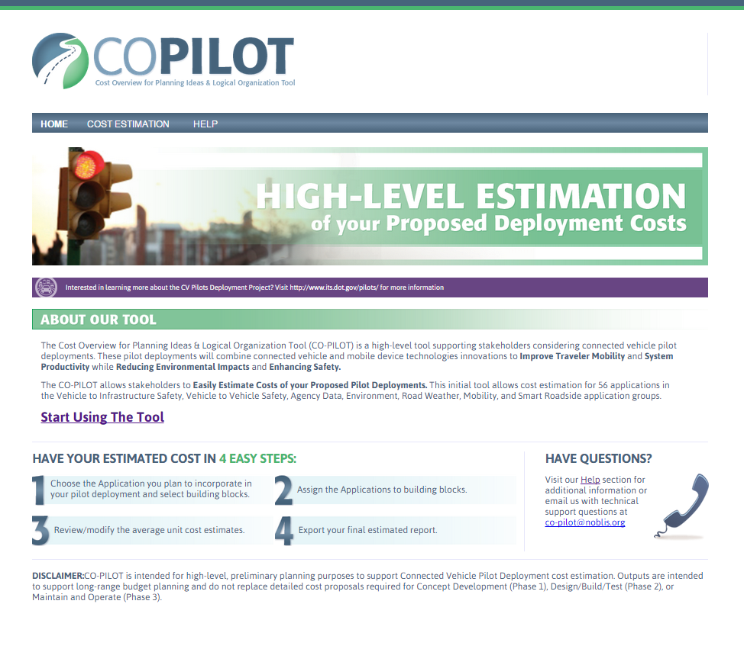
CO-PILOT Home Page
CO-PILOT Home page is at https://co-pilot.noblis.org
Link to this tool is available at http://www.its.dot.gov/pilots
Example for demonstration purposes in following slides is similar to the “Sunnyside” scenario at http://www.its.dot.gov/pilots/Sunnyside_v1.mp4

Slide 15
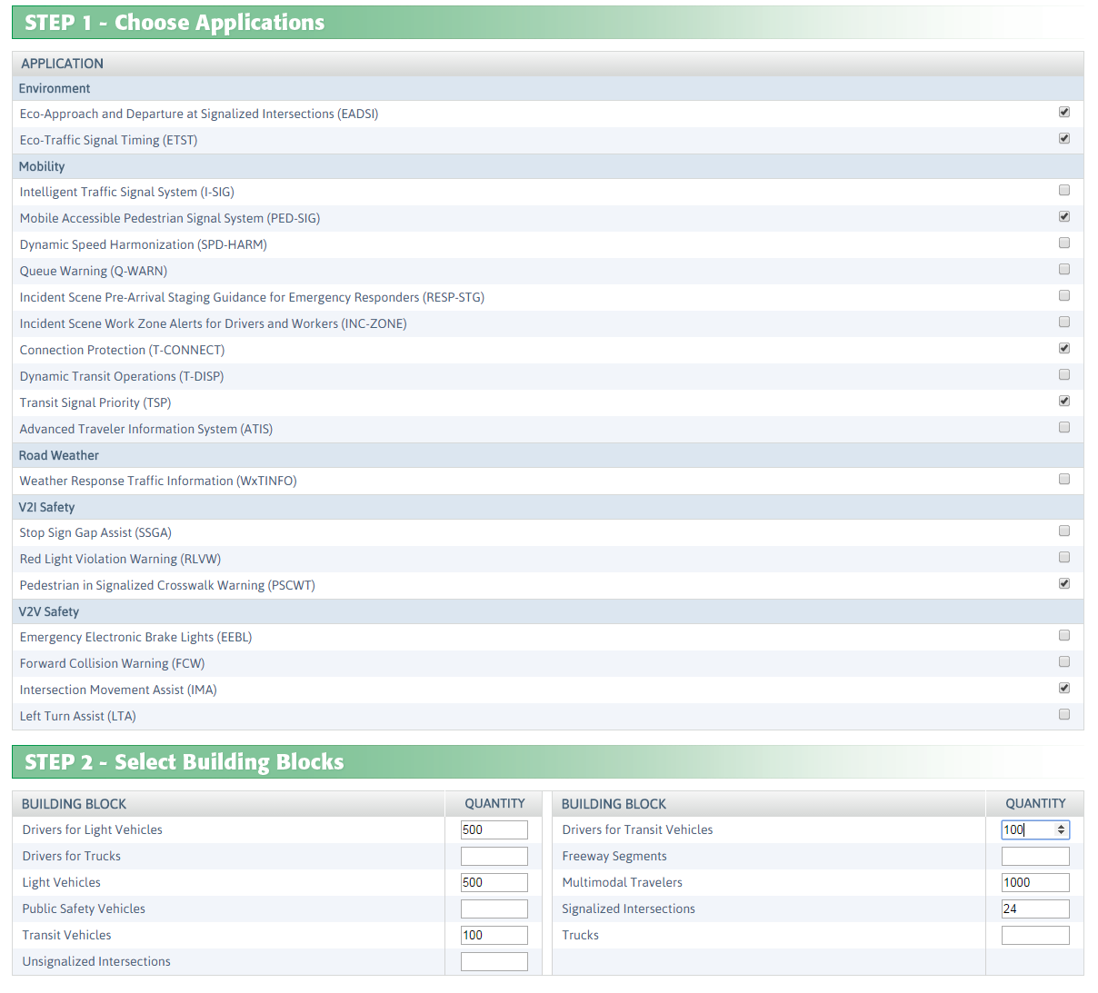
Application and Building Block Selection
Step 1: Select Applications
Step 2: Specify quantities for each Building Block
Note that only Building Blocks that are associated with the applications you have selected in Step 1 can be utilized in Step 2
Notes:
Possibly allow an “Other” app? Maybe this is an enhancement later if more funding
Due to time / budget, am currently dropping the idea of letting the user provide information on how they came up with the modified costs, if they modify the defaults.

Slide 16
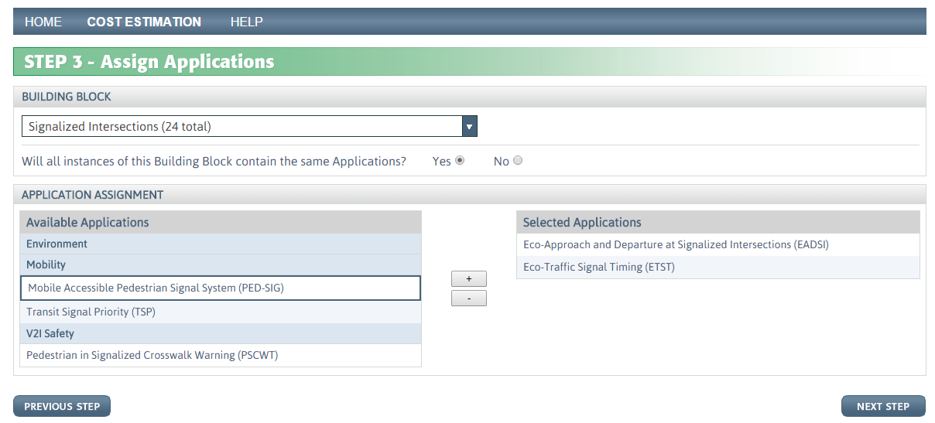
Assign Applications to Building Blocks
Step 3: Assign Applications to Building Blocks
Select each Building Block sequentially using the drop down list at the top of Step 3
All instances of a Building Block can have identical Application sets, or not. If all instances of a Building Block have the same applications, select “Yes” in response to the question “Will all instances of the Building Block contain the same Applications?”
User then highlights applications from the Available Applications list at left and uses the “+” to add to the Selected Applications list at right
The list of Available Applications is filtered to include only applications selected in Step 1, and further filtered to include only applications that use the selected Building Block
After completing these Application selections for a particular Building Block, use the drop down list at the top of Step 3 to similarly select the next Building Block and assign Applications to it
When all Building Blocks have applications assigned to them, click on the Next Step button
Note: the “Next Step” button is disabled until you’ve selected at least one application for each building block

Slide 17
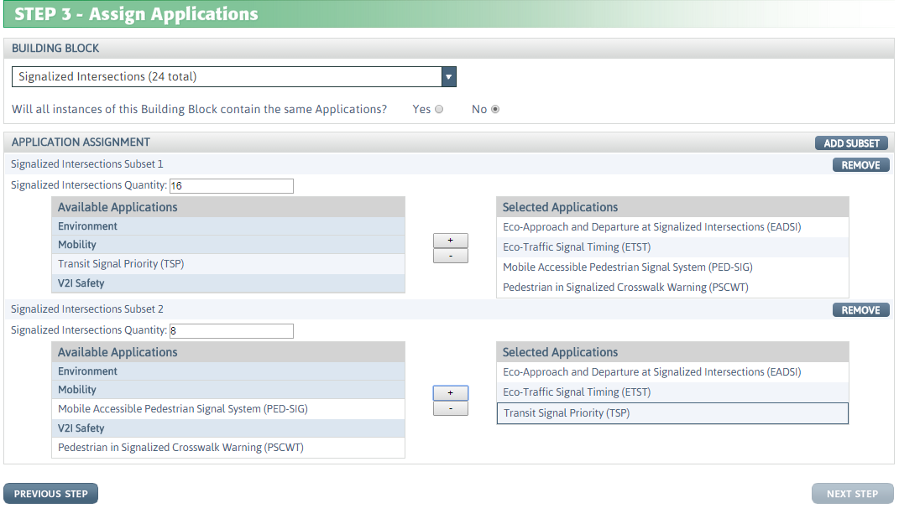
Assign Applications to Building Blocks (cont.)
Step 3: Assign Applications to Building Blocks (cont.)
If subsets of a Building Block have the same applications, rather than all instances of the Building Block, User selects “No” in response to the question “Will all instances of the Building Block contain the same Applications?”
User then proceeds to select Applications for this Building Block subset, and then for the other subsets for this Building Block
Click on the “Add Subset” button if more than two subsets are required
When all Building Blocks have applications assigned to them, click on the Next Step button

Slide 18
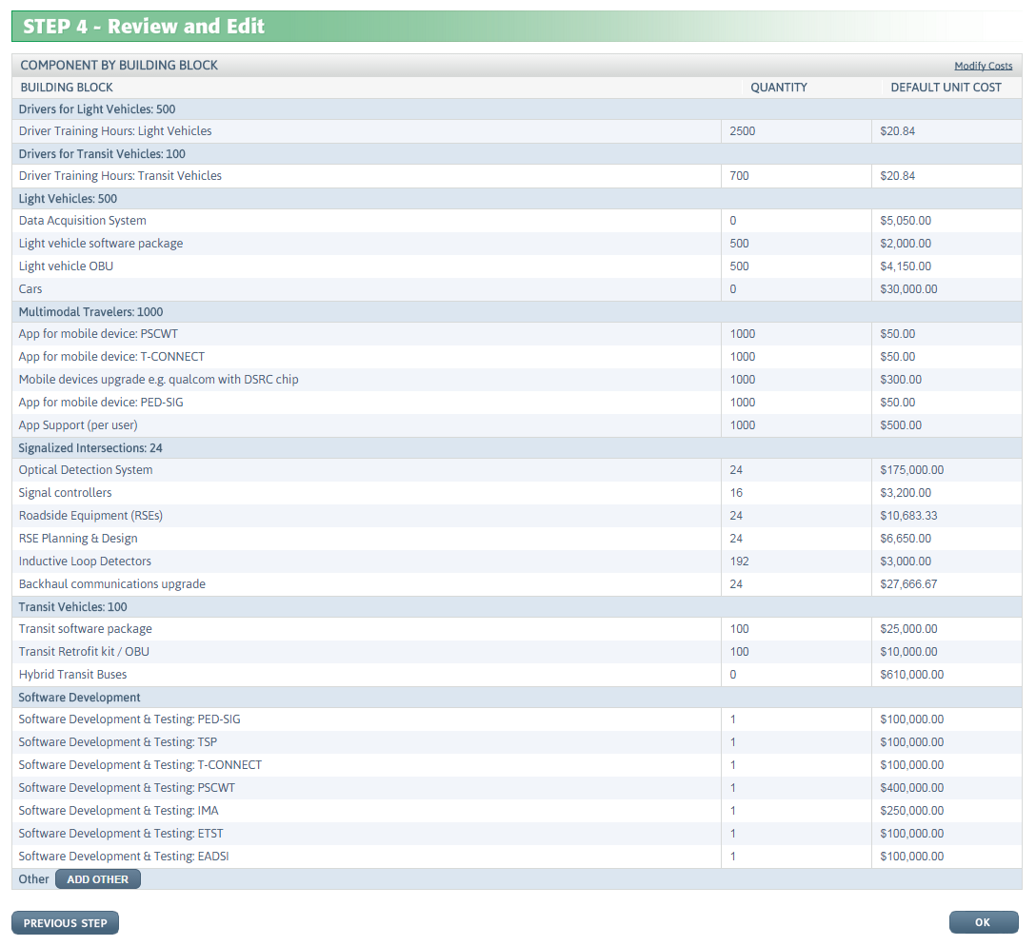
Review and Edit Component Quantities and Costs
Step 4: Review and Edit, if necessary
Quantities of each Cost Component at each Building Block (or each Building Block subset) are computed internally, and then presented to the user.
CO-PILOT assumes that if multiple apps at a Building Block each require one of a particular Component, only one of these Components is needed to cover all apps there, with some exceptions
In Step 4, user will be able to change the Quantities, Default Unit Costs, or add an “Other” cost component.
If Unit Costs are changed, the Cost Estimation will assume that cost is fixed rather than simulated by selecting randomly from a distribution
Click OK when modifications are completed
Notes:
Exceptions:
If there are app(s) that require regular Detectors at Signalized Intersections, and also app(s) that require Optical Detection Systems at the same Signalized Intersections, assume the regular Detectors won't be needed.
For Driver training, assume that if the training hours is x for an application, then the training hours for subsequent applications on that vehicle type is x/2

Slide 19
CO-PILOT Execution
CO-PILOT next executes n runs of the Monte Carlo simulation to account for uncertainty in both unit and overall costs. Each of the n runs will do the following:
The triangular distribution will be used to generate a unit cost for each cost component, using the mode, min, and max parameters in the database, or using fixed unit cost values if edited by the user
Unit costs for each component will be multiplied by component quantities to get a total cost estimate for each component

Slide 20
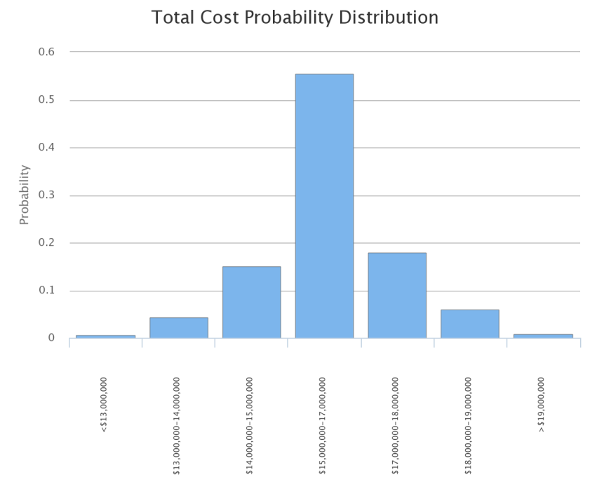
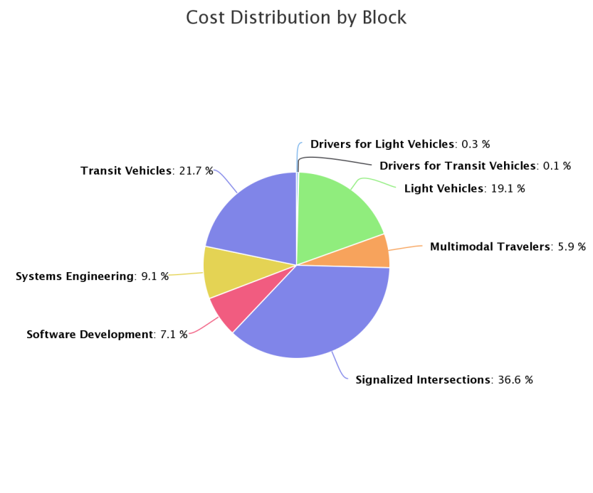
CO-PILOT Output
CO-PILOT presents the outputs (across the n simulation runs) as follows:
Histogram of the total project cost probability distribution – this example shows that there is very small chance of the costs exceeding $19M
Pie chart shows the cost distribution by building block on average – for this example, 36.6% of the costs are due to components at Signalized Intersections
Spreadsheet output (not shown) shows for each component the quantities, average input unit costs, average simulated unit costs, and average simulated total costs
The “simulated” costs are a result of the random sampling during the simulation, and will not exactly match the “input” costs
User can adjust the pilot design using the detail in the spreadsheet, if desired, or by modifying in CO-PILOT

Slide 21
CO-PILOT Upload
An existing CO-PILOT output spreadsheet can be uploaded into CO-PILOT, to expedite data entry for future runs
See “Have an existing CO-PILOT output spreadsheet?” at the upper right corner of the Cost Estimation pages
Click “Browse” to select the spreadsheet saved on your computer, then click Upload
Data in the spreadsheet is used to populate inputs in Steps 1 – 3, which can then be modified if desired

Slide 22
Contact Information
For assistance, please email co-pilot@noblis.org.

Slide 23
Privacy Policy
Noblis, Inc. ("Noblis") is committed to protecting your privacy. Please read this Privacy Policy for more details about how we use information you submit to the CO-PILOT website (“CO-PILOT”). This Privacy Policy constitutes the entire agreement between you and Noblis relating to the CO-PILOT website. By your use of CO-PILOT, you consent to be governed by this Privacy Policy.
1. Personally Identifiable Information
You can visit the CO-PILOT website without disclosing any information about yourself. Registration or login is not required to use CO-PILOT.
2. Connected Vehicle Pilot Deployment Information
We do not collect or store information on the Connected Vehicle Pilot Deployment scenarios or costs that you input to CO-PILOT.
3. Aggregated Information
To evaluate CO-PILOT and ensure that we are providing a tool of interest to you, we may collect and store statistical information regarding how you use CO-PILOT, the Internet Protocol address, the name of your Internet Service Provider, operating system, the website that referred you to CO-PILOT, and the time, date, and frequency that you view CO-PILOT. We may share this aggregated, statistical information with our other third-parties.
4. Disclosure for Lawful Purposes
Noblis reserves the right to access and disclose Aggregated Information to comply with applicable laws and lawful government requests, to operate its systems properly, or to protect itself or others.
5. Notification of Changes
Noblis reserves the right to modify this Privacy Policy at any time. Please review this Policy from time to time to ensure your familiarity with its terms. If you have any questions about this Privacy Policy, please contact co-pilot@noblis.org.

