Slide 1
Simple Offline Servicing for Windows 10 and Server 2019 and Server 2016 and Windows 7 and Server 2012 R2
https://www.osdeploy.com
@SeguraOSD

Slide 2
About the Speaker
20+ years Enterprise Experience
Expert in Enterprise OS Deployments
ConfigMgr, MDT, and Offline Deployments
Expert in Enterprise OS Customization
Custom Deployment Scripts and Group Policy
Presented at HASMUG, CTSMUG, DFWSMUG, and ExpertsLiveUS
Presenting at MMSMOA 2019
Thrice Nominated for Microsoft MVP

Slide 3
What is Offline Servicing?
Mount a WIM (OS or WinPE)
Do Something
Save the WIM

Slide 4
What is Offline Servicing OS Update Process?
Mount a WIM (OS or WinPE)
Apply Servicing Stack(s)
Apply Cumulative Update
Apply Adobe Security Update
Apply Dynamic Component Update(s)
Expand Dynamic Setup Update
Save the WIM

Slide 5
Why do I need to Update my Deployment OS?
MSDN and MVLS ISO’s are out of date
Applying Cumulative Updates during OS Deployment take a compounded amount of time
ConfigMgr does not perform Image Cleanup, this creating large WIMs
Dynamic Updates are needed to prevent Upgrade failure

Slide 6
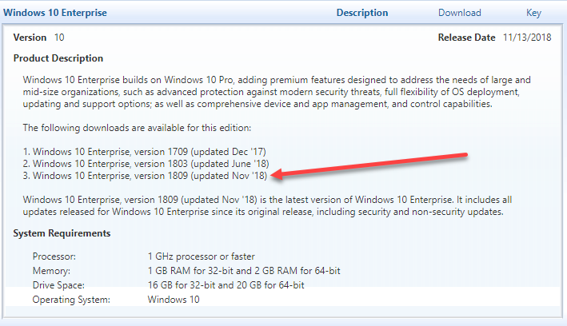
MVLS Images are not Updated

Slide 7
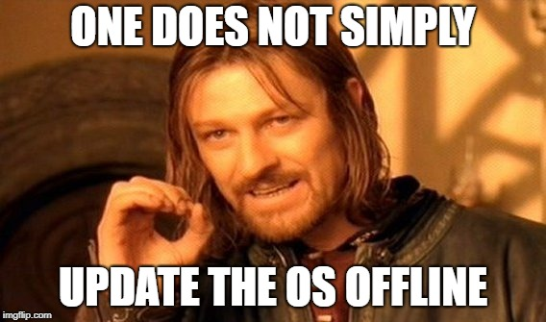
Is there a Simple Solution?

Slide 8
OSBuilder PowerShell Module
PowerShell Gallery
https://www.powershellgallery.com/packages/OSBuilder
Install-Module –Name OSBuilder –Scope CurrentUser
https://www.osdeploy.com/osbuilder/installation

Slide 9
Import-OSMedia
Extracts a single Windows Image index into OSMedia

Slide 10
Import-OSMedia Demo
10 Minutes (with 30 seconds of work)

Slide 11
Import-OSMedia
PowerShell Command Line
Import-OSMedia

Slide 12
Import-OSMedia
Extracts and Imports a single Windows Image index into OSMedia
Extracts all WinPE WIMs
Generates a full inventory of the Operating System
Full Windows Image Information including UBR
Appx Provisioned Packages
Windows Packages
Windows Capabilities
Windows Optional Features
Windows Update Packages

Slide 13
So how do we update this OSMedia?
Apply Dynamic Setup Update
Apply SSU and LCU to WinPE, WinRE, and WinSE (Windows Setup)
Apply SSU (Servicing Stack Updates)
Apply LCU (Latest Cumulative Update)
Apply ASU (Adobe Security Update)
Apply Dynamic Component Updates

Slide 14
Update-OSMedia Demo
60 Minutes (with 30 seconds of work)

Slide 15
Update-OSMedia
PowerShell Command Line
Update-OSMedia –DownloadUpdates –Execute

Slide 16
OSBuilder Update Cycle
Import
OS Media
Update
OS Media
Customize OS
Customized
OS Build
Download New Updates
Download New Updates
Update
OS Media
Customize OS
Customized
OS Build
Download New Updates
Update
OS Media
Customize OS
Customized
OS Build

Slide 17

Customize OS?

Slide 18
An OSBuild can … mess with Components
Enable NetFX 3.5
Remove Appx Provisioned Packages
Enable Windows Optional Features
Disable Windows Optional Features
Add Windows Capabilities
Remove Windows Capabilities
Add Windows Packages
Remove Windows Packages

Slide 19
An OSBuild can … win WinPE over
Add WinPE Drivers
Add WinPE Packages
Add WinPE DaRT
Customize WinPE using PowerShell Scripts
Customize WinPE using ExtraFiles

Slide 20
An OSBuild can … fine tune the OS
Add Windows Drivers
Add Start Layout
Use Windows Unattend.xml (not that cool)
Customize Windows using PowerShell Scripts
Modify the Registry
Add Features On Demand

Slide 21
An OSBuild can … speak several languages
Add Language Packs
Add Language Interface Packs
Add Language Experience Packs
Add Language Features on Demand
Set default Languages
Set default Locale

Slide 22
New-OSBuildTask Demo
2 Minutes (with 2 minutes of work)

Slide 23
New-OSBuild Demo
20 Minutes (with 30 seconds of work)

Slide 24
New Feature: OSBuild Templates Demo
5 Minutes (with 1 minute of work)

Slide 25
New Feature: OSBuild Registry Demo
5 Minutes (with 5 minutes of work)

Slide 26
New-OSBuild Demo
2 Minutes (with 2 minutes of work)

Slide 27
Other OSBuilder Features
Full Logging of all actions
Automatic Download of Updates
Task Based
Create a Bootable ISO
Create a Bootable USB

Slide 28
New-PEBuild
Create a Recovery Image
Create a WinPE Boot Image
Create an MDT Boot Image
DaRT can be applied to all Boot Images
Drivers, Extra Files, Custom Scripts, ADK Packages . . .

Slide 29
OSBuilder SASMUG Demo

Slide 30
Q and A
https://www.osdeploy.com/osbuilder/overview

Slide 31
Thank You SASMUG, Microsoft and the Sponsors!
https://www.osdeploy.com/osbuilder/overview

