Slide 1
Windows 10 Offline Servicing
@SeguraOSD
https://www.osdeploy.com

Slide 2
About the Speaker
20+ years in Enterprise OS Deployment
Expert in Enterprise OS Deployments
ConfigMgr, MDT, and Offline Deployments
Expert in Enterprise OS Customization
Custom Deployment Scripts and Group Policy
PowerShell and VBS geek
Studied at Harvard and Oxford
https://www.osdeploy.com

Slide 3
What is Offline Servicing?
https://www.osdeploy.com

Slide 4
What is Offline Servicing?
Mount a WIM
Install Servicing Stack Updates
Install Cumulative Updates
Inject Files
Save WIM Changes
https://www.osdeploy.com/osbuilder/knowledge/offline-servicing

Slide 5
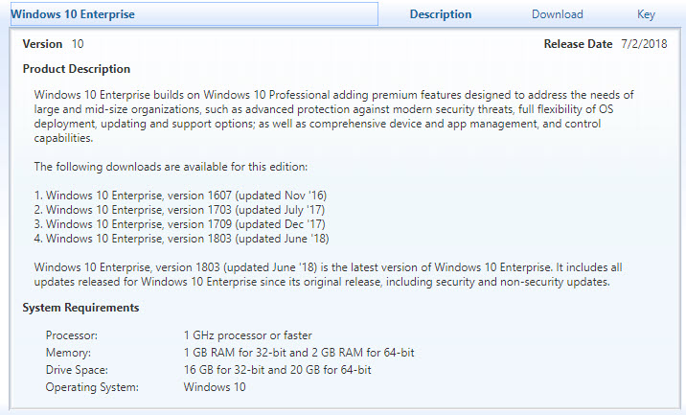
RTM Images are not updated regularly
https://www.osdeploy.com/osbuilder/knowledge/offline-servicing

Slide 6
What is the typical Offline Servicing process?
Mount the install.wim
Apply the latest Cumulative Update
Save the install.wim
This fails because the Cumulative Update did not really install due to not installing the Servicing Stack first!
https://www.osdeploy.com/osbuilder/knowledge/offline-servicing

Slide 7
What are Servicing Stacks?
https://www.osdeploy.com

Slide 8
What are Servicing Stacks?
A Servicing Stack tells Windows how to process a Windows Update Package (Cumulative Update)
Required for some Cumulative Updates
https://www.osdeploy.com/osbuilder/knowledge/servicing-stacks

Slide 9
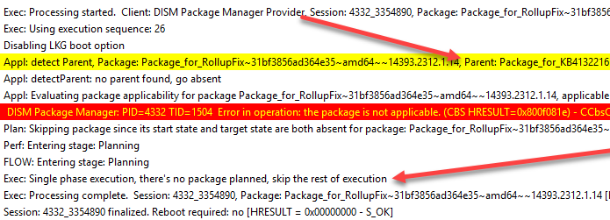
CU will not apply without the SSU
https://www.osdeploy.com/osbuilder/knowledge/servicing-stacks

Slide 10
What about the Sources directory?
https://www.osdeploy.com/osbuilder/knowledge/offline-servicing

Slide 11
What about the Sources directory?
You absolutely need to update this
Windows Setup will fail when booting from the ISO
Windows Upgrades will fail Compatibility Assistant
https://www.osdeploy.com/osbuilder/knowledge/offline-servicing

Slide 12
Windows 10 Upgrade Task Sequence Issues
DeviceMap and Device Inventory Failures in Win7 to Win10 1709 In-Place Upgrades
@surferstylee13
http://blog.ctglobalservices.com/configuration-manager-sccm/mag/devicemap-and-device-inventory-failures-in-win7-to-win10-1709-in-place-upgrades/
Windows 10 1709 In-Place Upgrade Hangs on Making Sure You're Ready to Install
@AdamGrossTX
http://www.asquaredozen.com/2018/05/21/windows-10-1709-in-place-upgrade-hangs-on-making-sure-youre-ready-to-install/
Both issues are caused by using outdated files in Sources!
https://www.osdeploy.com/osbuilder/knowledge/offline-servicing

Slide 13
What is the complete process?
Update Boot.wim and WinRE.wim with SSU, CU, and Image Cleanup
Update Install.wim with SSU, CU, Adobe SU, and Image Cleanup
Update Sources directory on OS Media
Can this be automated?
https://www.osdeploy.com/osbuilder/knowledge/offline-servicing

Slide 14
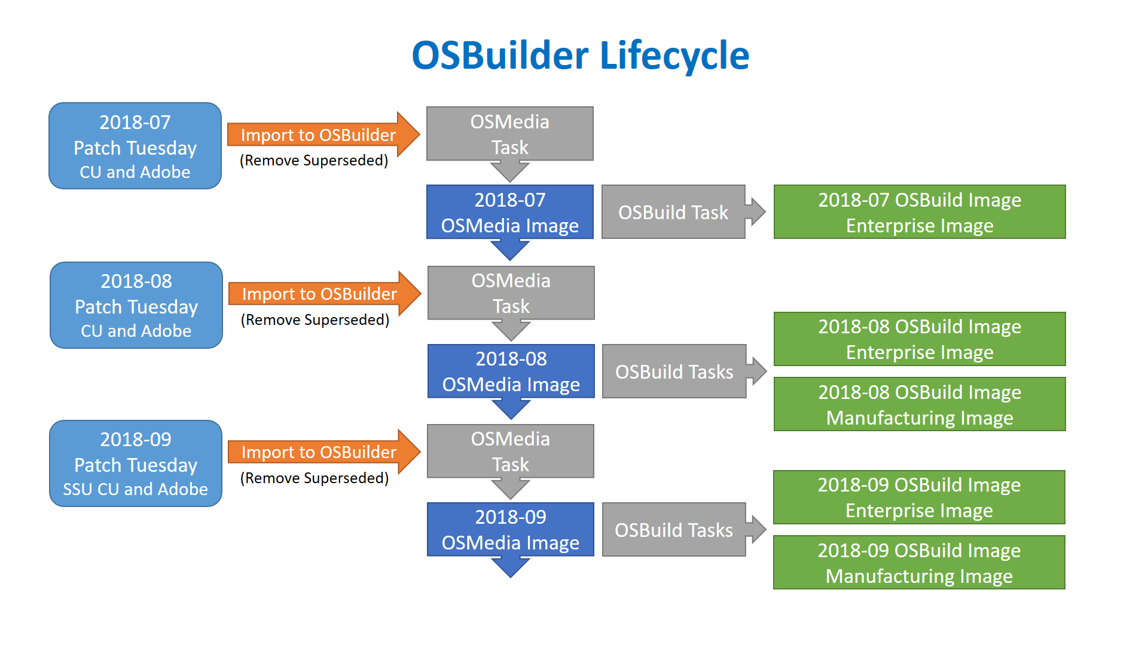
OSBuilder PowerShell Module
https://www.osdeploy.com/osbuilder/overview

Slide 15
OSBuilder PowerShell Module
PowerShell Gallery
https://www.powershellgallery.com/packages/OSBuilder
Install-Module –Name OSBuilder –Scope CurrentUser
https://www.osdeploy.com/osbuilder/installation

Slide 16
OSBuilder Demo
https://www.osdeploy.com/osbuilder/how-to

Slide 17
Q and A
https://www.osdeploy.com

Slide 18
Future Plans
OSConfig scripts to fully customize Windows 10 during a Task Sequence
PEBuilder to create a custom WinPE Tools Boot Image
OSDeploy Windows Setup Customization
https://www.osdeploy.com

Slide 19
Thank You Shaun and CTSMUG!
https://www.osdeploy.com

Slide 20
Thank You Shaun and CTSMUG!
https://www.osdeploy.com

Slide 21
Thank You Shaun and CTSMUG!
https://www.osdeploy.com

Slide 22
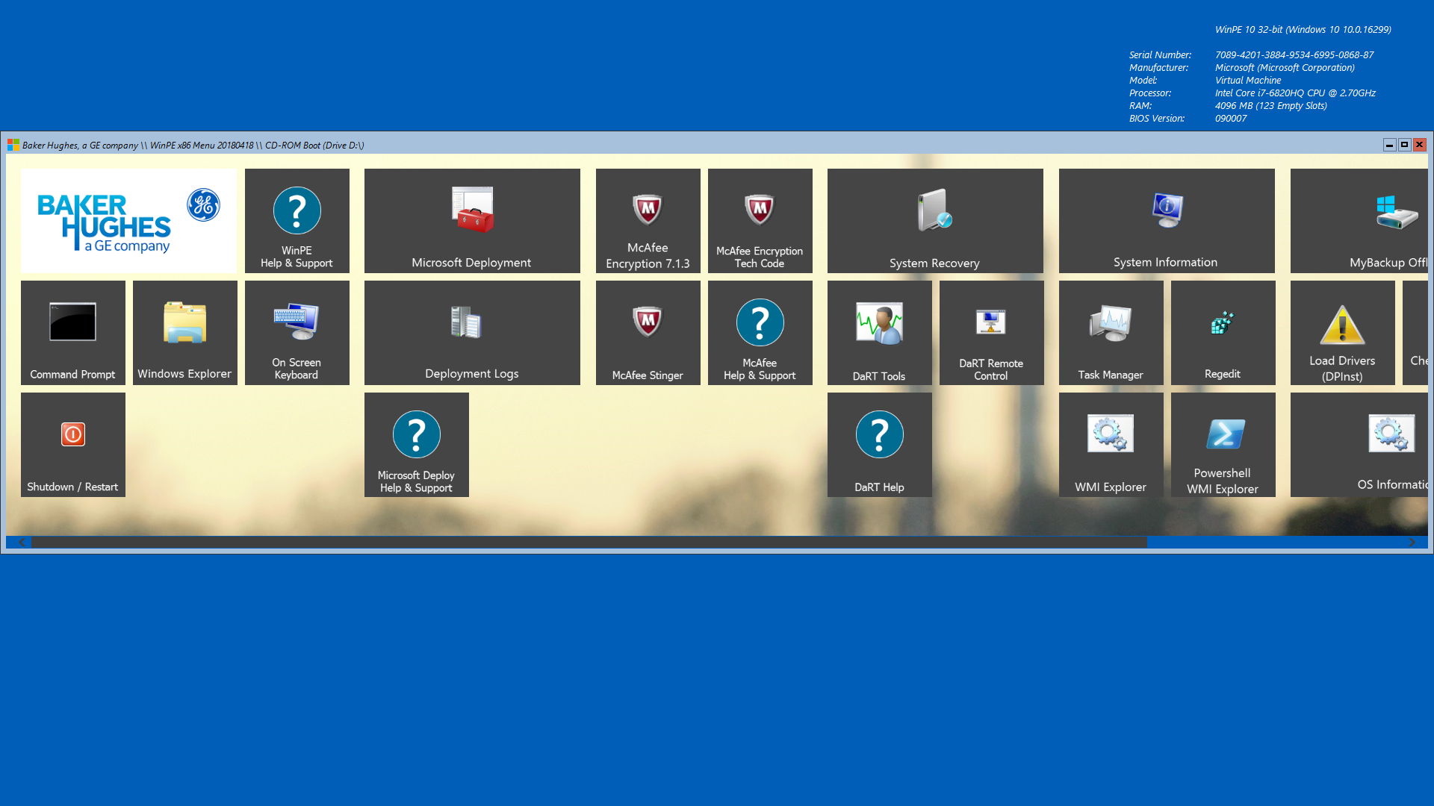
PEBuilder
https://www.osdeploy.com

