Slide 1
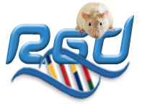

Identifying a genomic region using RGD tools
Literature Search (OntoMate)
Ontology Search
Based on Orthology to Another Species

Slide 2
Identifying a genomic region using… OntoMate
"OntoMate is an ontology-driven, concept-based literature search engine developed at RGD as an alternative for the basic PubMed search engine."
OntoMate tags abstracts with gene names, mutations, organism names and terms from the ontologies used at RGD.
https://rgd.mcw.edu/QueryBuilder/

Slide 3
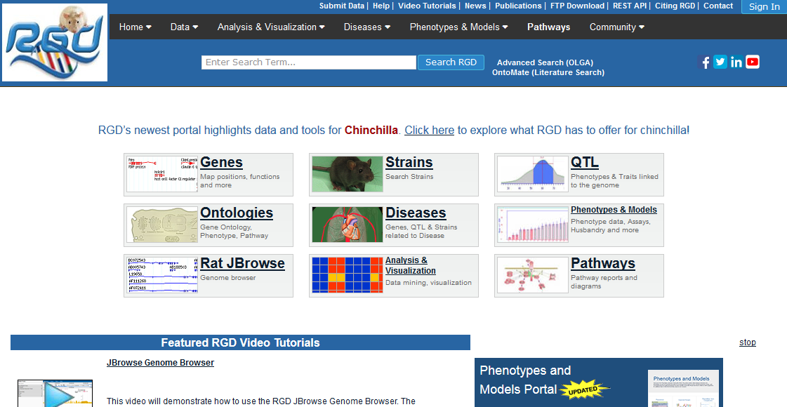
Identifying a genomic region using… OntoMate
https://rgd.mcw.edu

Slide 4
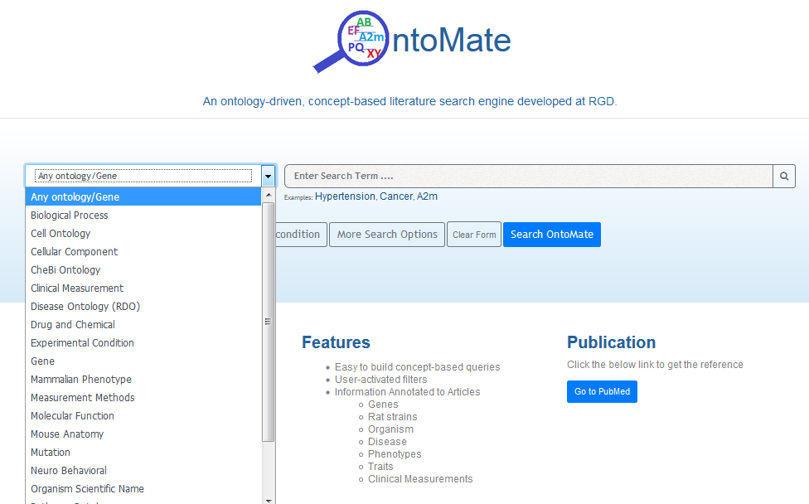
Identifying a genomic region using… OntoMate
Select an ontology/data type to narrow your search

Slide 5
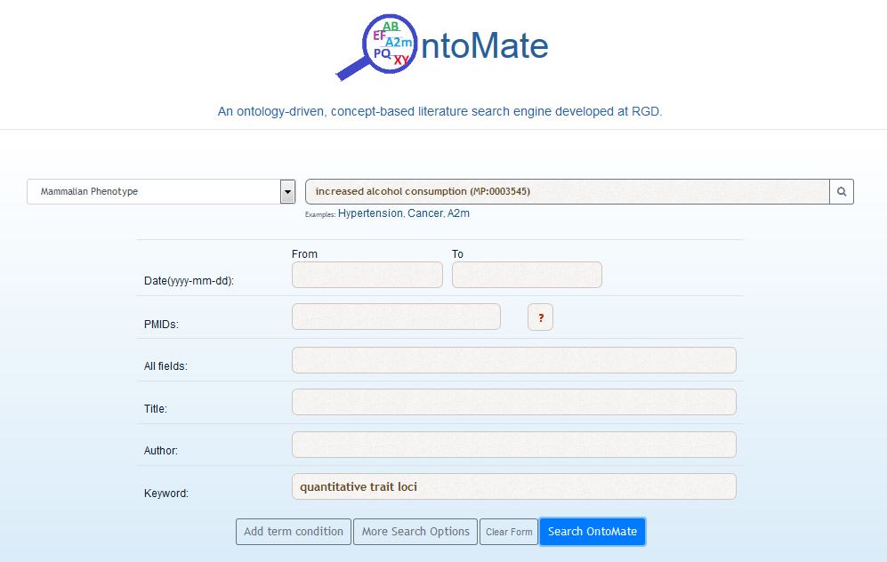
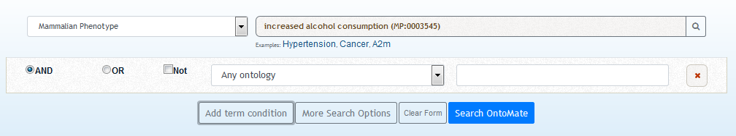
Identifying a genomic region using… OntoMate
Use "Add term condition" to add criteria to your search. Choose whether you want to join them using "And", "Or" or "Not".

Slide 6
Identifying a genomic region using… OntoMate
"More Search Options" opens a panel that gives you additional filters or search criteria. These are always added using "And".

Slide 7
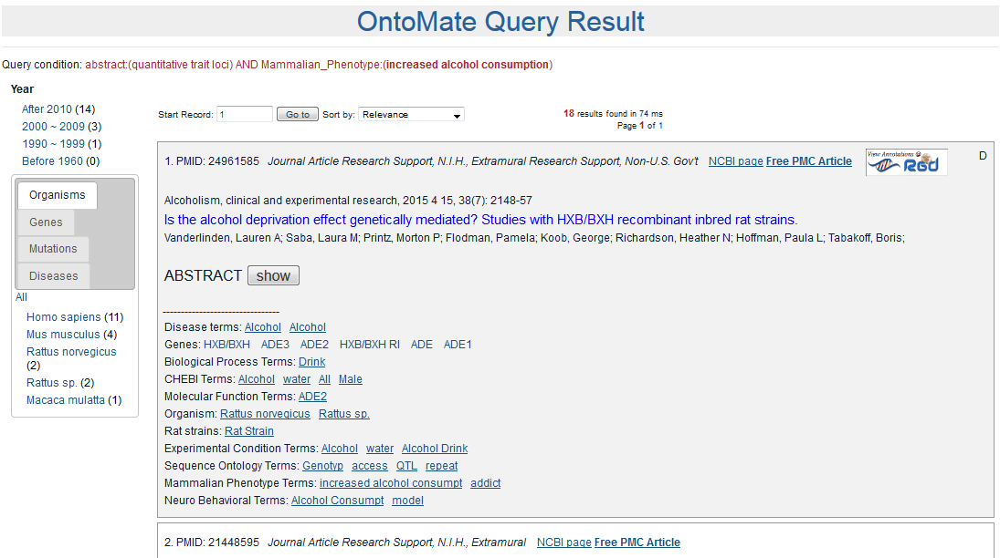
Identifying a genomic region using… OntoMate

Slide 8
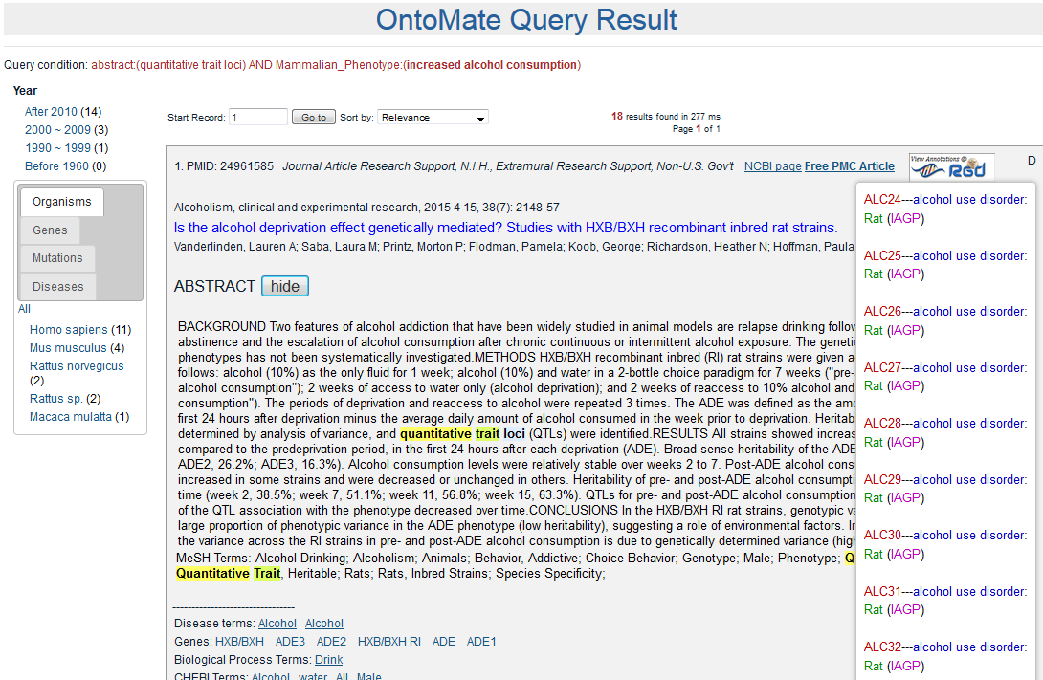
Identifying a genomic region using… OntoMate

Slide 9
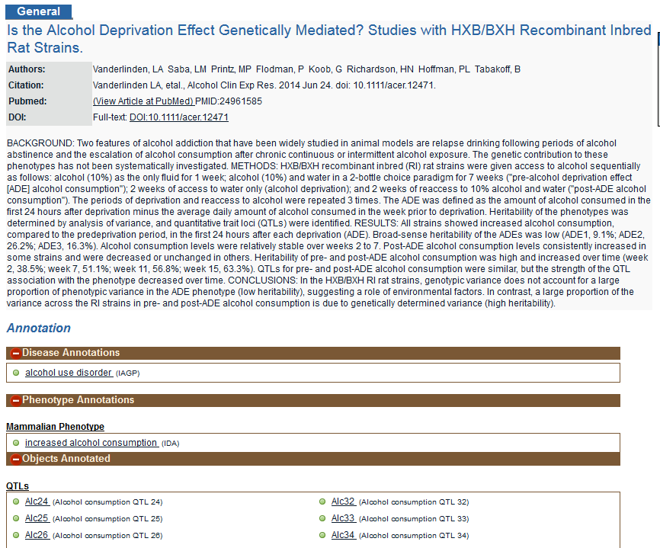
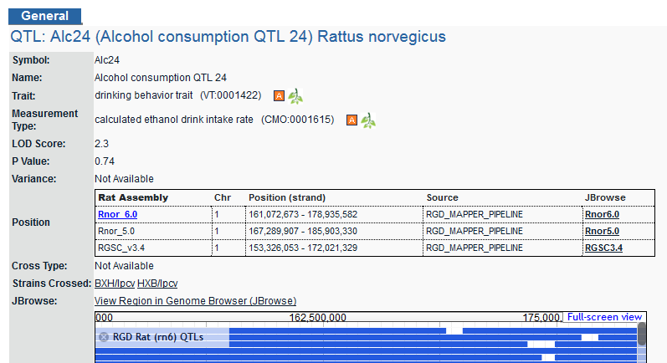
Identifying a genomic region using… OntoMate

Slide 10
Identifying a genomic region using… An Ontology Search

Slide 11
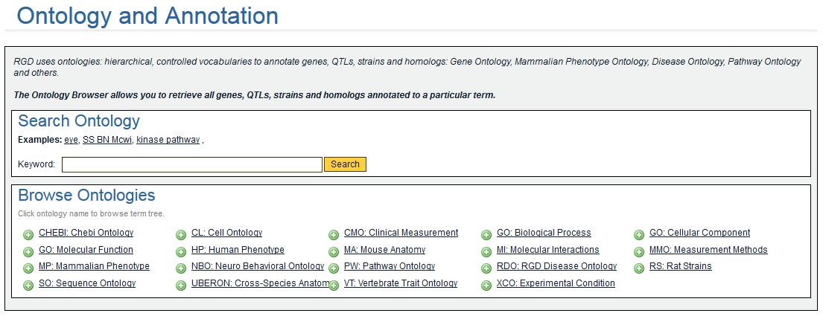
Identifying a genomic region using… An Ontology Search
alcohol

Slide 12
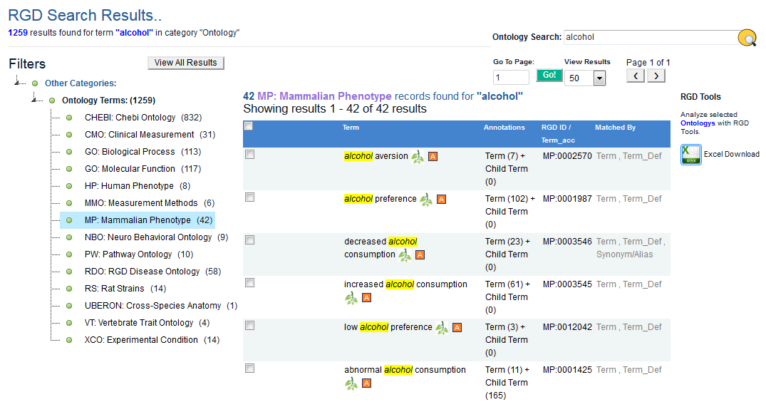
Identifying a genomic region using… An Ontology Search

Slide 13
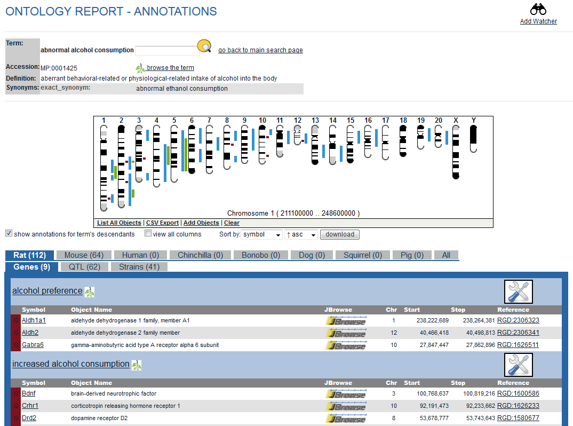
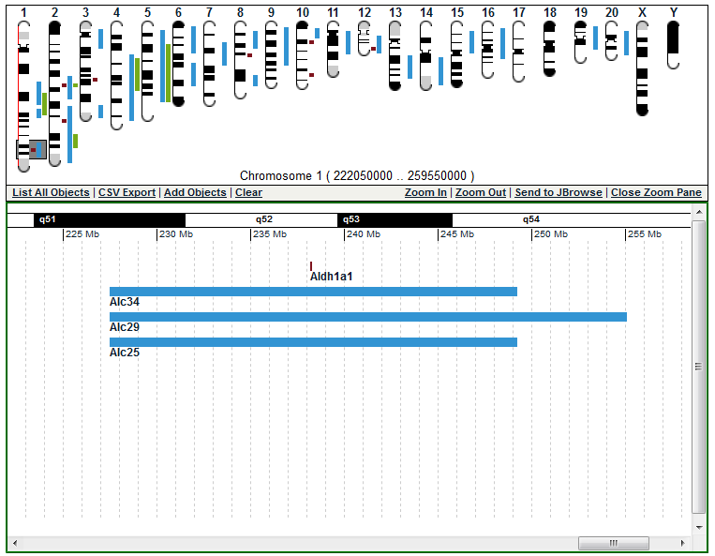
Identifying a genomic region using… An Ontology Search

Slide 14
Identifying a genomic region using… Orthology to Another Species

Slide 15
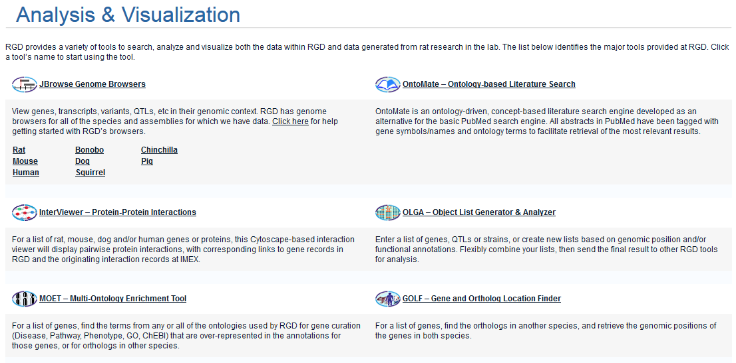
Identifying a genomic region using… Orthology to Another Species

Slide 16
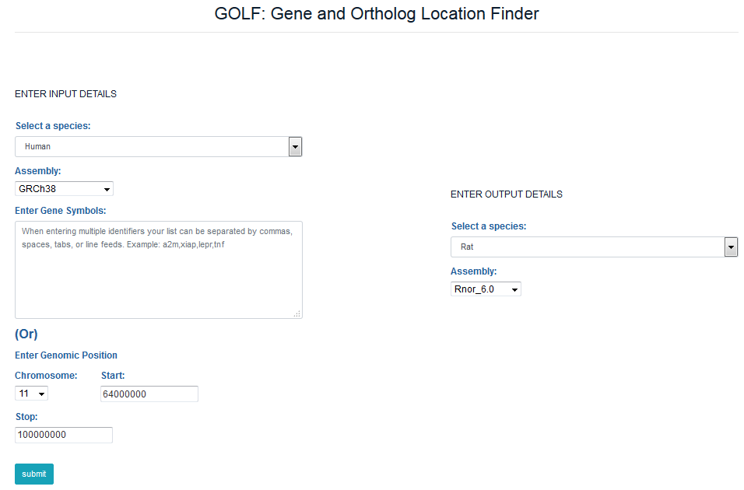
Identifying a genomic region using… Orthology to Another Species

Slide 17
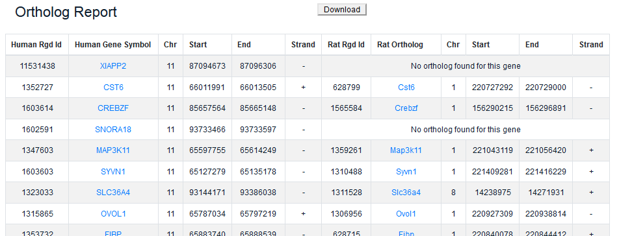
Identifying a genomic region using… Orthology to Another Species

