Slide 1


Interrogating a genomic region using RGD tools
Search for Orthologs (GOLF)
View the Neighborhood (JBrowse)
Find Strain-Specific Variants (Variant Visualizer)

Slide 2
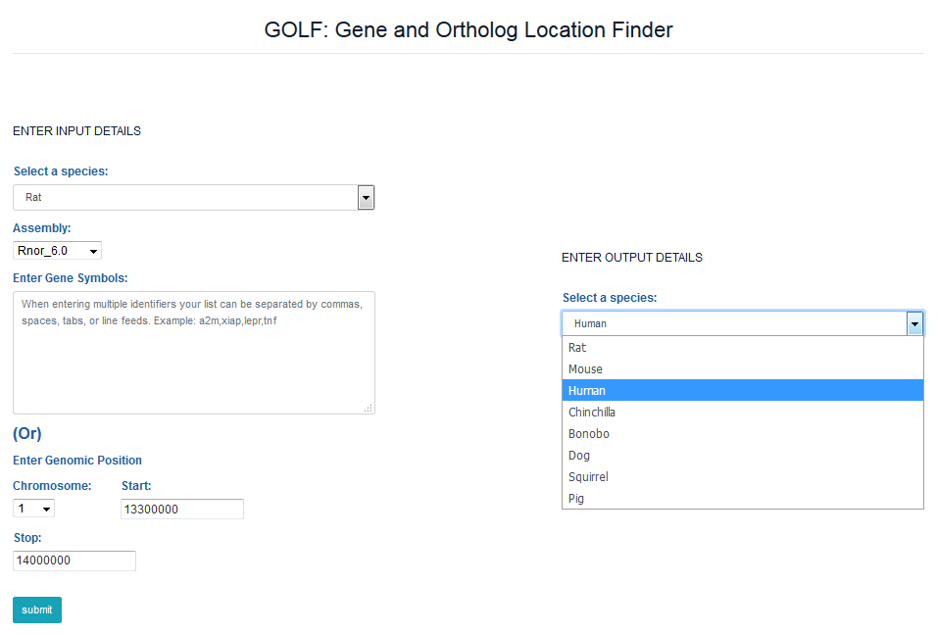
Interrogating a genomic region using… GOLF, the Gene and Ortholog Location Finder

Slide 3
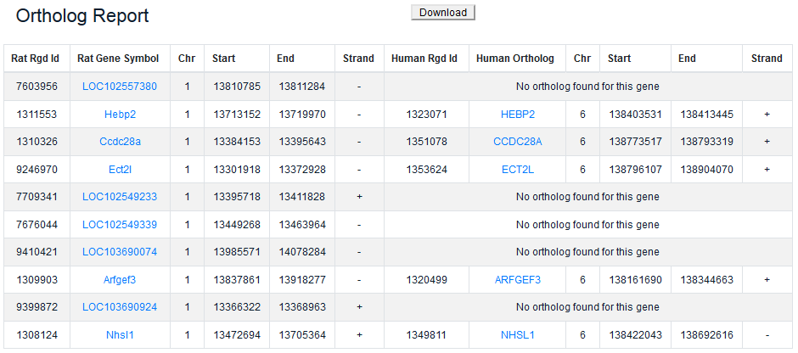
Interrogating a genomic region using… GOLF, the Gene and Ortholog Location Finder

Slide 4
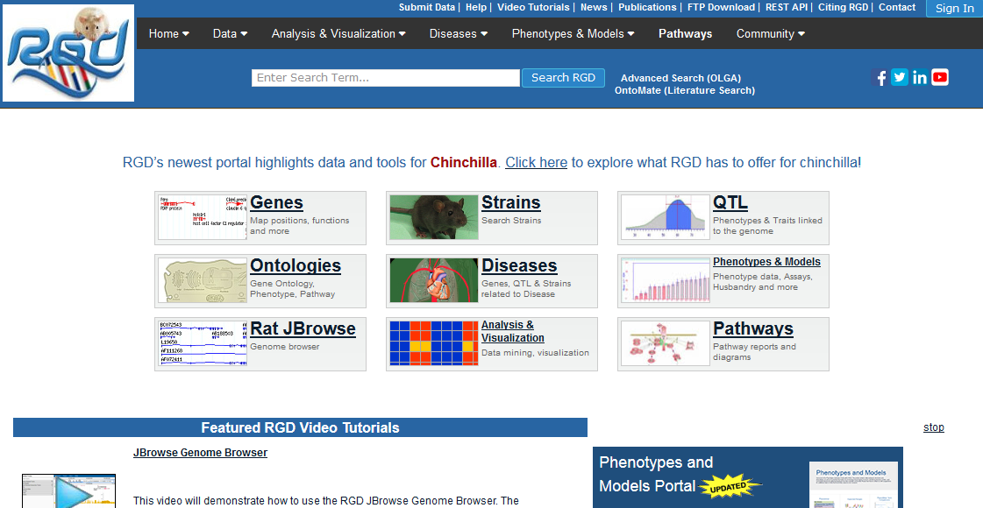
Interrogating a genomic region using… the JBrowse Genome Browser

Slide 5
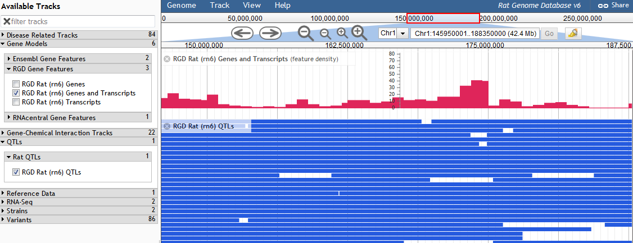
Interrogating a genomic region using… the JBrowse Genome Browser
Region around QTL Alc24

Slide 6
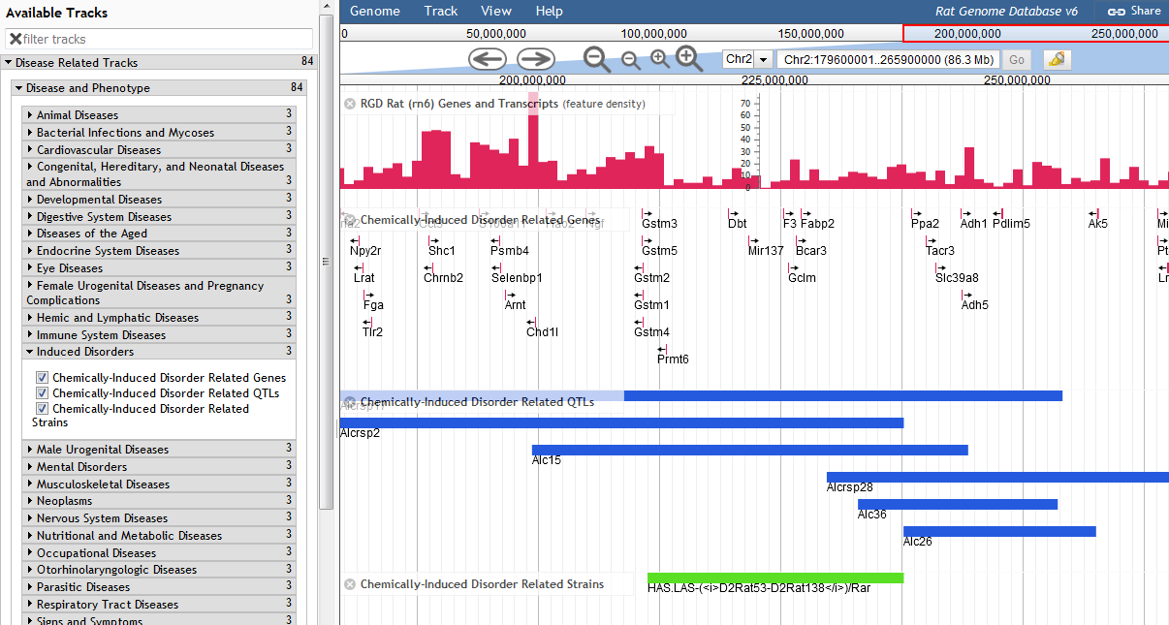
Interrogating a genomic region using… the JBrowse Genome Browser
Use Disease-Related tracks to find genes, QTL and strains annotated to chemically-induced diseases like alcohol use disorder

Slide 7
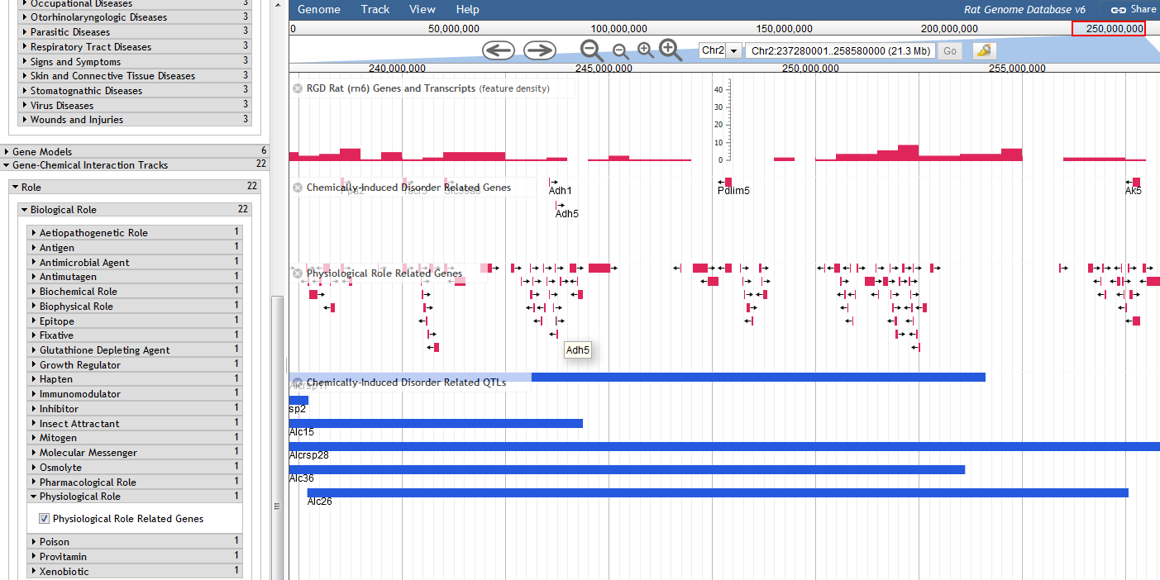
Interrogating a genomic region using… the JBrowse Genome Browser
Add Gene-Chemical Interaction tracks to explore genes in the region that interact with various classes of chemicals.

Slide 8
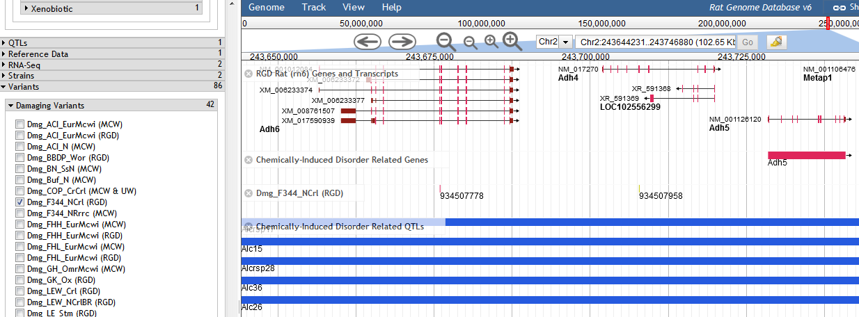
Interrogating a genomic region using… the JBrowse Genome Browser
Strain-specific variant tracks can be used to discover all of the variants in your region of interest. Use the Damaging Variant tracks to find only the possibly and probably damaging variants…but there is a better way.

Slide 9
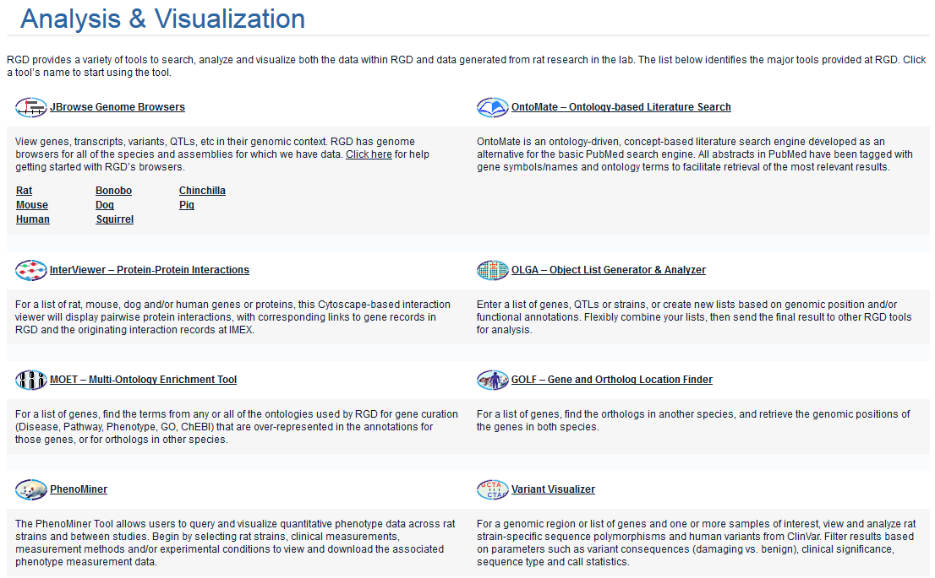
Interrogating a genomic region using… Variant Visualizer
Variant Visualizer is a tool to query for strain-specific variants in your gene, your gene list or your region of interest.

Slide 10
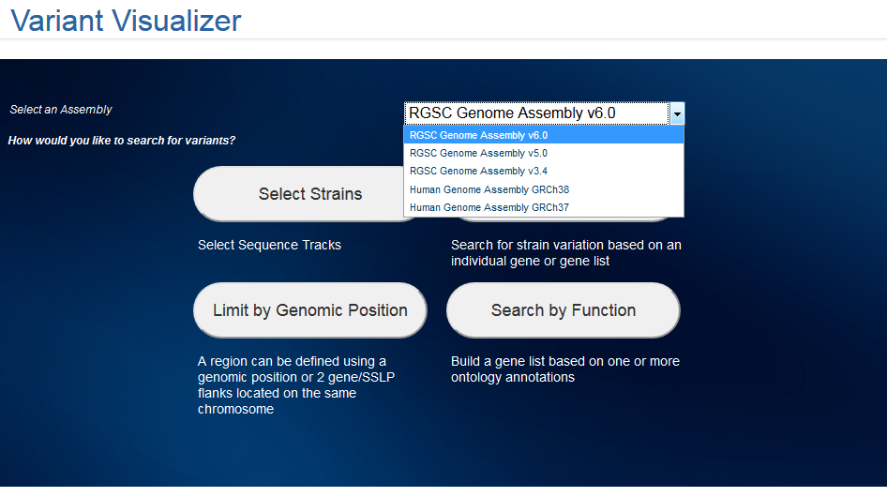
Interrogating a genomic region using… Variant Visualizer
RGD has variants for multiple strains on all of the most commonly used assemblies, as well as ClinVar clinical variants for human.

Slide 11
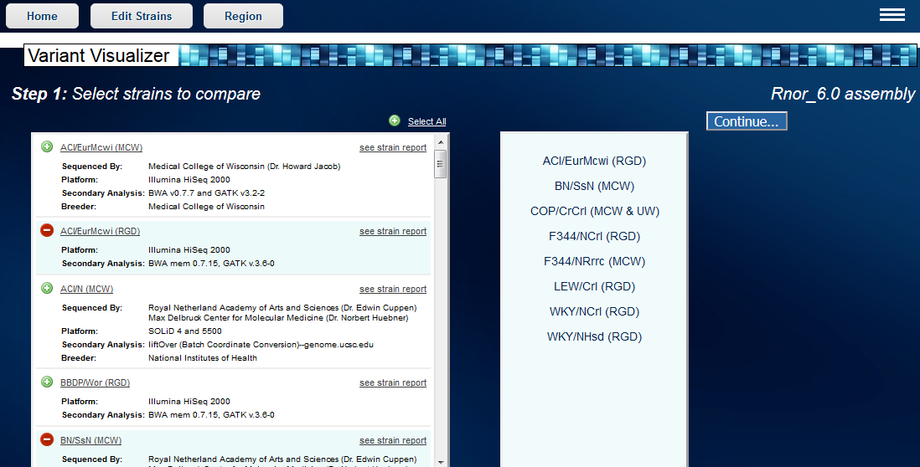
Interrogating a genomic region using… Variant Visualizer
Select any or all of the strains for a particular assembly using the +/- toggles or the "Select All" option.

Slide 12
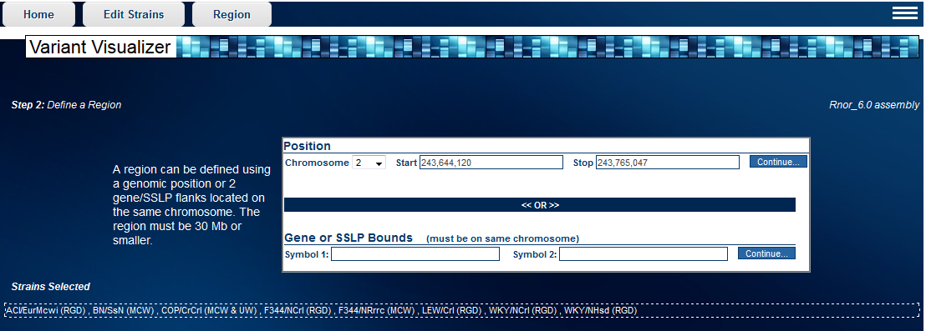
Interrogating a genomic region using… Variant Visualizer
Variant Visualizer offers multiple options for selecting a region or a group of genes. Here a region was selected.

Slide 13
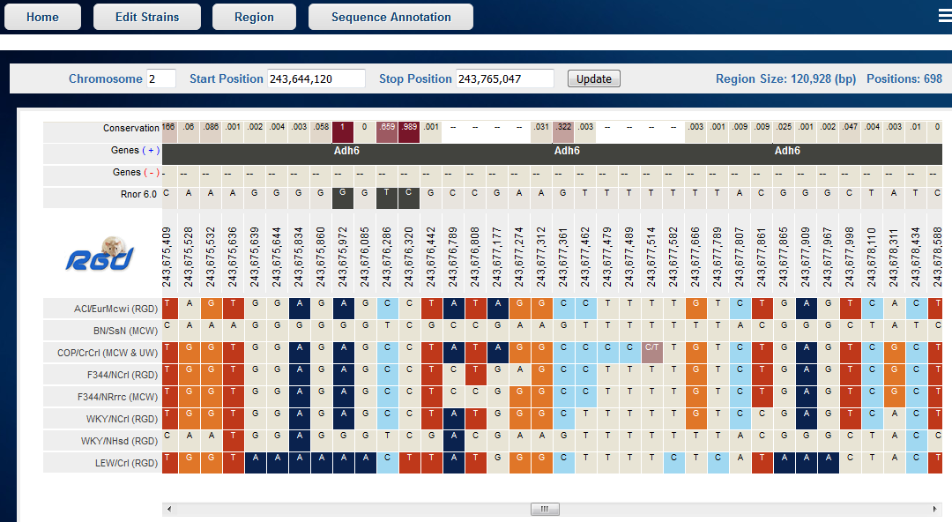
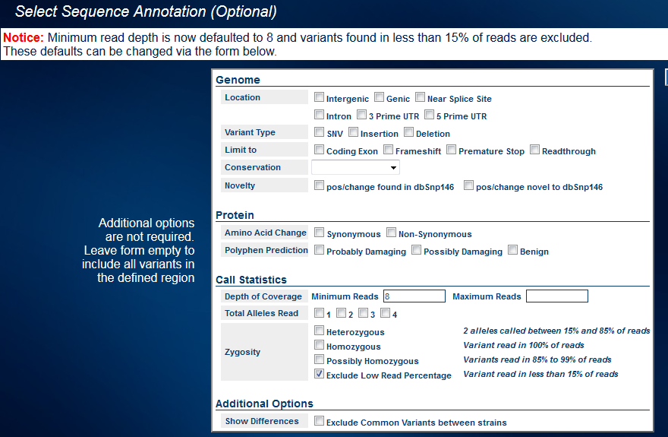
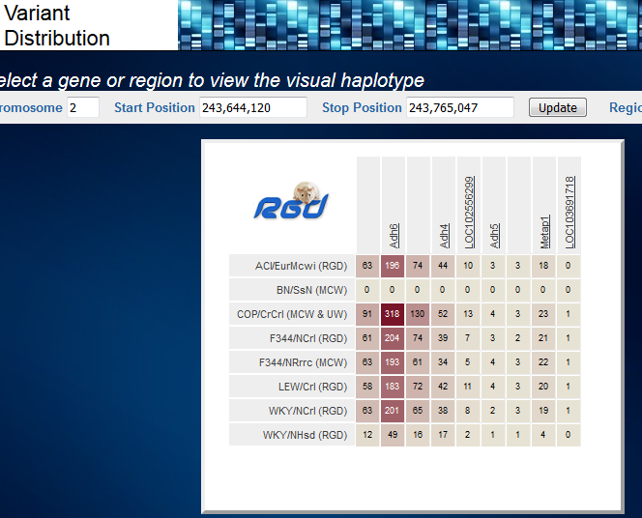
Interrogating a genomic region using… Variant Visualizer
If no selections are made in the "Sequence Annotation" screen, all of the variants are shown.

Slide 14
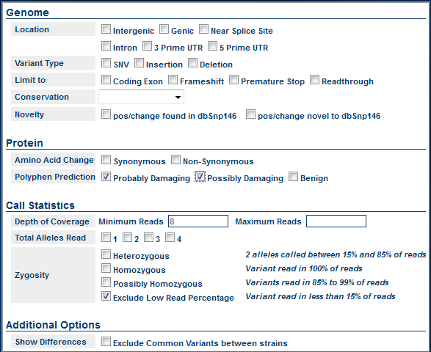
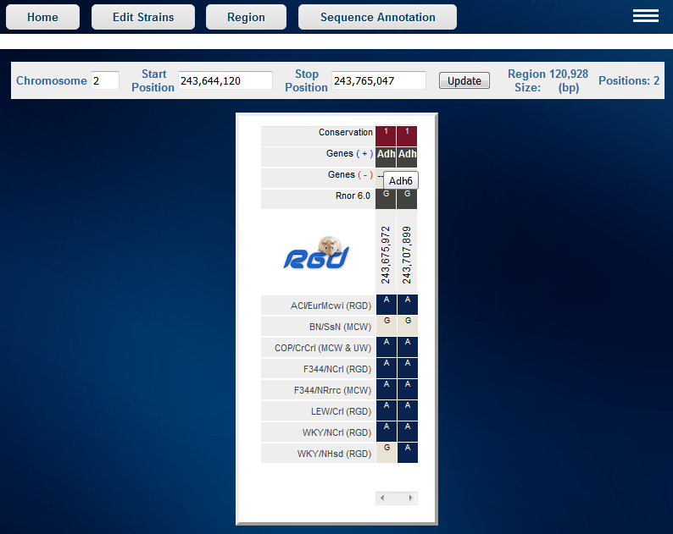
Interrogating a genomic region using… Variant Visualizer
Alternatively, make sequence annotation selections, such as choosing possibly and/or probably damaging variants to limit your results.

Slide 15
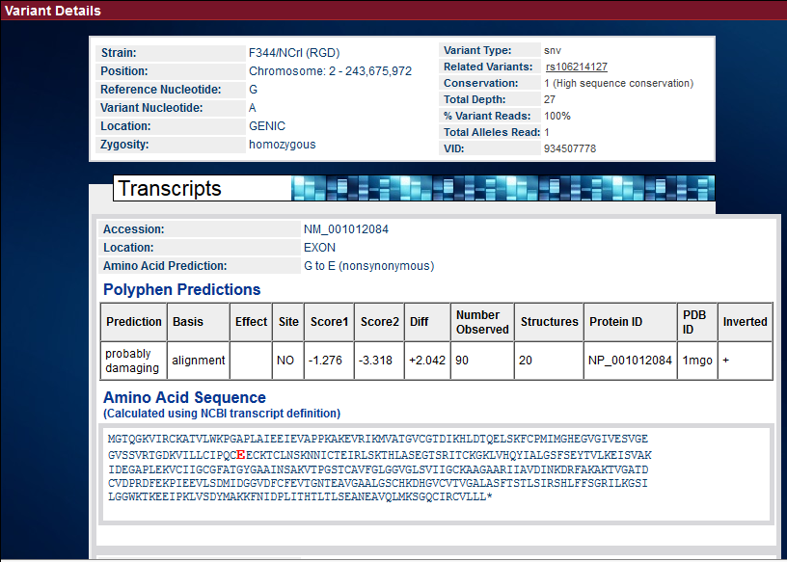
Interrogating a genomic region using… Variant Visualizer
Click on a variant for more details about the variant and its consequences.

