Slide 1
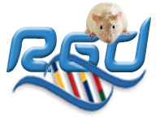

Examining your favorite gene(s) using RGD tools
Gene Report Page
Online List Generator & Analyzer (OLGA)
Gene Annotator Tool
Protein-Protein Interactions (InterViewer)
Multi Ontology Enrichment Tool (MOET)
Plus we've already looked at…
JBrowse
GOLF
Variant Visualizer

Slide 2
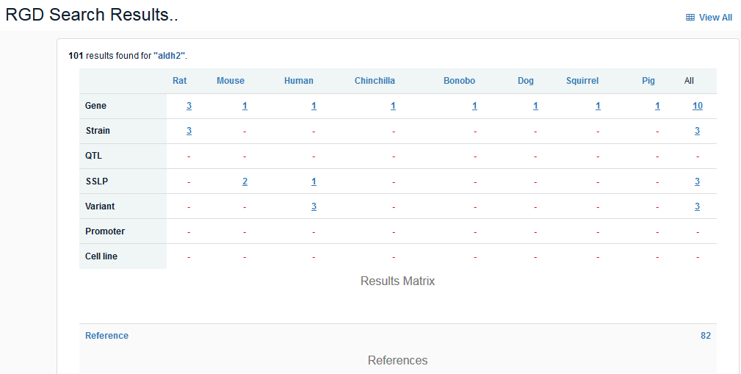
Examining your favorite gene(s) using… the Gene Report Page

Slide 3
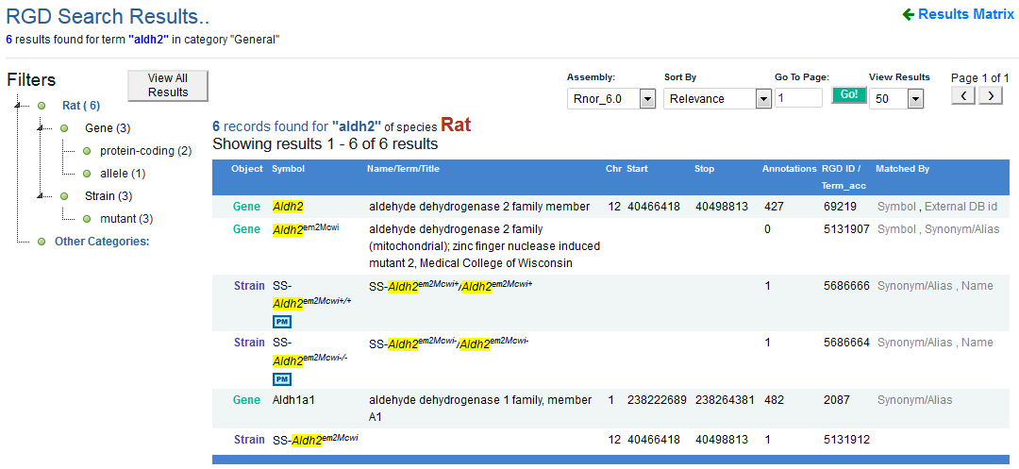
Examining your favorite gene(s) using… the Gene Report Page

Slide 4
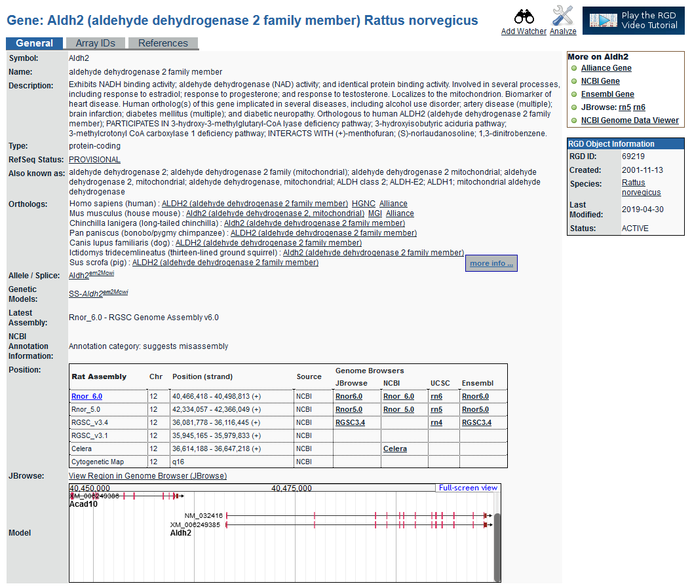
Examining your favorite gene(s) using… the Gene Report Page
The top of the gene report page has general information about the gene as well as information about orthologs, and about genetic models for that gene where applicable.

Slide 5
Examining your favorite gene(s) using… the Gene Report Page
RGD stores and presents position information for multiple genomic assemblies, as well as positions on genetic and RH maps where that data exists. Links are provided to multiple genome browsers.

Slide 6
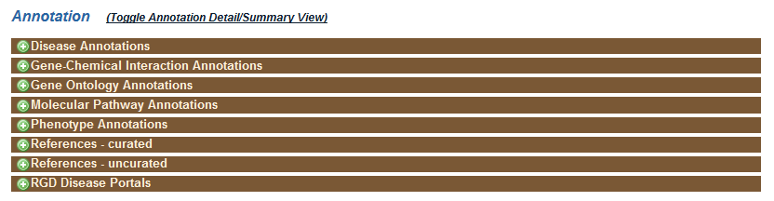
Examining your favorite gene(s) using… the Gene Report Page
Ontology annotations are the major source of information about a gene. RGD annotates genes using Disease, Gene Ontology, Pathway and Phenotype information, and imports annotations for Gene-Chemical Interactions from the Comparative Toxicogenomics Database.

Slide 7
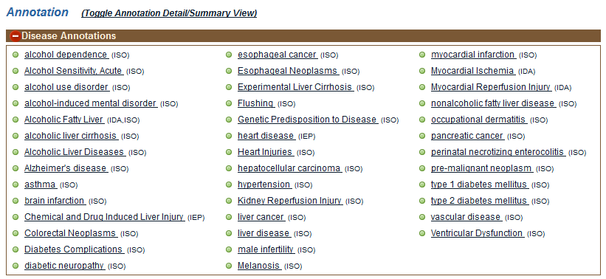
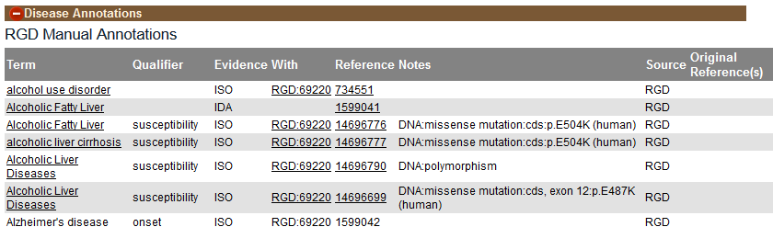
Examining your favorite gene(s) using… the Gene Report Page
Annotation sections open to show a summary view of the terms to which the gene has been annotated. Use the "Toggle Annotation Detail/Summary View" link to expand the display to show more information about each annotation, including a link to the originating research article.

Slide 8
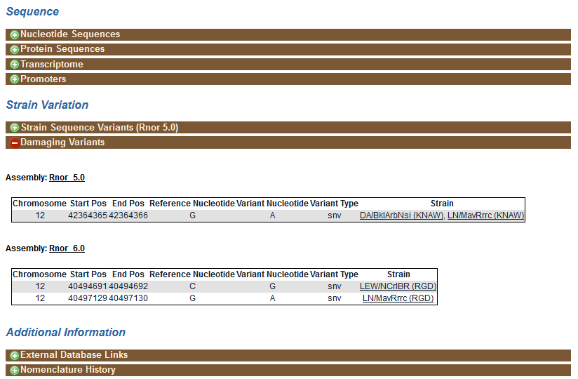
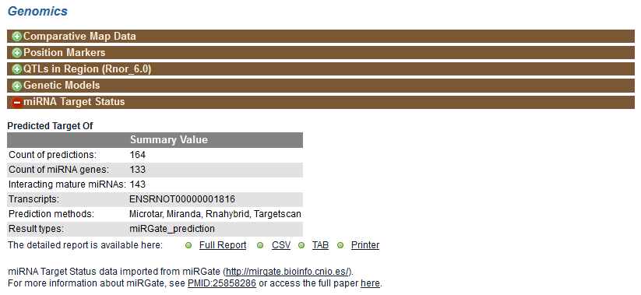
Examining your favorite gene(s) using… the Gene Report Page

Slide 9
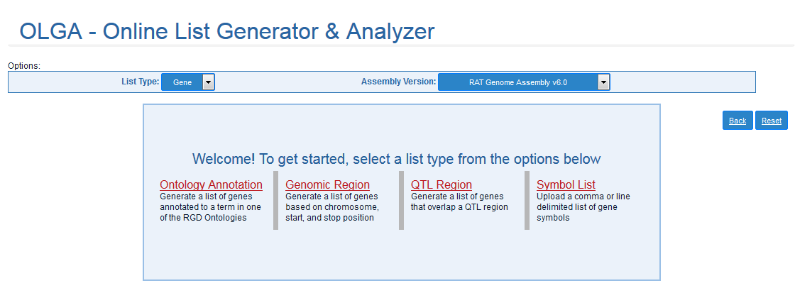
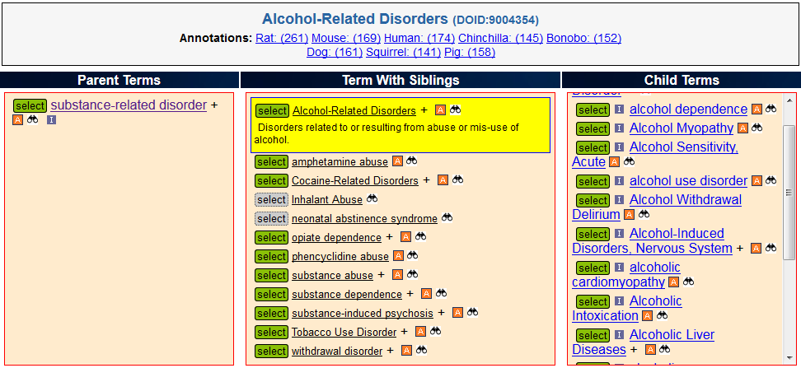
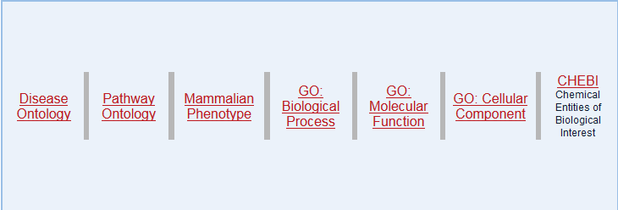
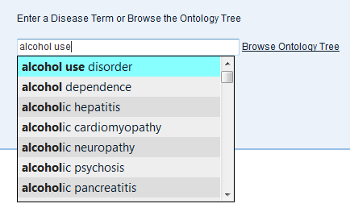
Examining your favorite genes using… OLGA and the Toolbox

Slide 10
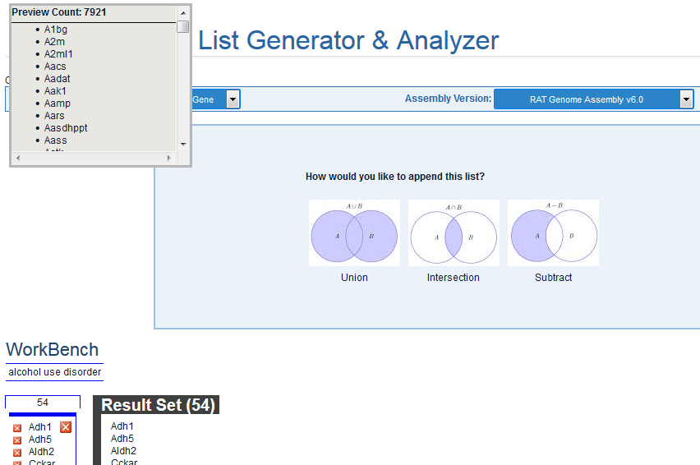
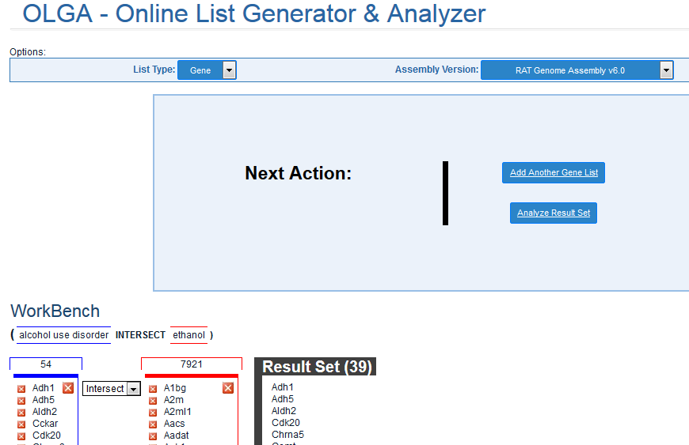
Examining your favorite genes using… OLGA and the Toolbox

Slide 11
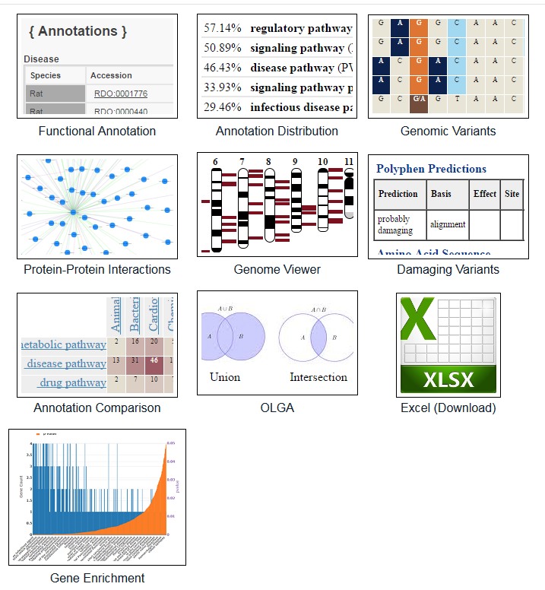
Examining your favorite genes using… OLGA and the Toolbox
Gene Annotator (GA) Tool

Slide 12
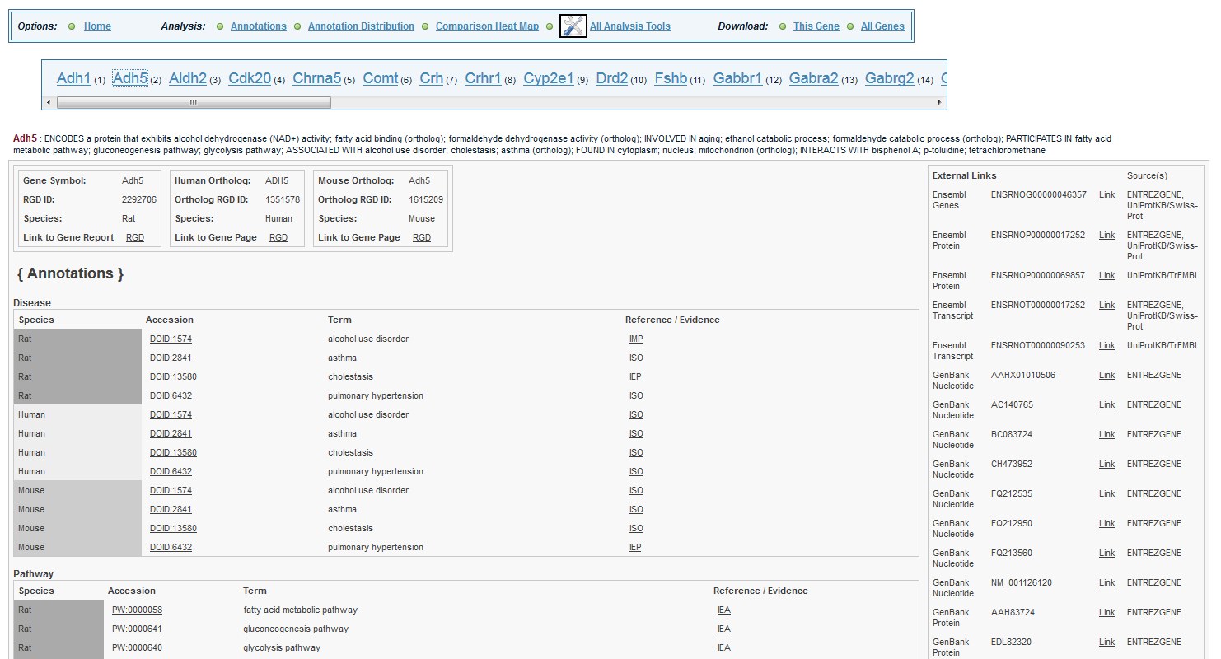
Examining your favorite genes using… the GA Tool
The "Annotations" section of the tool shows all of the annotations for each gene in the list and its orthologs, as well as a list of links to other databases.

Slide 13
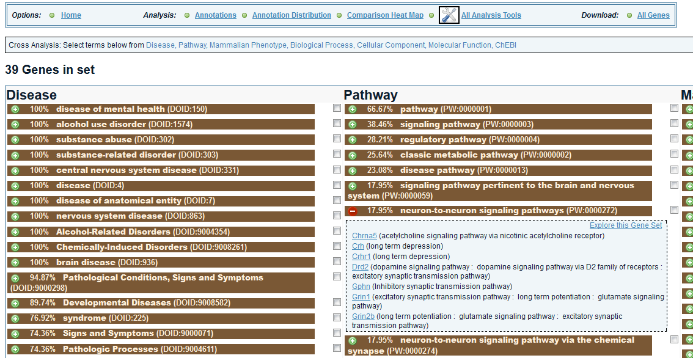
Examining your favorite genes using… the GA Tool
The "Annotation Distribution" section shows the list of ontology terms associated with the genes in the list in the order of the number of genes annotated to the term. Open a term to explore the subset of genes annotated to that term.

Slide 14
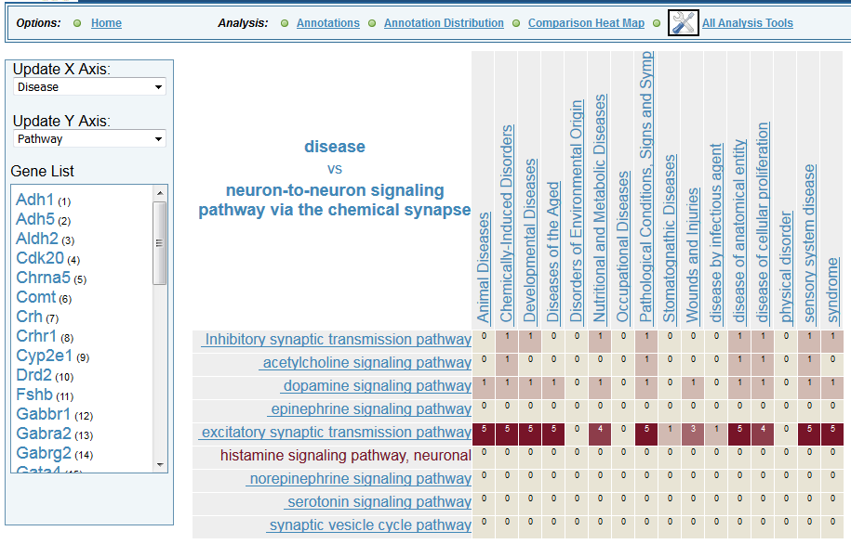
Examining your favorite genes using… the GA Tool
The "Comparison Heatmap" section lets you explore the sets of genes annotated to terms in both of two ontologies, or in separate branches of the same ontology.

Slide 15
Examining your favorite genes using… OLGA and the Toolbox
InterViewer: Protein-Protein Interactions

Slide 16
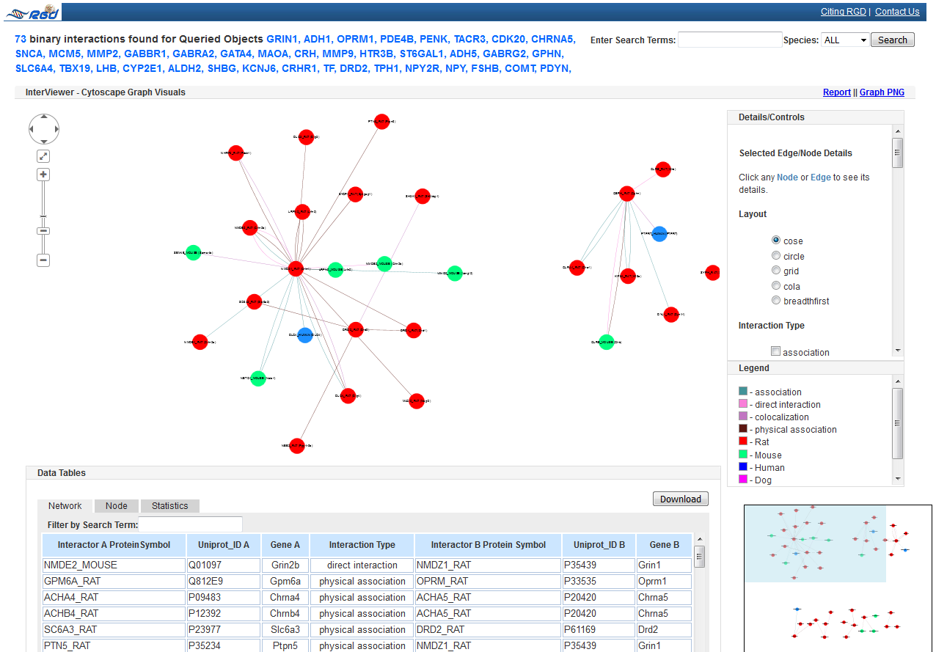
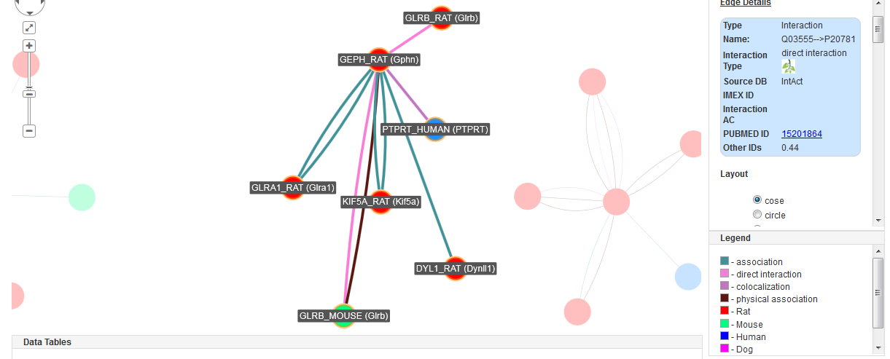
Examining your favorite genes using… InterViewer
InterViewer is an interactive Cytoscape-based interaction viewer. Click on a node to see information about that protein/gene and to highlight its interactions and interacting partners, or an edge to see details about that interaction.

Slide 17
Examining your favorite genes using… OLGA and the Toolbox
MOET:
Multi Ontology Enrichment Tool

Slide 18
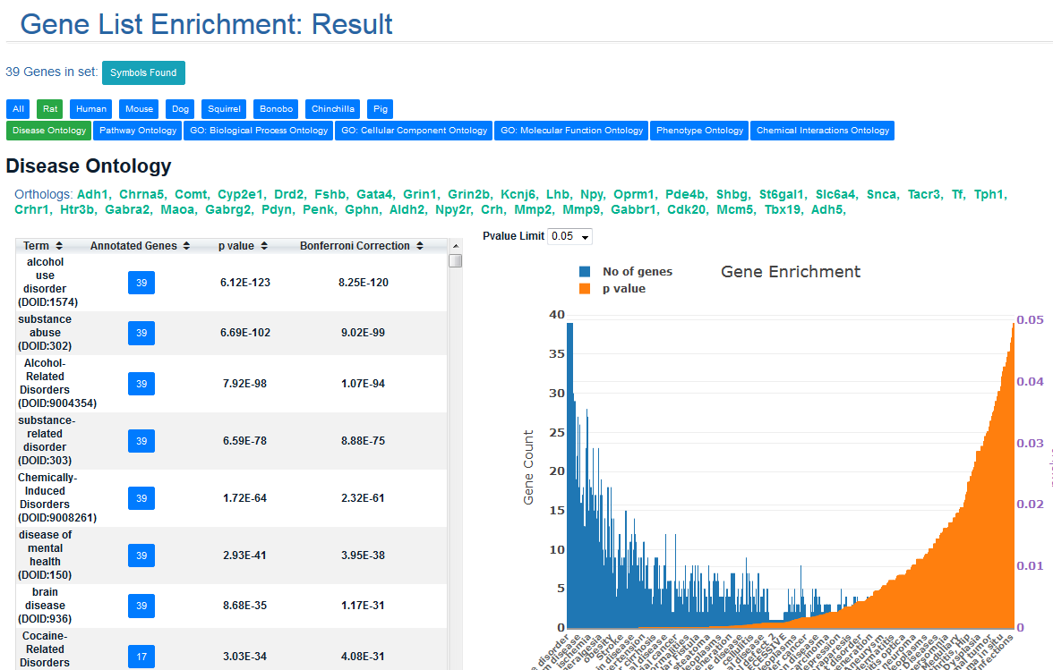
Examining your favorite genes using… MOET
Unlike most enrichment tools, MOET does enrichment for disease, pathway, phenotype and ChEBI, in addition to the Gene Ontology.

